Slide 1
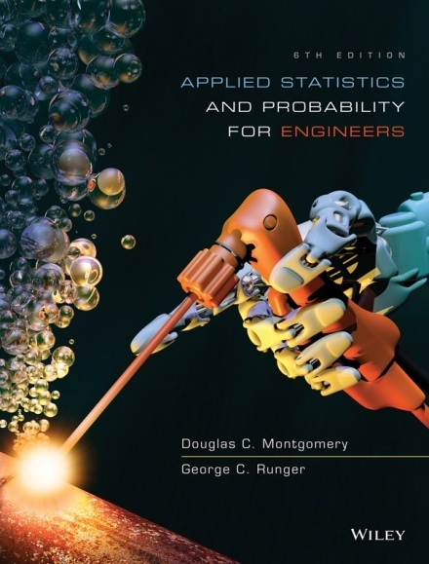
Applied Statistics and Probability for Engineers
Sixth Edition
Douglas C. Montgomery George C. Runger
Chapter 1
The Role of Statistics in Engineering

Slide 2
1
The Role of Statistics in Engineering
CHAPTER OUTLINE
1-1 The Engineering Method
and Statistical Thinking
1-2 Collecting Engineering
Data
1-2.1 Basic Principles
1-2.2 Retrospective Study
1-2.3 Observational Study
1-2.4 Designed Experiments
1-2.5 Observed Processes
Over Time
1-3 Mechanistic & Empirical
Models
1-4 Probability & Probability
Models

Slide 3
Learning Objectives for Chapter 1
After careful study of this chapter, you should be able to do the following:
Identify the role of statistics in engineering problem-solving process.
How variability affects the data collected and used for engineering decisions.
Differentiate between enumerative and analytical studies.
Discuss the different methods that engineers use to collect data.
Identify the advantages that designed experiments have in comparison to the other methods of collecting engineering data.
Explain the differences between mechanistic models & empirical models.
Discuss how probability and probability models are used in engineering and science.

Slide 4
What Engineers Do?
An engineer is someone who solves problems of interest to society with the efficient application of scientific principles by:
  Refining existing products
  Designing new products or processes

Slide 5
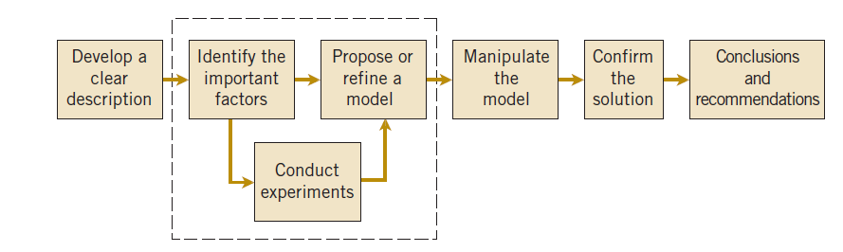
The Creative Process
Figure 1-1 The engineering method

Slide 6
Statistics Supports The Creative Process
The field of statistics deals with the collection, presentation, analysis, and use of data to:
  Make decisions
  Solve problems
  Design products and processes
It is the science of data.

Slide 7
Variability
Statistical techniques are useful to describe
and understand variability.
By variability, we mean successive observations
of a system or phenomenon do not produce
exactly the same result.
Statistics gives us a framework for describing this
variability and for learning about potential
sources of variability.

Slide 8
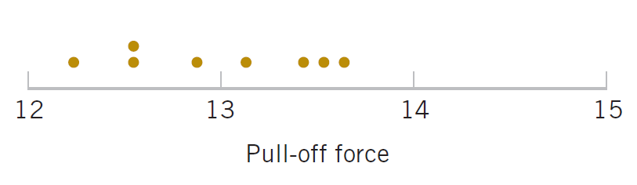
An Engineering Example of Variability
Eight prototype units are produced and their pull-off forces are measured (in pounds): 12.6, 12.9, 13.4, 12.3, 13.6, 13.5, 12.6, 13.1.
All of the prototypes does not have the same pull-off force. We can see the variability in the above measurements as they exhibit variability.
The dot diagram is a very useful plot for displaying a small body of data - say up to about 20 observations.
This plot allows us to see easily two features of the data; the location, or the middle, and the scatter or variability.
Figure 1-2 Dot diagram of the pull-off force data.

Slide 9
Basic Methods of Collecting Data
Three basic methods of collecting data:
  A retrospective study using historical data
    Data collected in the past for other purposes.
  An observational study
    Data, presently collected, by a passive observer.
  A designed experiment
    Data collected in response to process input changes.

Slide 10
Hypothesis Tests
Hypothesis Test
  A statement about a process behavior value.
  Compared to a claim about another process value.
  Data is gathered to support or refuse the claim.
One-sample hypothesis test:
  Example: Ford avg mpg = 30
  vs
  Ford avg mpg < 30
Two-sample hypothesis test:
  Example: Ford avg mpg – Chevy avg mpg = 0
  vs
  Ford avg mpg – Chevy avg mpg > 0

Slide 11
Factorial Experiment & Example
An experiment design which uses every possible combination of the factor levels to form a basic experiment with “k” different settings for the process. This type of experiment is called a factorial experiment.
Example:
Consider a petroleum distillation column:
  Output is acetone concentration
  Inputs (factors) are:
        Reboil temperature
        Condensate temperature
        Reflux rate
  Output changes as the inputs are changed by experimenter.

Slide 12
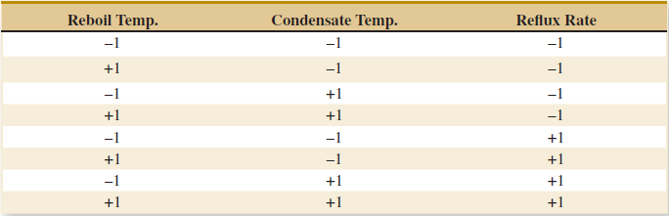
Factorial Experiment Example
  Each factor is set at 2 reasonable levels (-1 and +1)
  8 (2³) runs are made, at every combination of factors, to observe acetone output.
  Resultant data is used to create a mathematical model of the process representing cause and effect.
Table 1-1 The Designed Experiment (Factorial Design) for the Distillation Column

Slide 13
Fractional Factorial Experiment
Factor experiments can get too large. For
example, 8 factors will require 2⁸ = 256
experimental runs of the distillation column.
Certain combinations of factor levels can be
deleted from the experiments without degrading
the resultant model.
The result is called a fractional factorial
experiment.

Slide 14
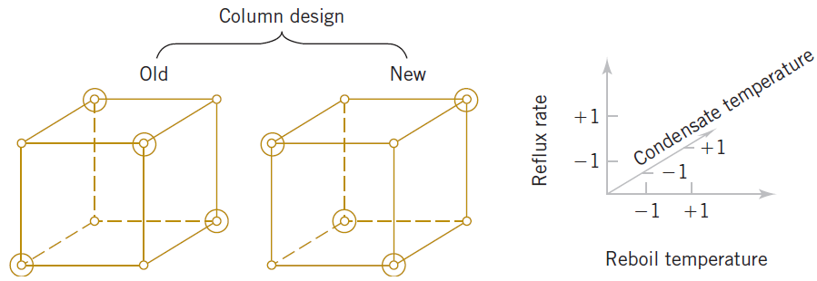
Fractional Factorial Experiment - Example
Figure 1-3 A fractional factorial experiment for the distillation column (one-half fraction) 2⁴ / 2 = 8 circled settings.

Slide 15
An Experiment in Variation
W. Edwards Deming, a famous industrial statistician & contributor to the Japanese quality revolution, conducted a illustrative experiment on process over-control or tampering.
Let’s look at his apparatus and experimental procedure.

Slide 16
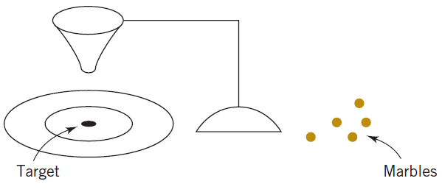
Deming’s Experimental Set-up
Marbles were dropped through a funnel onto a target and
the location where the marble struck the target was
recorded.
Variation was caused by several factors:
Marble placement in funnel & release dynamics, vibration, air
currents, measurement errors.
  Figure 1-4 Deming’s Funnel experiment

Slide 17
Deming’s Experimental Procedure
The funnel was aligned with the center of the target. Marbles were dropped. The distance from the strike point to the target center was measured and recorded.
Strategy 1: The funnel was not moved. Then the process was repeated.
Strategy 2: The funnel was moved an equal distance in the opposite direction to compensate for the error. He continued to make this type of adjustment after each marble was dropped. Then the process was repeated.

Slide 18
Deming’s Experimental Procedure
When both strategies were completed, he noticed the variability of the distance from the target for strategy 2 was approximately twice as large than for strategy 1.
The deviations from the target is increased due to the adjustments to the funnel . Hence, adjustments to the funnel do not decrease future errors. Instead, they tend to move the funnel farther from the target.
This experiment explains that the adjustments to a process based on random disturbances can actually increase the variation of the process. This is referred to as overcontrol or tampering.

Slide 19
Conclusions from the Deming Experiment
The lesson of the Deming experiment is that a process should not be adjusted in response to random variation, but only when a clear shift in the process value becomes apparent.
Then a process adjustment should be made to return the process outputs to their normal values.
To identify when the shift occurs, a control chart is used. Output values, plotted over time along with the outer limits of normal variation, pinpoint when the process leaves normal values and should be adjusted.

Slide 20
How Is the Change Detected?
A control chart is used. Its characteristics are:
  Time-oriented horizontal axis, e.g., hours.
  Variable-of-interest vertical axis, e.g., % acetone.
Long-term average is plotted as the center-line.
Long-term usual variability is plotted as an upper and lower control limit around the long-term average.
A sample of size n is taken and the averages are plotted over time. If the plotted points are between the control limits, then the process is normal; if not, it needs to be adjusted.

Slide 21
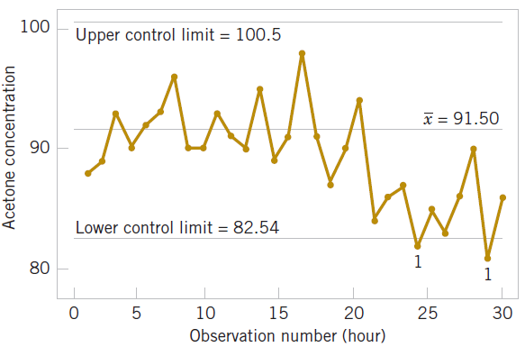
How Is the Change Detected Graphically?
The center line on the control chart is just the average of the concentration measurements for the first 20 samples
when the process is stable. The upper control limit and the lower control limit are located 3 standard deviations of the concentration values above and below the center line.
Figure 1-5 A control chart for the chemical process concentration data. Process steps out at hour 24 & 29. Shut down & adjust process.

Slide 22
Use of Control Charts
Deming contrasted two purposes of control charts:
Enumerative studies: Control chart of past production lots. Used for lot-by-lot acceptance sampling.
Analytic studies: Real-time control of a production process.

Slide 23
Mechanistic and Empirical Models
A mechanistic model is built from our underlying knowledge of the basic physical mechanism that relates several variables.
Example: Ohm’s Law
Current = V/R
I = E/R
I = E/R + ε
where ε is a term added to the model to account for the fact that the observed values of current flow do not perfectly conform to the mechanistic model.
The form of the function is known.

Slide 24
Mechanistic and Empirical Models
An empirical model is built from our engineering and scientific knowledge of the phenomenon, but is not directly developed from our theoretical or first-principles understanding of the underlying mechanism.
The form of the function is not known a priori.

Slide 25
An Example of an Empirical Model
In a semiconductor manufacturing plant, the finished semiconductor is wire-bonded to a frame. In an observational study, the variables recorded were:
  Pull strength to break the bond (y)
  Wire length (x₁)
  Die height (x₂)
The data recorded are shown on the next slide.

Slide 26
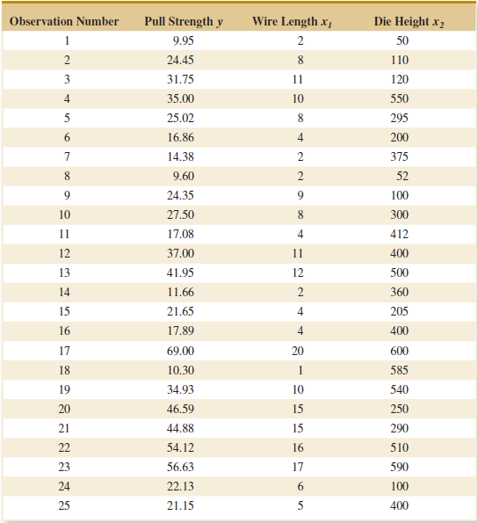
An Example of an Empirical Model
Table 1-2 Wire Bond Pull Strength Data

Slide 27
An Example of an Empirical Model
where the “hat,” or circumflex, over pull strength indicates that this is an estimated or predicted quality.
In general, this type of empirical model is called a regression model.
The estimated regression relationship is given by:

Slide 28
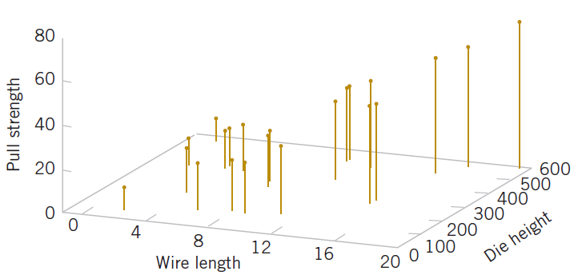
Visualizing the Data
Figure 1-6 Three-dimensional plot of the pull strength (y), wire length (x₁) and die height (x₂) data.

Slide 29
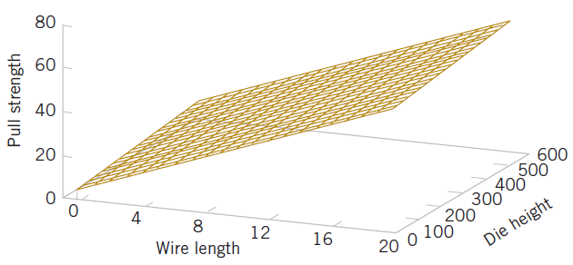
Visualizing the Resultant Model Using Regression Analysis
Figure 1-7 Plot of the predicted values (a plane) of pull strength from the empirical regression model.

Slide 30
Models Can Also Reflect Uncertainty
Probability models help quantify the risks involved in statistical inference, that is, risks involved in decisions made every day.
Probability provides the framework for the study and application of statistics.
Probability concepts will be introduced in the next lecture.

Slide 31
Important Terms & Concepts of Chapter 1
Analytic study
Cause and effect
Designed experiment
Empirical model
Engineering method
Enumerative study
Factorial experiment
Fractional factorial experiment
Hypothesis testing
Interaction
Mechanistic model
Observational study
Overcontrol
Population
Probability model
Problem-solving method
Randomization
Retrospective study
Sample
Statistical inference
Statistical process control
Statistical thinking
Tampering
Time series
Variability

