Slide 1

Applied Statistics and Probability for Engineers
Sixth Edition
Douglas C. Montgomery George C. Runger
Chapter 10
Statistical Inference for Two Samples

Slide 2
10
Statistical Inference for Two Samples
CHAPTER OUTLINE
10-1 Inference on the Difference in Means of Two Normal Distributions, Variances Known
10-1.1 Hypothesis tests on the difference in means, variances known
10-1.2 Type II error and choice of sample size
10-1.3 Confidence interval on the difference in means, variance known
10-2 Inference on the Difference in Means of Two Normal Distributions, Variance Unknown
10-2.1 Hypothesis tests on the difference in means, variances unknown
10-2.2 Type II error and choice of sample size
10-2.3 Confidence interval on the difference in means, variance unknown
10-3 A Nonparametric Test on the Difference in Two Means
10-4 Paired t-Tests
10-5 Inference on the Variances of Two Normal Populations
10-5.1 F distributions
10-5.2 Hypothesis tests on the ratio of two variances
10-5.3 Type II error and choice of sample size
10-5.4 Confidence interval on the ratio of two variances
10-6 Inference on Two Population Proportions
10-6.1 Large sample tests on the difference in population proportions
10-6.2 Type II error and choice of sample size
10-6.3 Confidence interval on the difference in population proportions
10-7 Summary Table and Roadmap for Inference Procedures for Two Samples

Slide 3
Learning Objectives for Chapter 10
After careful study of this chapter, you should be able to do the following:
Structure comparative experiments involving two samples as hypothesis tests.
Test hypotheses and construct confidence intervals on the difference in means of two normal distributions.
Test hypotheses and construct confidence intervals on the ratio of the variances or standard deviations of two normal distributions.
Test hypotheses and construct confidence intervals on the difference in two population proportions.
Use the P-value approach for making decisions in hypothesis tests.
Compute power, Type II error probability, and make sample size decisions for two-sample tests on means, variances & proportions.
Explain & use the relationship between confidence intervals and hypothesis tests.

Slide 4

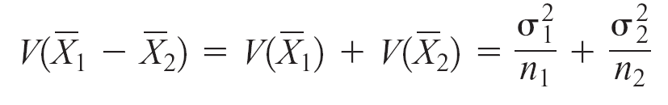
10-1: Inference on the Difference in Means of Two Normal Distributions, Variances Known
Assumptions
Let be a random sample from population 1.
Let be a random sample from population 2.
The two populations X₁ and X₂ are independent.
4. Both X₁ and X₂ are normal.

Slide 5
10-1: Inference on the Difference in Means of Two Normal Distributions, Variances Known
The quantity
(10-1)
has a N(0, 1) distribution.

Slide 6
10-1.1 Hypothesis Tests on the Difference in Means,
Variances Known
Null hypothesis: H₀: μ₁ − μ₂ = Δ₀
Test statistic: (10-2)
Alternative Hypotheses | P-Value | Rejection Criterion For Fixed-Level Tests
H₀: μ₁ − μ₂ ≠ Δ₀ | Probability above |z₀| and probability below − |z₀|, P = 2[1 − Φ(|z₀|)] | z₀ > z_{α/2} or z₀ < −z_{α/2}
H₁: μ₁ − μ₂ > Δ₀ | Probability above z₀, P = 1 − Φ(z₀) | z₀ > z_{α}
H₁: μ₁ − μ₂ < Δ₀ | Probability below z₀, P = Φ(z₀) | z₀ < −z_{α}

Slide 7
EXAMPLE 10-1 Paint Drying Time
A product developer is interested in reducing the drying time of a primer paint. Two formulations of the paint are tested; formulation 1 is the standard chemistry, and formulation 2 has a new drying ingredient that should reduce the drying time. From experience, it is known that the standard deviation of drying time is 8 minutes, and this inherent variability should be unaffected by the addition of the new ingredient. Ten specimens are painted with formulation 1, and another 10 specimens are painted with formulation 2; the 20 specimens are painted in random order. The two sample average drying times are minutes and minutes, respectively. What conclusions can the product developer draw about the effectiveness of the new ingredient, using α = 0.05?
The seven-step procedure is:
1. Parameter of interest: The difference in mean drying times, μ₁ − μ₂, and Δ₀ = 0.
2. Null hypothesis: H₀: μ₁ − μ₂ = 0.
3. Alternative hypothesis: H₁: μ₁ > μ₂.

Slide 8
EXAMPLE 10-1 Paint Drying Time - Continued
4. Test statistic: The test statistic is
where and n₁ = n₂ = 10.
5. Reject H₀ if: Reject H₀: μ₁ = μ₂ if the P-value is less than 0.05.
6. Computations: Since minutes and minutes, the test statistic is
Conclusion: Since z₀ = 2.52, the P-value is P = 1 − Φ(2.52) = 0.0059, so we reject H₀ at the α = 0.05 level
Interpretation: We can conclude that adding the new ingredient to the paint significantly reduces the drying time.

Slide 9
10-1.2 Type II Error and Choice of Sample Size
Use of Operating Characteristic Curves
Two-sided alternative:
One-sided alternative:

Slide 10
10-1.2 Type II Error and Choice of Sample Size
Sample Size Formulas
Two-sided alternative:
For the two-sided alternative hypothesis with significance level α, the sample size n₁ = n₂ = n required to detect a true difference in means of Δ with power at least 1 − β is
(10-5)
One-sided alternative:
For a one-sided alternative hypothesis with significance level α, the sample size n₁ = n₂ = n required to detect a true difference in means of Δ(≠Δ₀) with power at least 1 − β is
(10-6)

Slide 11
EXAMPLE 10-3 Paint Drying Time Sample Size
To illustrate the use of these sample size equations, consider the situation described in Example 10-1, and suppose that if the true difference in drying times is as much as 10 minutes, we want to detect this with probability at least 0.90. Under the null hypothesis, Δ₀ = 0. We have a one-sided alternative hypothesis with Δ = 10, α = 0.05 (so z_{α} = z_{0.05} = 1.645), and since the power is 0.9, β = 0.10 (so z_{β} = z_{0.10} = 1.28). Therefore, we may find the required sample size from Equation 10-6 as follows:
This is exactly the same as the result obtained from using the OC curves.

Slide 12
10-1.3 Confidence Interval on a Difference in Means, Variances Known
If and are the means of independent random samples of sizes n₁ and n₂ from two independent normal populations with known variance and , respectively, a 100(1 −α)% confidence interval for μ₁ − μ₂ is
where z_{α/2} is the upper α/2 percentage point of the standard normal distribution
(10-7)

Slide 13
EXAMPLE 10-4 Aluminum Tensile Strength
Tensile strength tests were performed on two different grades of aluminum spars used in manufacturing the wing of a commercial transport aircraft. From past experience with the spar manufacturing process and the testing procedure, the standard deviations of tensile strengths are assumed to be known. The data obtained are as follows: n₁ = 10, , σ₁ = 1, n₂ = 12, , and σ₂ = 1.5. If μ₁ and μ₂ denote the true mean tensile strengths for the two grades of spars, we may find a 90% confidence interval on the difference in mean strength μ₁ − μ₂ as follows:

Slide 14
10-1: Inference for a Difference in Means of Two Normal Distributions, Variances Known
Choice of Sample Size
(10-8)
Remember to round up if n is not an integer.
This ensures that the level of confidence does not drop below 100(1 − α)%.

Slide 15
10-1: Inference for a Difference in Means of Two Normal Distributions, Variances Known
One-Sided Confidence Bounds
Upper Confidence Bound
(10-9)
Lower Confidence Bound
(10-10)

Slide 16
10-2.1 Hypotheses Tests on the Difference in Means, Variances Unknown
Case 1:
We wish to test: H₀: μ₁ − μ₂ = Δ₀
H₁: μ₁ − μ₂ ≠ Δ₀
The pooled estimator of σ², denoted by , is defined by
(10-12)
The quantity
(10-13)
has a t distribution with n₁ + n₂ − 2 degrees of freedom.

Slide 17
Tests on the Difference in Means of Two Normal Distributions, Variances Unknown and Equal
Null hypothesis: H₀: μ₁ − μ₂ = Δ₀
Test statistic: |  | (10-14)
Alternative Hypothesis | P-Value | Rejection Criterion for Fixed-Level Tests
H₁: μ₁ − μ₂ ≠ Δ₀ | Probability above |t₀| and probability below−|t₀| | or
H₁: μ₁ − μ₂ > Δ₀ | Probability above t₀
H₁: μ₁ − μ₂ < Δ₀ | Probability below t₀

Slide 18
EXAMPLE 10-5 Yield from a Catalyst
Two catalysts are being analyzed to determine how they affect the mean yield of a chemical process. Specifically, catalyst 1 is currently in use, but catalyst 2 is acceptable. Since catalyst 2 is cheaper, it should be adopted, providing it does not change the process yield. A test is run in the pilot plant and results in the data shown in Table 10-1. Is there any difference between the mean yields? Use α = 0.05, and assume equal variances.
Observation Number | Catalyst 1 | Catalyst 2
1 | 91.50 | 89.19
2 | 94.18 | 90.95
3 | 92.18 | 90.46
4 | 95.39 | 93.21
5 | 91.79 | 97.19
6 | 89.07 | 97.04
7 | 94.72 | 91.07
8 | 89.21 | 92.75
 | s₁ = 2.39 | s₂ = 2.98

Slide 19
EXAMPLE 10-5 Yield from a Catalyst - Continued
The seven-step hypothesis-testing procedure is as follows:
Parameter of interest: The parameters of interest are μ₁ and μ₂, the mean process yield using catalysts 1 and 2, respectively.
2. Null hypothesis: H₀: μ₁ = μ₂
3. Alternative hypothesis: H₁: μ₁ ≠ μ₂
Test statistic: The test statistic is
5. Reject H₀ if: Reject H₀ if the P-value is less than 0.05.

Slide 20
EXAMPLE 10-5 Yield from a Catalyst - Continued
Computations: From Table 10-1 we have , s₁ = 2.39, n₁ = 8,
, s₂ = 2.98, and n₂ = 8.
Therefore
and
7. Conclusions: From Appendix Table V we can find t_{0.40,14} = 0.258 and
t_{0.25,14} = 0.692. Since, 0.258 < 0.35 < 0.692, we conclude that lower and upper bounds on the P-value are 0.50 < P < 0.80. Therefore, since the P-value exceeds α = 0.05, the null hypothesis cannot be rejected.
Interpretation: At 5% level of significance, we do not have strong evidence to conclude that catalyst 2 results in a mean yield that differs from the mean yield when catalyst 1 is used.

Slide 21
10-2.1 Hypotheses Tests on the Difference in Means, Variances Unknown
Case 2:
If H₀: μ₁ − μ₂ = Δ₀ is true, the statistic
is distributed as t with degrees of freedom given by
(10-15)
(10-16)

Slide 22
EXAMPLE 10-6 Arsenic in Drinking Water
Arsenic concentration in public drinking water supplies is a potential health risk. An article in the Arizona Republic (May 27, 2001) reported drinking water arsenic concentrations in parts per billion (ppb) for 10 metropolitan Phoenix communities and 10 communities in rural Arizona. The data follow:
Determine if there is any difference in mean arsenic concentrations between metropolitan Phoenix communities and communities in rural Arizona.
Metro Phoenix | Rural Arizona
( , s₁ = 7.63) | ( , s₂ = 15.3)
Phoenix, 3 | Rimrock, 48
Chandler, 7 | Goodyear, 44
Gilbert, 25 | New River, 40
Glendale, 10 | Apache Junction, 38
Mesa, 15 | Buckeye, 33
Paradise Valley, 6 | Nogales, 21
Peoria, 12 | Black Canyon City, 20
Scottsdale, 25 | Sedona, 12
Tempe, 15 | Payson, 1
Sun City, 7 | Casa Grande, 18

Slide 23
EXAMPLE 10-6 Arsenic in Drinking Water - Continued
The seven-step procedure is:
Parameter of interest: The parameters of interest are the mean arsenic concentrations for the two geographic regions, say, μ₁ and μ₂, and we are interested in determining whether μ₁ − μ₂ = 0.
Non hypothesis: H₀: μ₁ − μ₂ = 0, or H₀: μ₁ = μ₂
Alternative hypothesis: H₁: μ₁ ≠ μ₂
Test statistic: The test statistic is
Reject H₀ if : The degrees of freedom on are found as

Slide 24
EXAMPLE 10-6 Arsenic in Drinking Water - Continued
Therefore, using α = 0.05 and a fixed-significance-level test, we would reject
H₀: μ₁ = μ₂ if or if .
Computations: Using the sample data we find
7. Conclusions: Because , we reject the null hypothesis.
Interpretation: We can conclude that mean arsenic concentration in the drinking water in rural Arizona is different from the mean arsenic concentration in metropolitan Phoenix drinking water.

Slide 25
10-2.2 Type II Error and Choice of Sample Size
Example 10-8 Yield from Catalyst Sample Size
Consider the catalyst experiment in Example 10-5. Suppose that, if catalyst 2 produces a mean yield that differs from the mean yield of catalyst 1 by 4.0%, we would like to reject the null hypothesis with probability at least 0.85. What sample size is required?
Using s_{p} = 2.70 as a rough estimate of the common standard deviation σ, we have d = |Δ|/2σ = |4.0|/[(2)(2.70)] = 0.74. From Appendix Chart VIIe with
d = 0.74 and β= 0.15, we find n* = 20, approximately. Therefore, because
n* = 2n - 1,
and we would use sample sizes of n₁ = n₂ = n = 11.

Slide 26
10-2.3 Confidence Interval on the Difference in Means, Variance Unknown
Case 1:
If , and are the sample means and variances of two random samples of sizes n₁ and n₂, respectively, from two independent normal populations with unknown but equal variances, then a 100(1 - α)% confidence interval on the difference in means µ₁ - µ₂ is
(10-19)
where is the pooled estimate of the common population standard deviation, and is the upper α/2 percentage point of the t distribution with n₁ + n₂ - 2 degrees of freedom.

Slide 27
Example 10-9 Cement Hydration
Ten samples of standard cement had an average weight percent calcium of
with a sample standard deviation of s₁ = 5.0, and 15 samples of the lead-doped cement had an average weight percent calcium of with a sample standard deviation of s₂ = 4.0. Assume that weight percent calcium is normally distributed with same standard deviation. Find a 95% confidence interval on the difference in means, µ₁ - µ₂, for the two types of cement.
The pooled estimate of the common standard deviation is found as follows:
The 95% confidence interval is found using Equation 10-19:
Upon substituting the sample values and using t_{0.025,23} = 2.069,
which reduces to -0.72 ≤ m₁ - m₂ ≤ 6.72

Slide 28
10-2.3 Confidence Interval on the Difference in Means, Variance Unknown
Case 2:
If , and are the means and variances of two random samples of sizes n₁ and n₂, respectively, from two independent normal populations with unknown and unequal variances, an approximate 100(1 - α)% confidence interval on the difference in means µ₁ - µ₂ is
(10-20)
where v is given by Equation 10-16 and t_{/2,v} the upper  /2 percentage point of the t distribution with v degrees of freedom.

Slide 29
10-4: Paired t-Test
Null hypothesis: H₀: μ_{D} = Δ₀
Test statistic:
Alternative Hypothesis | P-Value | Rejection Criterion for Fixed-Level Tests
H₁: μ_{D} ≠ Δ₀ | Probability above |t₀| and probability below−|t₀|
H₁: μ_{D} > Δ₀ | Probability above t₀
H₁: μ_{D} < Δ₀ | Probability below t₀
(10-24)

Slide 30
Example 10-11 Shear Strength of Steel Girder
An article in the Journal of Strain Analysis [1983, Vol. 18(2)] reports a comparison of several methods for predicting the shear strength for steel plate girders. Data for two of these methods, the Karlsruhe and Lehigh procedures, when applied to nine specific girders, are shown in the table below.
Determine whether there is any difference (on the average) for the two methods.
Girder | Karlsruhe Method | Lehigh Method | Difference d_{j}
S1/1 | 1.186 | 1.061 | 0.125
S2/1 | 1.151 | 0.992 | 0.159
S3/1 | 1.322 | 1.063 | 0.259
S4/1 | 1.339 | 1.062 | 0.277
S5/1 | 1.2 | 1.065 | 0.135
S2/1 | 1.402 | 1.178 | 0.224
S2/2 | 1.365 | 1.037 | 0.328
S2/3 | 1.537 | 1.086 | 0.451
S2/4 | 1.559 | 1.052 | 0.507

Slide 31
Example 10-11 Shear Strength of Steel Girder
The seven-step procedure is:
1. Parameter of interest: The parameter of interest is the difference in mean shear strength for the two methods.
2. Null hypothesis: H₀: µ_{D} = 0
3. Alternative hypothesis: H₁: µ_{D} ≠ 0
4. Test statistic: The test statistic is
5. Reject H₀ if: Reject H₀ if the P-value is <0.05.
6. Computations: The sample average and standard deviation of the differences d_{j} are and s_{d} = 0.1350, and so the test statistic is
7. Conclusions: Because t_{0.0005.8} = 5.041 and the value of the test statistic
t₀ = 6.15 exceeds this value, the P-value is less than 2(0.0005) = 0.001. Therefore, we conclude that the strength prediction methods yield different results.
Interpretation: The data indicate that the Karlsruhe method produces, on the average, higher strength predictions than does the Lehigh method.

Slide 32
A Confidence Interval for μ_{D} from Paired Samples
If and s_{D} are the sample mean and standard deviation of the difference of n random pairs of normally distributed measurements, a 100(1 - α)% confidence interval on the difference in means 32 µ_{D} = µ₁ - µ₂ is
where t_{α/2,n-1} is the upper α /2% point of the t distribution with n - 1 degrees of freedom.
(10-25)

Slide 33
Example 10-12 Parallel Park Cars
The journal Human Factors (1962, pp. 375–380) reported a study in which n = 14 subjects were asked to parallel park two cars having very different wheel bases and turning radii. The time in seconds for each subject was recorded and is given in Table 10-4. From the column of observed differences, we calculate
d = 1.21 and s_{D} = 12.68. Find the 90% confidence interval for µ_{D} = µ₁ - µ_{2.}
Subject | 1(x_{1j}) | 2(x_{2j}) | (d_{j})
1 | 37.0 | 17.8 | 19.2
2 | 25.8 | 20.2 | 5.6
3 | 16.2 | 16.8 | -0.6
4 | 24.2 | 41.4 | -17.2
5 | 22.0 | 21.4 | 0.6
6 | 33.4 | 38.4 | -5.0
7 | 23.8 | 16.8 | 7.0
8 | 58.2 | 32.2 | 26.0
9 | 33.6 | 27.8 | 5.8
10 | 24.4 | 23.2 | 1.2
11 | 23.4 | 29.6 | -6.2
12 | 21.2 | 20.6 | 0.6
13 | 36.2 | 32.2 | 4.0
14 | 29.8 | 53.8 | -24.0
Notice that the confidence interval on µ_{D} includes zero. This implies that, at the 90% level of confidence, the data do not support the claim that the two cars have different mean parking times µ₁ and µ₂. That is, the value µ_{D} = µ₁ - µ₂ = 0 is not inconsistent with the observed data.
Table 10-4

Slide 34
10-5 Inferences on the Variances of Two Normal Populations
10-5.1 The F Distribution
We wish to test the hypotheses:
Let W and Y be independent chi-square random variables with u and v degrees of freedom respectively. Then the ratio
(10-28)
has the probability density function
(10-29)
and is said to follow the distribution with u degrees of freedom in the numerator and v degrees of freedom in the denominator. It is usually abbreviated as F_{u,v}.

Slide 35
10-5.2 Hypothesis Tests on the Ratio of Two Variances
Let be a random sample from a normal population with mean µ₁ and variance , and let
be a random sample from a second normal population with mean µ ₂ and variance . Assume that both normal populations are independent. Let and be the sample variances. Then the ratio
has an F distribution with n₁ − 1 numerator degrees of freedom and n₂ − 1 denominator degrees of freedom.

Slide 36
10-5.2 Hypothesis Tests on the Ratio of Two Variances
Null hypothesis:
Test statistic:
Alternative Hypotheses Rejection Criterion
(10-31)

Slide 37
Example 10-13 Semiconductor Etch Variability
Oxide layers on semiconductor wafers are etched in a mixture of gases to achieve the proper thickness. The variability in the thickness of these oxide layers is a critical characteristic of the wafer, and low variability is desirable for subsequent processing steps. Two different mixtures of gases are being studied to determine whether one is superior in reducing the variability of the oxide thickness. Sixteen wafers are etched in each gas. The sample standard deviations of oxide thickness are s₁ = 1.96 angstroms and
s₂ = 2.13 angstroms, respectively. Is there any evidence to indicate that either gas is preferable? Use a fixed-level test with α = 0.05.
The seven-step hypothesis-testing procedure is:
1. Parameter of interest: The parameter of interest are the variances of oxide thickness and .
2. Null hypothesis:
3. Alternative hypothesis:

Slide 38
10-5 Inferences on the Variances of Two Normal Populations
4. Test statistic: The test statistic is
5. Reject H₀ if : Because n₁ = n₂ = 16 and α = 0.05, we will reject if f₀ > f_{0.025,15,15} = 2.86 or if f₀ <f_{0.975,15,15} = 1/f_{0.025,15,15} = 1/2.86 = 0.35.
6. Computations: Because and , the test statistic is
7. Conclusions: Because f_{0..975,15,15} = 0.35 < 0.85 < f_{0.025,15,15} = 2.86, we cannot reject the null hypothesis at the 0.05 level of significance.
Interpretation: There is no strong evidence to indicate that either gas results in a smaller variance of oxide thickness.

Slide 39
10-5.3 Type II Error and Choice of Sample Size
Appendix Charts VIIo, VIIp, VIIq, and Vllr provide operating characteristic curves for the F-test given in Section 10-5.1 for a = 0.05 and a = 0.01, assuming that n₁ = n₂ = n. Charts VIIo and VIIp are used with the two-sided alternate hypothesis. They plot b against the abscissa parameter
for various n_{l} = n₂ = n. Charts VIIq and VIIr are used for the
one-sided alternative hypotheses.
(10-30)

Slide 40
Example 10-14 Semiconductor Etch Variability Sample Size
For the semiconductor wafer oxide etching problem in Example 10-13, suppose that one gas resulted in a standard deviation of oxide thickness that is half the standard deviation of oxide thickness of the other gas. If we wish to detect such a situation with probability at least 0.80, is the sample size n₁ = n₂ = 20 adequate ?
Note that if one standard deviation is half the other,
By referring to Appendix Chart VIIo with n₁ = n₂ = 20 and λ = 2, we find that
. Therefore, if , the power of the test (which is the probability that the difference in standard deviations will be detected by the test) is 0.80, and we conclude that the sample sizes n₁ = n₂ = 20 are adequate.

Slide 41
10-5.4 Confidence Interval on the Ratio of Two Variances
If and are the sample variances of random samples of sizes n₁ and n₂, respectively, from two independent normal populations with unknown variances and , then a 100(1 − α)% confidence interval on the ratio is
(10-33)
where and are the upper and lower α/2 percentage points of the F distribution with n₂ – 1 numerator and n₁ – 1 denominator degrees of freedom, respectively.
.A confidence interval on the ratio of the standard deviations can be obtained by taking square roots in Equation 10-33.

Slide 42
Example 10-15 Surface Finish for Titanium Alloy
A company manufactures impellers for use in jet-turbine engines. One of the operations involves grinding a particular surface finish on a titanium alloy component. Two different grinding processes can be used, and both processes can produce parts at identical mean surface roughness. The manufacturing engineer would like to select the process having the least variability in surface roughness. A random sample of n₁ = 11 parts from the first process results in a sample standard deviations s₁ =5.1 microinches, and a random sample of
n₁ = 16 parts from the second process results in a sample standard deviation of s₂ = 4.7 microinches. Find a 90% confidence interval on the ratio of the two standard deviations, σ₁ / σ_{2.}
Assuming that the two processes are independent and that surface roughness is normally distributed, we can use Equation 10-33 as follows:

Slide 43
Example 10-15 Surface Finish for Titanium Alloy - Continued
or upon completing the implied calculations and taking square roots,
Notice that we have used Equation 10-30 to find
f_{0.95,15,10} = 1/f_{0.05,10,15} = 1/2.54= 0.39.
Interpretation: Since this confidence interval includes unity, we cannot claim that the standard deviations of surface roughness for the two processes are different at the 90% level of confidence.

Slide 44
10-6.1 Large-Sample Test on the Difference in Population Proportions
We wish to test the hypotheses:
The following test statistic is distributed approximately as standard normal and is the basis of the test:
(10-34)

Slide 45
10-6.1 Large-Sample Test on the Difference in Population Proportions
Null hypothesis: H₀: p₁ = p₂
Test statistic:
(10-35)
Alternative Hypothesis | P-Value | Rejection Criterion for Fixed-Level Tests
H₁: p₁ ≠ p₂ | Probability above |z₀| and probability below -|z₀|. P = 2[1 - Φ(|z₀|)] | z₀ > z_{α/2} or z₀ < -z_{α/2}
H₁: p₁ > p₂ | Probability above z₀. P = 1 - Φ(z₀) | z₀ > z_{α}
H₁: p₁ < p₂ | Probability below z₀. P = Φ(z₀) | z₀ < -z_{α}

Slide 46
Example 10-16 St. John's Wort
Extracts of St. John's Wort are widely used to treat depression. An article in the April 18, 2001, issue of the Journal of the American Medical Association compared the efficacy of a standard extract of St. John's Wort with a placebo in 200 outpatients diagnosed with major depression. Patients were randomly assigned to two groups; one group received the St. John's Wort, and the other received the placebo. After eight weeks, 19 of the placebo-treated patients showed improvement, and 27 of those treated with St. John's Wort improved. Is there any reason to believe that St. John's Wort is effective in treating major depression? Use a =0.05.
The seven-step hypothesis testing procedure leads to the following results:
1. Parameter of interest: The parameters of interest are p₁ and p₂, the proportion of patients who improve following treatment with St. John's Wort (p₁) or the placebo (p₂).
2. Null hypothesis: H₀: p₁ = p₂
3. Alternative hypothesis: H₁: p₁ ≠ p₂
4. Test Statistic: The test statistic is

Slide 47
Example 10-16 St. John's Wort - Continued
where , , n₁ = n₂ = 100, and
5. Reject H₀ if: Reject H₀: p₁ = p₂ if the P-value is less than 0.05.
6. Computations: The value of the test statistic is
7. Conclusions: Since z₀ = 1.34, the P-value is P = 2[1 − Φ(1.34)] = 0.18,
we cannot reject the null hypothesis.
Interpretation: There is insufficient evidence to support the claim that St. John's Wort is effective in treating major depression.

Slide 48
10-6.2 Type II Error and Choice of Sample Size
If the alternative hypothesis is two sided, the β-error is
(10-37)

Slide 49
10-6.2 Type II Error and Choice of Sample Size
If the alternative hypothesis is H₁: p₁ > p₂,
(10-38)
and if the alternative hypothesis is H₁: p₁ < p₂,
(10-39)

Slide 50
10-6.2 Type II Error and Choice of Sample Size
For the two-sided alternative, the common sample size is
(10-40)
where q₁ = 1 − p₁ and q₂ = 1 − p₂.

Slide 51
10-6.3 Confidence Interval on the Difference in the Population Proportions
If and are the sample proportions of observations in two independent random samples of sizes n₁ and n₂ that belong to a class of interest, an approximate two-sided 100(1 − α)% confidence interval on the difference in the true proportions p₁ − p₂ is
(10-41)
where z_{α/2} is the upper α/2 percentage point of the standard normal distribution.

Slide 52
Example 10-17 Defective Bearings
Consider the process of manufacturing crankshaft hearings described in Example 8-8. Suppose that a modification is made in the surface finishing process and that, subse­quently, a second random sample of 85 bearings is obtained. The number of defective bearings in this second sample is 8. Therefore, because n₁ = 85, , n₂ = 85, and
. Obtain an approximate 95% confidence interval on the difference in the proportion of detective bearings produced under the two processes.

Slide 53
Example 10-17 Defective Bearings - Continued
This simplifies to
−0.0685 ≤ p₁ − p₂ ≤ 0.1155
Interpretation: This confidence interval includes zero. Based on the sample data, it seems unlikely that the changes made in the surface finish process have reduced the proportion of defective crankshaft bearings being produced.

Slide 54
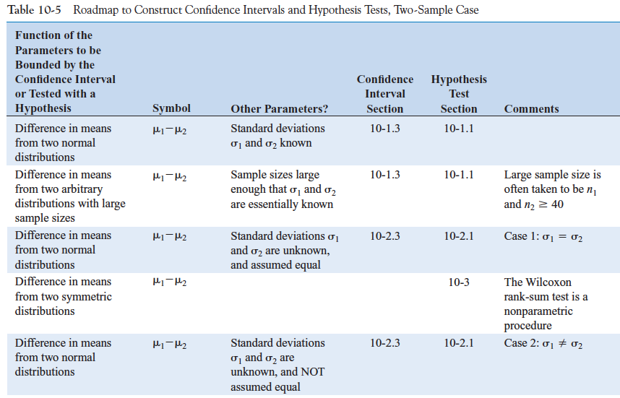
10-7: Summary Table and Road Map for Inference Procedures for Two Samples

Slide 55
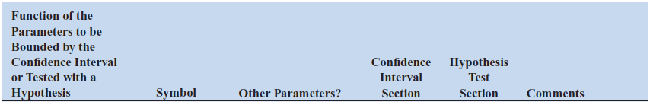
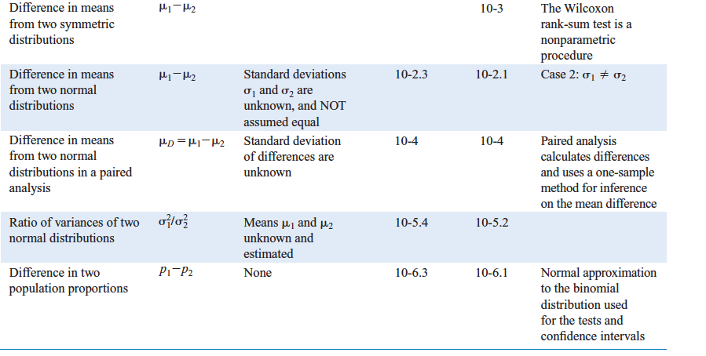
10-7: Summary Table and Road Map for Inference Procedures for Two Samples

Slide 56
Important Terms & Concepts of Chapter 10
Comparative experiments
Confidence intervals on:
Differences
Ratios
Critical region for a test statistic
Identifying cause and effect
Null and alternative hypotheses
1 & 2-sided alternative hypotheses
Operating Characteristic (OC) curves
Paired t-test
Pooled t-test
P-value
Reference distribution for a test statistic
Sample size determination for: Hypothesis tests
Confidence intervals
Statistical hypotheses
Test statistic
Wilcoxon rank-sum test

