Slide 1

Applied Statistics and Probability for Engineers
Sixth Edition
Douglas C. Montgomery George C. Runger
Chapter 11
Simple Linear Regression and Correlation

Slide 2
11
Simple Linear Regression and Correlation
CHAPTER OUTLINE
11-1 Empirical Models
11-2 Simple Linear Regression
11-3 Properties of the Least Squares
Estimators
11-4 Hypothesis Test in Simple Linear
Regression
11-4.1 Use of t-tests
11-4.2 Analysis of variance approach to test
significance of regression
11-5 Confidence Intervals
11-5.1 Confidence intervals on the slope and
intercept
11-5.2 Confidence interval on the mean
response
11-6 Prediction of New Observations
11-7 Adequacy of the Regression Model
11-7.1 Residual analysis
11-7.2 Coefficient of determination (R²)
11-8 Correlation
11-9 Regression on Transformed Variables
11-10 Logistic Regression

Slide 3
Learning Objectives for Chapter 11
After careful study of this chapter, you should be able to do
the following:
Use simple linear regression for building empirical models to engineering and scientific data.
Understand how the method of least squares is used to estimate the parameters in a linear regression model.
Analyze residuals to determine if the regression model is an adequate fit to the data or to see if any underlying assumptions are violated.
Test the statistical hypotheses and construct confidence intervals on the regression model parameters.
Use the regression model to make a prediction of a future observation and construct an appropriate prediction interval on the future observation.
Apply the correlation model.
Use simple transformations to achieve a linear regression model.

Slide 4
11-1: Empirical Models
Many problems in engineering and science involve exploring the relationships between two or more variables.
Regression analysis is a statistical technique that is very useful for these types of problems.
For example, in a chemical process, suppose that the yield of the product is related to the process-operating temperature.
Regression analysis can be used to build a model to predict yield at a given temperature level.

Slide 5
11-2: Simple Linear Regression
The simple linear regression considers a single regressor or predictor x and a dependent or response variable Y.
The expected value of Y at each level of x is a random variable:
E(Y|x) = β₀ + β₁x
We assume that each observation, Y, can be described by the model
Y = β₀ + β₁x + ε

Slide 6
11-2: Simple Linear Regression
Least Squares Estimates
The least-squares estimates of the intercept and slope in the simple linear regression model are
(11-1)
(11-2)
where and .

Slide 7
11-2: Simple Linear Regression
The fitted or estimated regression line is therefore
(11-3)
Note that each pair of observations satisfies the relationship
where is called the residual. The residual describes the error in the fit of the model to the i^{th} observation y_{i}.

Slide 8
11-2: Simple Linear Regression
Notation

Slide 9
EXAMPLE 11-1 Oxygen Purity
We will fit a simple linear regression model to the oxygen purity data in
Table 11-1. The following quantities may be computed:
and

Slide 10
EXAMPLE 11-1 Oxygen Purity - continued
Therefore, the least squares estimates of the slope and intercept are
and
The fitted simple linear regression model (with the coefficients reported to three decimal places) is

Slide 11
11-2: Simple Linear Regression
Estimating σ²
The error sum of squares is
It can be shown that the expected value of the error sum of squares is E(SS_{E}) = (n – 2)σ².

Slide 12
11-2: Simple Linear Regression
Estimating σ²
An unbiased estimator of σ² is
(11-4)
where SS_{E} can be easily computed using
(11-5)

Slide 13
11-3: Properties of the Least Squares Estimators
Slope Properties
Intercept Properties

Slide 14
11-4: Hypothesis Tests in Simple Linear Regression
11-4.1 Use of t-Tests
Suppose we wish to test
H₀: β₁ = β_{1,0}
H₁: β₁ ≠ β_{1,0}
An appropriate test statistic would be
(11-6)

Slide 15
11-4: Hypothesis Tests in Simple Linear Regression
11-4.1 Use of t-Tests
The test statistic could also be written as:
We would reject the null hypothesis if
|t₀| > t_{α/2,n - 2}

Slide 16
11-4: Hypothesis Tests in Simple Linear Regression
11-4.1 Use of t-Tests
Suppose we wish to test
H₀: β₀ = β_{0,0}
H₁: β₀ ≠ β_{0,0}
An appropriate test statistic would be
(11-7)

Slide 17
11-4: Hypothesis Tests in Simple Linear Regression
11-4.1 Use of t-Tests
We would reject the null hypothesis if
|t₀| > t_{α/2,n - 2}

Slide 18
11-4: Hypothesis Tests in Simple Linear Regression
11-4.1 Use of t-Tests
An important special case of the hypotheses of Equation 11-18 is
H₀: β₁ = 0
H₁: β₁ ≠ 0
These hypotheses relate to the significance of regression.
Failure to reject H₀ is equivalent to concluding that there is no linear relationship between x and Y.

Slide 19
11-4: Hypothesis Tests in Simple Linear Regression
EXAMPLE 11-2 Oxygen Purity Tests of Coefficients We will test for significance of regression using the model for the oxygen purity data from Example 11-1. The hypotheses are
H₀: β₁ = 0
H₁: β₁ ≠ 0
and we will use α = 0.01. From Example 11-1 and Table 11-2 we have
so the t-statistic in Equation 11-6 becomes
Practical Interpretation: Since the reference value of t is t_{0.005,18} = 2.88, the value of the test statistic is very far into the critical region, implying that H₀: β₁ = 0 should be rejected. There is strong evidence to support this claim. The P-value for this test is . This was obtained manually with a calculator.
Table 11-2 presents the Minitab output for this problem. Notice that the t-statistic value for the slope is computed as 11.35 and that the reported P-value is P = 0.000. Minitab also reports the t-statistic for testing the hypothesis H₀: β₀ = 0. This statistic is computed from Equation 11-7, with β_{0,0} = 0, as t₀ = 46.62. Clearly, then, the hypothesis that the intercept is zero is rejected.

Slide 20
11-4: Hypothesis Tests in Simple Linear Regression
11-4.2 Analysis of Variance Approach to Test Significance of Regression
The analysis of variance identity is
(11-8)
Symbolically,
SS_{T} = SS_{R} + SS_{E} (11-9)

Slide 21
11-4: Hypothesis Tests in Simple Linear Regression
11-4.2 Analysis of Variance Approach to Test Significance of Regression
If the null hypothesis, H₀: β₁ = 0 is true, the statistic
(11-10)
follows the F_{1,n-2} distribution and we would reject if f₀ > f_{α,1,n-2}.

Slide 22
11-4: Hypothesis Tests in Simple Linear Regression
11-4.2 Analysis of Variance Approach to Test Significance of Regression
The quantities, MS_{R} and MS_{E} are called mean squares.
Analysis of variance table:
Note that MS_{E} =
Source of Variation | Sum of Squares | Degrees of Freedom | Mean Square | F₀
Regression |  | 1 | MS_{R} | MS_{R}/MS_{E}
Error |  | n - 2 | MS_{E}
Total | SS_{T} | n - 1

Slide 23
11-4: Hypothesis Tests in Simple Linear Regression
EXAMPLE 11-3 Oxygen Purity ANOVA We will use the analysis of variance approach to test for significance of regression using the oxygen purity data model from Example 11-1. Recall that , S_{xy} = 10.17744, and n = 20. The regression sum of squares is
and the error sum of squares is
SS_{E} = SS_{T} - SS_{R} = 173.38 - 152.13 = 21.25
The analysis of variance for testing H₀: β₁ = 0 is summarized in the Minitab output in Table 11-2. The test statistic is f₀ = MS_{R}/MS_{E} = 152.13/1.18 = 128.86, for which we find that the P-value is , so we conclude that β₁ is not zero.
There are frequently minor differences in terminology among computer packages. For example, sometimes the regression sum of squares is called the “model” sum of squares, and the error sum of squares is called the “residual” sum of squares.

Slide 24
11-5: Confidence Intervals
11-5.1 Confidence Intervals on the Slope and Intercept
Definition
Under the assumption that the observation are normally and independently distributed, a 100(1 - α)% confidence interval on the slope β₁ in simple linear regression is
(11-11)
Similarly, a 100(1 - α)% confidence interval on the intercept β₀ is
(11-12)

Slide 25
11-5: Confidence Intervals
EXAMPLE 11-4 Oxygen Purity Confidence Interval on the Slope We will find a 95% confidence interval on the slope of the regression line using the data in Example 11-1. Recall that , and (see Table 11-2). Then, from Equation 11-11 we find
Or
This simplifies to
12.181 ≤ β₁ ≤ 17.713
Practical Interpretation: This CI does not include zero, so there is strong evidence (at α = 0.05) that the slope is not zero. The CI is reasonably narrow (±2.766) because the error variance is fairly small.

Slide 26
11-5: Confidence Intervals
11-5.2 Confidence Interval on the Mean Response
Definition
A 100(1 - α)% confidence interval about the mean response at the value of
, say , is given by
(11-13)
where is computed from the fitted regression model.

Slide 27
11-5: Confidence Intervals
Example 11-5 Oxygen Purity Confidence Interval on the Mean Response
We will construct a 95% confidence interval about the mean response for the data in Example 11-1. The fitted model is , and the 95% confidence interval on is found from Equation 11-13 as
Suppose that we are interested in predicting mean oxygen purity when
x₀ = 100%. Then
and the 95% confidence interval is
or
89.23 ± 0.75
Therefore, the 95% CI on μ_{Y|1.00} is
88.48 ≤ μ_{Y|1.00} ≤ 89.98
This is a reasonable narrow CI.

Slide 28
11-6: Prediction of New Observations
Prediction Interval
A 100(1 - α) % prediction interval on a future observation Y₀ at the value x₀ is given by
(11-14)
The value is computed from the regression model .

Slide 29
11-6: Prediction of New Observations
EXAMPLE 11-6 Oxygen Purity Prediction Interval
To illustrate the construction of a prediction interval, suppose we use the data in Example 11-1 and find a 95% prediction interval on the next observation of oxygen purity x₀ = 1.00%. Using Equation 11-14 and recalling from Example 11-5 that , we find that the prediction interval is
which simplifies to
86.83 ≤ y₀ ≤ 91.63
This is a reasonably narrow prediction interval.

Slide 30
11-7: Adequacy of the Regression Model
Fitting a regression model requires several assumptions.
  Errors are uncorrelated random variables with mean zero;
  Errors have constant variance; and,
  Errors be normally distributed.
The analyst should always consider the validity of these assumptions to be doubtful and conduct analyses to examine the adequacy of the model

Slide 31
11-7: Adequacy of the Regression Model
11-7.1 Residual Analysis
The residuals from a regression model are e_{i} = y_{i} - ŷ_{i} , where y_{i} is an actual observation and ŷ_{i} is the corresponding fitted value from the regression model.
Analysis of the residuals is frequently helpful in checking the assumption that the errors are approximately normally distributed with constant variance, and in determining whether additional terms in the model would be useful.

Slide 32
11-7: Adequacy of the Regression Model
EXAMPLE 11-7 Oxygen Purity Residuals
The regression model for the oxygen purity data in Example 11-1 is
.
Table 11-4 presents the observed and predicted values of y at each value of x from this data set, along with the corresponding residual. These values were computed using Minitab and show the number of decimal places typical of computer output.
A normal probability plot of the residuals is shown in Fig. 11-10. Since the residuals fall approximately along a straight line in the figure, we conclude that there is no severe departure from normality.
The residuals are also plotted against the predicted value in Fig. 11-11 and against the hydrocarbon levels x_{i} in Fig. 11-12. These plots do not indicate any serious model inadequacies.

Slide 33
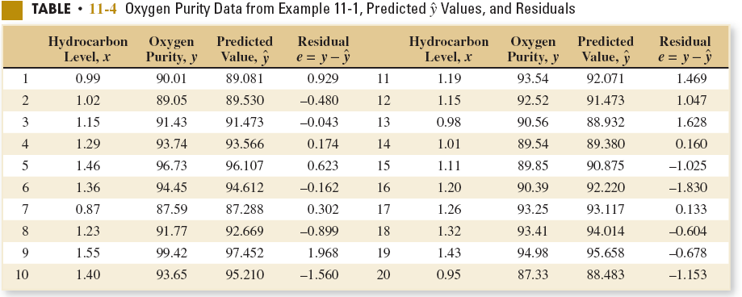
11-7: Adequacy of the Regression Model
Example 11-7

Slide 34
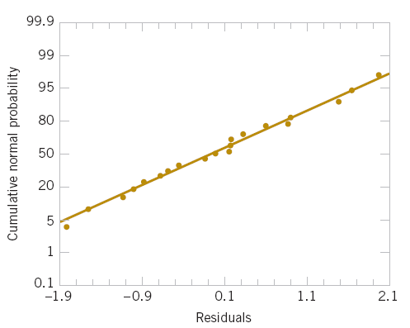
11-7: Adequacy of the Regression Model
Example 11-7
Figure 11-10 Normal probability plot of residuals, Example 11-7.

Slide 35
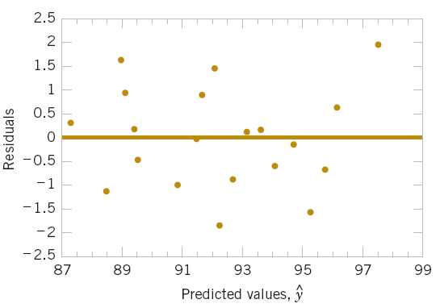
11-7: Adequacy of the Regression Model
Example 11-7
Figure 11-11 Plot of residuals versus predicted oxygen purity, ŷ, Example 11-7.

Slide 36
11-7: Adequacy of the Regression Model
11-7.2 Coefficient of Determination (R²)
The quantity
is called the coefficient of determination and is often used to judge the adequacy of a regression model.
0 ≤ R² ≤ 1;
We often refer (loosely) to R² as the amount of variability in the data explained or accounted for by the regression model.

Slide 37
11-7: Adequacy of the Regression Model
11-7.2 Coefficient of Determination (R²)
For the oxygen purity regression model,
R² = SS_{R}/SS_{T}
= 152.13/173.38
= 0.877
Thus, the model accounts for 87.7% of the variability in the data.

Slide 38
11-8: Correlation
We assume that the joint distribution of X_{i} and Y_{i} is the bivariate normal distribution presented in Chapter 5, and μ_{Y} and are the mean and variance of Y, μ_{X} and are the mean and variance X, and ρ is the correlation coefficient between Y and X. Recall that the correlation coefficient is defined as
(11-15)
where σ_{XY} is the covariance between Y and X.
The conditional distribution of Y for a given value of X = x is
(11-16)
where
(11-17)
(11-18)

Slide 39
11-8: Correlation
It is possible to draw inferences about the correlation coefficient ρ in this model. The estimator of ρ is the sample correlation coefficient
(11-19)
Note that
(11-20)
We may also write:

Slide 40
11-8: Correlation
It is often useful to test the hypotheses
H₀: ρ = 0
H₁: ρ ≠ 0
The appropriate test statistic for these hypotheses is
(11-21)
Reject H₀ if |t₀| > t_{α/2,n-2}.

Slide 41
11-8: Correlation
The test procedure for the hypothesis
H₀: ρ = 0
H₁: ρ ≠ 0
where ρ₀ ≠ 0 is somewhat more complicated. In this case, the appropriate test statistic is
Z₀ = (arctanh R - arctanh ρ₀)(n - 3)^{1/2} (11-22)
Reject H₀ if |z₀| > z_{α/2}.

Slide 42
11-8: Correlation
The approximate 100(1- α)% confidence interval is
(11-23)

Slide 43
11-8: Correlation
EXAMPLE 11-8 Wire Bond Pull Strength In Chapter 1 (Section 1-3) an application of regression analysis is described in which an engineer at a semiconductor assembly plant is investigating the relationship between pull strength of a wire bond and two factors: wire length and die height. In this example, we will consider only one of the factors, the wire length. A random sample of 25 units is selected and tested, and the wire bond pull strength and wire length arc observed for each unit. The data are shown in Table 1-2. We assume that pull strength and wire length are jointly normally distributed.
Figure 11-13 shows a scatter diagram of wire bond strength versus wire length. We have used the Minitab option of displaying box plots of each individual variable on the scatter diagram. There is evidence of a linear relationship between the two variables.
The Minitab output for fitting a simple linear regression model to the data is shown below.

Slide 44
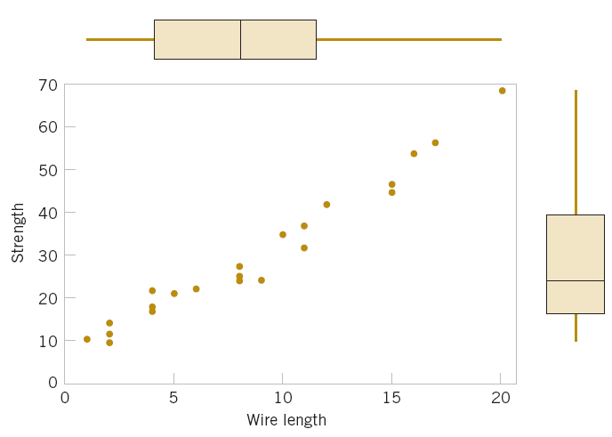
11-8: Correlation
Figure 11-13 Scatter plot of wire bond strength versus wire length, Example 11-8.

Slide 45
11-8: Correlation
Minitab Output for Example 11-8
Regression Analysis: Strength versus Length
The regression equation is
Strength = 5.11 + 2.90 Length
Predictor Coef SE Coef T P
Constant 5.115 1.146 4.46 0.000
Length 2.9027 0.1170 24.80 0.000
S = 3.093 R-Sq = 96.4% R-Sq(adj) = 96.2%
PRESS = 272.144 R-Sq(pred) = 95.54%
Analysis of Variance
Source DF SS MS F P
Regression 1 5885.9 5885.9 615.08 0.000
Residual Error 23 220.1 9.6
Total 24 6105.9

Slide 46
11-8: Correlation
Example 11-8 (continued)
Now S_{xx} = 698.56 and S_{xy} = 2027.7132, and the sample correlation coefficient is
Note that r² = (0.9818)² = 0.9640 (which is reported in the Minitab output), or that approximately 96.40% of the variability in pull strength is explained by the linear relationship to wire length.

Slide 47
11-8: Correlation
Example 11-8 (continued)
Now suppose that we wish to test the hypotheses
H₀: ρ = 0
H₁: ρ ≠ 0
with α = 0.05. We can compute the t-statistic of Equation 11-21 as
This statistic is also reported in the Minitab output as a test of H₀: β₁ = 0. Because t_{0.025,23} = 2.069, we reject H₀ and conclude that the correlation coefficient ρ ≠ 0.

Slide 48
11-8: Correlation
Example 11-8 (continued)
Finally, we may construct an approximate 95% confidence interval on r from Equation 11-23. Since arctanh r = arctanh 0.9818 = 2.3452, Equation 11-23 becomes
which reduces to
0.9585 ≤ ρ ≤ 0.9921

Slide 49
11-9: Transformation and Logistic Regression
We occasionally find that the straight-line regression model
Y = β₀ + β₁x + ε inappropriate because the true regression function is nonlinear. Sometimes nonlinearity is visually determined from the scatter diagram, and sometimes, because of prior experience or underlying theory, we know in advance that the model is nonlinear.
Occasionally, a scatter diagram will exhibit an apparent nonlinear relationship between Y and x. In some of these situations, a nonlinear function can be expressed as a straight line by using a suitable transformation. Such nonlinear models are called intrinsically linear.

Slide 50
11-9: Transformation and Logistic Regression
EXAMPLE 11-9 Windmill Power
A research engineer is investigating the use of a windmill to generate electricity and has collected data on the DC output from this windmill and the corresponding wind velocity. The data are plotted in Figure 11-14 and listed in Table 11-5
Observation Number, i | Wind Velocity (mph), x_{i} | DC Output, y_{i}
1 | 5.00 | 1.582
2 | 6.00 | 1.822
3 | 3.40 | 1.057
4 | 2.70 | 0.500
5 | 10.00 | 2.236
6 | 9.70 | 2.386
7 | 9.55 | 2.294
8 | 3.05 | 0.558
9 | 8.15 | 2.166
10 | 6.20 | 1.866
11 | 2.90 | 0.653
12 | 6.35 | 1.930
13 | 4.60 | 1.562
14 | 5.80 | 1.737
15 | 7.40 | 2.088
16 | 3.60 | 1.137
17 | 7.85 | 2.179
18 | 8.80 | 2.112
19 | 7.00 | 1.800
20 | 5.45 | 1.501
21 | 9.10 | 2.303
22 | 10.20 | 2.310
23 | 4.10 | 1.194
24 | 3.95 | 1.144
25 | 2.45 | 0.123
Table 11-5 Observed Values and Regressor Variable for Example 11-9.

Slide 51
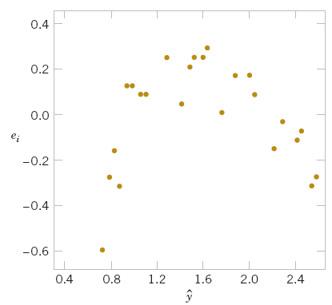
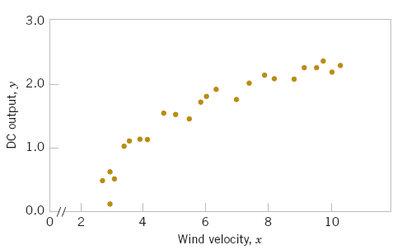
11-9: Transformation and Logistic Regression
Example 11-9 (Continued)
Figure 11-14 Plot of DC output y versus wind velocity x for the windmill data.
Figure 11-15 Plot of residuals e_{i} versus fitted values for the windmill data.

Slide 52
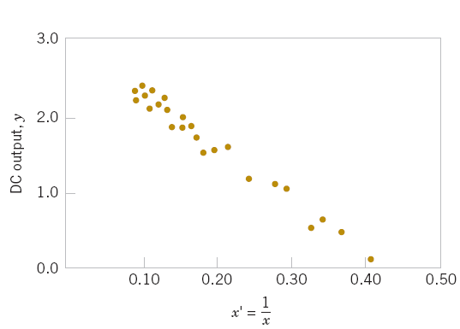
11-9: Transformation and Logistic Regression
Example 11-9 (Continued)
Figure 11-16 Plot of DC output versus x’ = 1/x for the windmill data.

Slide 53
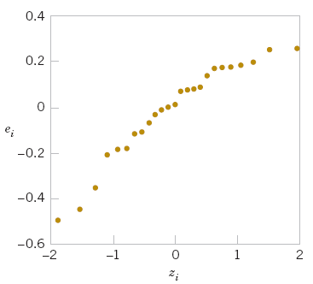
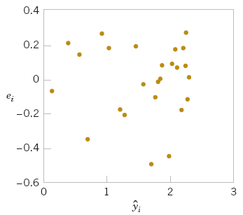
11-9: Transformation and Logistic Regression
Example 11-9 (Continued)
Figure 11-17 Plot of residuals versus fitted values
for the transformed model for the windmill data.
Figure 11-18 Normal probability plot of the residuals for the transformed model for the windmill data.
A plot of the residuals from the transformed model versus is shown in Figure 11-17. This plot does not reveal any serious problem with inequality of variance. The normal probability plot, shown in Figure 11-18, gives a mild indication that the errors come from a distribution with heavier tails than the normal (notice the slight upward and downward curve at the extremes). This normal probability plot has the z-score value plotted on the horizontal axis. Since there is no strong signal of model inadequacy, we conclude that the transformed model is satisfactory.

Slide 54
Important Terms & Concepts of Chapter 11
Analysis of variance test in regression
Confidence interval on mean response
Correlation coefficient
Empirical model
Confidence intervals on model parameters
Intrinsically linear model
Least squares estimation of regression model parameters
Logistics regression
Model adequacy checking
Odds ratio
Prediction interval on a future observation
Regression analysis
Residual plots
Residuals
Scatter diagram
Simple linear regression model standard error
Statistical test on model parameters
Transformations

