Slide 1
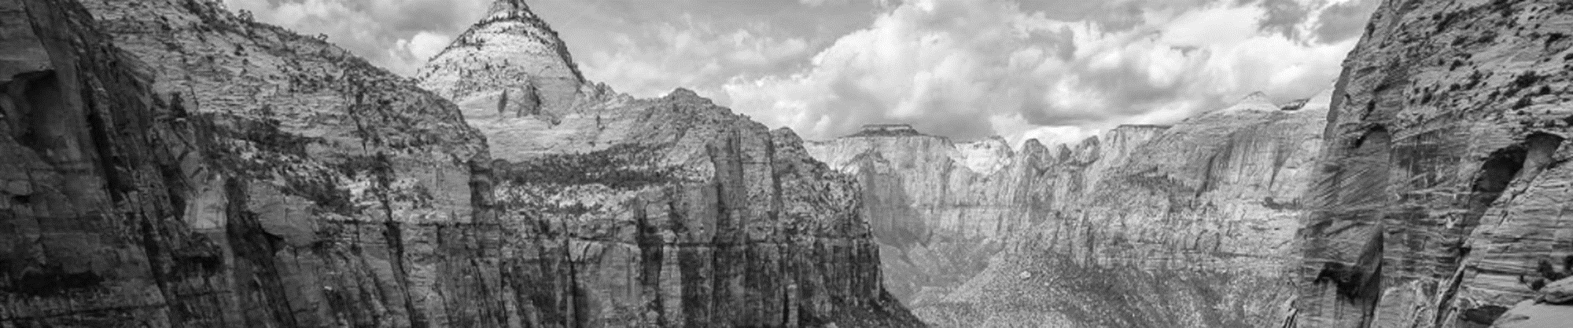
Nonstationary GEV Models
Hidden Markov Models
An Introduction to Statistical Modeling
of Extreme Values
Stuart Coles
Hidden Markov Models for Time Series
Walter Zucchini
Coles (2001), Zucchini (2016)
Notes:
GEV Problem # 6
HMM (Problem #4/7/10)

Slide 2
Outline
Nonstationary GEV models
    Stationary GEV modeling
    Nonstationary GEV modeling
    R code demonstration
II. Hidden Markov models
    - Mixture models
    - Markov chains
    - HMMs
    - R code demonstration

Slide 3
Outline
Nonstationary GEV models
    Stationary GEV modeling
    Nonstationary GEV modeling
    R code demonstration
II. Hidden Markov models
    - Mixture models
    - Markov chains
    - HMMs
    - R code demonstration

Slide 4
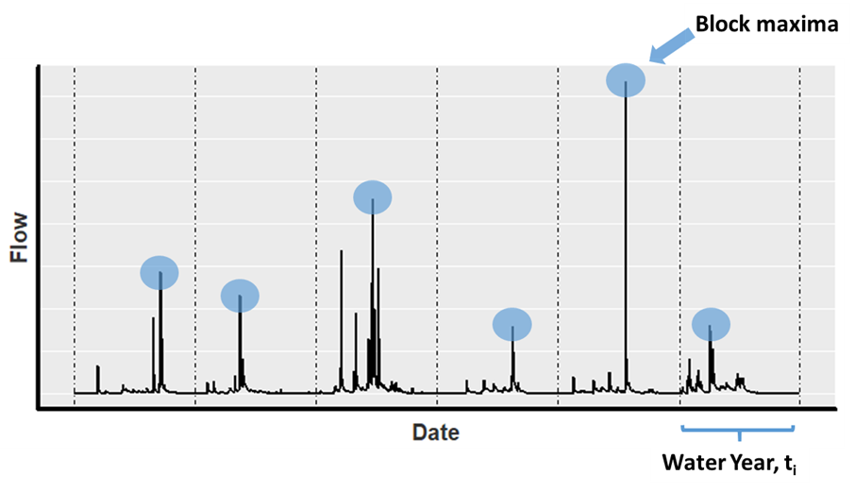
GEV
If you take the block maxima from a dataset (i.e. the yearly maxima of i.i.d variables, M₃₆₅ = max{X₁, . . . , X₃₆₅})
M_{N} converges to a GEV distribution

Slide 5
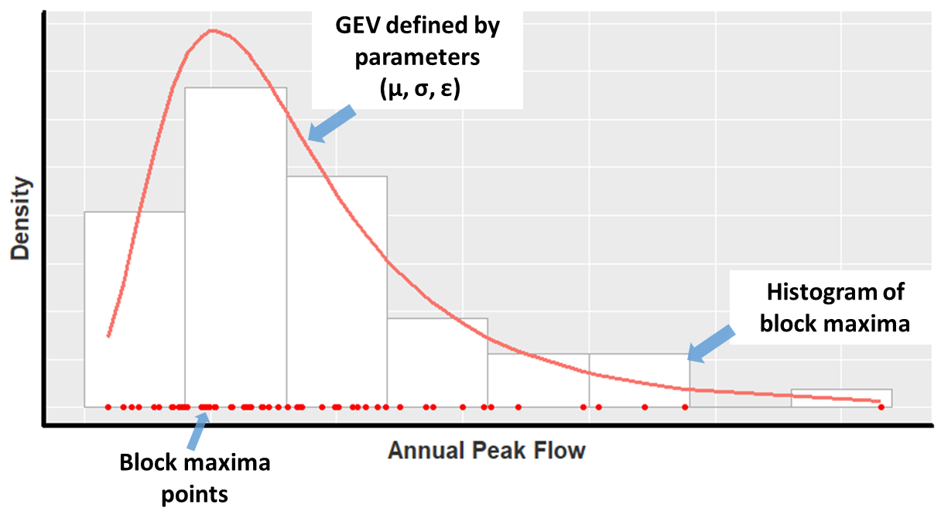

GEV
Generalized Extreme Value Distribution (GEV)
Industry standard for flood frequency analysis in the UK
3 parameter distribution
Assumes stationary risk
$$G\left(z\right)=exp\left\{−{\left[1−ε\frac{\left(z−μ\right)}{σ}\right]}^{\frac{−1}{ε}}\right\}$$
µ: location parameter
σ: scale parameter
ξ: shape parameter
(Coles 2001)

Slide 6
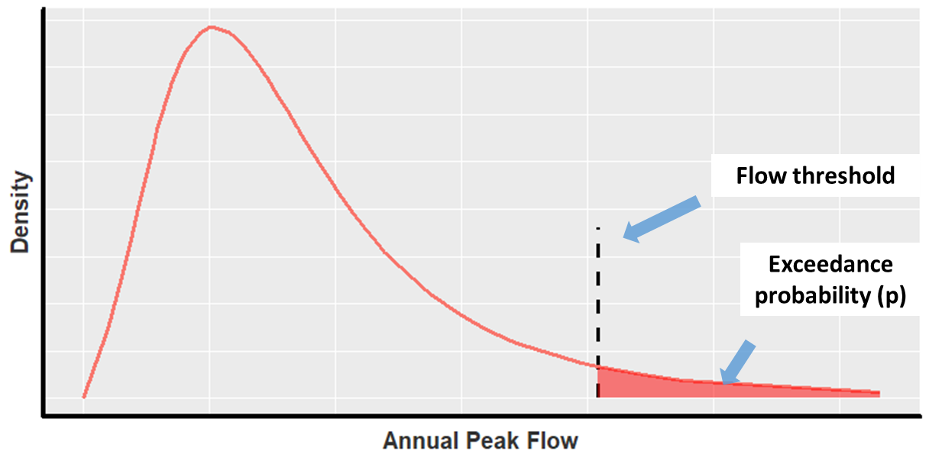
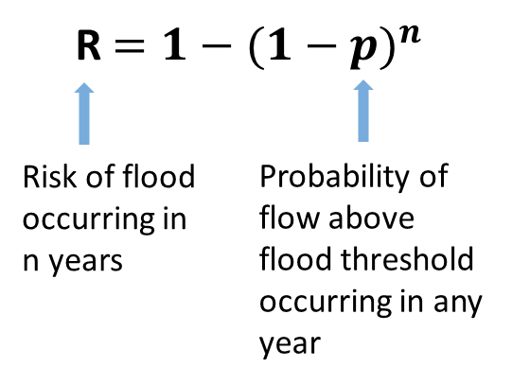
GEV
Generalized Extreme Value Distribution (GEV)
Calculate the risk of exceeding a flow level
(Coles 2001)
3. Calculate Risk of Flood

Slide 7

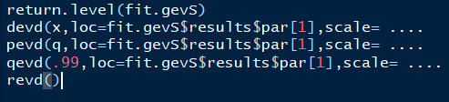
GEV
Generalized Extreme Value Distribution (GEV)
  extRemes 2.0: An Extreme Value Analysis Package in R
  Fit a stationary GEV distribution
  Perform standard operations
(Coles 2001)
Notes:
Eric Gilleland, Richard W. Katz

Slide 8



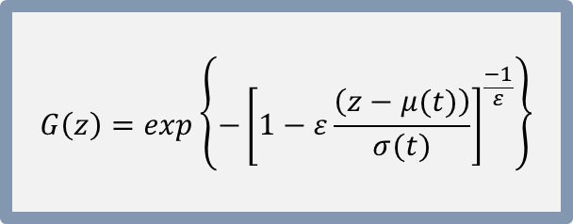
Nonstationary GEV
The nonstationary GEV model enables modeling of nonstationary risk
  Covariates (xn) to shift location (µ) and scale (σ) parameters of the distribution
  Commonly used covariates:
    Average precipitation
    Average temperature
    Ocean atmosphere system climate indices
$$G\left(z\right)=exp\left\{−{\left[1−ε\frac{\left(z−μ(t)\right)}{σ(t)}\right]}^{\frac{−1}{ε}}\right\}$$
$$μ\left(t\right)= β_{0,μ}+β_{1,μ}x_{1}+…+β_{n,μ}x_{n}$$
$$σ\left(t\right)= β_{0,σ}+β_{1,σ}x_{1}+…+β_{n,σ}x_{n}$$
$$ε=β_{0,ε}$$
(Coles 2001)

Slide 9
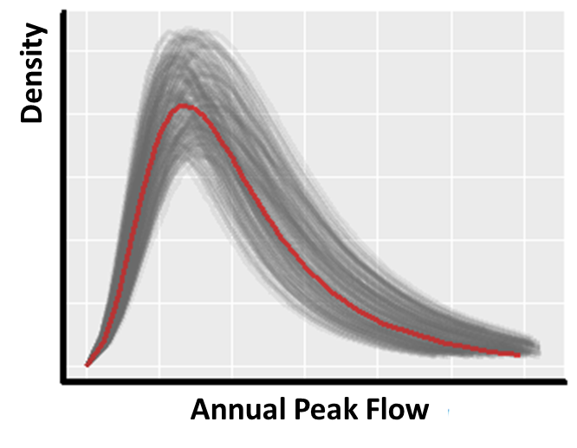
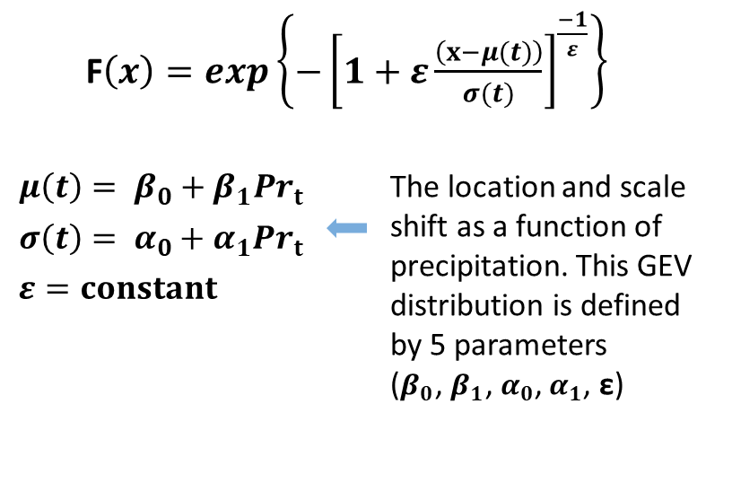
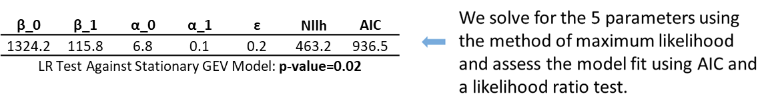

Nonstationary GEV
Example:
The nonstationary GEV model
The non-stationary GEV distribution can represent many different GEV distributions
Potential future GEV based on future precipitation
GEV $t_{1}$ =$Pr_{1}$
(Coles 2001)

Slide 10
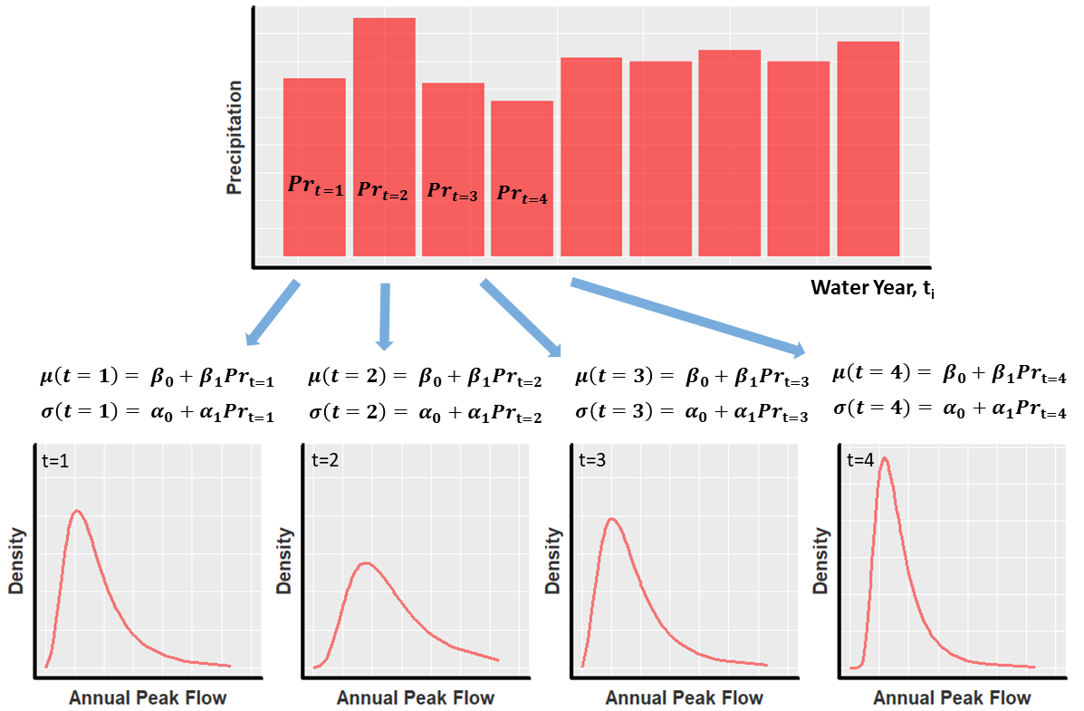
Nonstationary GEV
Example:
The nonstationary GEV model
(Coles 2001)

Slide 11
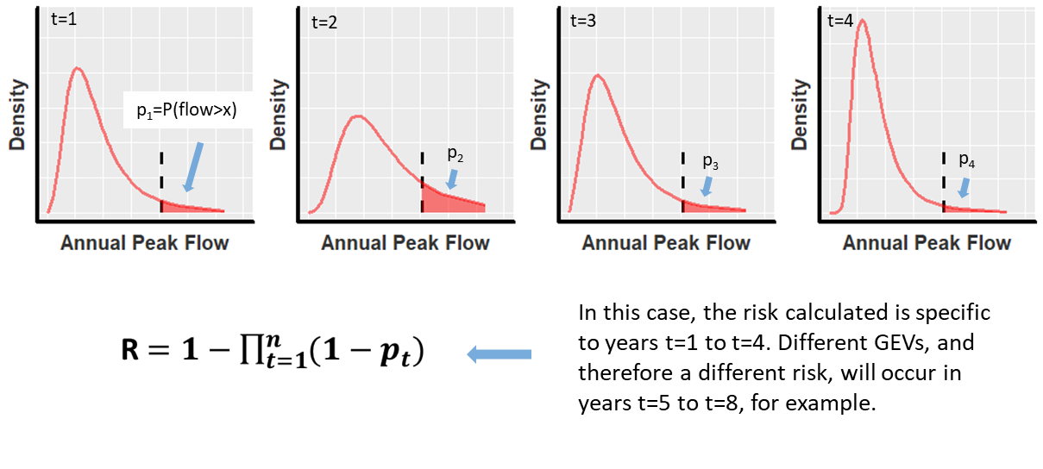
Nonstationary GEV
Example:
The nonstationary GEV model
(Coles 2001)

Slide 12
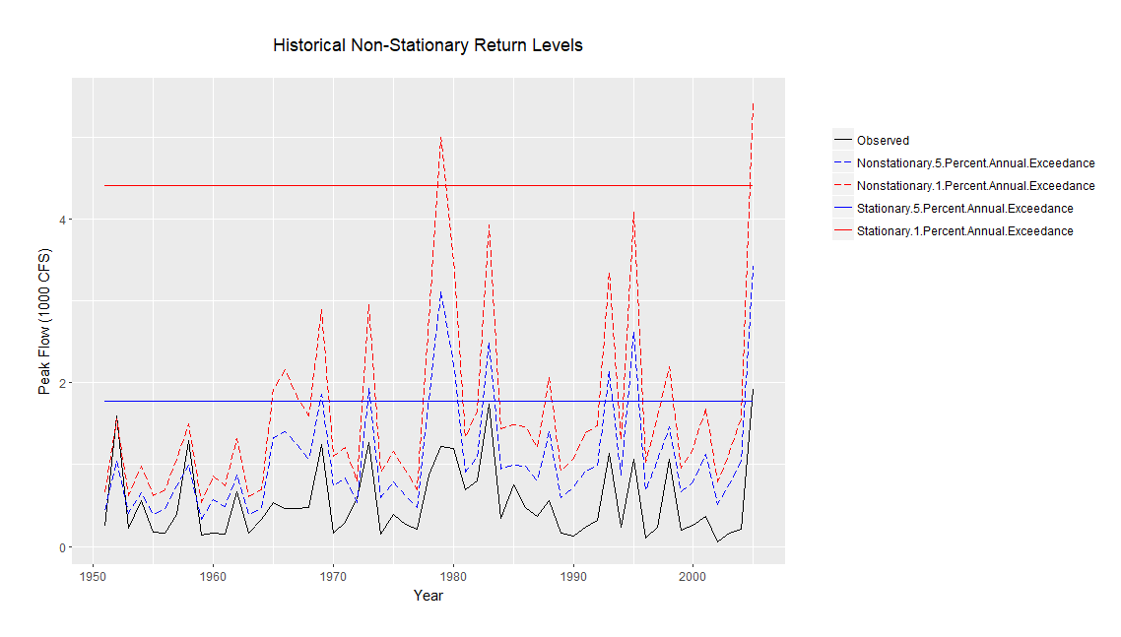
Nonstationary GEV
Example:
The nonstationary GEV model
(Coles 2001)

Slide 13

Nonstationary GEV
The nonstationary GEV model
  extRemes 2.0: An Extreme Value Analysis Package in R
  Fit a nonstationary GEV distributions
    Select best model using AIC/BIC/LR Test
  Model/risk assessment
(Coles 2001)
Notes:
return.level() command to plot historical fluctuation in flood risk

Slide 14
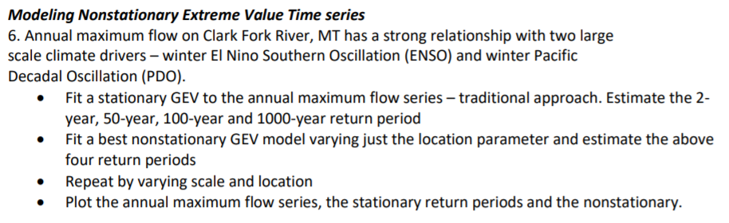
Nonstationary GEV
The nonstationary GEV model
(Coles 2001)
Notes:
return.level() command to plot historical fluctuation in flood risk

Slide 15
Outline
Nonstationary GEV models
    Stationary GEV modeling
    Nonstationary GEV modeling
    R code demonstration
II. Hidden Markov models
    - Mixture models
    - Markov chains
    - HMMs
    - R code demonstration
Notes:
Presenting in the context of GEV distribution

Slide 16
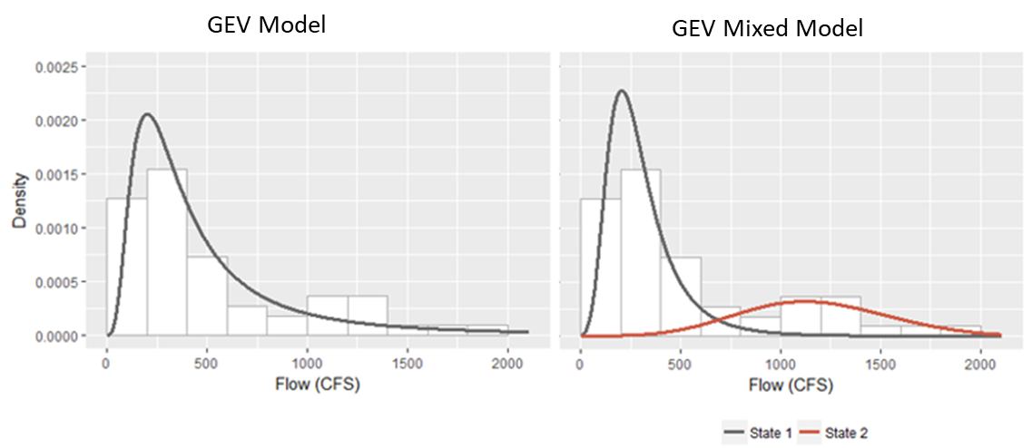

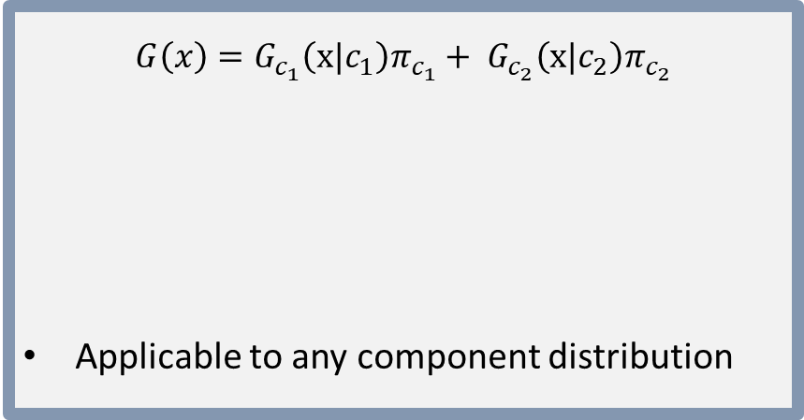
Mixed Models
GEV Model
Mixed models assume the record of observed floods have been sampled from multiple populations
$$G\left(x\right)=G_{c_{1}}\left(x|c_{1}\right)π_{c_{1}}+ G_{c_{2}}\left(x|c_{2}\right)π_{c_{2}}$$
Applicable to any component distribution
GEV State 1
Probability of being
In State 1
GEV Mixed Model
Coles (2001), Zucchini (2016)

Slide 17
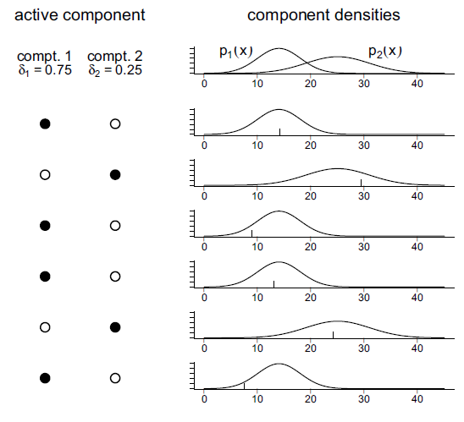





Mixed Models
There is a sequence of observed states that exists with a mixed model
$$g_{c_{1}}\left(x\right)$$
$$g_{c_{2}}\left(x\right)$$
State 1
State 2
$π_{c_{1}}$= 0.75
$π_{c_{2}}$= 0.25
$$G\left(x\right)=G_{c_{1}}\left(x|c_{1}\right)π_{c_{1}}+ G_{c_{2}}\left(x|c_{2}\right)π_{c_{2}}$$
t1
t2
State 1
Probability of being
In State 1
t3
t4
State Sequence = [C1, C2, C1, C1, C2, C1]
t5
t6
Coles (2001), Zucchini (2016)

Slide 18





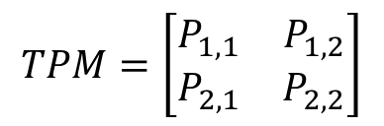
Markov Chains
Hidden Markov models:
The state sequence follows the Markov Property
$$g_{c_{1}}\left(x\right)$$
$$g_{c_{2}}\left(x\right)$$
State 1
State 2
$π_{c_{1}}$= 0.75
$π_{c_{2}}$= 0.25
The probability of being in a particular state is dependent on the previous state
  Incorporates an element of serial dependence
- Can be expressed as a transition probability matrix (TPM)
$${\operatorname{Pr}\left(C_{i,t+1} | C^{(t)}\right)=Pr⁡(C}_{i,t+1}|C_{i,t})$$
$$TPM=\left[\begin{matrix}P_{1,1} & P_{1,2} \\ P_{2,1} & P_{2,2}\end{matrix}\right]$$
State Sequence = [C1, C2, C1, C1, C2, C1]
Coles (2001), Zucchini (2016)

Slide 19
Hidden Markov Models (HMM)
Hidden Markov model
A doubly embedded stochastic process that can be used to model time series data
Each time-series observation is a stochastic sample from a corresponding, underlying distribution
2. The sequence of underlying distributions, or hidden states, follow a Markov chain
Observation 1
t=1
Observation 2
t=2
Observation 3
t=3
Observation 4
t=4
State 1
TPM
State 2
TPM
State 1
TPM
State 1
Coles (2001), Zucchini (2016)

Slide 20
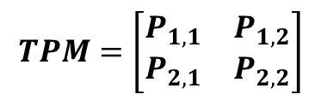

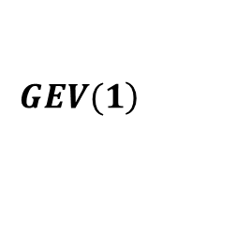

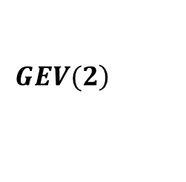
Hidden Markov Models (HMM)
Hidden Markov model
Expectation-Maximization (EM) Algorithm (Baum-Welch Algorithm)
Expectation Step: estimate of the data likelihood given parameter estimates
Maximization Step: data likelihood is maximized with respect to the parameters
The E‐step and M‐step are repeated until convergence of parameter values is achieved
Given a set of observed points, we are tasked with decoding:
A number of underlying distribution parameters
A transition probability matrix
$$\left.GEV(1\right)$$
$$\left.GEV(2\right)$$
$$μ_{1}{,σ}_{1}, ε_{1}$$
$$μ_{2}{,σ}_{2}, ε_{2}$$
$$TPM=\left[\begin{matrix}P_{1,1} & P_{1,2} \\ P_{2,1} & P_{2,2}\end{matrix}\right]$$
Coles (2001), Zucchini (2016)

Slide 21

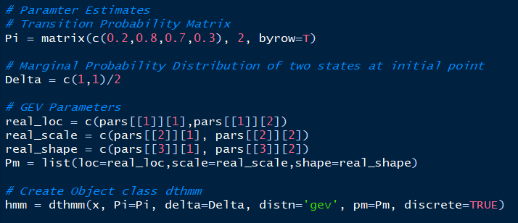

Hidden Markov Models (HMM)
Baum-Welch Algorithm
For other (gamma,LN,Nor…)
For GEV
Provide parameter estimates
  Delta provides initial probability distibrution of the hidden states
  (see nonstat in ?dthmm())
Run Baum-Welch algorithm
Simulate (see simulate() command)
Convergence Criteria
Coles (2001), Zucchini (2016)
Notes:
Generate 250 simulations from the fitted HMM. This involves generating the state sequence

Slide 22
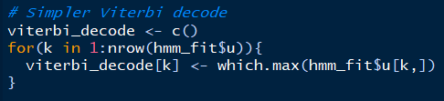
Hidden Markov Models (HMM)
Viterbi Algorithm
Predicts most likely sequence of Markov states given the observed dataset
This can be obtained from your fit model object
[1, 2, 2, 1, 1, 1, 1, 2, 2, 1, 1, 2, 1,]
Coles (2001), Zucchini (2016)

Slide 23

Hidden Markov Models (HMM)
Fit a logistic regression model to your decoded state sequence
Incorporate covariates
  - Local hydrometeorological data
  - Large scale ocean-atmosphere signals
Simulate: akin to using nonhomogeneous transition probability matrix
[1, 2, 2, 1, 1, 1, 1, 2, 2, 1, 1, 2, 1,]
Coles (2001), Zucchini (2016)

Slide 24
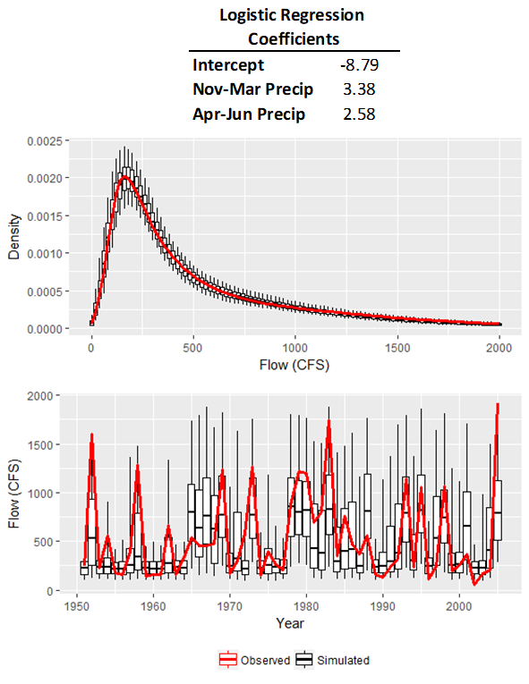
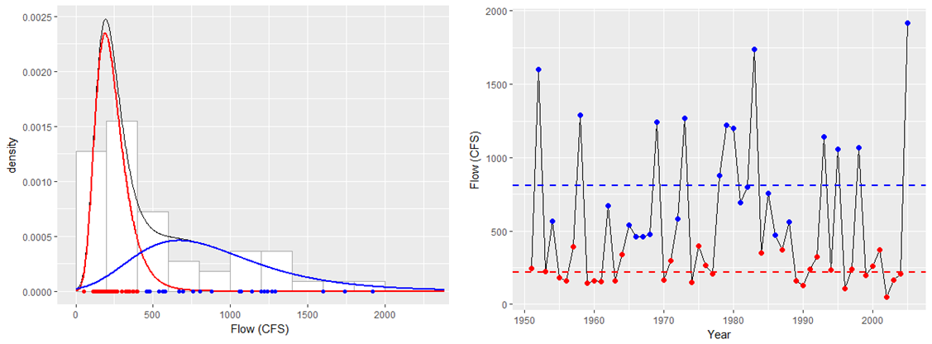
Hidden Markov Models (HMM)
Fit a logistic regression model to your decoded state sequence
Coles (2001), Zucchini (2016)

Slide 25
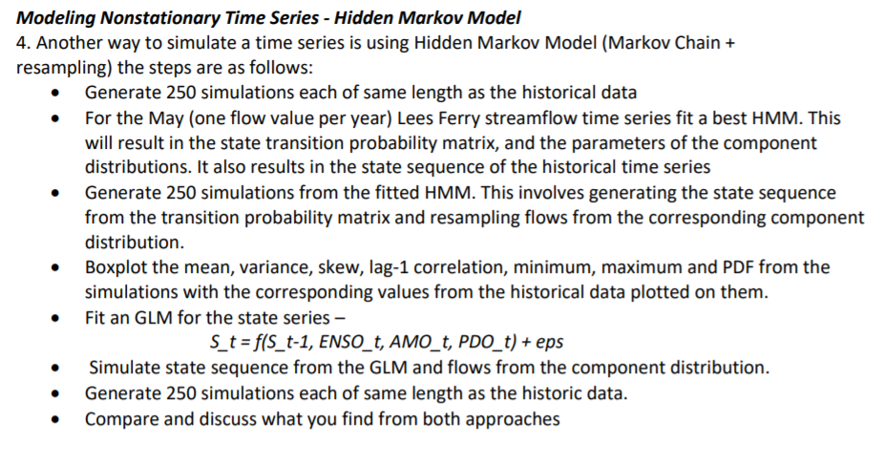
Hidden Markov Models (HMM)
Coles (2001), Zucchini (2016)

