Slide 1
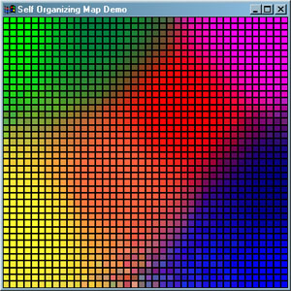
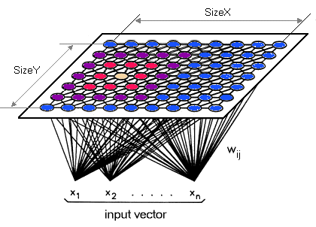
An Introduction to Self-Organizing Maps
November 1, 2018
Advanced Data Analysis Techniques
University of Colorado Boulder

Slide 2
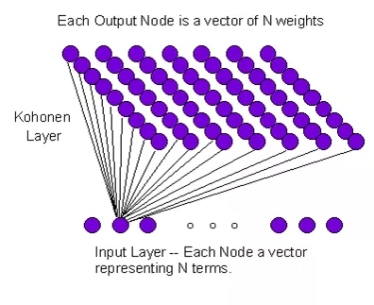
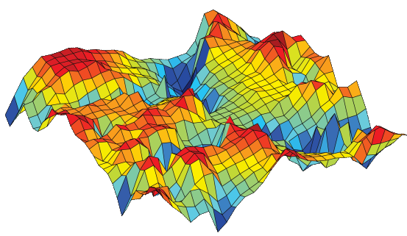
Self-Organizing Maps - Overview
Unsupervised Neural Network
Cluster High-Dimensional Data
Contains Input Layer, Weights, Kohonen Layer
Retains the Topology of the Input Data

Slide 3
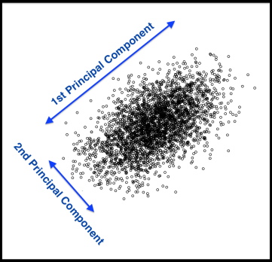

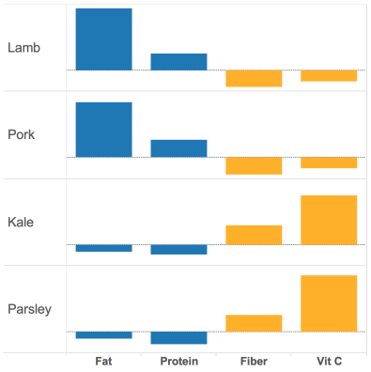
Other Clustering Methods
Principal Component Analysis
K Means

Slide 4

Self-Organizing Maps - Overview
Similarity between nodes
Nodes are organized in resulting map
Can capture nonlinear relationships
Nodes have physical meaning
Need to define grid size/type a priori
No method for determining best grid size
Can be computationally expensive

Slide 5
Define Terms
1
2
3
4
5
Node
1
Node 1
Node 2
Node 3
2
3
4
5
Node 25

Slide 6
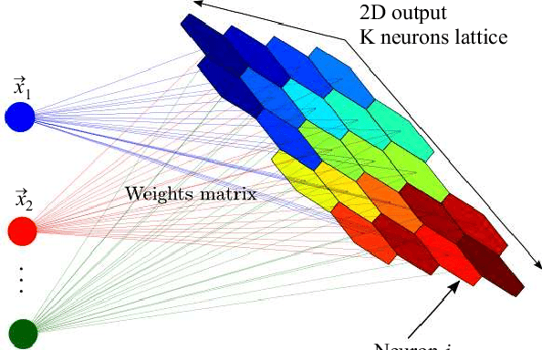
Define Terms
Node
Weight/Code Vector

Slide 7
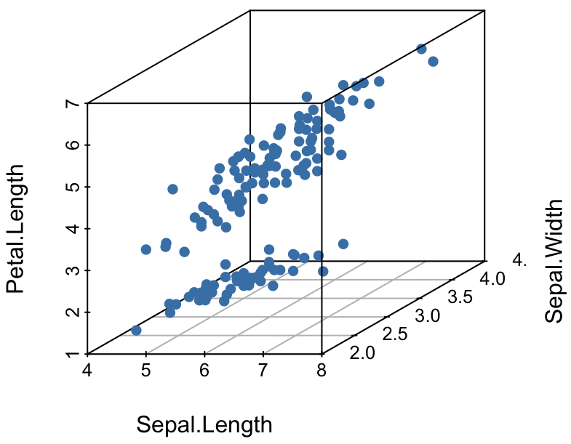
Define Terms
Node
Weight/Code Vector
x,y,z
Input Layer
x,y,z
x,y,z

Slide 8
Define Terms
Node
Weight/Code Vector
Input Layer
Kohonen Layer

Slide 9
Define Terms
Node
Weight/Code Vector
Input Layer
Kohonen Layer
Best Matching Unit, BMU

Slide 10
Define Terms
Node
Weight/Code Vector
Input Layer
Kohonen Layer
Best Matching Unit, BMU
Neighborhood/Radius

Slide 11
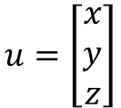
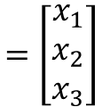
Input Layer
For a given observation, u, there are three variables:
Sepal.Length -> x
Sepal.Width -> y
Petal.Length -> z
$$u=\left[\begin{matrix}x \\ y \\ z\end{matrix}\right]$$
$$=\left[\begin{matrix}x_{1} \\ x_{2} \\ x_{3}\end{matrix}\right]$$

Slide 12
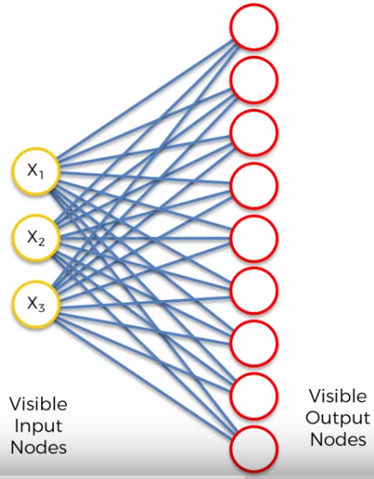
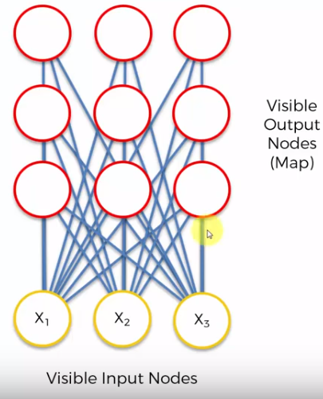
Learning Process

Slide 13
Learning Process
Step 1: Randomly position the grid’s nodes in the data space.

Slide 14
Learning Process
Step 2: Select one data point, either randomly or systematically cycling through the dataset in order
Data point u

Slide 15
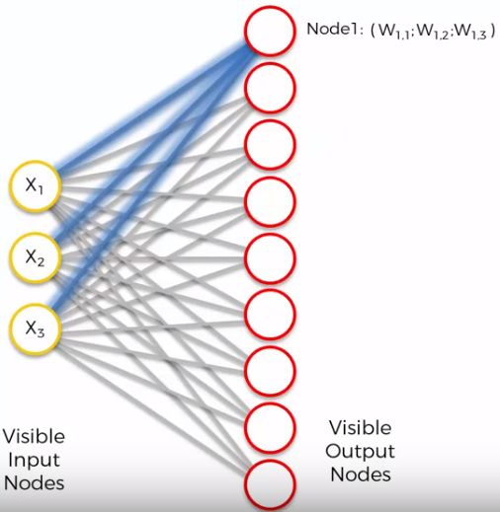
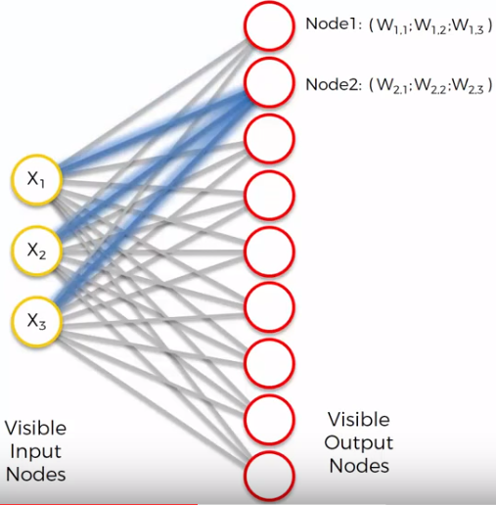
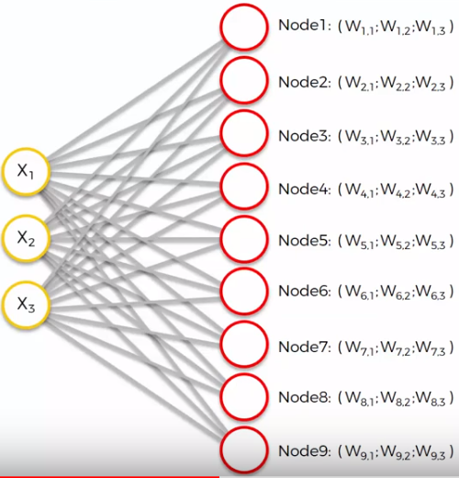
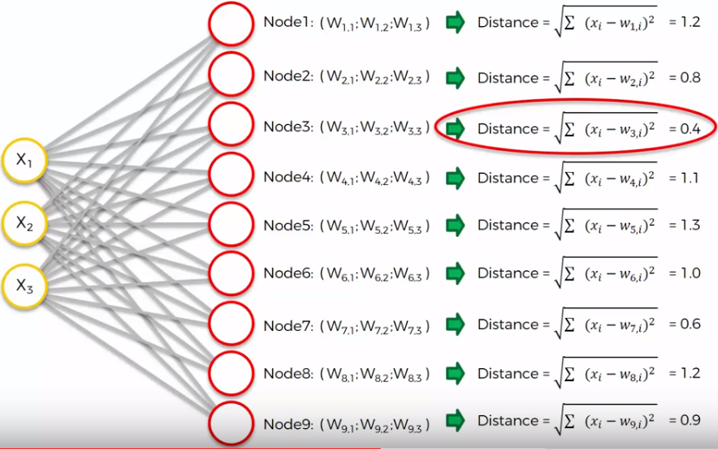
Learning Process
Step 3: Find the node that is closest to the chosen data point. This node is called the Best Matching Unit (BMU).

Slide 16
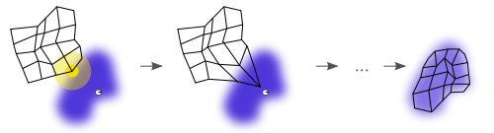
Learning Process
Step 4: Move the BMU closer to that data point. The distance moved by the BMU is determined by a learning rate, which decreases after each iteration.

Slide 17
Learning Process
Step 5: Move the BMU’s neighbors closer to that data point as well, with farther away neighbors moving less. Neighbors are identified using a radius around the BMU, and the value for this radius decreases after each iteration.

Slide 18

Learning Process
Step 6: Update the learning rate and BMU radius, before repeating Steps 1 to 4. Iterate these steps until positions of neurons have been stabilized.

Slide 19
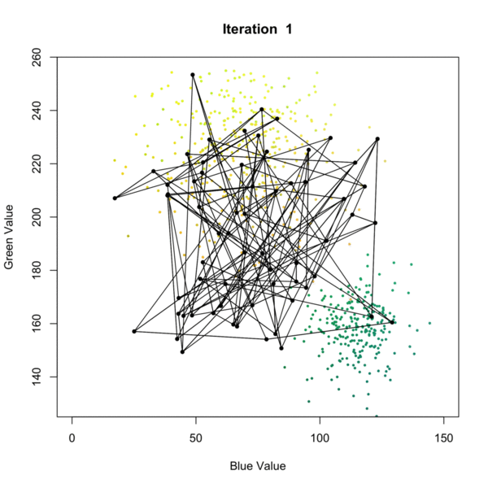
SOM Learning
Self-Organizing Map
Step 1: Randomly position the grid’s neurons in the data space.
Step 2: Select one data point, either randomly or systematically cycling through the dataset in order
Step 3: Find the neuron that is closest to the chosen data point. This neuron is called the Best Matching Unit (BMU).
Step 4: Move the BMU closer to that data point. The distance moved by the BMU is determined by a learning rate, which decreases after each iteration.
Step 5: Move the BMU’s neighbors closer to that data point as well, with farther away neighbors moving less. Neighbors are identified using a radius around the BMU, and the value for this radius decreases after each iteration.
Step 6: Update the learning rate and BMU radius, before repeating Steps 1 to 4. Iterate these steps until positions of neurons have been stabilized.

Slide 20
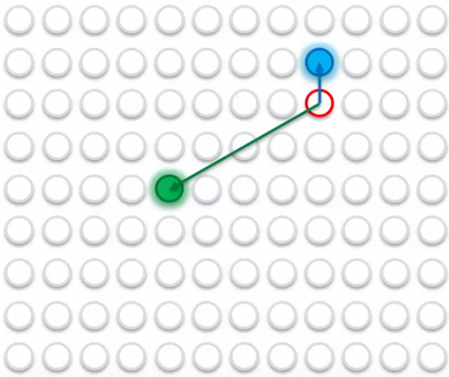
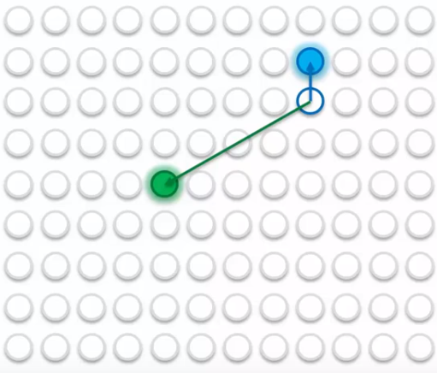
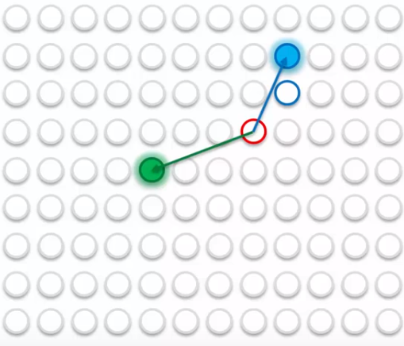
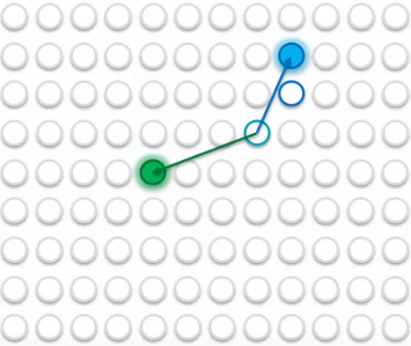
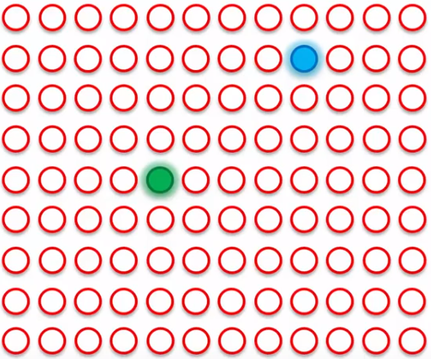
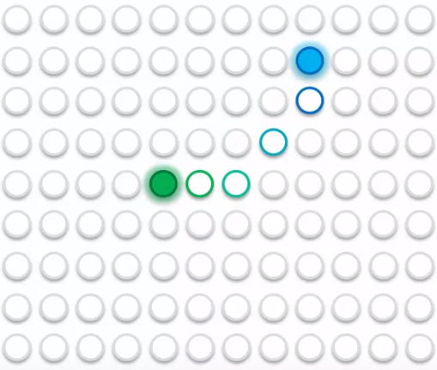
2D Map Perspective

Slide 21
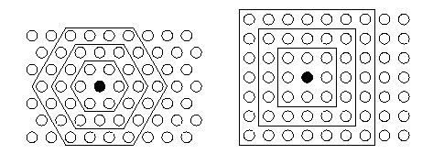
Grid Types
Toroidal Grid
Rectangular Grid

Slide 22
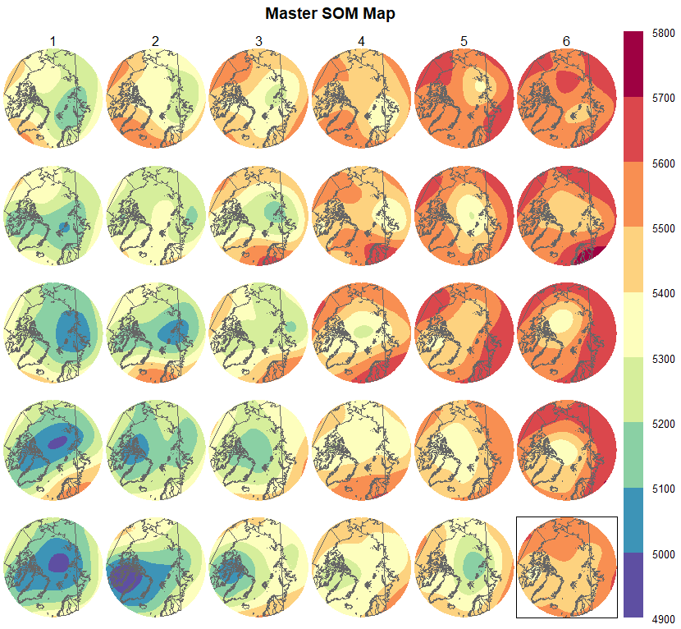
Result

Slide 23
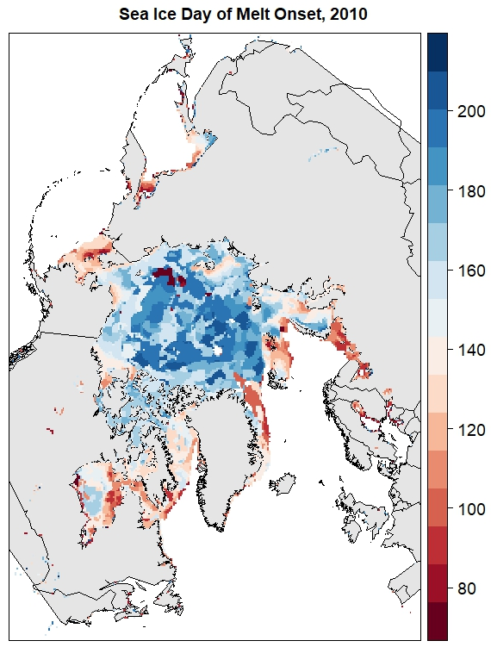
Melt Onset
Mortin et al., 2016

Slide 24
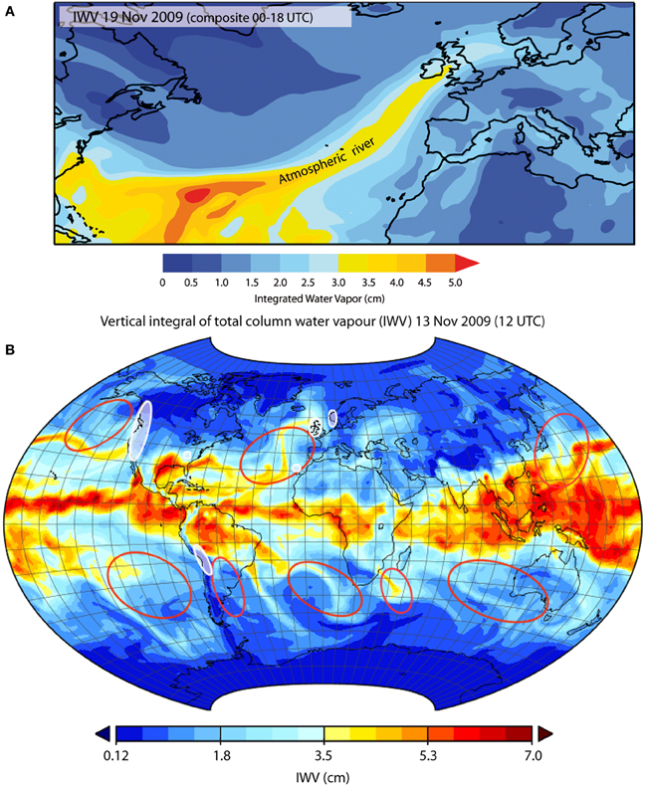
Atmospheric Rivers
https://www.frontiersin.org/articles/10.3389/feart.2014.00002/full

Slide 25
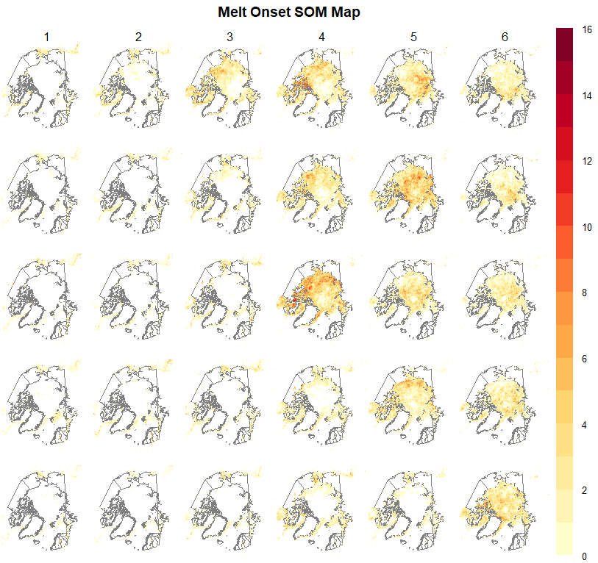
Preliminary Results
Low # of Melt Days
High # of Melt Days
count
m

Slide 26
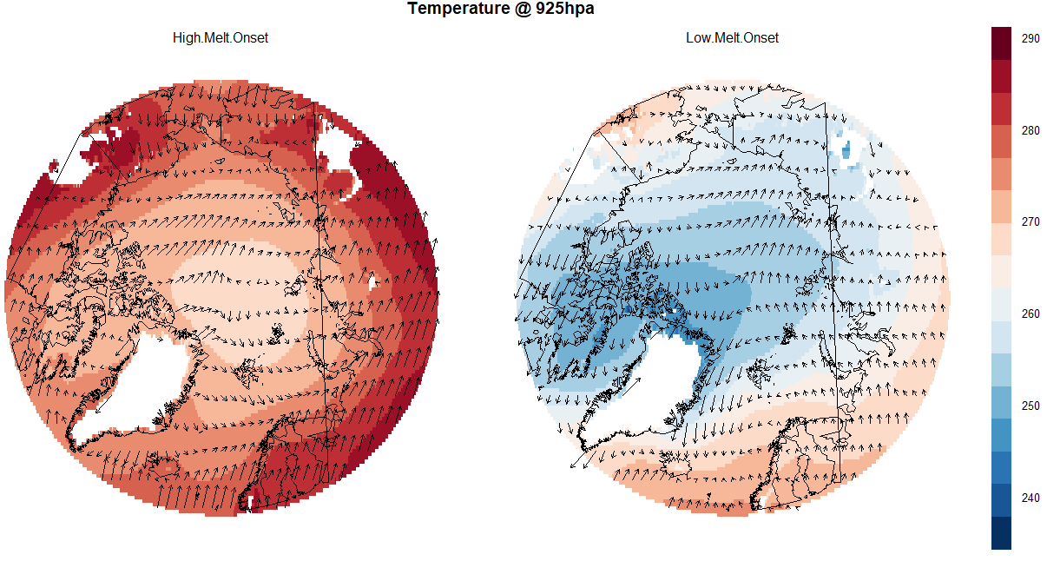
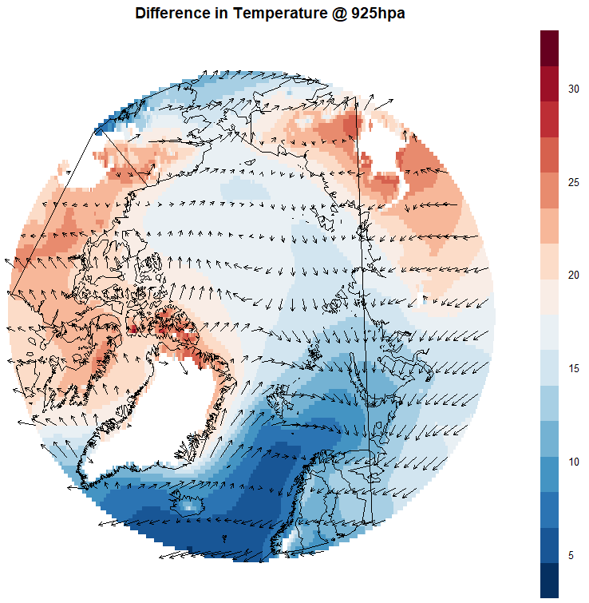
Preliminary Results – Surface Air Temperature
K
K

Slide 27
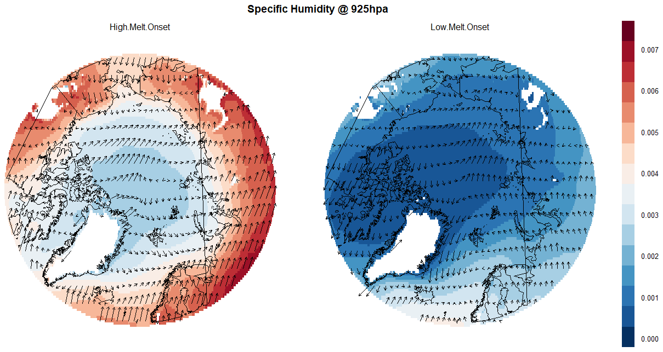
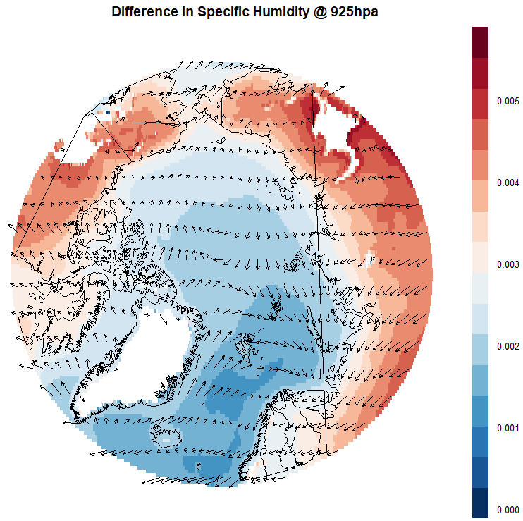
Preliminary Results – Surface Specific Humidity
kg/kg
kg/kg

Slide 28
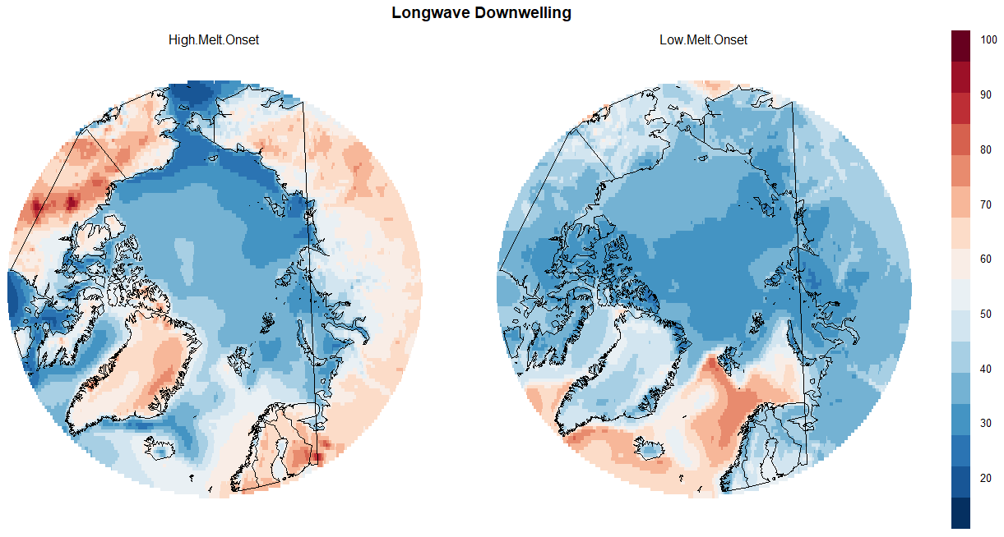
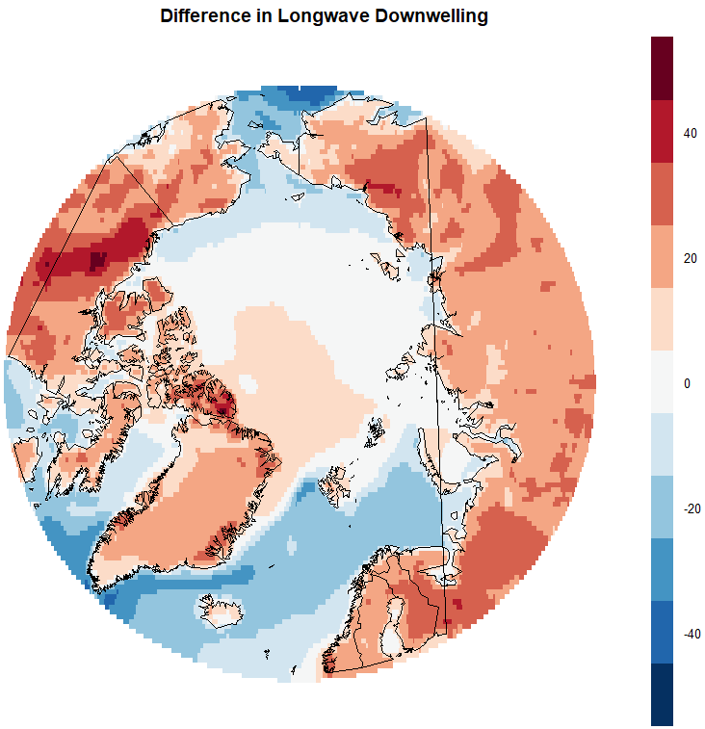
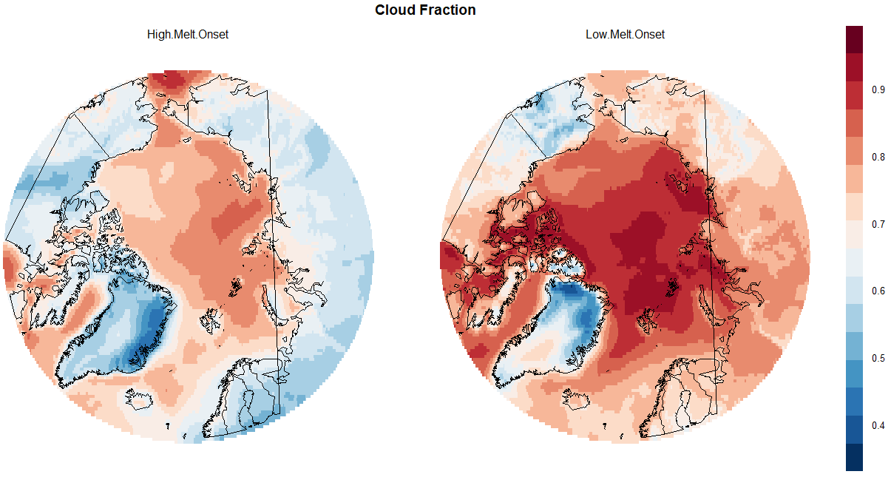
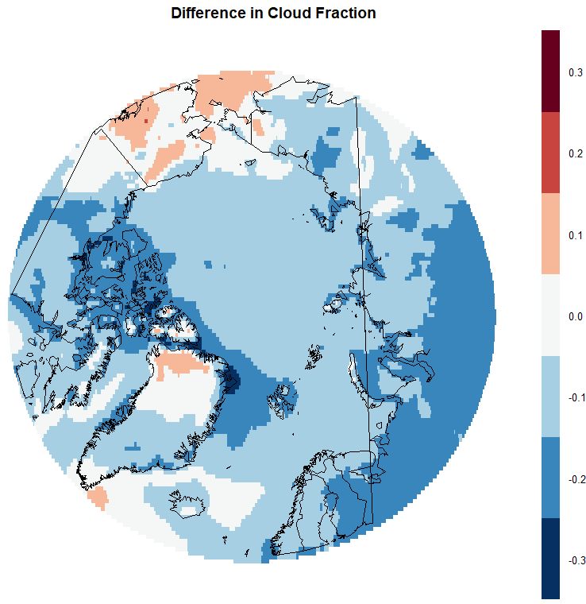
Preliminary Results – Energy
W/m^2
W/m^2

Slide 29
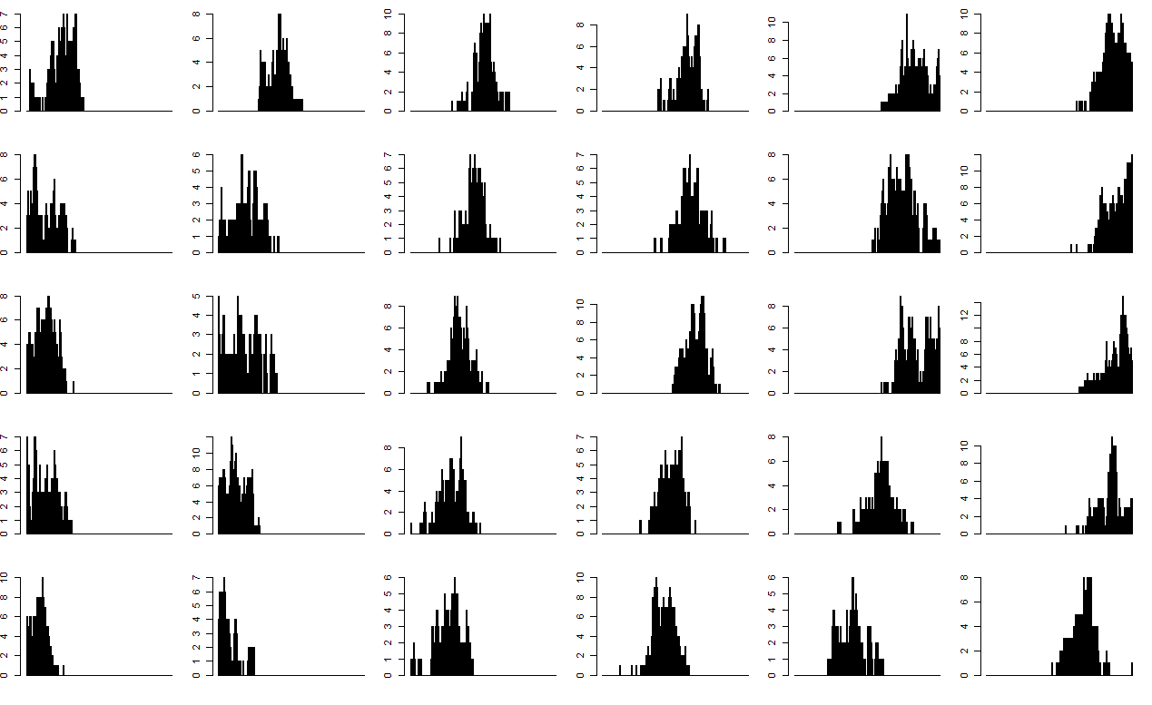
Preliminary Results – Day of Year

Slide 30
Thank you!
Questions?

