Slide 1
Physical Hydrology & Hydroclimatology (Multiscale Hydrology)
A science dealing with the properties, distribution and circulation of water.
R. Balaji
balajir@colorado.edu
CVEN5333 http://civil.colorado.edu/~balajir/CVEN5333
Includes Slides from Prof. Mike Gooseff

Slide 2
Lecture – Week 1
Context for learning hydrology
Water Resources Management
Space-time variability of moisture delivery and abstraction
Global water cycle
Mass Balance Equation
Global, continental, regional and watershed
Residence time of water in the system

Slide 3
Syllabus
PREREQUISITES:
Undergraduate physics (understanding of forces, laws of motion and thermal properties of matter), mathematics (calculus and algebra),
basic computer literacy (e.g. analyze and plot data, spreadsheets)

Slide 4
Class Goals
Provide you with a firm background in process-oriented hydrology
Large scale climate drivers and signatures to regional hydrology
Foster your ability to think critically the interconnections
Help you develop a strong understanding of physical science in preparation for engineering, research, and water management needs

Slide 5
Evaluation
Homework (35%)
Mix of problems from book and others
Due ~every two weeks
Must be organized and presented neatly
Include diagrams and a box around your final answer
Your name should be on each page
The entire assignment should be stapled together

Slide 6
Evaluation
Mid-term (20%) and Final Exam (30%)
Mid-term: Closed book, open notes, in class
Final: Comprehensive take-home exam
Hydroclimate Project (15%)
Climate connection and diagnostics of hydrologic variability
Predictability

Slide 7
Course Materials
I will use the class web site and Google Drive to
Post lecture presentations
Relevant research papers
Post homework assignments
Facilitate discussion or further exploration of class topics
Weekly e-mails with reading assignment/resources, to prepare for the following week
Hydrology and Water Resources Seminar
Wednesdays, ECCR1B41 11:15

Slide 8
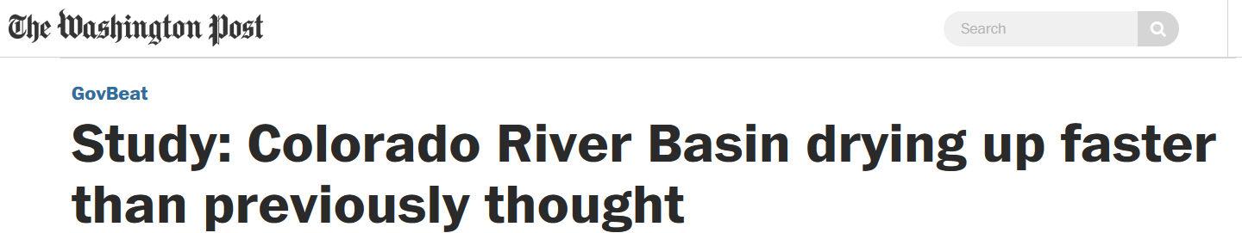
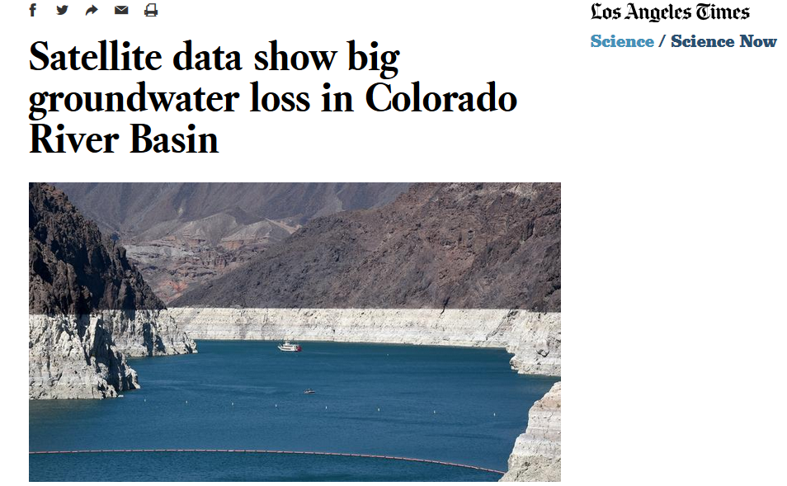
Motivation (from a recent drought)

Slide 9
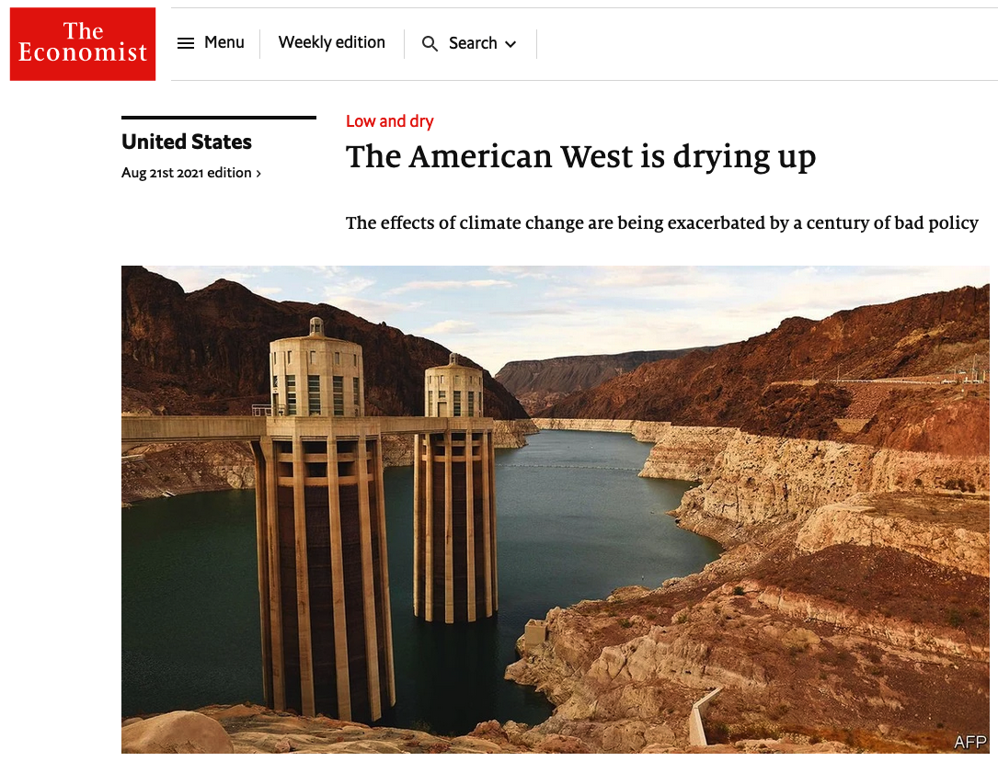
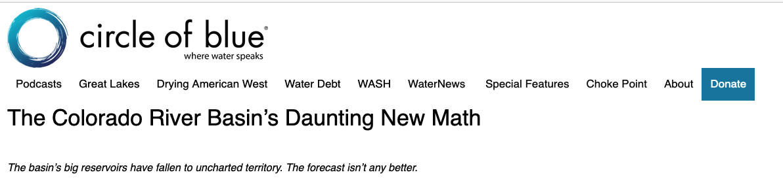
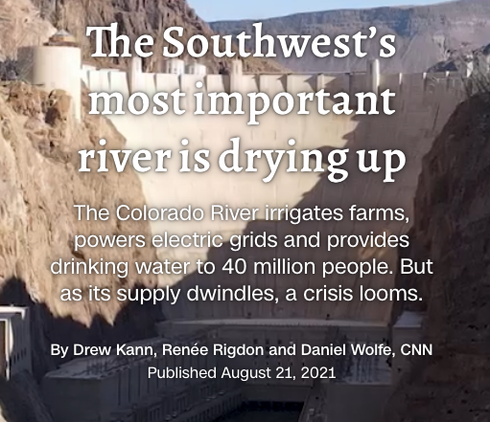

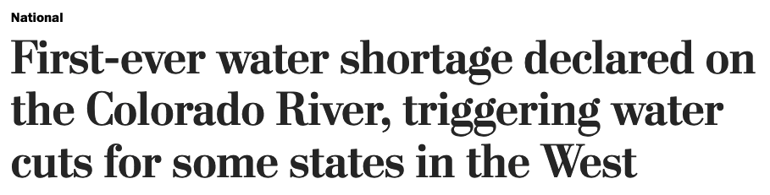
Lake Mead will fall below 1075’ on January 1, 2022, triggering first-ever ‘Tier 1’ water shortage in Lower Basin…..
August 21, 2021
August 13, 2021
August 16, 2021
August 21, 2021

Slide 10
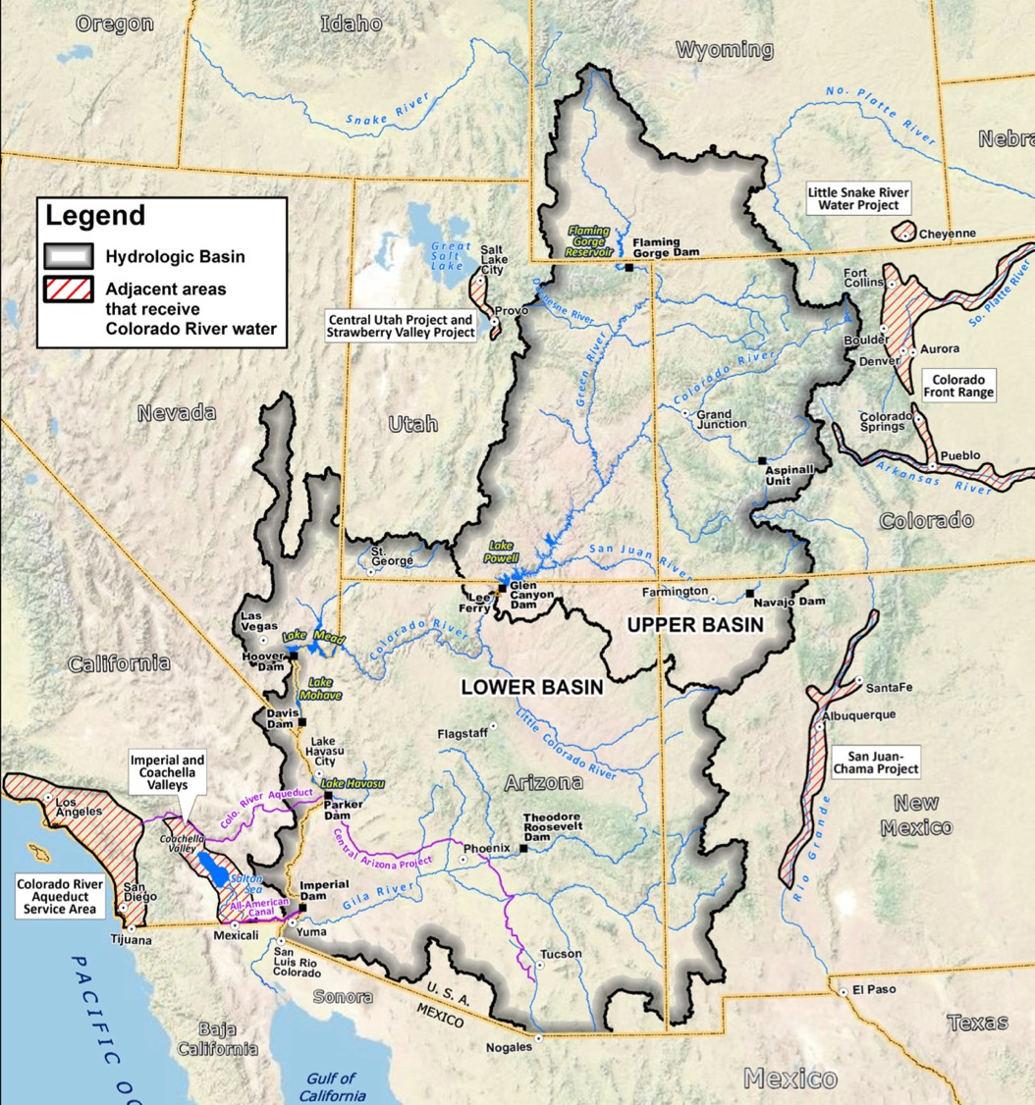
Colorado River
Colorado River Basin Overview
= Major Diversion
7 States, 2 Nations, 30 Tribes
8% of area of the Lower 48
Annual Flow ~14.75 MAF
= Hudson River
Worst drought in gaged record started 2000 ~12.4 MAF/yr
= ~19% decline annually
40 M People
All of the Major Cities in SW US
4.5m Irrigated Acres
Fully Allocated in 1922
Complex Use Agreements
Withdrawals equaled Supplies ~2000
New Projects still contemplated
No longer reaches the ocean

Slide 11
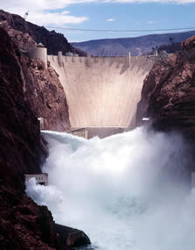
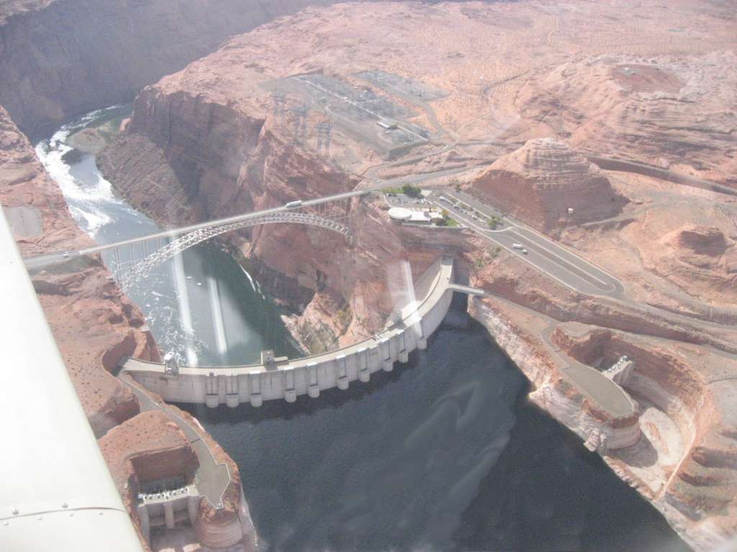

Slide 12
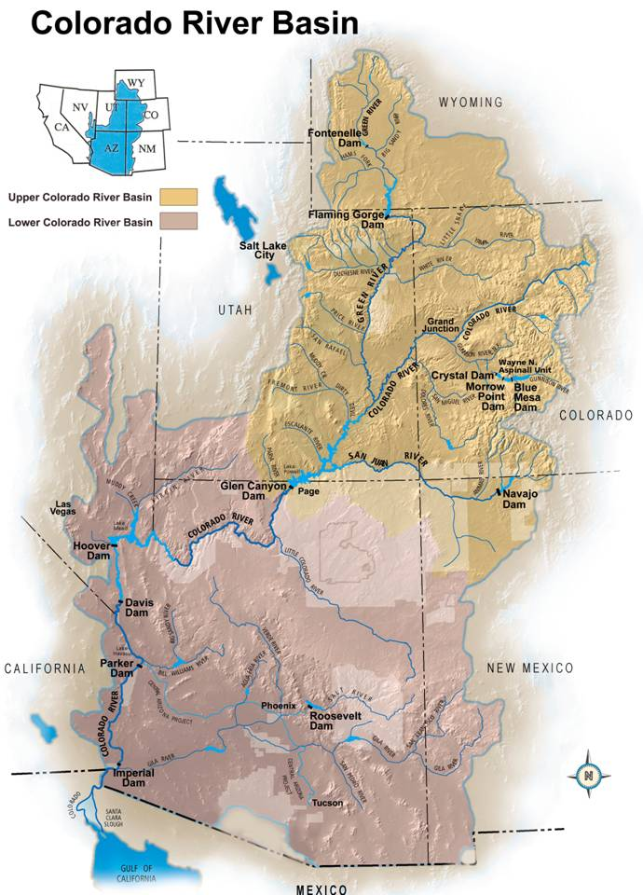
Colorado River Demand - Supply
UC CRSS stream gauges
LC CRSS stream gauges
What is the Colorado River System-wide Water supply risk profile under climate change?
Need to consider the entire syste (~60AF Storage)
Need to generate streamflow scenarios consistent with climate projections and combining (Paleo?)
Is there flexibility within the existing management framework?
Can Management Mitigate the future risk?

Slide 13
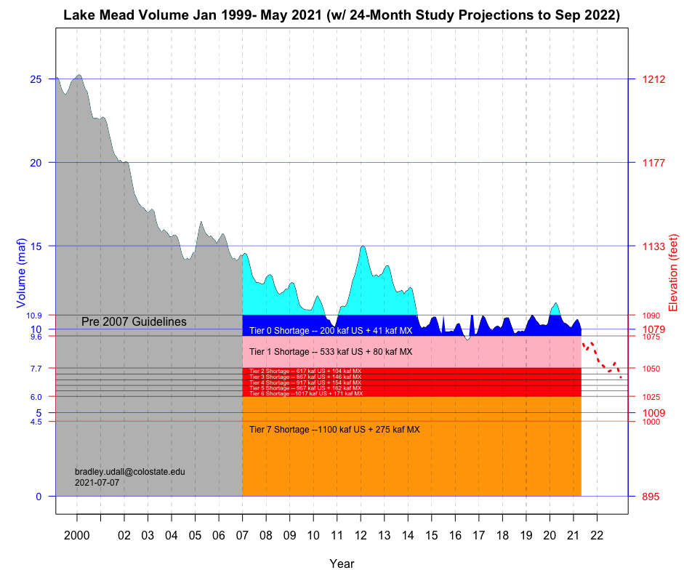
Tier 1 Levels

Slide 14
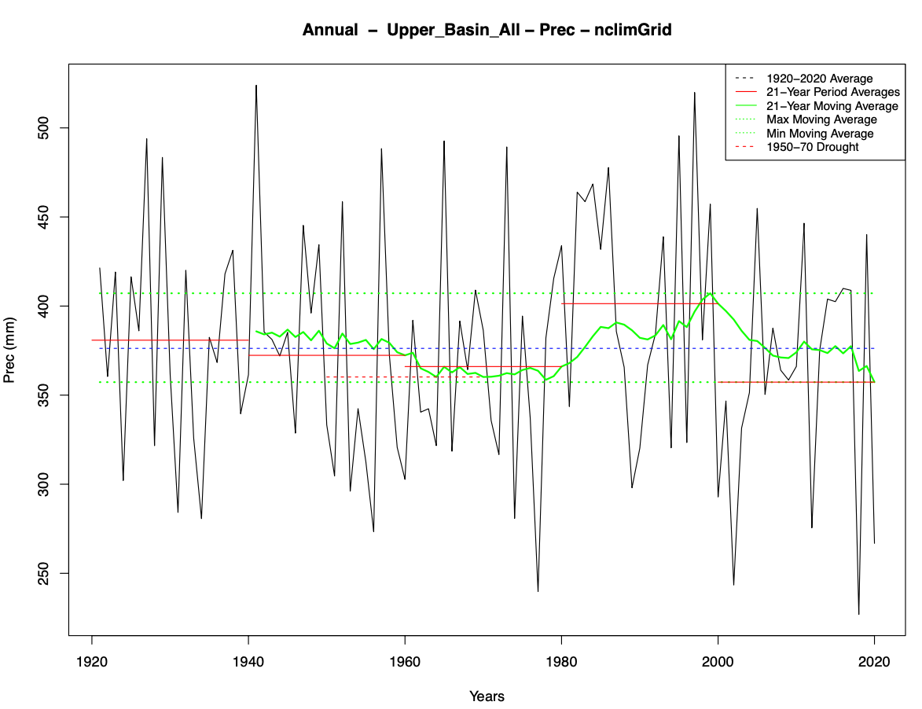
Annual Precipitation Decreases 2000-2020
21-Year Period tied with driest in 20th C
-22 mm reduction (-6%)
High Years (blue box) are low relative to 20C
2005, 2011, 2019
Low Years (red box) are very low relative to 20C
2000, 2002, 2012, 2018, 2020
3 of last 4 years bottom 15 (10?) since 1895

Slide 15
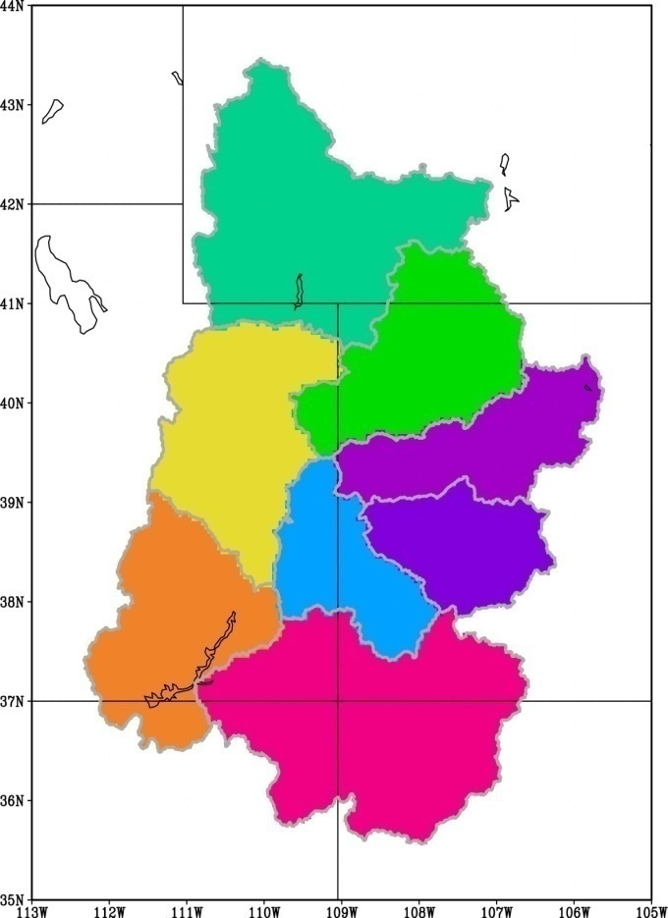
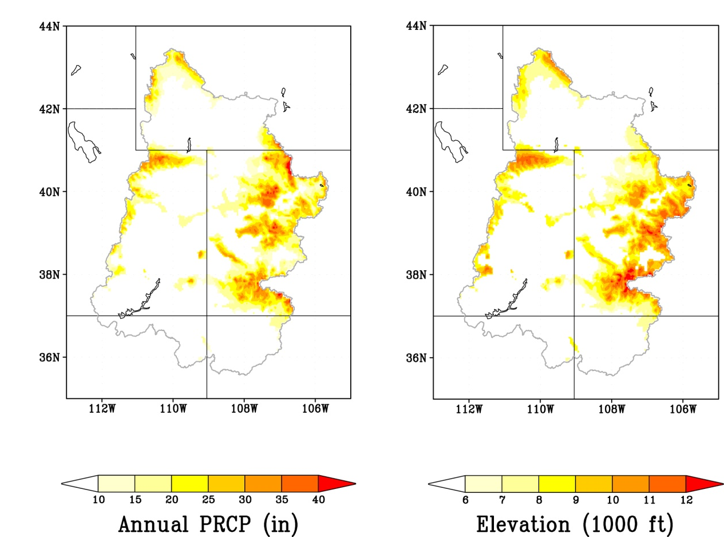
Scale Matters
Runoff Efficiency (How much Precip actually runs off) Varies Greatly from ~5% (Dirty Devil) to > 40% (Upper Mainstem)
You can’t model the basin at large scales and expect accurate results
GCMs (e.g. Milly, Seager) and H&E 2006 may get the right answer, but miss important topographical effects
% of Total Runoff
14.4%
16.1%
9.9%
24.9%
6.3%
14.1%
2.4%
11.8%
Notes:
15

Slide 16
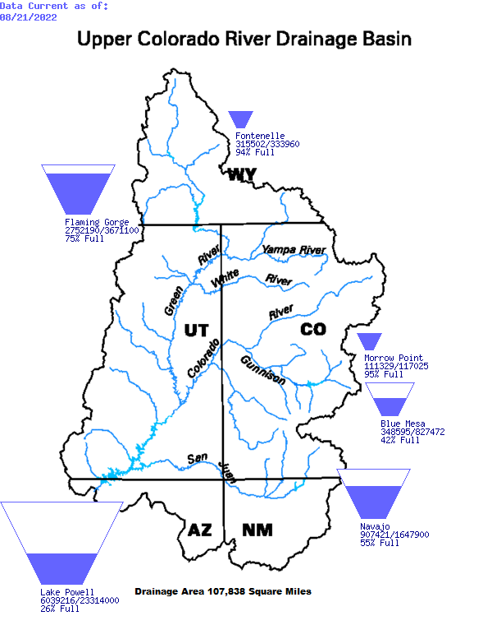
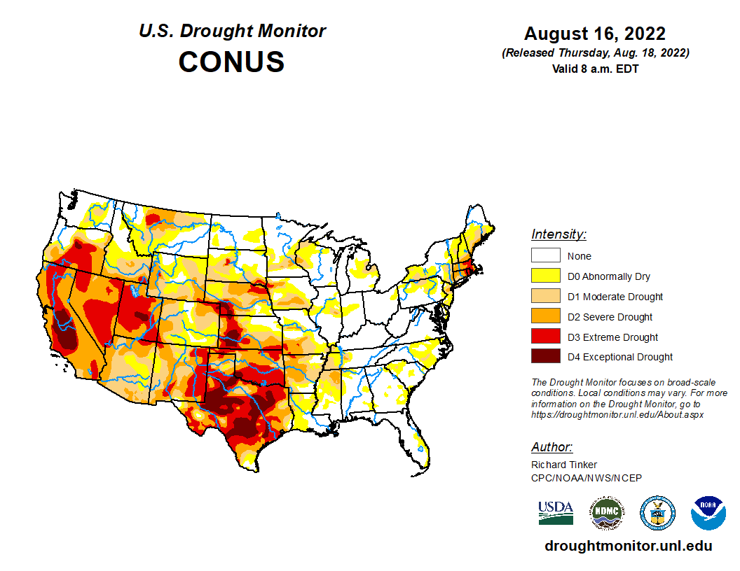

Slide 17
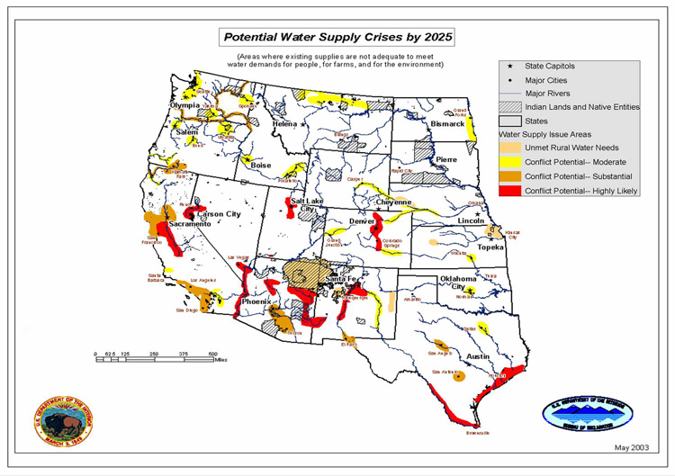
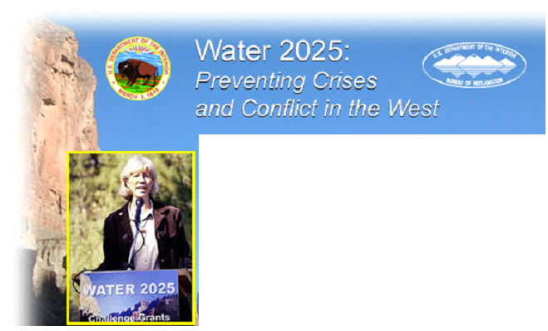
From http://www.doi.gov/water2025/index.html

Slide 18
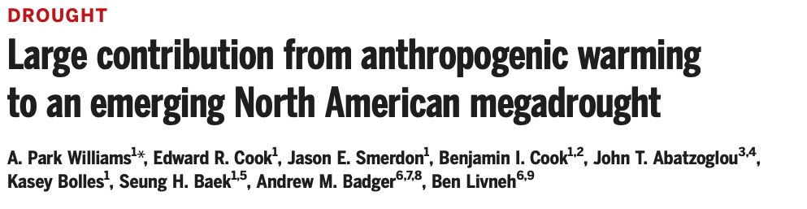
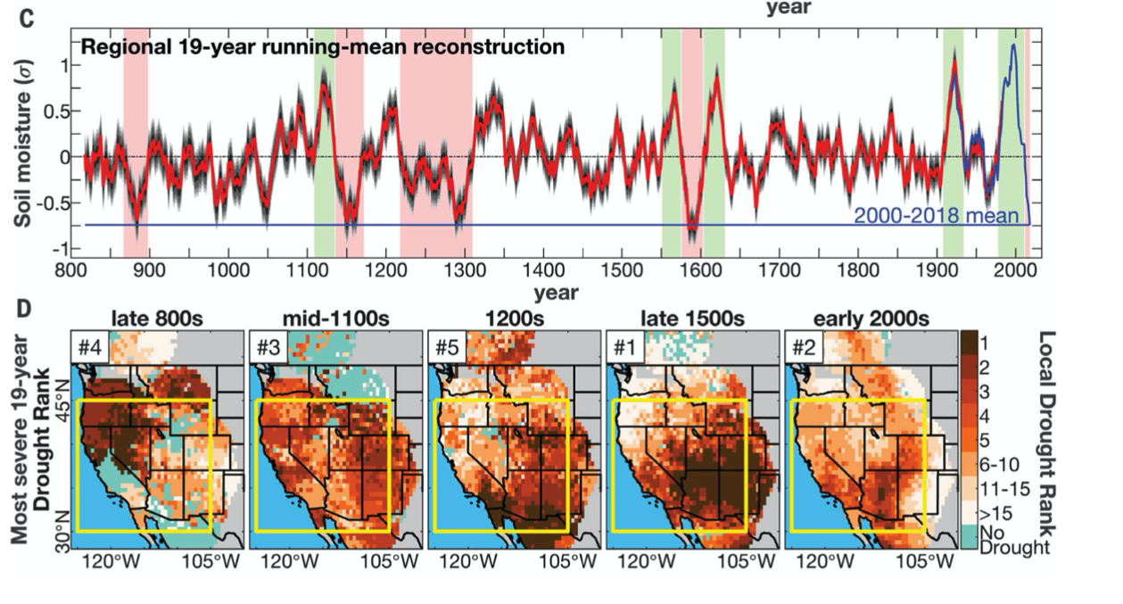
Emerging Megadrought
Science, April 2020
2000—2018 2nd Driest 19-year period since 800 AD as measured by JJA Soil Moisture
Caused by Natural Variability aided by anthropogenic drying
About 50% due to humans
Without anthropogenic drying, would be a moderate drought

Slide 19
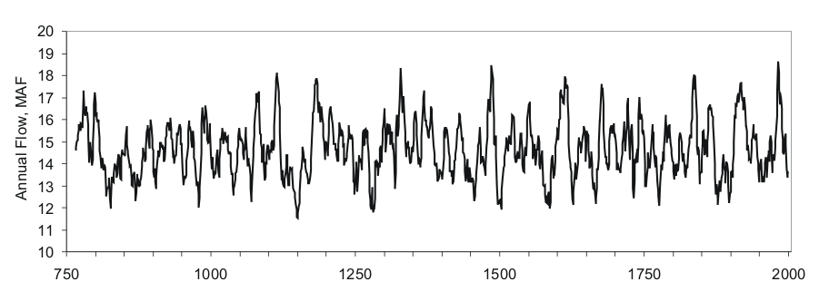
Paleo Perspective
Reconstruction of Colorado River at Lees Ferry streamflow, 762-2005, with 10-year running mean
Six 10-year periods before 1900 with reconstructed mean flow lower than 12 MaF (lowest: 1146-1155)
1905-1930 one of the three wettest ~25-year periods in 1200 years
Mid-1100s: 57-year period with mean flow of ~13 MaF
Century-scale non-stationarity: 100-year mean varies from 13.9 to 15.4 MaF
* Slide courtesy of Jeff Lukas, NOAA/WWA
Notes:
19
paleo reconstructed streamflow indicates that periods of more severe, sustained drought have occurred in the past.
overall substantial variability and lower mean per 100 year period.

Slide 20
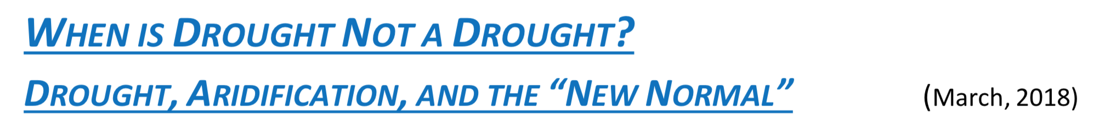
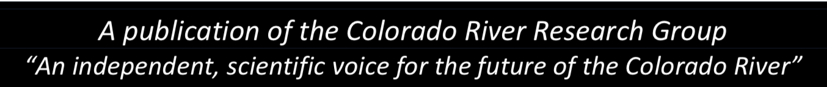
Aridification – not a drought
Declining Snowpack and earlier runoff
Higher Temperatures: >1.25°C
Drying Soil
Thirsty Atmosphere (holds more moisture)
Moving storm tracks (less certain, but a worry)
Shorter Winter
Megadrought

Slide 21
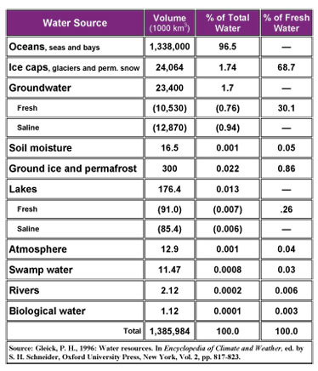

Slide 22
A Water Resources Management Perspective
Inter-decadal
Climate
Decision Analysis: Risk + Values
Time
Horizon
Facility Planning
Reservoir, Treatment Plant Size
Policy + Regulatory Framework
Flood Frequency, Water Rights, 7Q10 flow
Operational Analysis
Reservoir Operation, Flood/Drought Preparation
Emergency Management
Flood Warning, Drought Response
Data: Historical, Paleo, Scale, Models
Hours
Weather

Slide 23
Climate Variability
Daily
Annual
Inter-annual to Inter-decadal
Centennial
Millenial
Diurnal cycle
Seasonal cycle
Ocean-atmosphere coupled modes (ENSO, NAO, PDO)
Thermohaline circulation
Milankovich cycle (earth’s orbital and precision)

Slide 24
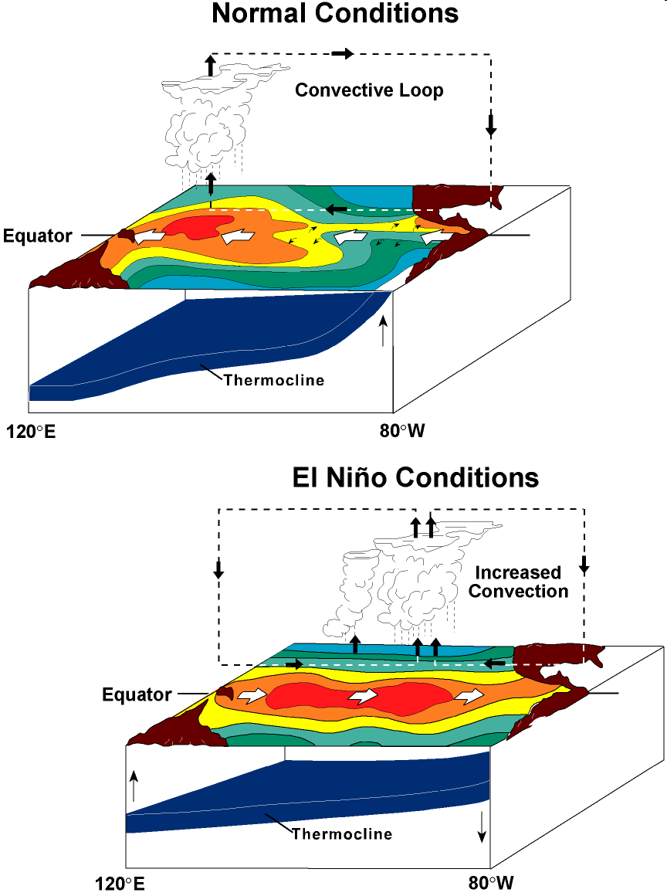
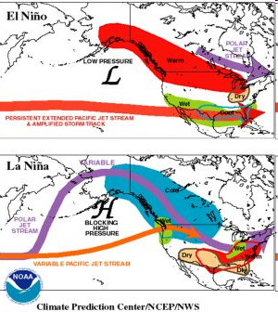

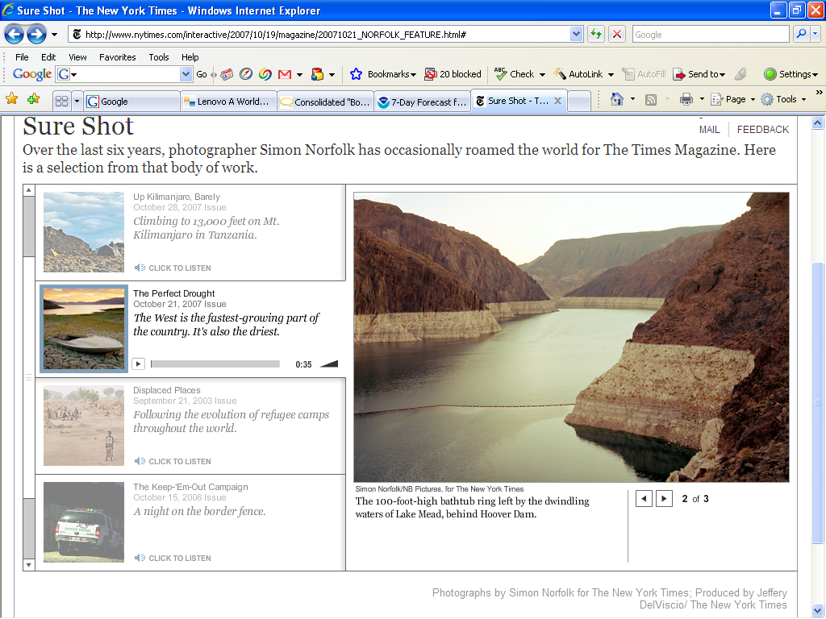
(Research) Framework
What Drives Year to Year
Variability in regional
Hydrology?
(Floods, Droughts etc.)
Diagnosis
Hydroclimate Predictions – Scenario Generation
(Nonlinear Time Series Tools, Watershed Modeling)
Forecast
Application
Decision Support System
(Evaluate decision strategies
Under uncertainty)

Slide 25


Water and Climate Change
The United Nations World Water Development Report 2020

Slide 26
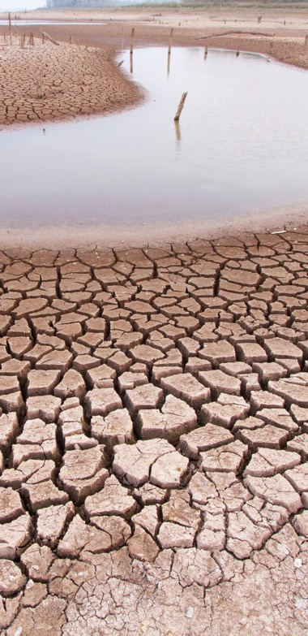
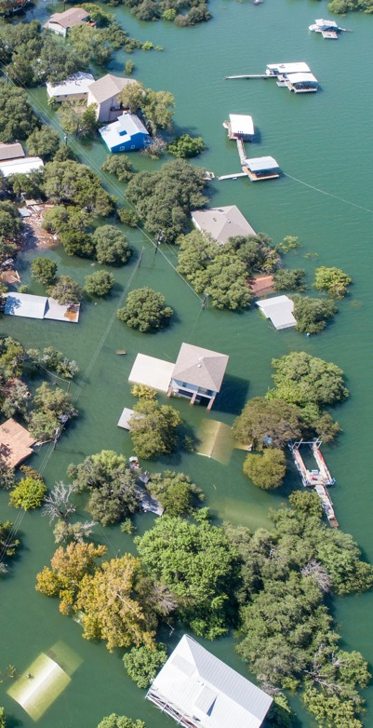
Water and Climate change
The hydrological changes induced by climate change will add challenges to the sustainable management of water resources, which are already under severe pressure in many regions of the world, and amplifies water-related extremes such as flood and droughts

Slide 27
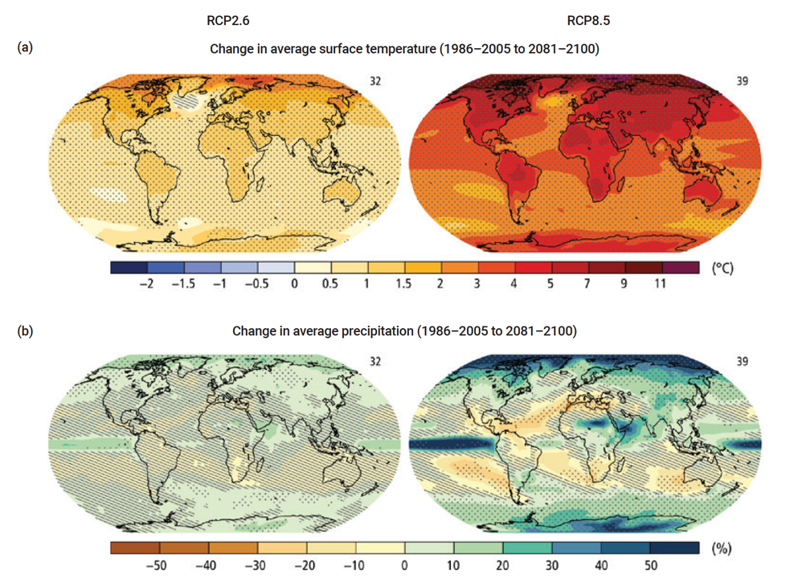
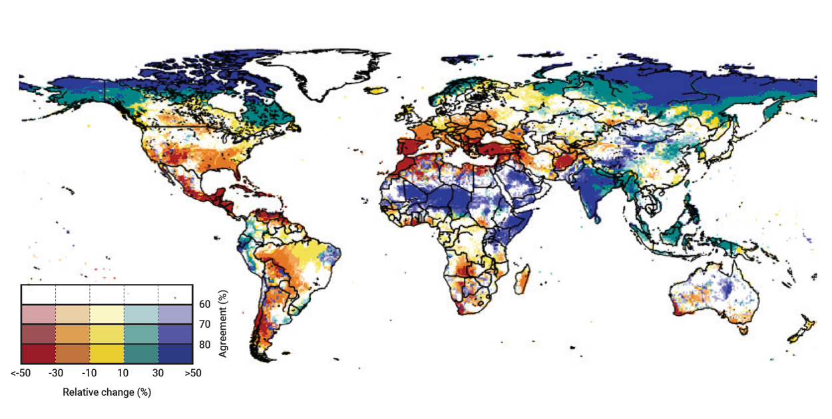
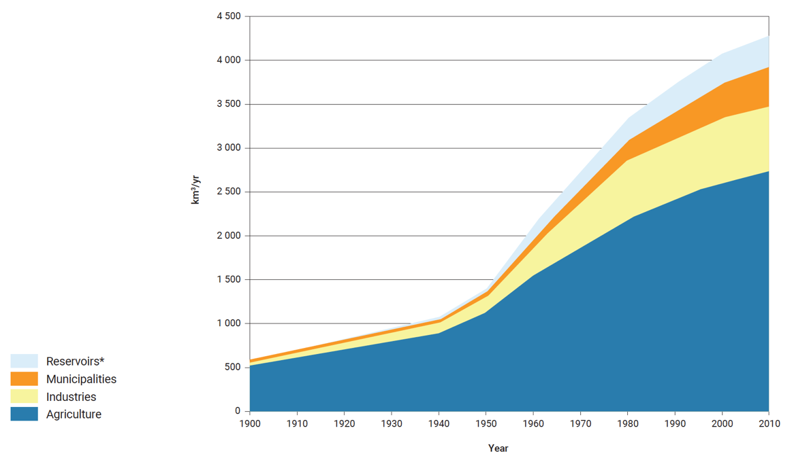
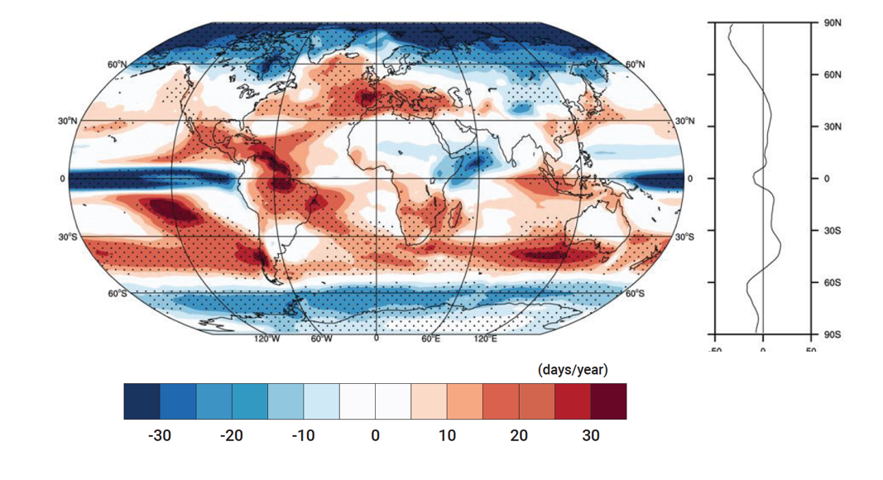
Impacts on Water Resources
Figure 5 Coupled Model Intercomparison Project Phase 5 (CMIP5) multi-model mean projections
Figure 6 CMIP5 multi-model ensemble average mean change in frequency of dry days (days/year) by 2060–2089, relative to the historical period 1960–1989, using the RCP8.5 forcing scenario
Figure 14 Global water withdrawals throughout the previous century
Figure 8 Climate change scenario trends in water availability
Note: The average of the model projections available for the 2081–2100 period under the RCP2.6 (left) and RCP8.5 (right) scenarios for (a) change in annual mean surface temperature and (b) change in annual mean precipitation, in percentages. Changes are shown relative to the 1986–2005 period. The number of CMIP5 models used to calculate the multi-model mean is indicated in the upper right corner of each panel. Stippling dots on indicates regions where the projected change is large compared to natural internal variability (i.e., greater than two standard deviations of internal variability in 20-year means) and where 90% of the models agree on the sign of change. Hatching (diagonal lines) on and shows regions where the projected change is less than one standard deviation of natural internal variability in 20-year means.
Note: Stippling indicates areas where at least 70% of the models agree on the sign of the change. Graph to the right: zonal mean values.
Note: This figure depicts the relative change in annual discharge at 2°C temperature increase compared with present day, under RCP8.5.
Note: *Evaporation from artificial lakes.
Source: AQUASTAT (2010).
Source: Adapted from IPCC (2014a, fig. 2.2, p. 61).
Source: Schewe et al. (2014, fig. 1, p. 3246). The Attribution Share-Alike 3.0 IGO (CC BY-SA 3.0 IGO) licence does not apply to this figure.
Source: Polade et al. (2014, fig. 2).
Notes:
Figure 14, Figure 8, Figure 6, and Figure 5

Slide 28
Adaptation and Mitigation
Adaptation encompasses a combination of natural, engineered and technological options, as well as social and institutional measures to moderate harm or exploit beneficial opportunities from climate change.
Mitigation comprises human interventions to reduce the sources or enhance the sinks of greenhouse gases (GHGs).

Slide 29
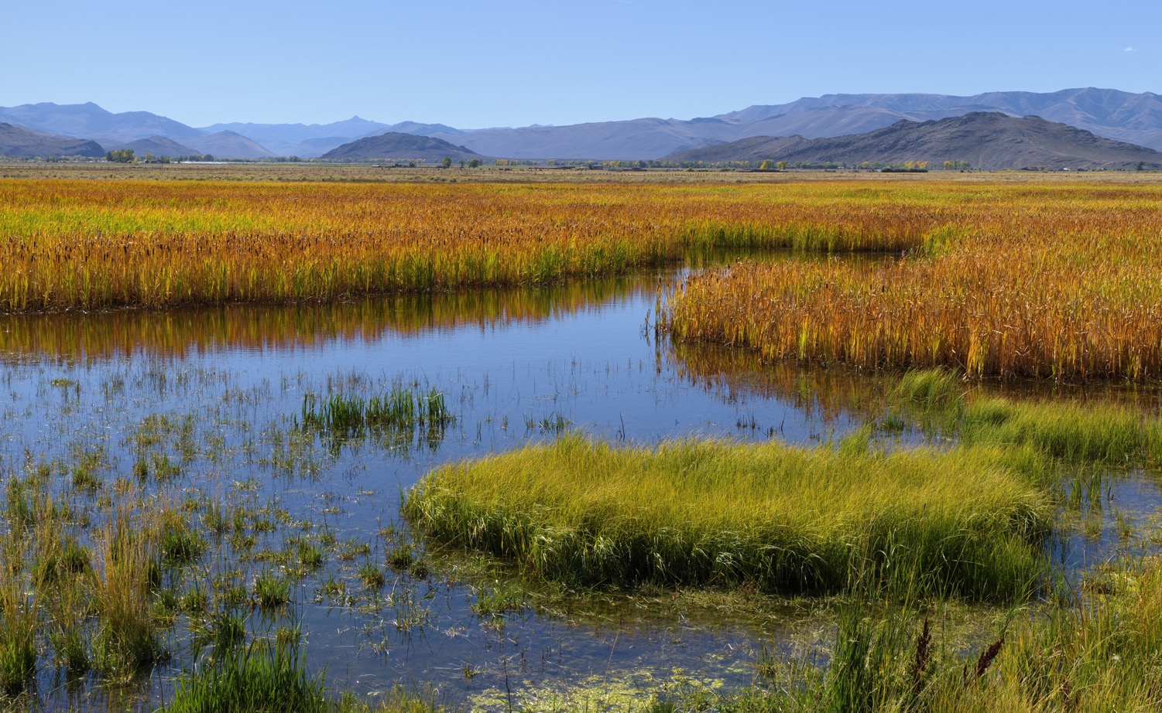
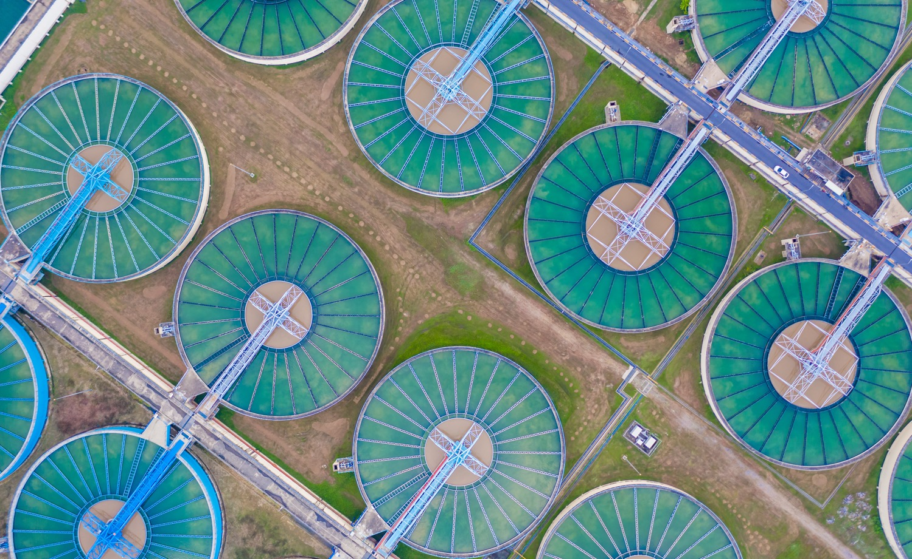
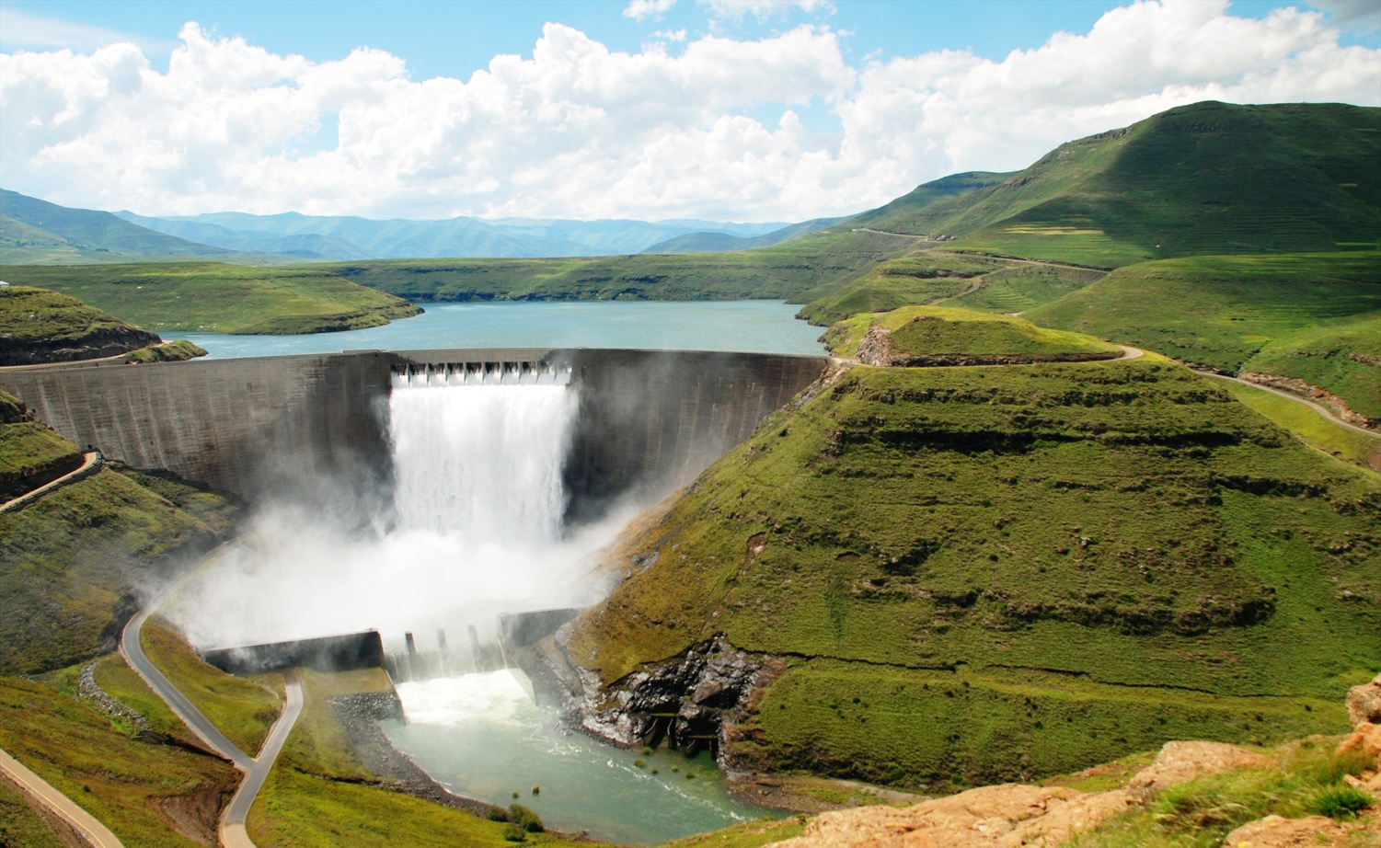
Water resources management, infrastructure and ecosystems

Slide 30
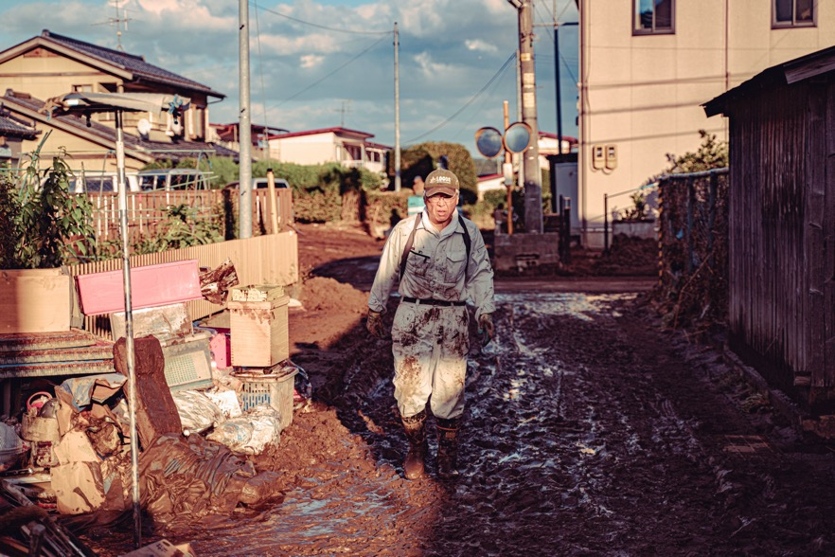
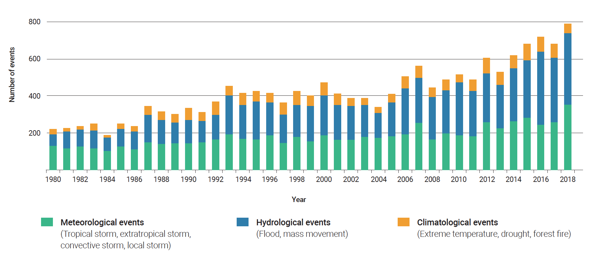
Disaster Risk Reduction
Figure 15 World weather-related natural catastrophes by peril, 1980–2018
The current impacts and future anticipated risks associated with extreme events demand sustainable solutions for climate change adaptation and Disaster Risk Reduction (DDR).
Note: Accounted events have caused at least one fatality and/or produced normalized losses ≥ US$100K, 300K, 1M, or 3M (depending on the assigned World Bank income group of the affected country).
Source: MunichRe, NatCatSERVICE (2019).

Slide 31
Global Water Stress balance of people (demand), water available (supply)
Water and Climate Change
UN Report 2020
Notes:
REPLACE WITH NEW VERSION FROM NATURE PAPER IN 2018????

Slide 32
Hydrologic Science in the hierarchy from basic sciences to water resources management
Basic Sciences
Mathematics
Statistics
Physics
Chemistry
Biology
Geosciences
Geology
Soil Science
Atmospheric Science
Ocean Science
Glaciology
Geochemistry
Economics
Law
Sociology
Political Science
Engineering Hydrology
Agriculture
Forestry
Fluid Mechanics
Hydraulic Engineering
Meteorology
Hydrologic Science
Water Resources Management
Modified From: National Research Council Committee on Opportunities in the Hydrologic Sciences (COHS), (1991), Opportunities in the Hydrologic Sciences, Editor, P. S. Eagleson, National Academy Press, Washington, D.C.

Slide 33
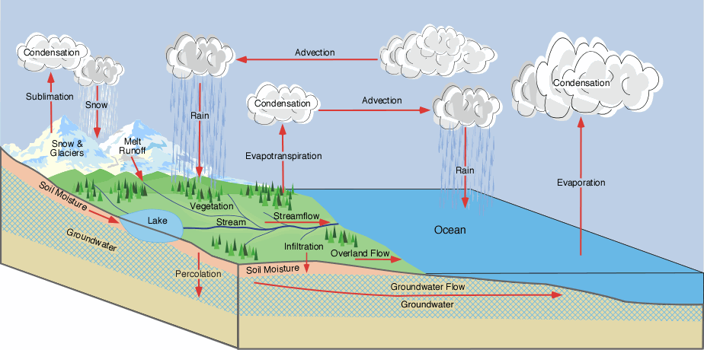
The Hydrologic Cycle
From Ross Woods

Slide 34
Hydrologic Cycle
Compartments (storage reservoirs):
Ocean
Atmosphere
Continent
Lakes & Streams
Glaciers, snowpacks
Groundwater
Mechanisms (interactions)
Precipitation (rain, snow)
Infiltration
Evaporation, Transpiration --> Evapotranspiration
Surface Runoff
Notes:
Compartments (storage reservoirs):
Ocean
Atmosphere
Continent
Surface impoundments (lakes, streams)
Glaciers, snowpacks
Groundwater
Mechanisms (interactions)
Precipitation (rain, snow)
Infiltration
Evaporation, Transpiration → Evapotranspiration
Surface Runoff

Slide 35
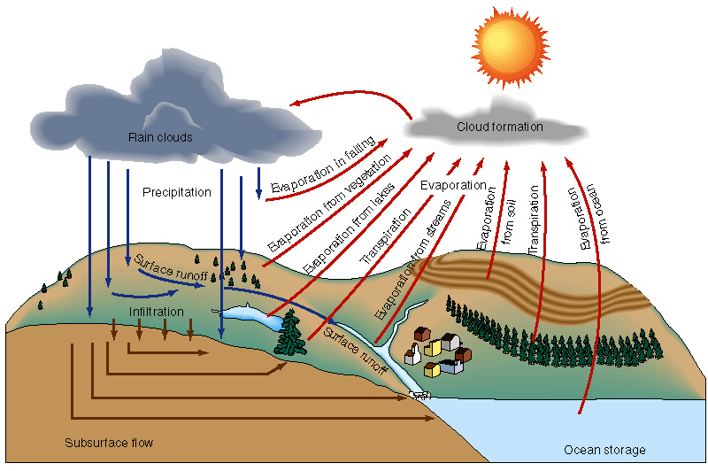
The Hydrologic Cycle
Conservative STORAGE = INPUT - OUTPUT
(over long periods)
Compartments are not equal in terms of storage or residence time
Notes:
Key Features:
Conservative: Storage = Input – Output (over a long period)
Water compartments are not equal in terms of storage or residence time

Slide 36
From Chow et al., 1988

Slide 37
Continental Water Balance m/yr
Europe
Asia
Africa
N America
Australia
0.73
0.73
0.69
0.67
0.74
0.41
0.44
0.55
0.38
0.51
0.32
0.29
0.14
0.29
0.23
Data from Brutsaert, 2005, Table 1.2
From Chow et al., 1988

Slide 38
Water Budgets Storage = Input – Output
Reservoir (box, compartment: M in mass units): An amount of material defined by certain physical, chemical, or biological characteristics that can be considered ~homogeneous
Ex. water in the ocean (property, reservoir)
Input: A flux of material into a reservoir
Output: A flux of material out of a reservoir
Flux: The amount of material transferred from one reservoir to another, per unit time (M/T or M/TL²)
Ex. The rate of evaporation of water from the surface ocean
Notes:
Reservoir (box, compartment: M in mass units): An amount of material defined by certain physical, chemical, or biological characteristics that can be considered homogeneous
Ex. water in the ocean (property, reservoir)
Input: A flux of material into a reservoir
Output: A flux of material out of a reservoir
Flux: The amount of material transferred from one reservoir to another per unit time (M/T or M/TL2)
Ex. The rate of evaporation of water from the surface ocean

Slide 39
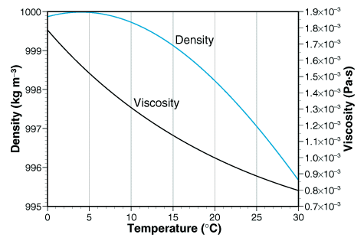
Hydrologic Mass Balance; recall…
ρ is roughly constant over this
“natural” range
Hornberger et al., 1998
Notes:
MAKE THE POINT THAT BECAUSE ρ IS ~CONSTANT, WE CAN DEAL WITH VOLUME BALANCES AND NOT WORRY ABOUT CHANGES IN ρ.

Slide 40
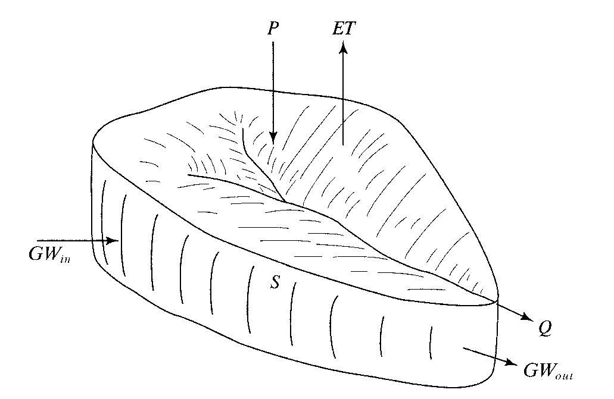

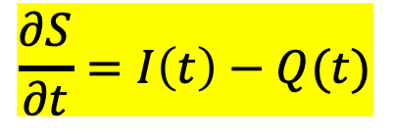
Hydrologic Mass Balance
The HC is defined by mass balance called a water budget; applied to a watershed: inputs (I) – outputs (Q) = storage (S)
But of course, these fluxes all occur dynamically;
One way to describe this is with a transfer function (Ω):
$$\frac{∂S}{∂t}=I\left(t\right)−Q(t)$$
$$Q=ΩI(t)$$

Slide 41
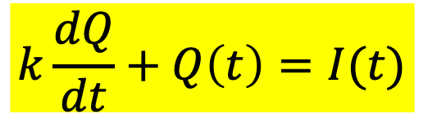
Hydrologic Mass Balance
If outputs are linearly related to storage, then: S = kQ where k has dimension of time
But, storage is difficult to measure directly, so we can eliminate it using the 2 above equations: if k is constant, this is a linear system. If k is a function of Q or I, then this is a non-linear system
$$k\frac{dQ}{dt}+Q\left(t\right)=I(t)$$

Slide 42
Water Budget of Earth Sounds easy… What’s the big deal?
We need to know the size of compartments (storage) and fluxes to compare the supply and demand of water in systems
To allocate resources, need to know the inputs (precip, etc.) and outputs (plant use, evap, etc.) so that the amount that can safely be extracted can be calculated
Notes:
We need to know the size of compartments (storage) and fluxes to compare the supply and demand of water in systems
To allocate resources, need to know the inputs (precip, etc.) and outputs (plant use, evap, etc.) so that the amount that can safely be extracted can be calculated

Slide 43
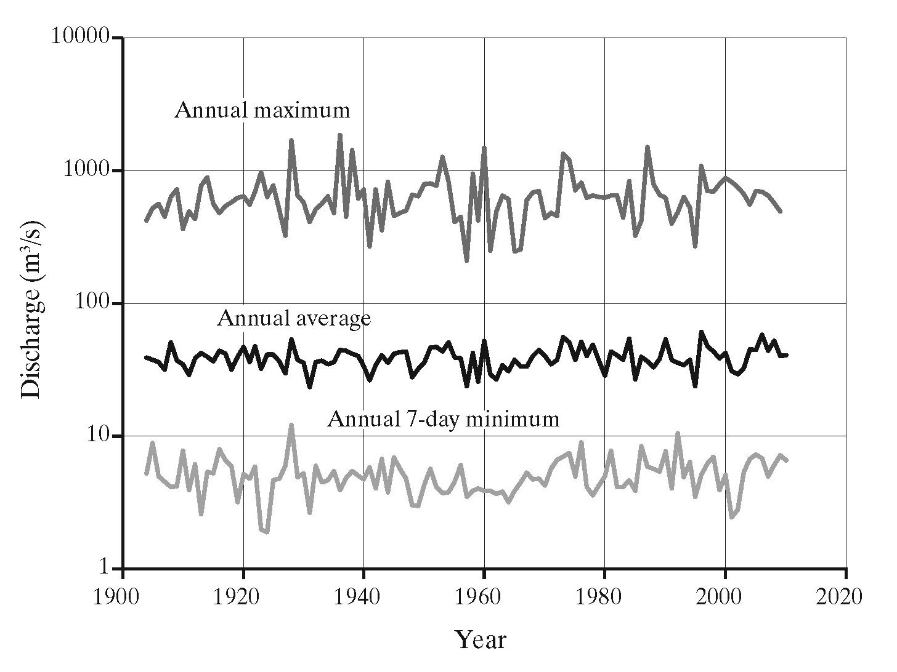
Water Budgets The big deal: Everything is dynamic!
Q(t)
Streamflow from Pemigewasset River, NH.
N.B. the y-axis is on a log-scale…

Slide 44
Simplicity
Hydrologists like simplicity, so we often state volumetric units [L³] as depths [L] applied to an area.
Example: A precipitation gauge may record a 3 cm storm. Assuming that the rainfall was uniform across a 1 km² catchment, 30,000 m³ of water entered the catchment as rain, but 3 cm is an easier quantity to deal with. Same with runoff…
Notes:
Hydrologists like simplicity, so we often state volumetric units [L³] as depths [L] applied to an area.
Example: A precipitation gauge may record a 3 cm storm. Assuming that the rainfall was uniform across a 1 km² catchment, 30,000 m³ of water entered the catchment as rain, but 3 cm is an easier quantity to deal with. Same with runoff…

Slide 45
Global water balance fluxes and stores
Storage in km³. Fluxes in km³/yr
From Dingman, 2002
From Brutsaert, 2005

Slide 46
World Water Balance
From Brutsaert, 2005

Slide 47
Water Balance
Atmospheric Water
Soil Water
Surface Water
Groundwater
Change of Storage
= Inflow - Outflow

Slide 48
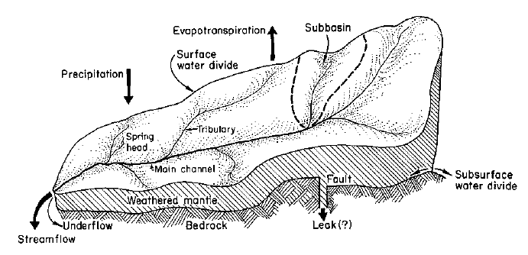
Watershed Hydrologic Cycle
Inputs:
Rain, Snow, Groundwater
Outputs (in red below):
Evaporation, Transpiration, Streamflow, Groundwater
Hewlett, 1969

Slide 49
Systems Perspective
Precipitation
Evaporation
Interception
Atmospheric Water
Σ
Transpiration
Surface Water
Overland Flow
Surface Runoff
Runoff to streams + ocean
Infiltration
Subsurface Flow
Subsurface Water
Σ
Groundwater recharge
Groundwater Flow
Notes:
Fill in arrows from Figure 1.2.1 in Chow et al.

Slide 50
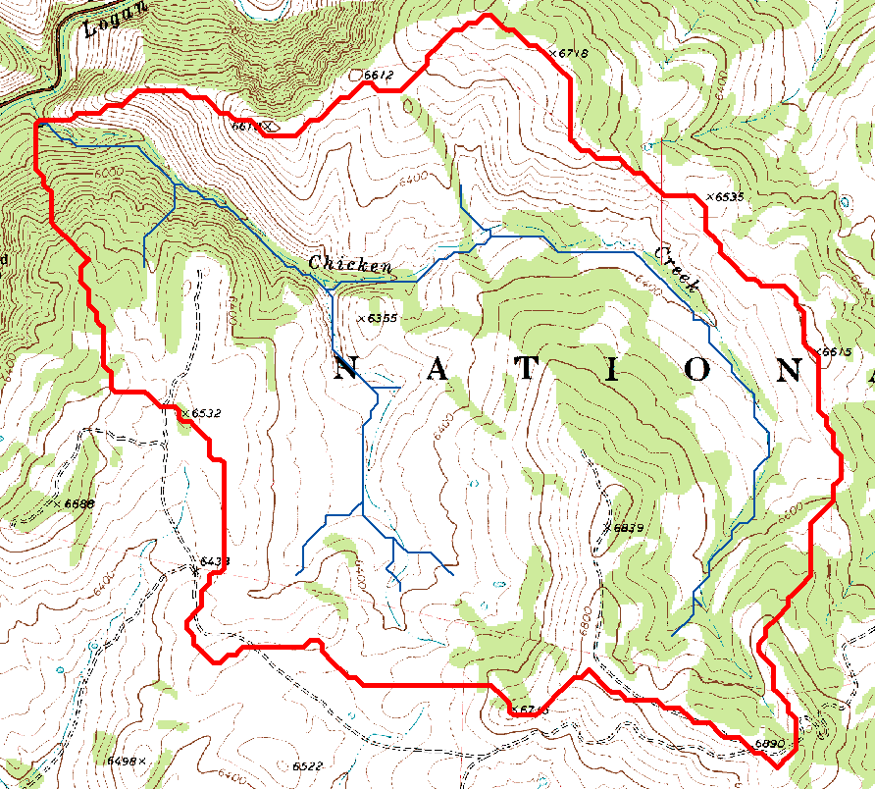
Watershed delineated on a topographic map

Slide 51
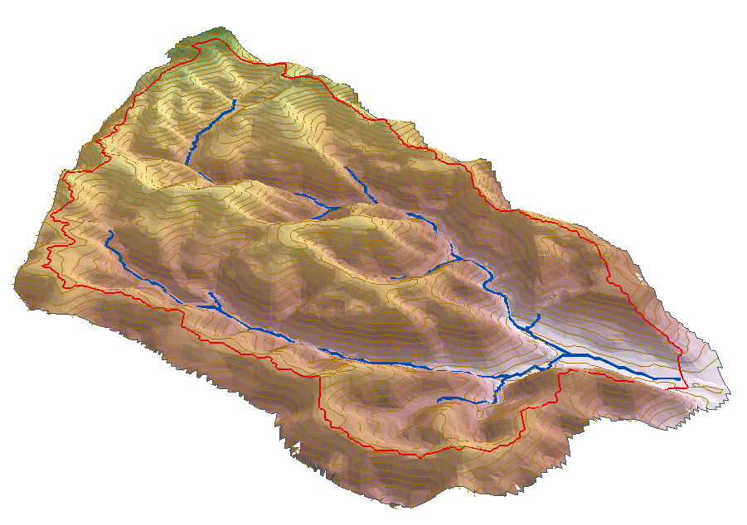
Watershed water balance
P
ET
G_{in}
Q
S
G_{out}

Slide 52
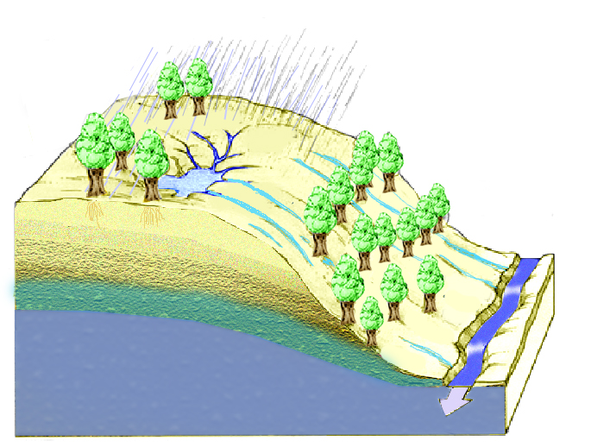
Regional Water Balance Equation
P
E
∆S=P-Q-E
P=Q+E
Q=P-E
∆S
Q

Slide 53
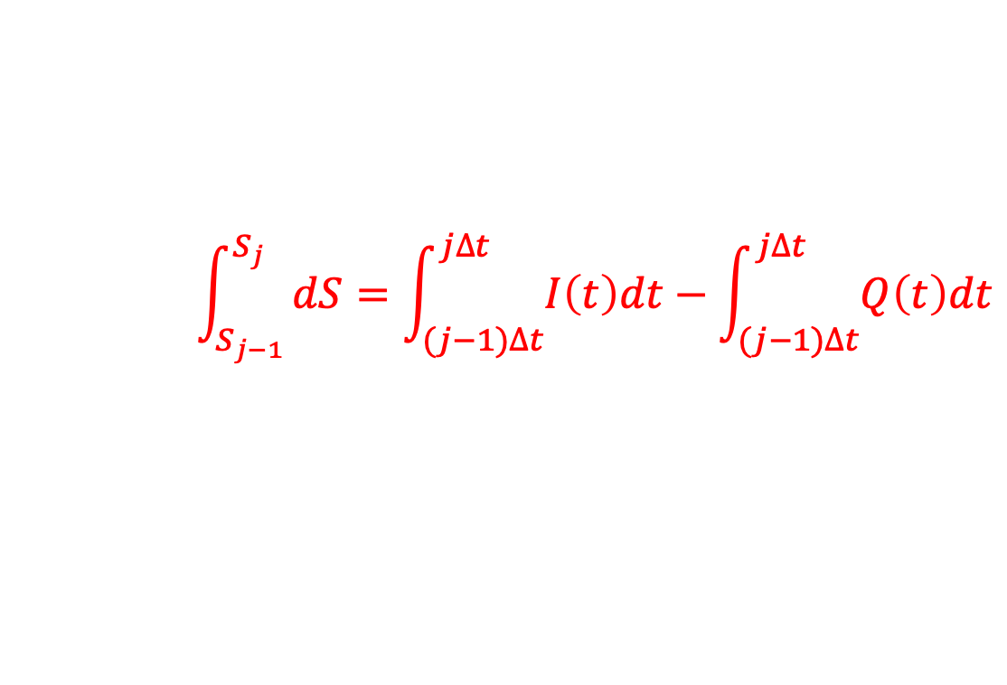

Discrete Time Continuity
We often need to break up a time-changing situation into small steps (dt) we can manage:
dS = I(t)dt – Q(t)dt
$$\int_{S_{j−1}}^{S_{j}}{dS=\int_{(j−1)∆t}^{j∆t}{I\left(t\right)dt}−\int_{(j−1)∆t}^{j∆t}{Q\left(t\right)dt}}$$
S_{j} – S_{j-1} = I_{j} = Q_{j} and S_{j} = S_{j-1} + ΔS_{j}
ΔS_{j}
$$S_{j}=S_{0}+\sum_{i=1}^{j}{(I_{i}−Q_{i})}$$
Notes:
FILL IN EQ 2.3.1 and 2.3.2 and 2.3.3 and 2.3.4

Slide 54
Discrete Time Continuity
Q(t) and I(t) are continuous in time. 2 ways to evaluate:
Sample Data Function (e.g., ):
streamflow
Q_{j} = Q(t_{j}) = Q(jΔt)
Q_{j} and Q(t) are both [L³/T] or [L/T]
Notes:
“rainfall”, then, FILL IN EQ 2.3.5
“streamflow”, then FILL IN 2.3.6 and 2.3.7

Slide 55


Discrete Time Continuity
Q(t) and I(t) are continuous in time. 2 ways to evaluate:
Pulse Data Function (e.g., ):
rainfall
$$Q_{j}=\int_{(j−2)∆t}^{j∆t}{Q\left(t\right)dt}$$
Q_{j} [L³] or [L]
but, Q(t) [L³/T] or [L/T]
Use Average Approach:
$$Q_{j}=\frac{1}{∆t}\int_{(j−2)∆t}^{j∆t}{Q\left(t\right)dt}$$
now, Q_{j} and Q(t) are both [L³/T] or [L/T]
Notes:
“rainfall”, then, FILL IN EQ 2.3.5
“streamflow”, then FILL IN 2.3.6 and 2.3.7

Slide 56
Example
Given: Calculate the storage of water in a watershed (7.03 mi²) as a function of time given the data for incremental precipitation across the watershed & streamflow measured at its outlet. Assume S₀ = 0.
PULSE
SAMPLE

Slide 57


Example Solution
Let’s change the Q(t) to PULSE data:
1) Average Q_{j} and Q_{j+1}
2) multiply this average by Δt, and then
3) Normalize by watershed area
From j₀ to j₁:
Q(0) = 203 cfs, and Q(0.5) = 246 cfs
$$Q_{1}=\left(\frac{203+246cfs}{2}\right)∗0.5hr∗\left(\frac{3600s}{1hr}\right)=4.04x{10}^{5}{ft}^{3}$$
$$Q_{1}=\left(\frac{4.04x{10}^{5}{ft}^{3}}{1.96x{10}^{8}{ft}^{2}}\right)=2.06x{10}^{−3}ft=0.02 in$$
A= 7.03mi² = 1.96x10⁸ ft² →
So now, ΔS₁ – I₁ – Q₁ = 0.15 in – 0.02 in
ΔS₁ = 0.13 in

Slide 58
Example Solution
Table 2.3.1

Slide 59
Example Solution

Slide 60


Slide 61
Hydrologic Data and Hydrologic Budget
USGS http://waterdata.usgs.gov
Logan River Mean Annual Flow 236.8 cfs
Streamstats http://water.usgs.gov/osw/streamstats/
Logan River Mean annual precipitation in inches 35.5
Area 214 mi²

Slide 63


Slide 64

Concept of Residence Time
Output, Q
[M/T or L³/T]
Recall:
Definition – average length of time that an entity (i.e., water molecule) will remain in a reservoir
This is only really meaningful at steady-state, when I = Q →
Storage, S
[M or L³]
Input, I
[M/T or L³/T]
$$T_{r}=\frac{S}{Q}=\frac{S}{I}$$
Notes:
Average length of time that an entity, in this case a water molecule, will remain in a reservoir
Only meaningful at steady-state where I = O
Residence time t = S/I = S/O

Slide 65
Exercise
Example: What is the residence time of water in the atmosphere?
Accessible atm water (above 800m) = 4.4x10⁶ km³
Continental precipitation = 110,303 km³/yr
Accessible fresh water above 800 m = 4.4 x 10⁶ km³
Continental precipitation = 110,303 km³/yr
T_{R} = S/I = 40 years
Notes:
Residence time of fresh water.
Accessible fresh water above 800 m = 4.4 x 10⁶ km³
Continental precipitation = 110,303 km³/yr
T_{R} = S/I = 40 years

Slide 66
Residence Times of Global Reservoirs
Location | Residence time
Oceans and seas | 3500 yrs
Groundwater | 2 weeks --> 10,000 yrs
Ice caps & glaciers | 10-10,000 yrs
Lakes & reservoirs | 1-100 yrs
Swamps | 1-10 yrs
Soil Moisture | 2 weeks --> 10 yrs
River Channels | ~2 weeks
Atmospheric Water | ~ 10 days
Biosphereic Water | ~1 week

Slide 68




Ex.: Modeling Watershed Functioning
One way to model stream discharge (q) is to relate it to watershed storage dynamics (dS/dt):
$$\frac{dS}{dt}=p−et−q$$
Re-arranged to put q in terms of S:
$$q=f_{w1}(S)$$
q
Where, f_{W1} is a watershed storage function
Then, use chain rule to differentiate:
$\frac{dq}{dt}=\frac{dq}{dS}\frac{dS}{dt}=\frac{dq}{dS}(p−et−q$)

Slide 69






Modeling Watershed Functioning
Now we can represent dq/dS as:
One can now approximate dq/dt as a power-law function of q:
$$\frac{dq}{dS}=f_{w2}(q)$$
$$=\frac{dq/dt}{dS/dt}$$
$$=\frac{dq/dt}{p−et−q}$$
$$−\frac{dq}{dt}=a q^{b}$$
Kirchner, 2009 WRR

Slide 70



Modeling Watershed Functioning
This can then be integrated to solve for a simple function that predicts q:
$$q=[a\left(2−b\right)− \\ (S−S_{0})]^{1/(2−b)}$$
Or, as a function of instantaneous p, et, and q:
$$dq=aq^{b−1}\left(p−et−q\right)dt$$
Kirchner, 2009 WRR

