Slide 1
Physical Hydrology & Hydroclimatology
(Multiscale Hydrology)
A science dealing with the properties, distribution and circulation of water.
R. Balaji
balajir@colorado.edu
CVEN5333 http://civil.colorado.edu/~balajir/CVEN5333
Includes slides from Prof. Mike Gooseff

Slide 2
Infiltration and unsaturated flow
Learning objective
Be able to calculate infiltration, infiltration capacity and runoff rates using the methods described in the Rainfall Runoff workbook chapter 5 and Dingman chapter 8.

Slide 3
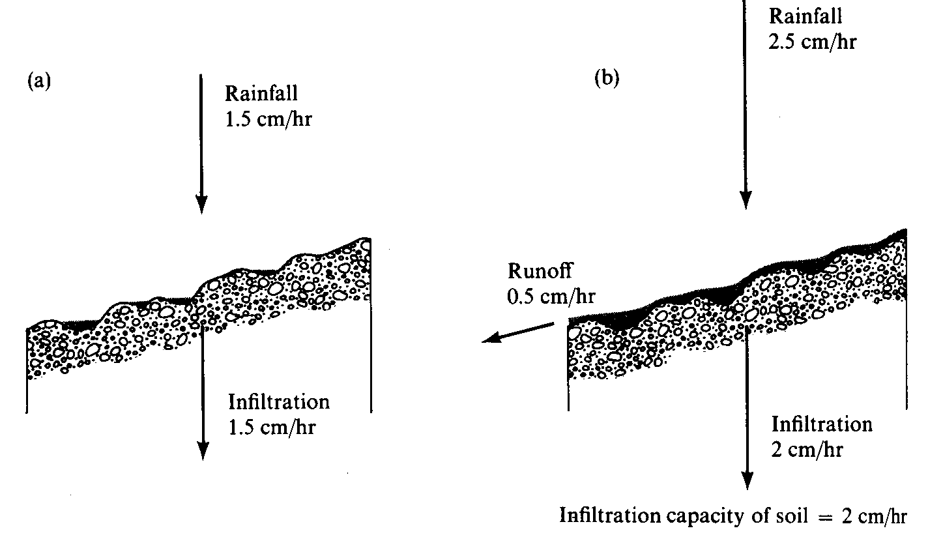
Surface Runoff occurs when surface water input exceeds infiltration capacity. (a) Infiltration rate = rainfall rate which is less than infiltration capacity. (b) Runoff rate = Rainfall intensity – Infiltration capacity. (from Dunne and Leopold, 1978)

Slide 4
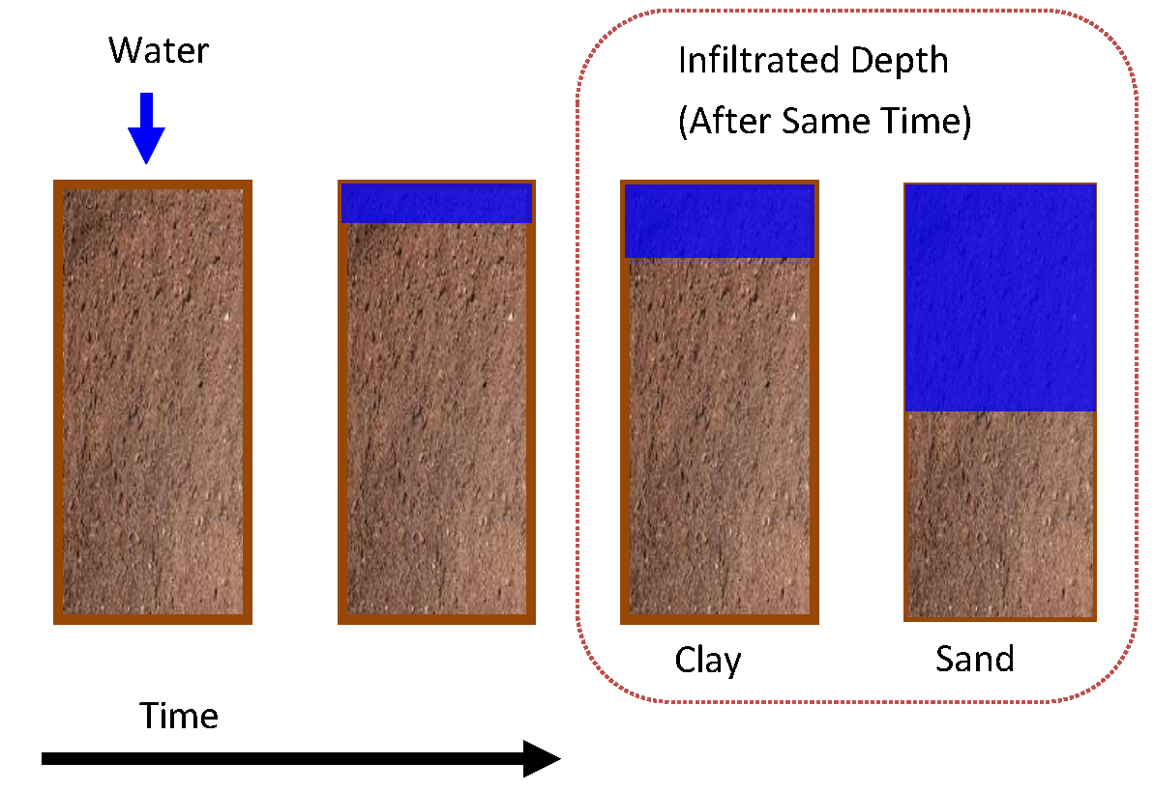
Infiltration
Simple Conceptual Model
Notes:
http://www.intechopen.com/books/crop-production/irrigation-of-sandy-soils-basics-and-scheduling

Slide 5
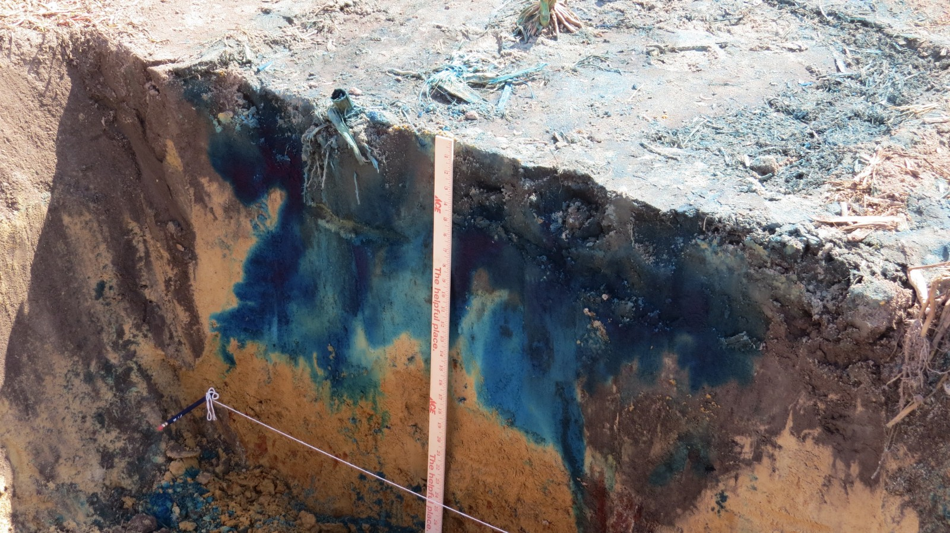
Infiltration
Reality…
Notes:
http://newsstand.clemson.edu/wp-content/uploads/2015/09/IMG_0022.jpg

Slide 6
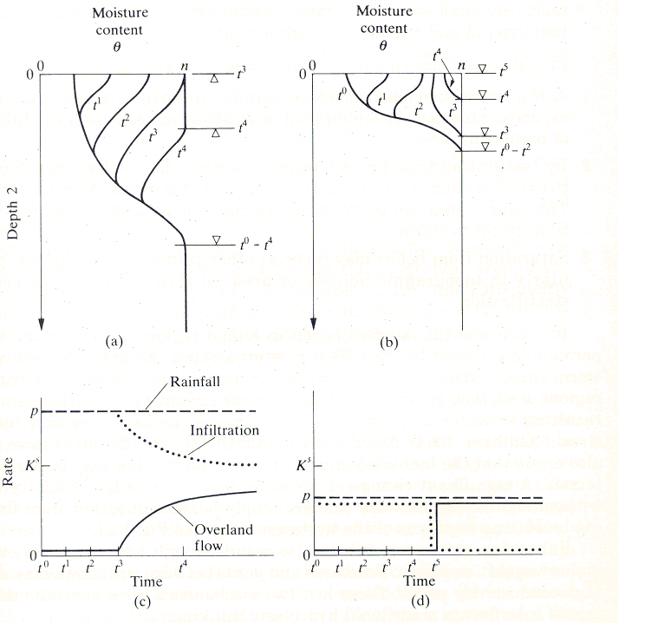
Saturation excess runoff generation mechanism
Water table near surface
Finite volume of water can infiltrate before soil completely saturated
No further infiltration
All further precipitation is runoff
Occurs in lowlands, zones of convergent topography
Partial contributing area concept
Dunne Mechanism
Saturation from Below
Notes:
Figure 38. Saturation excess runoff generation mechanism. (a) Moisture content versus depth profiles, and (b) Runoff generation time series. (from Bras, 1990)

Slide 7
Infiltration excess runoff generation mechanism
Initially dry soil
Suction large at surface
Total head gradient large
Large infiltration capacity
Penetration of moisture from rainfall
Suction reduces
Infiltration capacity reduces
Excess precipitation becomes runoff
(a)
Saturation from Above
Horton Mechanism
(b)
Notes:
Figure 37. Infiltration excess runoff generation mechanism. (a) Moisture content versus depth profiles and (b) Runoff generation time series. (from Bras, 1990)

Slide 8
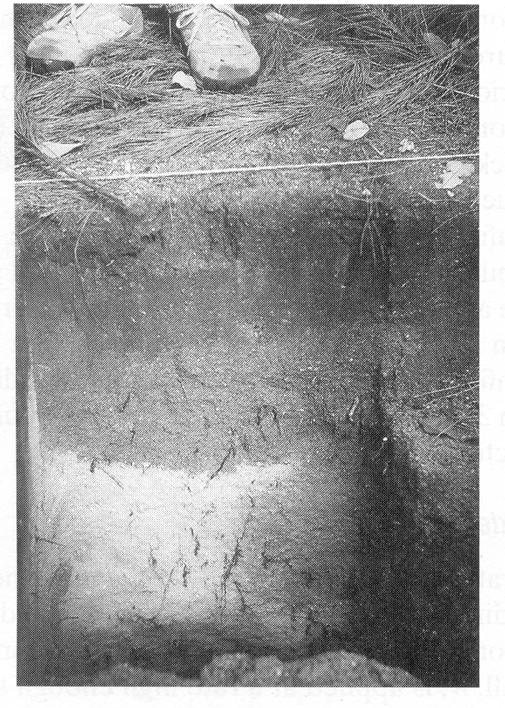
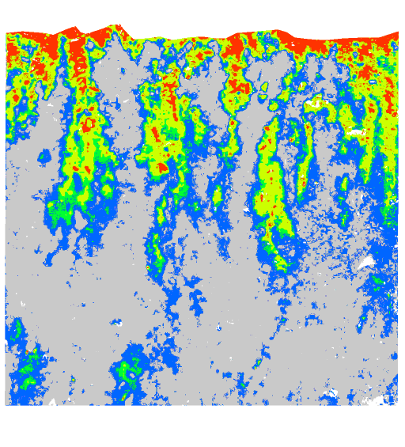
Need Equations to describe reduction in infiltration capacity as depth of water that has infiltrated increases (wetting front propagates downwards), recognizing that this may be a simplification
Wetting front in a sandy soil exposed after intense rain (from Dingman, 1994).
Preferential pathway infiltration (Markus Weiler, ETH Zurich)

Slide 9
Infiltration some definitions
Water input rate, w(t) – rate at which water arrives at the surface due to rain, snowmelt, or irrigation (from t=0 to t=T_{w})
Infiltration rate, f(t) – rate at which water enters the soil from the surface
Infiltrabilility/Infiltration capacity, f*(t) – maximum rate of f(t) that can occur at any time; note that this changes during the infiltration event.
Notes:
Water input rate, w(t) – rate at which water arrives at the surface due to rain, snowmelt, or irrigation (from t=0 to t=T_{w})
Infiltration rate, f(t) – rate at which water enters the soil from the surface
Infiltrabilility/Infiltration capacity, f*(t) – maximum rate of f(t) that can occur at any time; note that this changes during the infiltration event.

Slide 10
Infiltration some definitions
Depth of ponding, H(t) – the depth of water standing on the surface.
3 ponding conditions:
  No ponding: infiltration rate is the same as water-input rate; H(t) = 0; w(t) ≤ f*(t)
  Saturation from above: ponding is present because water-input rate exceeds infiltratability; H(t) > 0; f(t) = f*(t) ≤ w(t)
  Saturation from below: ponding is present because the water table has risen to the surface; H(t) ≥ 0; f(t) = f*(t) = 0
Notes:
Depth of ponding, H(t) – the depth of water standing on the surface.
3 ponding conditions:
No ponding: infiltration rate is the same as water-input rate; H(t) = 0; w(t) ≤ f*(t)
Saturation from above: ponding is present because water-input rate exceeds infiltratability; H(t) > 0; f(t) = f*(t) ≤ w(t)
Saturation from below: ponding is present because the water table has risen to the surface; H(t) ≥ 0; f(t) = f*(t) = 0

Slide 11
Infiltration Process
What’s the sequence of infiltration?
Let’s assume that rainfall rate is constant…
At first, all rain will infiltrate
Then, as time goes on, the infiltration capacity of the soil decreases
As a consequence, the actual infiltration rate decreases
Notes:
What’s the sequence of infiltration?
Let’s assume that rainfall rate is constant…
At first, all rain will infiltrate
Then, as time goes on, the infiltration capacity of the soil decreases
As a consequence, the actual infiltration rate decreases

Slide 12
Infiltration Process
4. If infiltration decreases
but rainfall rate stays the
same, what happens?
So, the rate sequence is:
Notes:
4. If infiltration decreases but rainfall rate stays the same, what happens?
PONDING (note t_{p} on graph)
So, the rate sequence is:
FILL IN EQNS AND TIMES

Slide 13
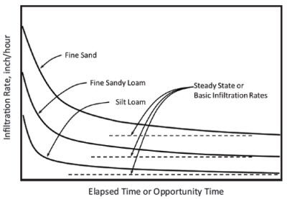
Infiltration Process
Amount and rate of infiltration is controlled by:
Surface K
rate of water application
Starting θ
Surface slope/roughness
Soil chemical characteristics
Properties of water
Notes:
Amount and rate of infiltration is controlled by:
Surface K
rate of water application
Starting θ
Surface slope/roughness
Soil chemical characteristics
Properties of water
https://www.pioneer.com/home/site/us/agronomy/library/soil-water-mgmt/

Slide 14
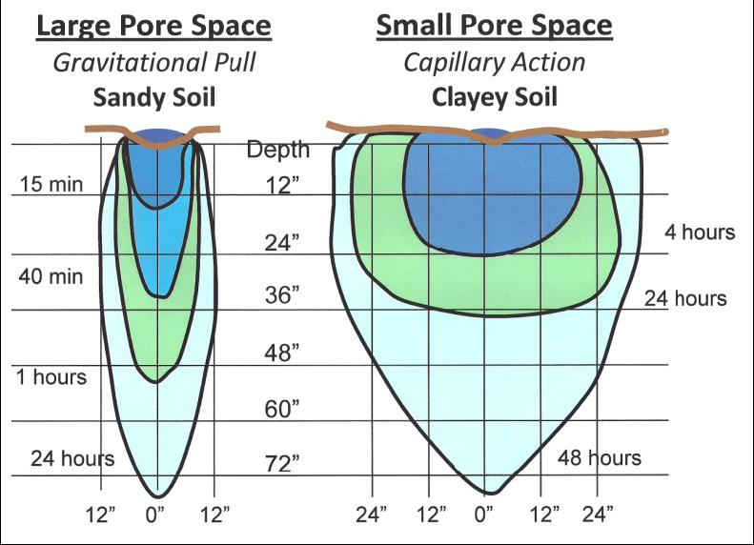
Example: comparing infiltration in sandy vs. clayey soils…
Notes:
http://www.intechopen.com/books/crop-production/irrigation-of-sandy-soils-basics-and-scheduling

Slide 15
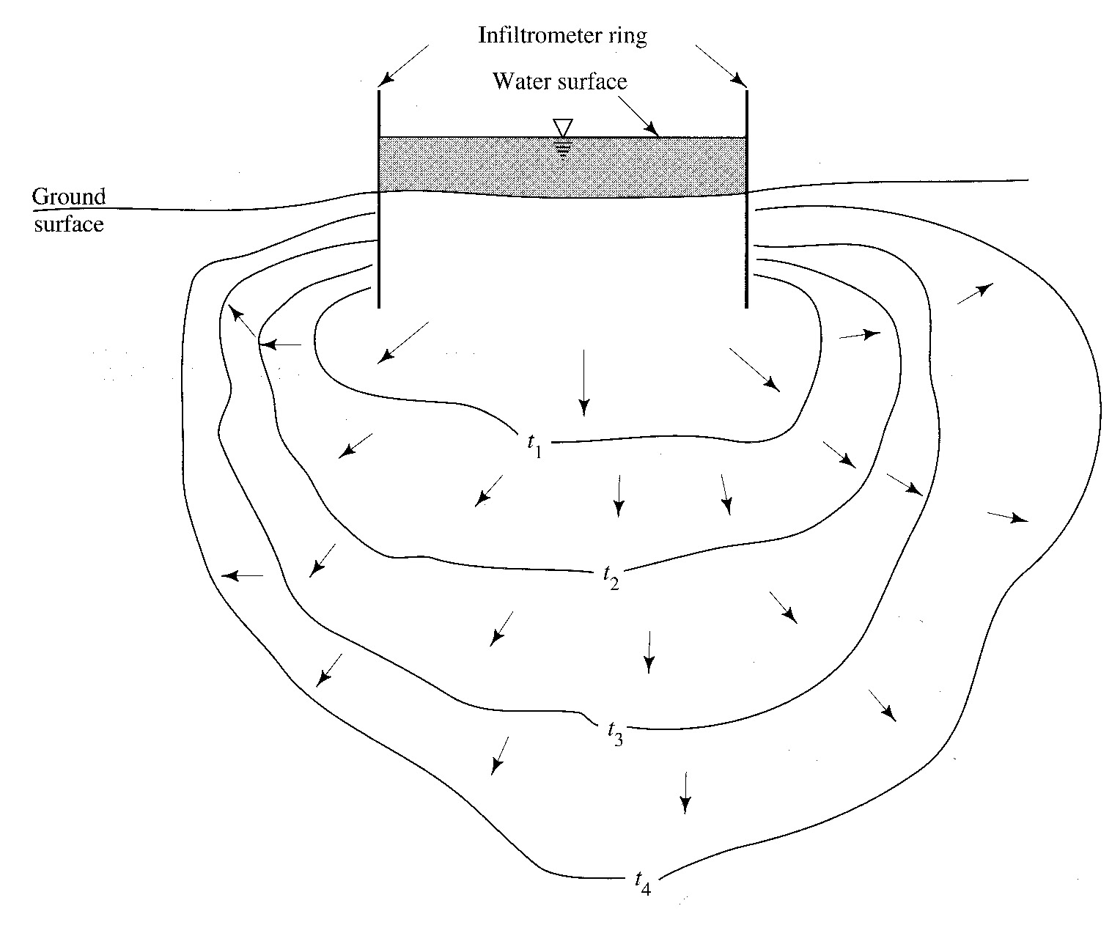
Measuring Infiltration
Ring Infiltrometer
Basic idea – create a constant head boundary at surface and
record rate of infiltration (i.e., rate of refill to keep water level constant)
Notes:
Basic idea – create a constant head boundary at surface and record rate of infiltration (i.e., rate of refill to keep water level constant)

Slide 16
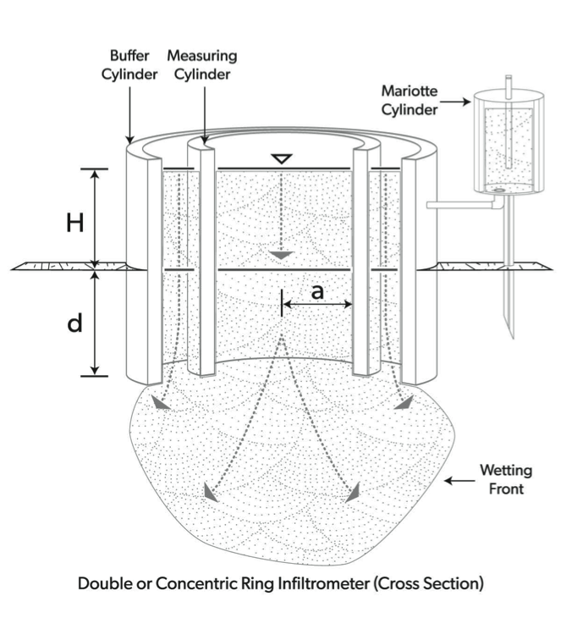
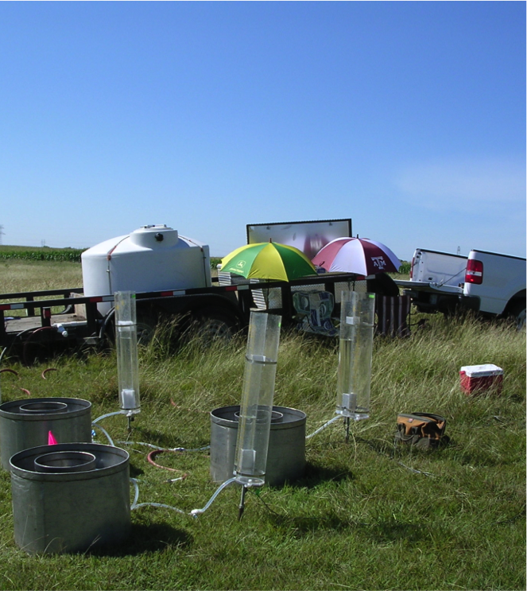
Measuring Infiltration
Double Ring Infiltrometer – more control
Notes:
http://www.environmentalbiophysics.org/double-ring-infiltrometers-versus-dual-head-infiltrometers/

Slide 17
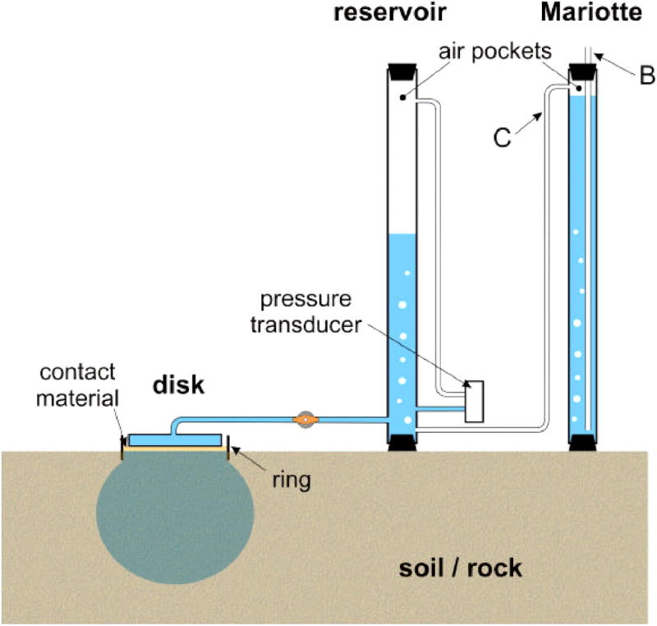
Measuring Infiltration
Tension/Disc Infiltrometer
Similar idea to ring infiltrometers
Water enters the soils though a porous disc

Slide 18
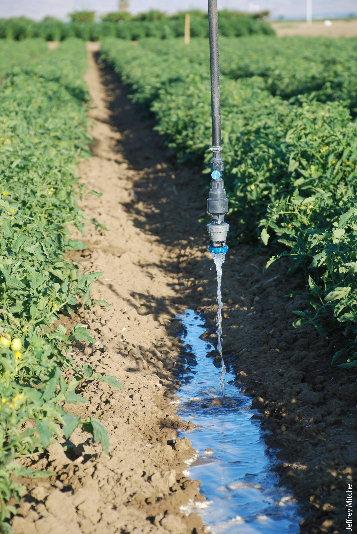
Measuring Infiltration
Sprinkler-Plot Studies
Mass balance of water applied to a plot of interest:
f(t) = w – q(t)
Measure runoff from plot, q(t)
Notes:
Mass balance of water applied to a plot of interest:
f(t) = w – q(t)
Measure runoff from plot, q(t)
http://calag.ucanr.edu/Archive/?article=ca.v070n02p62

Slide 19
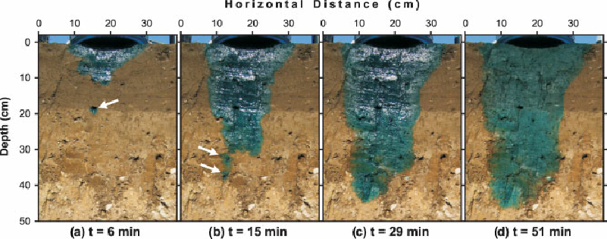
Measuring Infiltration
Sprinkler-Plot Studies
Alternatively, you can look for infiltrated water (and dye)
Notes:
https://www.researchgate.net/figure/229728827_fig5_Figure-8-Time-lapse-photographs-of-infiltration-along-a-vertical-soil-section-at

Slide 20
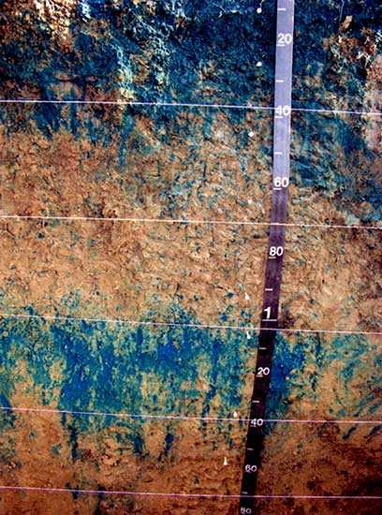
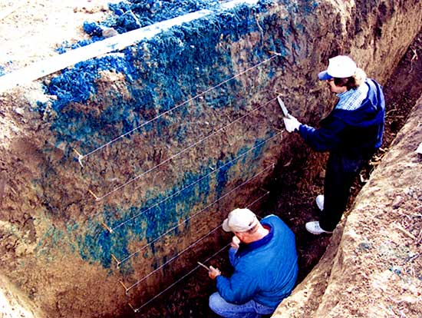
Measuring Infiltration
Sprinkler-Plot Studies
Notes:
http://www.kgs.ku.edu/Hydro/Publications/2007/OFR07_14/

Slide 21
Infiltration
Infiltration rate models
A few ground rules:
Darcian flow rules in the subsurface; soil volumes are large compared to void sizes; preferential flow through micropores can happen as well
Upward air flow through the soil is neglected
Water movement due to osmotic or thermal gradients during freezing or thawing
is not considered…
Notes:
A few ground rules:
Darcian flow rules in the subsurface; soil volumes are large compared to void sizes; preferential flow through macropores can happen as well
Upward air flow through the soil is neglected
Water movement due to osmotic or thermal gradients during freezing or thawing is not considered…

Slide 22
Unsat’d Darcy’s Law
Woah, everything seems to be a function of moisture content. This is a tough problem…

Slide 23
Unsat’d Darcy’s Law:
1-D flow in vertical direction
This describes the steady flow of soil moisture, but what about transience?

Slide 24
Unsat’d Darcy’s Law:
1-D flow in vertical direction
Continuity equation for the case of vertical flow
Difference between the inflow and outflow rates across control volume
Rate of change in mass within a small control volume
=
By assembling the equation from the last slide (Darcy for unsat’d) and the continuity equation, we arrive at the 1-D Richard’s Equation

Slide 25
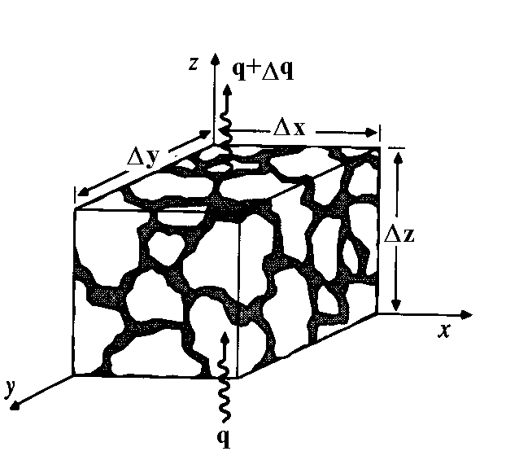
Continuity equation in an unsaturated porous medium.
Δθ Δx Δy Δz =
(q Δx Δy – (q+Δq) Δx Δy) Δt

Slide 26
3 dimensional continuity equation.
_{z z}
q_{y}
q_{x}
q_{x}+Δq_{x}
q_{y}+Δq_{y}
_{z}

Slide 27
Richard's Equation
Continuity
Darcy
Pressure and elevation head
h = ψ+z
Soil moisture characteristic
Pressure head as independent variable
Specific moisture capacity

Slide 28
Diffusion form of Richard's Equation
Soil water Diffusivity

Slide 29
Green-Ampt model idealization of wetting front penetration into a soil profile
Initial moisture content θ_{o}
Saturation moisture content θ_{s} equivalent to porosity, n
0.1
0.2
0.3
0.4
0.5
Moisture content, θ
t₁
t₂
L
10
t₃
20
t₄
Δθ
Depth, z, (cm)
30
40
Notes:
Figure 37. Green-Ampt model idealization of wetting front penetration into a soil profile.

Slide 30
Infiltrability – Depth Approximation

Slide 31
Cumulative infiltration at ponding
Time to ponding
Infiltration under ponded conditions

Slide 32
Green – Ampt infiltration parameters for various soil classes (Rawls et al., 1983). The numbers in parentheses are one standard deviation around the parameter value given.
Soil Texture | Porosity n | Effective porosity θ_{e} | Wetting front soil suction head |ψ_{f}| (cm) | Hydraulic conductivity K_{sat} (cm/hr)
Sand | 0.437 (0.374-0.500) | 0.417 (0.354-0.480) | 4.95 (0.97-25.36) | 11.78
Loamy sand | 0.437 (0.363-0.506) | 0.401 (0.329-0.473) | 6.13 (1.35-27.94) | 2.99
Sandy loam | 0.453 (0.351-0.555) | 0.412 (0.283-0.541) | 11.01 (2.67-45.47) | 1.09
Loam | 0.463 (0.375-0.551) | 0.434 (0.334-0.534) | 8.89 (1.33-59.38) | 0.34
Silt loam | 0.501 (0.420-0.582) | 0.486 (0.394-0.578) | 16.68 (2.92-95.39) | 0.65
Sandy clay loam | 0.398 (0.332-0.464) | 0.330 (0.235-0.425) | 21.85 (4.42-108.0) | 0.15
Clay loam | 0.464 (0.409-0.519) | 0.309 (0.279-0.501) | 20.88 (4.79-91.10) | 0.1
Silty clay loam | 0.471 (0.418-0.524) | 0.432 (0.347-0.517) | 27.30 (5.67-131.50) | 0.1
Sandy clay | 0.430 (0.370-0.490) | 0.321 (0.207-0.435) | 23.90 (4.08-140.2) | 0.06
Silty clay | 0.479 (0.425-0.533) | 0.423 (0.334-0.512) | 29.22 (6.13-139.4) | 0.05
Clay | 0.475 (0.427-0.523) | 0.385 (0.269-0.501) | 31.63 (6.39-156.5) | 0.03

Slide 33
Philip Model

Slide 34
Cumulative infiltration at ponding
Time to ponding
Infiltration under ponded conditions

Slide 35
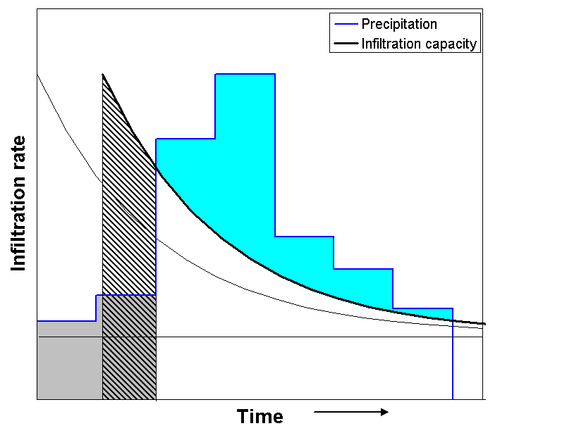
t₀
t_{o}
t₁
Time Compression Approximation
Notes:
Figure 40. Partition of surface water input into infiltration and runoff using the Horton infiltration equation. Ponding starts at t1. The cumulative depth of water that has infiltrated up to this time is the area F1 (shaded gray). This is less than the maximum possible infiltration up to t1 under the fc(t) curve. To accommodate this the fc(t) curve is shifted in time by an amount to so that the cumulative infiltration from to to t1 (hatched area) equals F1. Runoff is precipitation in excess of fc(t-to) (blue area).

Slide 36
Horton Infiltration Model

Slide 37
Cumulative infiltration at ponding
Time to ponding
Infiltration under ponded conditions
Given F_{s}, t_{s} solve for t_{o} implicitly then use 2nd equation

Slide 38
f₀
t₀
f₁
F₁
t_{o}
t₁
Notes:
Figure 40. Partition of surface water input into infiltration and runoff using the Horton infiltration equation. Ponding starts at t1. The cumulative depth of water that has infiltrated up to this time is the area F1 (shaded gray). This is less than the maximum possible infiltration up to t1 under the fc(t) curve. To accommodate this the fc(t) curve is shifted in time by an amount to so that the cumulative infiltration from to to t1 (hatched area) equals F1. Runoff is precipitation in excess of fc(t-to) (blue area).

Slide 39
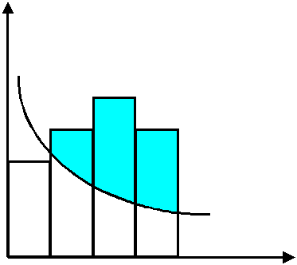
Surface Water Input
Infiltration Capacity
Runoff
Runoff
Time
Notes:
Figure 41. Pulse runoff hyetograph obtained from surface water input hyetograph and variable infiltration capacity.

Slide 40
A
Initialize: at t = 0, F_{t} = 0
Calculate infiltration capacity f_{c} from F_{t}, column 1 of table.
f_{c} ≤ w_{t}
f_{c}> w_{t}
Is f_{c} ≤ w_{t}
B
C
Ponding occurs throughout interval: F_{t+Δt} calculated using infiltration under ponded conditions equations with t_{s}=t and F_{s}= F_{t}.
Column 3.
No ponding at the beginning of the interval. Calculate tentative values
and column 1.
D
Ponding starts during the interval. Solve for F_{p} from w_{t}, column 2.
Δt' = (F_{p}-F_{t})/w_{t}
F_{t+Δt} calculated using infiltration under ponded conditions equations with t_{s}=t+Δt' and F_{s}= F_{p}. Column 3.
E
No ponding throughout interval
F
Infiltration is f_{t} = F_{t+Δt}-F_{t}
Runoff generated is r_{t}= w_{t}Δt - f_{t}
G
Increment time t=t+Δt
Notes:
Figure 42. Flow chart for determining infiltration and runoff generated under variable surface water input intensity.

Slide 41
Notes:
Figure 43. Rainfall Hyetograph, Infiltration Capacity and Runoff Generated in Example 1. Numbers are infiltration in cm in each interval.

Slide 42
Equations for variable surface water input intensity infiltration calculation.

Slide 43
0.303
0.146
0.159
0.178
0.00005
Notes:
Figure 43. Rainfall Hyetograph, Infiltration Capacity and Runoff Generated in Example 1. Numbers are infiltration in cm in each interval.

Slide 44
0.282
0.289
0.249
0.032
0.004
Notes:
Figure 44. Rainfall Hyetograph, Infiltration Capacity and Runoff Generated in Example 2. Numbers are infiltration in cm in each interval.

Slide 45
0.165
0.119
0.080
0.0003
Notes:
Figure 45. Rainfall Hyetograph, Infiltration Capacity and Runoff Generated in Example 3. Numbers are infiltration in cm in each interval.

