Slide 1
Physical Hydrology & Hydroclimatology (Multiscale Hydrology)
A science dealing with the properties, distribution and circulation of water.
R. Balaji
balajir@colorado.edu
CVEN5333 http://civil.colorado.edu/~balajir/CVEN5333
Includes slides from Prof. Mike Gooseff

Slide 2
Evapotranspiration
Evapotranspiration
Basics, Importance
Physics of Evaporation
Turbulent Transfer of Heat, Momentum and Vapor
Diffusion
Energy – Balance
Mass Transfer
Combination – Penman approach
Pan Evaporation, Evaporation from open water
Evaporation from bare soil
Transpiration
Penman-Monteith
PET, Crop ET
Physical Hydrology, Dingman (Chapter 6, Appendix D)
Terrestrial Hydrometeorology, Shuttleworth, (Chapter 2,3)
Hydrology, Bras (Chapter 5)
Chow (Chapter 3)

Slide 3
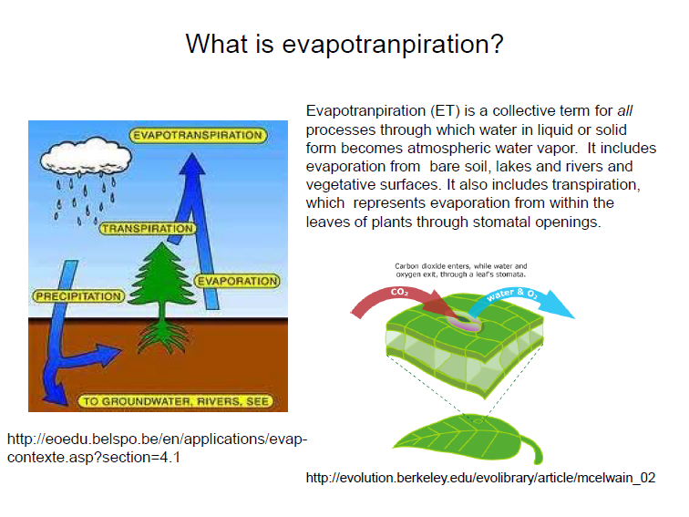

Slide 4
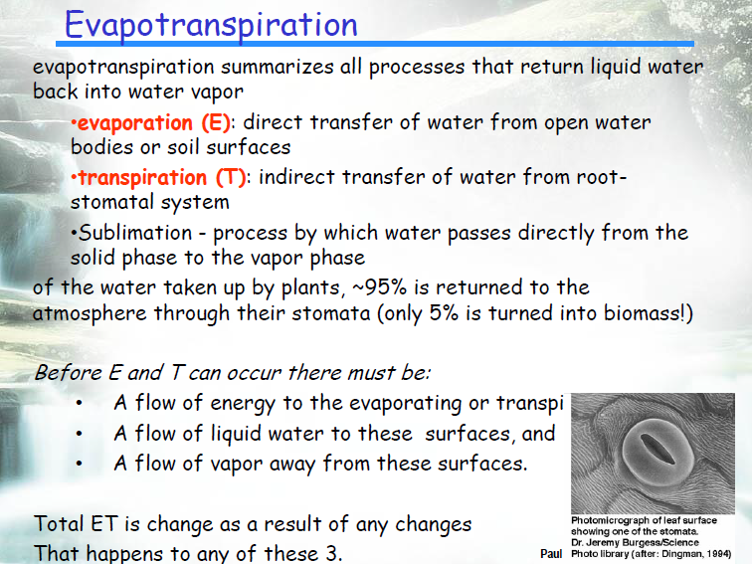

Slide 5
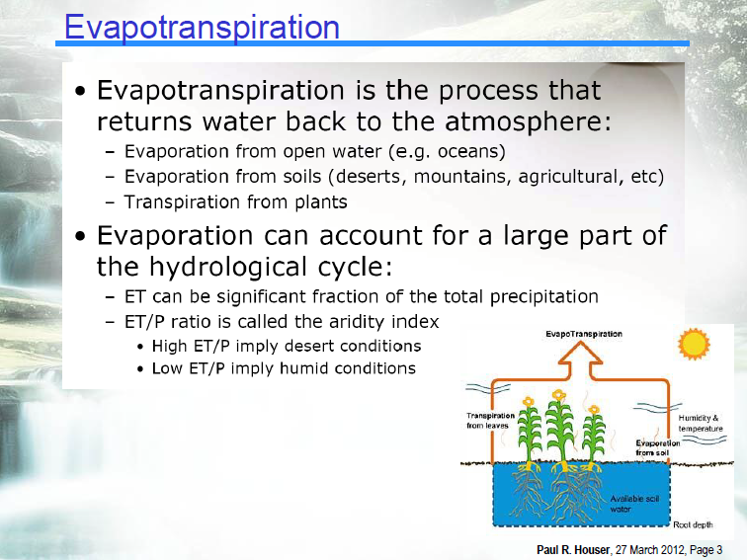

Slide 6
Evapotranspiration – Fundamentals
Flux of water from the land surface back to the atmosphere
About 61% of precipitated water is evapotranspired back to the atmosphere
Evaporation and Transpiration are both driven by energy from the sun
Notes:
Flux of water from the land surface back to the atmosphere
About 61% of precipitated water is evapotranspired back to the atmosphere
Evaporation and Transpiration are both driven by energy from the sun

Slide 7
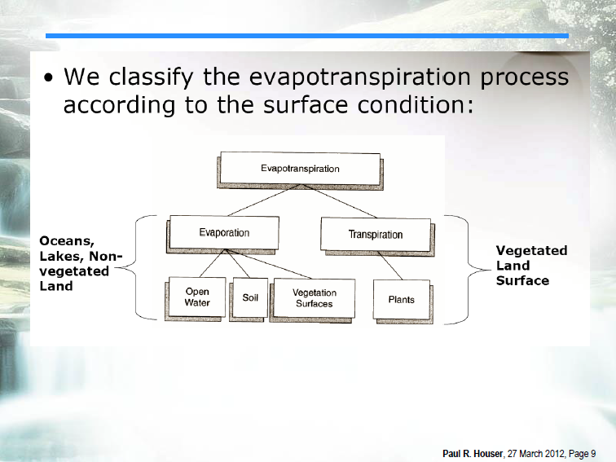

Slide 8
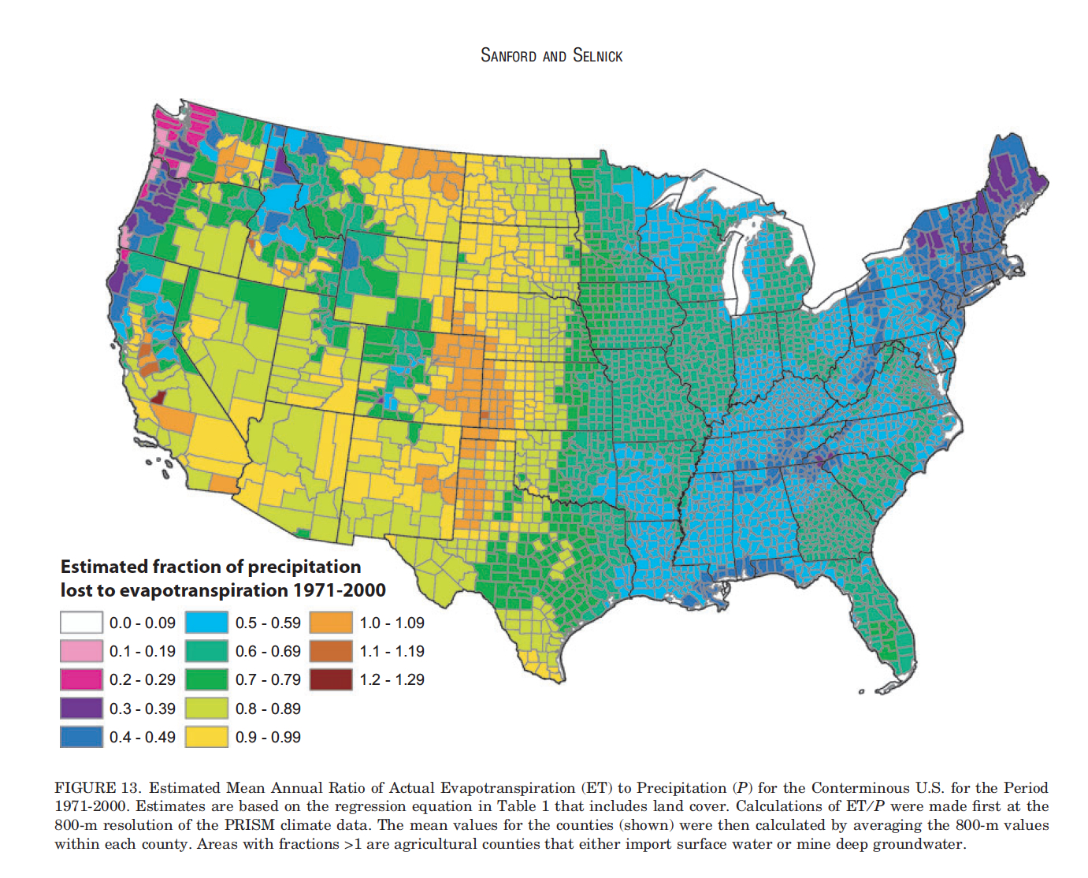
Unsaturated Zone Characteristics – Components
Sanford & Selnick, JAWRA 2012

Slide 9
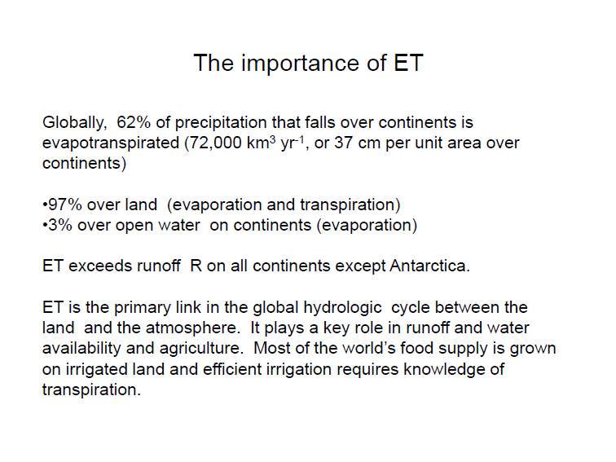

Slide 10

Why do we care about ET?
E and T are happening all the time…
In plants, T → Life
Globally, ~62% of precip goes through ET to get back to the atmosphere
42% is T
3% is open-water E
Rest is interception E and bare soil E
They are invisible fluxes!
These fluxes have associated energy transfers
Human water use influences ET across irrigated lands, etc.
Notes:
E and T are happening all the time…
In plants, T → life
Globally, ~62% of precip goes through ET to get back to the atmosphere
42% is T
3% is open-water E
Rest is interception E and bare soil E
They are invisible fluxes!
These fluxes have associated energy transfers… (recall λ_{v})
Human water use influences ET across time and space
Irrigated lands, etc.

Slide 11
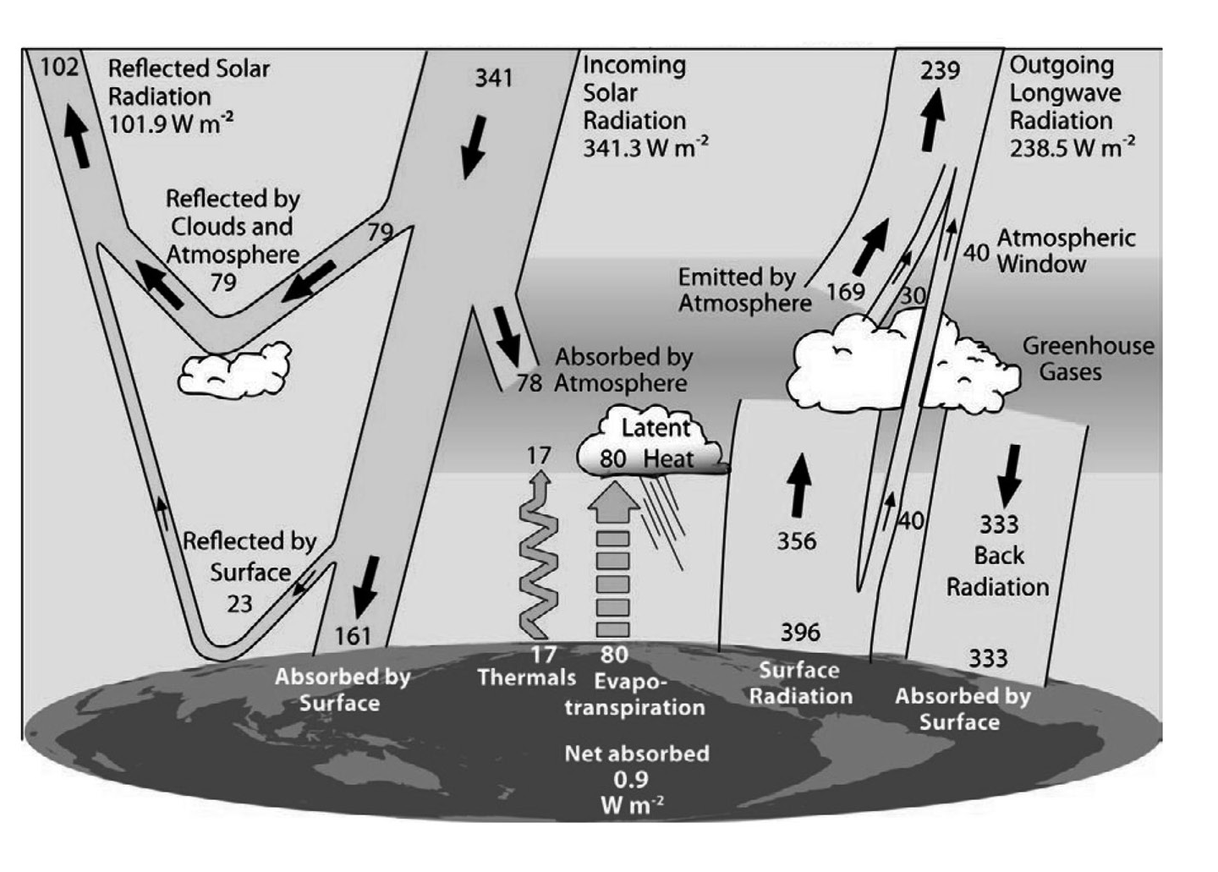
Recall global energy fluxes…
ET is 80 W/m²
Incoming Solar Radiation is 341 W/m²
ET is 23.5% of incoming solar!
Notes:
ET is 80 W/m²
Incoming Solar Radiation is 341 W/m²
ET is 23.5% of incoming solar!

Slide 12
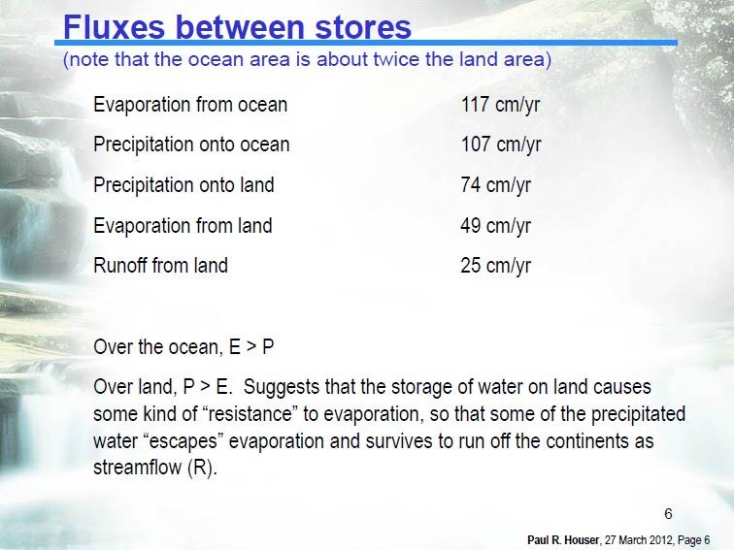

Slide 13
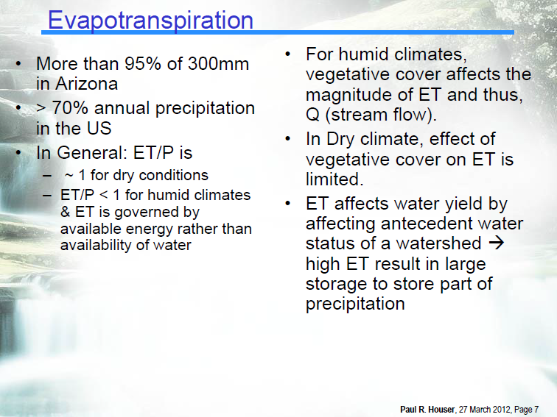

Slide 14
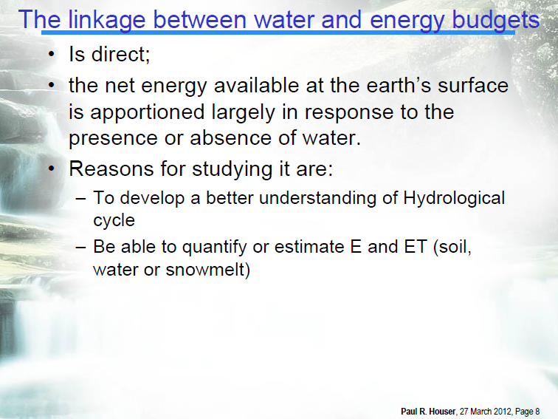

Slide 15
Evaporation – Basics
Based on an energy balance, evaporation is the natural phase change of liquid water to water vapor
The energy balance is driven by the input of solar radiation
Energy balance basics:
All objects contain sensible heat
Substances use latent heat (λ) during phase changes
Notes:
Based on an energy balance, evaporation is the natural phase change of liquid water to water vapor
The energy balance is driven by the input of solar radiation
Energy balance basics:
All objects contain sensible heat
Substances use latent heat (l) during phase changes

Slide 16
Evaporation – Potential Evaporation
Potential Evaporation E_{p} [L/T] is the quantity of water evaporated per unit area, per unit time from an idealized, extensive free-water surface under existing atmospheric conditions.
Assumptions
No limitation of water
ignore influence of evaporation on meteorological conditions
E < E_{p}
Notes:
Potential Evaporation E_{o} [mm/d] is the quantity of water evaporated per unit area, per unit time from an idealized, extensive free water surface under existing atmospheric conditions.
Assumptions
No shortage of water
Ignore influence of evaporation on meteorological parameters
AND, E <= Ep

Slide 17
Evaporation – Physics of Evaporation & Energy Exchange
Conservation of mass
Conservation of energy
Ideal gas law as it pertains to water vapor
Latent heat of phase change (vaporization)
Turbulent transfer near the ground

Slide 18
Evaporation – Conceptual molecular model
Env. Hydrol., Figure 4.2

Slide 19
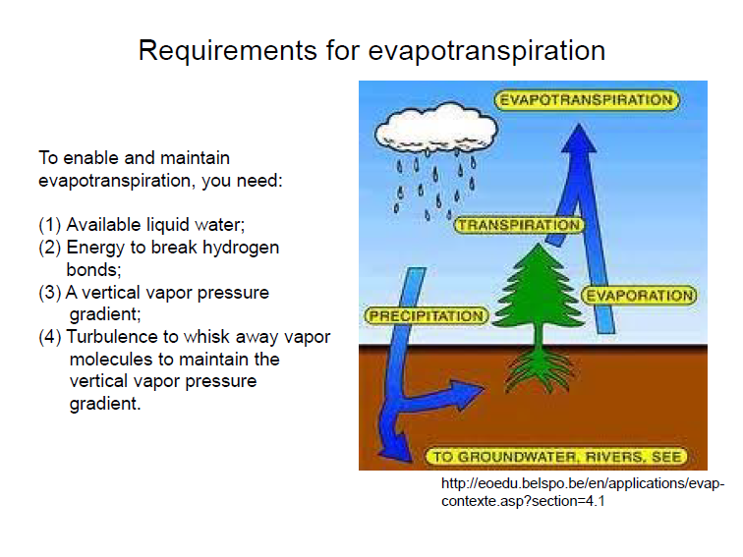

Slide 20
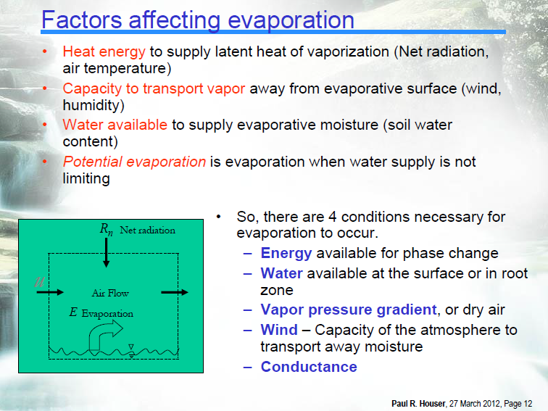

Slide 22
Evaporation – Conceptual molecular model
Requirements –
Water availability: soil moisture or open water is available to be evaporated
Energy input: net radiation drives the evolution of surface temperature, which drives energy state of surface and difference from air (energy gradient).
Transport of vapor away from surface: aerodynamic resistance regulates transport of vapor (or energy) away from the surface via turbulent motions.
Notes:
Requirements –
Water availability: soil moisture or open water is available to be evaporated
Energy input: net radiation drives the evolution of surface temperature, which drives energy state of surface and difference from air (energy gradient).
Transport of vapor away from surface: aerodynamic resistance regulates transport of vapor (or energy) away from the surface via turbulent motions.

Slide 23
Evaporation – Energy Balance Method
According to the first law of thermodynamics, the net radiant energy received at the land surface must be conserved
All matter has internal energy due to the kinetic and potential energy associated with individual molecules.
Notes:
According to the first law of thermodynamics, the net radiant energy received at the land surface must be conserved.
All matter has internal energy due to the kinetic and potential energy associated with individual molecules.

Slide 24
Evaporation – Energy Balance Model
To ‘free’ the molecules, they must overcome the latent heat of vaporization which is the quantity of heat energy needed to break the hydrogen bonds between molecules
Notes:
FILL IN EQNS
To ‘free’ the molecules, they must overcome the latent heat of vaporization, λ_{v}, which is the quantity of heat energy needed to break the hydrogen bonds between molecules.

Slide 25

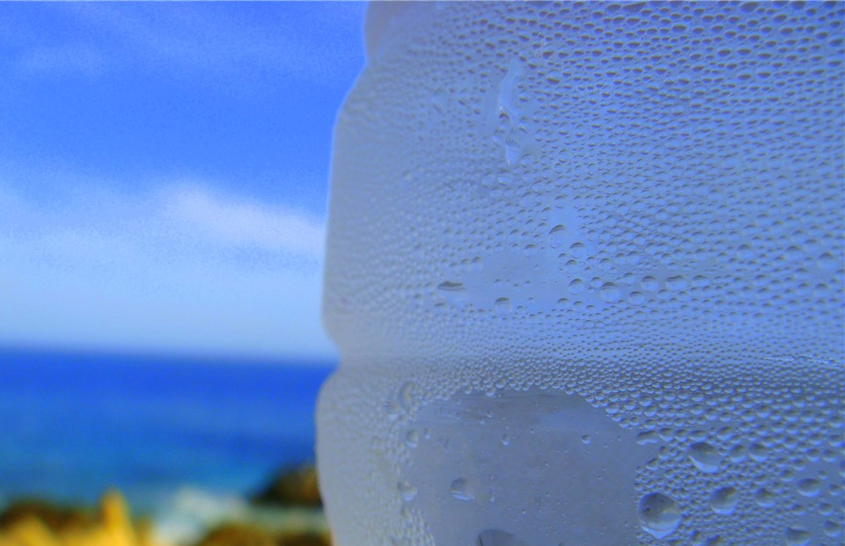
Evaporation - Latent Heat Exchange
Evaporation → transfer of heat out of the evaporating surface (i.e., the surface cools)
Condensation → transfer of heat into the air (i.e., the air warms)
Condensation on the surface of an object is always accompanied by a transfer of heat to the surface (i.e., the surface warms)
Notes:
Evaporation → transfer of heat out of the evaporating surface (i.e., the surface cools)
Condensation → transfer of heat into the air (i.e., the air warms)
Condensation on the surface of an object is always accompanied by a transfer of heat to the surface (i.e., the surface warms)

Slide 26
Evaporation – Latent Heat Exchange
The latent heat transfer rate is:
Where, E is the rate of evaporation [LT⁻¹]; ρ_{w} is the density of water [ML⁻³]
But, λ_{v} (MJ/kg) changes as a function of the temperature of the evaporating surface (T_{s}, ºC):
λE = λ_{v} ρ_{w} E
λ_{v} = 2501 – 0.000236T_{s}
Notes:
Fill in EQ 3.17 in Dingman
Fill in EQ 3.18 in Dingman (note the units)

Slide 27
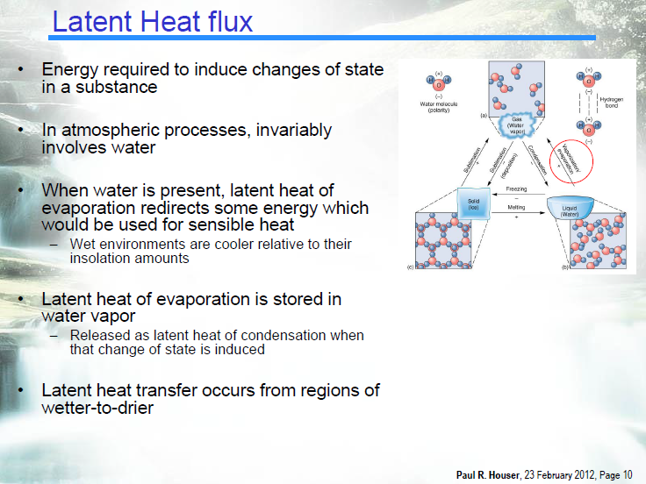

Slide 28
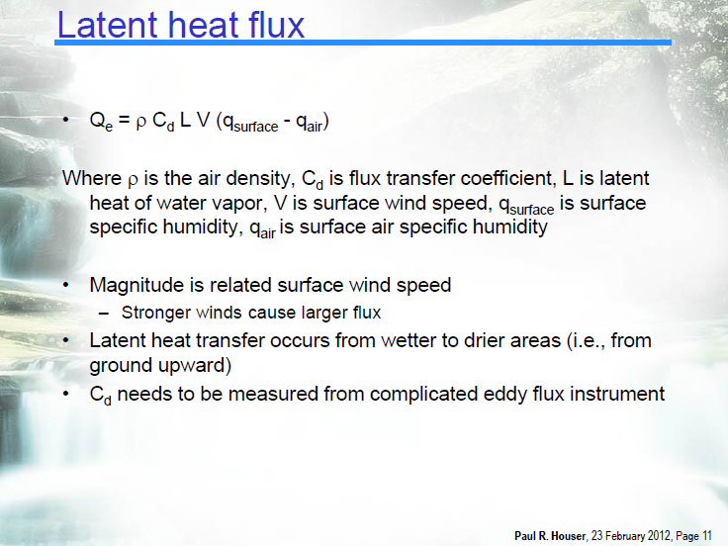

Slide 29
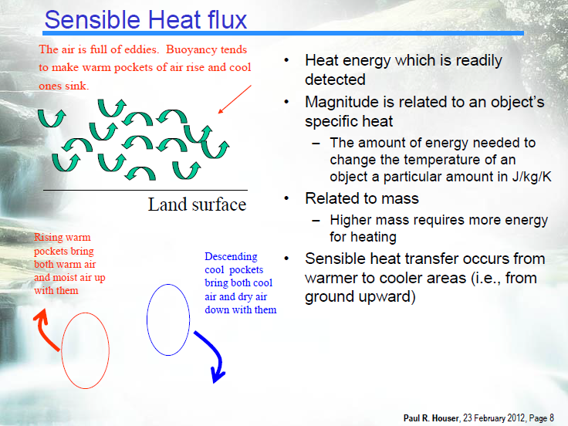

Slide 30
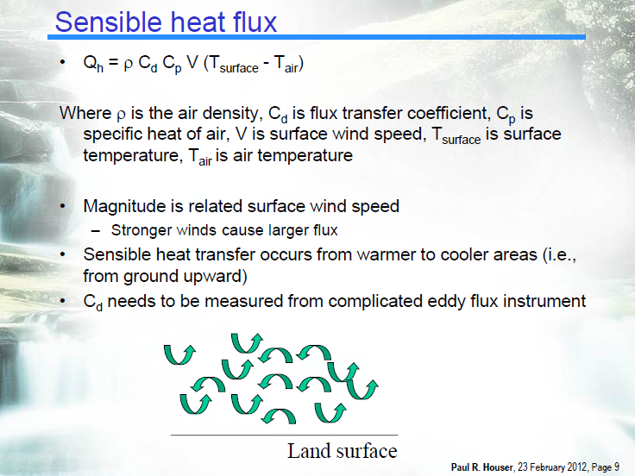

Slide 31
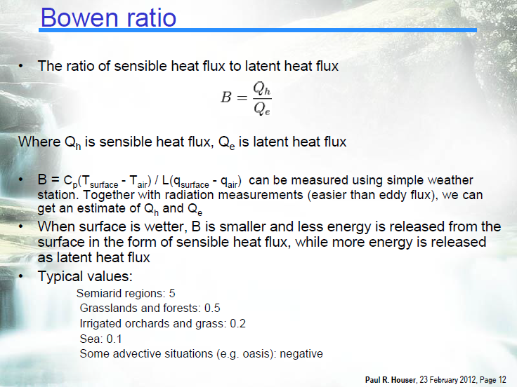

Slide 32
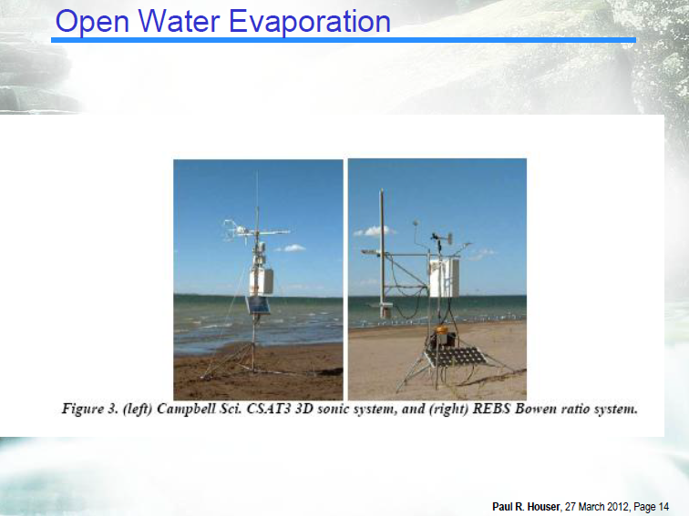

Slide 33
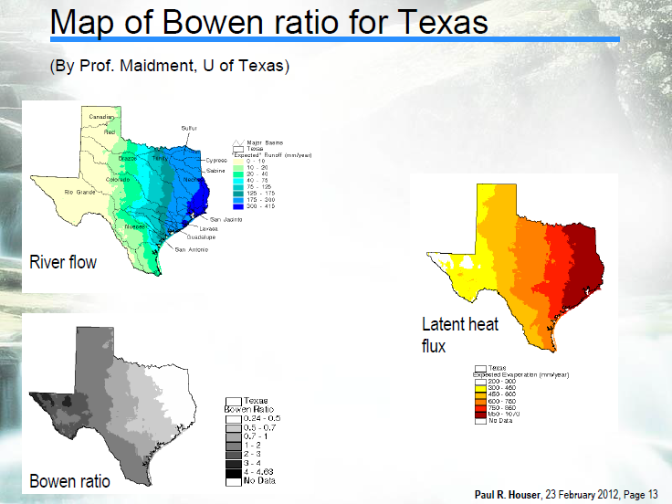

Slide 34
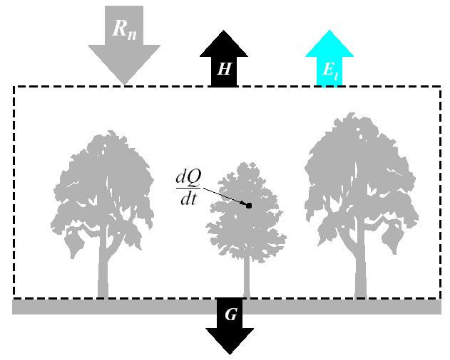
Evaporation & Heat-Exchange Processes 5. Bowen Ratio, Evaporative Fraction…
Consider a simple energy balance:
Hornberger et al., 1998
Notes:
FILL IN 2 EQNS

Slide 35
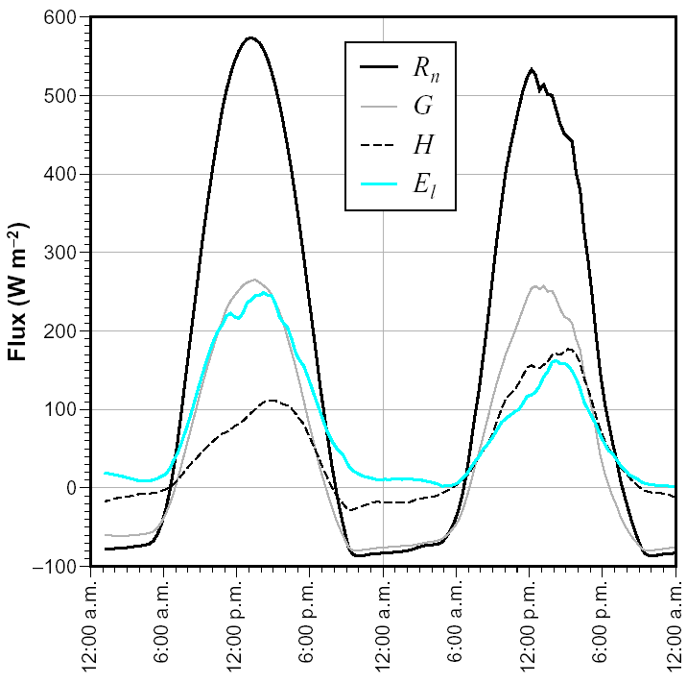
Evaporation & Heat-Exchange Processes 5. Bowen Ratio, Evaporative Fraction…
Max E corresponds to max R_{n}
Also note that at start, soil was saturated, so during day 1, λE is big (lots of ET).
On day 2, λE decreases as the soil dries.
λE
Hornberger et al., 1998

Slide 36
Evaporation & Heat-Exchange Processes 5. Bowen Ratio, Evaporative Fraction…
ET is approximately PET at saturated soil conditions
Why this relationship?
Hornberger et al., Figure 2.12

Slide 37
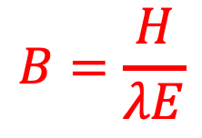
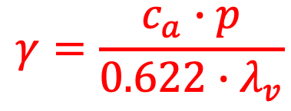
Evaporation & Heat-Exchange Processes 5. Bowen Ratio, Evaporative Fraction…
Bowen ratio – ratio of sensible heat to latent heat
And, γ is defined as the psychrometric constant:
It’s not actually constant, γ = f (p, elevation, T)
$$B=\frac{H}{λE}$$
$$γ=\frac{c_{a}∙p}{0.622∙λ_{v}}$$
Notes:
Bowen ratio – ratio of sensible heat to latent heat
FILL IN EQ. 6.19, 6.20 from DINGMAN
And, g is defined as the psychrometric constant: FILL IN EQ. 6.21 from DINGMAN
It’s not actually constant, γ = f(p, elevation, T)

Slide 38
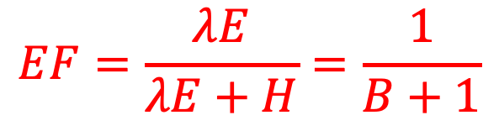
Evaporation & Heat-Exchange Processes 5. Bowen Ratio, Evaporative Fraction…
We can also define the evaporative fraction (EF), of ET as:
This is the ratio of latent heat flux to total turbulent heat flux
$$EF=\frac{λE}{λE+H}=\frac{1}{B+1}$$
Notes:
We can also define the evaporative fraction (EF), of ET as:
FILL IN EQ 6.22 from DINGMAN
This is the ratio of latent heat flux to total turbulent heat flux…

Slide 39
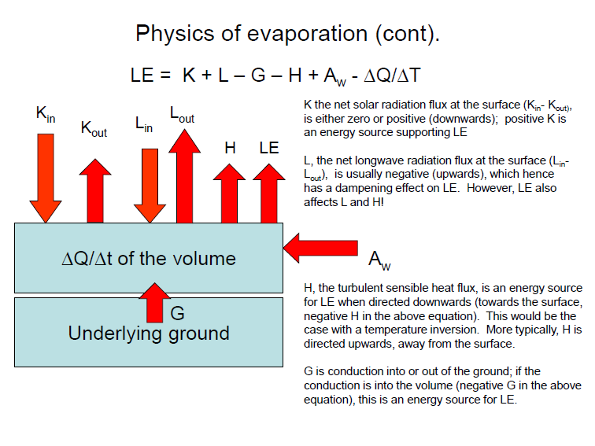

Evaporation & Heat-Exchange Processes 6. Full Energy Balance
We can write a full energy balance (on average) for evaporation/condensation as:
$$λE=K+L−G−H+A_{w}−\frac{ΔU}{Δt}$$
evaporation
ground heat flux
net shortwave radiation input
change in the amount of heat stored per unit area over some time scale.
sensible heat flux
net longwave radiation input
net input associated with inflows and outflows of water
Notes:
We can write a full energy balance (on average) for evaporation/condensation as:
$$λE=K+L−G−H+A_{w}−\frac{ΔU}{Δt}$$
Where, λE is evaporation
K – net shortwave radiation input
L – net longwave radiation input
G – net output via conduction downward from the surface
H – net output of sensible heat with the atmosphere
Aw - net input associated with inflows and outflows of water
DU/Dt = change in the amount of heat stored in the body per unit area over some time scale.
THUS, evaporation must be balanced by some combination of heat inputs from radiation or sensible yheat from the atm, ground, water, or loss of heat energy in the evaporating body…

Slide 40
Classification of ET Processes
Type of surface – open water, bare soil, leaf or canopy, reference crop, land region
Availability of water – unlimited vs. limited by stomata openings (plants)
Stored-energy use – ΔU may change a lot or a little
Water-advected energy use – A_{w} may be big or small
Notes:
Type of surface – open water, bare soil, leaf or canopy, reference crop, land region…
Availability of water – unlimited vs. limited by stomata openings (plants)
Stored-energy use – ΔU may change a lot or a little.
Water-advected energy use – Aw may be big or small...

Slide 41
Classification of ET Processes
ET Type | Type of Surface | Availability of water to surface | Stored Energy Use | Water-Advected Energy Use
Free-Water E | Open water | unlimited | none | none
Lake E | Open water | unlimited | maybe | maybe
Bare-soil E | Bare soil | Limited to unlimited | negligible | none
Transpiration | Leaf or canopy | limited | negligible | none
Interception E | Leaf or canopy | unlimited | negligible | none
PET | Reference crop | Limited to air, unlim to plants | none | none
AET | Land area | Varies in time, space | negligible | none
Notes:
FILL IN FROM TABLE 6.1, p. 257

Slide 42
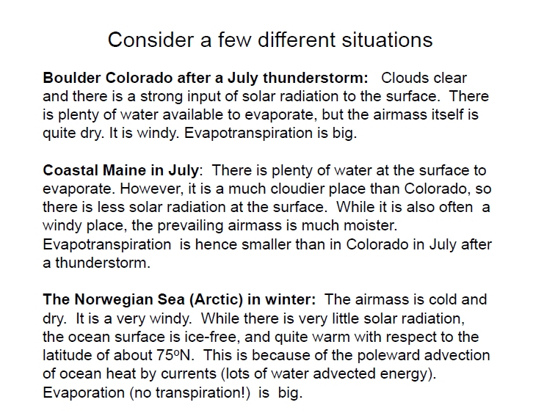

Slide 43
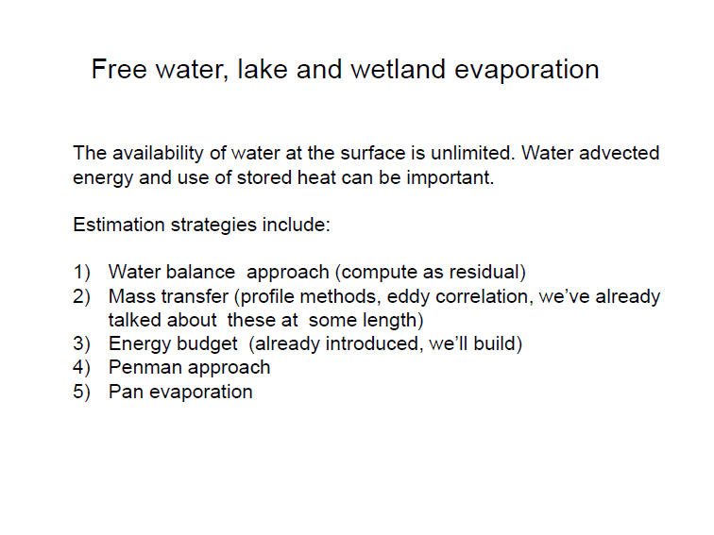

Slide 44
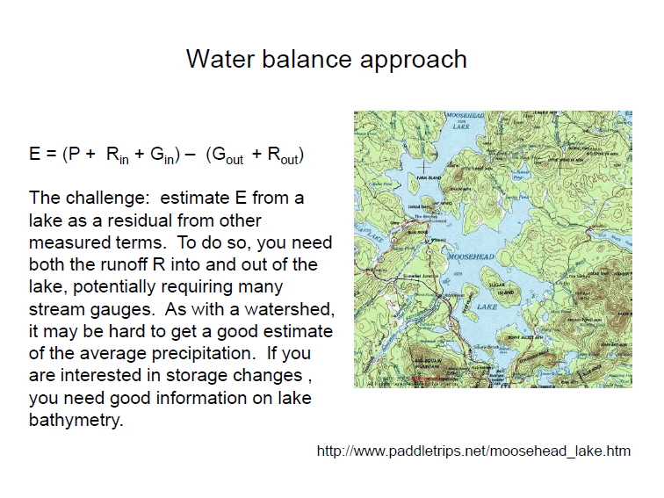

Slide 45
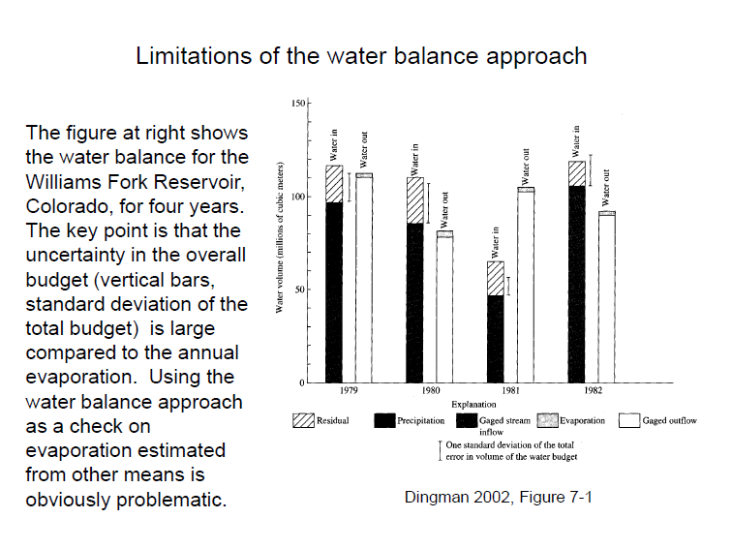

Slide 46
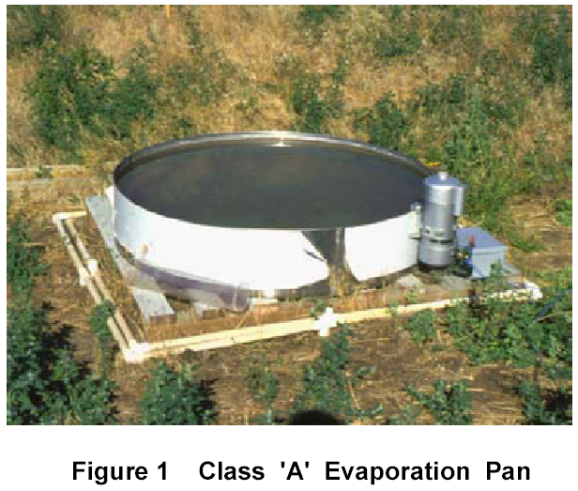
Free-Water & Lake Evaporation Pan Evaporation Measurement
Direct Measurement
Evaporation pans
Mass balances
Estimates from Met Data
E = Δstage – Precip
S₂ = S₁ – E + Precip
U.S. Weather Bureau Class A Evaporation Pan is 1.2 m in diameter and 250 mm deep. When installed it is elevated 150 mm off the ground. The operating water level is a depth of 175 – 200 mm. The water level in the pan is therefore kept 50 – 75 mm from the rim. A stilling well located on the side of the Class A Pan has a level sensor and is used to record the water depth. The measurements can be taken automatically. - British Columbia Ministry of Ag., Food, & Fisheries

Slide 47
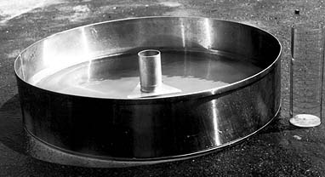
Evaporation from a Pan
Mass balance equation
Pans measure more evaporation than natural water bodies because:
1) less heat storage capacity (smaller volume)
2) heat transfer
3) wind effects
National Weather Service Class A type
Installed on a wooden platform in a grassy location
Filled with water to within 2.5 inches of the top
Evaporation rate is measured by manual readings or with an analog output evaporation gauge

Slide 48
Evaporation pans are not all equal
Env. Hydrol., Figure 4.9

Slide 49
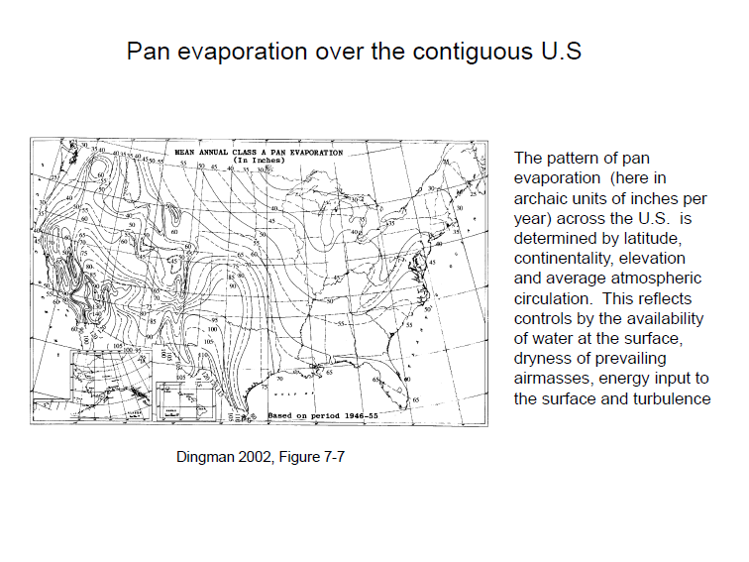

Slide 50
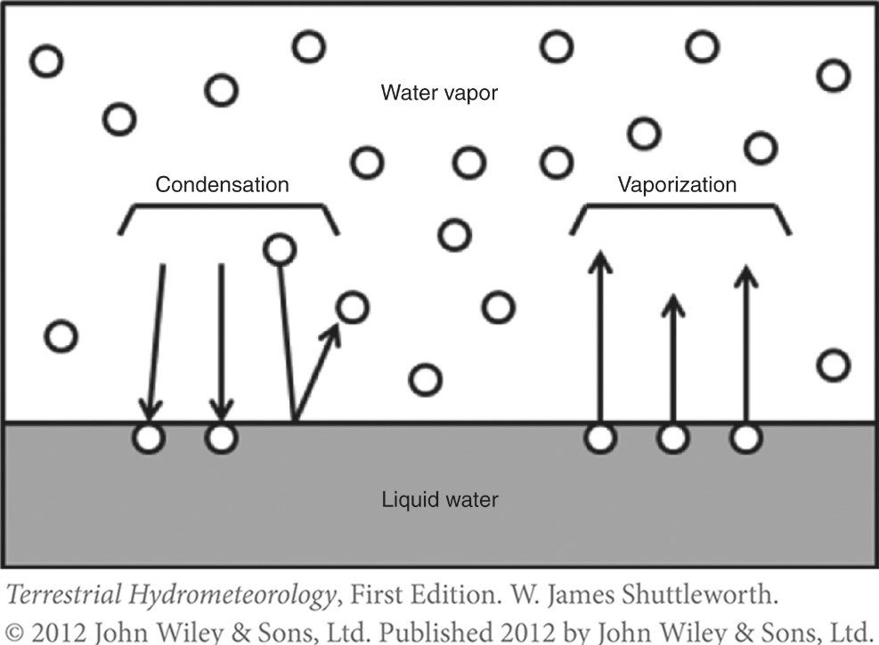
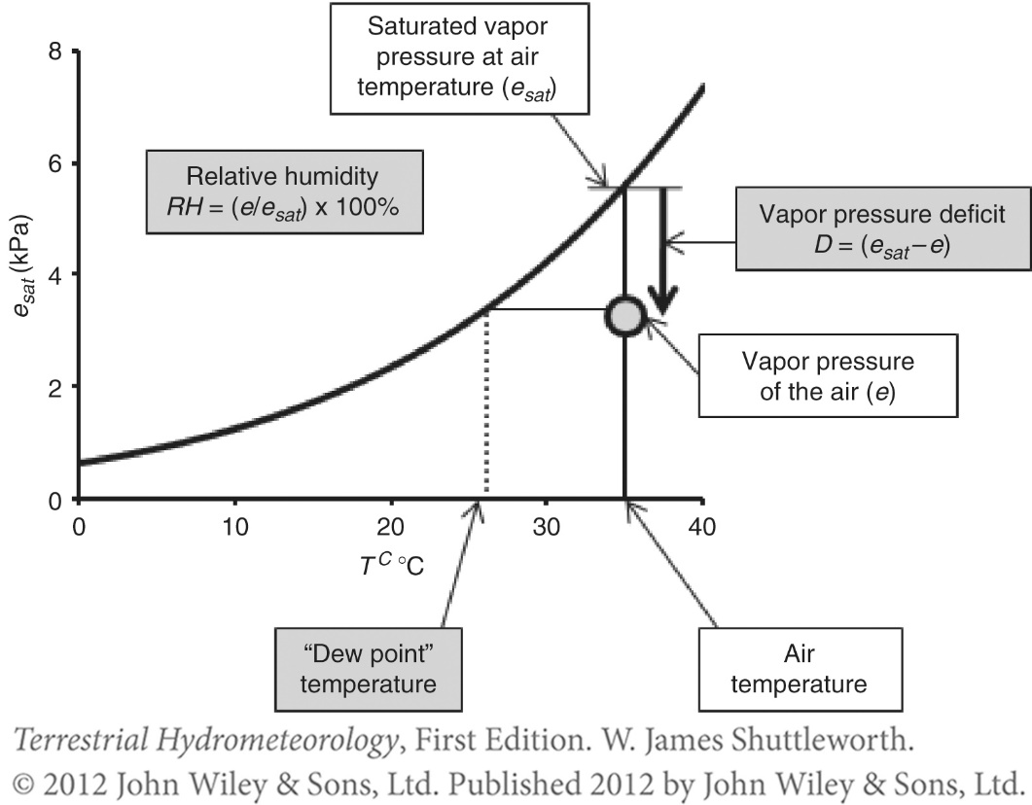
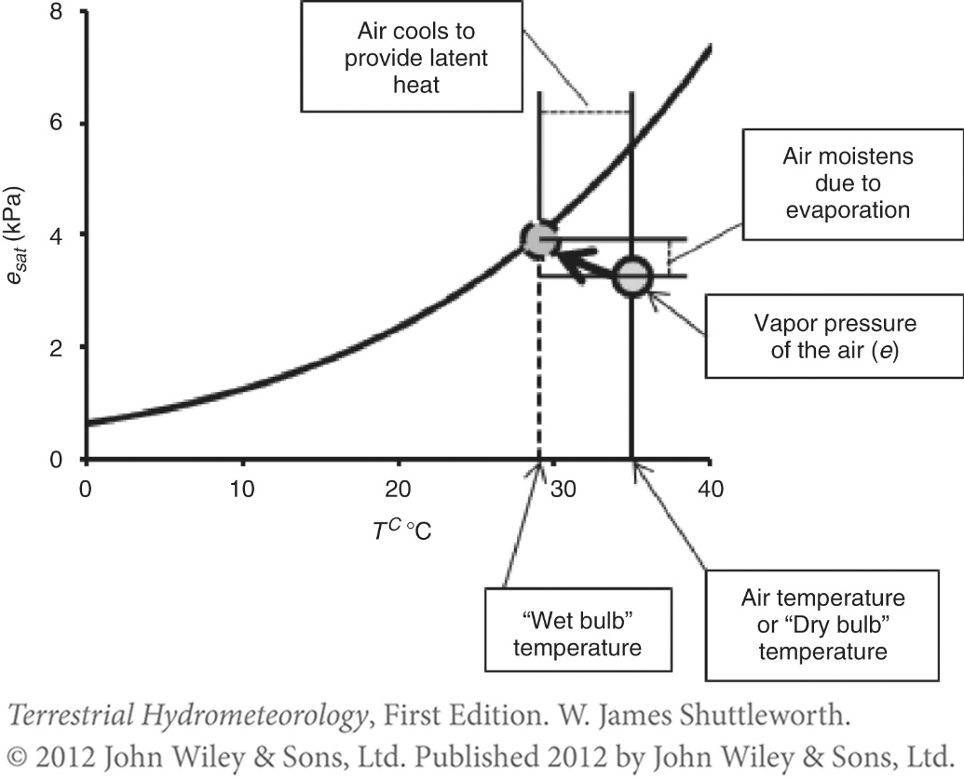
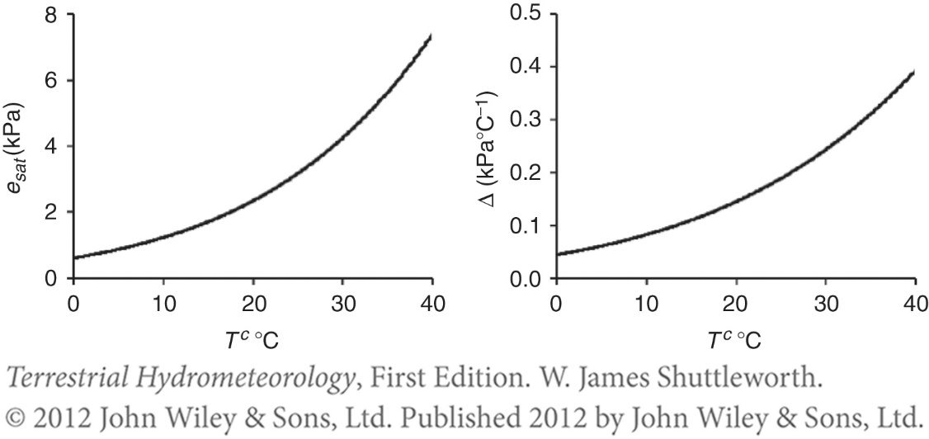

Slide 51
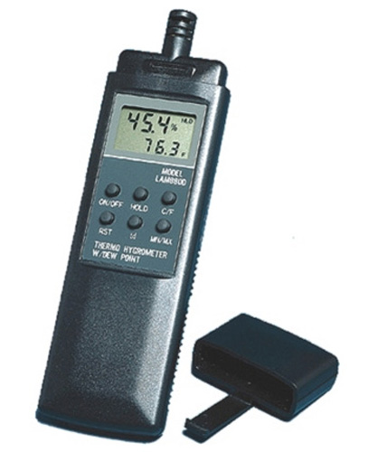

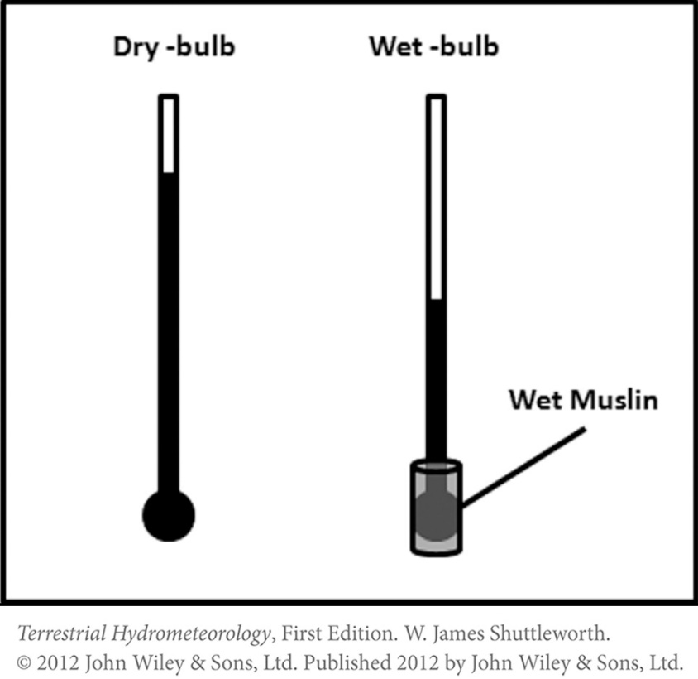

Slide 52
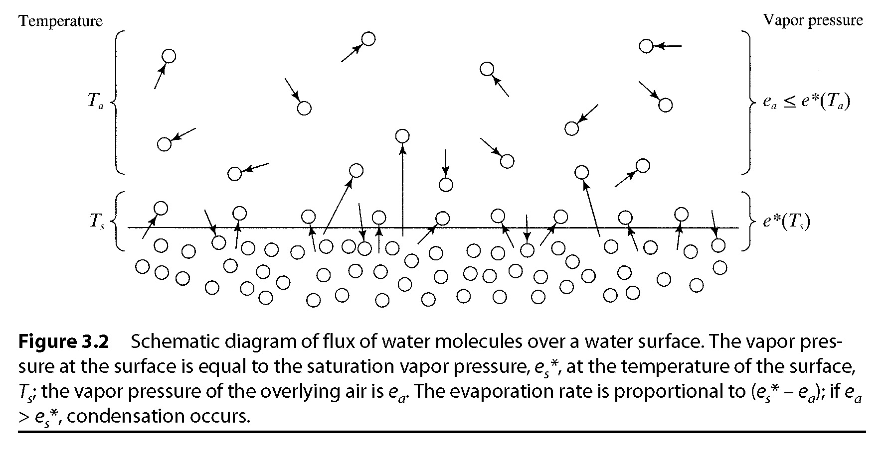

Slide 53
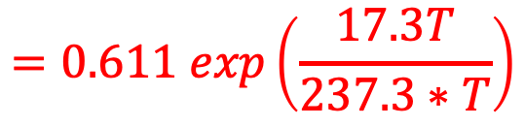
Evaporation & Heat-Exchange Processes 1. Vapor-Pressure Relations
The vapor pressure (e) of an evaporating surface is
Where, e*(T_{s}) is approximated by (T = T_{s}):
Above this surface,
Where, e*[T(z)] = e*(z) is the saturation vapor pressure at the air temperature
e_{s} = e*(T_{s})
$$=0.611 exp\left(\frac{17.3T}{237.3∗T}\right)$$
e*(T)
e(z) = RH(z) x e*[T(z)]
Notes:
The vapor pressure (e) of an evaporating surface is
FILL IN EQ 6.1 from DINGMAN
Where, e*(T_{s}) is approximated by:
FILL IN EQ 6.2 from DINGMAN
Above this surface,
FILL IN EQ 6.3 from DINGMAN
Where, e*[T(z)] = e*(z) is the saturation vapor pressure at the air temperature

Slide 54
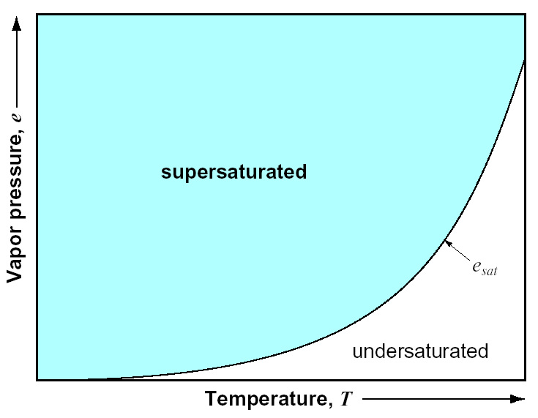
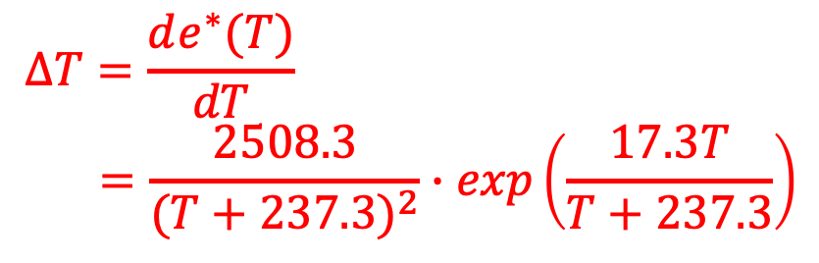
Evaporation & Heat-Exchange Processes 1. Vapor-Pressure Relations
One approach to estimating ET is to evaluate the derivative of the e* curve:
$$ΔT=\frac{de^{∗}(T)}{dT} \\ =\frac{2508.3}{(T+237.3)^{2}}∙exp\left(\frac{17.3T}{T+237.3}\right)$$
e*
Notes:
One approach to estimating ET is to evaluate the derivative of the e* curve:
FILL IN EQ 6.4 from DINGMAN

Slide 55
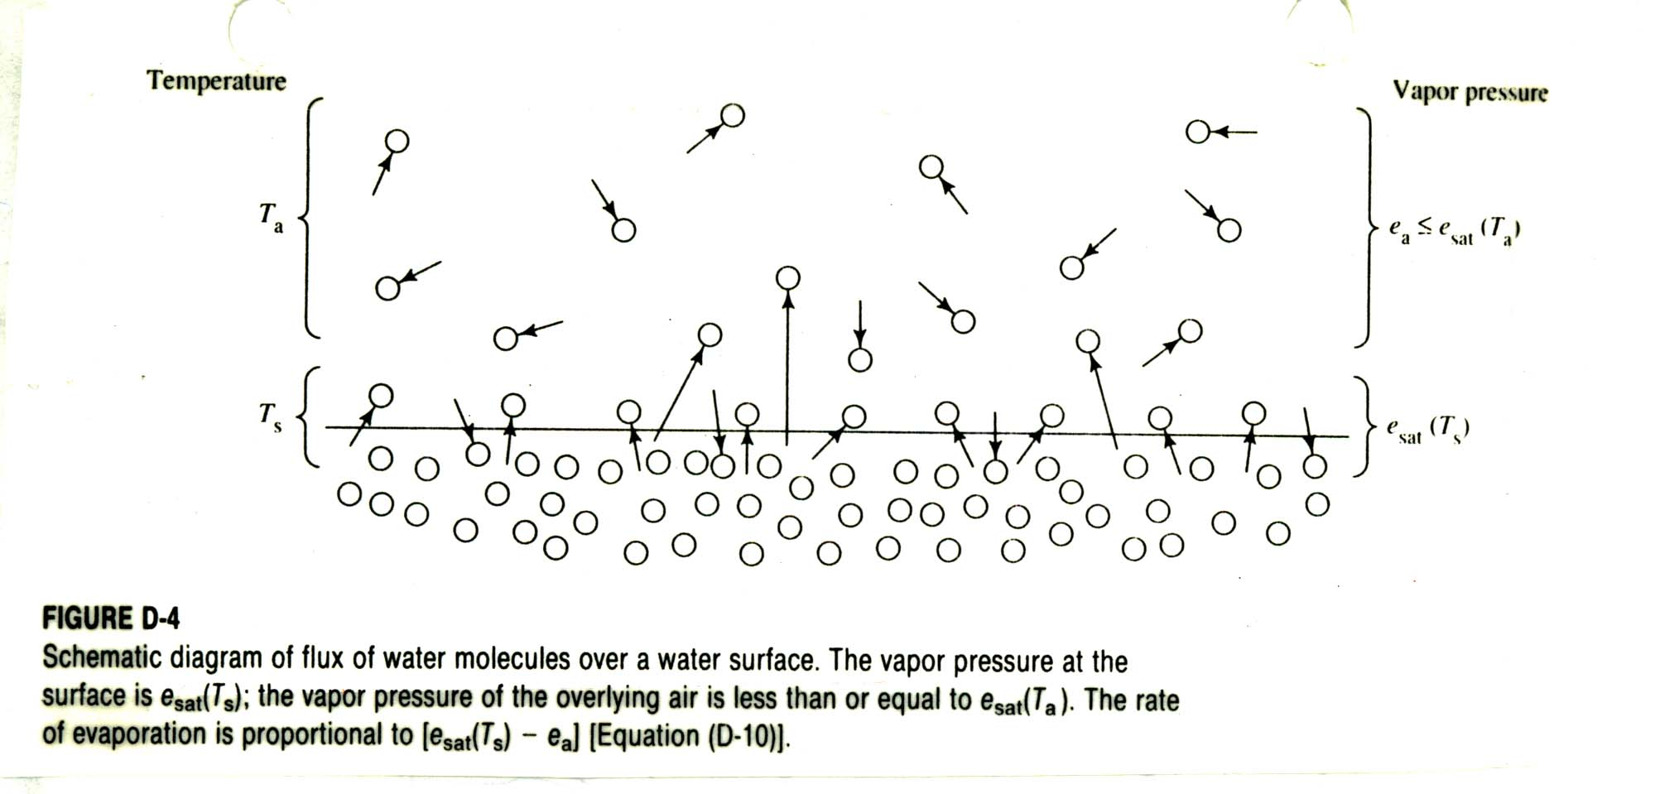
Vapor Transport
The vapor pressure at the surface is e_{s}(T_{s}); the vapor pressure of the overlying air is relative humidity times e_{s}(T_{a}). The rate of evaporation is proportional to e_{s} – e_{a}.
e_{s}(T_{a})
T_{d}
e_{a}
T_{a}

Slide 56
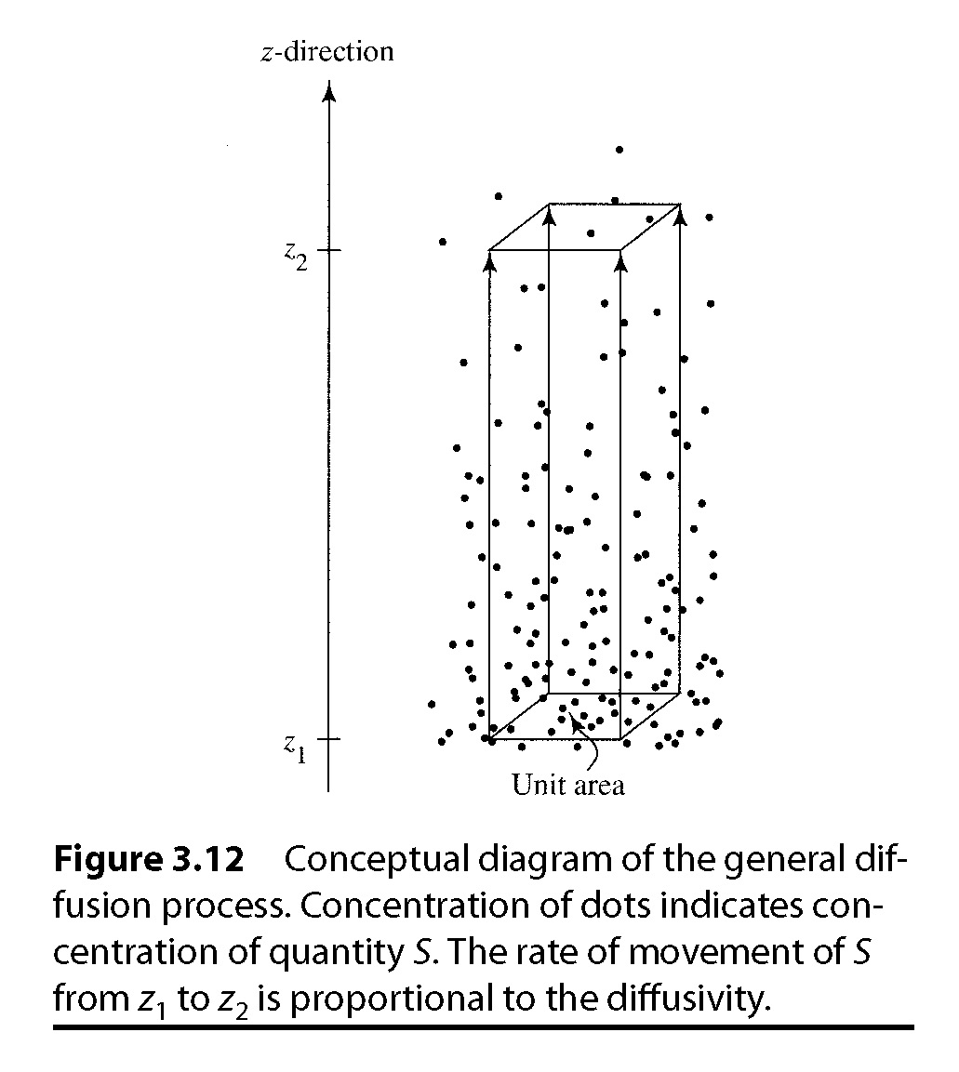
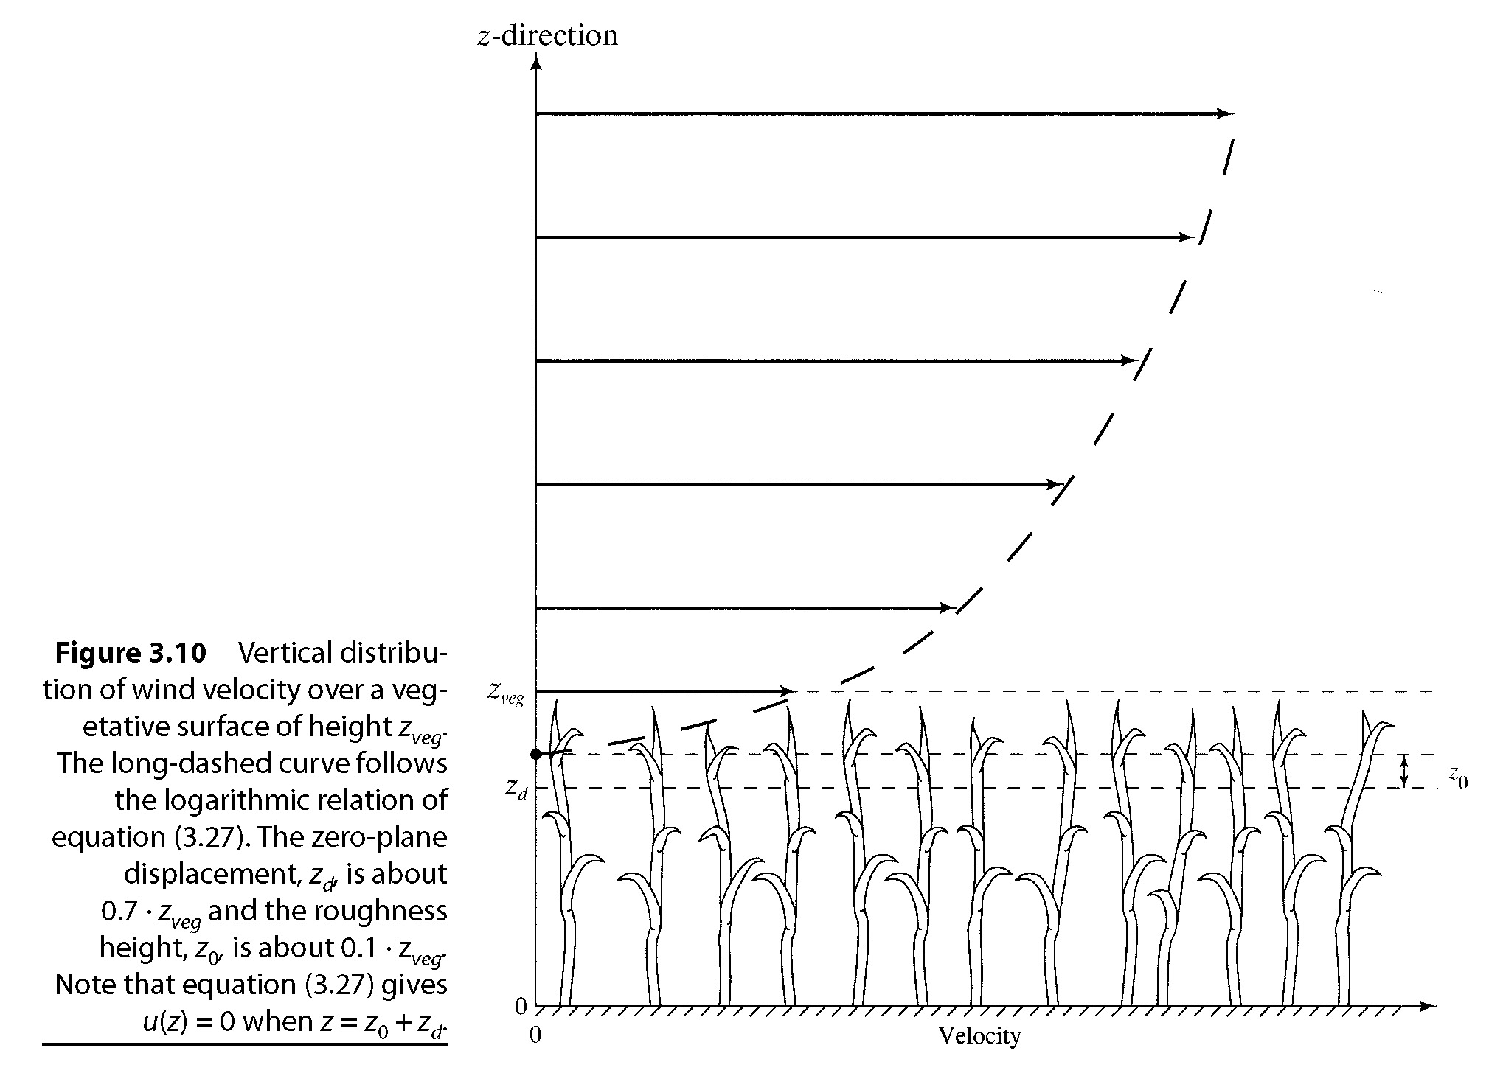
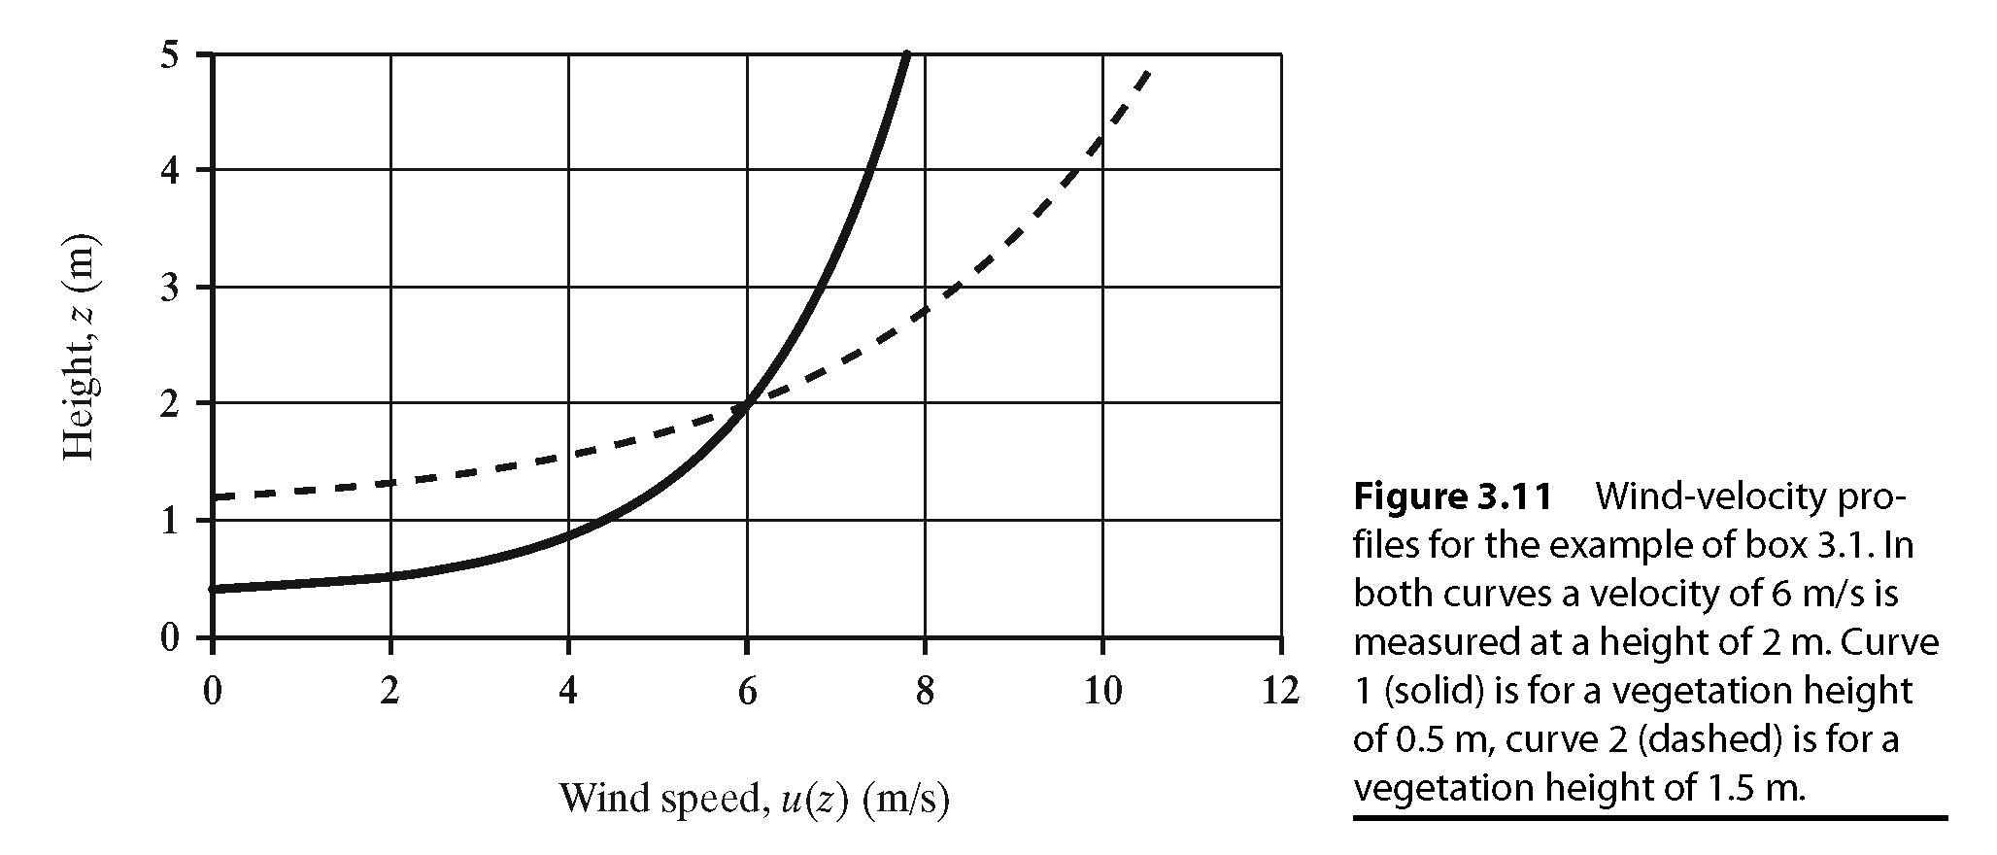
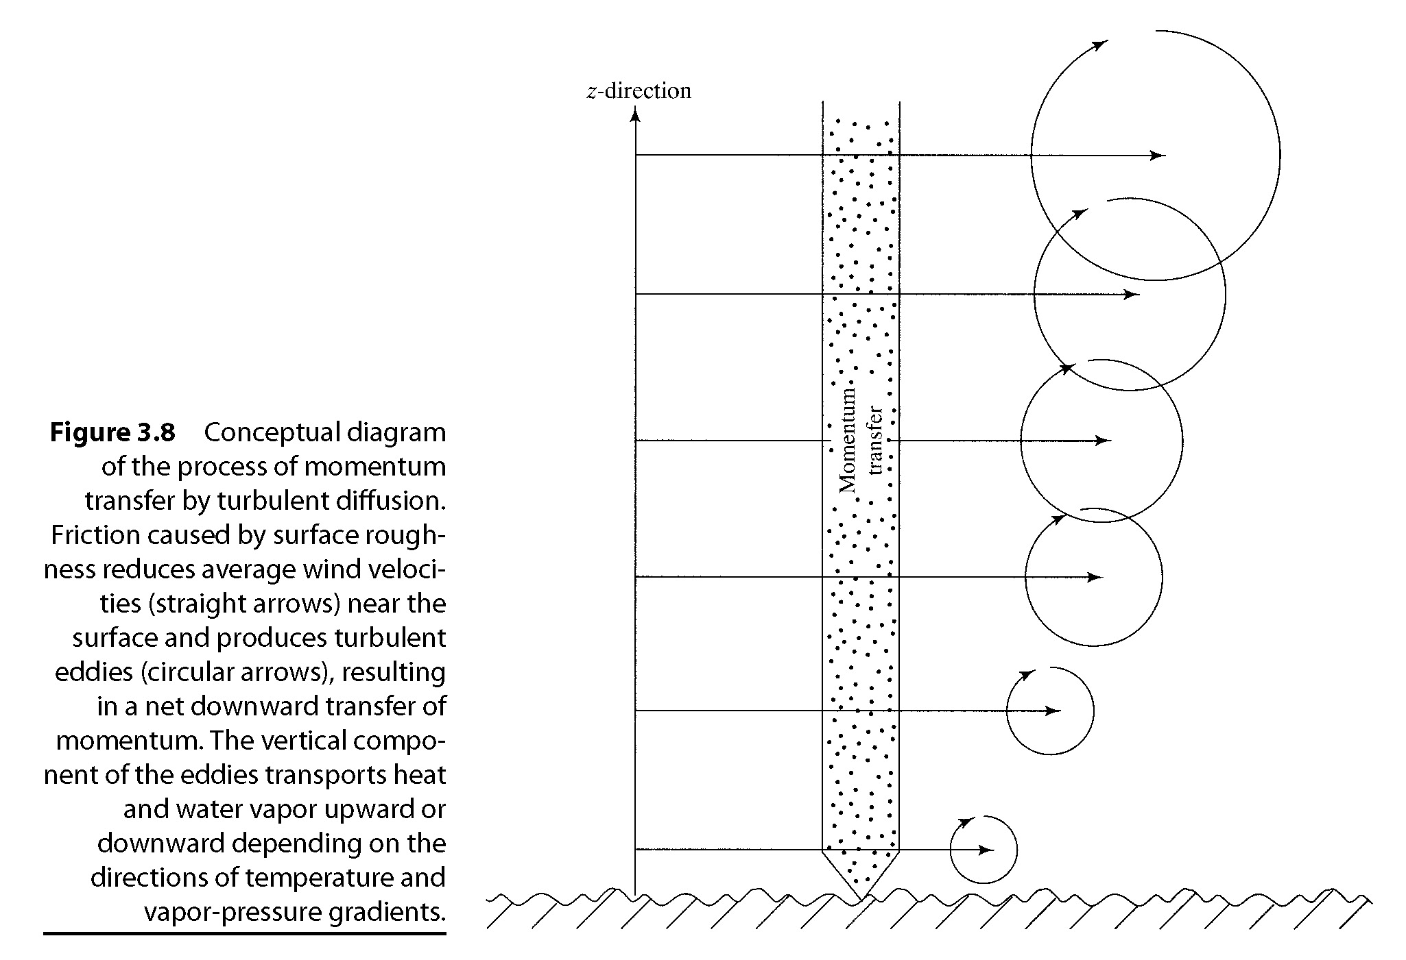

Slide 57
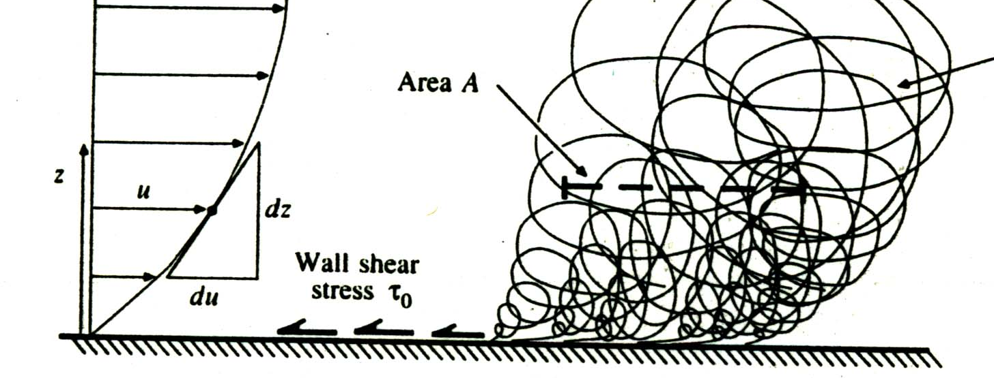









Turbulent transfer near the ground
$$v_{a}=\frac{1}{k}u_{∗}\ln\left(\frac{z−z_{d}}{z_{o}}\right)$$
$k$=0.4 von Karman
$$v_{a}$$
$${z_{d}≈0.7 z}_{veg}$$
$${z_{o}≈0.1 z}_{veg}$$
$$z_{d}$$
$$z_{o}$$
$$z_{veg}$$
From Chow et al., 1988

Slide 58


Evaporation & Heat-Exchange Processes 2. Evaporation as a Diffusive Process
Recall Fick’s Law: $F_{s}=−D_{s}(z)\frac{dχ_{s}(z)}{dz}$
The diffusivity term (D_{S}) characterizes vertical transport by turbulent eddies that result from: (1) friction acting on horizontal winds, and (2) buoyancy due to heating of the surface
If buoyancy effects are minimal (i.e., neutral stability), we can use the Prandtl-von Karman velocity distribution to characterize u(z):
$$u\left(z\right)=\frac{1}{κ}u_{∗}∙ln\left(\frac{z−z_{d}}{z_{0}}\right)$$
= 0.4
z_{d} is zero-plane displacement height
z₀ is roughness height
Notes:
The diffusivity term (D_{S}) characterizes vertical transport by turbulent eddies that result from: (1) friction acting on horizontal winds, and (2) buoyancy due to heating of the surface
If buoyancy effects are minimal (i.e., neutral stability), we can use the Prandtl-von Karman velocity distribution to characterize u(z):
FILL IN EQ 6.6 from DINGMAN

Slide 59

Evaporation & Heat-Exchange Processes 2. Evaporation as a Diffusive Process
Recall that we can estimate evaporation rate with a mass-transfer equation:
$$E=−\frac{0.622ρ_{a}}{p{∙ρ}_{w}}\frac{κ^{2}\left[u\left(z_{2}\right)−u\left(z_{1}\right)\right]∙[e\left(z_{2}\right)−e\left(z_{1}\right)]}{{\left[ln\left(\frac{z_{2}−z_{d}}{z_{1}−z_{d}}\right)\right]}^{2}}$$
Now, if we set u at surface to 0, and e_{s} as the vapor pressure of the evaporating surface, we get $E=−\frac{0.622ρ_{a}}{p{∙ρ}_{w}}\frac{κ^{2}\left[u\left(z_{m}\right)\right]∙[e\left(z_{m}\right)−e_{s}]}{{\left[ln\left(\frac{z_{m}−z_{d}}{z_{0}}\right)\right]}^{2}}$

Slide 60


Evaporation & Heat-Exchange Processes 2. Evaporation as a Diffusive Process
And, with the several constants involved, we can simplify to this as a function of z_{m} and saturated vapor pressure at the surface (e_{s}*):
$$E=1.20x{10}^{−6}\frac{u(z_{m})∙[e_{s}^{∗}−e\left(z_{m}\right)]}{{\left[ln\left(\frac{z_{m}−z_{d}}{z_{0}}\right)\right]}^{2}}$$
We can also define a water-vapor transfer coefficient, K_{E} to then show that:
Thus, E ∝ e, u
$$E=K_{E}∙u\left(z_{m}\right)∙[e_{s}−e\left(z_{m}\right)]$$
Notes:
And, with the several constants involved, we can simplify to this as a function of zm and saturated vapor pressure at the surface (e_{s}*):
$$E=1.20x{10}^{−6}\frac{u(z_{m})∙[e_{s}^{∗}−e\left(z_{m}\right)]}{{\left[ln\left(\frac{z_{m}−z_{d}}{z_{0}}\right)\right]}^{2}}$$
We can also define a water-vapor transfer coefficient, K_{E} to then show that:
FILL IN EQ 6.12 from DINGMAN
Thus, E ∝ e, u

Slide 61


Evaporation & Heat-Exchange Processes 3. Latent Heat Exchange
Recall: $λE=ρ_{w}∙λ_{v}∙E$
vapor
Latent Heat of Vaporization
liquid
Latent Heat of Fusion (melting)
solid

Slide 62

Evaporation & Heat-Exchange Processes 4. Sensible Heat Exchange
Also based on Fick’s law:
$$H=−ρ_{a}∙c_{p}\frac{κ^{2}\left[u\left(z_{2}\right)−u\left(z_{1}\right)\right]∙[T\left(z_{1}\right)−T\left(z_{2}\right)]}{{\left[ln\left(\frac{z_{2}−z_{d}}{z_{1}−z_{d}}\right)\right]}^{2}}$$
We can further simplify, but ultimately, the sensible heat flux is proportional to the product of the near surface T and u:
H = K_{H} ∙ u(z_{m}) ∙ [T_{s} - T(z_{m})]
Notes:
Also based on Ficks law:
$$H=−ρ_{a}∙c_{p}\frac{κ^{2}\left[u\left(z_{2}\right)−u\left(z_{1}\right)\right]∙[T\left(z_{1}\right)−T\left(z_{2}\right)]}{{\left[ln\left(\frac{z_{2}−z_{d}}{z_{1}−z_{d}}\right)\right]}^{2}}$$
We can further simplify, but ultimately, the sensible heat flux is proportional to the product of the near surface T and u:
FILL IN EQ 6.18 from DINGMAN

Slide 63
Mass Transfer / Aerodynamic Method

Slide 64

Bowen Ratio
γ- psychrometric constant
Using standard values for P and λ_{v} the value is 0.066 [kPa/K]

Slide 65
Bowen Ratio Energy Balance Method
A = R_{n} – G = LE + H = LE(1+β)

Slide 66


Slide 67
Free-Water & Lake Evaporation
Theoretical concept of free-water evaporation, aka Potential Evaporation (E₀) - rate of evaporation that would occur from an extended open-water surface under current meteorologic conditions without heat-storage or water-advected energy effects
Lake evaporation – is E₀ adjusted for advection and heat-storage effects in a given water body
Notes:
Theoretical concept of free-water evaporation, aka Potential Evaporation (E₀) - rate of evaporation that would occur from an extended open-water surface under current meteorologic conditions without heat-storage or water-advected energy effects
Lake evaporation – is E₀ adjusted for advection and heat-storage effects in a given water body…

Slide 68

Free-Water & Lake Evaporation Eddy Correlation
Theoretically, based on trying to quantify turbulent fluxes of moisture in the air:
Practically, it’s mathematically complex and tends to yield evaporation estimates that are ~80% of rates calculated by energy balance approaches
$$E_{0}=\frac{ρ_{a}}{ρ_{w}}⋅\overline{v′⋅q′}$$
Notes:
Theoretically, based on trying to quantify turbulent fluxes of moisture in the air:
FILL IN EQ. 6.24
Practically, it’s mathematically complex and tends to yield evaporation estimates that are ~80% of rates calculated by energy balance approaches

Slide 69





Eddy Correlation Approach
$$E \sim \overline{w′q′}$$
$w^{′}$ is vertical wind velocity component fluctuation
$q^{′}$ is specific humidity fluctuation

Slide 70

Free-Water & Lake Evaporation Mass Transfer
Theoretically, based on fundamental mass transfer (from a few slides ago): $E= K_{E}∙u\left(z_{m}\right)∙[e_{s}−e\left(z_{m}\right)]$
Where, b₀ accounts for free-convection and b₁ depends on the height and location at which u and e are measured…
If buoyancy effects are negligible, b₀ = 0 and b₁ = K_{E}
E₀ = [b₀ + b₁ ∙ u(z_{m})] ∙ [e_{s} – e(z_{m})]
Notes:
Theoretically, based on fundamental mass transfer (from a few slides ago): $$E= K_{E}∙u\left(z_{m}\right)∙[e_{s}−e\left(z_{m}\right)]$$
FILL IN EQ 6.25
Where, b₀ accounts for free-convection and b₁ depends on the height and location at which u and e are measured…
If buoyancy effects are negligible, b₀=0 and b₁ = K_{E}

Slide 71

Free-Water & Lake Evaporation Mass Transfer
We can further simplify by setting z₀ for water surfaces to 5x10⁻⁴m, and z_{d} = 0m, and z_{m} = 2m
$$E_{0}=1.78×{10}^{−8}∙u\left(2m\right)∙[e_{s}−e\left(2m\right)]$$
However, free convection plays a role… Example: if T_{water} > T_{air} then, water warms air, which rises, causing turbulent transport of water vapor + heat away from the surface
Notes:
We can further simplify by setting z₀ for water surfaces to 5x10⁻⁴m, and z_{d} = 0m, and z_{m} = 2m
$$E_{0}=1.78×{10}^{−8}∙u\left(2m\right)∙[e_{s}−e\left(2m\right)]$$
However, free convection plays a role… Example: water temp > air temp leads to warm air and then warm air rises, causing turbulent transport of water vapor and heat away from the surface

Slide 72
Free-Water & Lake Evaporation Mass Transfer
Practically, the method is very sensitive to how you handle b₀ and b₁ (K_{E}) and how you handle the lake heat content
The method is derived for instantaneous rate of E under given instantaneous values, but is often applied over some time period (i.e., not instantaneous)
Notes:
Practically, the method is very sensitive to how you handle b₀ and b₁ (K_{E}), and how you handle the lake heat content
The method is derived for instantaneous rate of E under given instantaneous values, but is often applied over some time period (i.e., not instantaneous)

Slide 73





Free-Water & Lake Evaporation Energy Balance
Solving $λE=K+L−G−H+A_{w}−\frac{ΔU}{Δt}$ for a rate, E yeilds:
By definition then, E₀ is calculated as
And sensible heat loss is replaced by:
$$E=\frac{K+L−G−H+A_{w}−{ΔU}/{Δt}}{λ_{v}⋅ ρ_{w}}$$
$$E_{0}=\frac{K+L−H}{λ_{v}⋅ ρ_{w}}$$
H = BλE
$$E=\frac{K+L−G+A_{w}−{ΔU}/{Δt}}{λ_{v}⋅ ρ_{w} (1+B)}$$
$$E_{0}=\frac{K+L}{λ_{v}⋅ ρ_{w}(1+B)}$$
Notes:
We can further simplify by setting z₀ for water surfaces to 5x10⁻⁴m, and z_{d} = 0m, and z_{m} = 2m
$$E_{0}=1.78×{10}^{−8}∙u\left(2m\right)∙[e_{s}−e\left(2m\right)]$$
However, free convection plays a role… Example: water temp > air temp leads to warm air and then warm air rises, causing turbulent transport of water vapor and heat away from the surface

Slide 74


Free-Water & Lake Evaporation Penman model
What if we could combine the mass transfer and energy balance approaches?
$$E_{0}=\frac{\left(Δ\left(T\right)+net radiation\right)+(γ+mass transer)}{∆T+ γ}$$
N.B. – no reliance on water surface temp!
$$E_{0}=\frac{Δ(T)∙\left(K+L\right)+γ∙K_{E}∙ρ_{w}∙λ_{v}∙{u(z}_{m})∙e^{∗}(z_{m})∙[1−RH(z_{m})]}{ρ_{w}∙λ_{v}∙(∆(T)+γ)}$$

Slide 75
Combination Method Concepts
R_{n} – G = LE + H
e_{s}(T_{a})
e_{s}(T_{s})
T_{s}
T_{a}

Slide 76
Combination or Penman Method

Slide 77
Priestley Taylor Method
This is also sometimes taken as an estimate of equilibrium potential evapotranspiration for well watered surface

Slide 78
From Brutsaert, 2005

Slide 79
From Brutsaert, 2005

Slide 80
Method Information Requirements
Mass Transfer
Bowen Ratio / Energy Balance
R_{N}
Combination

Slide 81
Summary of ET Equations
Bowen Ratio
Mass Transfer
Combination
Priestly Taylor
What happens in these equations if the wind speed doubles?

Slide 82
Evapotranspiration Feedbacks
+
R_{n}
+
-
-
-
+
G
Conditions adjust to varying inputs. Calculations can interpret adjustments, but should not be used to predict the effect of changing one variable without considering the adjustments of connected variables

Slide 83

Free-Water & Lake Evaporation Penman model
How well does it work?
Compared to pan evaporation measurements, it works pretty well.
Notes:
Rearrange the mass-transfer equation for sensible heat into:
Rearrange the SEB into: H = Rn + LE - G and substitute into above eqn

Slide 84


Slide 85
Soil Water Evaporation
Stage 1. For soils saturated to the surface, the evaporation rate is similar to surface water evaporation.
Stage 2. As the surface dries out, evaporation slows to a rate dependent on the capillary conductivity of the soil.
Stage 3. Once pore spaces dry, water loss occurs in the form of vapor diffusion. Vapor diffusion requires more energy input than capillary conduction and is much, much, slower.
Note that for soils under a forest canopy, R_{net}, vapor pressure deficit, and turbulent transport (wind) are lower than for exposed soils.

Slide 86


Slide 87

Soil water loss with different cover
_{Forest Soil}

Slide 88

Rooting Depth Effects
_{Surface}
_{2 months later}

Slide 89

Bare Soil Evaporation
Water near the surface is evaporated from the pores between soil grains

Slide 90

Bare Soil Evaporation occurs in stages…
Stage 1 – evaporation from wet soil;
controlled by surface energy balance and mass transfer conditions at the surface
rate is ~ that of free-water evaporation
water lost from soils is replaced by other subsurface water
Notes:
Stage 1 – evaporation from wet soil;
controlled by surface energy balance and mass transfer conditions;
rate is ~ that of free-water evaporation
water lost from soils is replaced by other subsurface water

Slide 91

Bare Soil Evaporation occurs in stages…
Stage 2 – “soil controlled”, rate is lower than stage 1 (0.7 – 3.5 mm/d)
controlled by water movement in soil pores (vapor diffusion and film flow)
Notes:
Stage 2 – “soil controlled”, rate is lower than stage 1 (0.7 - 3.5 mm/d)
controlled by water movement in soil pores (vapor diffusion and film-flow)

Slide 92
Evaporation
Transfer of H₂O from liquid to vapor phase
Diffusive process driven by
Saturation (vapor density) gradient ~ (ρ_{s} – ρ_{a})
Aerial resistance ~ f(wind speed, temperature)
Energy to provide latent heat of vaporization (radiation)
Transpiration is plant mediated evaporation
Same result (water movement to atmosphere)
Summative process = evapotranspiration (ET)
Dominates the fate of rainfall
~ 95% in arid areas
~ 70% for all of North America

Slide 93

Evapo-Transpiration
ET is the sum of
Evaporation: physical process
from free water
Soil
Plant intercepted water
Lakes, wetlands, streams, oceans
Transpiration: biophysical process modulated by plants (and animals)
Controlled flow through leaf stomata
Species, temperature and moisture dependent

Slide 94




Four Requirements for ET
_{Energy}
_{Water}
_{NP}
_{Vapor Pressure Gradient}
_{Wind}
_{TP}

Slide 95

Evapotranspiration has Multiple Components

Slide 96

Transpiration (Dingman P 294)
Absorption of soil water by roots
Translocation through plant vascular system
Stomata open to take in CO₂ for photosynthesis and water is lost by transpiration
Plants control stomata openings to regulate photosynthesis and transpiration
from http://www.trunity.net/envsciClone/articles/view/177351/?topic=81575

Slide 97


Transpiration
Plant mediated diffusion of soil water to atmosphere
Soil-Plant-Atmosphere Continuum (SPAC)
Transpiration and productivity are tightly coupled
Transpiration is the primary leaf cooling mechanism under high radiation
Provides a pathway for nutrient uptake and matrix for chemical reactions
Worldwide, water limitations are more important than any other limitation to plant productivity
CO₂
H₂O
1 : 300

Slide 98


Slide 99
Total System ET – Ordered Process
Intercepted Water → Transpiration → Surface Water → Soil Water
Why?
Implications for:
Cloud forests
Understory vegetation in wetlands
Deep rooted arid ecosystems

Slide 100

Interception
Surface tension holds water falling on forest vegetation.
Leaf Storage
Fir 0.25”
Pines 0.10”
Hardwoods 0.05”
Litter 0.20”
SP Plantations 0.40”.
Interception Loss (% of rainfall)
Hardwoods 10-20% (less LAI)
Conifers 20-40%
Mixed slash and Cypress Florida Flatwoods 20%

Slide 101

Transpiration Dominates the Evaporation Process
_{Trees have:}
Large surface area
More turbulent air flow
Conduits to deeper moisture sources
T/ET
Hardwood ~80%
White Pine~60%
Flatwoods ~75%

Slide 102

Cover | Evaporation | Interception | Transpiration
Forest | 10% | 30% | 60%
Meadow | 25% | 25% | 50%
Ag | 45% | 15% | 40%
Bare | 100%

Slide 103

The driving force of transpiration is the difference in water vapor concentration, or vapor pressure difference, between the internal spaces in the leaf and the atmosphere around the leaf

Slide 104
Transpiration
The physics of evaporation from stomata are the same as for open water. The only difference is the conductance term.
Conductance is a two step process
stomata to leaf surface
leaf surface to atmosphere

Slide 105

Transpiration

Slide 106

Stomata respond to
Light
Humidity
Water content (related to soil moisture)
Temperature
Other factors such as wind, CO₂, chemicals
from http://www.ck12.org/

Slide 107


Slide 108

How Does Water Get to the Leaf?
Water is PULLED, not pumped. Water within the whole plant forms a continuous network of liquid columns from the film of water around soil particles to absorbing surfaces of roots to the evaporating surfaces of leaves.
It is hydraulically connected.

Slide 109

Even a perfect vacuum can only pump water to a maximum of a little over 30 feet. At this point the weight of the water inside a tube exerts a pressure equal to the weight of the atmosphere pushing down
So why doesn’t the continuous column of water in trees taller than 34 feet collapse under its own weight? And how does water move UP a tall tree against the forces of gravity?
> 100 meters

Slide 110



Water is held “up” by the surface tension of tiny menisci (“menisci” is the plural of meniscus) that form in the microfibrils of cell walls, and the adhesion of the water molecules to the cellulose in the microfibrils
cell wall microfibrils of carrot

Slide 111
The SPAC (soil-plant-atmosphere continuum)
Ψ_{w} (atmosphere)
≈ -95 MPa
Ψ_{w} (small
branch)
≈ -0.8 MPa
Ψ_{w} (stem)
≈ -0.6 MPa
Ψ_{w} (root)
≈ -0.5 MPa
Ψ_{w}(soil) ≈ -0.1 MPa

Slide 112

Cohesion-Tension Theory:
(Böhm, 1893; Dixon and Joly, 1894)
The cohesive forces between water molecules keep the water column intact unless a threshold of tension is exceeded (embolism). When a water molecule evaporates from the leaf, it creates tension that “pulls” on the entire column of water, down to the soil.
Notes:
To understand WHY the pipeline is vulnerable:
LOOK AT MECHANISM: COHESION – TENSION – THEORY
about 100 yrs ago – proposed independently by Boehm and by Dixon and Joly
Transpiration
Capillary forces – Tension – NEGATIVE PRESURE
Water is pulled up – cohesive forces between water molecules keep the water column together
Conduits are dead
Class: Tug-of-war – the air pulls on one end, the soil particles on the other end
Very simple mechanism and very cheap - driven by the sun
Once the pipeline is in place
plants don’t have to use energy for water transport
What makes the pipeline “vulnerable”?
It’s the MAGNITUDE of the NEGATIVE Xylem Pressure

Slide 113


?
ET = Rain * 0.80
ET = Rain * 0.95
1,000 mm * 0.80 = 800 mm
1,000 mm * 0.95 = 950 mm
Assume Q & ΔS = 0
G = P - ET
G = 50 mm
G = 200 mm
4x more groundwater recharge from open stands than from highly stocked plantations.
NRCS is currently paying for growing more open stands, mainly for wildlife.

Slide 114


Slide 115

Trading Environmental Priorities?
Water for Carbon
Water for Energy
Jackson et al. 2005 (Science)

Slide 116






Canopy and atmospheric conductance
Resistance Analogy
$$E= K_{at} { C}_{at} \left(e_{s}−e_{a}\right)$$
$$ET=K_{at} C_{effective} \left(e_{s}−e_{a}\right)$$
$$\frac{1}{C_{effective}}=\frac{1}{C_{at}}+\frac{1}{C_{can}}$$
$$C_{can}=f_{s}∙LAI∙C_{leaf}$$
from Shuttleworth 1993
from Dingman (2002)

Slide 117


Slide 118


Slide 119


Slide 120


Slide 121


Slide 122


Slide 123




Penman-Monteith Model
$$E=\frac{∆∙\left(K+L\right)+ρ_{a}∙c_{a}{∙C}_{at}∙e_{a}^{∗}\left(1−W_{a}\right)}{ρ_{w}∙λ_{v}∙\left(∆+γ\right)}$$
Open water
$$ET=\frac{∆∙\left(K+L\right)+ρ_{a}∙c_{a}{∙C}_{at}∙e_{a}^{∗}\left(1−W_{a}\right)}{ρ_{w}∙λ_{v}∙\left(∆+γ∙\left(1+\frac{C_{at}}{C_{can}}\right)\right)}$$
Vegetation
$$ET=\frac{∆A+ρ_{a}∙c_{a}∙D/r_{a}}{ρ_{w}∙λ_{v}∙\left(∆+γ∙\left(1+\frac{r_{s}}{r_{a}}\right)\right)}$$
Shuttleworth 4.2.27 resistance notation
D = vapor pressure deficit
$$r_{s}=1/C_{can} r_{a}=1/{C_{at}}$$

Slide 124



Soil moisture functions for actual ET
Common – consistent with “Crop factor” concept
$$ET=f\left(θ_{rel}\right)∙PET$$
Theoretically preferable based on resistance/conductance concept (Dingman 7-69)
$\frac{ET}{PET}=\frac{∆+γ∙\left(1+\frac{C_{at}}{C_{can}[f_{θ}\left(∆θ\right)=1]}\right)}{∆+γ∙\left(1+\frac{C_{at}}{C_{can}[f_{θ}\left(∆θ\right)]}\right)}$
from Shuttleworth 1993

Slide 125


Slide 126


Slide 127


Slide 128


Slide 129
Water Availability: PET vs. AET
PET (potential ET) is the expected ET if water is not limiting
Given conditions of: wind, Temperature, Humidity
AET (actual ET) is the amount that is actually abstracted (realizing that water may be limiting)
AET = α * PET
Where α is a function of soil moisture, species, climate
In Florida, ~ α is unity for the summer, 0.75 otherwise
ET:PET is low in arid areas due to water limitation
ET ~ PET in humid areas due to energy limitation

Slide 130
A Simple Catchment Water Balance
Consider the net effects of the various water balance components (esp. ET)
ET controlled by water availability and atmospheric demand
The “Budyko” Curve
Dry conditions: when PET:P → ∞, AET:P → 1 and Q:P → 0
Wet conditions: when PET:P → 0 AET → PET

Slide 131
Theory vs. Real Data – Budyko curves across the world’s catchments
AET:P
PET:P

Slide 132

Complimentary (Advection-Aridity) Approach (Dingman p314)
from Dingman (2002)

Slide 133


Slide 134


Slide 135


