Slide 1
Physical Hydrology & Hydroclimatology (Multiscale Hydrology)
A science dealing with the properties, distribution and circulation of water.
R. Balaji
balajir@colorado.edu
CVEN5333 http://civil.colorado.edu/~balajir/CVEN5333
Includes slides from Prof. Mike Gooseff

Slide 2
Snow & Snomelt
Formation
Characteristics
Measurement
Distribution
Snomelt
Energy and mass balance
Snomelt Modeling
Physical Hydrology, Dingman (Chapter 5, Appendix D)
Hydrology, Bras (Chapter 6)
Prof. Mark Serreze, CU Geography & Prof. Tarboton, USU
Comet – MedEd
http://www.comet.ucar.edu/class/hydromet/09_Oct13_1999/docs/cline/comet_snowhydro/index.htm
Utah Energy Balance Model
http://www.neng.usu.edu/cee/faculty/dtarb/snow/snow.html

Slide 4
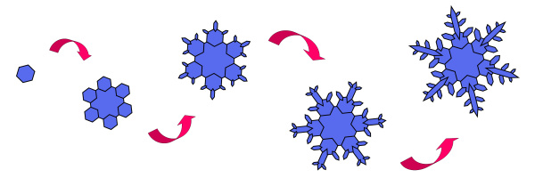
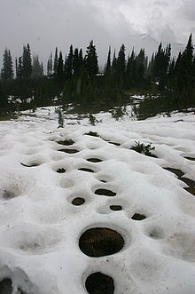
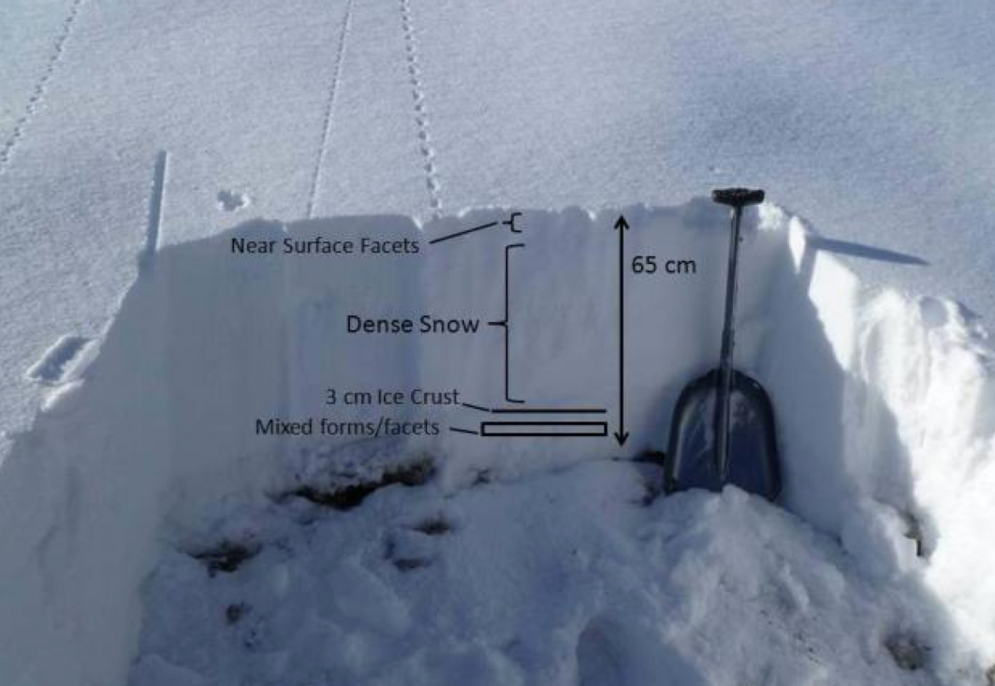
The “Snow Cycle”
Formation in the atmosphere
Snowfall
Snowpack development, metamorphosis
Snow ablation (melt, sublimation)
…the rest of the hydrologic cycle...

Slide 5
Hydrologic Significance of Snow
~ 67% of world’s fresh water found in snow and ice
Only 3% of permanent snow & ice is located outside the polar regions
~ 60 years of earth annual ppt is locked up in snow and ice
~ 50% of ice & snow outside the poles is in the Himalayas; also critical to Europe, Asia, S. Am., Western US
90% of runoff in N. AZ, NM due to rain-on-snow events
~80-85% of Colorado River Basin Runoff from snowmelt

Slide 6
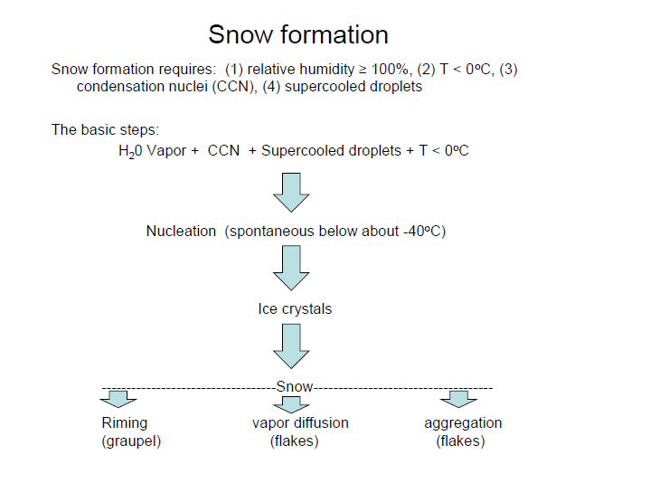

Slide 7
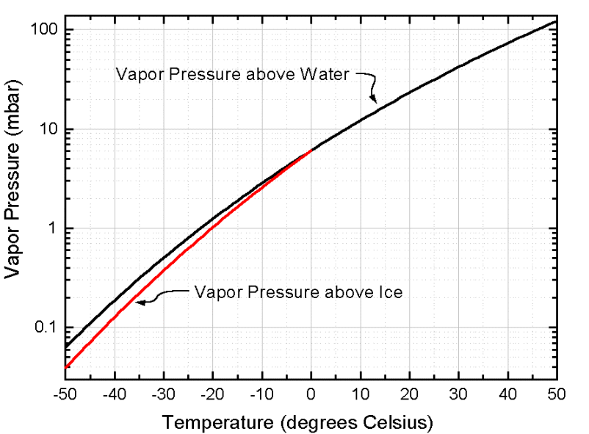
Atmospheric Snow Crystal Formation
Ice Nucleation - the condensation of water vapor from supersaturated air onto aerosol particles (0.01 - 1 μm in size) must first occur
Water molecules are able to “escape” from a liquid surface more easily than from an ice surface.
So, for a given freezing temperature, e over water is greater than the e over ice.
SnowCrystals.com
Notes:
Ice Nucleation - the condensation of water vapor from supersaturated air onto aerosol particles (0.01 - 1 μm in size) must first occur
Water molecules are able to “escape” from a liquid surface more easily than from an ice surface.
So, for a given freezing temperature, e over water is greater than the e over ice.

Slide 8
Ice Nucleation 2 types
Homogeneous – spontaneous process that requires no nuclei; it’s the formation of ice crystals from supercooled water droplets that occurs around -40ºC
Heterogeneous –
Deposition Nucleus (Vapor Deposition)
Contact Nucleation (Riming)
Aggregation
Notes:
Homogeneous – spontaneous process that requires no nuclei; it’s the formation of ice crystals from supercooled water droplets that occurs around -40ºC
Heterogeneous –
Deposition Nucleus (Vapor Deposition)
Contact Nucleation (Riming)
Aggregation

Slide 9
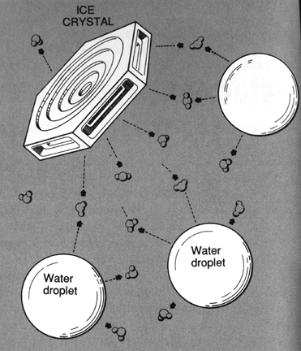
Heterogeneous Ice Nucleation Vapor Deposition
Diffusion of water vapor onto an ice crystal surface
Undersaturated wrt water, oversaturated wrt ice
Ice crystals grow at the expense of water droplets (which haven’t yet frozen)
The Avalanche Handbook, 1993
Notes:
Diffusion of water vapor onto an ice crystal surface
Undersaturated wrt water, oversaturated wrt ice
Ice crystals grow at the expense of water droplets (which haven’t yet frozen)

Slide 10
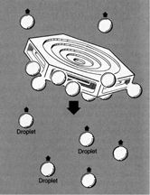
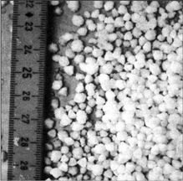
Heterogeneous Ice Nucleation Riming
Supercooled water droplets (liquid) attach to snow grain by contact
Typical formation process of snowflakes
Can result in graupel, hail or sleet
Droplet
Droplet
Droplet
The Avalanche Handbook, 1993
Notes:
Supercooled water droplets (liquid) attach to snow grain by contact
Typical formation process of snowflakes
Can result in graupel, hail or sleet

Slide 11
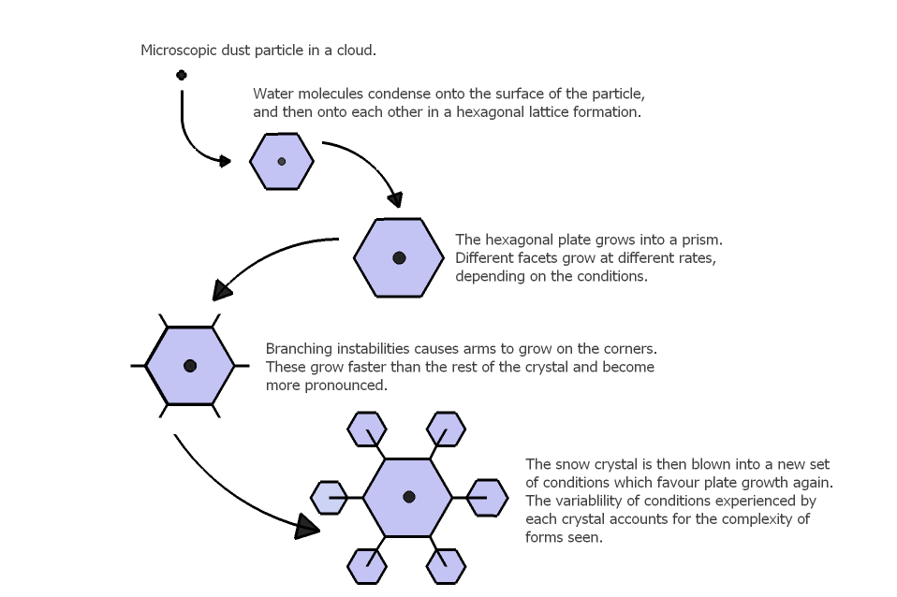
Typical Explanation of Crystal Formation
Notes:
http://www.thenakedscientists.com/HTML/articles/article/science-of-snowflakes/

Slide 12
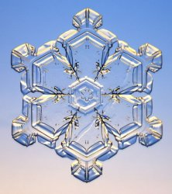
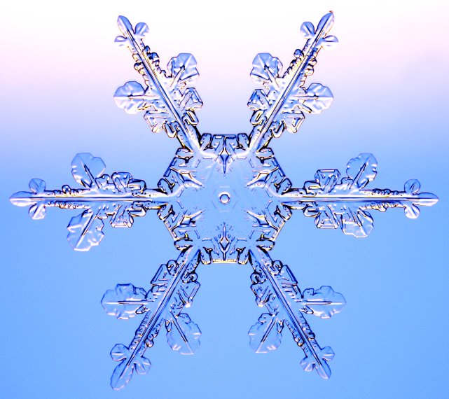
Crystal Growth
The growth of snow crystals depends on a balance between faceting and branching.
Faceting tends to make simple flat surfaces
Branching tends to make more complex structures.
SnowCrystals.com
Notes:
The growth of snow crystals depends on a balance between faceting and branching.
Faceting tends to make simple flat surfaces
Branching tends to make more complex structures.

Slide 13
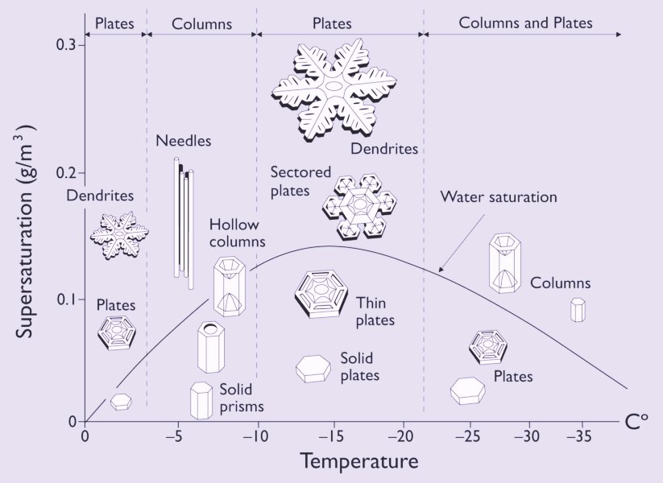
Crystal Growth function of T & e
SnowCrystals.com

Slide 14
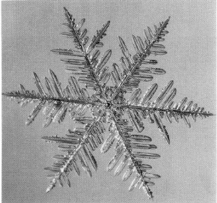
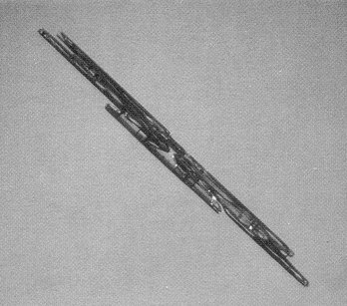
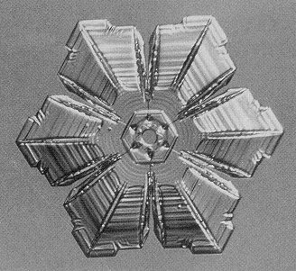
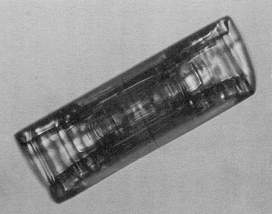
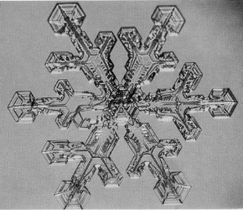
Snow Crystal Formation
A-Axis
Growth
C-Axis
Growth
Dendrite
Needle
Sectored Plate
Prism
(Column)
Dendritic
Sectored Plate

Slide 15
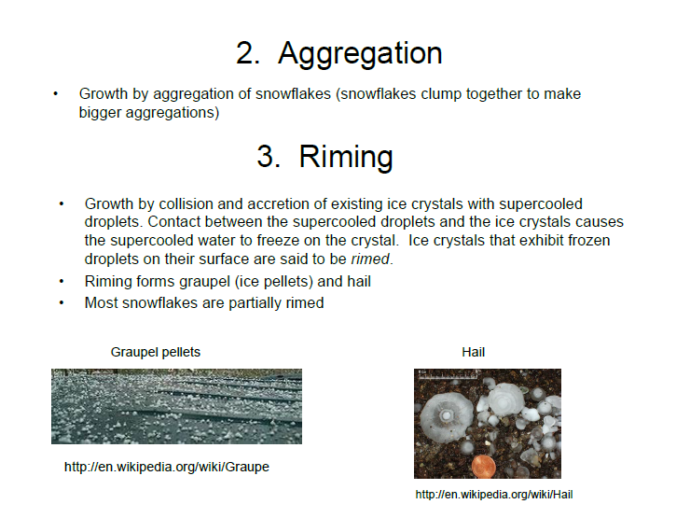

Slide 16
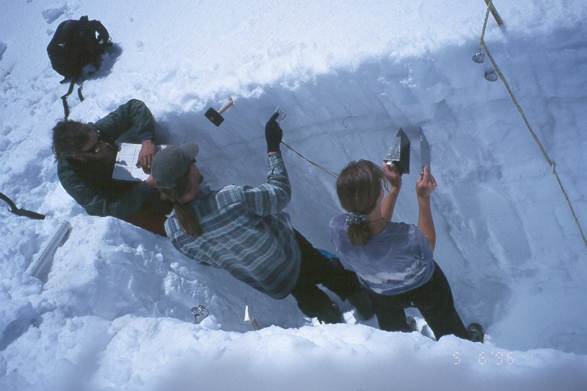
Snow Pack Characteristics

Slide 17
Snow Pack Characteristics
What is a Snow Pack?
Porous Medium
ice + air (+ liquid water)
Generally composed of layers of different types of snow
more or less homogeneous within one layer
Ice is in form of crystals and grains that are usually bonded together
forms a texture with some degree of strength

Slide 18
Snow Pack Characteristics
Primary physical characteristics of deposited snow
Hardness
Strength
Water Equivalent
Depth
Grain Shape
Temperature
Density
Grain Size
Impurities
Liquid Water Content
Albedo

Slide 19
Snow Pack Characteristics
Snow Water Equivalent (SWE)
The height of water if a snow cover is completely melted, on a corresponding horizontal surface area.
Snow Depth x (Snow Density/Water Density)

Slide 20
Density of Snow Cover
Snow Depth for
One Inch Water
Snow Type
Density (kg/m³)
Wild Snow
10 to 30
98” to 33”
Ordinary new snow immediately
after falling in still air
50 to 65
20” to 15”
Settling Snow
70 to 90
14” to 11”
Average wind-toughened snow
280
3.5”
Hard wind slab
350
2.8”
New firn snow
400 to 550
2.5” to 1.8”
Advanced firn snow
550 to 650
1.8” to 1.5”
Thawing firn snow
600 to 700
1.6” to 1.4”

Slide 21
Snow Pack Characteristics
Grain Shape
The “Smoking Gun”
One of the most tell-tale characteristics that allows inference of snow pack evolution
Morphological classification of snow grains
several have been developed

Slide 22
Snow Pack Characteristics
General Attributes of Grain Shape
Appearance:
solid, hollow, broken, abraded, partly melted, rounded, angular
Surface:
rounded facets, stepped or striated, rimed
Interconnections:
bonded, unbonded, bond size, clustered, number of bonds per grain, oriented texture, arranged in columns

Slide 23
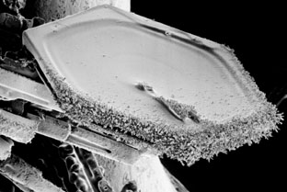
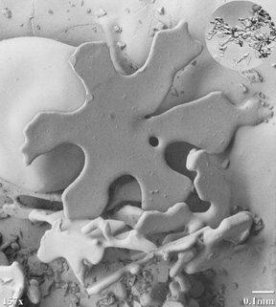
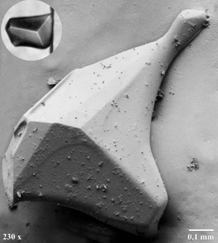
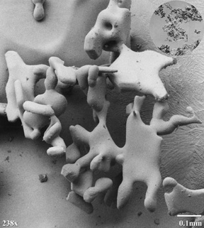
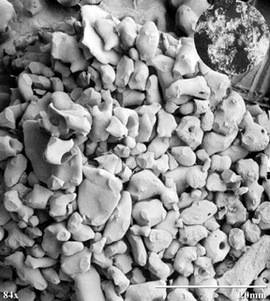
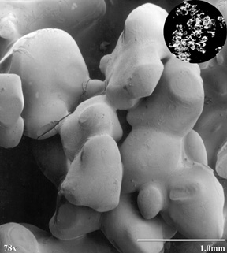
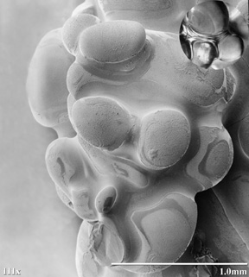
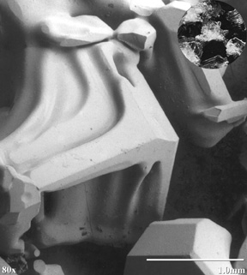
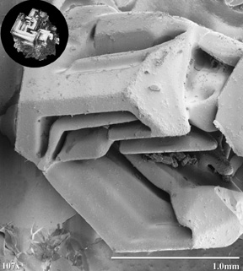
Snow Grain Shapes
Rime on Plate Crystal
Early Rounding
Faceted Growth
Early Sintering (Bonding)
Wind-Blown Grains
Melt-Freeze with
No Liquid Water
Melt-Freeze with
Liquid Water
Faceted Layer Growth
Hollow, Faceted Grain
(Depth Hoar)

Slide 24
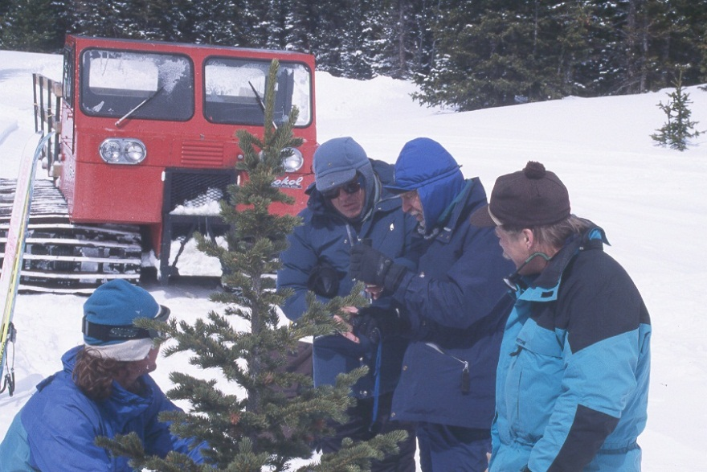
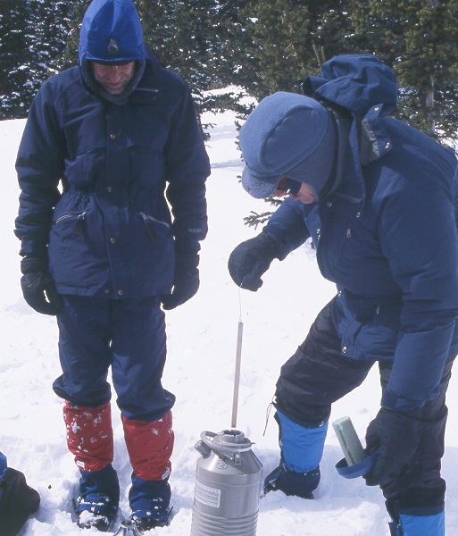
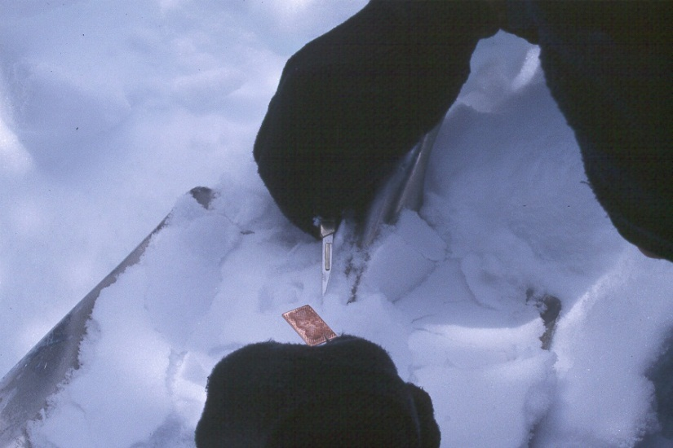
Electron Microscopy of Snow Crystals

Slide 25
Snow Pack Characteristics
Grain Size
The average size of the characteristic grains within a mass of snow
its greatest extension in mm
Term
Size (mm)
Very Fine
< 0.2
Fine
0.2 - 0.5
Medium
0.5 - 1.0
Coarse
1.0 - 2.0
Very Coarse
2.0 - 5.0
Extreme
> 5.0

Slide 26
Snow Pack Characteristics
Liquid Water Content
Wetness, Percentage by volume
Term
Remarks
Approximate Range
Dry
Usually T < 0ºC, but can occur at any temperature up to 0ºC. Little tendency for snow grains to stick together.
0%
T = 0ºC. The water is not visible even at 10x magnification. Has a distinct tendency to stick together.
Moist
<3%
T = 0ºC. The water can be seen at 10x magnification by its miniscus between grains, but cannot be pressed out by squeezing snow (pendular regime).
Wet
3-8%
Very Wet
T = 0ºC. The water can be pressed out by squeezing snow, but there is an appreciable amount of air (funicular regime).
8-15%
Slush
T = 0ºC. The snow is flooded with water and contains a relatively small amount of air.
>15%

Slide 27
Snow Characteristics
Temperature
Two basic situations:
Variation in temperature between the top of the snow pack and the ground
Temperature Gradient
Largely determined by thickness of snow pack and the mean snow surface temperature
Base of snow pack is usually near 0ºC
No temperature gradient
Isothermal

Slide 28
Snow Characteristics
Diurnal Temperature Gradients

Slide 29
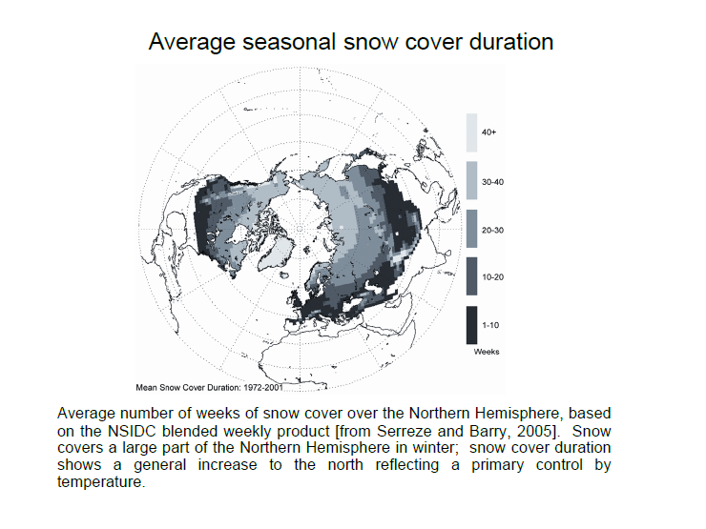

Slide 30
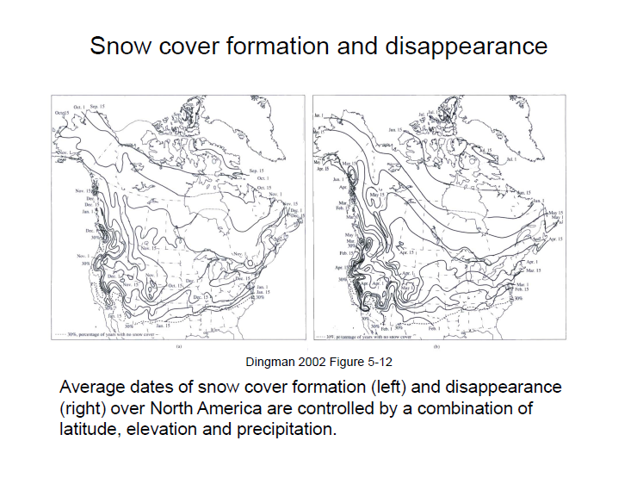

Slide 31
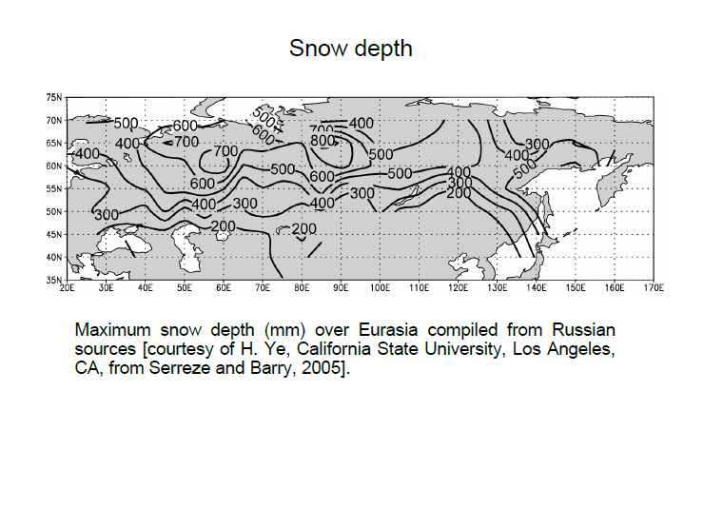

Slide 32
Definitions and Terms
Snow: porous form of solid water of relatively low density. It is an aggregate of delicately skeletal ice crystals formed in the atmosphere through sublimation
There are many forms of ice crystals; more than 6,000 have been mapped and several classification schemes developed

Slide 33
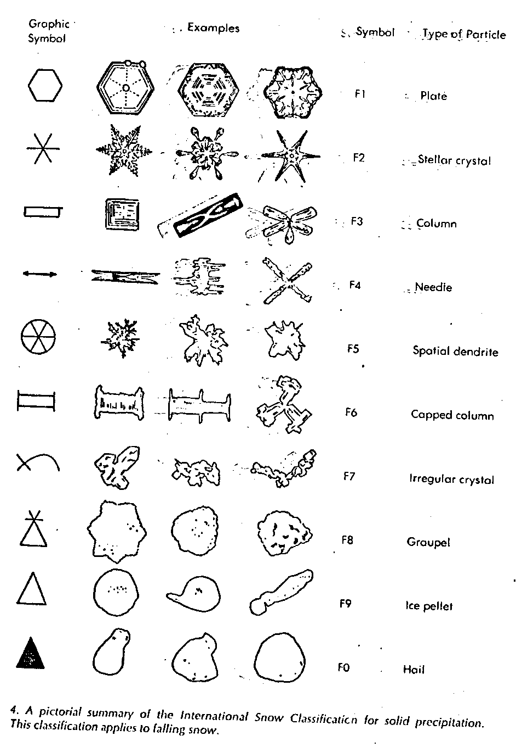
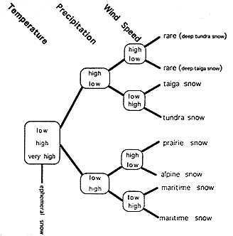
Snow Classification
Courtesy CRREL - http://www.crrel.usace.army.mil/alaska-office/snoclass.html

Slide 34
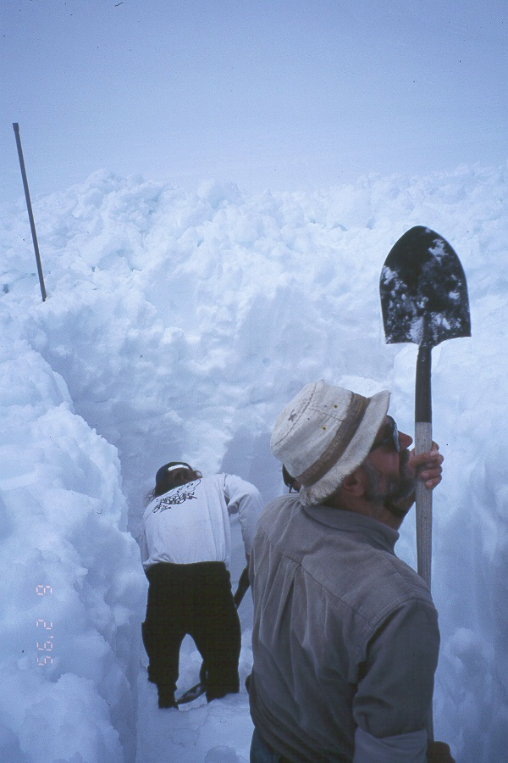
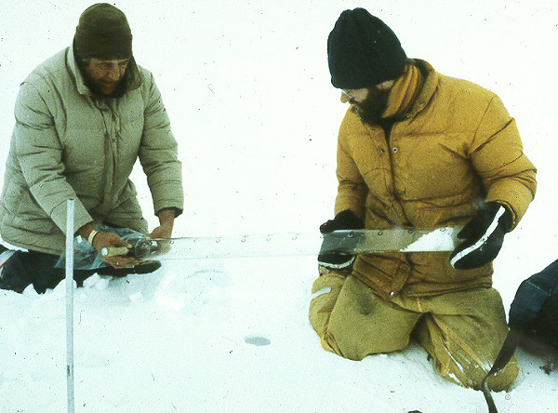
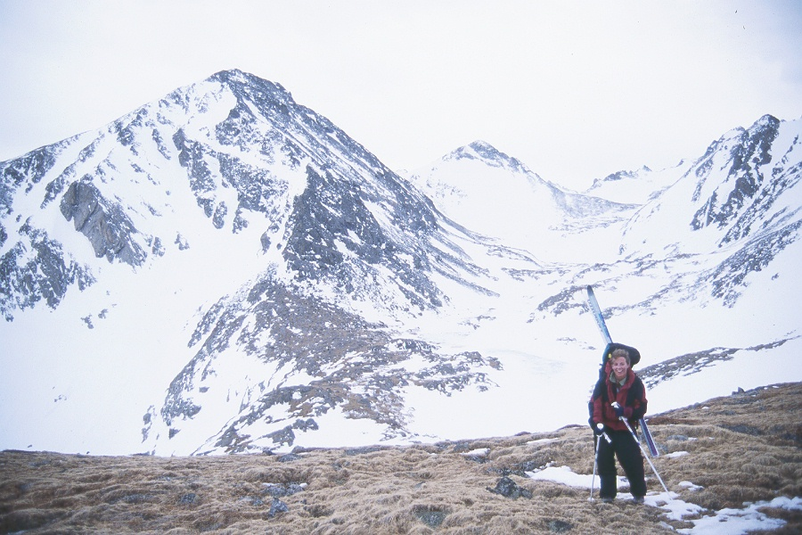
Snow Measurement

Slide 35
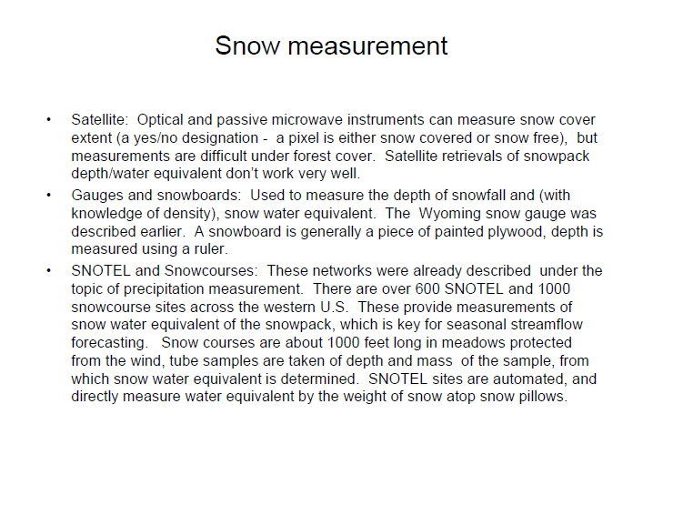

Slide 36
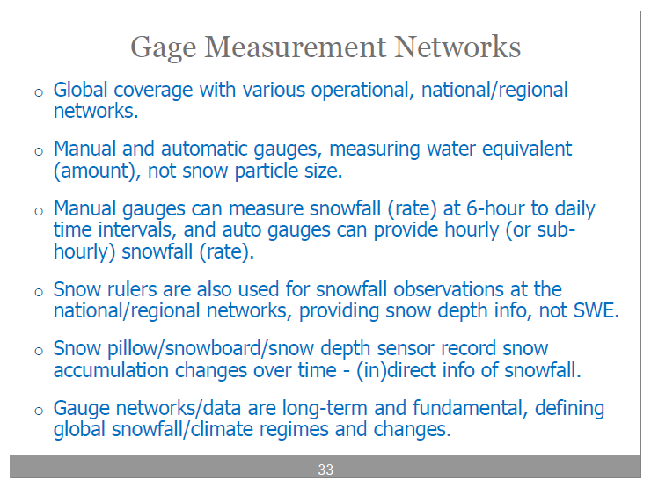

Slide 37
Snow Measurement
Ground Observations
Snow Water Equivalent (SWE)
Snow Pillows
SNOTEL Sites (Western U.S.)
Snow Courses
Transects with snow depth and density
Snow Tubes/Cutters
measure volume and mass of snow cores
Snow Pits
Measure vertical profiles of SWE, and other snow pack variables.

Slide 38
Snow Measurement
Grain Size
Temperature
Hardness
Stratigraphy
Depth
Density
Chemistry

Slide 39
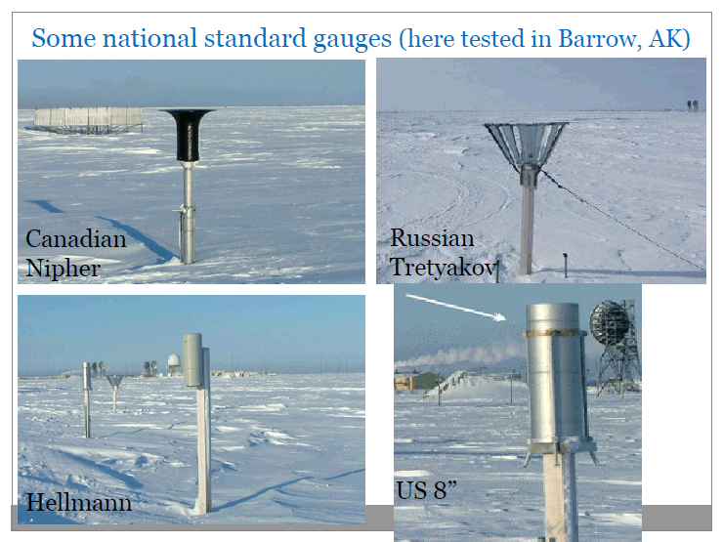

Slide 40
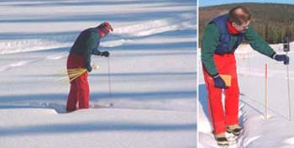
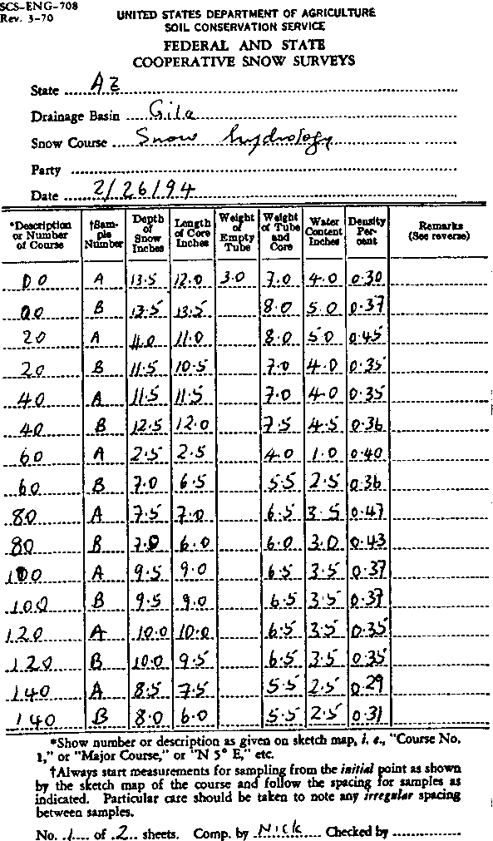
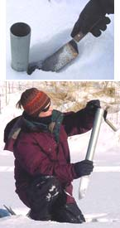
Snow survey
Snow tube field survey
Depth of snow
Length of core
Weight of empty tube
Weight of tube + core
Water content
(tube + core) - tube
Density
WC / snow depth
Courtesy http://www.gi.alaska.edu/alison/ALISON_measures.html

Slide 41
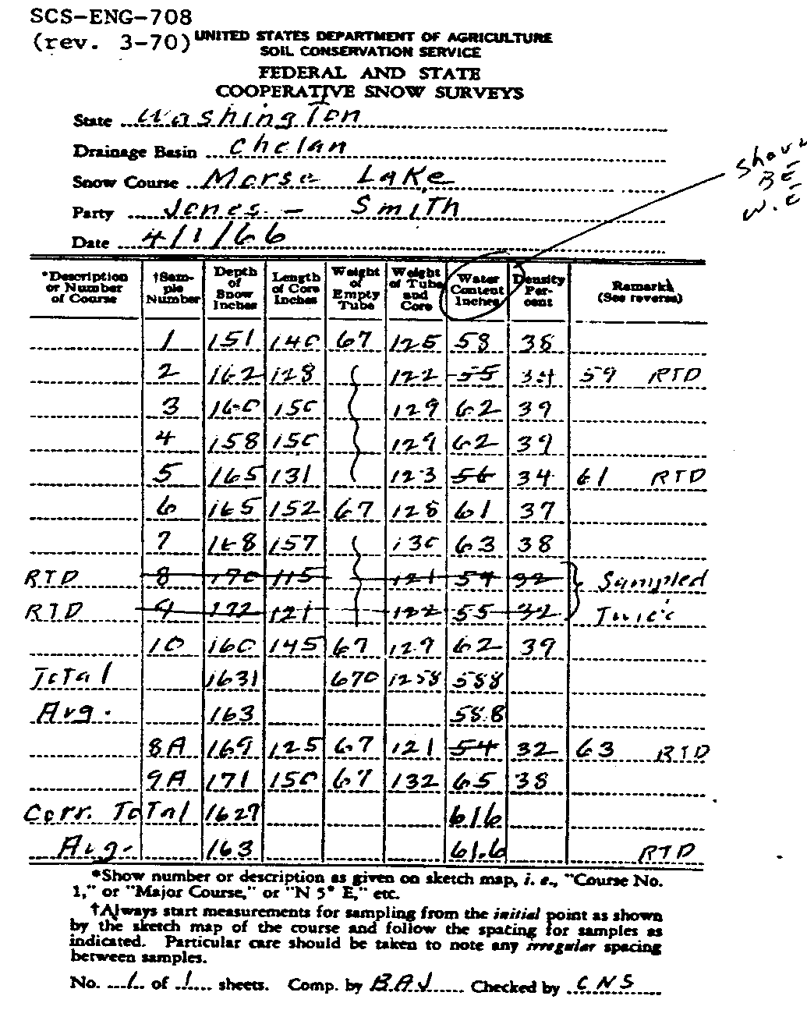
Snow Survey –Manual Approach
http://www.wcc.nrcs.usda.gov/factpub/sect_4a.html
Filling out the sheet:
Examples: WE = (125 – 67) = 58
(122 – 67) = 55
Examples: density = 58/151 = 0.38
55/162 = 0.34

Slide 42
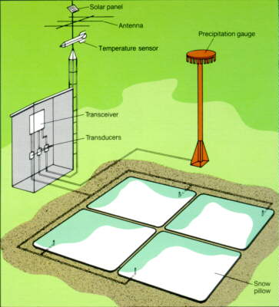
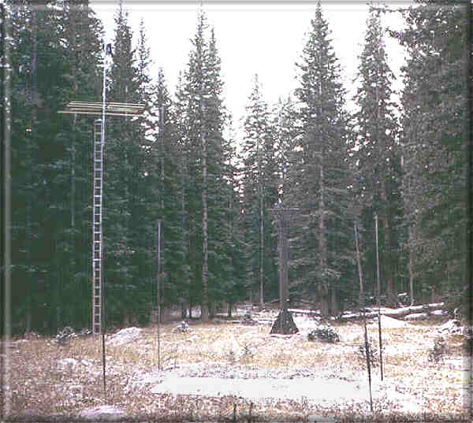
Snow Survey - SNOTEL
Brooklyn Lake SNOTEL site - http://www.wcc.nrcs.usda.gov

Slide 43
Where do I Get Data?
http://www.wcc.nrcs.usda.gov/snow/ - online source for SNOTEL data
Example

Slide 44
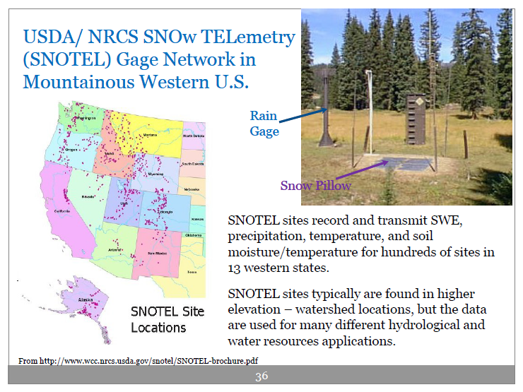

Slide 45
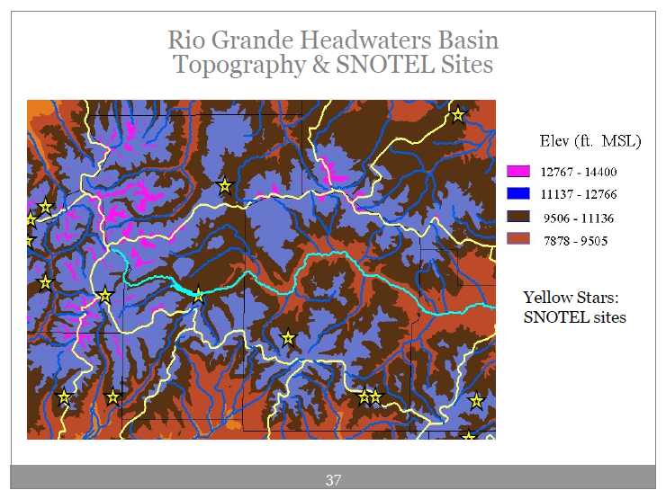

Slide 46


Slide 47



Other ways to measure snow
Ultrasonic Snow Depth Sensor
Inexpensive
Remote sensing instrument
Rain/Snow Station Standpipe
12” standpipe
Above snow depth
Glycol in top; tipping bucket in the bottom
http://www.rickly.com/

Slide 48
Snow Measurement
Airborne Snow Survey Program
Snow Water Equivalent (SWE) estimated from attenuation of naturally occurring terrestrial gamma radiation.
Typical flight line is 16 km long, measuring a ground swath 3000 m wide.
Measures average SWE over area of ~5 km²
1800 flight lines throughout coterminous U.S.
Two twin-engine aircraft fly ~900 lines/year.

Slide 49
Snow Measurement
Airborne Snow Survey Program

Slide 50



Snow Measurement
Airborne Snow Survey Program

Slide 51
Snow Measurement
Airborne SWE Measurement Theory
Airborne SWE measurements are made using the following relationship:
Where:
C and C₀ = Uncollided terrestrial gamma count rates over snow and dry, snow-free soil,
M and M₀ = Percent soil moisture over snow and dry, snow-free soil,
A = Radiation attenuation coefficient in water, (cm²/g)

Slide 52


Snow Measurement
Airborne SWE: Accuracy and Bias
Airborne measurements include ice and standing water that ground measurements generally miss.
RMS Agricultural Areas: 0.81 cm
RMS Forested Areas: 2.31 cm

Slide 53

Airborne Snow Survey Products

Slide 54
Airborne Snow Survey Products
.B GAMMA 990120 /SAIRF/SWIRF
:TO ------ Service Hydrologist (Please give HARDCOPY to SH)
:FROM ---- Tom Carroll, (612) 361-6610 ext 225, Minneapolis, Minnesota
:Visit our web page at www.nohrsc.nws.gov
:SUBJECT - AIRBORNE SNOW WATER EQUIVALENT DATA 990120222453
:-----------------------------------------------------------------------
: Total No. of flight lines sent = 10
:-----------------------------------------------------------------------
:Line Survey %SC SWE SWE %SM Est Fall %SM Pilot
:No. Date (in) (35%) (M) Typ Date (F) Remarks
:=======================================================================
MI113 DY990120 / 100 / 1.8 : 1.2, 25 SE 0 , 25 OLD CRUSTY SNOW
MI114 DY990120 / 100 / 2.3 : 1.7, 25 SE 0 , 25
MI115 DY990120 / 100 / 0.8 : 0.3, 25 SE 0 , 25 TOWN LINE RVR FRZ
MI116 DY990120 / 100 / 0.7 : 0.2, 25 SE 0 , 25 HOUGHTON LAKE FROZEN
MI117 DY990120 / 100 / 1.8 : 1.3, 25 SE 0 , 25
MI118 DY990120 / 100 / 1.6 : 1.0, 25 SE 0 , 25
MI121 DY990120 / 100 / 1.6 : 1.0, 25 SE 0 , 25 MUSKEGON RVR OPEN 90
MI123 DY990120 / 100 / 1.8 : 1.3, 25 SE 0 , 25
MI124 DY990120 / 100 / 1.9 : 1.4, 25 SE 0 , 25 TWIN RVR PRTLY OPN
MI138 DY990120 / 100 / 3.1 : 2.6, 25 SE 0 , 25
.END
Conditions on the ground observed over the survey area were of complete
snow cover with frozen lakes and many frozen rivers. Partially open
rivers are noted in the survey line comments.
NNNN

Slide 55
Snow Measurement
Satellite Hydrology Program
AVHRR and GOES Imaging Channels

Slide 56
Snow Measurement
Remote Sensing of Snow Cover
(NOAA 16)

Slide 57

Snow Measurement
NOAA-15 1.6 Micron Channel

Slide 58


Snow Measurement
NOAA-16 1.6 Micron Channel
Snake River Valley, Idaho
SNOW
Visible Channel
1.6 micron Channel

Slide 59

Satellite Hydrology Products
Satellite Areal Extent of Snow Cover

Slide 60

Satellite Hydrology Products
Snow Cover by Elevation

Slide 61
Satellite Hydrology Products
Snow Cover by Basin
.BR MSP 990121 DM012018 DC01212234 /SAIPZ
:----------------------------------------------------------------------
:National Weather Service - Office of Hydrology
:National Operational Hydrologic Remote Sensing Center
:Chanhassen, Minnesota (612) 361-6610
:----------------------------------------------------------------------
:Satellite Areal Extent of Snow Cover (percent), Elevation Zones (1000ft)
:Composite Analysis 9901181615 - 9901211830
:
:BASIN SA Name
: ezone1 ezone2 ezone3 ezone4 ezone5
AFRA3L 0.0 : AGUA FRIA - ROCK SPRINGS
: 2.0- 5.0 5.0- 7.0
: 0.0 0.0
ALMA3L 0.0 : ALAMO RESERVIOR
: 1.2- 4.0 4.0- 6.6
: 0.0 0.0
LKPA3L 0.0 : AGUA FRIA - LAKE PLEASANT
: 1.6- 4.0 4.0- 7.0
: 0.0 0.0

Slide 62

Satellite Hydrology Products
Snow Water Equivalent (SWE) Analysis

Slide 63
Satellite Hydrology Products
SWE Analysis by Basin
.BR MSP 990122 DM012018 DC01220349 /SWIPZ
:----------------------------------------------------------------------
:National Weather Service - Office of Hydrology
:National Operational Hydrologic Remote Sensing Center
:Chanhassen, Minnesota (612) 361-6610
:----------------------------------------------------------------------
:Estimated Snow Water Equivalent (inches), Elevation Zones (1000ft)
:Composite Analysis 9901190000 - 9901212400
:
:BASIN SW Name
: ezone1 ezone2 ezone3 ezone4 ezone5
AFMA3 0.0 : AGUA FRIA NR MAYER
: 3.6- 5.5 5.5- 7.6
: 0.0 0.0
AFPU1 7.8 : AMERICAN FORK NR AMERICAN FORK
AFRA3L 0.0 : AGUA FRIA - ROCK SPRINGS
: 2.0- 5.0 5.0- 7.0
: 0.0 0.0
ALEC2 7.1 : EAST R - ALMONT
: 8.0- 9.0 9.0-10.0 10.0-13.1
: 3.8 5.6 8.8

Slide 64
More terms
Snowpack density (ρ_{s}): Weight per unit volume
Fresh snow 0.1 g/cm³
Ripe snow 0.4 g/cm³
Snow water equivalent (WE): weight of snow expressed as the depth of water over unit area
D = depth of snow (cm)
Ρ_{w} = density of water (g/cm³)
Ripe snowpack: snowpack that is ready to yield water. Any addition of energy or liquid water will result in a corresponding amount of snow being released as water.

Slide 65
More Terms
Cold snow: Snow with temp < 0° C
Temperature Deficit (T_{s}): snowpack temp. below 0 deg. C
Thermal Deficiency: Heat required to raise the temperature of 1cm WE by 1° C
Heat capacity of ice = 0.5 cal/g/°C
Latent Heat of Fusion: heat required to change 1g of dry snow at 0° C to a liquid state without changing the temperature
80 cal/g = 80 cal/cm³

Slide 66
What Happens When Water Hits the Pack?
After a cold period, the pack temp. is at or below 0°C
As it warms, some snow at surface melts…
Water percolates into pack, hits the ice, and freezes
Recrystallization process → films of water which increases ice crystal size in the pack
Freezing liberates latent heat, which warms the snowpack
Continues until the pack → 0°C

Slide 67


When the Snow Gets to 0°C
Usually is rounded ice crystals
2-5 mm in size
“corn snow”
Water holding capacity and transmission properties similar to coarse sand
Percolating influx water brings pack to field capacity
2-8% by volume
This pack is “ripe”
Adding water or temperature will produce runoff
http://www.avalanche.org/~uac/encyclopedia/cornsnow.htm

Slide 68
Total retention storage
Defined as the total amount of melt that must be added to a snowpack before liquid water is released
When this occurs, the snowpack is ripe

Slide 69
Sources of energy
Radiation
Shortwave
Longwave
Convection – condensation melt: turbulent exchange of sensible heat and direct condensation on the surface
Rain melt: sensible heat added from rainwater
Conduction melt: heat conducted from the ground

Slide 70
Wind Effects on Snow
Vegetation manipulation works…
Thinning not very efficient
Patch cuts more – up to 35% increase
Effects last for 5+ years
Worry about watershed management goals
Flooding
Water quality
Multiple use

Slide 71


Slide 72


Slide 73
Snow Metamorphism
Why snow grains change...

Slide 74
Snow Metamorphism
Changes in snow morphology that take place as a functions of temperature and pressure
Factors changed by metamorphism
density -- strength
porosity -- thermal conductivity
reflectivity of radiant energy (albedo)

Slide 75
Snow Metamorphism
Why does snow undergo metamorphism?
Close to melting temperature
Thermodynamically unstable
large surface to volume ratio, therefore large surface free energy
minimum surface to volume ratio is sphere
Compaction due to overlying layers

Slide 76
Snow Metamorphism
Two types of snow metamorphism:
DRY
No liquid water present
Temperature less than 0ºC
Solid state in equilibrium with vapor
WET
Liquid water present
Temperature equal to 0ºC (usually)

Slide 77
Snow Metamorphism
Dry Metamorphism:
Driven by water vapor movement in pores
Vapor movement is driven by vapor pressure gradient, controlled by:
temperature: saturation vapor pressure depends on temperature; warmer areas can hold more vapor than colder areas
radius of curvature: how curved a particular part of a snow grain is; increased radius of curvature, increased vapor density
grain size: decreased grain size, increased radius of curvature, therefore increased vapor density

Slide 78
Snow Metamorphism
Two Types of Dry Metamorphism:
Equitemperature (ET)
Destructive - destroys crystal structure
Temperature Gradient (TG)
Constructive - builds grains

Slide 79
Snow Metamorphism
ET Dry Metamorphism:
reduces surface free energy to its stable state
Depends mostly on radius of curvature
Convex: positive; steeper convexity is higher radius, which can hold a higher vapor density over it
Hollows: negative
Vapor flows along gradient - from points to hollows
Reduces surface to volume ratio, therefore density increases (fills pore spaces)
Structural strength increases (builds bonds)
Rounds the snow grains

Slide 80

ET Dry Snow Metamorphism
Reduces surface free energy to its stable state
Depends mostly on radius of curvature
Convex: positive; steeper convexity is higher radius, which can hold a higher vapor density over it
Hollows: negative
Vapor flows along gradient - from points to hollows
Result: rounds the snow grains
- Reduces SA:V, therefore ρ increases (fills pore spaces)
- Structural strength increases (builds bonds)
Modified from D. Cline
The Avalanche Handbook, 1993
Notes:
Reduces surface free energy to its stable state
Depends mostly on radius of curvature
Convex: positive; steeper convexity is higher radius, which can hold a higher vapor density over it
Hollows: negative
Vapor flows along gradient - from points to hollows
Result: rounds the snow grains

Slide 81

Gradients, Gradients…
Temperature gradients drive vapor pressure gradients within the snowpack
Hornberger et al., 1998, Fig 2.1

Slide 82


Slide 83

Mass Movement
Vapor pressure gradients force vapor to move up toward less saturated locations of the snowpack
The Avalanche Handbook, 1993
Notes:
Vapor pressure gradients force vapor to move up toward less saturated locations of the snowpack

Slide 84

Sintering (bonding)
Water molecules move to concave regions (low vapor pressure) to form necks between grains
The Avalanche Handbook, 1993
Notes:
Water molecules move to concave regions (low vapor pressure) to form necks between grains

Slide 85
TG Dry Snow Metamorphism
TG Dry Metamorphism:
Kinetic growth - rate of vapor transport very fast
Builds angular, faceted grains, with poor bonding
Resulting strength is poor, density decreases
Must have temperature gradient of 10oC/m or greater
Must have snow density less than 350 kg/m3
maintain sufficient vapor flow
Modified from D. Cline
Notes:
TG Dry Metamorphism:
Kinetic growth - rate of vapor transport very fast
Builds angular, faceted grains, with poor bonding
Resulting strength is poor, density decreases
Must have temperature gradient of 10ºC/m or greater
Must have snow density less than 350 kg/m³
maintain sufficient vapor flow

Slide 86

Wet Snow Metamorphism
Liquid water in the snow pack
Acts like supercharged Dry ET metamorphism
rates are accelerated
small grains are destroyed preferentially
large grains become rounded (equilibrium forms)
Melting and refreezing results in large, bonded grain clusters
Notes:
Liquid water in the snow pack
Acts like supercharged Dry ET metamorphism
rates are accelerated
small grains are destroyed preferentially
large grains become rounded (equilibrium forms)
Melting and refreezing results in large, bonded grain clusters

Slide 87

Results: Heterogeneity
Good or bad?
The Avalanche Handbook, 1993

Slide 88


Slide 89

Snow Cover Distribution

Slide 90
Snow Cover Distribution
Three Spatial Scales
Macroscale
Areas up to 10⁶ km²
Characteristic Distances of 10-1000 km
Dynamic meteorologic effects are important
Mesoscale
Characteristic Distances of 100 m to 10 km
Redistribution of snow along relief features due to wind
Deposition and accumulation of snow may be related to terrain variables and to vegetation cover
Microscale
Characteristic Distances of 10 to 100 m
Differences in accumulation result from variations in air flow patterns and transport

Slide 91
Snow Cover Distribution
Effect of Topography
The depth of seasonal snow cover usually increases with elevation if other influencing factors do not vary with elevation
This trend is generally due to:
increase in the number of snowfall events
decrease in evaporation and melt
The rate of increase with elevation may vary widely from year-to-year
However, elevation alone is not a causative factor in snow cover distribution
Many other factors must be considered:
slope, aspect, vegetation, wind, temperature, and characteristics of the parent weather systems

Slide 92
Snow Cover Distribution
Effect of Vegetation
Snow falling into a vegetation canopy is influenced by two phenomena:
Turbulent air flow above and within the canopy
may lead to variable snow input rates and microscale variation in snow loading on the ground
Direct interception of snow by the canopy elements
may either sublimate or fall to the ground
Processes are related to vegetation type, vegetation density, and the presence of nearby open areas

Slide 93
Snow Cover Distribution
Forested Environments
Differences in snow accumulation between different species of conifers is usually small compared to between coniferous and deciduous stands
coniferous stands are all relatively efficient snow interceptors
Once intercepted, cohesion between snow particles helps keep snow in the canopy for extended time periods
snow is more susceptible to sublimation losses in the canopy than on the forest floor
High surface area to mass ratio

Slide 94
Snow Cover Distribution
Forested Environments
Most studies show greater snow accumulation in clearings than in the forest
Most of the difference develops during storms, not between storms
redistribution of intercepted snow by wind to clearings is not typically a significant factor
Interception and subsequent sublimation are the major factors contributing to the difference
20-45%
Greater Snow
Accumulation

Slide 95



Snow Cover Distribution
Open Environments
Over highly exposed terrain, the effects of meso- and micro-scale differences in vegetation and terrain features may produce wide variations in accumulation patterns.

Slide 96

Snow Cover Distribution
Open Environments
Relative accumulation on various landscapes in an open grassland environment
Normalized to snow accumulation on level plains under fallow

Slide 97

Blowing Snow

Slide 98
Blowing Snow
Two major hydrological influences of wind transport of snow:
Redistribution of Snow Water Equivalent
Loss of Water by Sublimation

Slide 99
Blowing Snow
Four Factors
1. Shear Velocity
2. Threshold Wind Speed
3. Types of Transport
4. Transport Rates

Slide 100
Blowing Snow
Shear Velocity
Movement of snow particles occurs when the drag force exerted on the snow surface by the wind exceeds the surface shear strength.
The total atmospheric shear stress, J, is equal to p_{a}u*², where p_{a} is the air density and u* is the friction (shear) velocity.

Slide 101
Blowing Snow
Shear Velocity - Wind
The friction velocity u* is usually calculated from wind profiles, but can be estimated from a single 10-m wind speed (u₁₀):
u₁₀ = 5 m/s
Antarctic Ice Sheet
u* =u₁₀/26.5
u* = 0.19
Snow-covered Lake
u* =u₁₀ ^{1.18}/41.7
u* = 0.16
Snow-covered
Fallow Field
u* =u₁₀ ^{1.30}/44.2
u* = 0.18

Slide 102
Blowing Snow
Threshold Shear Velocity - Snow
u*_{t} is the friction velocity at which snow transport begins
depends on snow characteristics
Older, wind-hardened,
dense or wet-snow:
u*_{t} = 0.25 - 1.0 m/s
Fresh, loose, dry snow,
and during snowfall:
u*_{t} = 0.07 - 0.25 m/s

Slide 103
Blowing Snow
Three Types of Transport
TYPE
MOTION
HEIGHT
WINDSPEED
Creep
Roll
< 1 cm
<< 5 m/s
Saltation
Bounce
1 cm - 10 cm
5 - 10 m/s
Turbulent
Diffusion
Suspended
1 m - 100 m
> 10 m/s

Slide 104
Blowing Snow
Transport Rates
Approximately proportional to u₁₀³
Double the wind speed, ~8 times the transport rate
4 times the wind speed, ~64 times the transport rate
Depends on snow surface conditions, availability of erodible snow, wind characteristics.

Slide 105
Blowing Snow
Sublimation Losses
Snow particles are more exposed to atmosphere during wind transport
Sublimation losses can be very high as a result
depends on transport rate, transport distance, temperature, humidity, wind speed, and solar radiation

Slide 106
Blowing Snow
Sublimation Losses
Mean Annual Blowing Snow Sublimation
CANADA, 1970-1976
Loss in mm SWE over 1 km
22
25
16
20
30
22
50
25

Slide 107


Blowing Snow
Effect on Snow Characteristics
Mechanical fragmentation and sublimation losses result in small, rounded particles
Windblown snow deposits are inherently more dense
Snow crystal
collected during
snowfall under
calm winds
Windblown snow
particle collected
during transport
2 mm

Slide 108

Blowing Snow

Slide 109


Slide 110


Slide 111


Slide 112

Snow Ablation
Definition – the loss of snowpack through snow melt and/or snow sublimation
Surface energy balance dictates energy changes to the snowpack
The snow used to be this deep…
Notes:
Definition – the loss of snowpack through snow melt and/or snow sublimation
Surface energy balance dictates energy changes to the snowpack
Image: nicholas.edu

Slide 113

Snow Ablation
The energy available for
Snow melt or ablation is a function of the
Energy balance (inputs – outputs) of the snowpack
Notes:
The energy available for snow melt or ablation is a function of the energy balance (inputs – outputs) of the snowpack
Image: www.meted.ucar.edu

Slide 114

Snow Ablation Modeling
There can be a great difference in the amount of water
Notes:
There can be a great difference in the amount of water in a snowpack (as observed with SNOTEL sites, etc.) and the amount of water that melts into streams
Image: http://hydro.vwrrc.vt.edu/about/snowmelt_hb/

Slide 115
Temperature Index Model
Simplified model relating degree days > 0ºC to snowmelt
Degree days = (time > 0ºC) * (Temp - 0ºC)
Thus, a relationship between air temperature and snowmelt
General form:
M = a DD
M is melt (mm), a is the Degree Day Factor (mm/(d ºC)), and DD is the degree-days > 0ºC (ºC*d)
Rango & Martinec, 1995
Notes:
Simplified model relating degree days > 0ºC to snowmelt
Degree days = (time > 0ºC) * (Temp - 0ºC)
Thus, a relationship between air temperature and snowmelt
General form:
M = a DD
M is melt (mm), a is the Degree Day Factor (mm/(d ºC)), and DD is the degree-days > 0ºC (ºC*d)

Slide 116

Temperature Index Model
We can relate 2 things that are easily measured: snowmelt and air temperature
Danville, VT
March, 1973
Degree-Day Factor is the slope of this line
Dingman, 1998

Slide 117



DDF depends on…
DDF depends on location: forest vs. open areas
DDF increases in time
DDF depends on snow density
open
general
forest
Rango & Martinec, 1995
Notes:
DDF depends on location: forest vs. open areas
DDF increases in time
DDF depends on snow density

Slide 118
Snowmelt

Slide 119
Water in snow
Meltwater is generated at the surface of the snowpack,
We would assume that gravity would move meltwater vertically into and through the snow pack
Rain on snow also supplies liquid water to the surface of the snowpack
Hydrologic analogy is groundwater infiltration and movement – precipitation at the ground surface infiltrates and then percolates vertically toward the groundwater table
Notes:
Meltwater is generated at the surface of the snowpack,
We would assume that gravity would move meltwater vertically into and through the snow pack
Rain on snow also supplies liquid water to the surface of the snowpack
Hydrologic analogy is groundwater infiltration and movement – precipitation at the ground surface infiltrates and then percolates vertically toward the groundwater table

Slide 120

Water in snow
Water moves in preferential channels
Once melt occurs at the snow surface, we lose track of it as liquid water infiltrates into the snowpack
Preferential flow common, but we don’t understand from first principles
Notes:
Water moves in preferential channels
Once melt occurs at the snow surface, we lose track of it as liquid water infiltrates into the snowpack
Preferential flow common, but we don’t understand from first principles

Slide 121
Water Flow Through Snow
Wide Range of Flow Velocities
2-60 cm/min
Depends on several factors
internal snow pack structure
condition of the snow pack prior to introduction of water
amount of water available at the snow surface
Notes:
Wide Range of Flow Velocities
2-60 cm/min
Depends on several factors
internal snow pack structure
condition of the snow pack prior to introduction of water
amount of water available at the snow surface

Slide 122
Water Flow Through Snow
Flow through Homogeneous Snow
At melting temperature, a thin film of water surrounds each snow grain
Much of the water can flow through this film
Once pores are filled, laminar flow can occur
Very efficient mechanism for draining the snow pack
Notes:
Flow through Homogeneous Snow
At melting temperature, a thin film of water surrounds each snow grain
Much of the water can flow through this film
Once pores are filled, laminar flow can occur
Very efficient mechanism for draining the snow pack

Slide 123
Water Flow Through Snow – Four Liquid Water Regimes
Capillary: < 1% free water
water doesn’t drain due to capillary tension
Unsaturated: 1-14% free water
water drains by gravity, but air spaces are continuous
Pendular Regime
Saturated: > 14% free water
water drains by gravity, but air spaces are discontinuous
Funicular Regime
Melt/Freeze
water melts and refreezes, possibly several times, before it drains from the snow pack
Notes:
Capillary: < 1% free water
water doesn’t drain due to capillary tension
Unsaturated: 1-14% free water
water drains by gravity, but air spaces are continuous
Pendular Regime
Saturated: > 14% free water
water drains by gravity, but air spaces are discontinuous
Funicular Regime
Melt/Freeze
water melts and refreezes, possibly several times, before it drains from the snow pack

Slide 124
Water Flow Through Snow – Liquid Water Transmission
Melt and rain water are lagged and attenuated as they move through the snow cover.
Function of depth, density, ice layers, grain size, and refreezing.
Rain
Notes:
Melt and rain water are lagged and attenuated as they move through the snow cover.
Function of depth, density, ice layers, grain size, and refreezing.

Slide 125


Slide 126


Slide 127


Slide 128


Slide 129


Slide 130


Slide 131


Slide 132


Slide 133


Slide 134
Snow Energy Exchanges
Q_{sn}
Q_{le}
(Q_{si}-Q_{r}) + (L_{in} - L_{out}) + Q_{h} + Q_{e} + Q_{g} + Q_{p} - dU/dt = Q_{m}
Q_{si}
L_{in}
L_{out}
Q_{r}
Modified from D. Cline

Slide 135


Slide 136


Slide 137


Slide 138


Slide 139


Slide 140


Slide 141


Slide 143


Slide 144


Slide 145


Slide 146


Slide 147
An Energy Balance Snowmelt Model for use in Spatially Distributed Hydrologic Models
(UEB, Utah Energy Balance Model)
David G. Tarboton
Utah Water Research Laboratory
Utah State University
www: http://www.engineering.usu.edu/dtarb/snow/snow.html

Slide 148
Snow Energy Exchanges
Q_{sn}
Q_{le}
(Q_{si}-Q_{r}) + (L_{in} - L_{out}) + Q_{h} + Q_{e} + Q_{g} + Q_{p} - dU/dt = Q_{m}
Q_{si}
L_{in}
L_{out}
Q_{r}
Modified from D. Cline

Slide 149
Snow Model Physics and Parameterizations
Inputs
Wind
Fluxes dependent on
surface temperature
Q (T ,T )
Q (e ,T )
Q (T )
h a s
e a s
le
s
Thermally
active
layer
State variables
Snow
Energy Content U
Q
Water Equivalence W
D
Soil
e
Q
Q
g
m

Slide 150
Model Structure
Predictor + Corrector Numerical Integration
{
Predictor
Corrector
{

Slide 151
Surface Energy Balance
External Forcing
Surface temperature dependent fluxes
Depth sensitivity to
diurnal temperature
fluctuation
Energy Balance /Equilibrium at surface
If T_{s} > 0 ºC ⇒ Conduction cannot accommodate surface energy inputs
⇒ Surface melt is generated. Set T_{s} = 0 ºC
⇒ Additional energy is advected downwards by surface melt inflow

Slide 152
Surface Energy Balance – With Forest Canopy
External Forcing
Surface temperature dependent fluxes
Depth sensitivity to
diurnal temperature
fluctuation
Energy Balance /Equilibrium at surface
If T_{s} > 0 ºC ⇒ Conduction cannot accommodate surface energy inputs
⇒ Surface melt is generated. Set T_{s} = 0 ºC
⇒ Additional energy is advected downwards by surface melt inflow

Slide 153
Melt Outflow Calculation

Slide 154
Shortwave Radiation

Slide 155
Atmospheric Transmissivity
Bristow, K. L. and G. S. Campbell, (1984), "On the Relationship Between Incoming Solar Radiation and the Daily Maximum and Minimum Temperature," Agricultural and Forest Meteorology, 31: 159-166.

Slide 156
Reflective Properties of Snow
Modified from D. Cline

Slide 157
Albedo
Dickinson, R. E., A. Henderson-Sellers and P. J. Kennedy, (1993), "Biosphere-Atmosphere Transfer Scheme (BATS) Version 1e as Coupled to the NCAR Community Climate Model," NCAR/TN-387+STR, National Center for Atmospheric Research.

Slide 158

Shortwave Radiation & Snow
Why does snow albedo decrease over time?
Modified from D. Cline, Handbook of Snow

Slide 159
Effect of Illumination angle
Dickinson, R. E., A. Henderson-Sellers and P. J. Kennedy, (1993), "Biosphere-Atmosphere Transfer Scheme (BATS) Version 1e as Coupled to the NCAR Community Climate Model," NCAR/TN-387+STR, National Center for Atmospheric Research.

Slide 160
Calibration
Data: Central Sierra Snow laboratory winter of 85/86.
1. Drive model with net radiation input.
• Match overall accumulation and ablation of W
• Match surface temperatures
2. Drive model with observed incident radiation.
• Adjust albedo parameters so that observed and net radiation matches.
3. Compare Melt Outflow

Slide 161

Calibration of z_{o} and K_{s} to match observations with Net Radiation Input

Slide 162

Surface conductance K_{s} adjusted to match diurnal surface temperature fluctuations

Slide 163

Surface conductance K_{s} adjusted to match diurnal surface temperature fluctuations

Slide 164
Drive with incident solar radiation, adjust albedo.

Slide 165

Confirm agreement between modeled and observed Net Radiation

Slide 166

Calibrate K_{sat} to match Melt Outflow

