Slide 1
Physical Hydrology & Hydroclimatology
(Multiscale Hydrology)
A science dealing with the properties, distribution and circulation of water.
R. Balaji
balajir@colorado.edu
CVEN5333 http://civil.colorado.edu/~balajir/CVEN5333
Includes slides from Prof. Mike Gooseff

Slide 2
Physical factors in the generation of runoff
Learning objectives
Be able to describe the processes involved in runoff generation
Be able to distinguish between infiltration excess, saturation excess and subsurface stormflow runoff generation mechanisms and identify when and where each is more likely to occur
Be able to describe the physical factors resulting in the occurrence of runoff by the different mechanisms

Slide 3

Resources
Rainfall Runoff Module Online, http://hydrology.usu.edu/RRP,
Chapters 1 - 3
Dingman Chapters 10
Chow Book Chapters 5, 7
Jeff McDonnell Website (http://www.cof.orst.edu/cof/fe/watershd/)
Benchmark papers in streamflow
generation processes (many at
http://www.cof.orst.edu/cof/fe/watershd/fe537/bpapers.html)

Slide 4
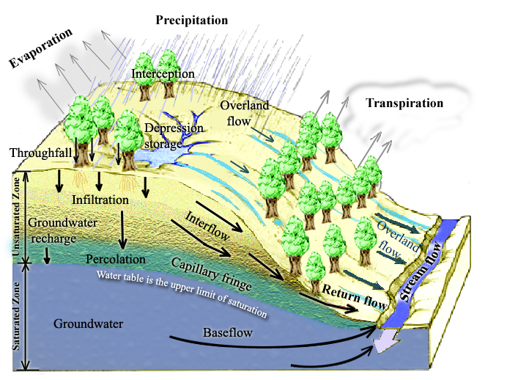
Physical Processes involved in Runoff Generation
Rainfall Runoff Processes
Notes:
Figure 1. Physical Processes involved in Runoff Generation.

Slide 5
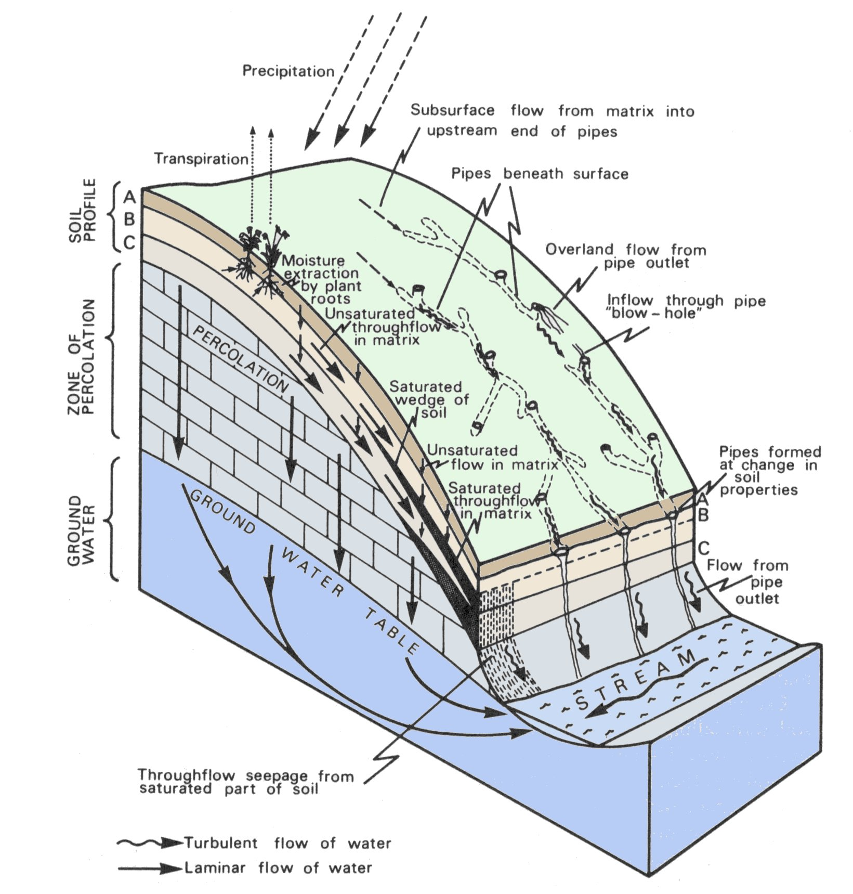
Pathways followed by subsurface runoff on hillslopes
(from Kirkby, 1978)
Notes:
Figure 2. Pathways followed by subsurface runoff on hillslopes

Slide 6
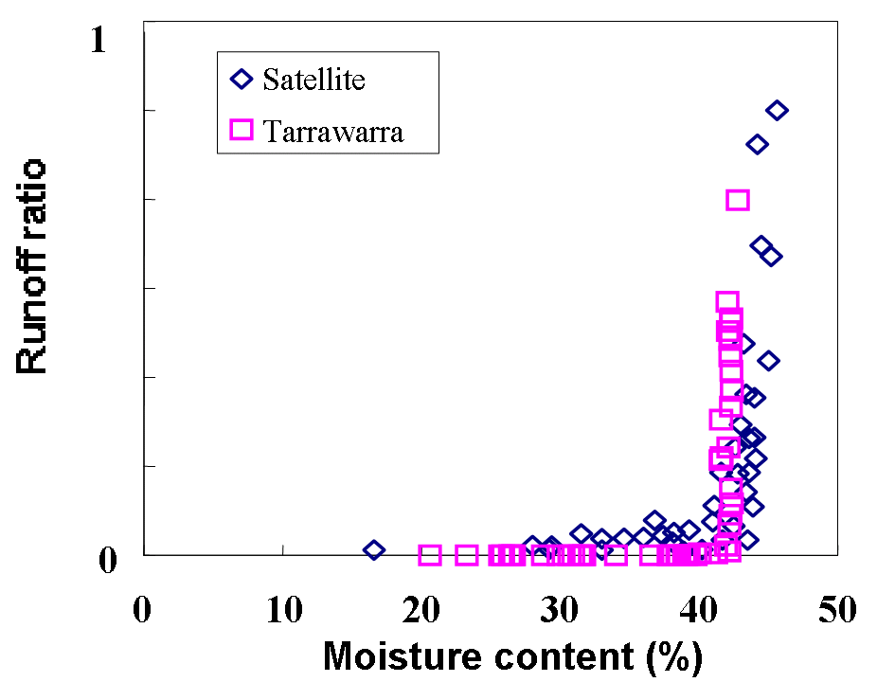
Threshold Hillslope Response
Relationship between runoff ratio and soil moisture content. (Woods et al., 2001.)

Slide 7
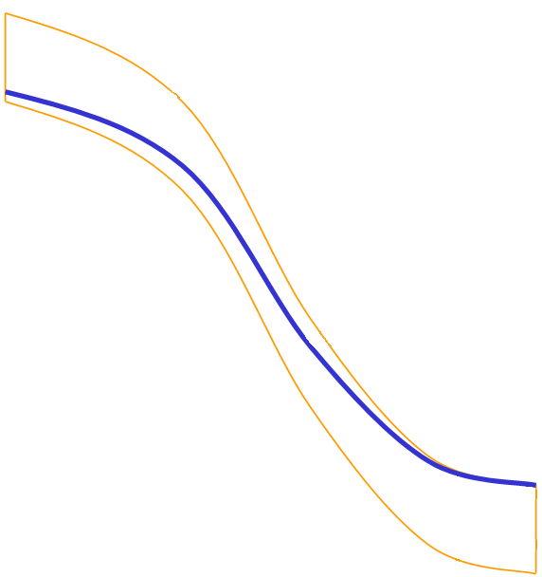
Relation between runoff and depth to groundwater
(b) 103 m from stream
(a) 14 m from stream,
Two different locations in the Svartberget catchment (Seibert et al., 2003)
Notes:
Figure 4. Relation between runoff and depth to groundwater for two different locations in the Svartberget catchment (Seibert et al., 2003)

Slide 8
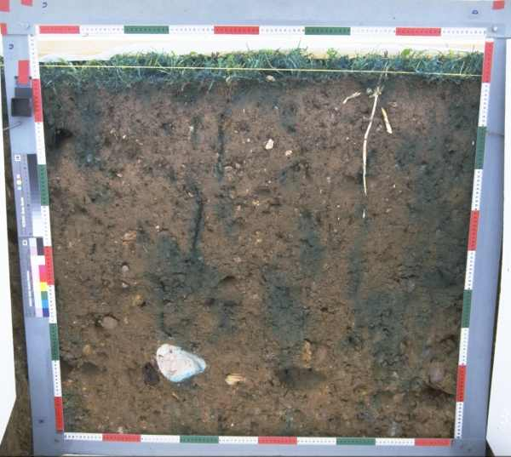
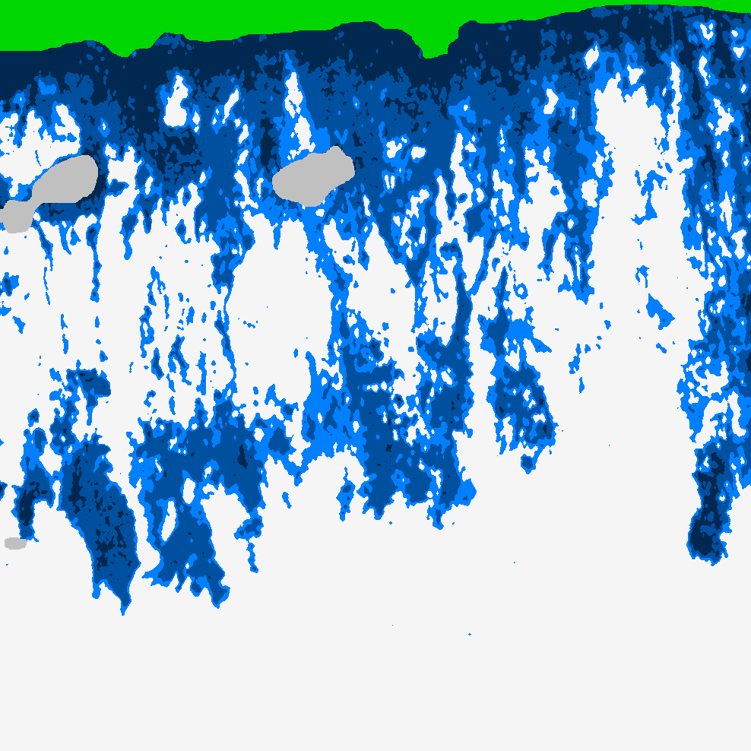
Infiltration follows preferential pathways
(a) Photograph of cross section through soil following dye tracing experiment. (b) Moisture content inferred from dye tracing experiment. (Courtesy of Markus Weiler)

Slide 9
Wetting may occur at depth before at the surface
See preferential pathway infiltration animation http://hydrology.neng.usu.edu/RRP/ (ch 2)

Slide 10
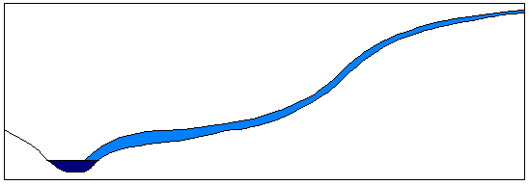
Runoff Generation Mechanisms
P
(a) Infiltration excess overland flow
(also called Horton overland flow)
f
P
P
q_{o}
f
(following Beven, 2001)
See infiltration excess runoff generation animation http://hydrology.neng.usu.edu/RRP/ (ch 2)

Slide 11
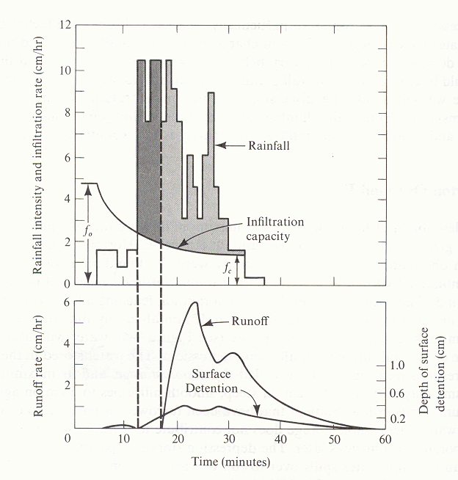
f₀
f₁
Figure 7. Rainfall, runoff, infiltration and surface storage during a natural rainstorm. The shaded areas under the rainfall graph represent precipitation falling at a rate exceeding the infiltration rate. The dark grey area represents rainfall that enters depression storage, which is filled before runoff occurs. The light grey shading represents rainfall that becomes overland flow. The initial infiltration rate is f₀, and f₁ is the final constant rate of infiltration approached in large storms. (from Dunne and Leopold, 1978)

Slide 12
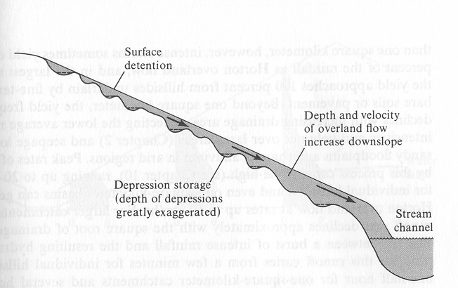
Overland flow moves downslope as an irregular sheet (from Dunne and Leopold, 1978)

Slide 13
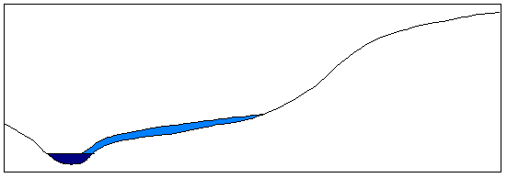
(b) Partial area infiltration excess overland flow
P
Fraction of area contributing to overland flow
q_{o}
P
P
f
(following Beven, 2001)

Slide 14
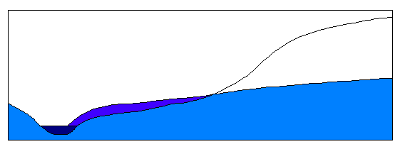
(c) Saturation excess overland flow
P
Variable source area
P
P
q_{o}
q_{r}
q_{s}
(following Beven, 2001)
See saturation excess runoff generation animation http://hydrology.neng.usu.edu/RRP/ (ch 2)

Slide 15
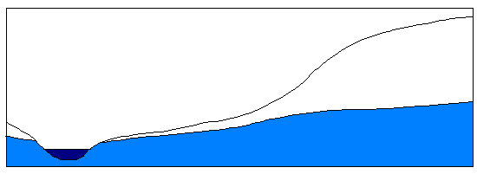
(d) Subsurface stormflow
P
P
P
q_{s}
(following Beven, 2001)
See subsurface runoff generation animation http://hydrology.neng.usu.edu/RRP/ (ch 2)

Slide 16
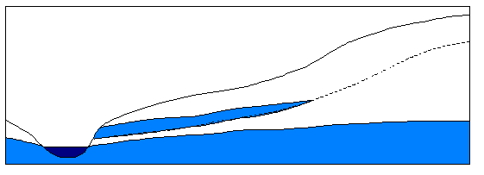
(e) Perched subsurface stormflow
P
Horizon 1
Horizon 2
P
P
q_{s}
Impeding layer
(following Beven, 2001)
See perched layer stormflow runoff generation animation http://hydrology.neng.usu.edu/RRP/ (ch 2)

Slide 17
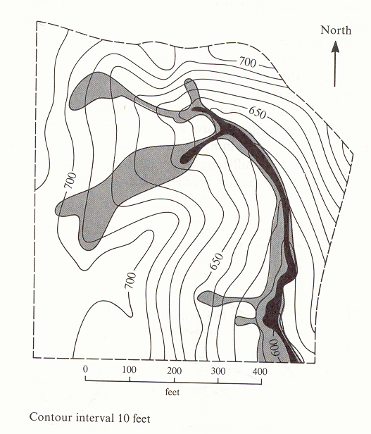
Map of saturated areas showing expansion during a single rainstorm. The solid black shows the saturated area at the beginning of the rain; the lightly shaded area is saturated by the end of the storm and is the area over which the water table had risen to the ground surface. (from Dunne and Leopold, 1978)

Slide 18
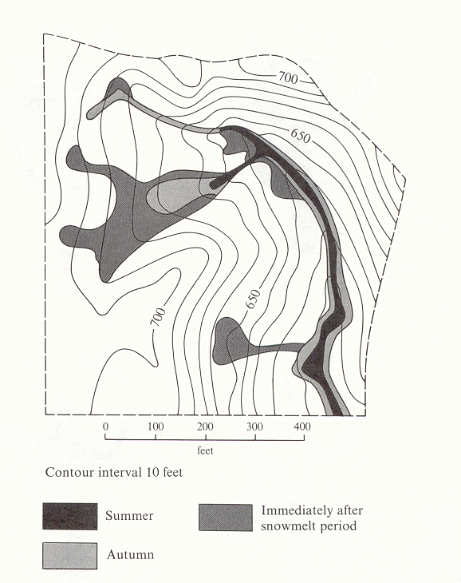
Seasonal variation in pre-storm saturated area (from Dunne and Leopold, 1978)

Slide 19
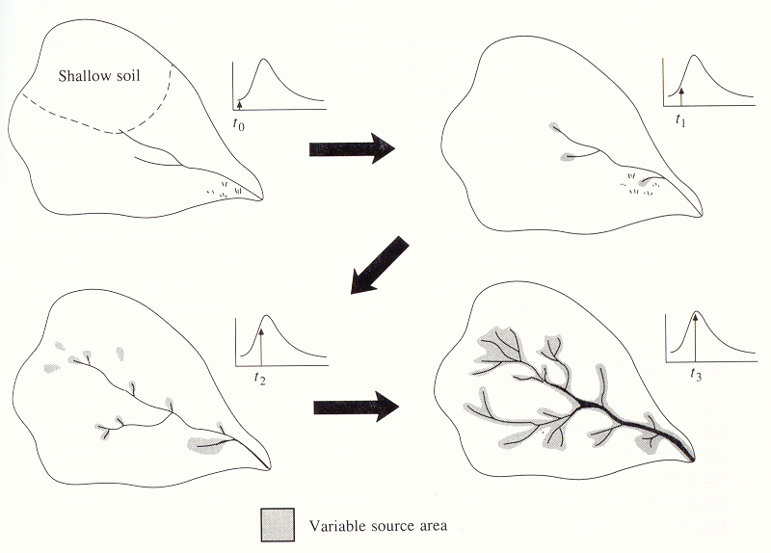
Variable Source Area Concept (from Chow et al, 1988). The small arrows in the hydrographs show how the streamflow increases as the variable source extends into swamps, shallow soils and ephemeral channels. The process reverses as streamflow declines.

Slide 20
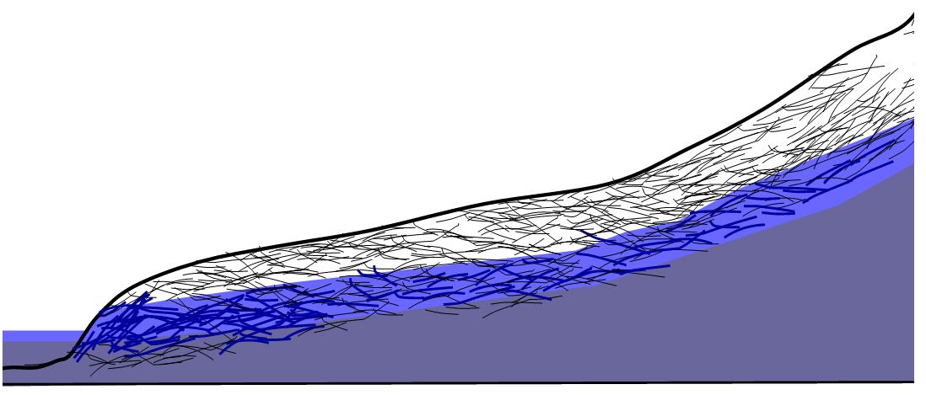
Transmissivity Feedback
Schematic illustration of macropore network being activated due to rise in groundwater resulting in rapid lateral flow.

Slide 21
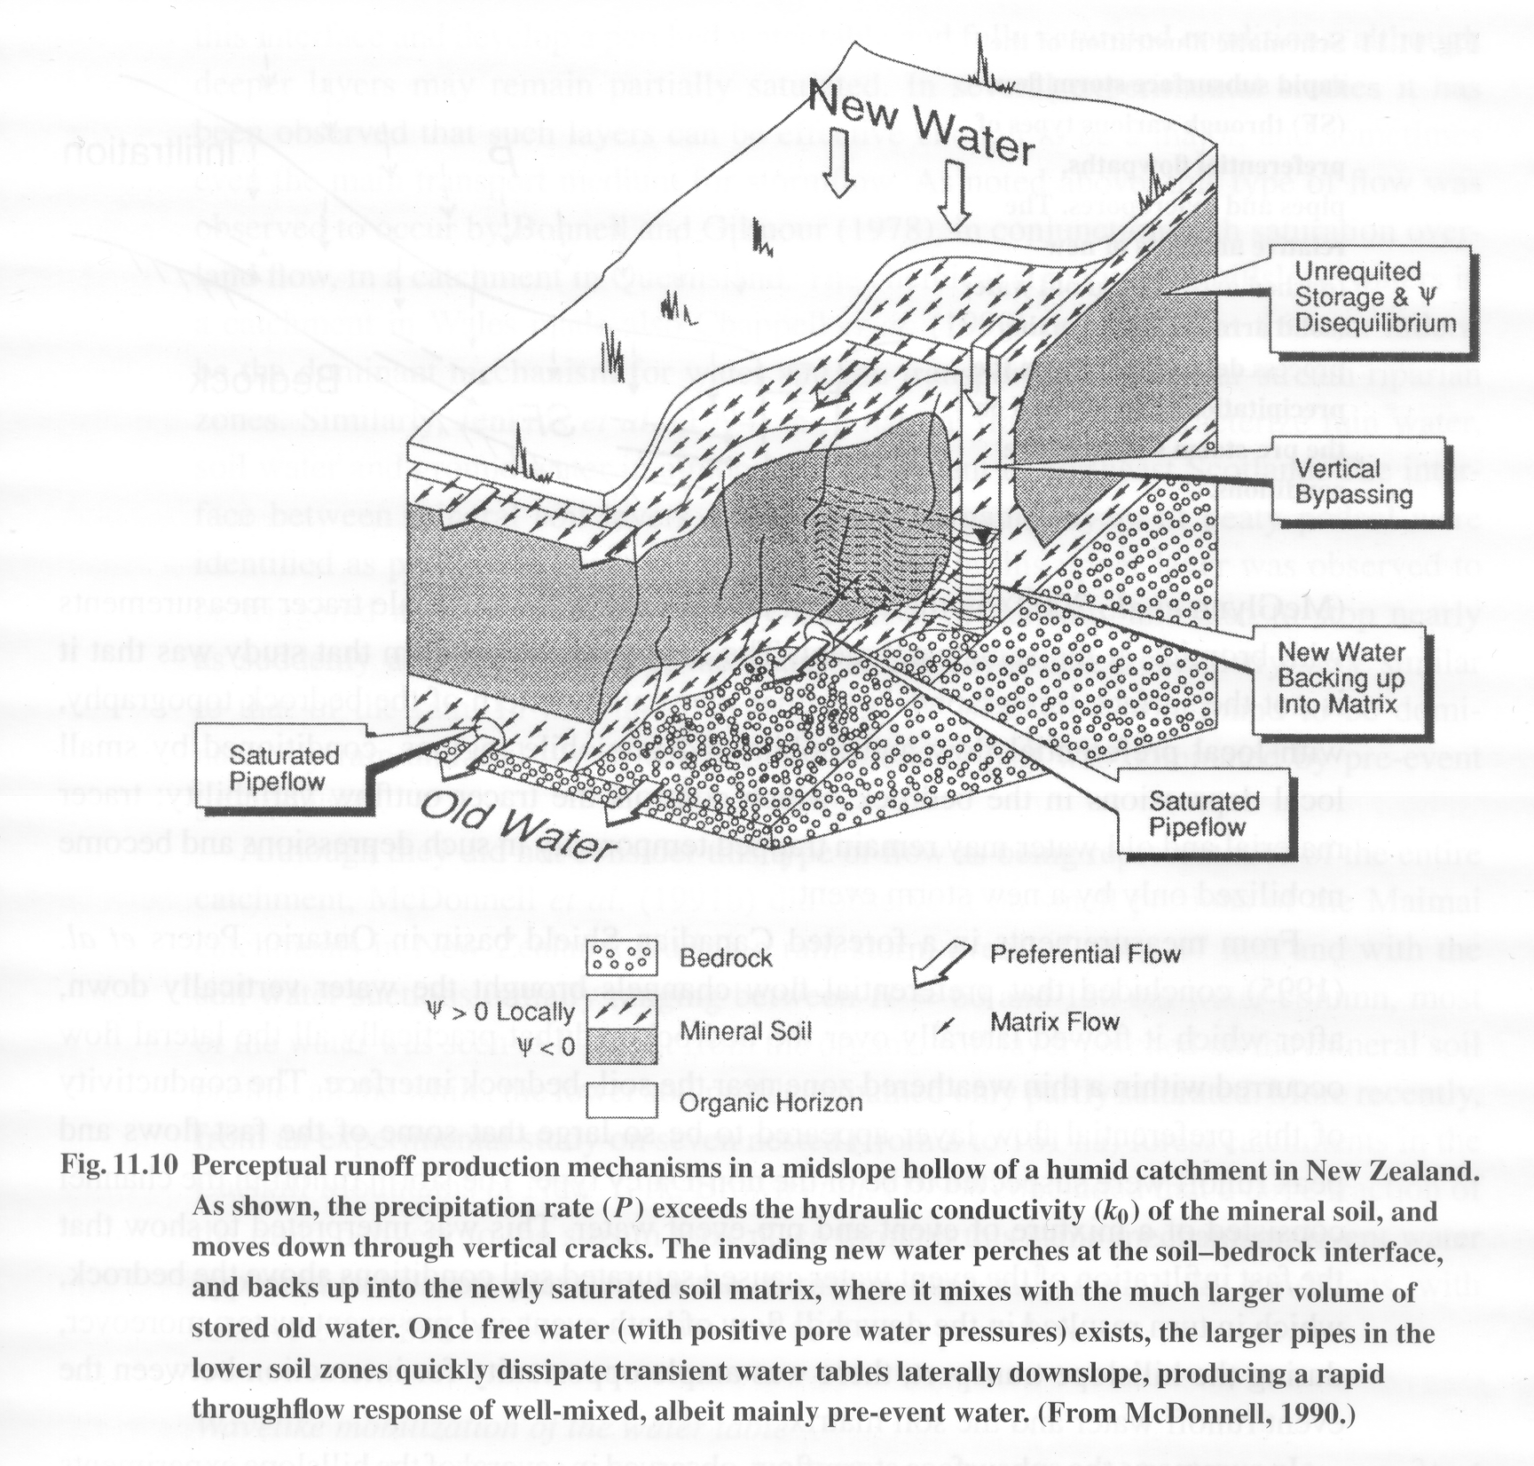
Brutsaert, 2005

Slide 22
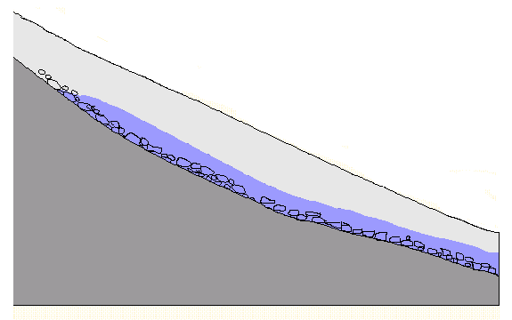
Rapid lateral flow at soil bedrock interface.
Soil
Low permeable bedrock

Slide 23
Features of subsurface stormflow
Unimpeded entry by new water from rainfall into the soil
Rapid downslope flow through preferential paths
Mixing with old water depending on rainfall intensity and soil moisture status
From Brutsaert, 2005, p454

Slide 24
(a)
Rain
Water
table
Baseflow
0 θ_{s} 0 θ_{s}
Rain
(b)
Water
table
Baseflow + subsurface stormflow
0 θ_{s} 0 θ_{s}
Rain
(c)
Direct precipitation
on saturated zone
Water
table
Return flow
Baseflow + subsurface stormflow
0 θ_{s} 0 θ_{s}
Groundwater ridging subsurface stormflow processes in an area of high infiltration rate.
Notes:
Figure 12. Groundwater ridging subsurface stormflow processes in an area of high infiltration rate.

Slide 25
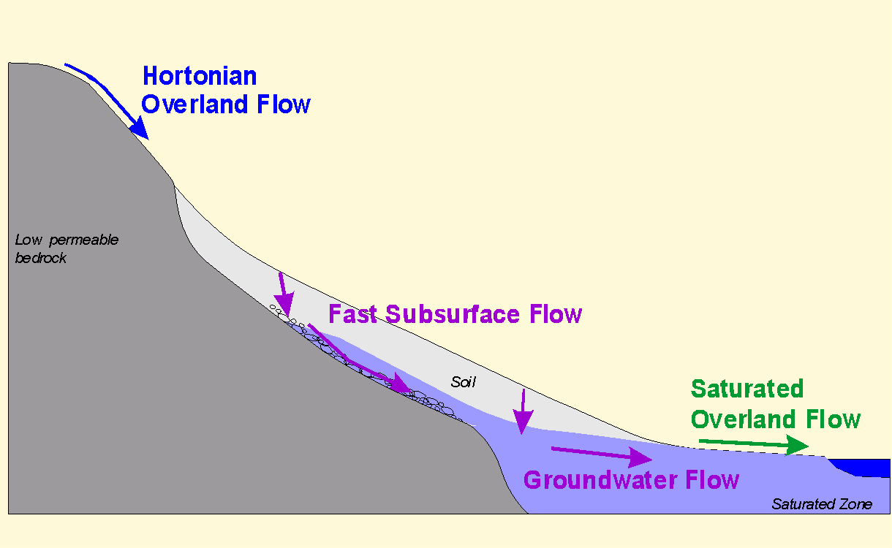
The particular runoff process that dominates is place and time dependent

Slide 26
Evapotranspiration
Surface Water Input
Hortonian OF
Infiltration capacity
Saturation OF
Saturation
Variable
source area
Infiltration
Return flow
Soil regolith
Regolith subsurface flow
(interflow)
Percolation
Deeper groundwater aquifer
Aquifer subsurface flow
(baseflow)
Notes:
Figure 13. Hydrological Pathways involved in different runoff generation processes. Infiltration excess pathways are shown in red. Saturation excess and subsurface stormflow pathways are shown in blue. Groundwater and baseflow pathways in black and Evapotranspiration is green.

Slide 27
Summary points
A bewildering range of hydrologic, climatic, topographic and soil conditions which favor different mechanisms
Extreme complexity suggests a single unifying model may not be possible or desirable
Distributed models allow exploration of consequences of simplifying assumptions and can lead to better understanding of the interplay between processes and pathways
Mathematical rigor may instill false confidence and undeserved sense of realism
Catchment scale parameterizations have difficulty representing spatial variability
From Brutsaert, 2005, p457-461

Slide 28
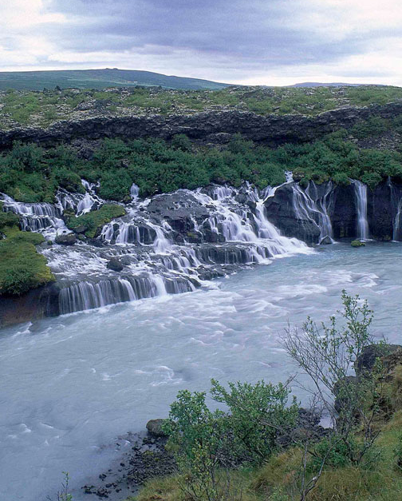
Rainfall-Runoff Modeling
Catchment-scale responses
  “Engineering” Methods
    Rational Method
    SCS Curve-Number Method
    Unit Hydrograph
  Process Based Method
    TOPMODEL

Slide 29
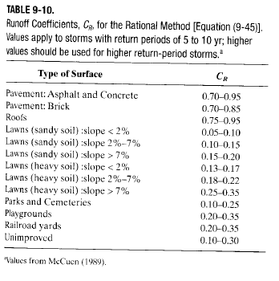
Rainfall-Runoff Models
Rational Method
Based on a proportionality between effective rainfall intensity (p*) and peak discharge (q_{pk})
ε_{R} is a unit conversion factor
A_{D} is the drainage area
Used mostly for
catchment response
modeling
q_{pk} = ε_{R} C_{R} p* A_{D}
Notes:
FILL IN EQ
Used mostly for urban and suburban catchment response modeling

Slide 30
Rainfall-Runoff Models
SCS Curve Number Method
Based on soil characteristics within a basin
  First compute P*, which is equivalent to Q*:
  Then, compute S_{max} (watershed storage):
  The Curve Number is determined by the soil type and antecedent moisture conditions

Slide 31
Curve Numbers for Antecedent Soil Moisture Condition II
 | Hydrologic Soil Group
Land Use Description | A | B | C | D
Commercial, row houses and townhouses | 80 | 85 | 90 | 95
Fallow, poor condition | 77 | 86 | 91 | 94
Cultivated with conventional tillage | 72 | 81 | 88 | 91
Cultivated with conservation tillage | 62 | 71 | 78 | 81
Lawns, poor condition | 58 | 74 | 82 | 86
Lawns, good condition | 39 | 61 | 74 | 80
Pasture or range, poor condition | 68 | 79 | 86 | 89
Pasture or range, good condition | 39 | 61 | 74 | 80
Meadow | 30 | 58 | 71 | 78
Pavement and roofs | 100 | 100 | 100 | 100
Woods or forest thin stand, poor cover | 45 | 66 | 77 | 83
Woods or forest, good cover | 25 | 55 | 70 | 77
Farmsteads | 59 | 74 | 82 | 86
Residential quarter-acre lot, poor condition | 73 | 83 | 88 | 91
Residential quarter-acre lot, good condition | 61 | 75 | 83 | 87
Residential half-acre lot, poor condition | 67 | 80 | 86 | 89
Residential half-acre lot, good condition | 53 | 70 | 80 | 85
Residential 2-acre lot, poor condition | 63 | 77 | 84 | 87
Residential 2-acre lot, good condition | 47 | 66 | 77 | 81
Roads | 74 | 84 | 90 | 92
Source: From NRCS, 1984.
Group A – low runoff potential, well drained soils (K_{sat} > 0.3 in/hr)
Group B – moderate infiltration, fairly deep soils (K_{sat} ~ 0.15-0.3 in/hr)
Group C – slow infiltration rate soils, fine texture (K_{sat} ~ 0.05-0.15 in/hr)
Group D – high runoff potential, clay soils (K_{sat} < 0.05 in/hr)

Slide 32
Adjustments to Runoff Curve Number (CN) for Dry
or Wet Antecedent Soil Moisture Conditions
 | Factors to Convert Curve Number
 | for AMC II to AMC I or AMC III
Curve Number (AMC II) | AMC I (dry) | AMC III (wet)
10 | 0.40 | 2.22
20 | 0.45 | 1.85
30 | 0.50 | 1.67
40 | 0.55 | 1.50
50 | 0.62 | 1.40
60 | 0.67 | 1.30
70 | 0.73 | 1.21
80 | 0.79 | 1.14
90 | 0.87 | 1.07
100 | 1.00 | 1.00
AMC I – dormant season moisture < 0.5”, growing < 1.4”
AMC II – dormant season moisture >0.5”, <1.1”; growing season >1.4”, <2.1”
AMC III – dormant season moisture >1.1”, growing season >2.1”

Slide 33
SCS Method
Then, compute the hydrograph and its timing:
T_{r} =
q_{pk} =
Q
time
T_{b} =

Slide 34
Example
George’s house is just downstream of a 4-acre watershed that presently has mature forest on top of a Crosby soil. He is worried that the new townhouse development will increase the amount of water flowing in the creek by his house.
Using a 2 inch storm determine the increase in water volume that will flow by George’s house due to the development.

Slide 35
Step 1--Calculate S numbers
  -Crosby soil is Type C (tables will provide this)
  -CN (AMC II) mature forest is 70
  -CN (AMC II) townhouses is 90
  -Convert to AMC III-worst case scenario
  -CN 70*1.21=84.7
  -CN 90*1.07=96.3
  -S (forest) = 1.81in =
  -S (townhouses) = 0.38in =
Notes:
Step 1--Calculate S numbers
-Crosby soil is Type C (tables will provide this)
-CN (AMC II) mature forest is 70
-CN (AMC II) townhouses is 90
-Convert to AMC III-worst case scenario
-CN 70*1.21=84.7
-CN 90*1.07=96.3
-S (forest) = 1.81in =
-S (townhouses) = 0.38in =

Slide 36
Curve Numbers for Antecedent Soil Moisture Condition II
 | Hydrologic Soil Group
Land Use Description | A | B | C | D
Commercial, row houses and townhouses | 80 | 85 | 90 | 95
Fallow, poor condition | 77 | 86 | 91 | 94
Cultivated with conventional tillage | 72 | 81 | 88 | 91
Cultivated with conservation tillage | 62 | 71 | 78 | 81
Lawns, poor condition | 58 | 74 | 82 | 86
Lawns, good condition | 39 | 61 | 74 | 80
Pasture or range, poor condition | 68 | 79 | 86 | 89
Pasture or range, good condition | 39 | 61 | 74 | 80
Meadow | 30 | 58 | 71 | 78
Pavement and roofs | 100 | 100 | 100 | 100
Woods or forest thin stand, poor cover | 45 | 66 | 77 | 83
Woods or forest, good cover | 25 | 55 | 70 | 77
Farmsteads | 59 | 74 | 82 | 86
Residential quarter-acre lot, poor condition | 73 | 83 | 88 | 91
Residential quarter-acre lot, good condition | 61 | 75 | 83 | 87
Residential half-acre lot, poor condition | 67 | 80 | 86 | 89
Residential half-acre lot, good condition | 53 | 70 | 80 | 85
Residential 2-acre lot, poor condition | 63 | 77 | 84 | 87
Residential 2-acre lot, good condition | 47 | 66 | 77 | 81
Roads | 74 | 84 | 90 | 92
Source: From NRCS, 1984.
Adjustments to Runoff Curve Number (CN) for Dry
or Wet Antecedent Soil Moisture Conditions
 | Factors to Convert Curve Number
 | for AMC II to AMC I or AMC III
Curve Number (AMC II) | AMC I (dry) | AMC III (wet)
10 | 0.40 | 2.22
20 | 0.45 | 1.85
30 | 0.50 | 1.67
40 | 0.55 | 1.50
50 | 0.62 | 1.40
60 | 0.67 | 1.30
70 | 0.73 | 1.21
80 | 0.79 | 1.14
90 | 0.87 | 1.07
100 | 1.00 | 1.00

Slide 37
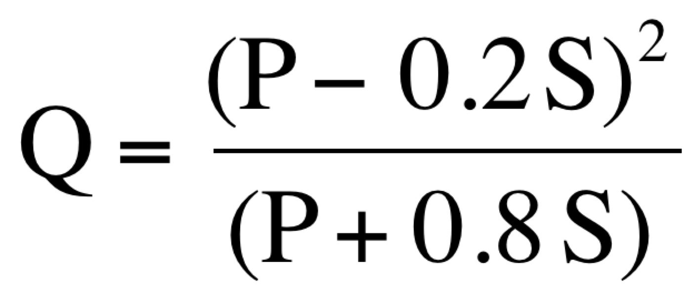
Step 2-Calculate Q (excess runoff)
  P = 2 inches rainfall
  Q(forest) = 0.91 inches
  Q(townhouses) = 1.61 inches
Notes:
Step 2-Calculate Q (excess runoff)
P = 2 inches rainfall
Q(forest) = 0.91 inches
Q(townhouses) = 1.61 inches

Slide 38
Step 3-Calculate volume
  Area= 4 acre
  Excess rainfall = 0.91in (forest) =
  Excess rainfall = 1.61in (townh) =
  Volume (forest) = 4*0.08=0.32 acre ft
  Volume (townh) = 4*0.13=0.52 acre ft
  Volume (forest) = 14,000ft³
  Volume (townh) = 22,600ft³
  Volume of runoff will increase 61%
Notes:
Step 3-Calculate volume
Area= 4 acre
Excess rainfall = 0.91in (forest) = 0.08ft
Excess rainfall = 1.61in (townh) = 0.13ft
Volume (forest) = 4*0.08=0.32 acre ft
Volume (townh) = 4*0.13=0.52 acre ft
Volume (forest) = 14,000ft³
Volume (townh) = 22,600ft³
Volume of runoff will increase 61%

Slide 39
Goal is to quantify watershed response without consideration of detailed subscale processes
Runoff (mm/hr)
Runoff and Flow
Flow (m³/s)
Time
Flow = f(Runoff, Watershed hydrologic properties)

Slide 40

Systems approach to event flow
From Dingman, 2002, Physical Hydrology

Slide 41
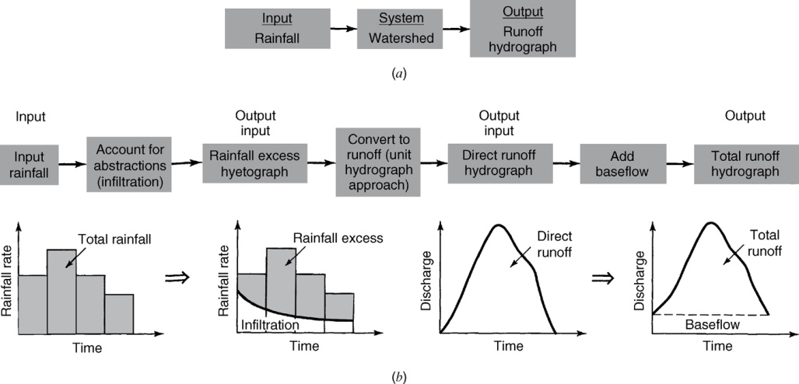
Rainfall – Runoff Analysis
From Mays, 2011, Ground and Surface Water Hydrology

Slide 42
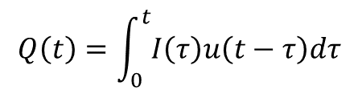

Linear Systems
Assume superposition, i.e. the principle of additivity
Convolution integral
$$Q\left(t\right)=\int_{0}^{t}{I\left(τ\right)u\left(t−τ\right)dτ}$$
$$3u\left(t−τ_{1}\right)+2u(t−τ_{2})$$
From Chow et al., 1988, Applied Hydrology

Slide 43
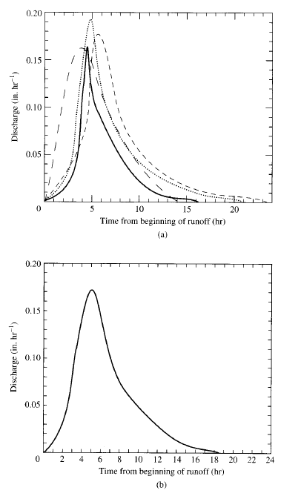
Rainfall Runoff Models
Unit Hydrograph
Assumes a linear watershed response to a unit effective input – generally found from empirical observations: e.g., 1 inch of rain in 2.5 hours, or 1 inch of rain in 1 hour.
Dingman, Figure 9-45

Slide 44
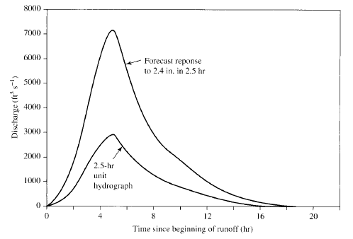
Rainfall Runoff Models
Unit Hydrograph
Consider an increase in AMOUNT of precipitation
For larger storms, with the same duration, scale unit hydrograph by # of “unit inputs”
We had 2.5 hr unit hydrograph, what is the response to 2.4 in. in 2.5 hr?
All points on increased response hydrograph are 2.4*unit hydrograph
Notes:
All points on increased response hydrograph are 2.4*unit hydrograph

Slide 45
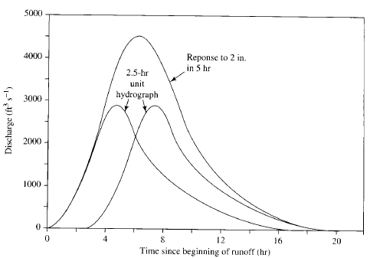
Rainfall Runoff Models
Unit Hydrograph
Consider an increase in the DURATION of precipitation
For longer storms, same amount, lag smaller unit hydrographs, then add them
We had 2.5 hr unit hydrograph, what is the response to 2 in. in 5 hours?
Add 2 - 2.5 hr unit hydrographs and lag by 2.5 hours
Notes:
Add 2 - 2.5 hr unit hydrographs and lag by 2.5 hours

Slide 46
Linear Response at Discrete Time Steps
Excess Precipitation

Slide 47
A D_{u} hour unit hydrograph is the characteristic response of a given watershed to a unit volume (e.g. 1 in or cm) of effective water input (usually rain) applied at a constant rate for D_{u} hours
Runoff (mm/hr)
Runoff and Flow
Flow (m³/s)
Time

Slide 48
Assumptions (Chow P 214)
Excess rainfall has constant intensity within effective duration
Excess rainfall is uniformly distributed over watershed
The base time of the direct runoff hydrograph from an increment of excess rainfall is constant
The ordinates of all direct runoff hydrographs are proportional to the amount of direct runoff
For a given watershed the hydrograph resulting from a given excess rainfall reflects the unchanging characteristics of the watershed

Slide 49
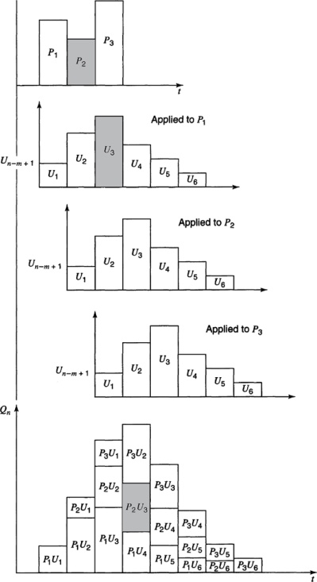
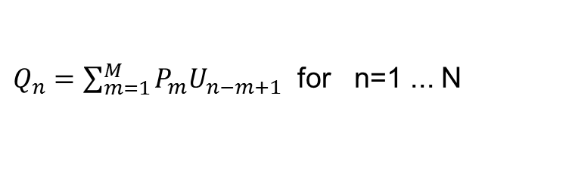
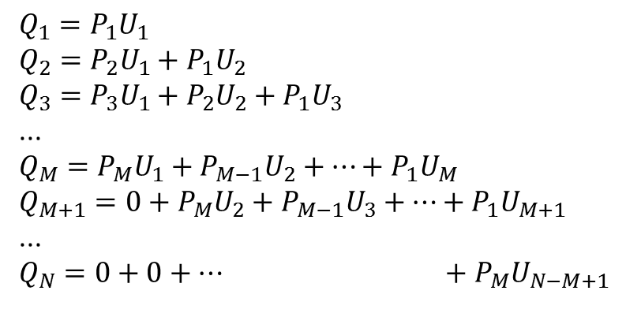
Calculating a Hydrograph from a Unit Hydrograph
$$Q_{1}=P_{1}U_{1}$$
$$Q_{2}=P_{2}U_{1}+P_{1}U_{2}$$
$$Q_{3}=P_{3}U_{1}+P_{2}U_{2}+P_{1}U_{3}$$
...
$$Q_{M}=P_{M}U_{1}+P_{M−1}U_{2}+…+P_{1}U_{M}$$
$$Q_{M+1}=0+P_{M}U_{2}+P_{M−1}U_{3}+…+P_{1}U_{M+1}$$
...
$$Q_{N}=0+0+… +P_{M}U_{N−M+1}$$
$Q_{n}=\sum_{m=1}^{M}{P_{m}U_{n−m+1}}$ for n=1 ... N
Chow page 217
From Mays, 2011, Ground and Surface Water Hydrology

Slide 50
Example
The 1- hr unit hydrograph for a watershed is given below. Determine the runoff from this watershed for the storm pattern given. The abstractions have a constant rate of 0.3 in/ h.
Time ( hr) | 1 | 2 | 3 | 4 | 5 | 6
Precipitation ( in) | 0.5 | 1 | 1.5 | 0.5
Unit hydrograph ( cfs) | 10 | 100 | 200 | 150 | 100 | 50

Slide 51
Example

Slide 52
Limitations
Linearity is violated when deeper water flows faster.
Rainfall is seldom uniform in space
Effective input is very uncertain and depends on antecedent conditions

Slide 53
Example
Determine the 1- hr unit hydrograph for a watershed using the precipitation pattern and runoff hydrograph below. The abstractions have a constant rate of 0.3 in/ hr, and the baseflow of the stream is 0 cfs.
Time (h) | 1 | 2 | 3 | 4 | 5 | 6 | 7 | 8 | 9 | 10
Precipitation (in) | 0.5 | 1 | 1.5 | 0.5
Runoff (cfs) | 2 | 27 | 122 | 292 | 385 | 300 | 185 | 80 | 10 | 0

Slide 54


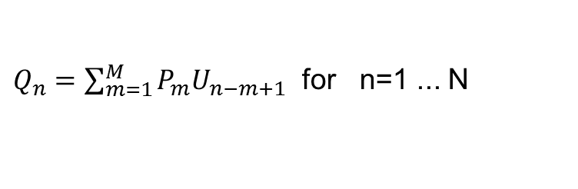
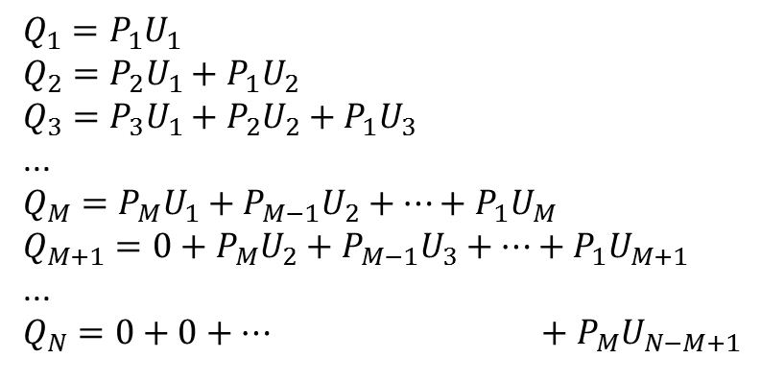

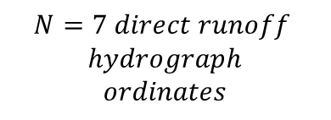
Calculating a Hydrograph from a Unit Hydrograph and visa versa
$$Q_{1}=P_{1}U_{1}$$
$$Q_{2}=P_{2}U_{1}+P_{1}U_{2}$$
$$Q_{3}=P_{3}U_{1}+P_{2}U_{2}+P_{1}U_{3}$$
...
$$Q_{M}=P_{M}U_{1}+P_{M−1}U_{2}+…+P_{1}U_{M}$$
$$Q_{M+1}=0+P_{M}U_{2}+P_{M−1}U_{3}+…+P_{1}U_{M+1}$$
...
$$Q_{N}=0+0+… +P_{M}U_{N−M+1}$$
$Q_{n}=\sum_{m=1}^{M}{P_{m}U_{n−m+1}}$ for n=1 ... N
$$M=3 precip inputs$$
$$L=5 unit hydrograph$$
$$ordinates$$
$$N=7 direct runoff$$
$$hydrograph$$
$$ordinates$$
$$N=L+M−1$$
From Mays, 2011, Ground and Surface Water Hydrology

Slide 55
Determining the Unit Hydrograph from Direct Runoff Hydrograph Observations
M =4 precip values
N=9 Direct Runoff Hydrograph Ordinates
L=N=M+1=6 Unit Hydrograph ordinates
9 equations to solve for 6 U values
(Overdetermined system – use least squares with Solver)
Any 6 initial U values
Minimize this by changing these

Slide 56
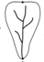
Which hydrograph is associated with each watershed
A
1
B
2
3
C

Slide 57
Time Area Diagram
Distribution function of area by travel time to outlet
Under assumptions of constant velocity
t = d/v
This provides a geomorphological basis for defining the unit response function.

Slide 58
Channel Network “Width” Function
x
x
The number of channels at a distance x from the outlet

Slide 59
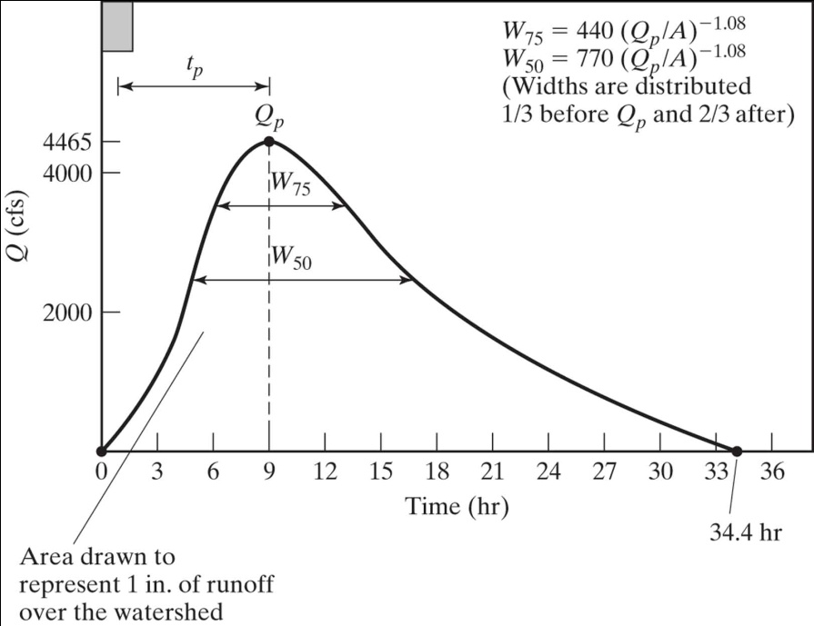
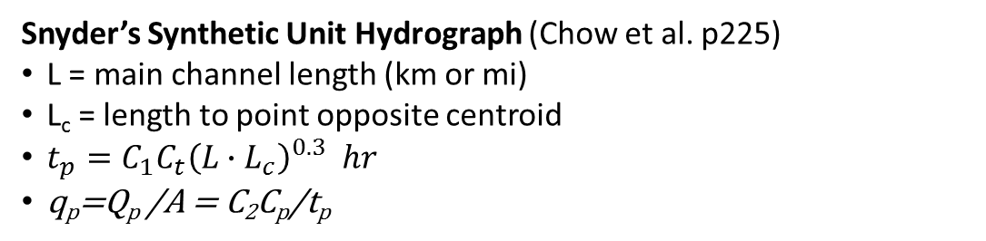
Synthetic Unit Hydrographs
A unit hydrograph is intended to quantify the unchanging characteristics of the watershed
The synthetic unit hydrograph approach quantifies the unit hydrograph from watershed attributes
1/3
2/3
Snyder’s Synthetic Unit Hydrograph (Chow et al. p225)
L = main channel length (km or mi)
L_{c} = length to point opposite centroid
$t_{p}=C_{1}C_{t}{\left(L∙L_{c}\right)}^{0.3} hr$
q_{p}=Q_{p} /A = C₂C_{p}/t_{p}

Slide 60
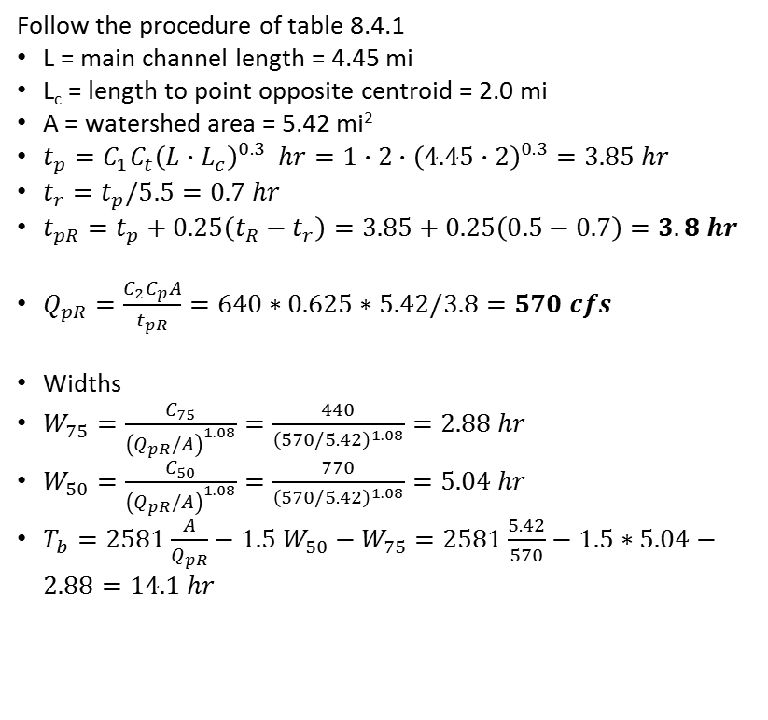
Example Snyder's Synthetic Unit Hydrograph
A watershed has a drainage area of 5.42 mi²; the length of the main stream is 4.45 mi, and the main channel length from the watershed outlet to the point opposite the center of gravity of the watershed is 2.0 mi. Using Ct = 2.0 and Cp = 0.625, determine the standard synthetic unit hydrograph for this basin. What is the standard duration? Use Snyder’s method to determine the 30- min unit hydrograph parameter.
Follow the procedure of table 8.4.1
L = main channel length = 4.45 mi
L_{c} = length to point opposite centroid = 2.0 mi
A = watershed area = 5.42 mi²
$t_{p}=C_{1}C_{t}{\left(L∙L_{c}\right)}^{0.3} hr=1∙2∙{\left(4.45∙2\right)}^{0.3}=3.85 hr$
$t_{r}=t_{p}/5.5=0.7 hr$
$t_{pR}=t_{p}+0.25\left(t_{R}−t_{r}\right)=3.85+0.25\left(0.5−0.7\right)=3.8 hr$
$Q_{pR}=\frac{C_{2}C_{p}A}{t_{pR}}=640∗0.625∗5.42/3.8=570 cfs$
Widths
$W_{75}=\frac{C_{75}}{{\left(Q_{pR}/A\right)}^{1.08}}=\frac{440}{{\left(570/5.42\right)}^{1.08}}=2.88 hr$
$W_{50}=\frac{C_{50}}{{\left(Q_{pR}/A\right)}^{1.08}}=\frac{770}{{\left(570/5.42\right)}^{1.08}}=5.04 hr$
$T_{b}=2581\frac{A}{Q_{pR}}−1.5 W_{50}−W_{75}=2581\frac{5.42}{570}−1.5∗5.04−2.88=14.1 hr$
(4.05,570)
(3.09,427.5)
(5.97,427.5)
(2.37,285)
W₇₅
(7.41,285)
W₅₀
1/3
2/3
(14.1,0)

Slide 61
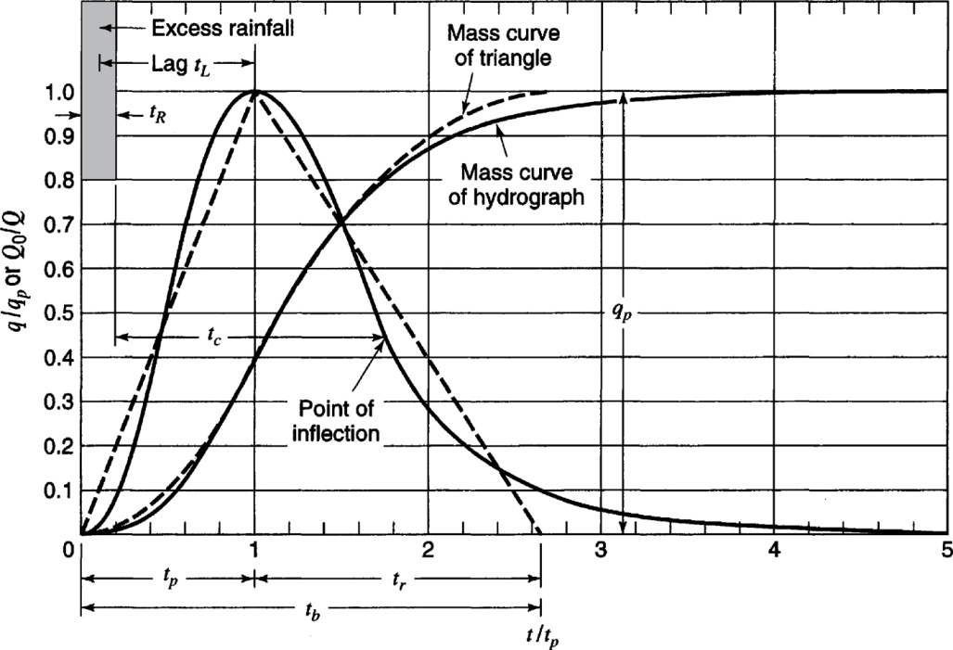
SCS Dimensionless Unit Hydrograph
From Mays, 2011, Ground and Surface Water Hydrology

Slide 62
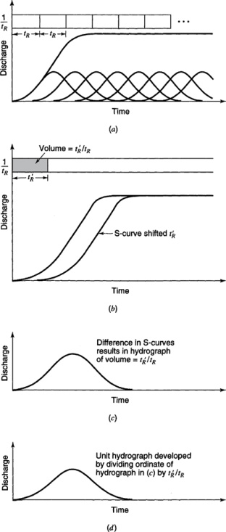
Unit Hydrographs of Different Durations - S Curves
From Mays, 2011, Ground and Surface Water Hydrology

Slide 63
Example
The 1- hr unit hydrograph for a watershed is given below. Determine the 2 hr unit hydrograph.
Time ( hr) | 1 | 2 | 3 | 4 | 5 | 6
Unit hydrograph ( cfs) | 10 | 100 | 200 | 150 | 100 | 50

Slide 64
S Curve to Develop 2 hr unit hydrograph

