Slide 1
Physical Hydrology & Hydroclimatology (Multiscale Hydrology)
A science dealing with the properties, distribution and circulation of water.
R. Balaji
balajir@colorado.edu
CVEN5333 http://civil.colorado.edu/~balajir/CVEN5333

Slide 2
Lecture Week-2
Mass Balance .. Contd from Week – 1
Examples
Watershed transfer functions
Residence Times
(See ppt of Week-1 lecture)
Reservoir sizing
Sequent Peak method
Optimal Yield

Slide 3
Storage-Yield Analysis
Sequent Peak Algorithm
R_{t} = y
K_{t} = K_{t-1} + R_{t} – Q_{t}
If K_{t} < 0, K_{t}=0
S = Max(K_{t})

Slide 4
Loucks, Chapter 11
Pages 342-346

Slide 7
Reservoir Storage-Yield Analysis
R/Q

Slide 8
Reservoir Reliability Analysis

Slide 9
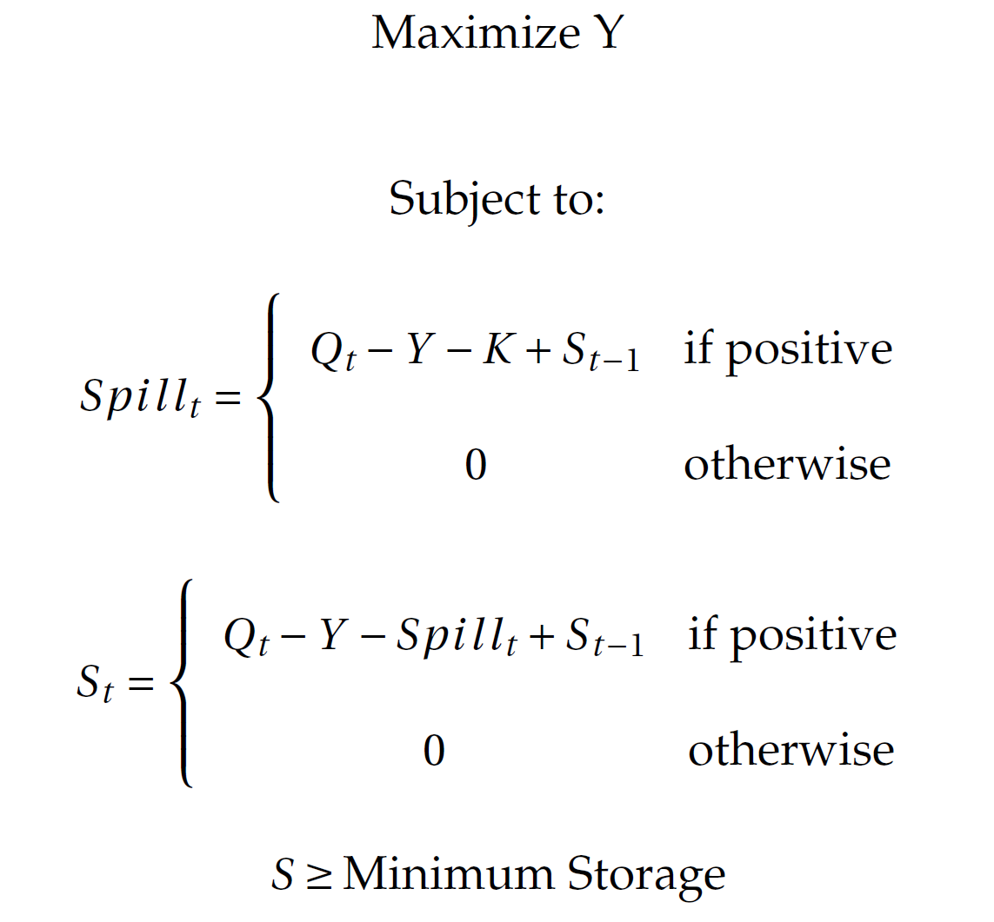
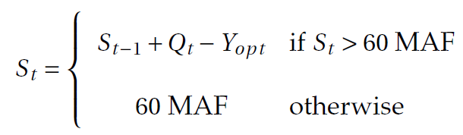
Optimal Yield
Y = Yield (MaF)
Spill_{t}= Overflow (MaF)
Q_{t} = Paleo-reconstructed inflow (MaF/yr)
K = Reservoir capacity (MaF)
S_{t-1} = Previous year storage (MaF)
S_{t} = Current storage (MaF)
Minimum Storage is specified
System storage = 60MaF
Average storage is computed for
the optimal yield Y_{opt}, as the
average of:
Notes:
Whole problem has been set up as a simple optimization problem. Max Yield subject to the constraints that if there is more water in tub you spill and water left there is no spill and likewise we let the water in the tub go to a certain user specified minimum storage.
Once we have optimal yield in the system we then compute the storage response of the sequence of yields.
Qt is the inflow sequence

Slide 10
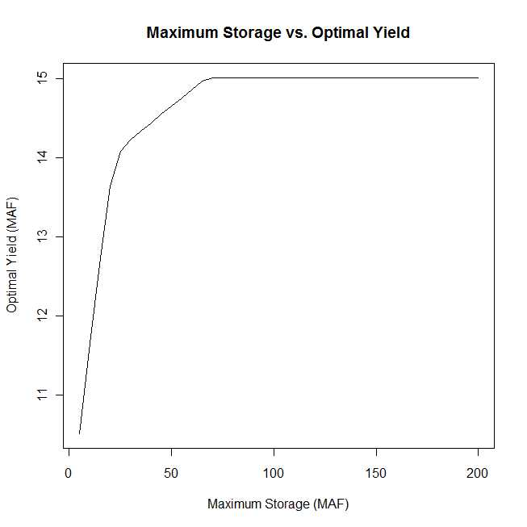
Why not build more storage?
Plot of Optimal yield vs. storage potential
larger tub does NOT lead to greater yield
optimal yield plateaus at ~15MaF at around 70 MaF
Temporal Variability! The cause

