Slide 1
Physical Hydrology & Hydroclimatology (Multiscale Hydrology)
A science dealing with the properties, distribution and circulation of water.
R. Balaji
balajir@colorado.edu
CVEN5333 http://civil.colorado.edu/~balajir/CVEN5333

Slide 2
Lecture Week – 3 Sep 6
Estimating mass balance quantities (especially ET)
Under uncertainty
Quantifying temporal variability
Basic statistics
Coefficient of variability
Persistence
Autocorrelation
Flow Duration Curve (FDC)

Slide 3
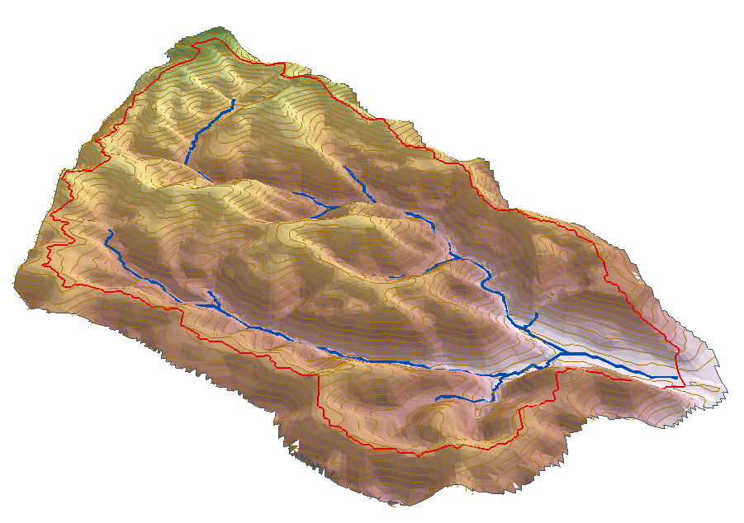
Estimation of Areal ET
P
ET
G_{in}
Q
S
G_{out}

Slide 4
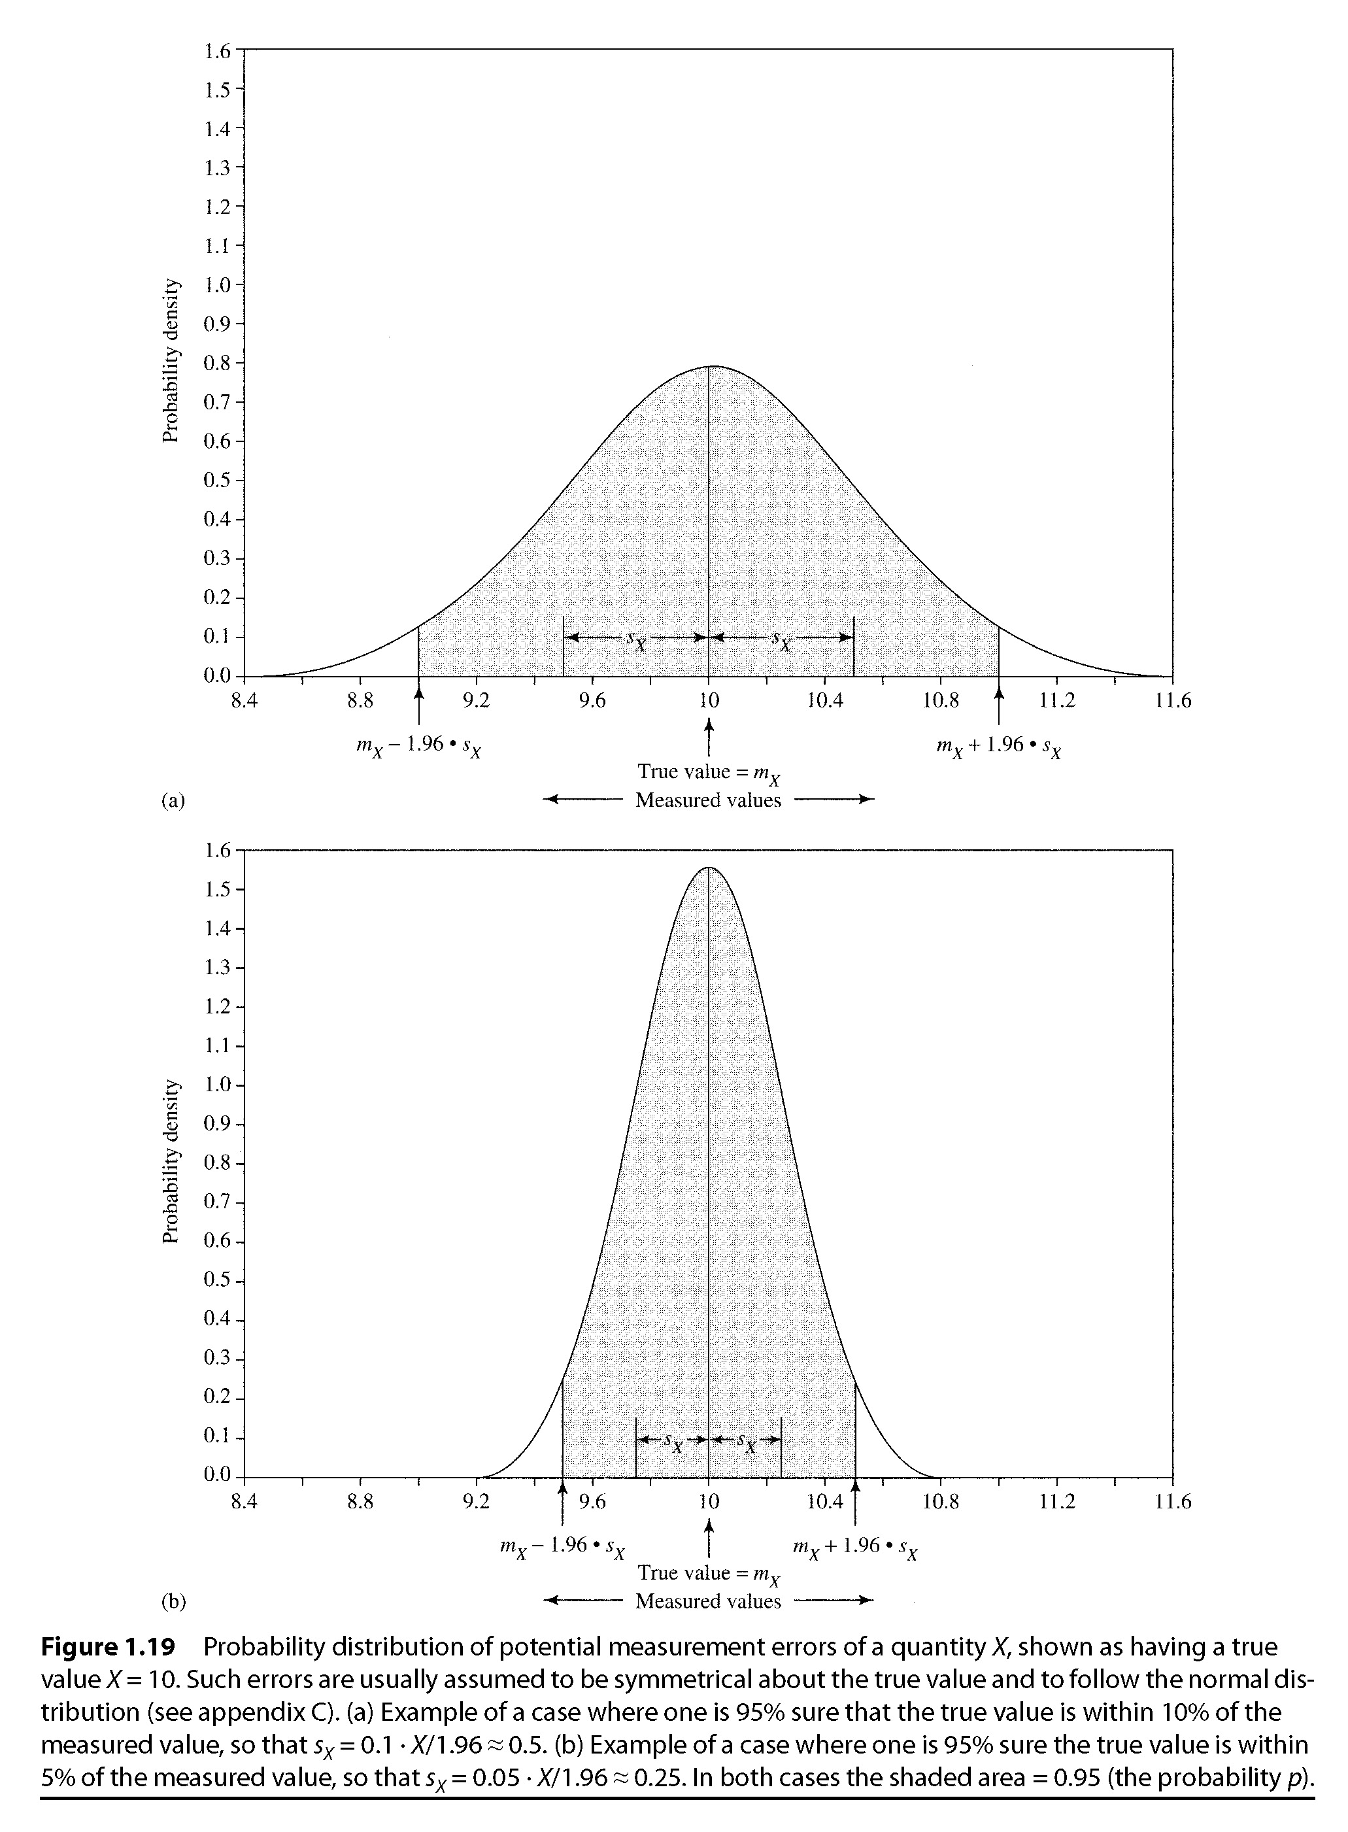
Estimation of areal ET
Assume G_{in} and G_{out} small and at equilibrium Change in storage is zero
ET = P - Q
Assume storage is negligible
m_{ET} = m_{p} – m_{Q}
Errors: model and measurement
Accuracy of precipitation and streamflow
Absolute and relative uncertainty
Independent errors s²_{x+y} = s²_{x} + s²_{y}

Slide 5
Estimation of areal ET
Assume Gin and Gout small
Assume storage is negligible
m_{ET} = m_{p} – m_{Q}
Errors: model and measurement
Accuracy of precipitation and streamflow
Relative uncertainty (u_{P}) is measurement uncertainty or accuracy
Absolute uncertainty (m_{p} u_{P})
Assuming Normal Distribution of measurement errors
Pr{m_{p} - m_{p} u_{P} <= true precipitation <= m_{p} + m_{p} u_{P} } = 0.95
m_{p} u_{P} = 2*s_{P} Where s_{P} is the estimated standard deviation for precipitation
Similarly for Q and ET

Slide 6
Example of ET estimate (2-1)
NH Oyster river
Average precip 1066mm/year, uncertain 10% (at 95% level)
Average drainage outflow 551 mm/year, 5% uncertain
m_{ET} = 1066 – 551 mm/year = 515 mm/yr
Uncertainty = SQRT {(1066*.1)**2 + (551*.05)**2} = 55.1 mm/yr
Relative uncertainty = 2 (55.1/515) = 0.214
Pr {405 < μ_{ET} < 625} = .95

Slide 7
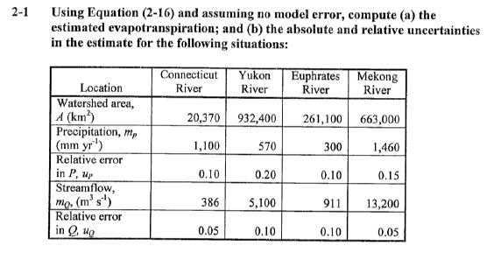
Exercise 2-1

Slide 8
Exercise 2-1
M(ET) = m(p) – m(q)
s^2(ET) = s^2(p) + s^2(q)
Convert from m^3/s to mm/yr
Q/A=386 m^3/s /20370km^2 = 598 mm/yr
S(p)=0.1*p = 110 mm/yr
S(q) = 0.05*598 mm/yr
S(ET) = sqrt( s(q)^2 +s(p)^2) = 114 mm/yr
Relative error =114 mm/yr/598 mm/y=23%
Similarly: Yukon River 115/398 = 29%
Euphrates: 32/190 = 17%
Mekong: 221/832 = 27%

Slide 9
Logan River Annual Aggregate Time Series
2500
mean cfs
7 day min cfs
2000
max cfs
1500
cfs
1000
500
0
1920
1930
1940
1950
1960
1970
1980
1990
2000

Slide 10
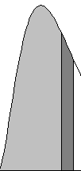
Random variables
Probability density
function
Cumulative distribution
function

Slide 11
Space/time variability
Continuous series – samples
Expectation, Mean, standard deviation, median, extremes (max/min), percentile, coefficient of variation (CV)
Flow duration curves (FDC) flow rate (q) vs. cumulative distribution (Q)
Exceedence probability E P_{Q}(q_{p}) = 1 – F_{Q}(q_{p}) = Pr {Q>q_{p}}

Slide 12
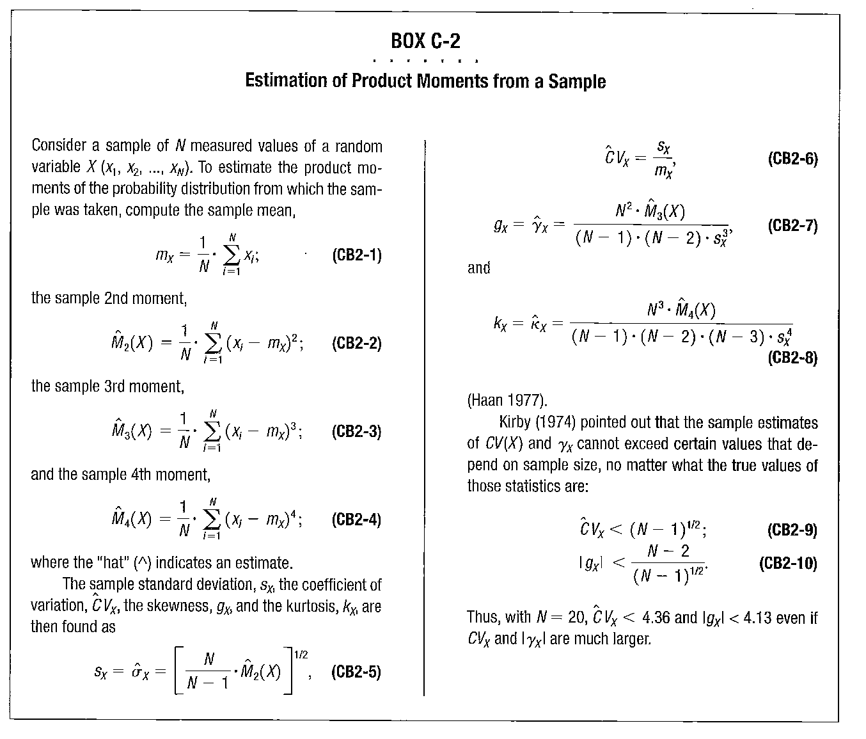
From Dingman, 2002

Slide 13
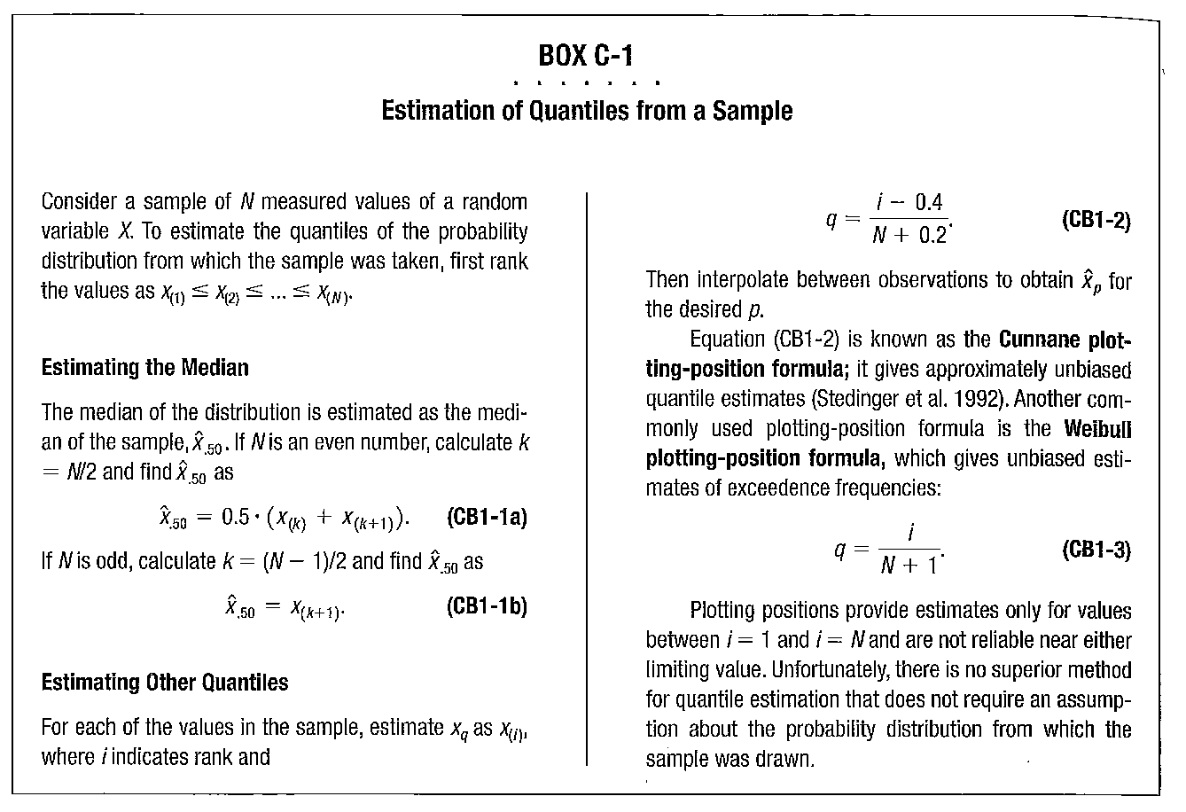
From Dingman, 2002

Slide 14
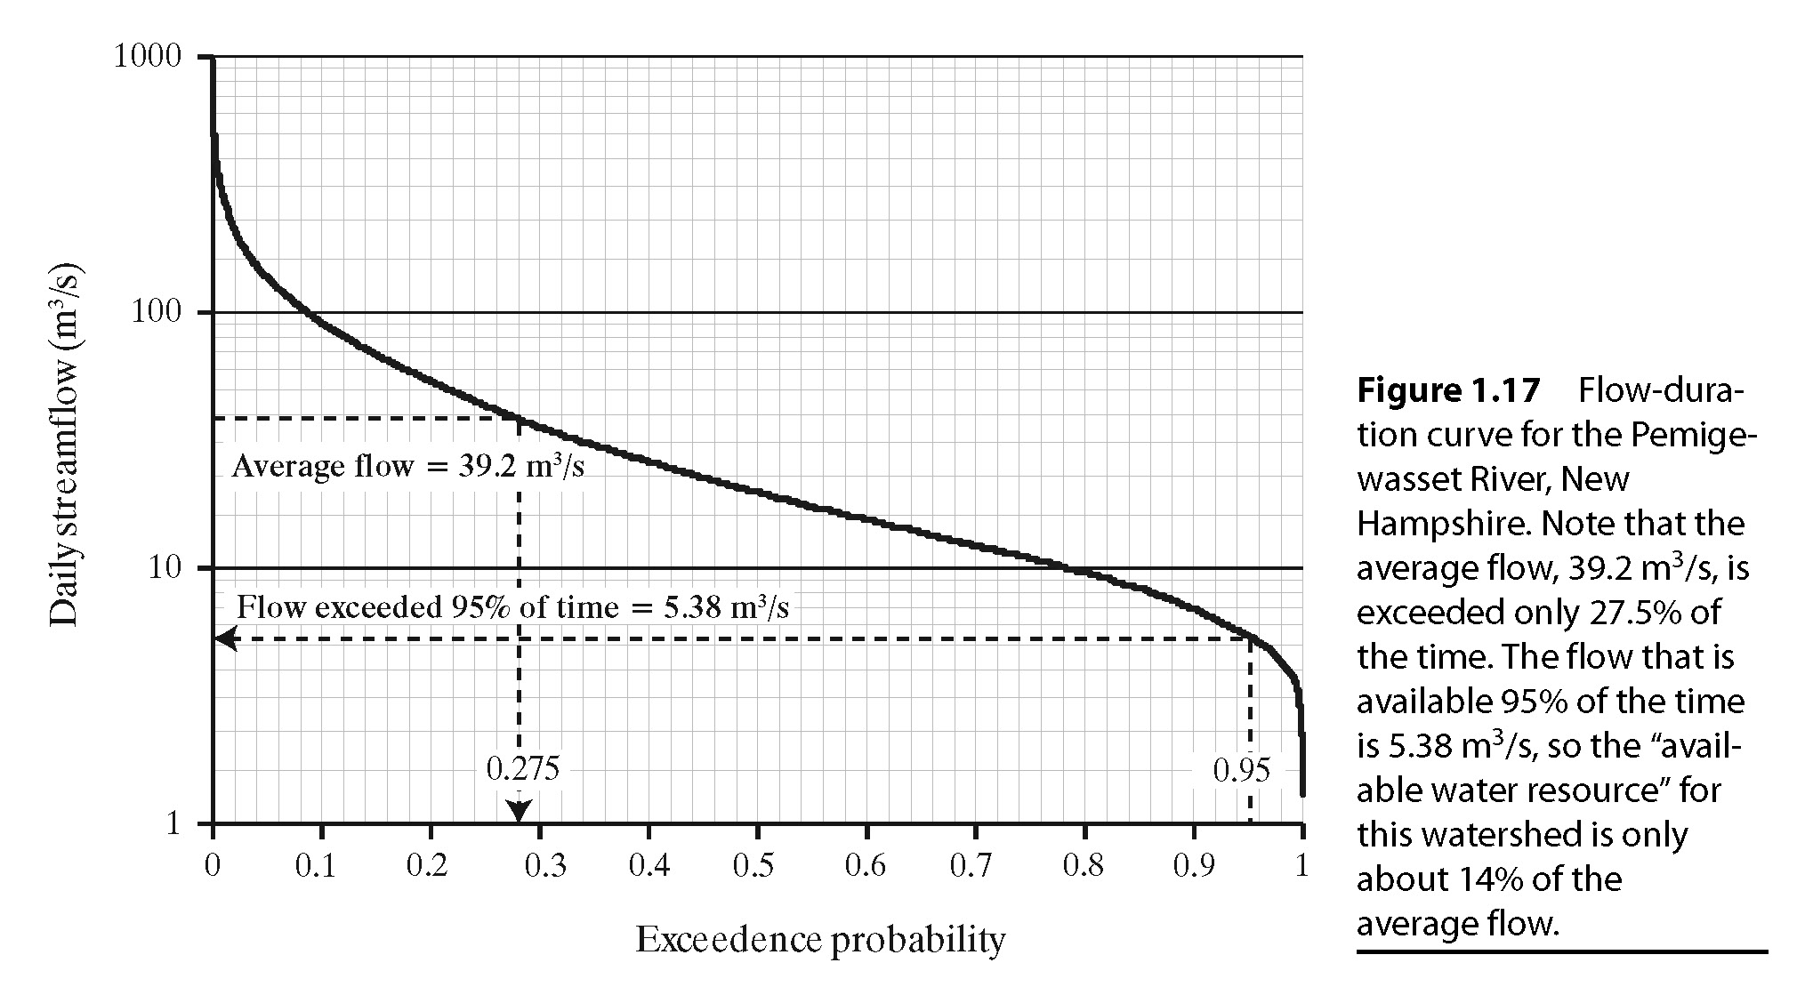
Flow Duration Curve

Slide 15
FDC can be constructed on
7-day Min Flow
Average daily flow
Average annual flow
etc
Relatively flat slopes at Upper end of FDC
Snowmelt driven floods
Large basin with storms
of several days
Steep slopes at Upper end of FDC
Flashy streams
Intense storms of short duration
Flat slopes at low end
significant groundwater storage
frequent precipitation inputs

Slide 16
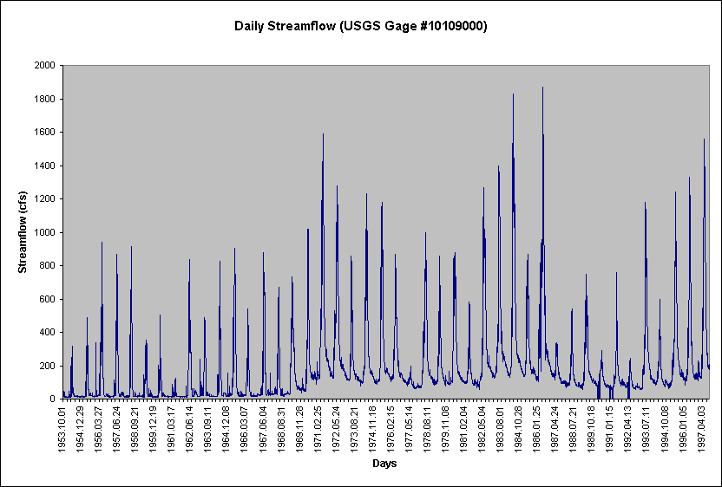

Slide 17
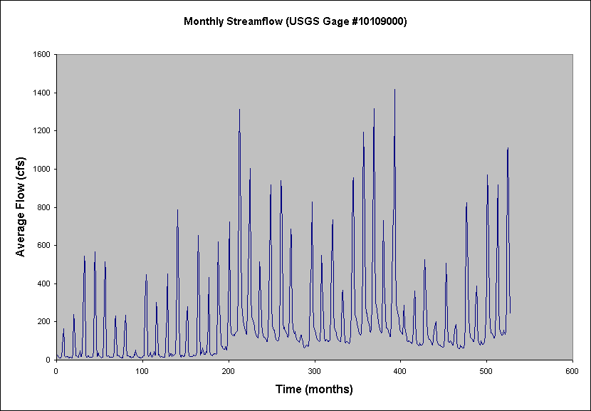

Slide 18
Mean of Monthly Streamflow. Alafia River

Slide 20
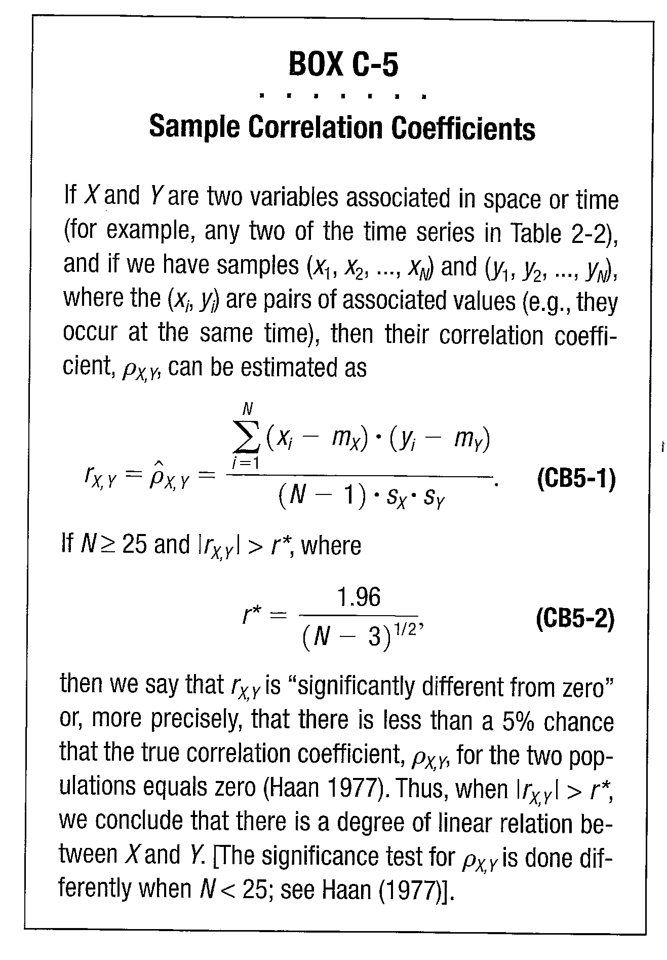
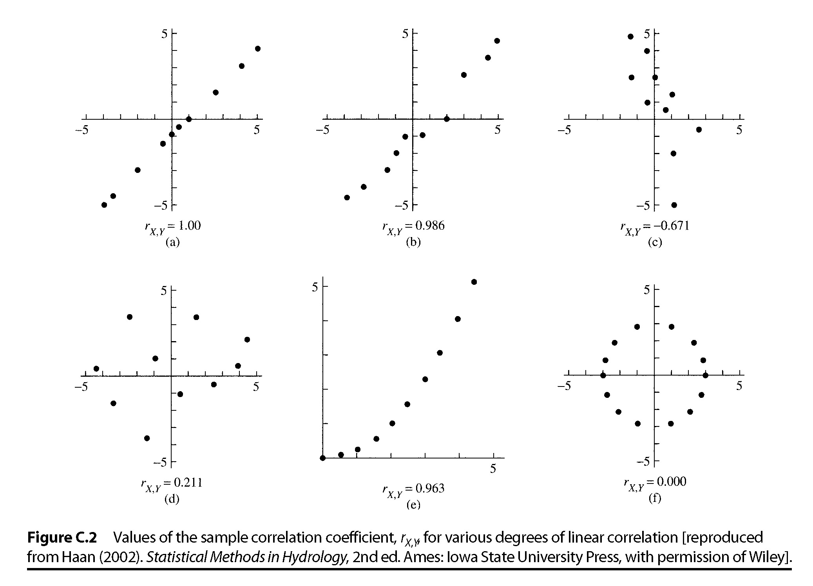
From Dingman, 2002

Slide 21
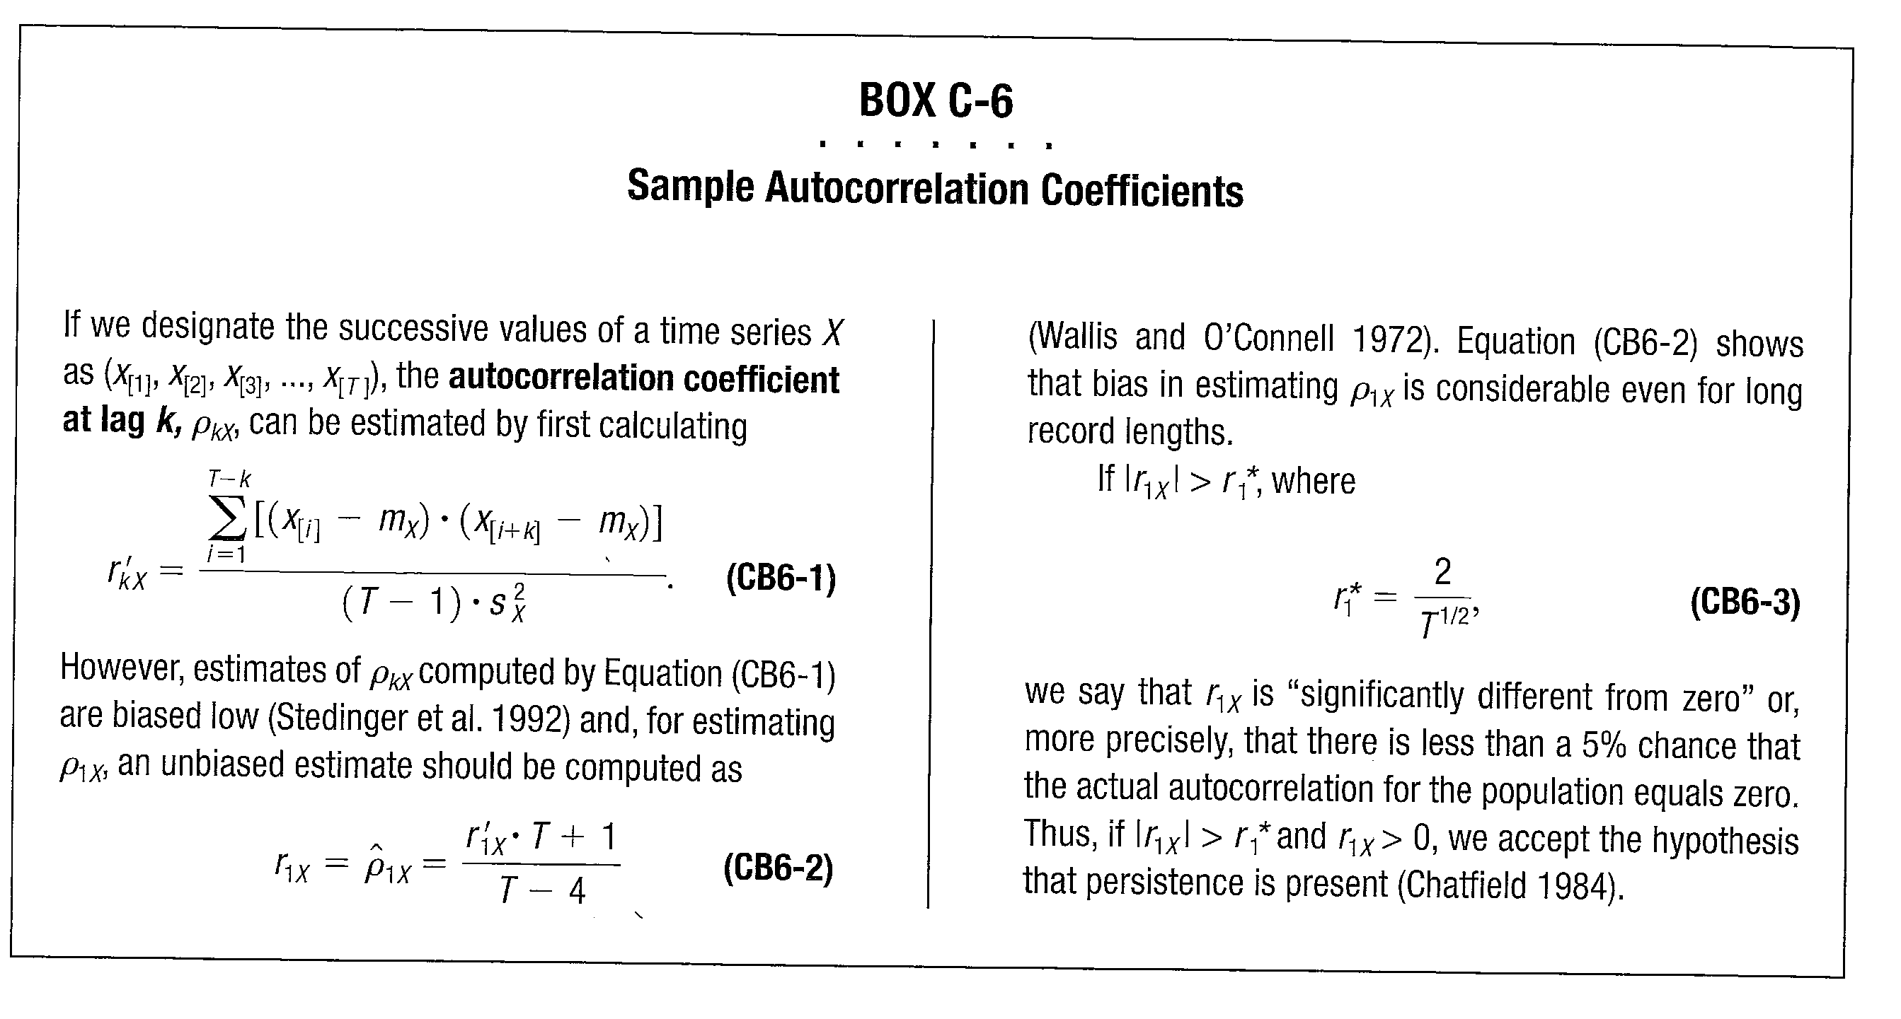
From Dingman, 2002

Slide 22
Alafia river: Autocorrelation
Autocorrelation of standardized flow

Slide 23
Alafia River: Monthly streamflow distribution

Slide 24
Time Series Box Plot
Median
Box (Red Lines) enclose 50% of the values

Slide 25
Box Plot
Outliers: beyond 1.5*IQR
Whiskers: 1.5*IQR or largest value
Box: 25th %tile to 75th %tile
Line: Median (50th %tile) - not the mean
Note: The range shown by the box is called the “Inter-Quartile Range” or IQR.
This is a robust measure of spread. It is insensitive to outliers since it is based purely on the rank of the values.

