Slide 1
Physical Hydrology & Hydroclimatology
(Multiscale Hydrology)
A science dealing with the properties, distribution and circulation of water.
R. Balaji
balajir@colorado.edu
CVEN5333 http://civil.colorado.edu/~balajir/CVEN5333

Slide 2
Lecture Week – 3 – Sep 8
Spatial and temporal scales of moisture delivery and hydrologic process of relevance
Partitioning of Precipitation into Evaporation and Runoff at annual time scale
  Runoff ratio
  Aridity/Dryness index
  Budyko (1974) curves
  Global P-E
Space-Time variability of runoff ratio

Slide 4
Partition of precipitation into streamflow and evapotranspiration
P=Q+E
E=P
E
Q
E=Ep
E
P

Slide 5
Partition of precipitation into streamflow and evapotranspiration
P=Q+E
E=P
E
Q
E=Ep
W=Q/P 1
W=Q/P 0
E
Arid
Water Limited
P
Humid
Energy Limited

Slide 6
Rearranged with Aridity Index axes
E/P
E=Ep
Energy limited upper bound
E=P
Water limited upper bound
1
Evaporative Fraction
Q/P
Budyko, 1974
Humid
Arid
Ep/P
Energy Limited
Water Limited
Dryness (Available Energy /Precip)

Slide 7
E/P=ϕ(R/P) Budyko, 1974
E/P
1
Evaporative Fraction
ν ≈ 2
Dryness (Available Energy/Precip)
R/P

Slide 9
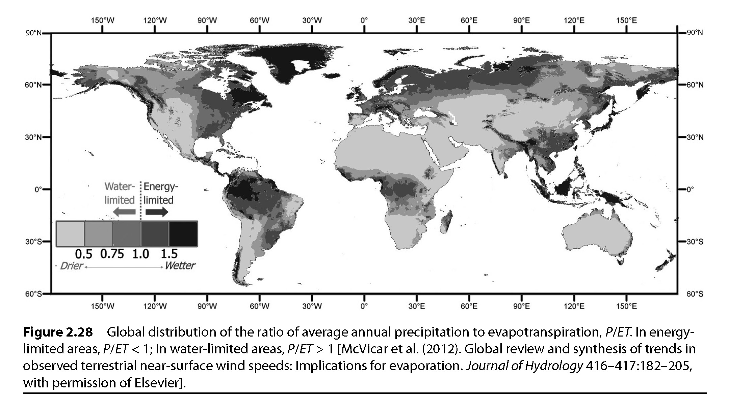
Global PET

Slide 10
Some examples from Utah
ID | Watershed
1302 | West Canyon Creek near Cedar Fort
1402 | White River Below Tabbyune Creek
2102 | Yellowstone River near Altonah
2104 | Duchesne River near Tabiona

Slide 11
What else controls the water balance partition function (Budyko curve)?
E/P
Soil Storage/ Retention or Residence time
E = R : energy limited upper bound
large
medium
small
1
E = P : water limited upper bound
Evapotranspiration fraction
Theoretical functional form
f(R/P, S/(Pτ))
R/P
humid
arid
energy limited
water limited
Dryness (available energy /precip)

Slide 12
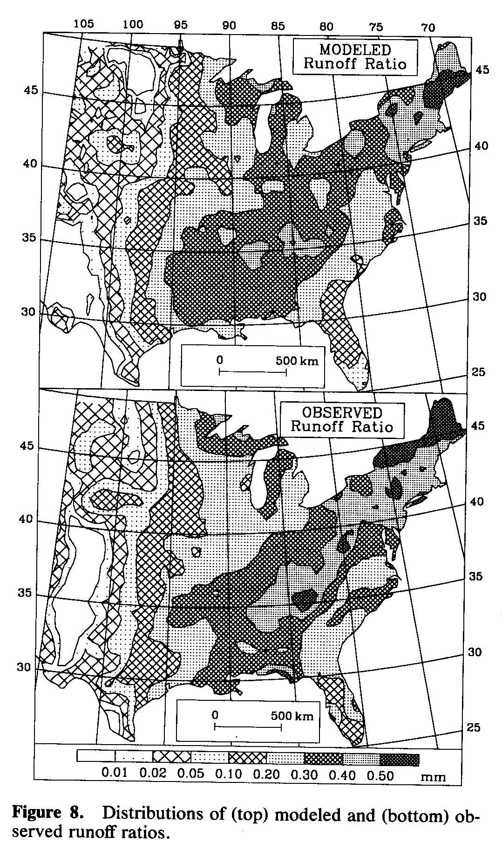
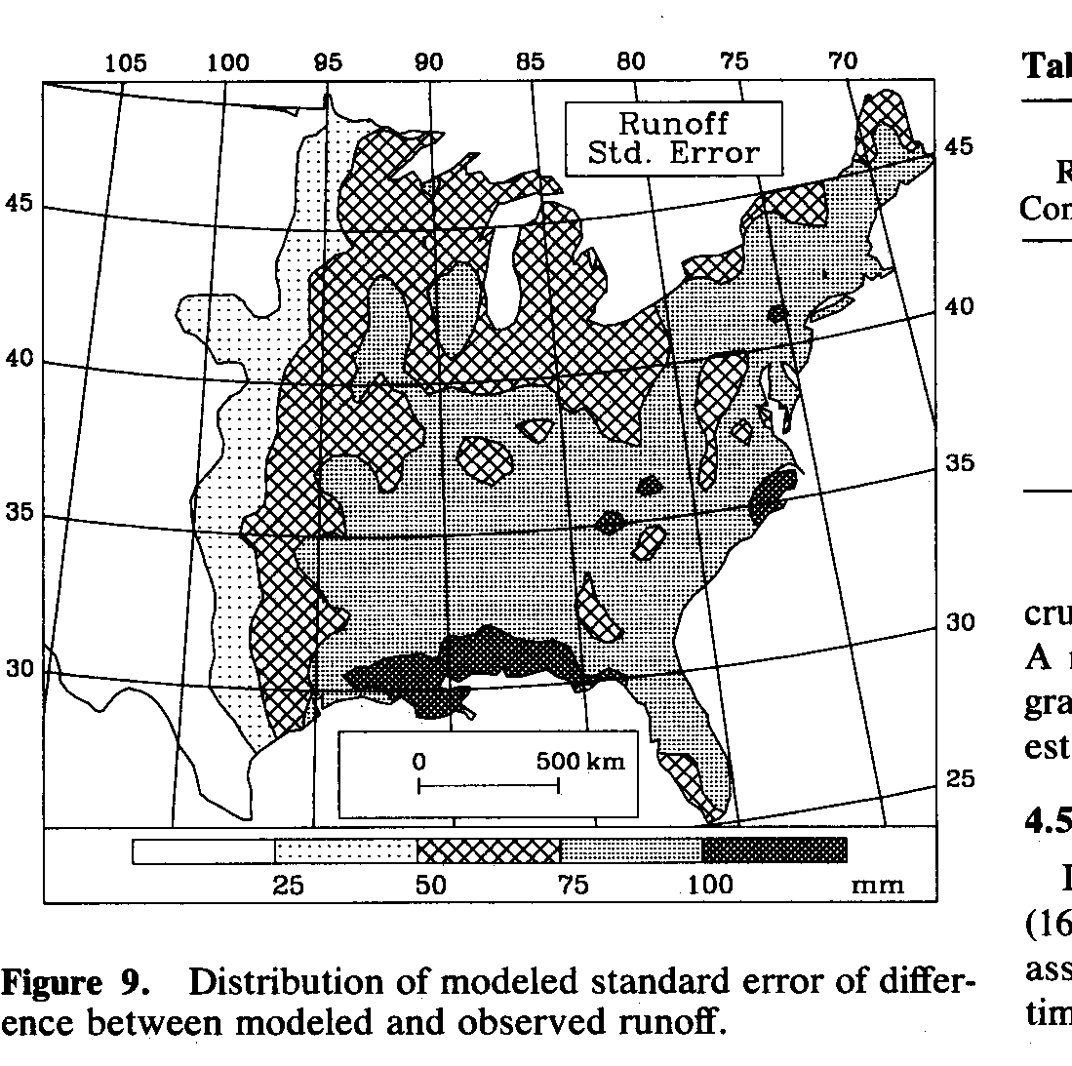
Uncalibrated Runoff Ratio
Explains 88% of geographic variance
Remaining 12% difference is consistent with uncertainty in model input and observed runoff
Low
High
Milly, P. C. D., (1994), "Climate, Soil Water Storage, and the Average Annual Water Balance," Water Resources Research, 30(7): 2143-2156.

Slide 13
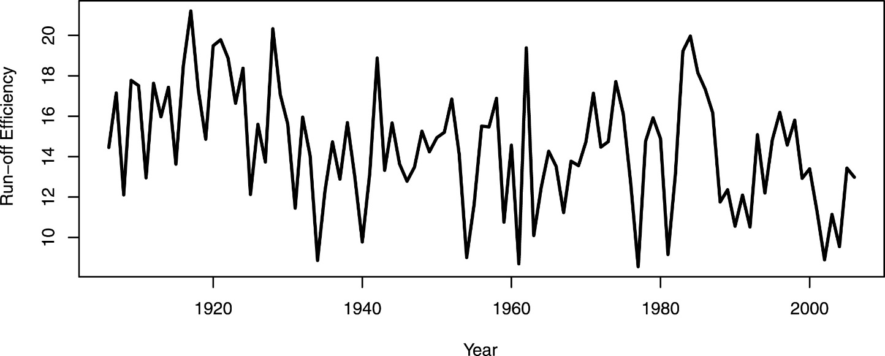
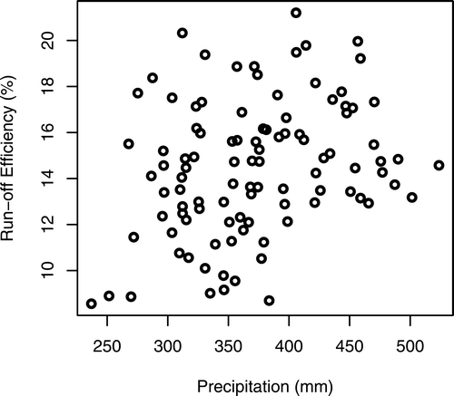
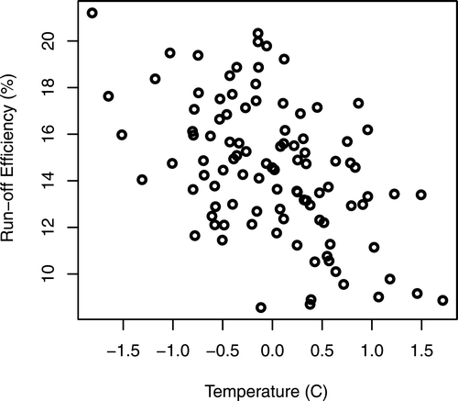
Runoff Efficiency of CO River, Nowak et al. (2012, Journal of Climate)

Slide 14
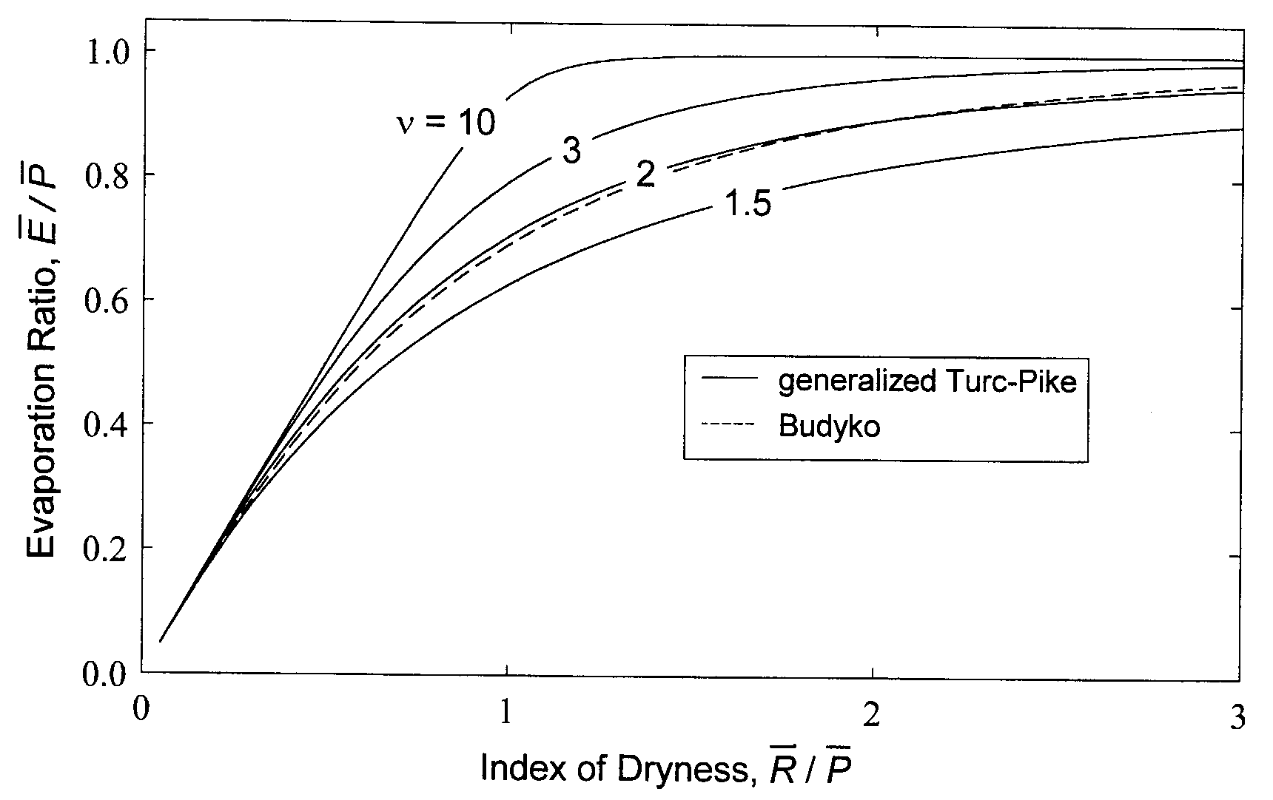
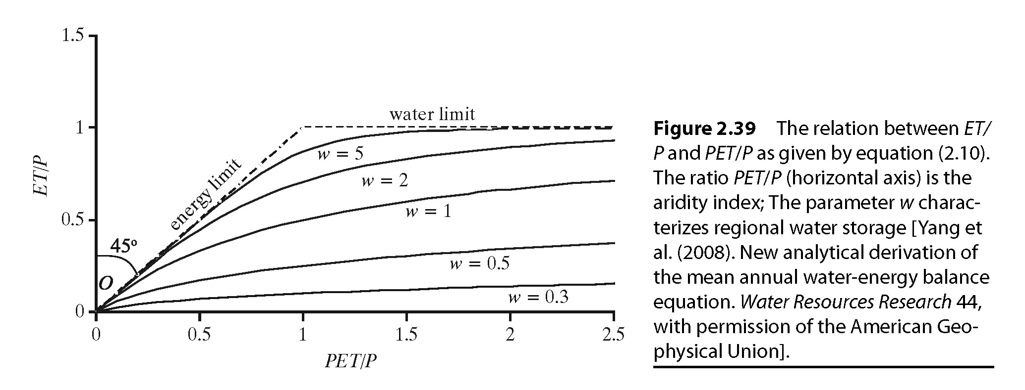
Milly/Budyko Model – Framework for predictions hypothesis testing
Q/P
Increasing variability in soil capacity or areas of imperviousness
Increasing Retention or Soil capacity
Increasing variability in P – both seasonally and with storm events
Milly, P.C.D. and K.A. Dunne, 2002,
Macroscale water fluxes 2: water and energy
supply control of their interannual variability, Water Resour. Res., 38(10).

Slide 15
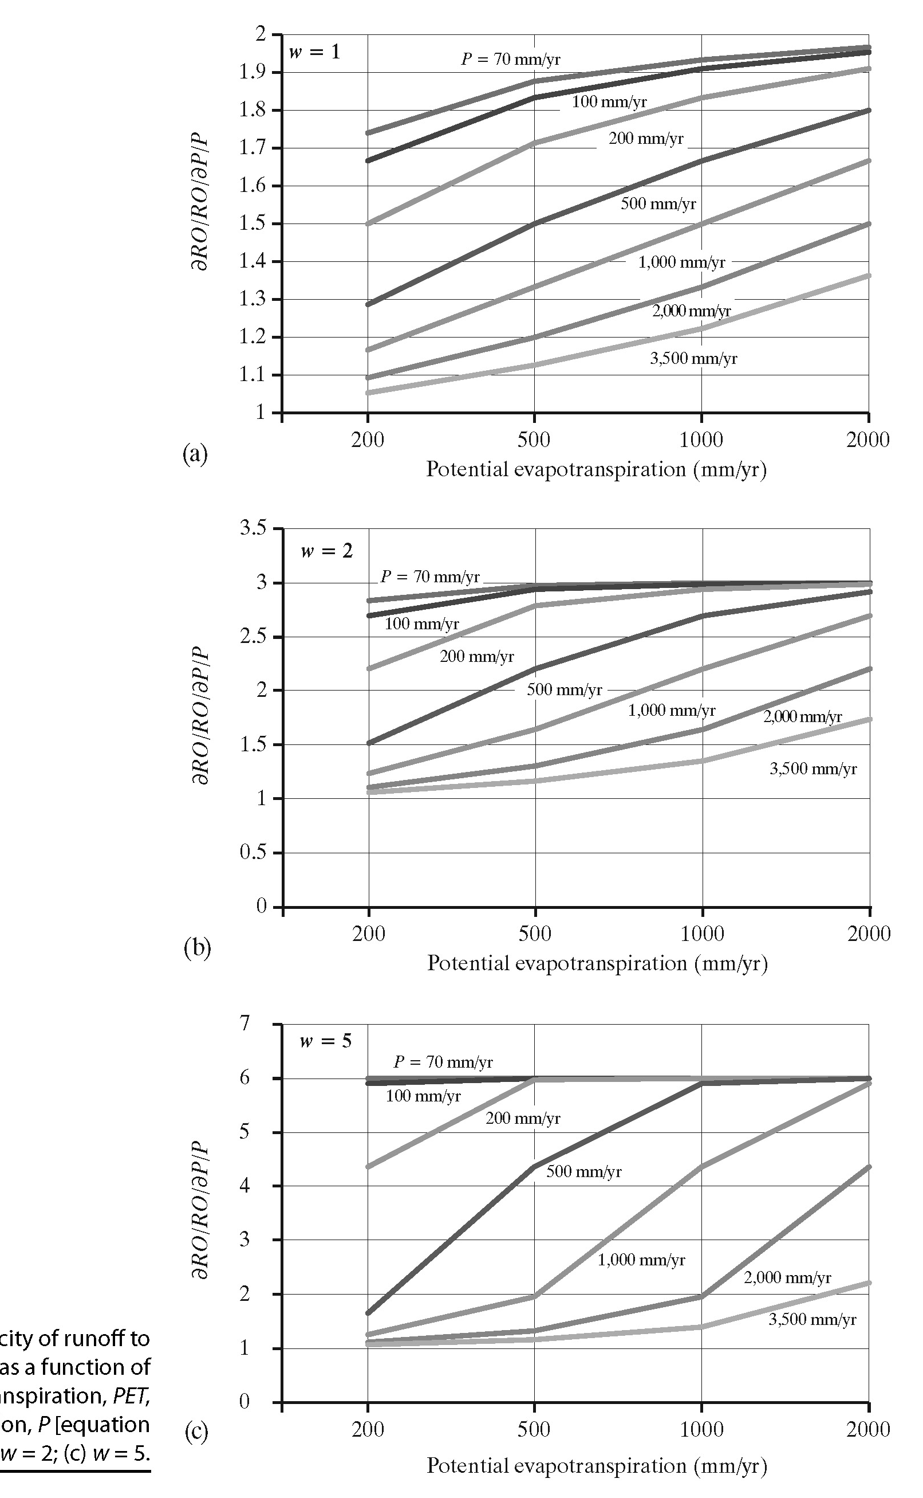
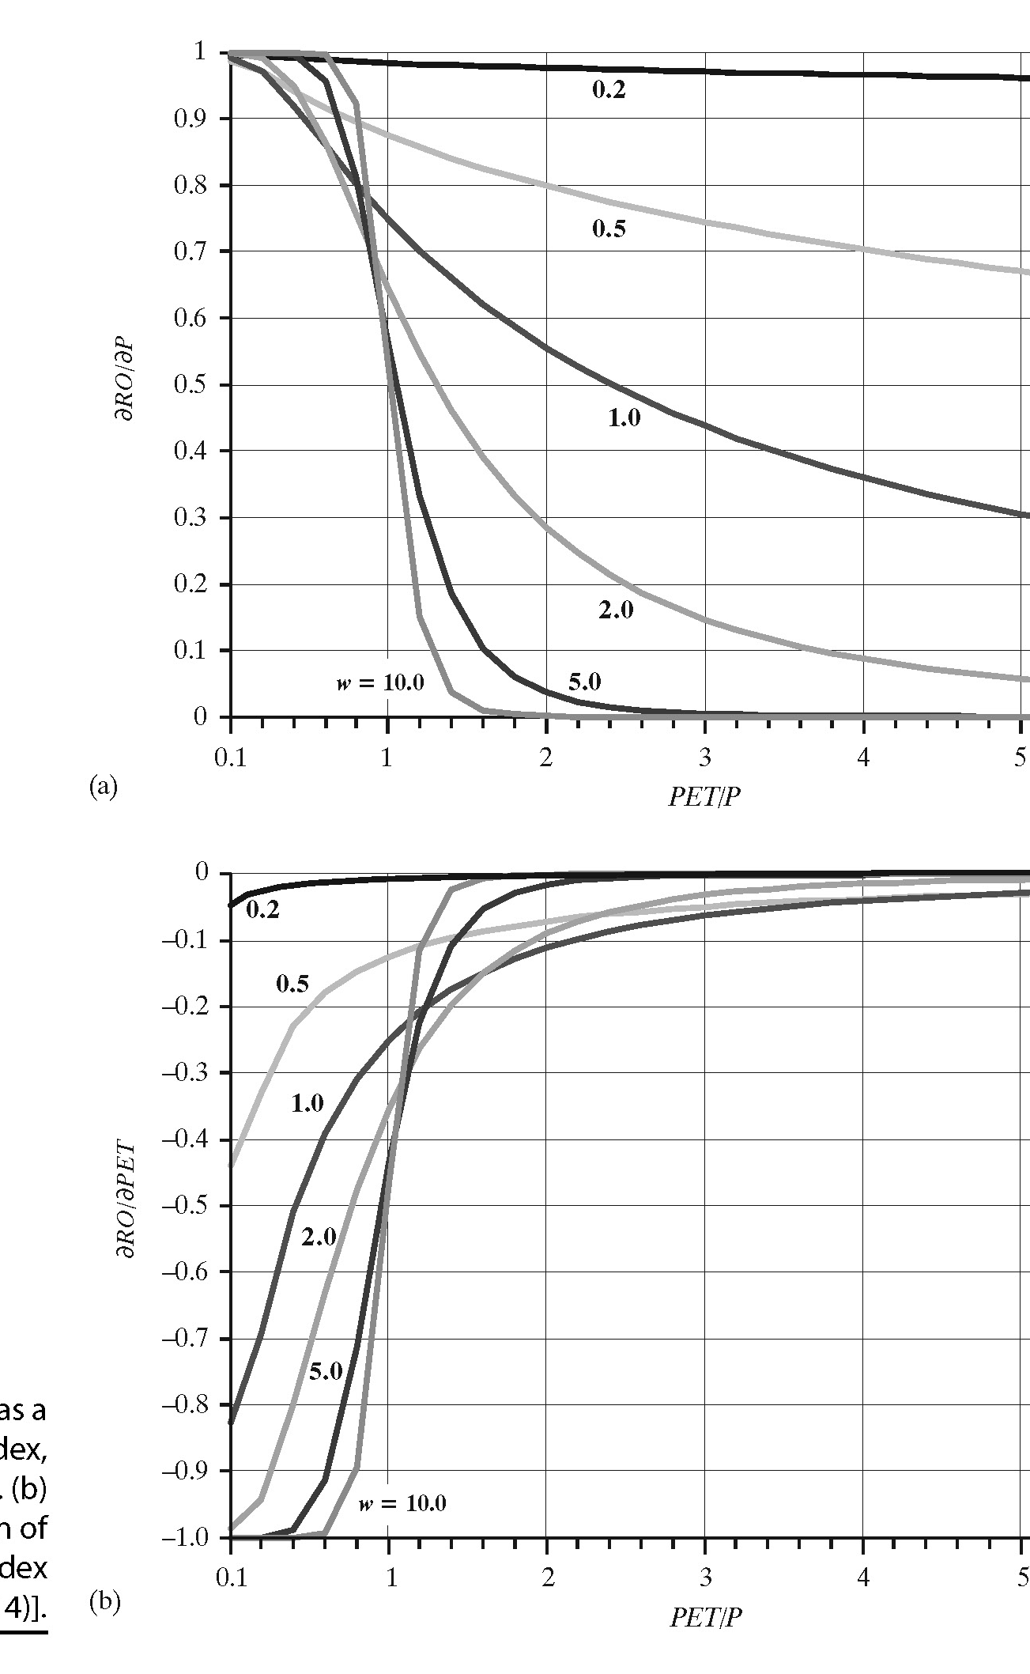
Elasticity and Aridity Indices

