Slide 1
Physical Hydrology & Hydroclimatology
(Multiscale Hydrology)
A science dealing with the properties, distribution and circulation of water.
R. Balaji
balajir@colorado.edu
CVEN5333 http://civil.colorado.edu/~balajir/CVEN5333
Includes slides from Prof. Mike Gooseff

Slide 2
Lectures Week – 5 - 6
Water Vapor in Atmosphere
  Basics
Vertical Gradients in Atmosphere
  Temperature
  Pressure
Atmospheric Stability
Precipitation
  Formation
  Areal estimation
  Physical Hydrology, Dingman (Chapter 3, Appendix E)
  Terrestrial Hydrometeorology, Shuttleworth, (Chapter 2,3)
  Hydrology, Bras (Chapter 3)

Slide 3
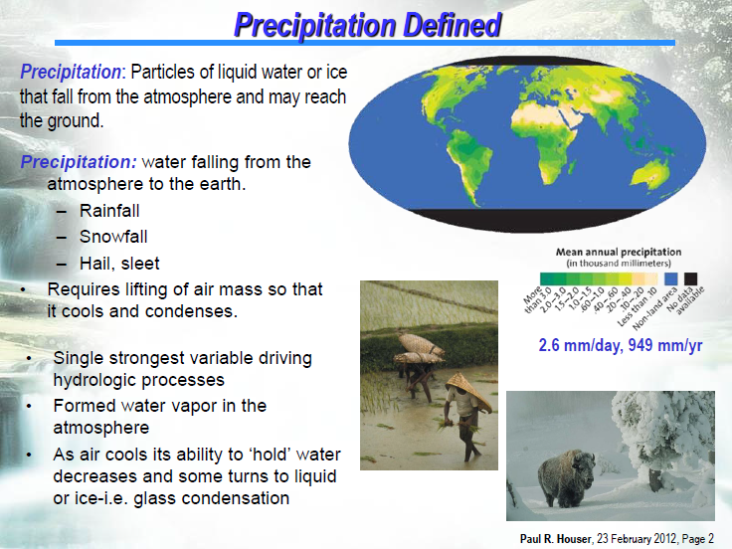

Slide 4
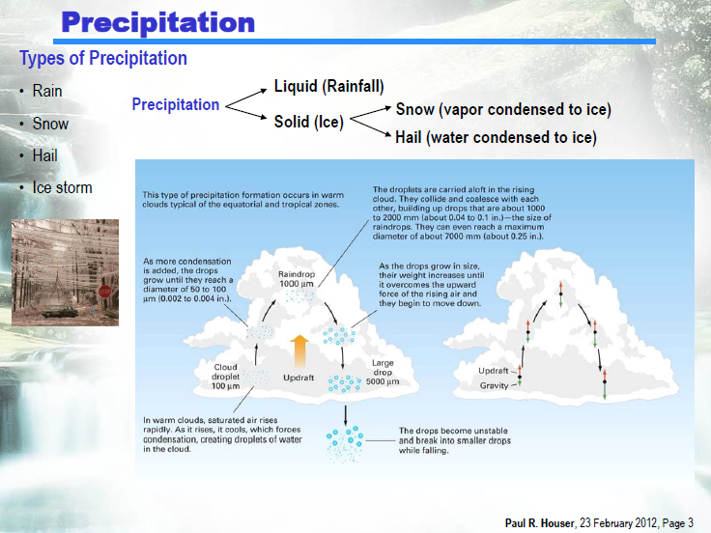

Slide 5
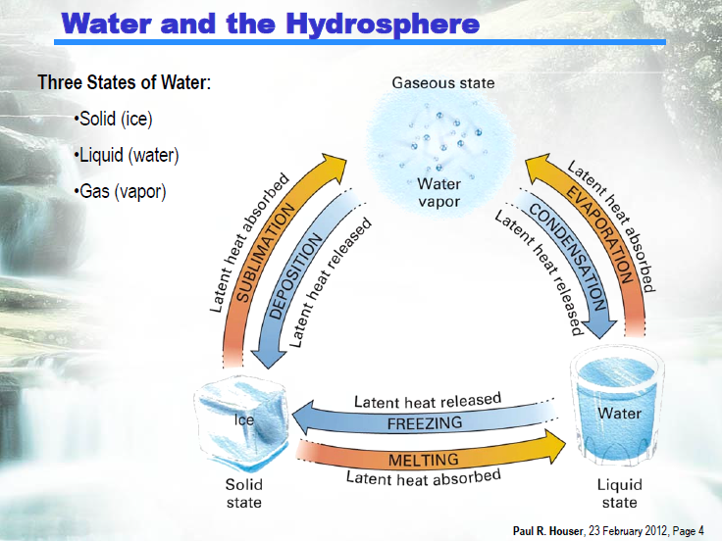

Slide 6
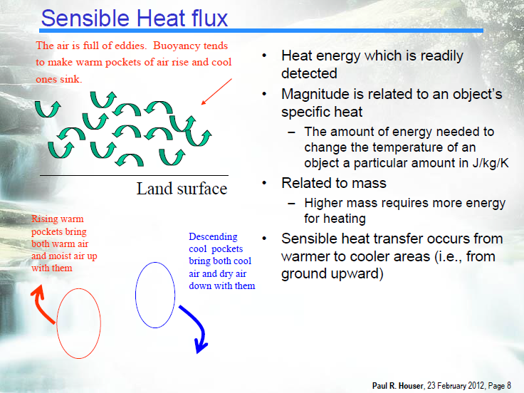

Slide 7
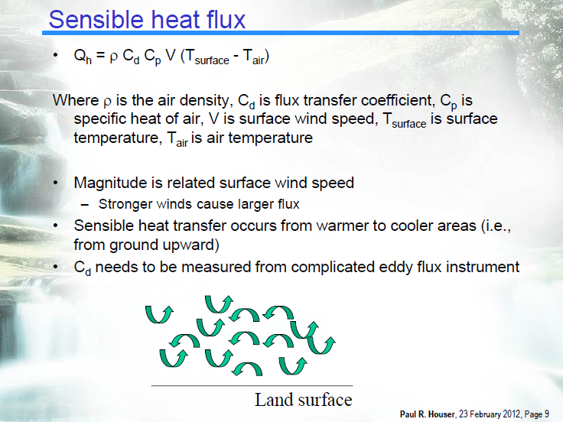

Slide 8
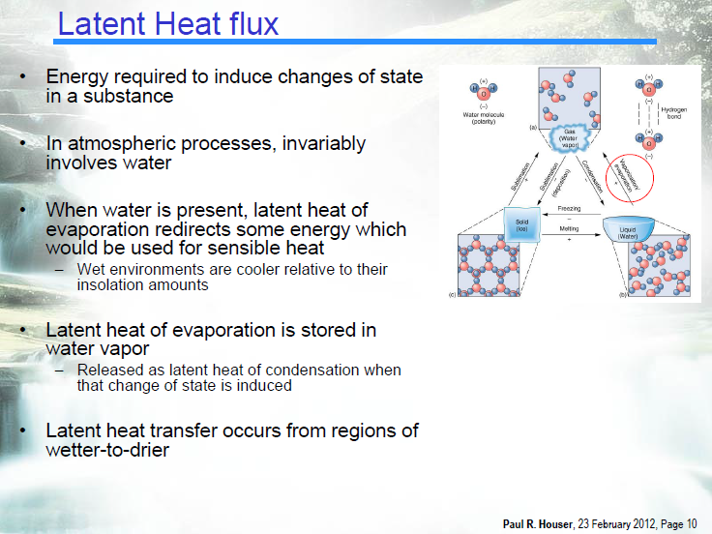

Slide 9
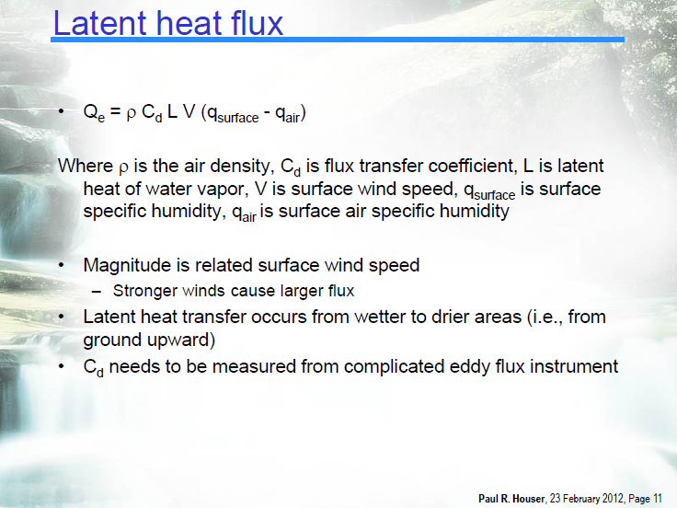

Slide 10
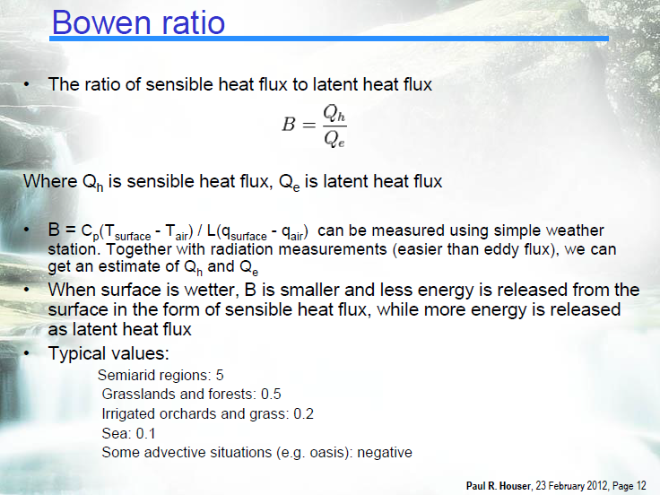

Slide 11
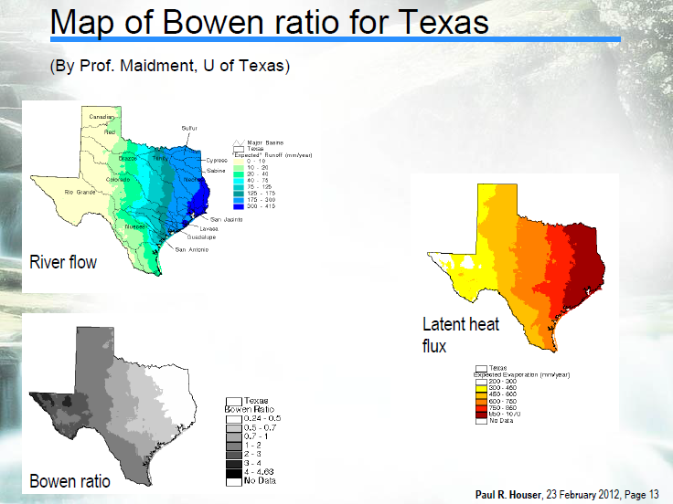

Slide 12
Thermodynamics of Cloud Formation –
Parcel Theory
Several different thermodynamic mechanisms for cooling an air parcel:
  - radiative cooling
  - cooling via conduction
However the most efficient mechanism for cooling air is so called adiabatic cooling as a result of vertical uplift
Notes:
Several different thermodynamic mechanisms for cooling an air parcel:
radiative cooling,
cooling via conduction
However the most efficient mechanism for cooling air is so-called adiabatic cooling as a result of vertical uplift.

Slide 13
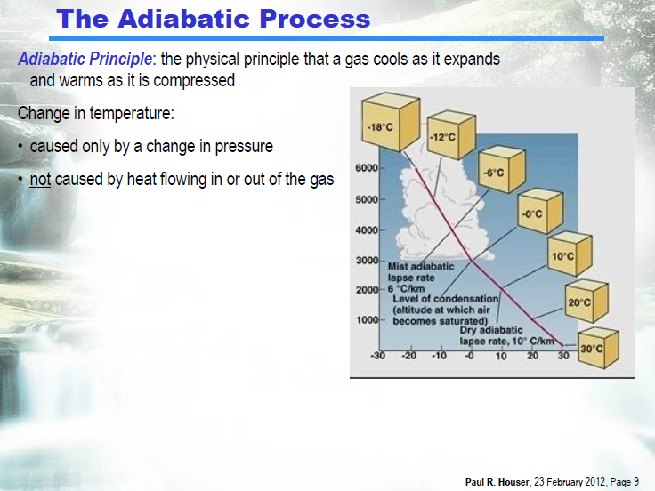

Slide 14
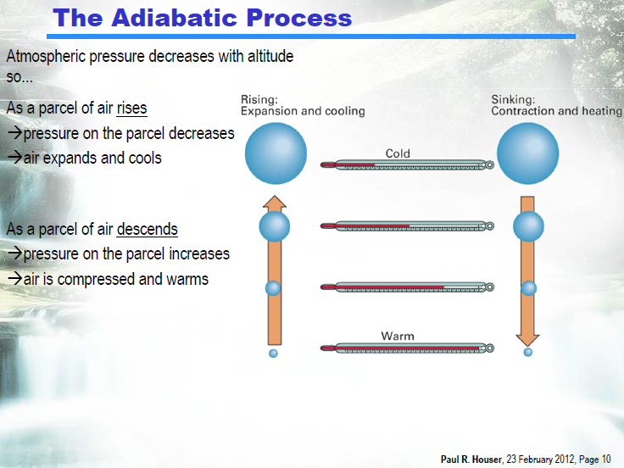

Slide 15
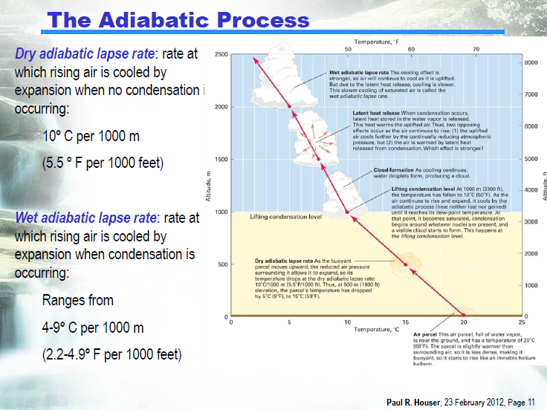

Slide 16
Thermodynamics of Cloud Formation –
Parcel Theory
Requirement for cloud formation: condensation mechanism whereby water vapor molecules are converted to liquid or ice
We will use “parcel theory” - a conceptual representation - to “follow” parcels of air as they move through the atmosphere
  Specific humidity of an air parcel (q) is conserved
  (i.e., q is constant) as a parcel moves,
  Given this fact, vapor will be carried around by a parcel right up until the parcel becomes saturated
Notes:
Requirement for cloud formation: condensation mechanism whereby water vapor molecules are converted to liquid or ice.
We will use “parcel theory” - a conceptual representation - to “follow” parcels of air as they move through the atmosphere
Specific humidity of an air parcel (q) is conserved (i.e. q = constant) as a parcel moves, if no condensation.
Given this fact, vapor will be carried around by a parcel right up until the parcel becomes saturated

Slide 17
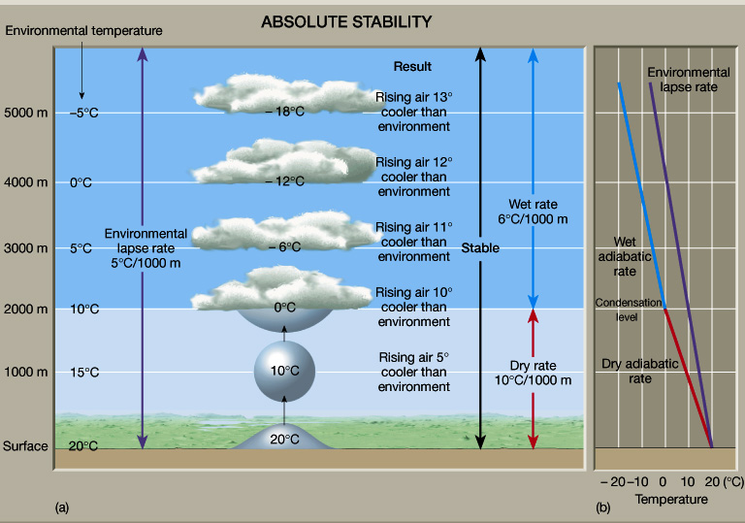
http://www.ux1.eiu.edu/~cfjps/1400/stability.html
Notes:
Moist adiabatic lapse rate = 0.6°C per 100 m.
Remember -- This is an average lapse rate. The actual one varies!!!
If the moisture falls out of the parcel as rain, the process is not reversible.
Reversible only if no moisture has been removed!
If we (somehow) lift the parcel: It will cool at the dry adiabatic lapse rate.
The parcel will find itself cooler than the environmental (sounding) temperature.
At the same pressure, a cooler parcel will be more dense than the environment.
Being denser, the parcel will descend back to where it came from.
STABLE!

Slide 18
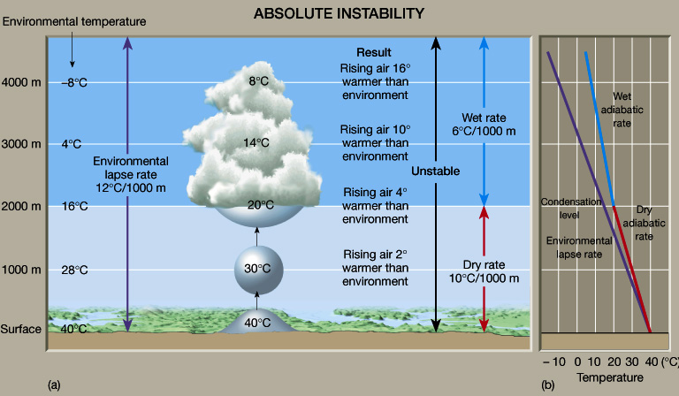
http://www.ux1.eiu.edu/~cfjps/1400/stability.html
Notes:
If we (somehow) lift the parcel: It will cool at the dry adiabatic lapse rate.
The parcel will find itself warmer than the environmental (sounding) temperature.
At the same pressure, a warmer parcel will be less dense than the environment.
Being less dense, the parcel will ascend and move farther from where it came from.
UNSTABLE!

Slide 19
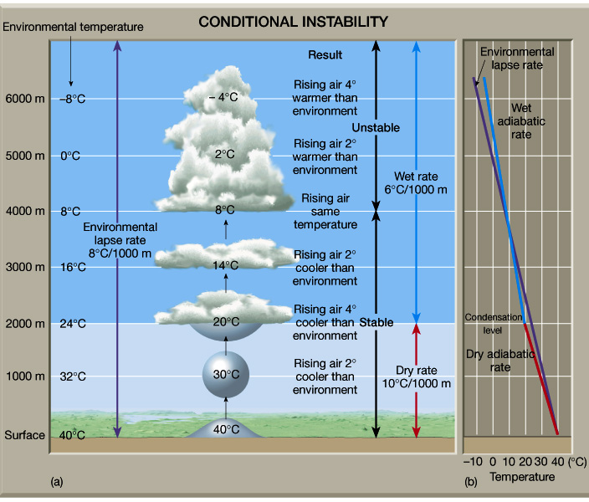
http://www.ux1.eiu.edu/~cfjps/1400/stability.html
Notes:
If we (somehow) lift the parcel: It will cool at the dry adiabatic lapse rate.
The parcel will find itself at the same temperature than the environmental (sounding) temperature.
Being the same density, the parcel will not be accelerated in any direction and will remain where it is.
NEUTRAL STABILITY! -- Dry Neutral, or Conditional Instability

Slide 20
Hydrostatic Atmosphere
dM = ρAdz
F
dF=dM g
A
dz
dP = dF/A = ρgdz
F+dF

Slide 21
Physical properties of moisture in the air
Dingman, Chapter 3 (Section 3.1 and 3.2)

Slide 22
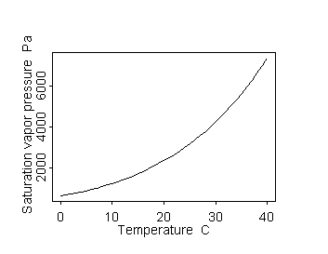
How much water can the air hold?
:
Saturation vapor pressure e_{s}(t). The maximum vapor pressure that is thermodynamically stable.
mb, for T in ºC
See Goff-Gratch (1946) for more precise equation or Lowe (1977) for polynomials for efficient evaluation
e_{s}(T_{a})
T_{d}
e_{a}
T_{a}
Relative humidity. Vapor pressure relative to saturation vapor pressure. (usually expressed as %)
Dew point. T_{d}. The temperature to which a parcel of air has to be cooled at constant (vapor) pressure to reach saturation

Slide 23
Virtual Temperature
Also
with
This suggests
The temperature that dry air should have in order to have the same density as moist air with given q, T, p (Brutsaert, 2005, p25)

Slide 24
Vertical Profiles of the Atmosphere - Moisture
There is no standard water vapor profile
In general, higher latitudes have less water vapor since they are colder.
The lower humidity is largely controlled by the saturated specific humidity
Notes:
There is no standard water vapor profile
In general, higher latitudes have less vapor since they are colder.
The lower humidity is largely controlled by the saturated specific humidity

Slide 25
Vertical Profiles of the Atmosphere - Moisture
Specific humidity
drops off quickly
with height
q ~ 0 at the top of the troposphere
Why does q decrease with z?
Notes:
Specific humidity quickly drops off with height
q~0 at the top of the troposphere
Why does q decrease with z?

Slide 26
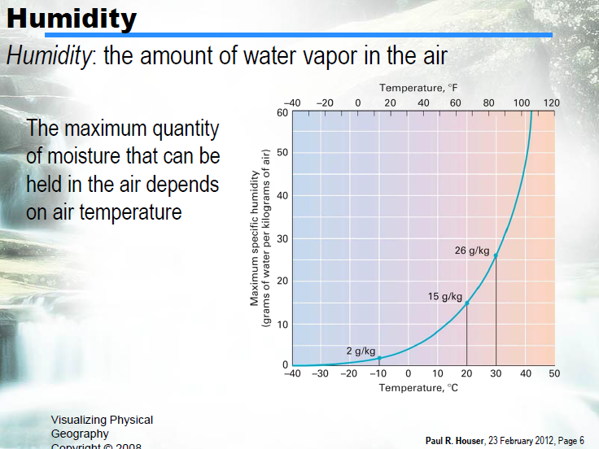

Slide 27
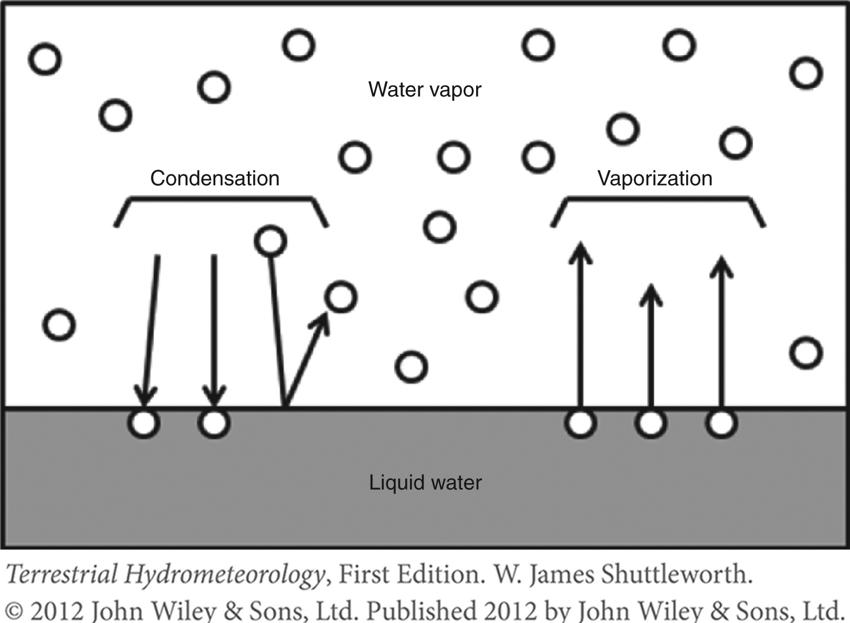
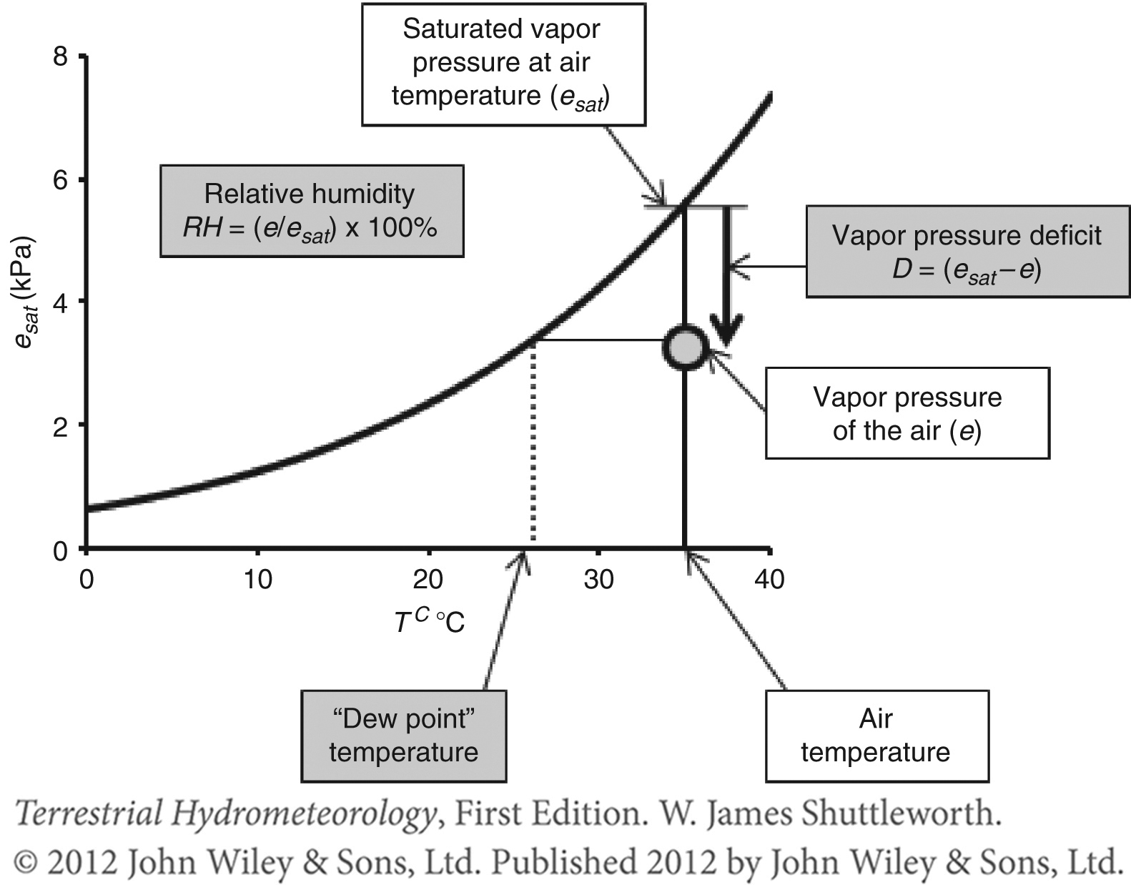
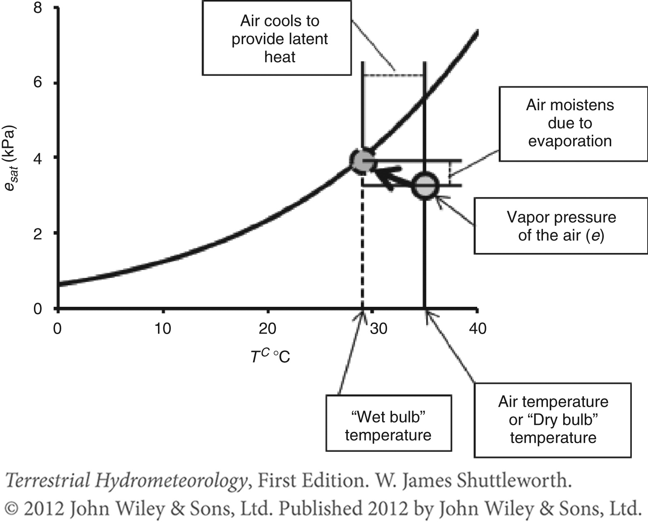
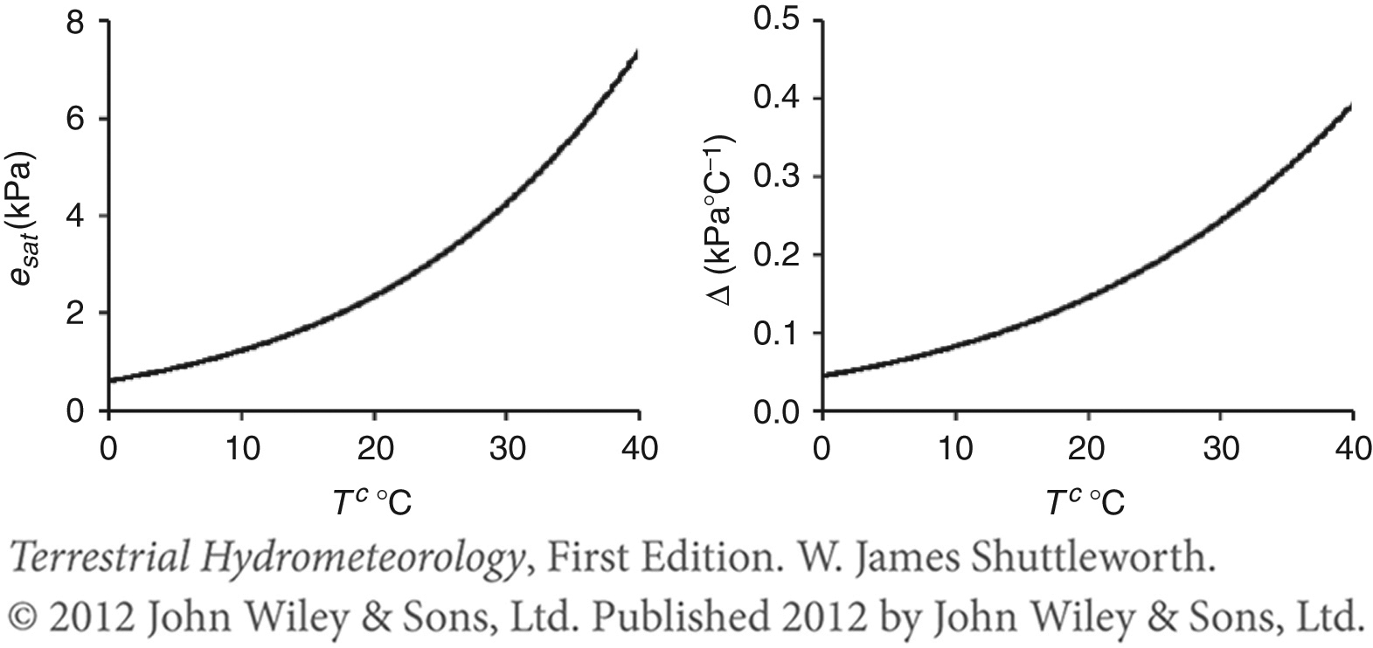

Slide 28
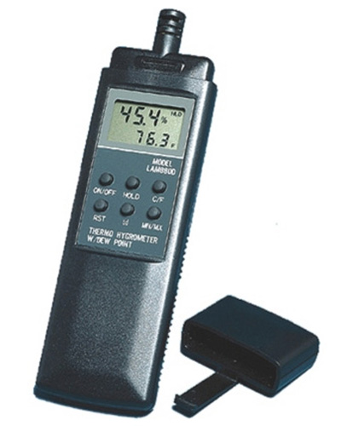
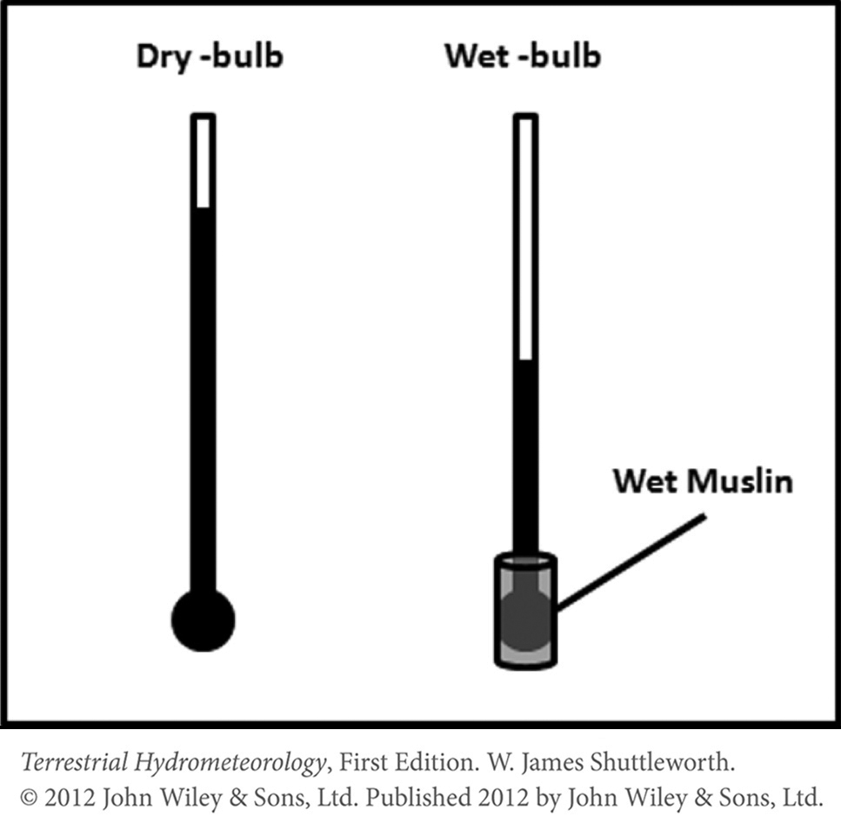

Slide 29
Vertical Profiles of the Atmosphere –
Total Precipitable Water
The bulk amount of vapor in the atmospheric column; amount (mass) of water that would be yielded (per unit area) if all vapor were condensed out of the column of air.
This is calculated as the integral of the water vapor mass with elevation:
Units: kg H₂O/m²
Notes:
The bulk amount of vapor in the atmospheric column; amount (mass) of water that would be yielded (per unit area) if all vapor were condensed out of that column of air.
This is calculated as the integral of the water vapor mass with elevation:
FILL IN EQN
Units: kg H₂O/m²

Slide 30
Vertical Profiles of the Atmosphere –
Total Precipitable Water
However, it’s difficult to measure vapor density.
So, we can substitute in specific humidity and hydrostatic pressure terms to give this integral instead:

Slide 31
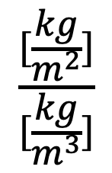
Vertical Profiles of the Atmosphere –
Total Precipitable Water
Of course, if clouds exist, must consider
ice and liquid as well
We can convert the W_{p} values to a depth of water by normalizing to the density of water:
W_{p}/ρ dimensional analysis:
Typical values are 1-5 cm
$$\frac{[\frac{kg}{m^{2}}]}{[\frac{kg}{m^{3}}]}$$
Notes:
Of course, if clouds exist, must consider ice and liquid as well
We can convert the W_{p} values to a depth of water by normalizing to the density of water:
W_{p}/ρ, dimensional analysis: [kg/m²]
[kg/m³]
Typical values are 1-5 cm

Slide 32
Formation of Precipitation
Source of moisture
Lifting mechanism (orographic or heating)
Phase change from vapor to water - Energy
Small nuclei or dust for droplet formation
Droplets must grow as they fall to earth
From Bedient

Slide 33
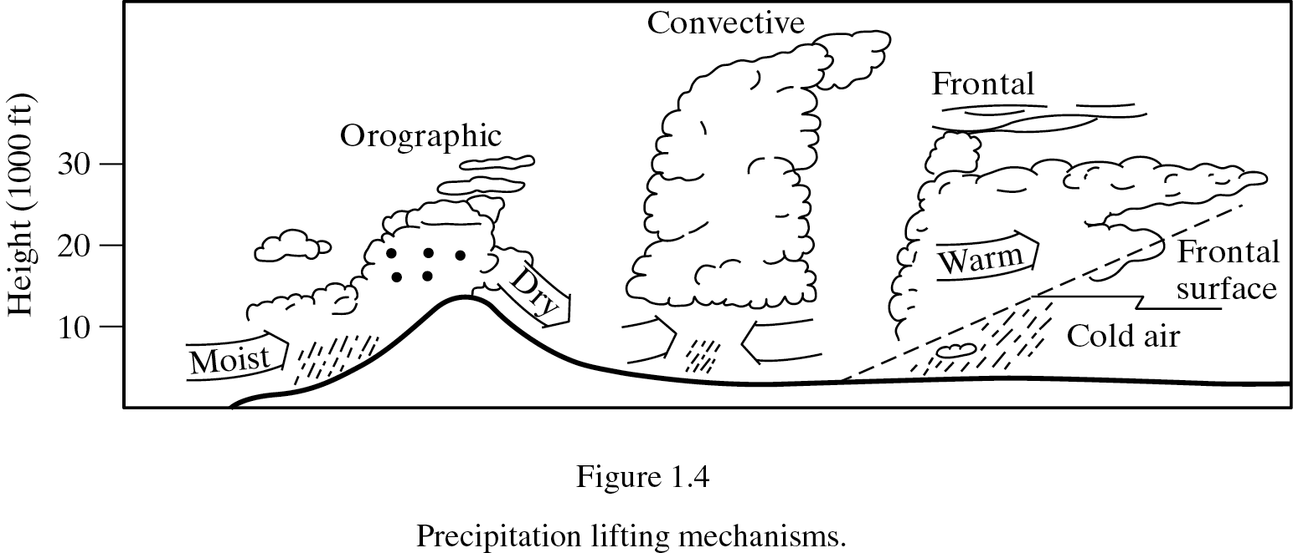
Lifting Mechanisms
From Bedient

Slide 34
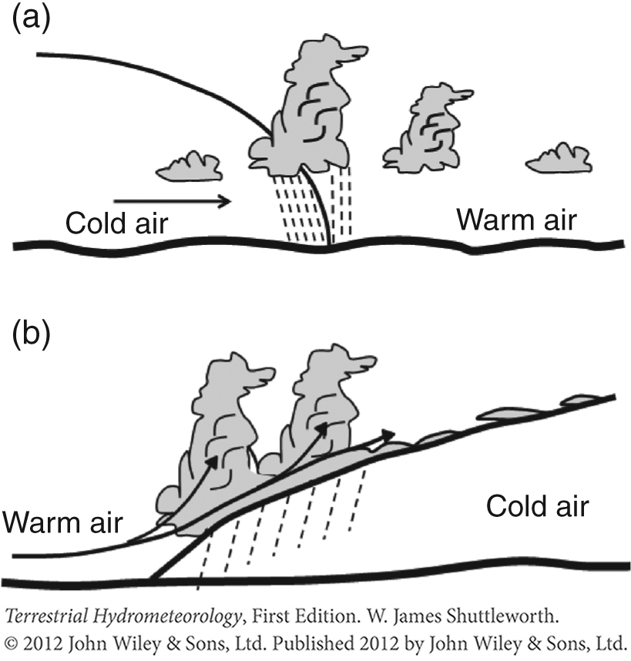
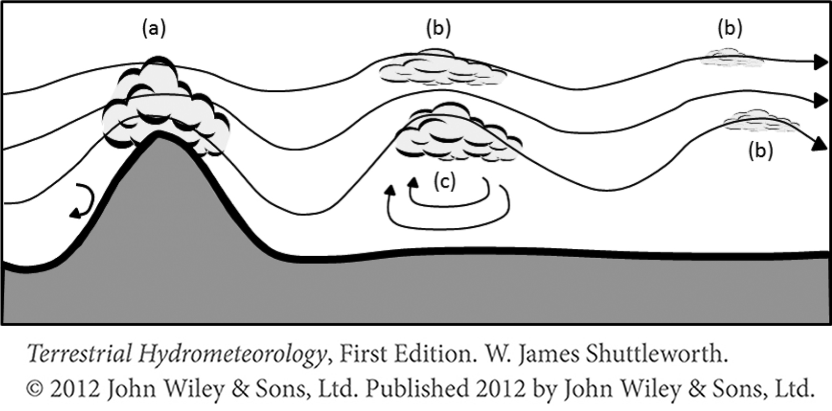
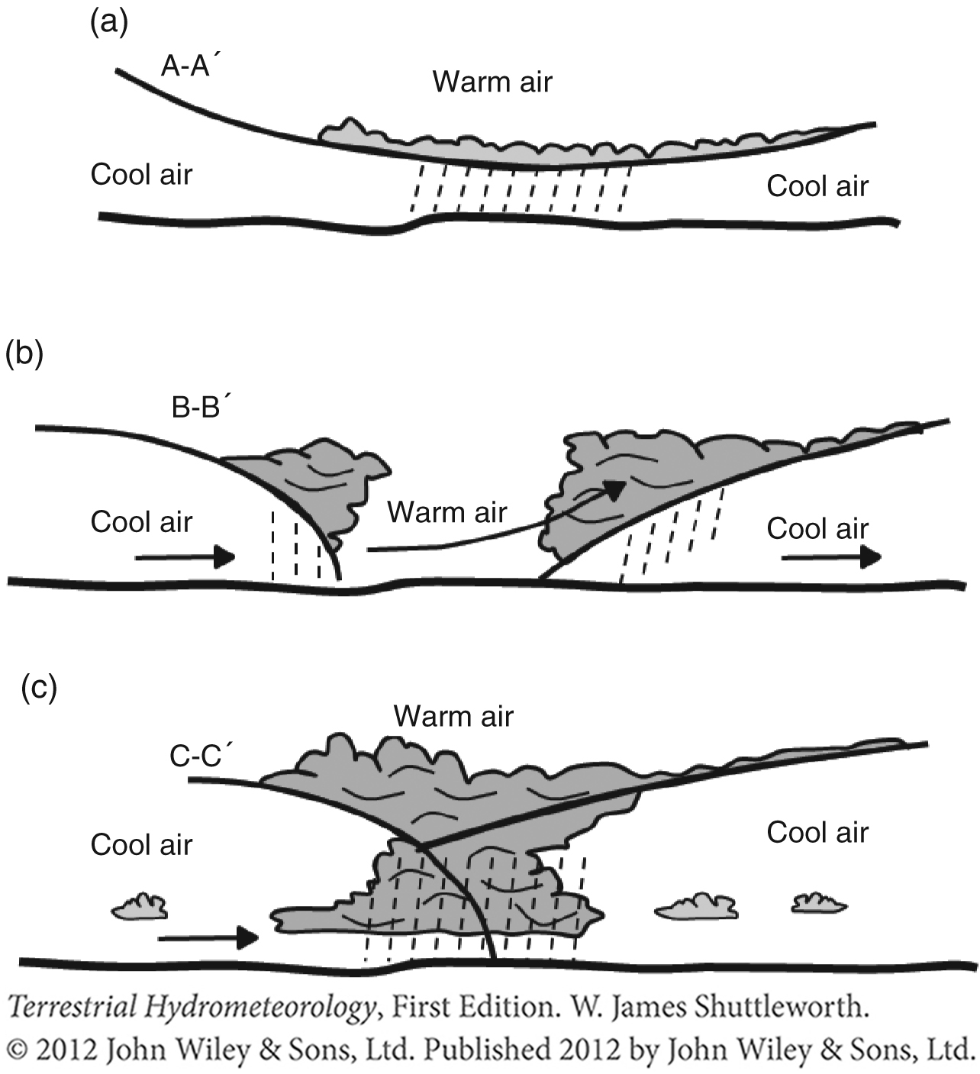
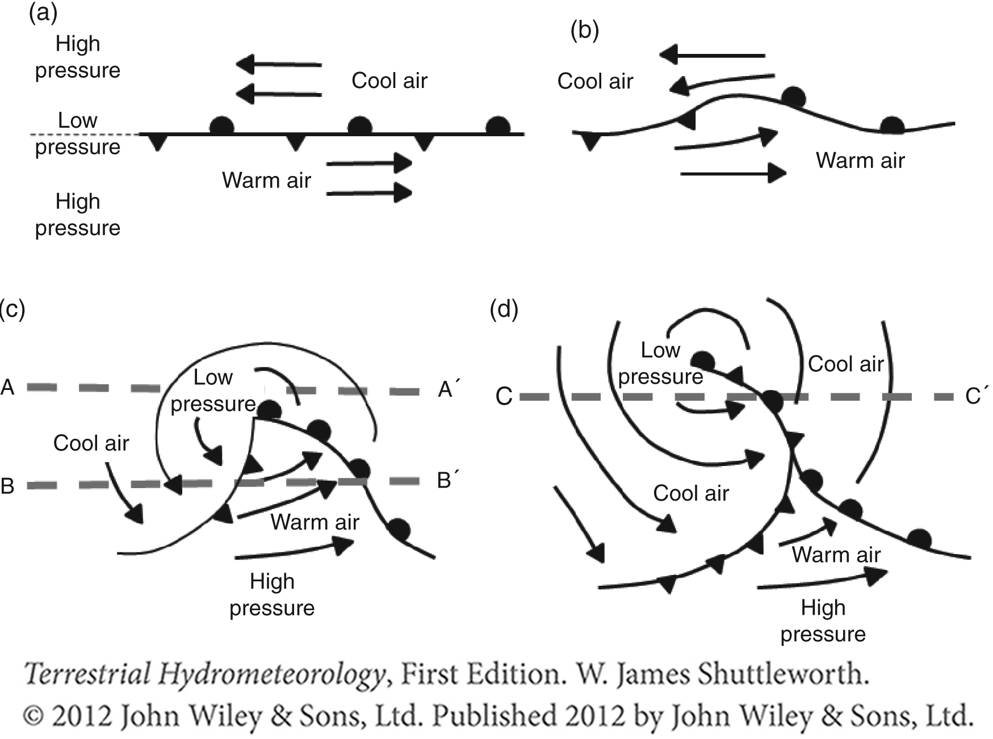

Slide 35
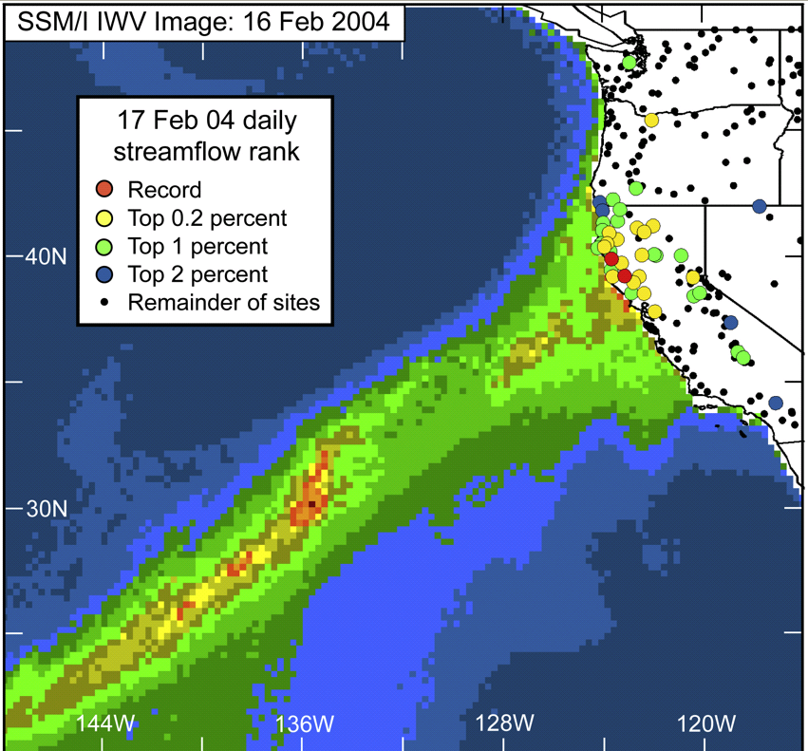
Ralph, F. M., P. J. Neiman, G. A. Wick, S. I. Gutman, M. D. Dettinger, D. R. Cayan, and A. B. White (2006), Flooding on California's Russian River: Role of atmospheric rivers, Geophys. Res. Lett., 33, L13801, doi:10.1029/2006GL026689.

Slide 36
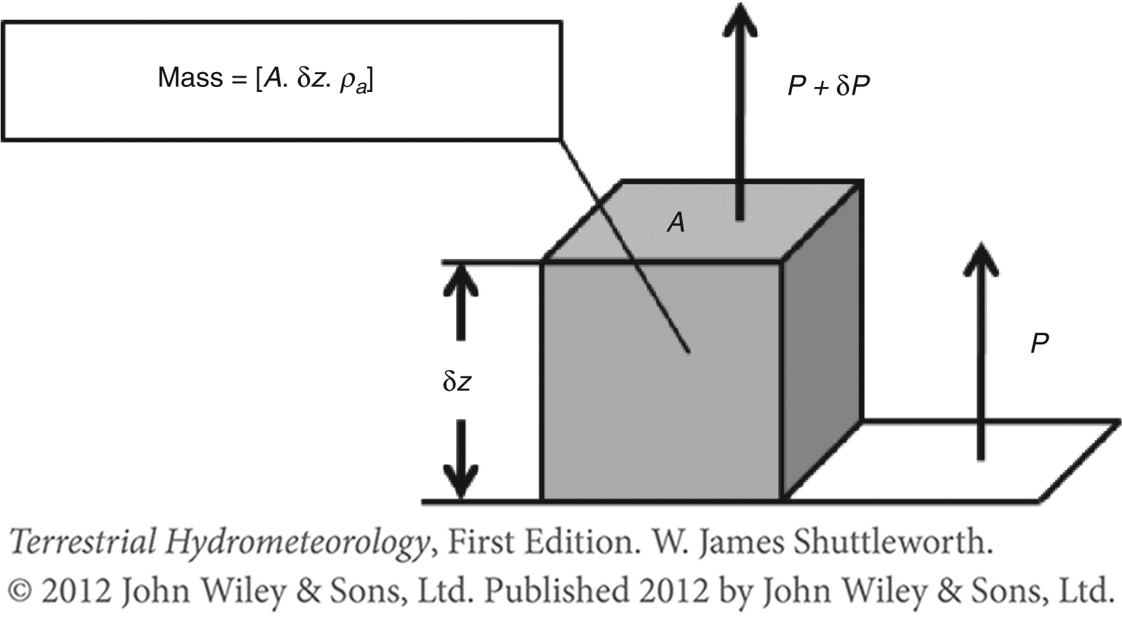
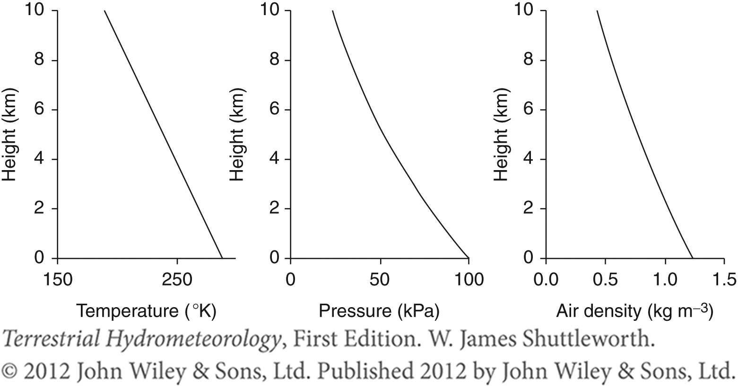
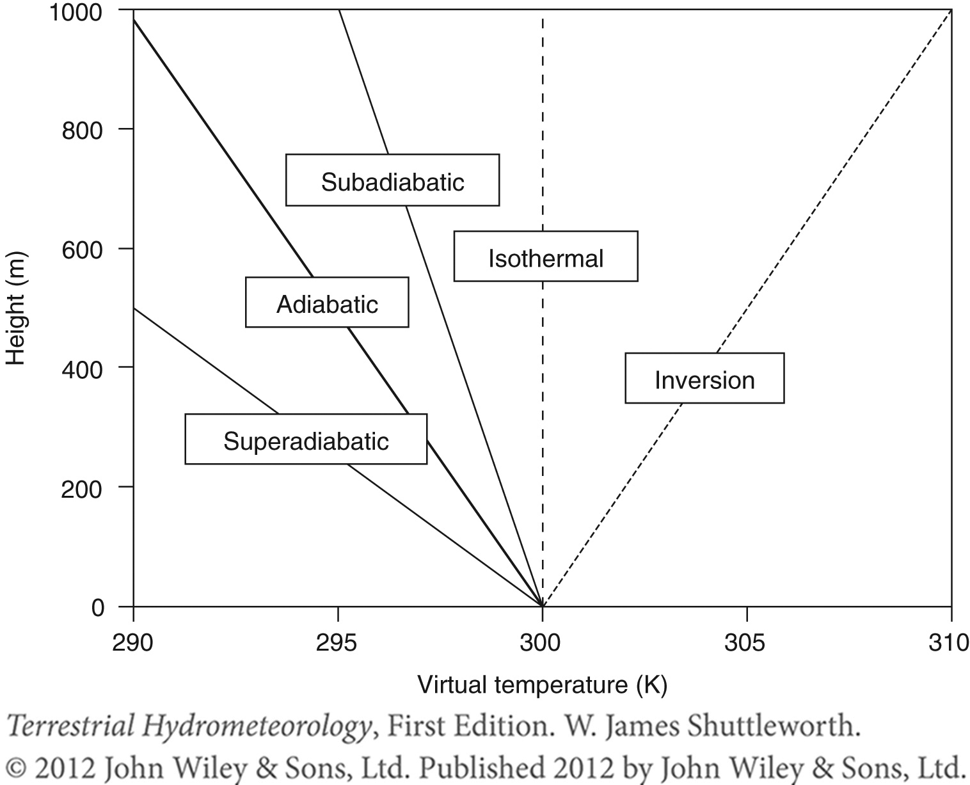
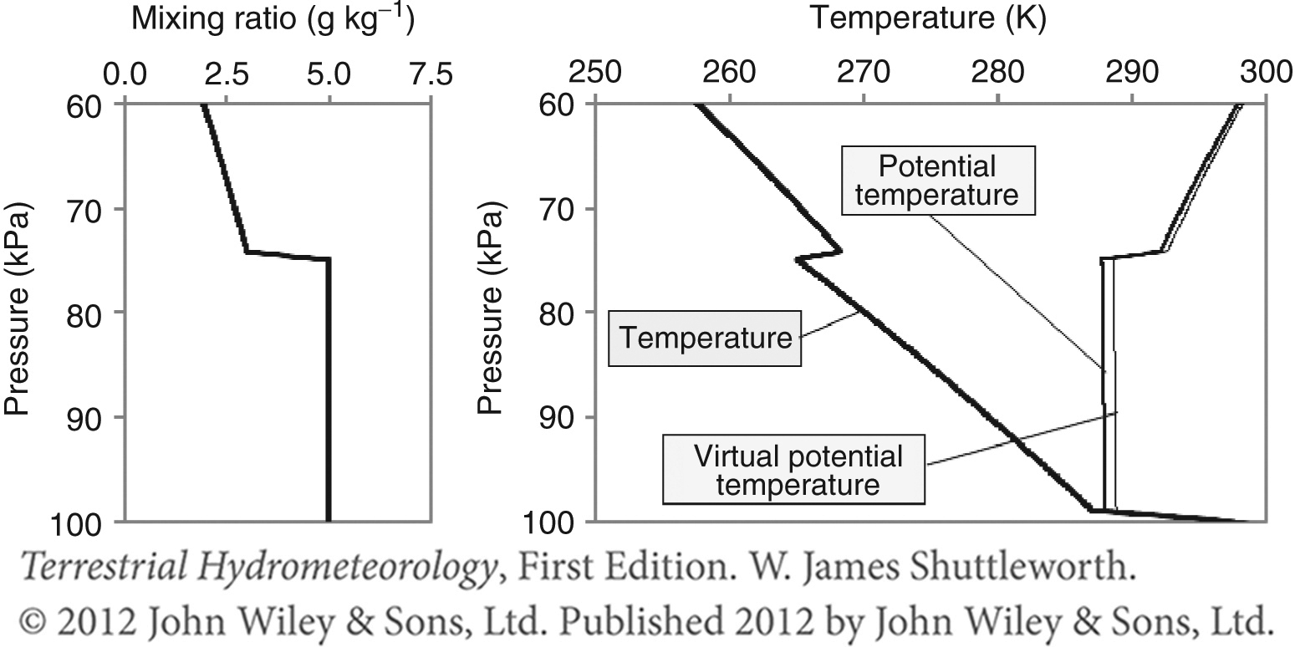

Slide 37
ATMOSPHERIC STABILITY
Dry Adiabatic Lapse Rate (10 ⁰C/km)
Environmental Lapse Rate
Altitude
Moist Adiabatic Lapse Rate (6 ⁰C/km). Lower due to release of latent heat of condensation from moist air
Temp
Modified from Bedient

Slide 38
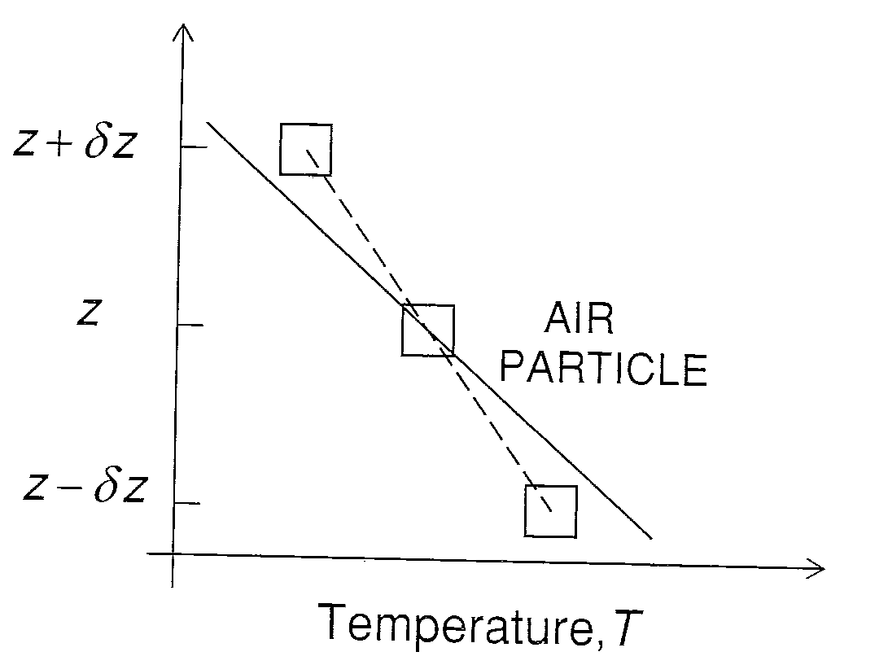
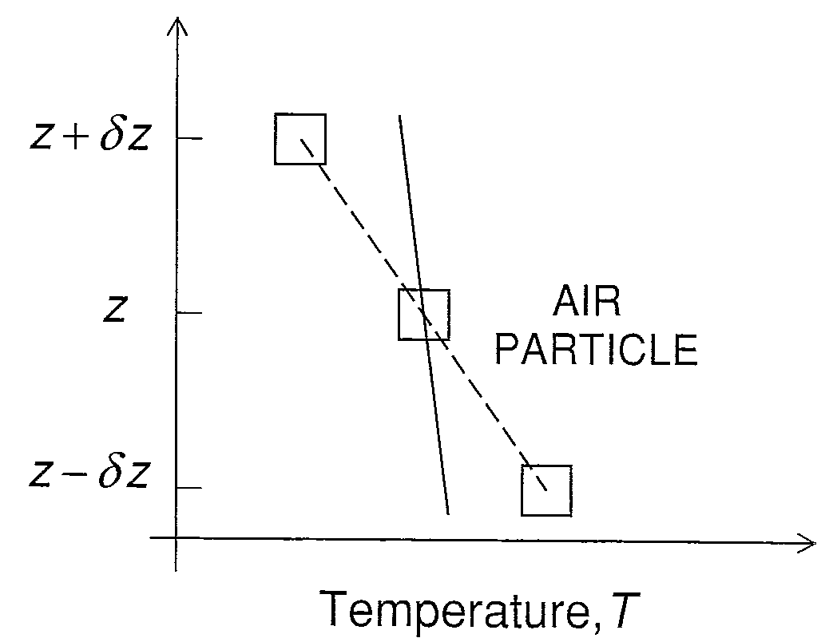
Atmospheric Stability
Stable
Unstable
Ambient lapse rate < adiabatic lapse rate of lifted parcel
Ambient lapse rate > adiabatic lapse rate of lifted parcel
From Brutsaert, 2005

Slide 39
Conditional instability of partially saturated atmosphere
Gamma > Gamma(s) – Unstable
Gamma < Gamma(s) – Stable
Gamma = Gama(s) - Neutral
From Brutsaert, 2005

Slide 40
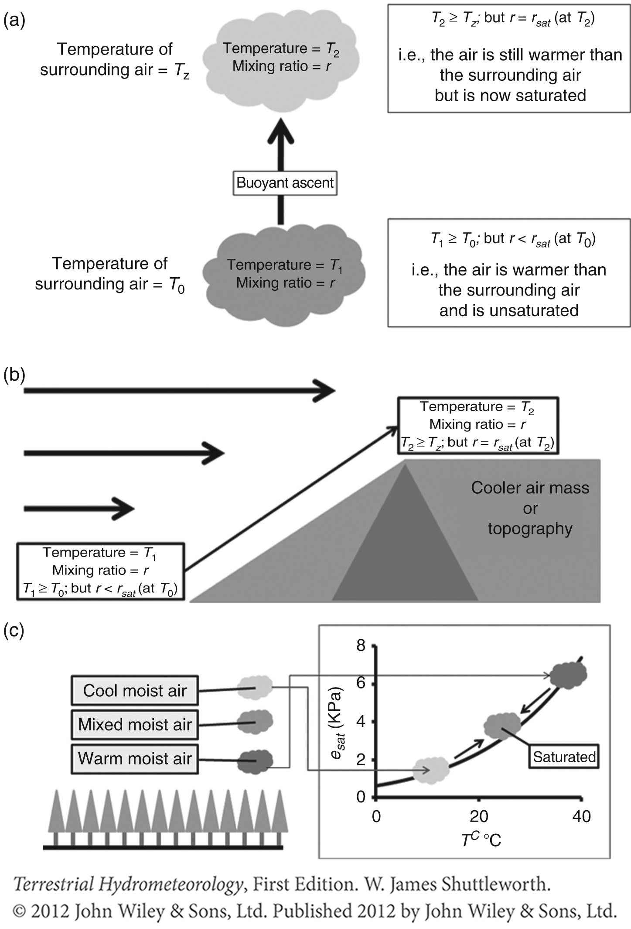
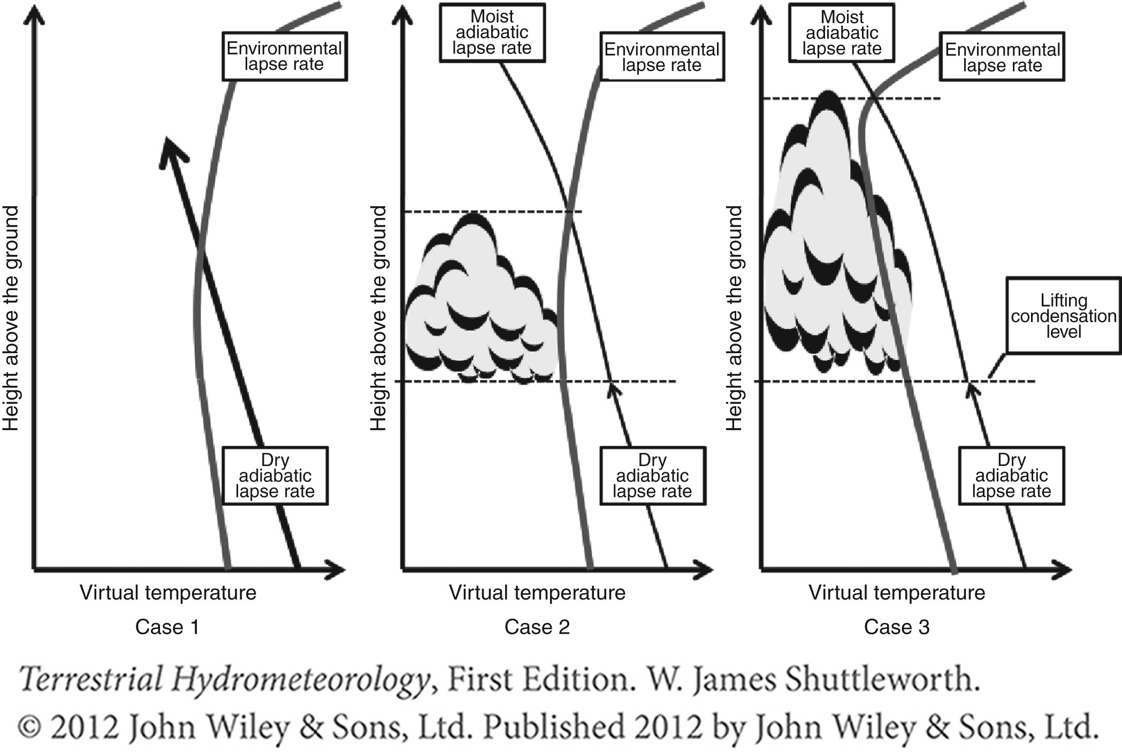
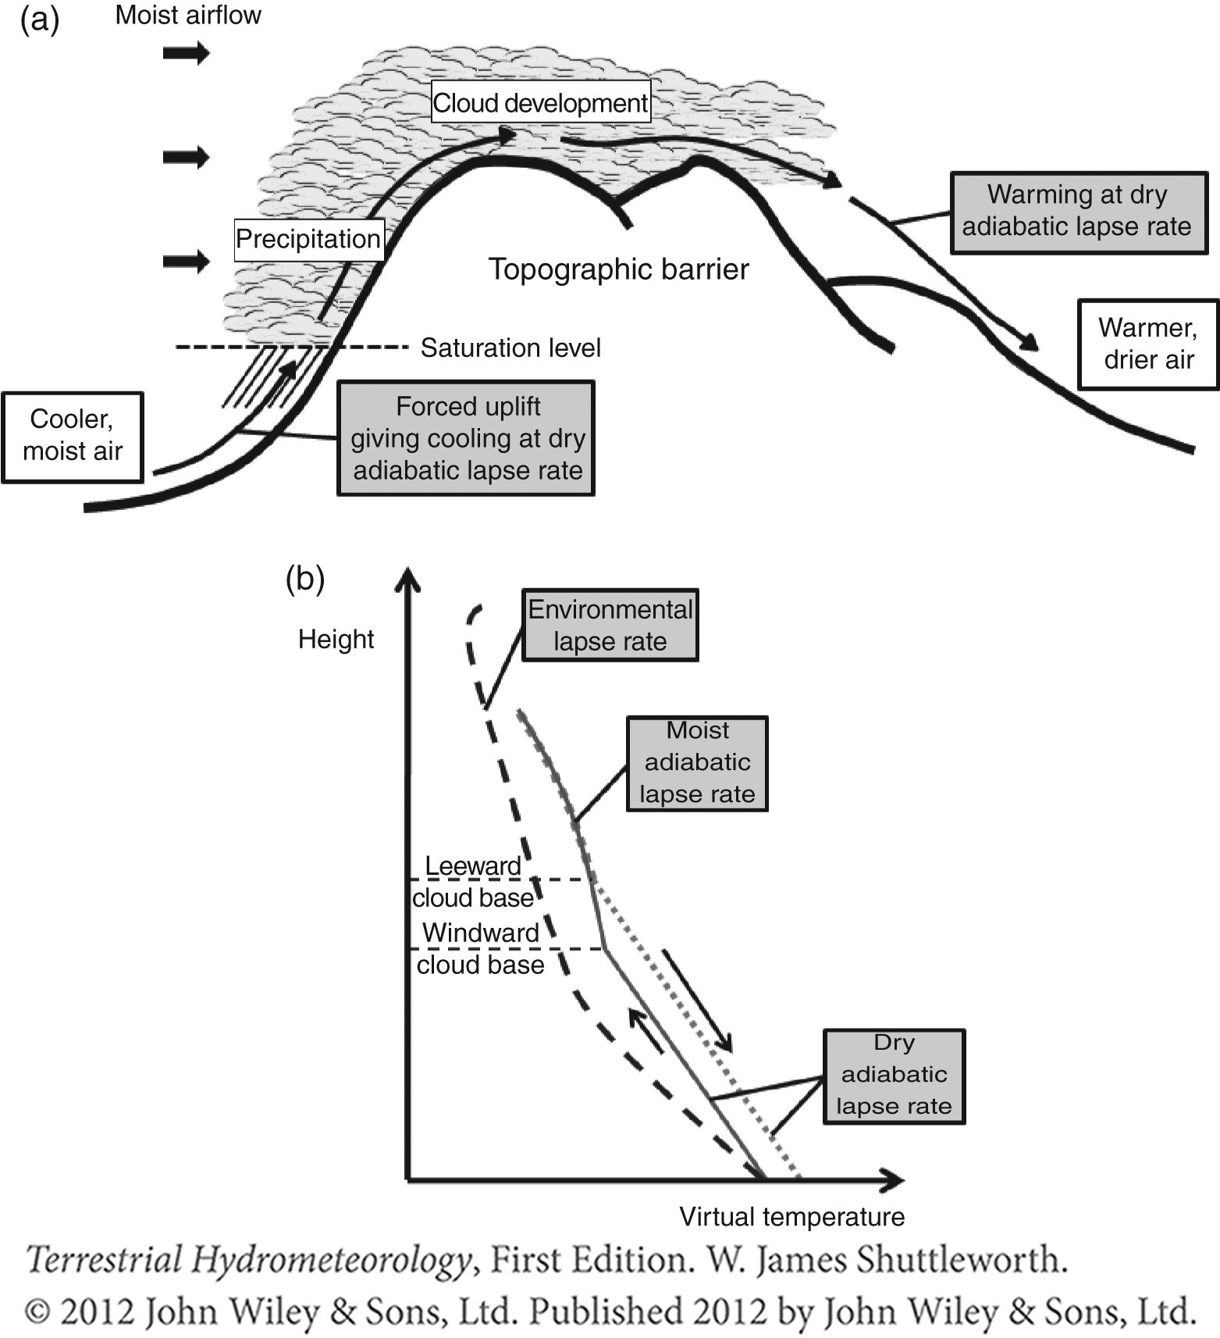

Slide 41
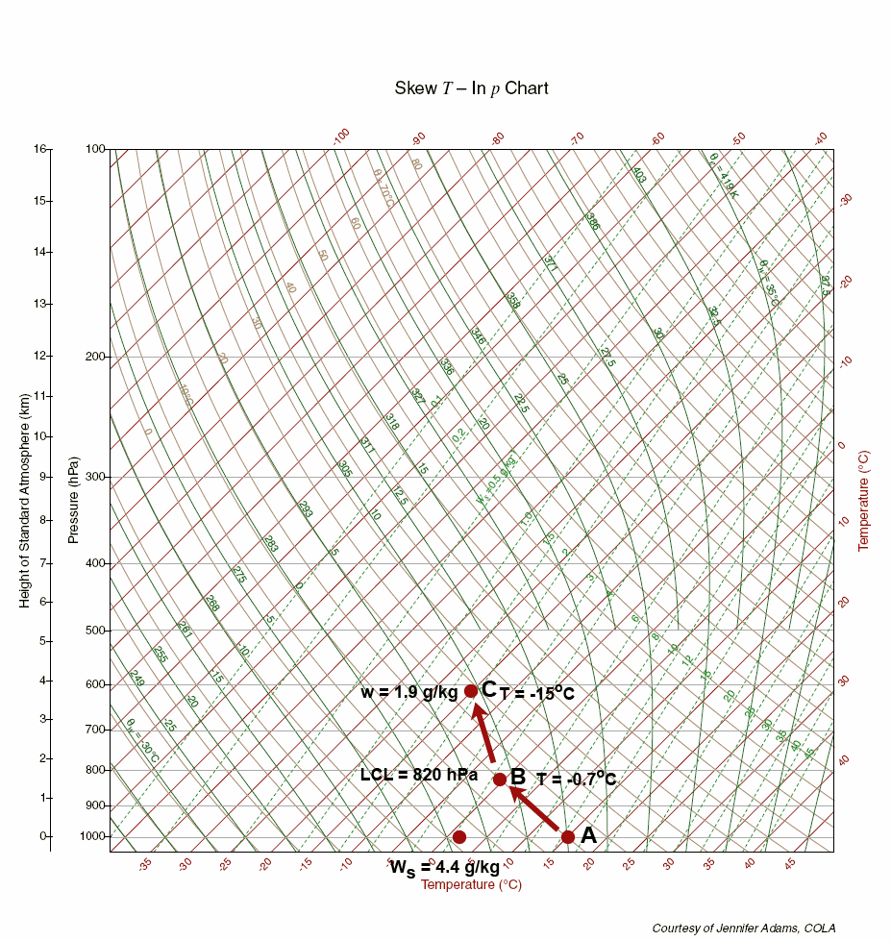

Slide 42
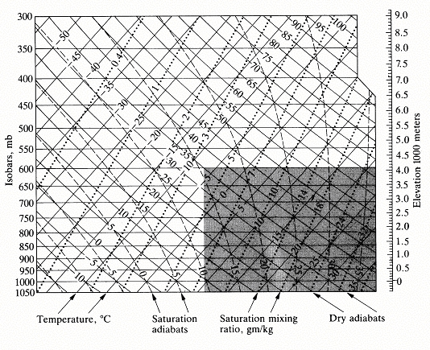

Slide 44
Meteorology of Precipitation
Precipitation requires
  Cooling to below dew point
  Condensation nuclei
  Drop growth
Primary cooling mechanism is uplift
Precipitation amounts frequently larger than precipitable water
  Requirement for supply of water vapor
  Convergence and uplift
Weather systems
  Extratropical cyclone/frontal system
  Intertropical convergence zone
  Hurricane
  Convection (Thunderstorms) following surface heating.
  Orography

Slide 45
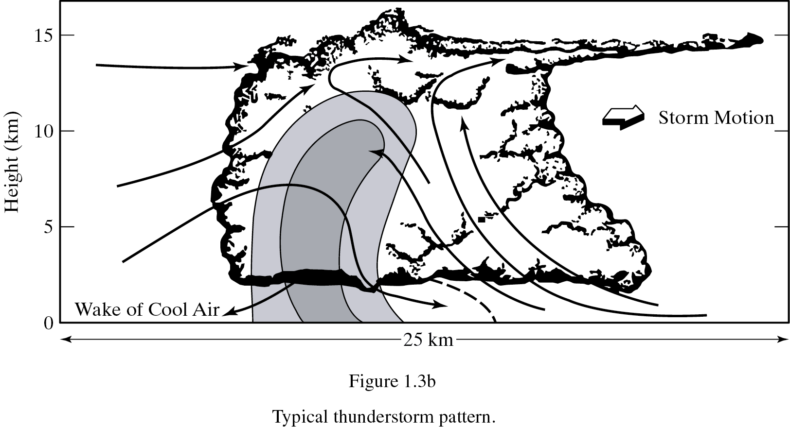
Major Thunderstorm
From Bedient

Slide 46
From Dingman,1994

Slide 47
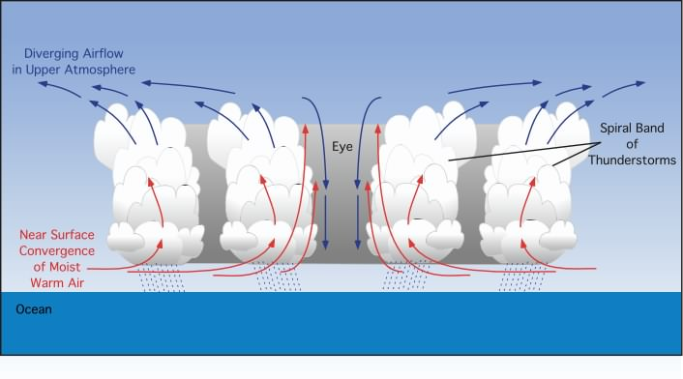
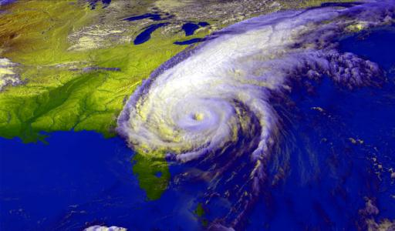
Hurricane Floyd, September 15, 1999
Graphical model showing a vertical cross-section of the air circulation, clouds, and precipitation associated with a hurricane.
From http://www.physicalgeography.net/fundamentals/7u.html

Slide 48
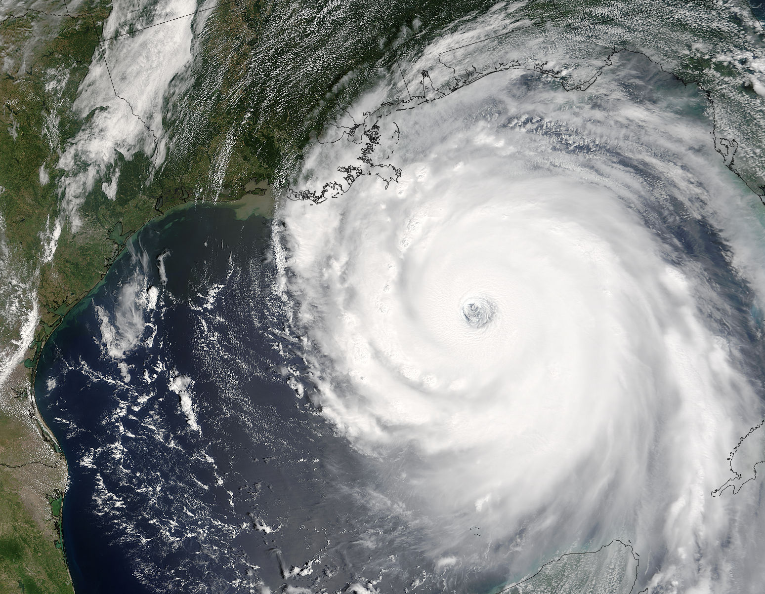
Hurricane Katrina in the Gulf - 8/29/2005
From Bedient
Katrina 08-28-2005 at 17:00 UTC

Slide 49
From Bras, 1990

Slide 50
From Brutsaert, 2005

Slide 51
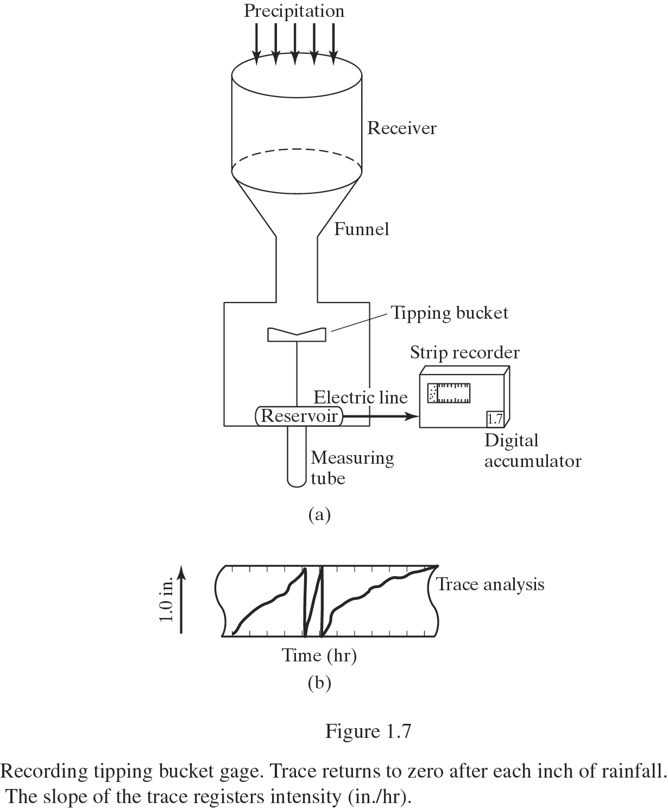
Measuring Rainfall - Tipping
Bucket
Recording gage
Collector and Funnel
Bucket and Recorder
Accurate to .01 ft
Telemetry- computer
From Bedient

Slide 52
Precipitation Measurement –
Observe and Report
So, we need records to evaluate to determine design criteria for civil infrastructure
We can measure precipitation in 2 ways:
- Point measurements at a gauge
- Across an area using radar
Notes:
So, we need records to evaluate to determine design criteria for civil infrastructure
We can measure precipitation in 2 ways:
Point measurements at a gauge
Across an area using radar

Slide 53
Precipitation Measurement – characterization
We characterize precipitation by:
  Amount – the total precipitation for an event (storm) or length of time (day, month, etc.), reported as a depth of water (mm, in)
  Duration – temporal length of an event, reported in units of time (hr, d)
  Intensity – rate of precipitation input (Amount per time), reported as depth / time (mm/d)
Notes:
Amount – the total precipitation for an event (storm) or length of time (day, month, etc.), reported as a depth of water (mm, in)
Duration – temporal length of an event, reported in units of time (hr, d)
Intensity – rate of precipitation input (Amount per time), reported as depth / time (mm/d)

Slide 54
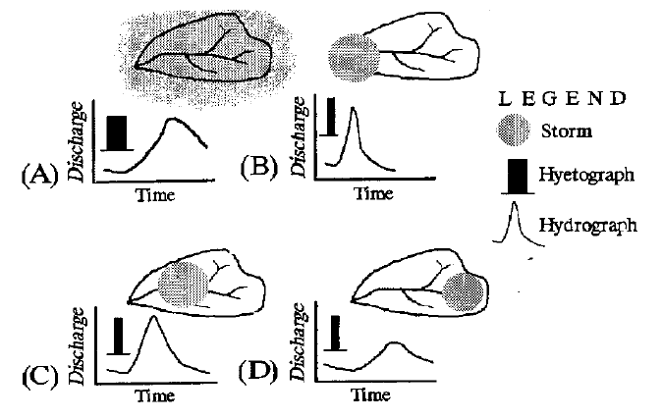
Precipitation Measurement –
Precipitation Variability
Precipitation is in general and
variable
Fig. 2, Black, 1997
Notes:
Precipitation is in general spatially and temporally variable

Slide 55
Precipitation Measurement –
Interpretation of Data
Time distributions
  Records of precipitation displayed as
  Range of timescales of interest
Area distributions
  Using point data to find
  Isohyetal Method
  Thiessen method
Notes:
Time distributions
Records of precipitation displayed as hyetographs
Range of timescales of interest (hours to seasons to years to decades)
Area distributions
Using point data to find average rainfall
Isohyetal Method
Thiessen method

Slide 56
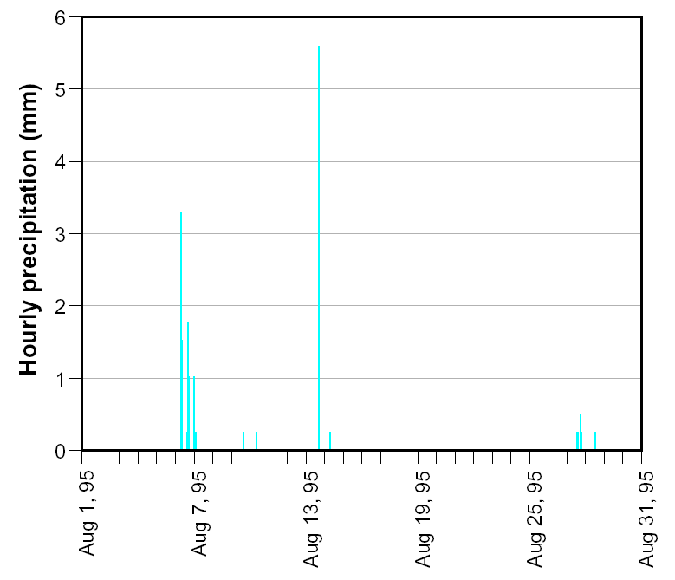
Precipitation Measurement –
Data as recorded…
Hyetograph –
Hourly hyetograph for a site near Charlottesville, Virginia
Hourly precipitation is
Hornberger et al., 1998, Fig 2.2
Notes:
Hyetograph – temporal record of precipitation
Hourly hyetograph for a site near Charlottesville, Virginia
Hourly precipitation is very heterogeneous, and often zero…

Slide 57
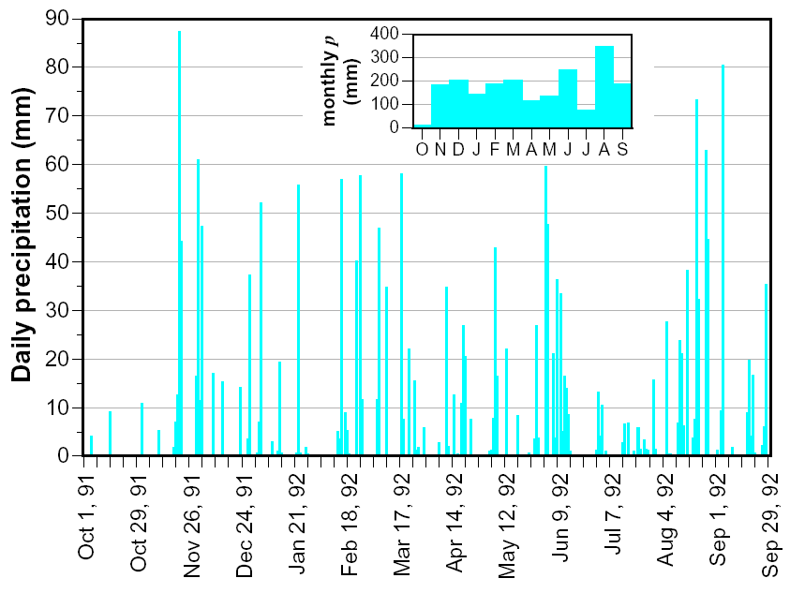
Precipitation Measurement –
Precipitation Records
Hyetographs record
In general, we want to know:
Averages
Standard Deviations
Extremes
Probabilities
Return Periods
This is
Hornberger et al., 1998, Fig 2.3
Notes:
Hyetographs record something and nothing...
In general, we want to know:
Averages
Standard Deviations
Extremes
Probabilities
Return Periods
This is Frequency Analysis

Slide 58
The Hyetograph
Graph of Rainfall Rate (in/hr) vs Time (hr) at a single gage location
Usually plotted as a bar chart of gross RF
Net Rainfall is found by subtracting infiltration
Integration of Net Rainfall over time =
  Direct RO Vol (DRO) in inches over a Watershed
From Bedient

Slide 59
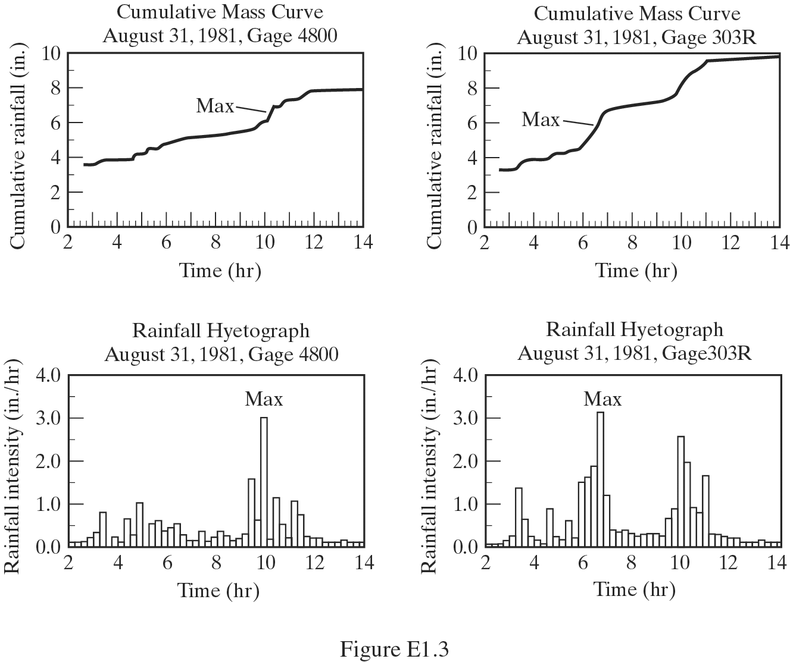
Mass Curves & Rainfall Hyetographs
From Bedient

Slide 60

Precipitation Measurement –
Statistics on Different Time Scales, Distributions
Hornberger et al., 1998, Fig 2.7

Slide 61

Precipitation Measurement –
Storm Types
Figure 2.14
Environmental Hydrology, 2002

Slide 62


Precipitation Measurement –
Spatial & Temporal Precipitation Variability
Fig. 2.5 – Hornberger et al., 1998

Slide 63


Precipitation Measurement –
Calculating Precipitation Inputs
We want to know how much water entered the basin in a precipitation event
Isohyetal Method
General Integration Method
Fig. 2.4 – Hornberger et al., 1998

Slide 64

Thiessen Polygons - Areal Average Rainfall from Gages
Connect gages with lines
Form triangles as shown
Create perpendicular bisectors of the triangles
Each polygon is formed by lines and WS boundary
P = Σ (A_{i}*P_{i}) / A_{T}
From Bedient

Slide 65

Thiessen Method for Average Rain
Step 1
Notes:
Figure 2.15

Slide 66
Thiessen Method for Average Rain
Step 2
Notes:
Figure 2.15

Slide 67
Thiessen Method for Average Rain
Step 3
Notes:
Figure 2.15

Slide 68
Thiessen Method for Average Rain
Step 4
Notes:
Figure 2.15
After summing areas and rainfall Thiessen predicts 2.08 inches, and the mean is 1.97 inches. This is because the heavier rainfall amounts in center of study area get more carry more area and weight in the calculation.

Slide 69

From Bedient
Rainfall Averaging Methods

Slide 70

Precipitation Measurement – gauges
Measured at a single location.
Precipitation is measured in 1 of 3 gauge types:
  Storage gauge – collect rain and calibrated to read depth of precipitation
  Weighing-recording gauge – rain collected in a bucket is weighed and the weight is recorded periodically
Source: USA Today, Chad Palmer
Notes:
Measured at a single location. Precipitation is measured in 1 of 3 gauge types:
Storage gauge – collect rain and calibrated to read depth of precipitation
Weighing-recording gauge – rain collected in a bucket is weighed and the weight is recorded periodically

Slide 71


Precipitation Measurement – gauges
Tipping Bucket Gauge
– small calibrated buckets on a “see-saw” when one fills, it tips and spills, then the other fills, tips and spills. The number of tips are recorded
Source: Rickly Hydrological
Source: USA Today, Chad Palmer
Notes:
Tipping Bucket gauge – small calibrated buckets on a “see-saw” when one fills, it tips and spills, then the other fills, tips and spills. The number of tips are recorded

Slide 72
Precipitation Measurement – gauges
Problems with gauges:
  Mis-readings by operator or by datalogger
  Limitations of methods
    Not accurate for small events (< 0.01 in)
    Tipping buckets often under measure
    large events because they cannot keep up with the intensity
    Weighing gauge becomes less sensitive
    as it gets full
Notes:
Problems with gauges:
Mis-readings (by operator or data logger)
Limitations of methods
Not accurate for small events, less than 0.01 in.
Tipping buckets often under measure large events because they cannot keep up with the intensity
Weighing gauge becomes less sensitive as it gets full

Slide 73


Precipitation Measurement –
Gauge Errors

Slide 74
Precipitation Measurement – gauges
Gauge performance is affected by:
  Nearby obstacles decrease gauge ‘catch’
  Height of gauge opening affects catch
  Evaporation
  out of gauge
  Wind field
  near gauge
Notes:
Gauge performance is affected by:
Nearby obstacles decrease gauge “catch”
Height of gauge opening affects catch
Evaporation out of gauge
Wind field near gauge

Slide 75
Precipitation Measurement –
Location of Gages
Gauges measure point precipitation
True precipitation unaffected by surroundings-
Clearance distance 2 times height of object
For large areas multiple gauges are needed for more accurate estimates
Notes:
Gauges measure point precipitation
True precipitation unaffected by surroundings- winds, trees, buildings
Clearance distance 2 times height of object
For large areas multiple gauges are needed for more accurate estimates

Slide 76
RADAR Rainfall Estimates
NEXRAD provides real-time data
on a ~16 km² (6 mi²) grid
Each estimate represents an average rainfall amount over the entire 4 x 4 km² area
NEXRAD rainfall estimates compare well with point rain gage measurements (r² ~ 0.9)
From Bedient

Slide 77


Slide 78
Thermodynamics of Cloud Formation –
Parcel Theory
@right, the cloud base (LCL) occurs at 3 km
The location of the cloud base depends on the initial temperature and
humidity contained in the near-surface air parcel.
Notes:
@right, the cloud base (LCL) occurs at 3 km
The location of the cloud base depends on the initial temperature and humidity contained in the near-surface air parcel.

Slide 79
Cloud Microphysics
Cooling via adiabatic uplift is necessary for cloud formation, but not sufficient alone
Particulates that are often found in the atmosphere (aerosols, ash, salt, etc.), facilitate formation of hydrometeors as cloud condensation nuclei (CCN)
Notes:
Cooling via adiabatic uplift is necessary for cloud formation, but not sufficient alone
Particulates that are often found in the atmosphere (aerosols, ash, salt, etc.), facilitate formation of hydrometeors as cloud condensation nuclei (CCN)

Slide 80
Cloud Microphysics – nucleation processes
Homogeneous nucleation - process of water vapor molecules spontaneously condensing
form a liquid droplet (or ice crystal)
  Possible, but rare because of the small size of water molecules (0.3nm diameter) and high surface tension of water (which increases with decreasing diameter)
Heterogeneous nucleation - CCNs
(~0.2 um diameter) provide a
site for water vapor molecules to
condense onto
Notes:
Homogeneous nucleation - process of water vapor molecules spontaneously condensing to form a liquid droplet (or ice crystal)
Possible, but rare because of the small size of water molecules (0.3 nm diameter) and high surface tension of water (which increases with decreasing diameter)
Heterogeneous nucleation - CCNs (~0.2 um diameter) provide a site for water vapor molecules to condense onto

Slide 81


Cloud Microphysics – cloud seeding
Notes:
http://www.blueplanet.nsw.edu.au/mi--water--cloud-seeding/.aspx

Slide 82
Cloud Microphysics – hydrometeor size dictates its fate
Hydrometeor must be sufficient size (volume, mass) to:
i) achieve terminal velocities that are > updraft velocity in the cloud and
ii) survive evaporation between the cloud base and the surface.
Notes:
Hydrometeor must be sufficient size to:
i) achieve terminal velocities that are > updraft velocity in the cloud and
ii) survive evaporation between the cloud base and the surface.

Slide 83
Cloud Microphysics growing hydrometeors
In warm clouds (T>0ºC, and made up of liquid water and vapor only) there are two primary growth mechanisms:
Diffusional condensation - individual water vapor molecules diffuse through the air (as a result of vapor concentration gradients) and attach to a CCN or existing droplet
  Slow process: one vapor molecule at a time
Notes:
In warm clouds (T>0ºC, and made up of liquid water and vapor only) there are two primary growth mechanisms:
Diffusional condensation - individual water vapor molecules diffuse through the air (as a result of vapor concentration gradients) and attach to a CCN or existing droplet.
Slow process: one vapor molecule added at a time

Slide 84
Cloud Microphysics growing hydrometeors
Coalescence Growth – droplets of sufficient size exist in the cloud start to fall relative to
the updraft
  Bigger droplets fall faster
  than smaller ones,
  overtaking them
  Much faster process responsible
  for generating droplets that fall
  out of the cloud
Notes:
Coalescence Growth – droplets of sufficient size exist in the cloud start to fall relative to the updraft.
Bigger droplets fall faster than smaller ones, overtaking them
Much faster process responsible for generating droplets that fall out of the cloud

Slide 85
Cloud Microphysics –
Summary of drop formation
Uplift occurs in the cloud
Saturated conditions yield condensation
Droplets form in a process of being uplifted
and falling within the cloud
When drops are big enough, they fall out of the cloud
Notes:
Uplift occurs in cloud
Saturated conditions yield condensation
Droplets form in a process of being uplifted and falling within the cloud
When drops are big enough, they fall out of the cloud

Slide 86
Meteorology of Precipitation –
Uplift
Uplift is required to form precipitation
4 main mechanisms that cause vertical uplift:
Large-scale Horizontal convergence
large-scale air masses of similar thermal
characteristics coming together
at the surface, being
forced upward as a
result of
mass conservation
Notes:
Uplift is required to form precipitation
4 main mechanisms that cause vertical uplift:
Large-scale Horizontal convergence
large-scale air masses of similar thermal characteristics coming together at the surface, being forced upward as a result of mass conservation

Slide 87
Meteorology of Precipitation –
Uplift
Large-scale Horizontal convergence – examples
the ITCZ which is the coming together of the surface branches of the Hadley cells
Notes:
the InterTropical Convergence Zone which is the coming together of the surface branches of the Hadley cells
http://tnhsprgteam.blogspot.com/2011/07/what-is-intertropical-convergence-zone.html

Slide 88
Meteorology of Precipitation –
Large-scale Horizontal convergence – examples
A tropical depression is an area of relatively low
atmospheric pressure
At latitudes of +/- 5-20º latitude the Coriolis force is strong enough that cyclonic flow
patterns can form around low pressure centers with surface winds
converging toward the
low pressure center
Notes:
A tropical depression is an area of relatively low atmospheric pressure.
At latitudes of +/- 5-20º latitude the Coriolis force is strong enough that cyclonic flow patterns can form around low pressure centers with surface winds converging toward the low pressure center.

Slide 89
Meteorology of Precipitation –
Uplift
2. Frontal convergence
Occurs mostly in mid-latitudes
convergence of air masses with different thermal characteristics (temperatures)
Cold air masses from
high latitudes
Notes:
Uplift is required to form precipitation
4 main mechanisms that cause vertical uplift:
Large-scale Horizontal convergence
large-scale air masses of similar thermal characteristics coming together at the surface, being forced upward as a result of mass conservation

Slide 90
Meteorology of Precipitation –
2. Frontal convergence
A “front” is an interface (a strong temperature
gradient) between the two converging air masses
While both air masses are generally moving, one usually overtakes the other;
has a higher velocity
Fronts are labeled by
the overtaking air mass
Uplift is driven by
buoyancy: ρ_{warm} < ρ_{cold}
Notes:
A “front” is an interface (a strong temperature gradient) between the two converging air masses
While both air masses are generally moving, one usually overtakes the other; has a higher velocity
Fronts are labeled by the overtaking air mass
Uplift is driven by buoyancy: ρ_{warm} < ρ_{cold}
WARM front over COLD front…

Slide 92


Slide 93


Slide 94


An aside – Extra-Tropical Cyclones
Low pressure area that forms near the boundary between warm and cool air masses.
Warm air rises up over the cold air mass, and some of the cold air sinks and flows under the warm air mass, the cyclone "deepens" (the air pressure becomes lower) and the winds around the system increase.
Notes:
Low pressure area that forms near the boundary between warm and cool air masses.
Warm air rises up over the cold air mass, and some of the cold air sinks and flows under the warm air mass, the cyclone "deepens" (the air pressure becomes lower) and the winds around the system increase.
http://www.weatherquestions.com/What_is_a_cyclone.htm

Slide 95

Tropical Cyclones
NOT associated with fronts
Fueled by warm oceans (>27ºC)
Born in easterlies, so initial movement is westward, but they end up moving poleward

Slide 96

Tropical Cyclone in cross-section
Notes:
http://apollo.lsc.vsc.edu/classes/met130/notes/chapter15/vertical_circ.html

Slide 97

Tropical Cyclone in cross-section
Notes:
http://apollo.lsc.vsc.edu/classes/met130/notes/chapter15/vertical_circ.html

Slide 98

Meteorology of Precipitation –
Uplift
3. Thermal Convection
Heated air from the surface rises in the atmosphere
Example: convective thunderstorms
Notes:
4. Thermal Convection
Heated air from the surface rises in the atmosphere
Example: convective thunderstorms
https://en.wikipedia.org/wiki/Atmospheric_convection#/media/File:Thunderstorm_formation.jpg

Slide 99
Meteorology of Precipitation –
Uplift
4. Orographic uplift
vertical uplift is the result of air masses flowing over significant relief
uplift → adiabatic cooling → condensation
AND: descent → adiabatic warming
Notes:
3. Orographic uplift
vertical uplift is the result of air masses flowing over topography of significant relief
uplift → adiabatic cooling → condensation
AND: descent → adiabatic warming
leeward side surface air will have less specific humidity (due to condensate left behind) and will be warmer

Slide 100
Notes:
https://upload.wikimedia.org/wikipedia/commons/d/d3/Average_precipitation_in_the_lower_48_states_of_the_USA.png

Slide 101

Meteorology of Precipitation –
Orographic Precipitation
West to east profile with Pacific Ocean at the west (left).
Clearly precipitation drops off after the first 4 mountain ranges.

Slide 102

When does it snow/rain/sleet?
Notes:
http://www.differencebetween.info/difference-between-snow-sleet-and-freezing-rain

