Slide 1
Physical Hydrology & Hydroclimatology
(Multiscale Hydrology)
A science dealing with the properties, distribution and circulation of water.
R. Balaji
balajir@colorado.edu
CVEN5333 http://civil.colorado.edu/~balajir/CVEN5333

Slide 2
Goal?
A basic quantitative understanding of how the global climate system works, to allow informed assessment of climate based forecasts and their role in hydrology and water resources systems.
Climatology
Large Scale Drivers of Climate System
  Interannual and Interdecadal
Diagnostics / Prediction - steps

Slide 3
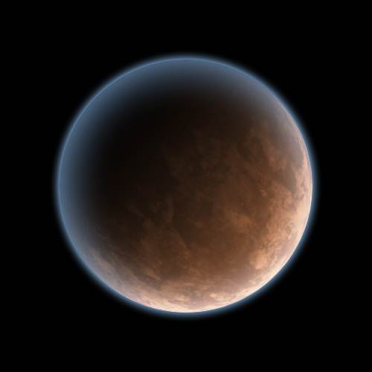


Atmosphere
Energy flux
(transport)
Heat flux
(transport)
Slide from Simon Wang

Slide 4
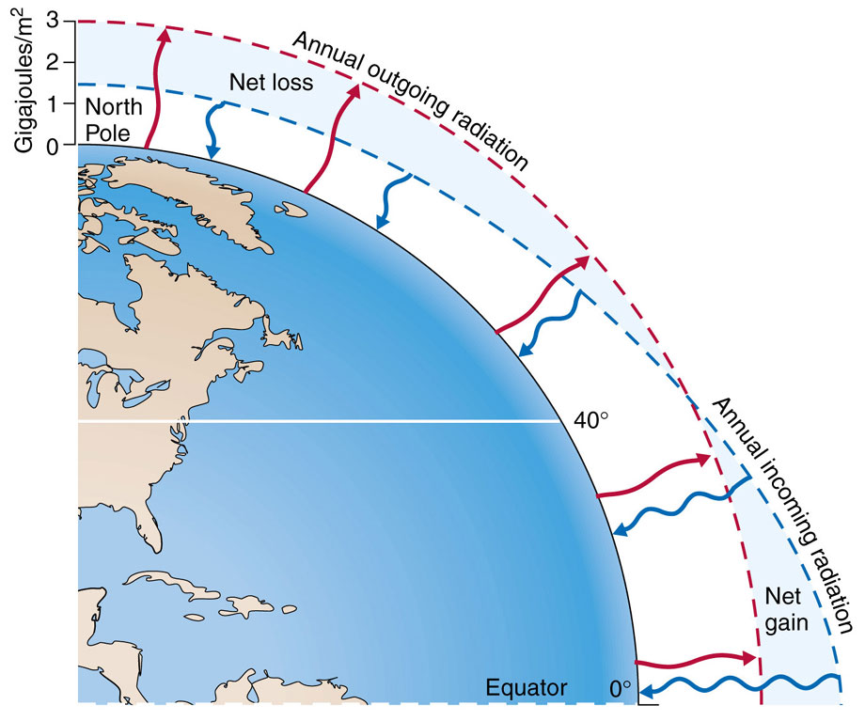

Slide 5
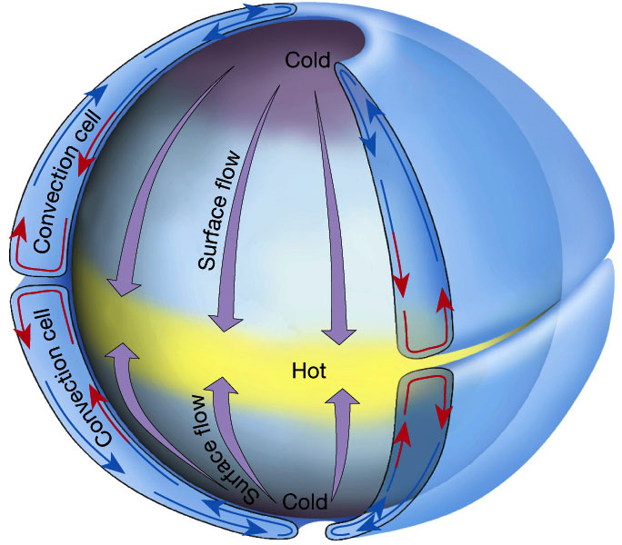
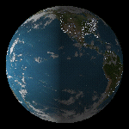
Single-Cell Model
A rotating Earth would introduce [ what ] force?
Slide from Simon Wang

Slide 6
Coriolis Effect
http://www.youtube.com/watch?v=_36MiCUS1ro&feature=related

Slide 7
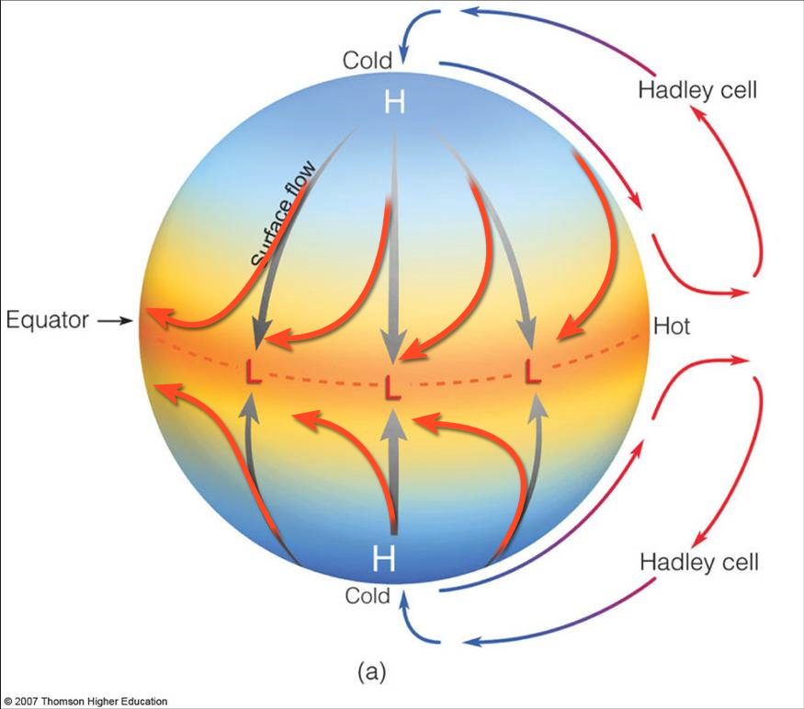
Single-Cell Model:
Explains why there are
tropical easterlies
(trade winds)
“Ideal Hadley Cell (Model)”
Slide from Simon Wang

Slide 8
Single-Cell Model:
But there is a problem…
Upper-level winds
“Ideal Hadley Cell (Model)”
Slide from Simon Wang

Slide 9
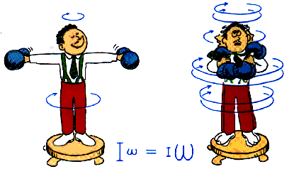
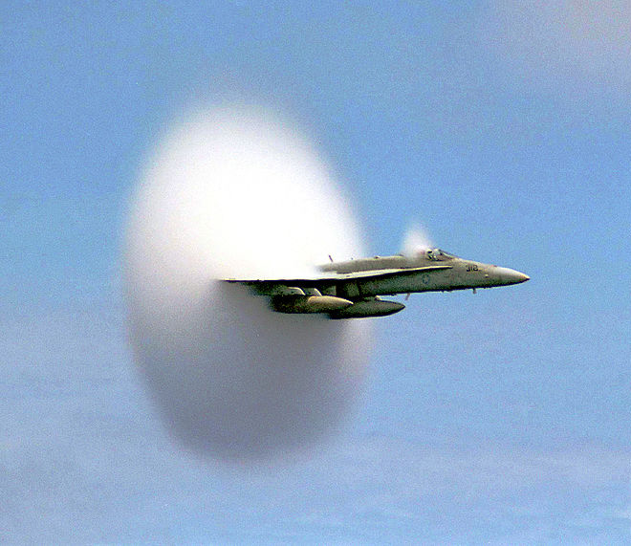
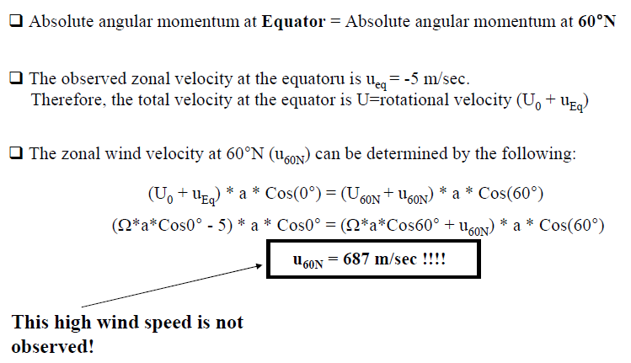
Single-Cell Model:
The problem is…
Speed of sound: ~ 330 m/sec
Slide from Simon Wang

Slide 10
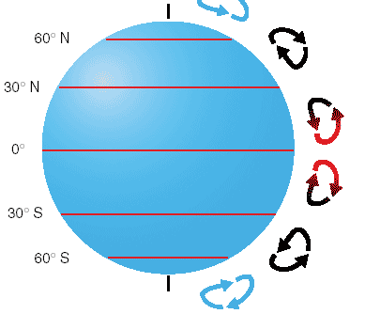
Single-Cell Model → Three-Cell Model
Taking Coriolis
force into account
Upper-level winds
~100 km/hr
(or 60 mph)
Slide from Simon Wang

Slide 11
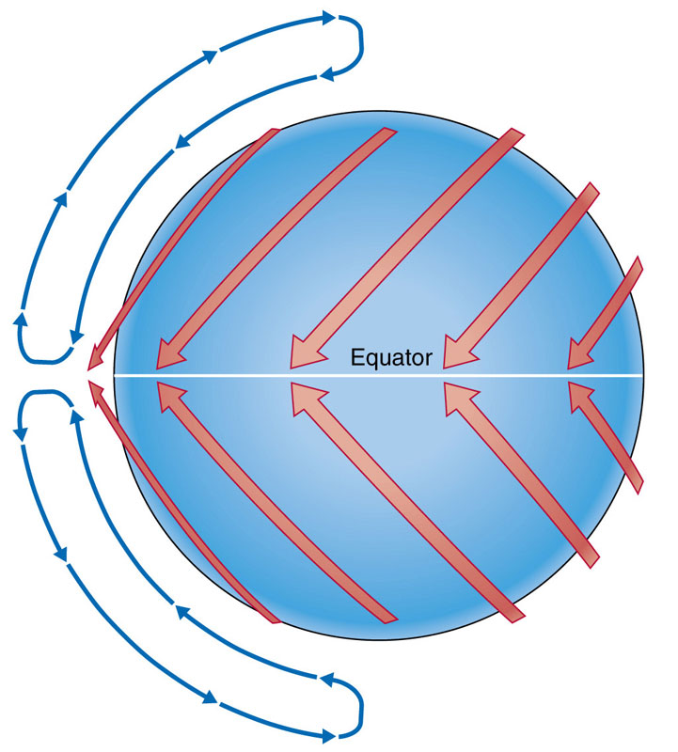
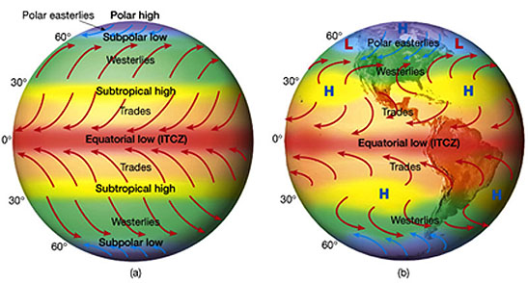
Single-Cell Model → Three-Cell Model
Continent-Ocean
(topographical) influences
Slide from Simon Wang

Slide 12
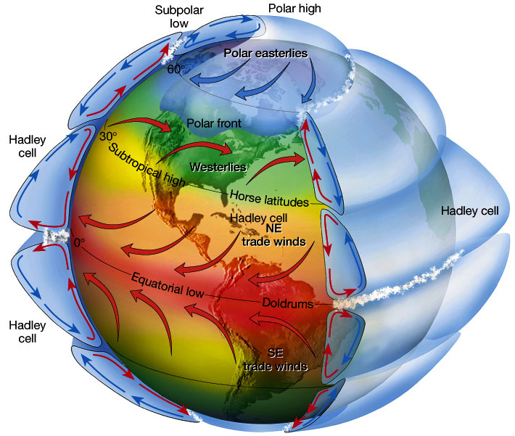
Three-Cell Model
Slide from Simon Wang

Slide 13
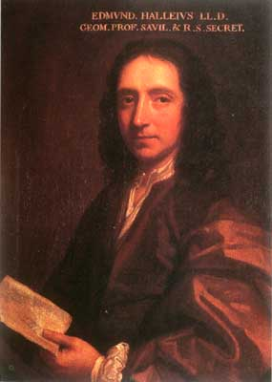
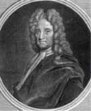
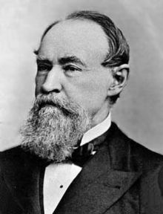
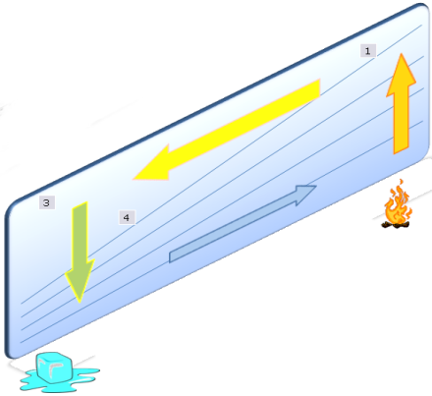


Three-Cell Model: Scientific evolution
Halley
Hadley
Ferrel
Thermally direct
circulation forcing
air towards equator
Earth’s rotation and
the conservation of
linear momentum
cause the Trade Winds
Coriolis force deflects
winds toward the east
and pulls air from south
+ Conservation of
angular momentum
170 years!
Slide from Simon Wang

Slide 14
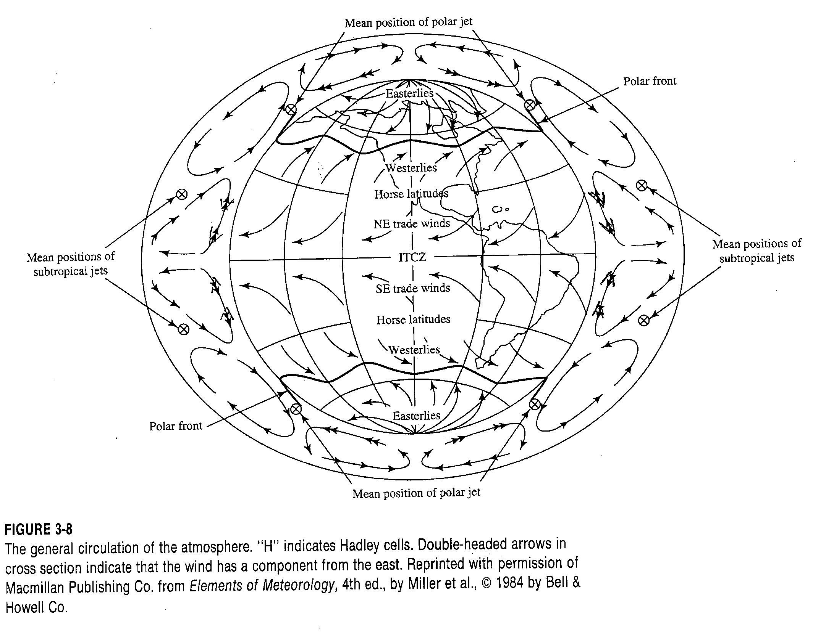
From Dingman, 1994

Slide 15
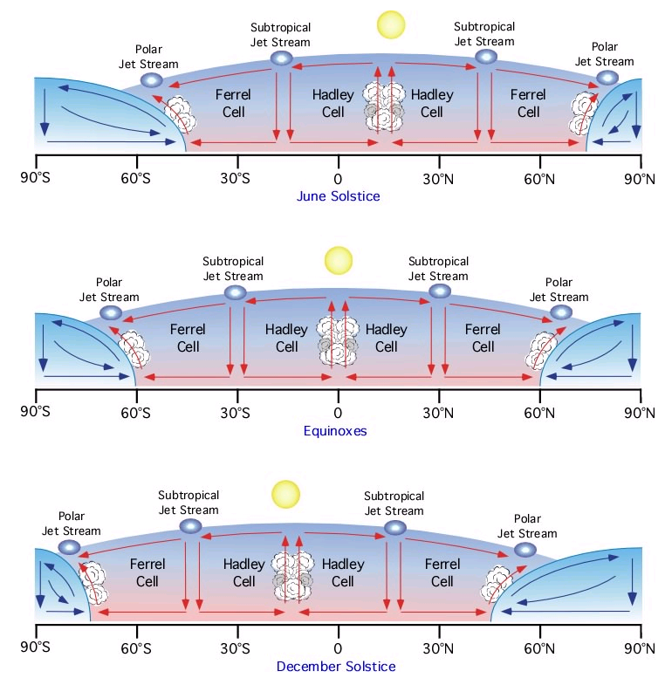
Seasonal movement of the Earth's global circulation patterns.
Pidwirny, M. (2006). "Tropical Weather and Hurricanes". Fundamentals of Physical Geography, 2nd Edition. Viewed 9/22/08. http://www.physicalgeography.net/fundamentals/7u.html

Slide 16
From Brutsaert, 2005

Slide 17
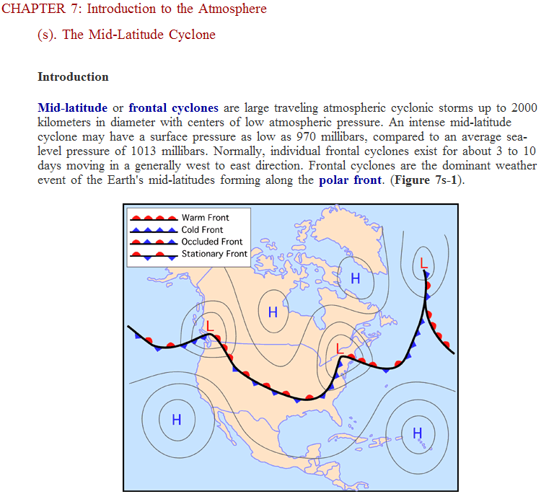
From http://www.physicalgeography.net/fundamentals/7s.html

Slide 18
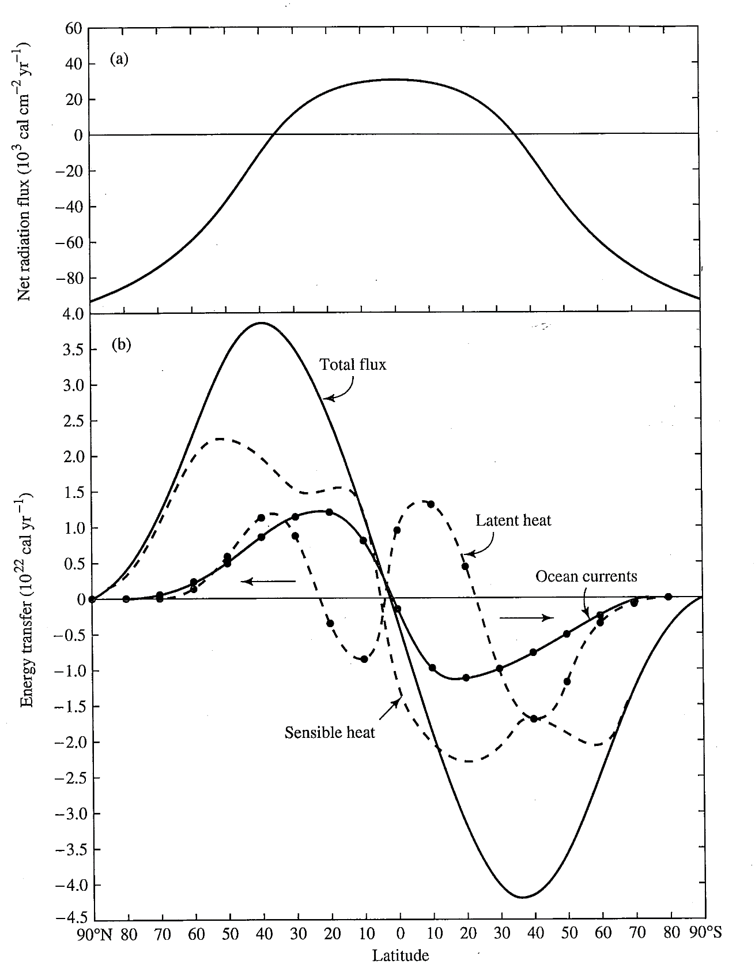
From Dingman, 1994

Slide 19
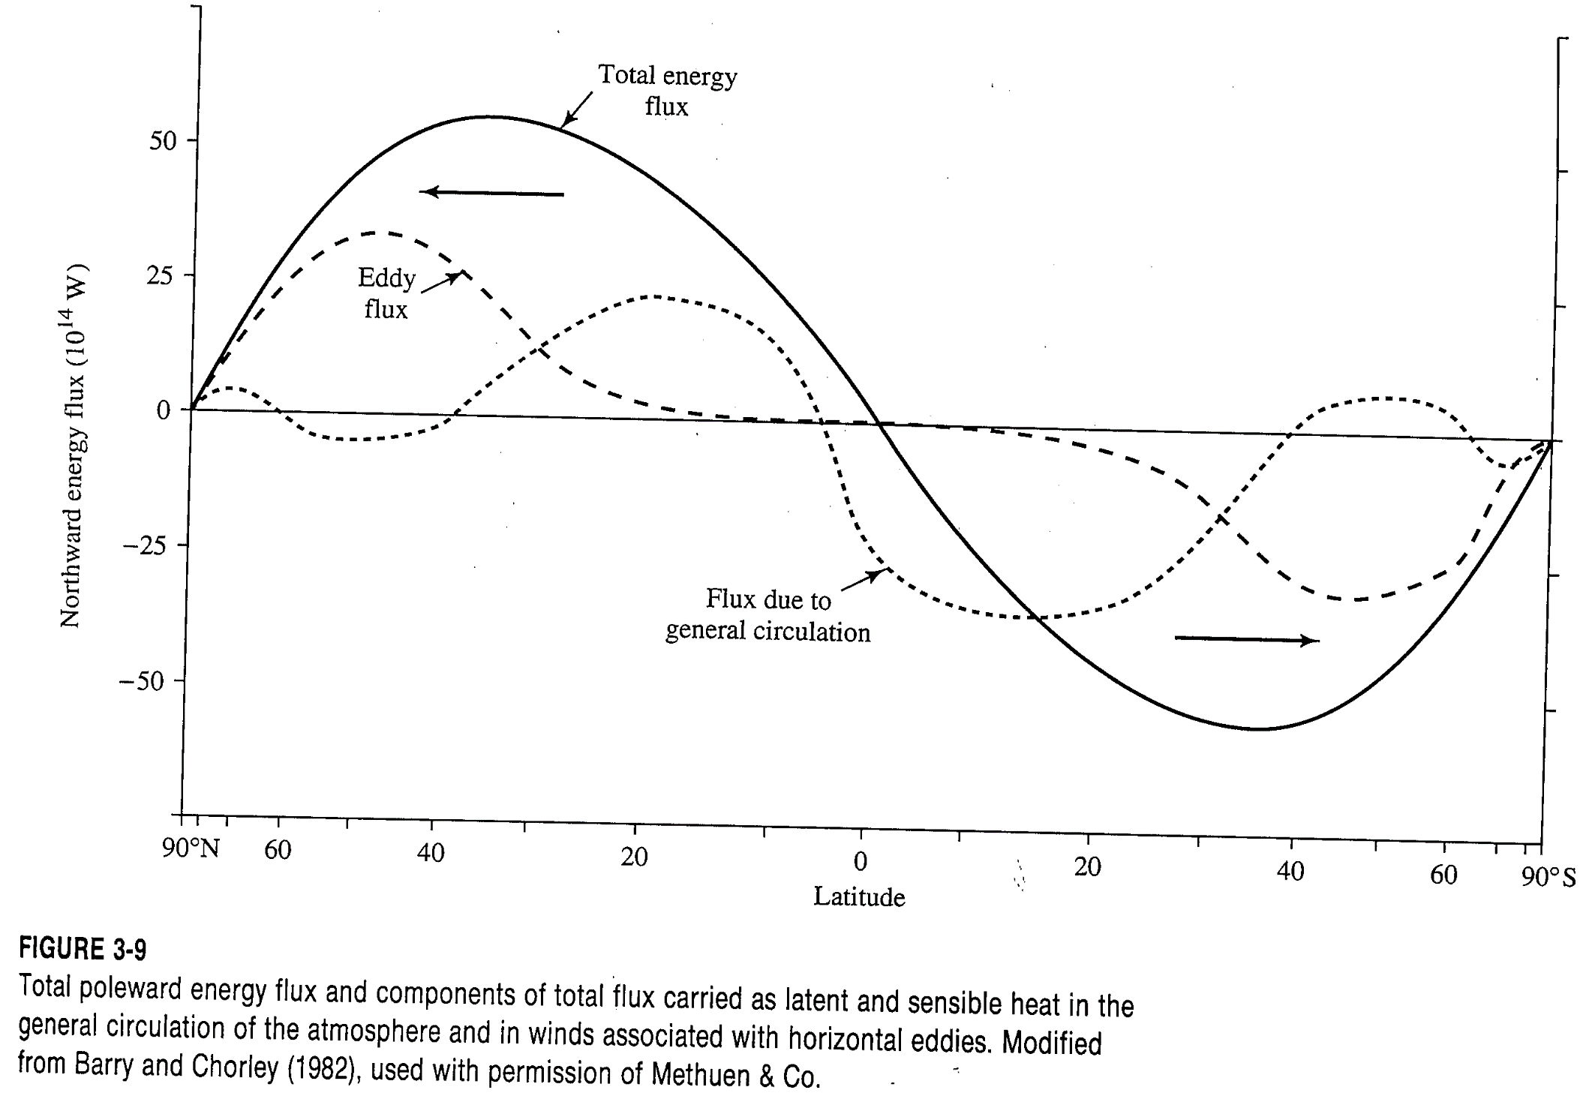
From Dingman, 1994

Slide 20
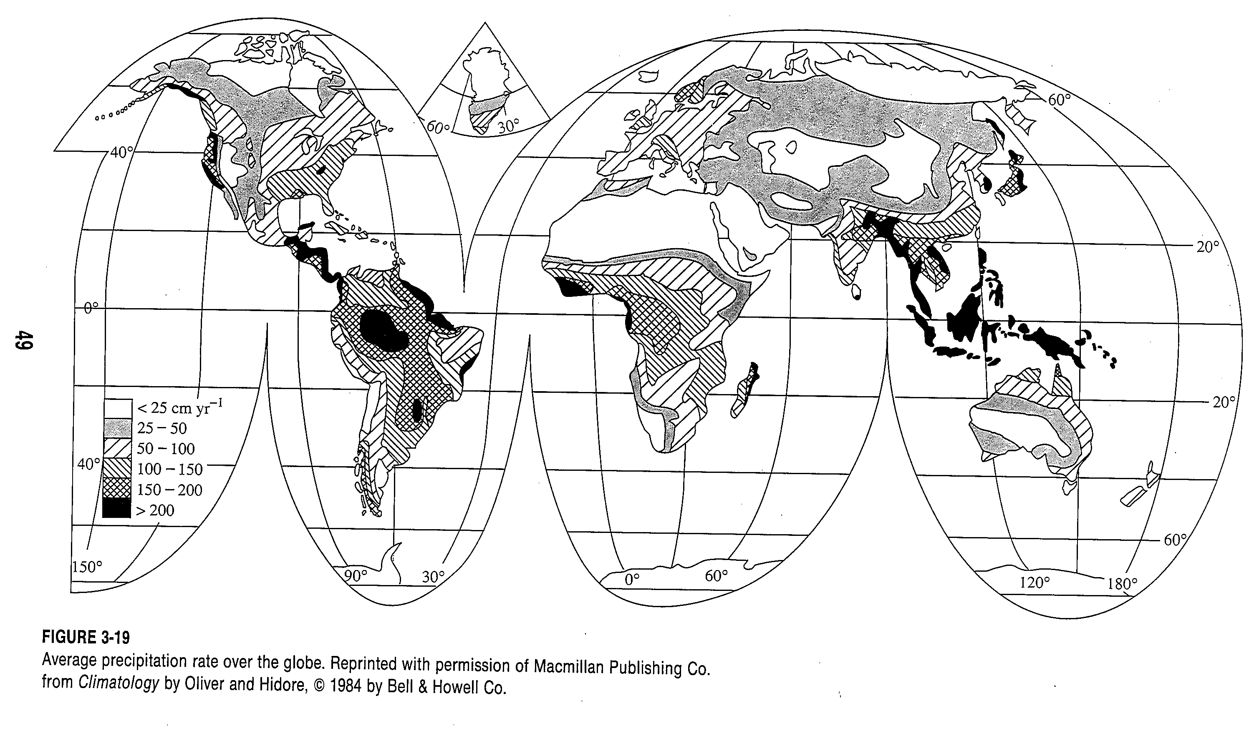
From Dingman, 1994

Slide 21
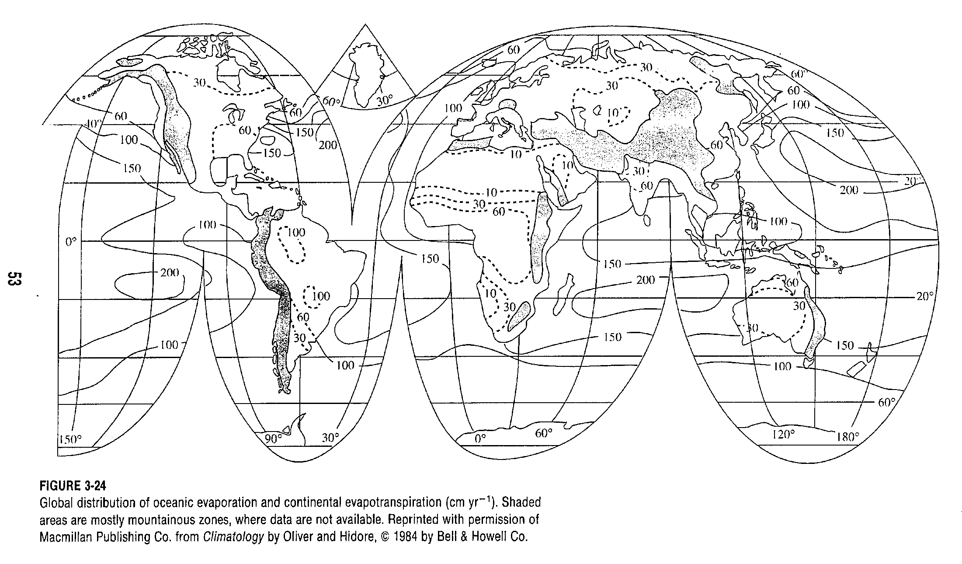
From Dingman, 1994

Slide 22
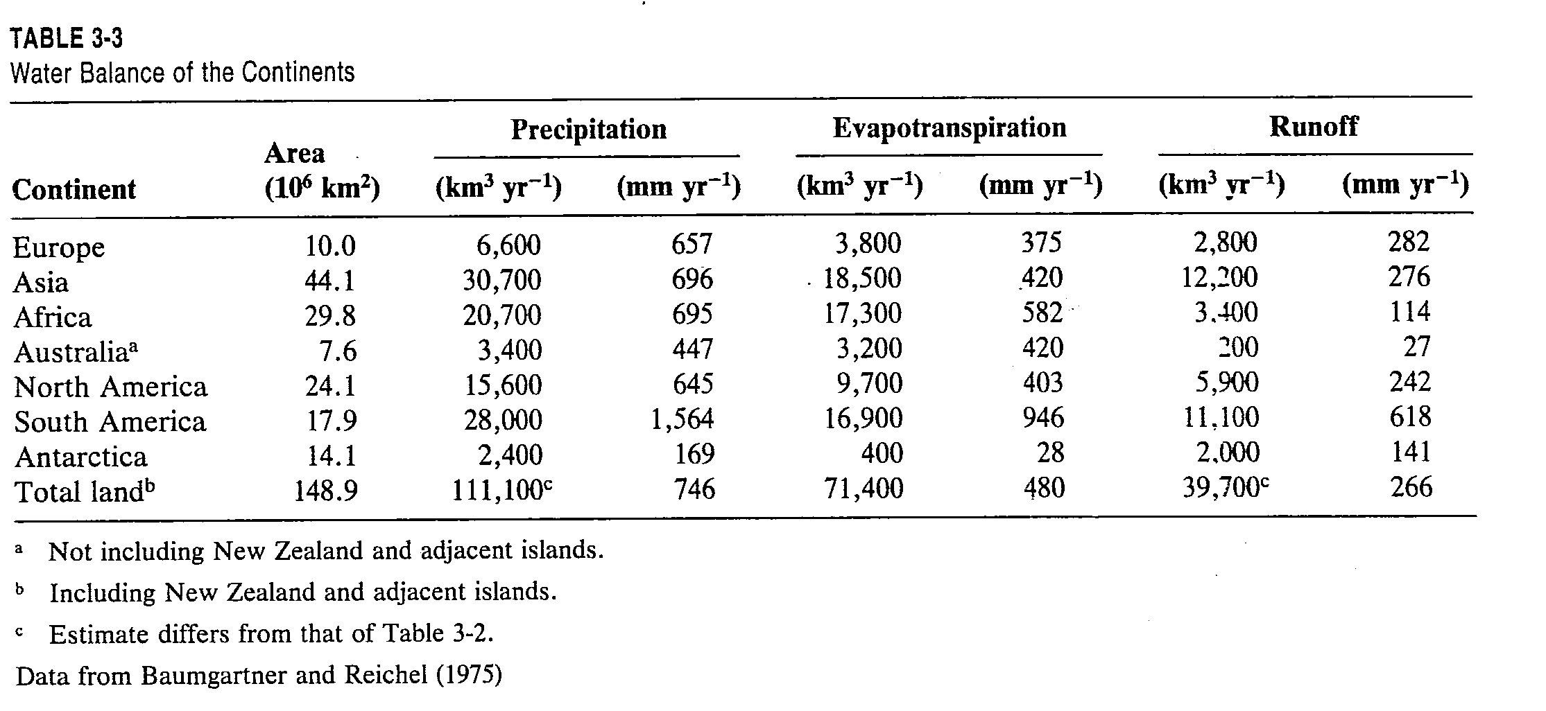
From Dingman, 1994

Slide 23
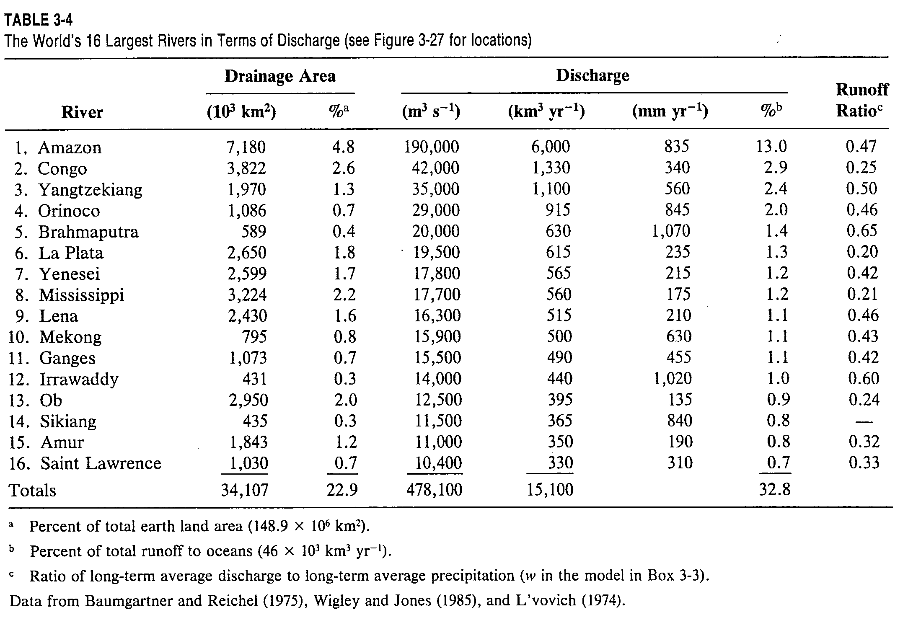
From Dingman, 1994

Slide 24
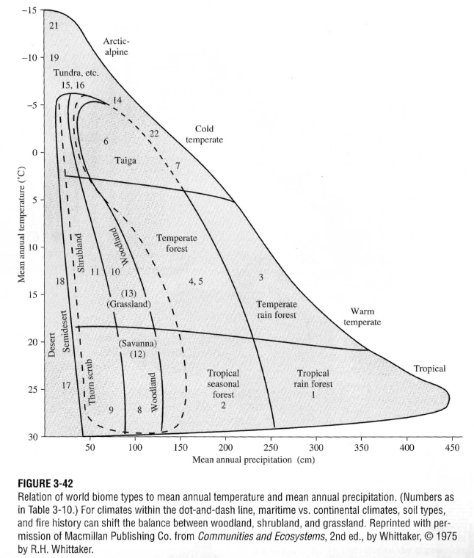
From Dingman, 2002

Slide 25
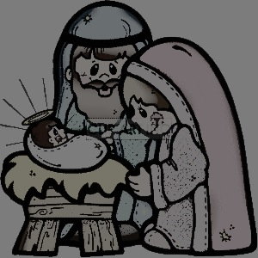
El Niño what used to be a local feature has turned into a global phenomenon

Slide 26
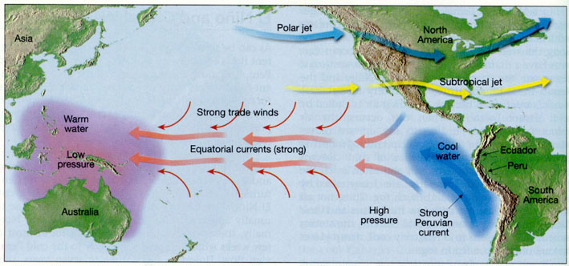
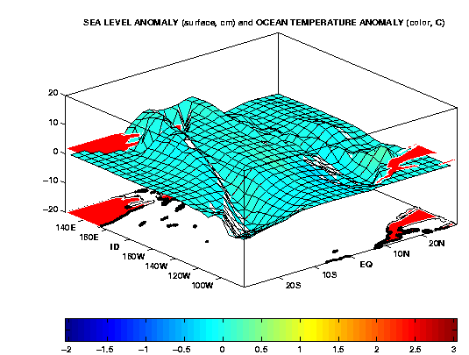
→ affects
air pressure

Slide 27
El Niñ﻿o: local phenomenon
→ regional
→ global !!
→ “coupled” mode

Slide 28
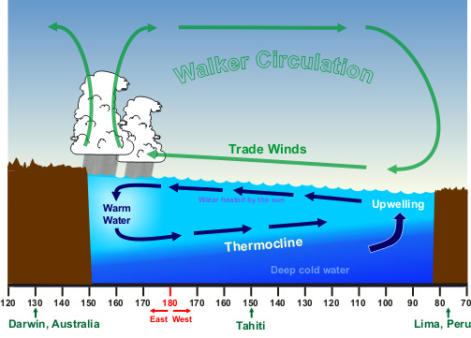

Coupled System: Normal
A thermocline is a thin layer in the ocean in which temperature changes more rapidly with depth than above or below. The thermocline appears to be an invisible blanket which separates the upper mixed layer from the calm deep water below.

Slide 29
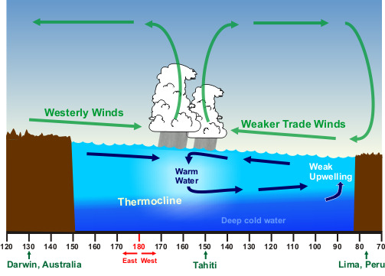
Coupled System: El Niño

Slide 30
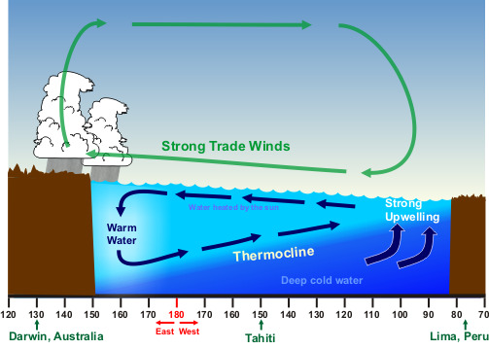
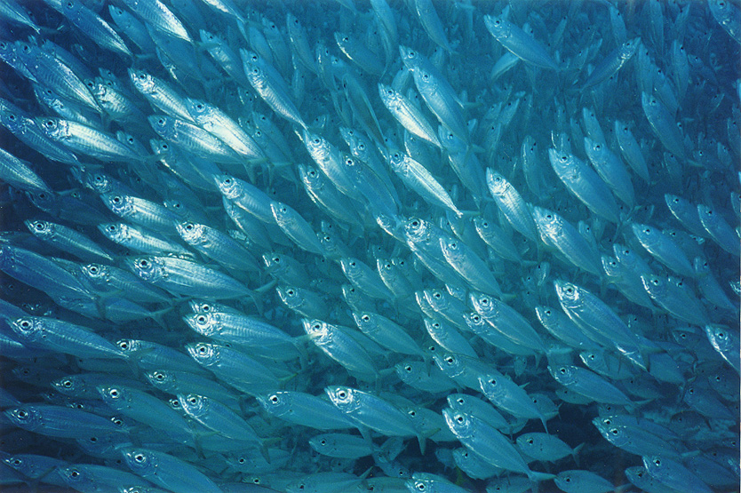
Coupled System: La Niña

Slide 31
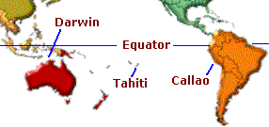
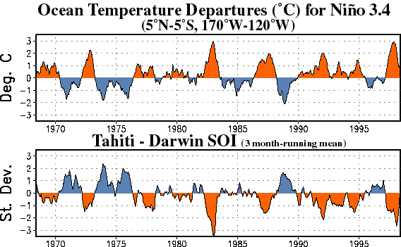
ENSO Monitoring
Index:
(Sea)
(Air)

Slide 32
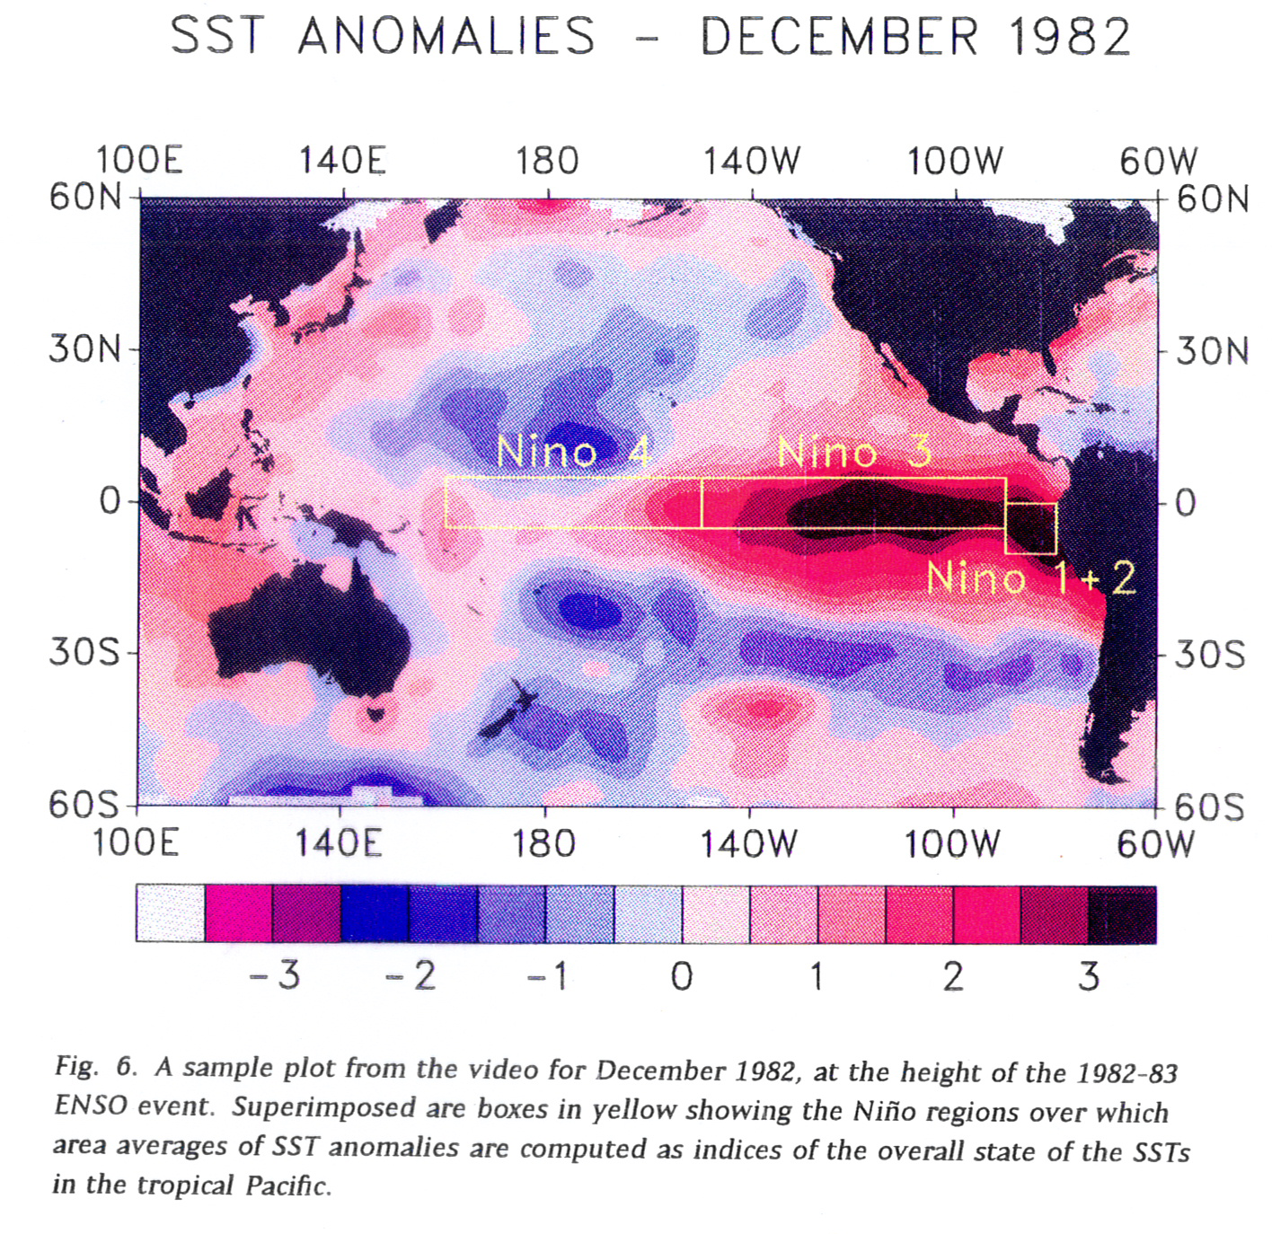

Slide 33
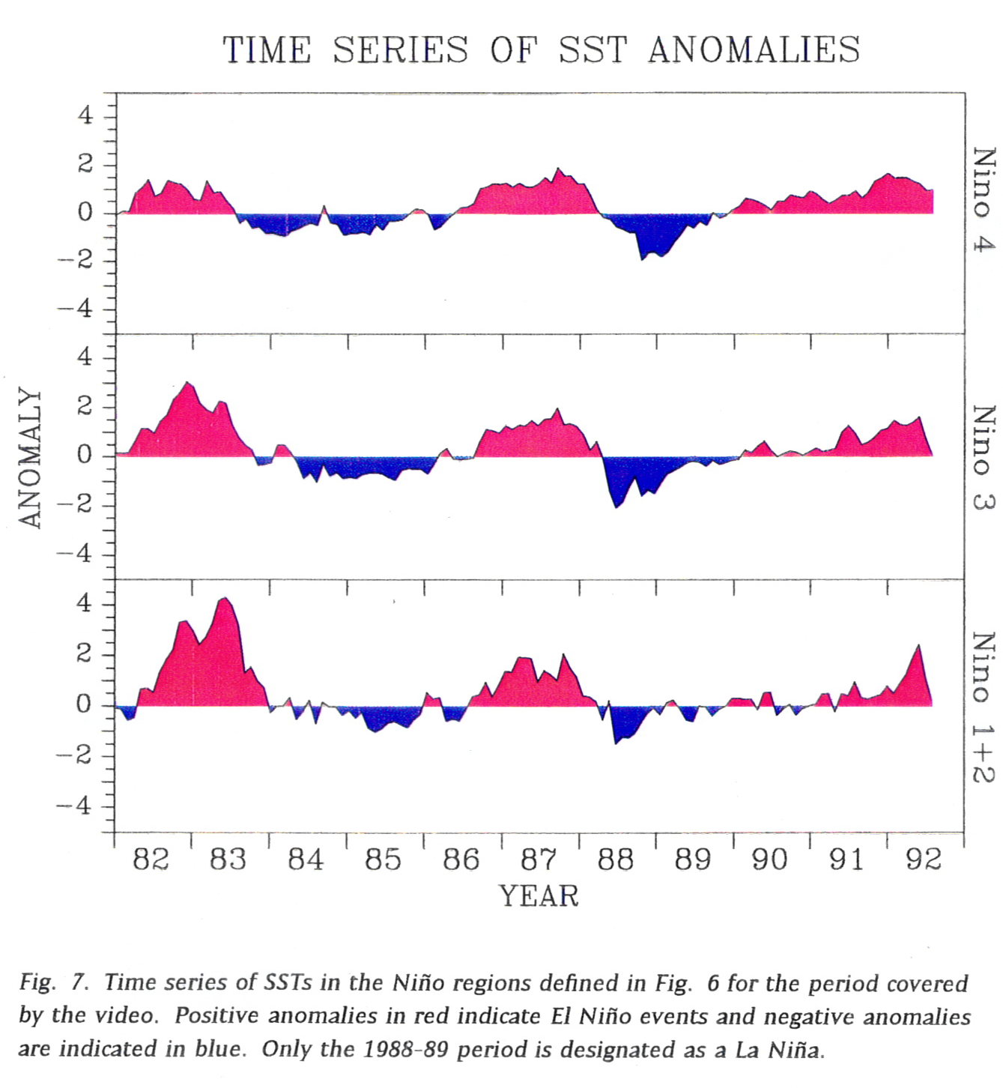

Slide 34
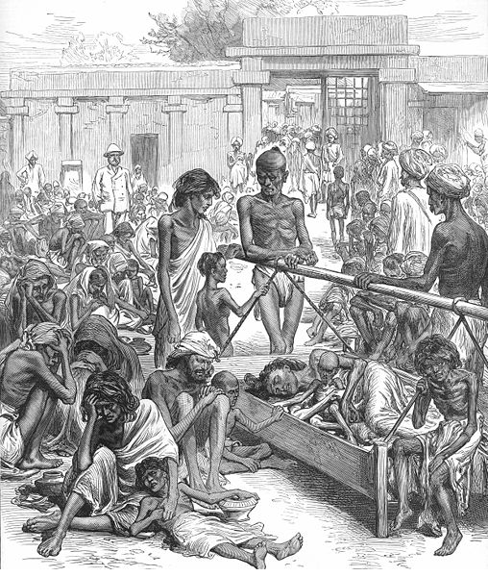
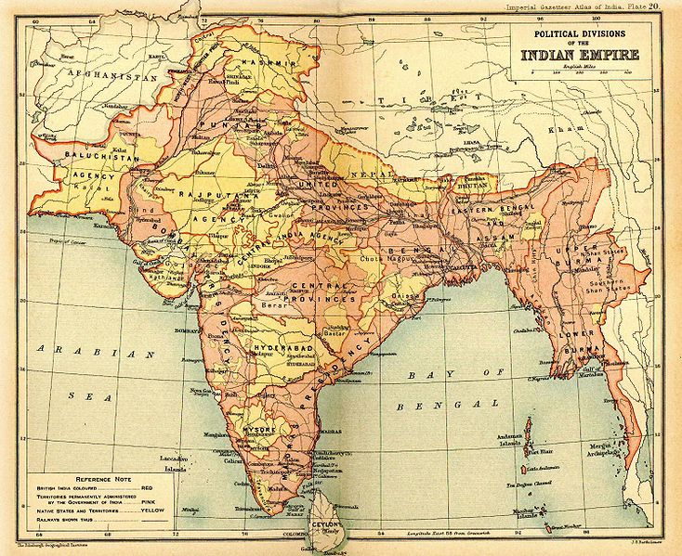
Southern Oscillation
India - great famine in 1876-78

Slide 35
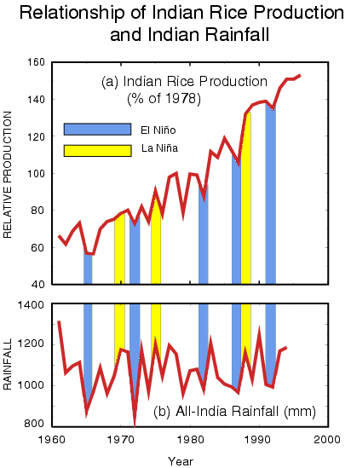
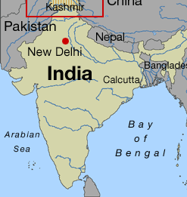
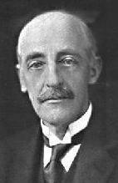
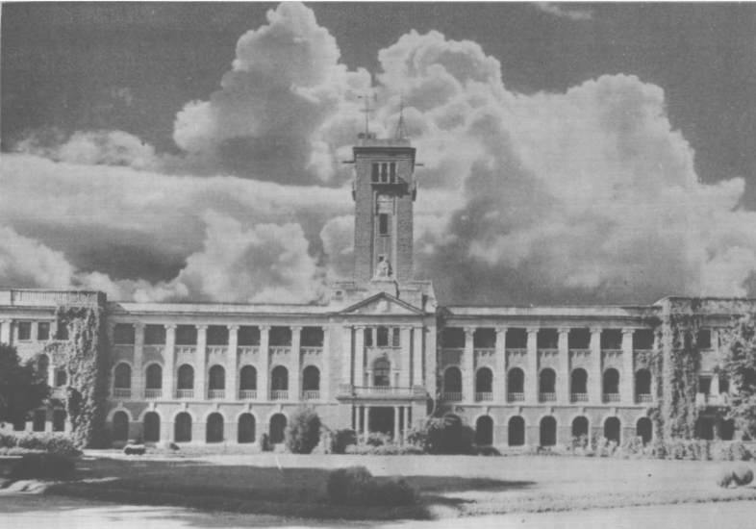
Amount and timing both undergo large year-to-year variability.
Head of the Indian Meteorological Service. After an 1899 famine that was caused by monsoon failure, was asked in 1904 to predict the vagaries of India's monsoons. Noticed a phenomenon associated with barometric pressure readings on the eastern and western sides of the pacific…
Sir. Gilbert Walker
Meteorological Office, Pune (Built in 1928)

Slide 36
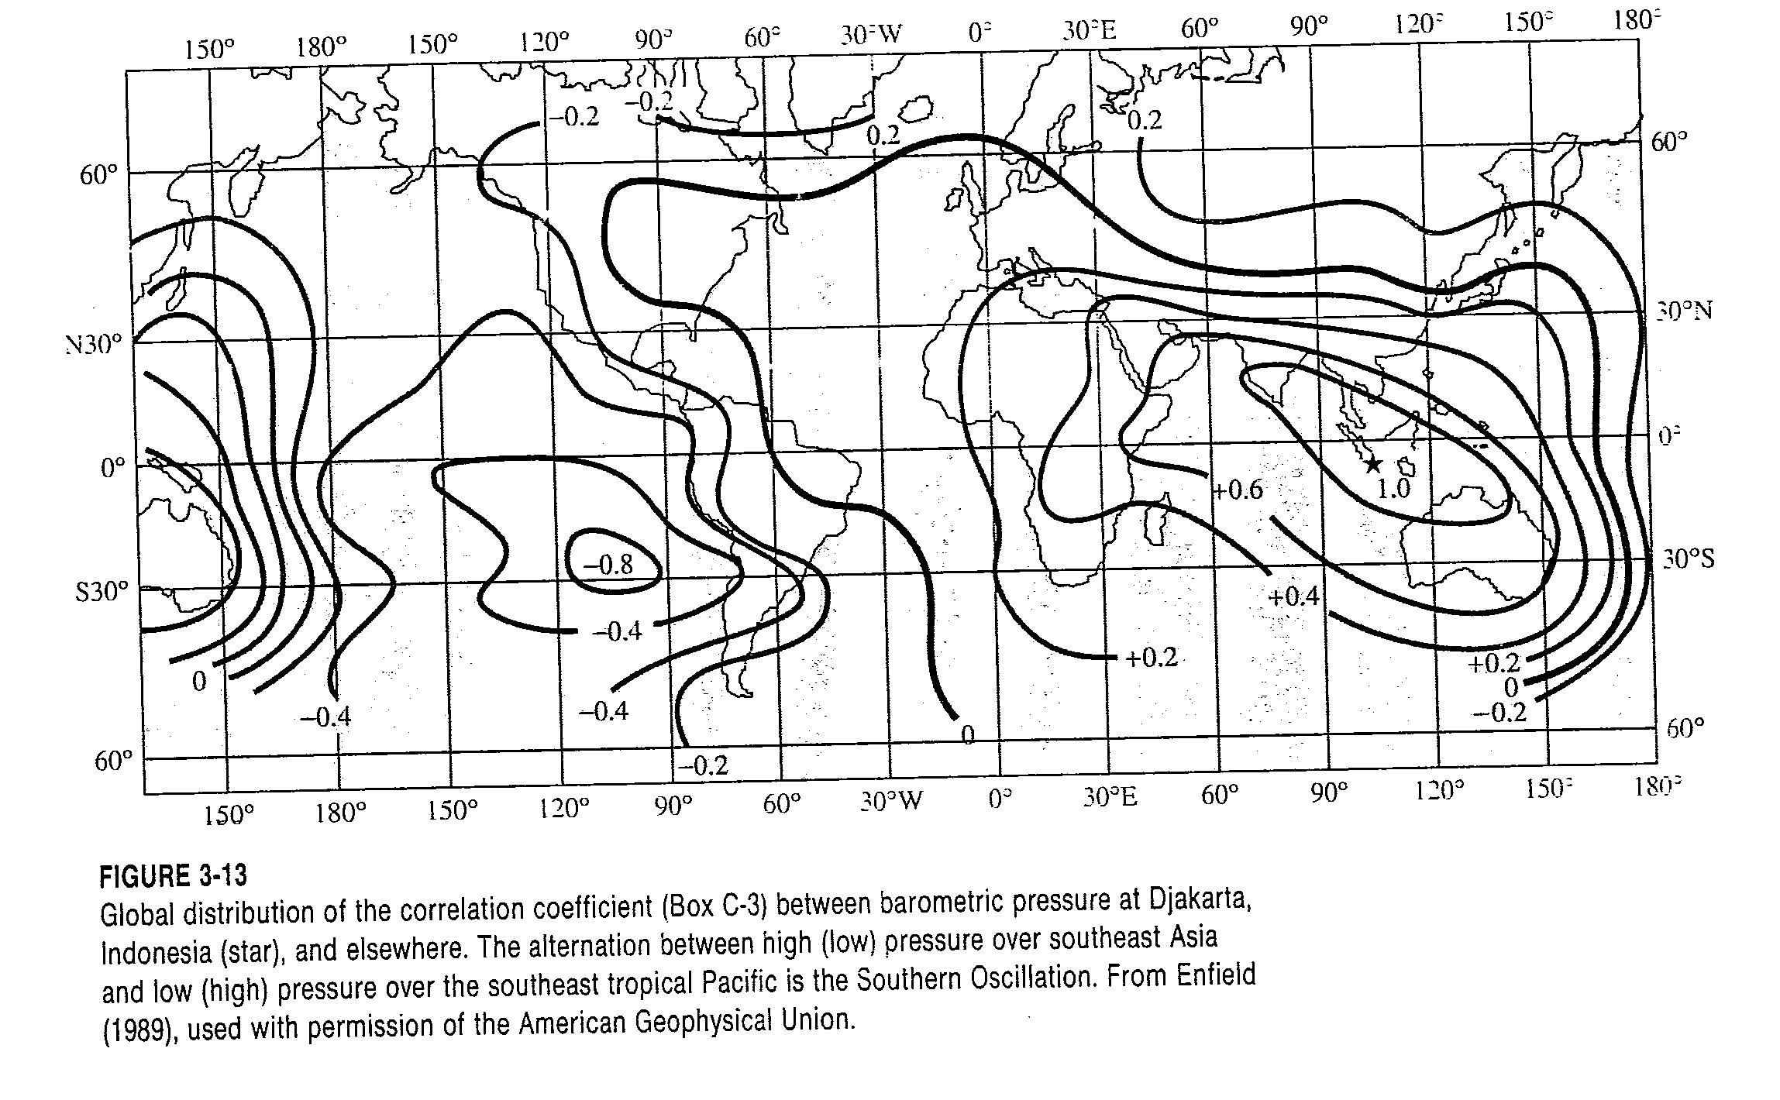
From Dingman, 1994

Slide 37
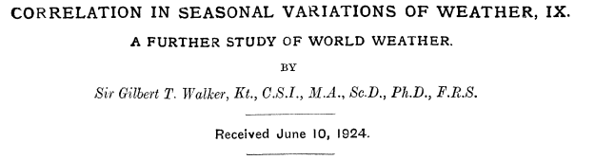
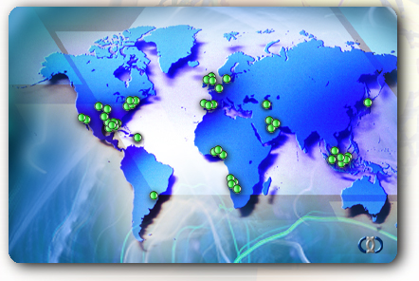
Sir. Gilbert Walker

Slide 38

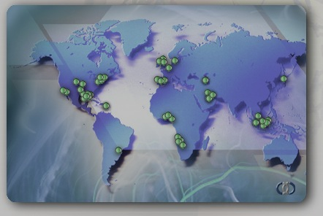
Correlation coefficient
of surface pressure
0.2
0.1
0.2
0.4
Sir. Gilbert Walker
-0.2
-0.4
0.4
-0.28
0.3
0.6
0.5
-0.5

Slide 39
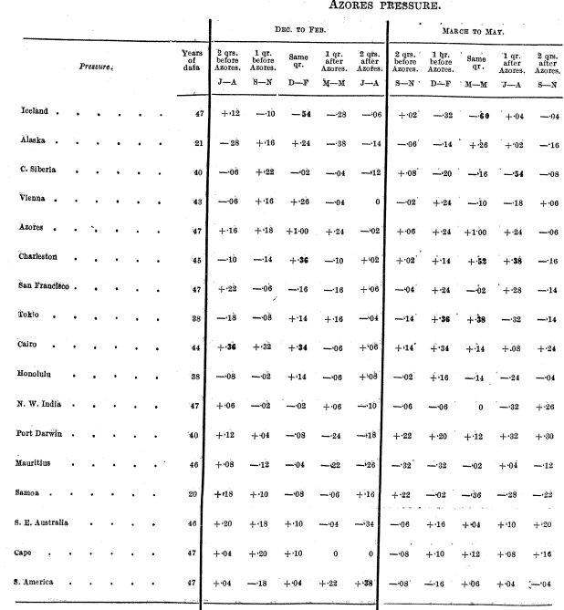
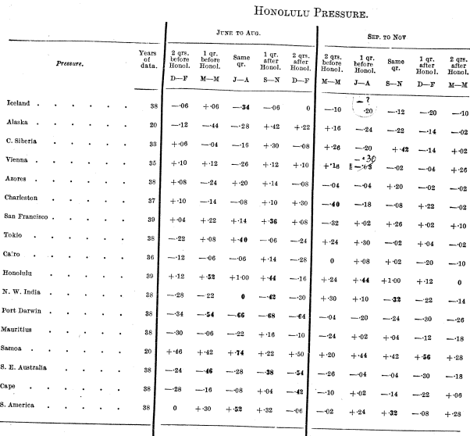
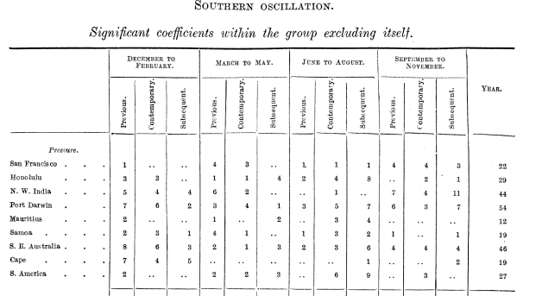
Correlation table
Walker, G.T., 1924. 275-333. (~60 pages)
Sir. Gilbert Walker

Slide 40


El Niño + Southern Oscillation = ENSO
(Sea)
(Air)
(Interaction)
Jacob Bjerknes (1897-1975)
A Norwegian meteorologist, Bjerknes became famous in his twenties for his role in the discovery of the polar front in weather systems.

Slide 41

The vertical circulation in the troposphere is called “Walker Circulation”, also known as the “tropical east-west circulation” by atmospheric scientists.
Hadley circulation (1735)
These early discoveries laid the foundation of an important climate phenomenon – “teleconnection”.

Slide 42


teleconnection wave train:
Height
anomaly
500mb height
field change
Warm water

Slide 43


Slide 44

Teleconnection: That’s how El Nino affects climate!

Slide 45


Global Impacts of ENSO

Slide 46

The Perfect Ocean
Hoerling and Kumar (2003) explained recent drought with warm west Pacific and Indian Oceans and drawn some implication for future drought.

Slide 47

The Asymmetric Response to El Nino and La Nina and a “Green’s Function” of Precipitation Response to SST anomalies

Slide 48


SSTA

Slide 49
Notice more
Hurricanes during
La Nina years
and vice-versa
Notice negative
correlations
between #of Atlantic
Hurricanes and SSTs
Over Eastern Tropsical
Pacific → La Nina
pattern

Slide 50
Hurricane Tracks - 1997
1997 was strongest El Nino year → Fewer hurricanes

Slide 51
Hurricane Tracks - 2000
2000 was a strong La Nina year → more hurricanes

Slide 52
Positive NAO
Stonger than usual
Subtropical High
Deeper than Normal Icelandic
Low
Warm and Wet Winters in Europe
Cold and Dry Winters in N. Canada
Eastern US – Mild and Wet Winter

Slide 53
The Time Series and Positive Phase of the Pacific Decadal Oscillation
Source: Nathan Mantua, University of Washington

Slide 54


Winter NAO
Summer (JJA) PDSI
correlations with
winter (DJF) NINO3
Rajagopalan et al., 2000

Slide 55




Slide 56
Climate Drivers
A basic quantitative understanding of how the global climate system works, to allow informed assessment of climate based forecasts and their role in hydrology and water resources systems.
ENSO - http://www.elnino.noaa.gov/
Pacific Decadal Oscillation - http://jisao.washington.edu/pdo/
Tropical Atlantic Mode - http://www.aoml.noaa.gov/phod/research/tav/tcv/amm/index.php
North Atlantic Oscillation - http://www.ldeo.columbia.edu/res/pi/NAO/
Arctic Oscillation - http://nsidc.org/arcticmet/patterns/arctic_oscillation.html
Atlantic Multidecadal Oscillation - http://www.aoml.noaa.gov/phod/amo_fig.php
Indian Ocean Dipole

Slide 57




(Research) Framework
What Drives Year to Year
Variability in regional
Hydrology?
(Floods, Droughts etc.)
Diagnosis
Hydroclimate Predictions – Scenario Generation
(Nonlinear Time Series Tools, Watershed Modeling)
Forecast
Application
Decision Support System
(Evaluate decision strategies
Under uncertainty)

Slide 58
Climate Diagnostics
Select hydroclimate variable (precipitation, temperature, streamflow, peak flow, 7Q10, water quality variable etc.) of interest
Identify ‘high’ (years with high values) and ‘low’ years
Create anomaly composite (average) spatial maps of large scale climate variables for the ‘high’ and ‘low’ years of interest
  Sea surface temperature (global)
  500mb geopotential heights (similar to sea level pressure)
  500mb or surface winds (regional, global)
  Precipitable water (regional)
  Etc.
Identify regions with high/low values in these maps
Put together plausible mechanism of interannual variability using your large scale climate knowledge
Create correlation maps with large scale climate variables (as above) for
  Input forcing season
  Preceding months/seasons (to identify predictors)
Identify areas of high/low correlation from the preceding month/season correlation maps
Create predictors (i.e., spatial average of variables over the identified regions)
Incorporate them in a regression framework for prediction.

