Slide 1
Physical Hydrology & Hydroclimatology
(Multiscale Hydrology)
A science dealing with the properties, distribution and circulation of water.
R. Balaji
balajir@colorado.edu
CVEN5333 http://civil.colorado.edu/~balajir/CVEN5333
Includes slides from Prof. Mike Gooseff

Slide 2
Water in Soil
Learning objectives
Be able to quantify the properties of water held in and flowing through soil (porosity, moisture content, pressure, suction, hydraulic conductivity)
References
Rainfall-Runoff Processes workbook chapter 4
Dingman Chapters 7 and 8
Chow Chapter 4

Slide 3
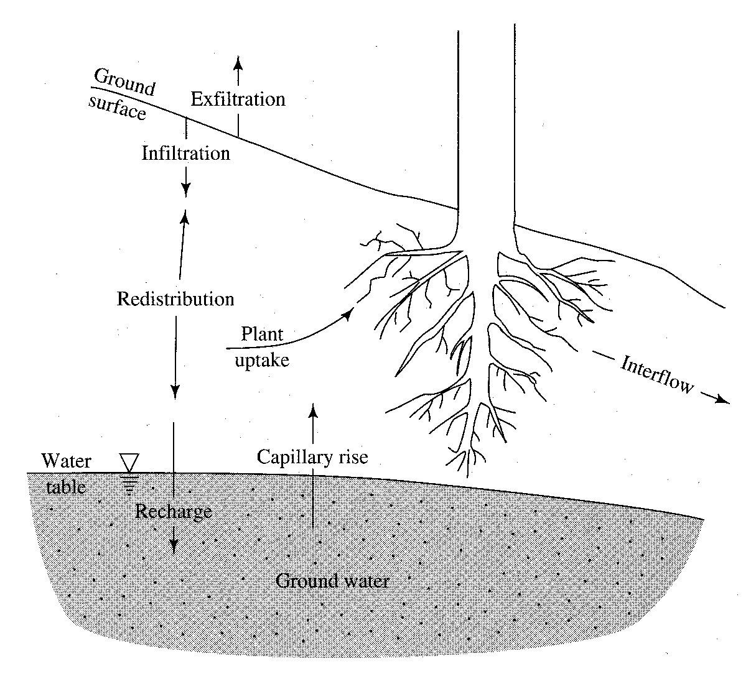
Conceptual model of subsurface water
Many hydrologic processes occur here in the skin of the landscape
Precip that reaches the ground can infiltrate or move overland…

Slide 4
Unsaturated Zone
Location
The subsurface is generally composed of roots, soil, air and water
Water content of soils generally increases
with depth
Notes:
The subsurface is generally composed of roots, soil, air, and water
Water content of soils generally increases with depth

Slide 5
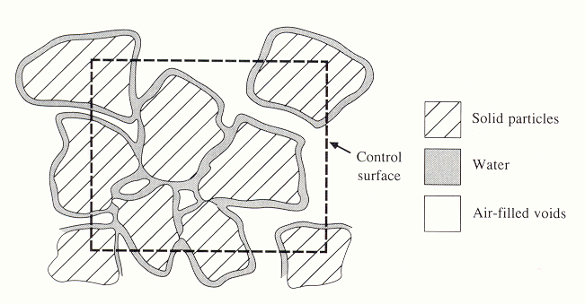
Notes:
Figure 21. Cross section through an unsaturated porous medium (from Chow et al. 1988)

Slide 6
Well graded silt, sand, gravel mixture
Uniformly graded sand
Figure 22. Illustrative grain-size distribution curves. The boundaries between size classes designated as clay, silt, sand and gravel are shown as vertical lines.

Slide 7
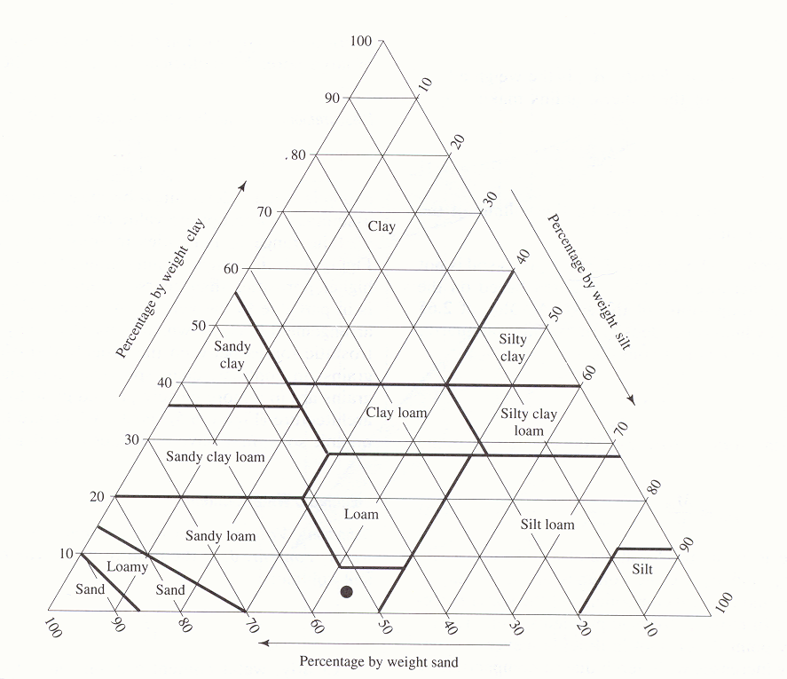
B
A
Soil texture triangle, showing the textural terms applied to soils with various fractions of sand, silt and clay. (from Dingman, 2002)

Slide 8
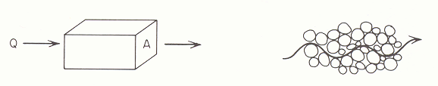
Macroscopic and microscopic concepts of porous medium flow. (from Freeze and Cherry, 1979)

Slide 9
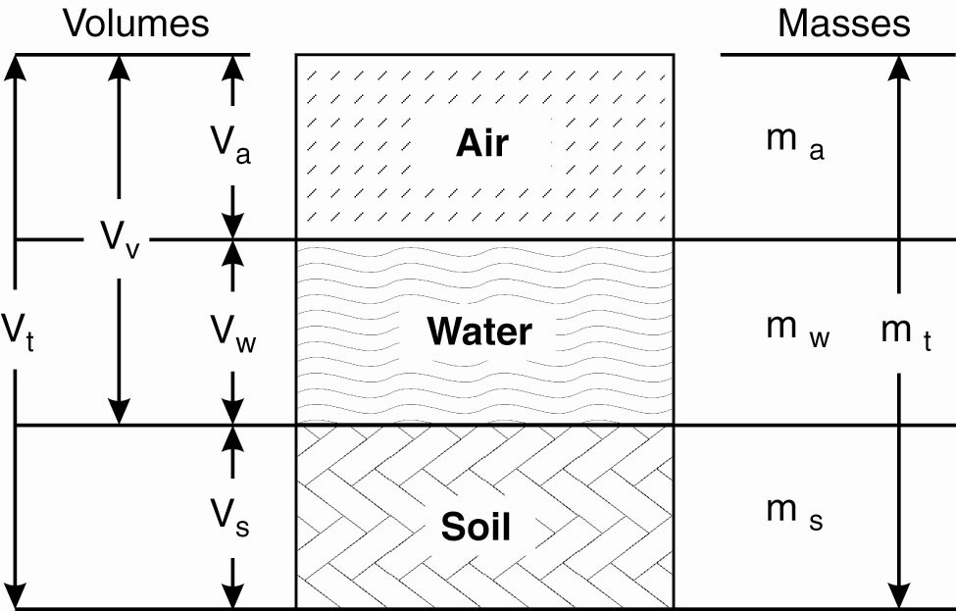
Porous Media Characteristics –
Soil Matrix Recipe
V_{a}
m_{v}
V_{v}
V_{t}
V_{w}
m_{w}
m_{t}
Env. Hydrol., Figure 3.3
V_{m}
m_{m}

Slide 10
Porous Media Characteristics –
Porosity (η or φ)
Definition: the proportion of pore space in a volume of soil
What is the range of values for porosity?
0 to 1.0
Measurement: the ratio of the bulk density to the density of soil:
$$φ=1−\frac{ρ_{b}}{ρ_{m}}$$
Notes:
WHAT IS THE RANGE OF VALUES FOR POROSITY? 0-1

Slide 11
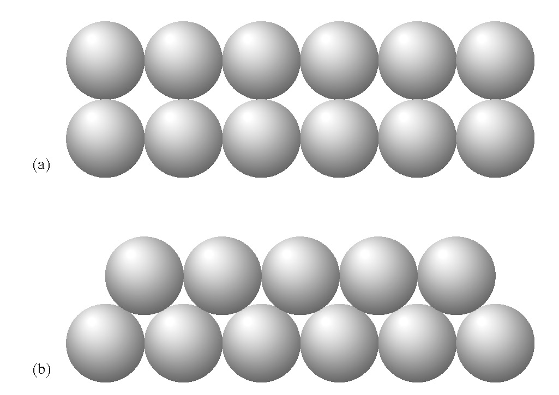
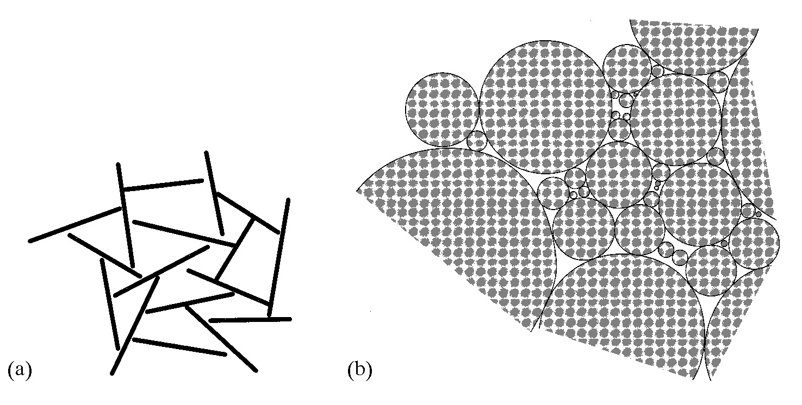
Porous Media Characteristics –
Porosity (η or φ)
T/F? Porosity is affected by the amount of water in the soil.
Porosity is affected by the arrangement of soil particles:
FALSE
Notes:
Left image: porosity of top = 0.91, porosity of bottom = 0.35

Slide 12
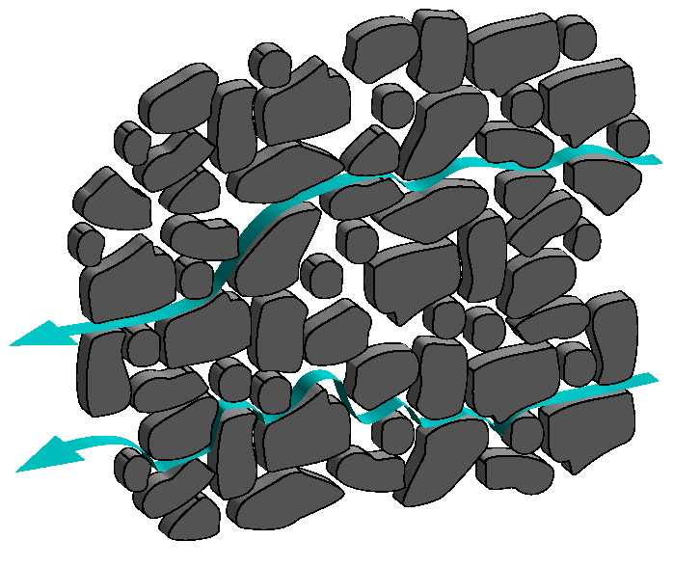
Groundwater Fluid Dynamics
Water moves down gradient, from high head (or potential) to low head.
Unlike common fluid dynamics examples, porous media induce a tortuous flow path
- Extremely complex flowpath geometry which cannot be specified completely
Notes:
The position, size, and shape of each particle or grain in the porous media cannot be specified.
Frictionless flow is meaningless in this situation, we expect head losses to play the predominant role in mediating flow

Slide 13
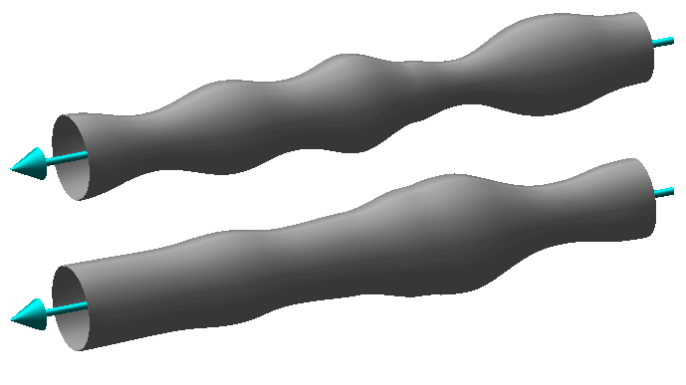
Groundwater Fluid Dynamics: simplifying the problem…
First, simplify by “straightening” the tortuous flowpath and idealizing the flowpath as a pipe of variable diameter

Slide 14
Groundwater Fluid Dynamics: simplifying the problem…
Second, replace variable radius tubes with an equivalent set of constant radius tubes.
Our conceptual model of flow through a porous media is now flow through a bundle of small tubes of different diameters
Conceptual model is drastically oversimplified, but allows forward progress for quantifying the problem

Slide 15
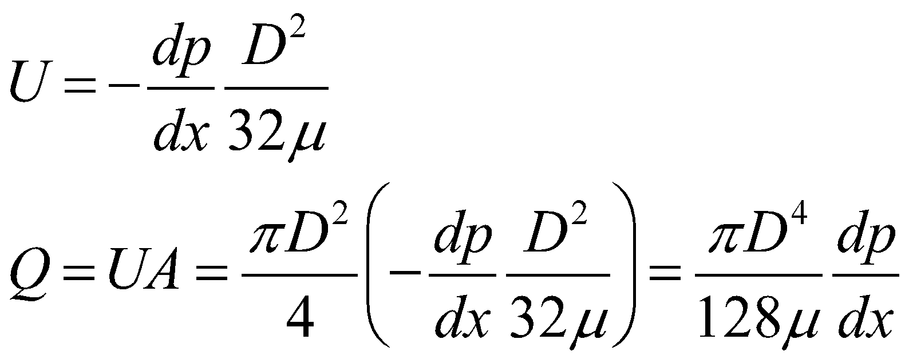
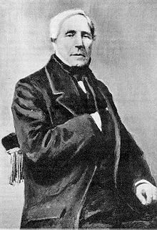
Groundwater Fluid Dynamics: simplifying the problem…
Narrow tube and small velocities, assume
laminar conditions
We can describe the velocity and flow through the tube with Poiseulle’s Law
Consider a single tube of diameter D…
U – velocity
p – pressure
D – diameter
A – area
μ – dynamic viscosity
Notes:
Narrow tube and small velocities, assume laminar flow conditions
We can describe the velocity and flow through the tube with Poiseulle’s Law

Slide 16
Groundwater Fluid Dynamics: from tubes to pores…
Recall….
Discharge varies as the 4th power of the tube diameter
If our “tube” is analogous to pores in a complex media, then groundwater flow should be dependent of the texture and grain size of the porous media…
Notes:
Discharge varies as the 4th power of the tube diameter
If our “tube” is analogous to pores in a complex media, then GW flow should be dependent of the texture and grain size of the porous media…

Slide 17
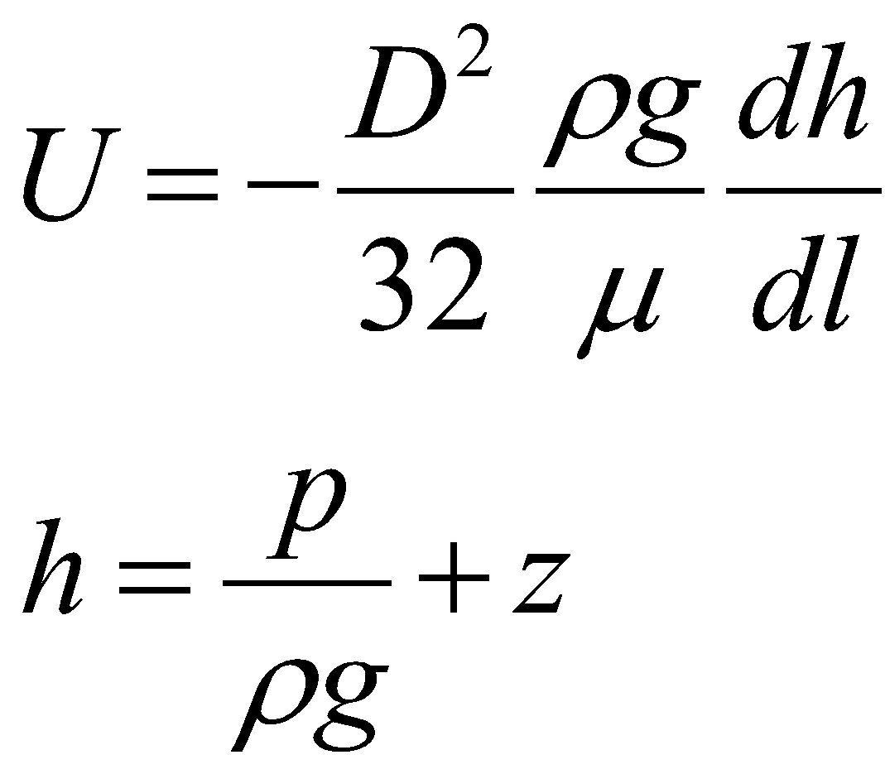
Groundwater Fluid Dynamics: hydraulic head
GW flow does not need to be horizontal, vertical
flow components demand for some accounting of gravity
- Hydraulic head (h) [L] is the mechanical energy
per unit weight at location
Note: both pressure and elevation components considered
Notes:
GW flow does not need to be horizontal, vertical flow components demand for some accounting of gravity
- Hydraulic head (h) [L] is the mechanical energy per unit weight at location l: both pressure and elevation components considered

Slide 18
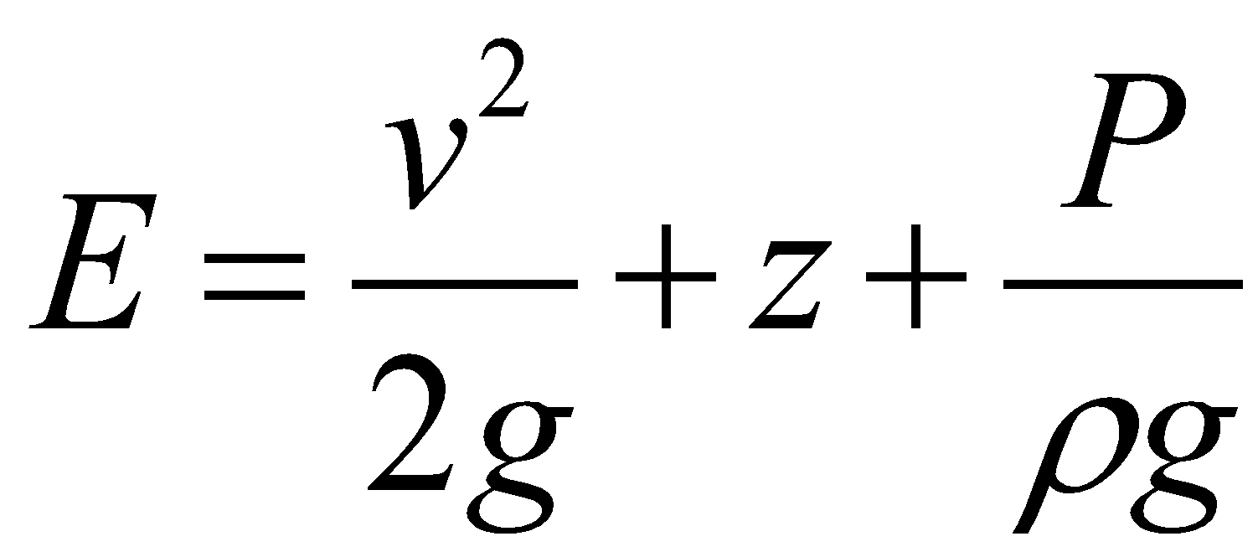
Groundwater Fluid Dynamics: recall fluid mechanics 101…
Bernoulli equation specifies the total fluid energy per unit weight E [L]
Kinetic
Energy
Potential
Energy
Pressure
Energy
For steady, frictionless, and incompressible flow
fluid energy is conserved! Thus, E = constant along a flow path
Notes:
KINETIC POTENTIAL PRESSURE
For steady, frictionless, and incompressible flow fluid energy is conserved! i.e. E = constant along a flow path

Slide 19
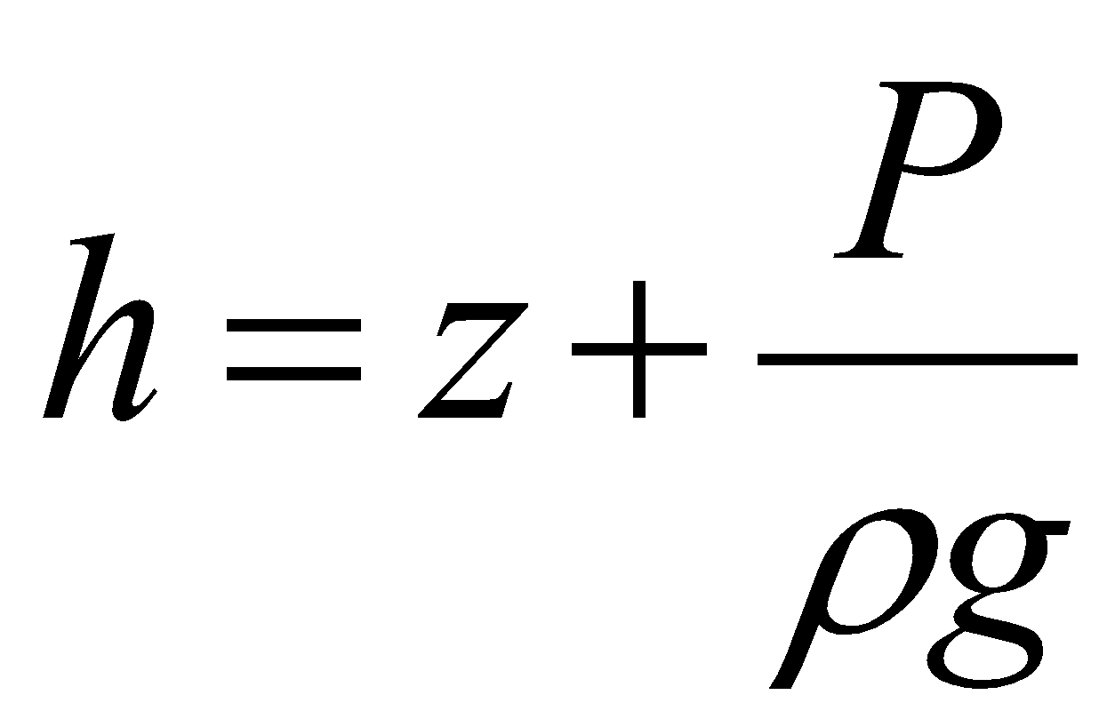
Groundwater Fluid Dynamics: negligible kinetic energy in groundwaters…
Kinetic
HEAD
Potential
HEAD
Pressure
HEAD
Hydraulic head is the total mechanical energy per unit weight of water!

Slide 20
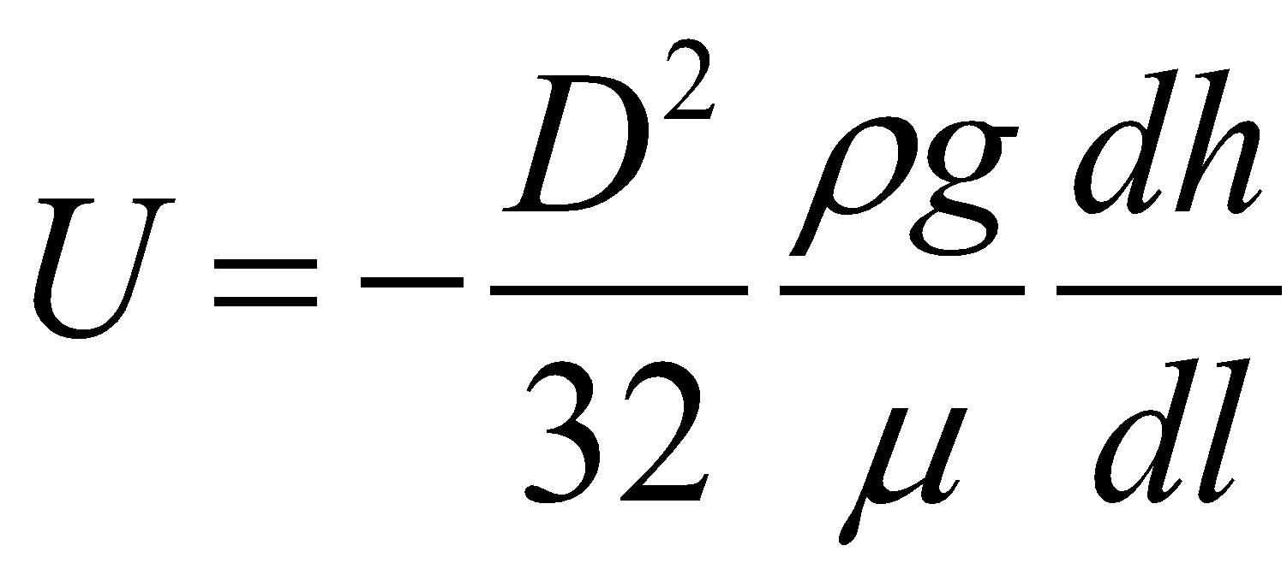
Groundwater Fluid Dynamics: scale of observation….
A
Q
This only pertains to a single flowpath, and we have yet to explain velocities or discharge for the entire system

Slide 21
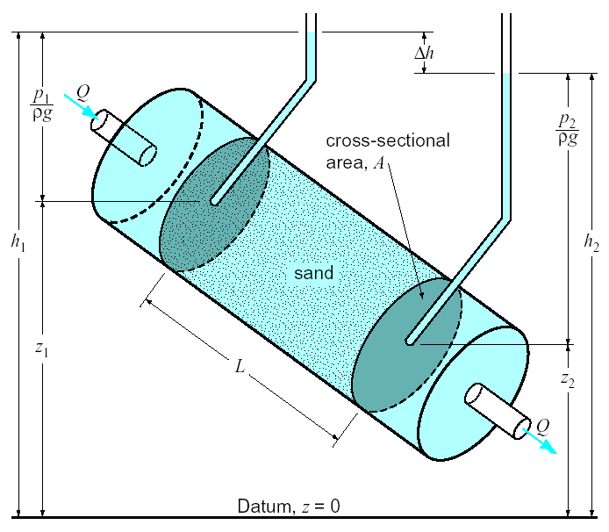
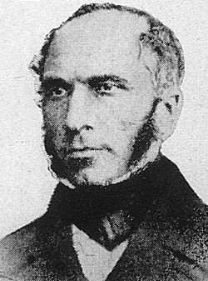
Groundwater Fluid Dynamics:
Darcy’s Experiments….
What parameters influence flow through a porous media?

Slide 22
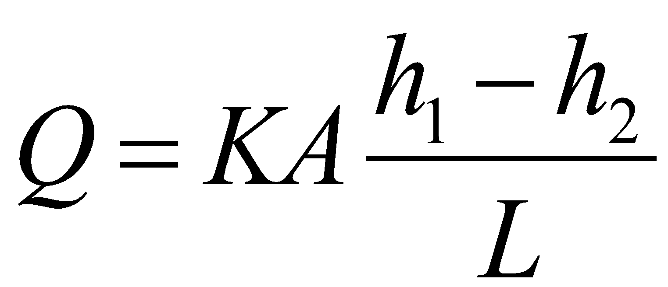
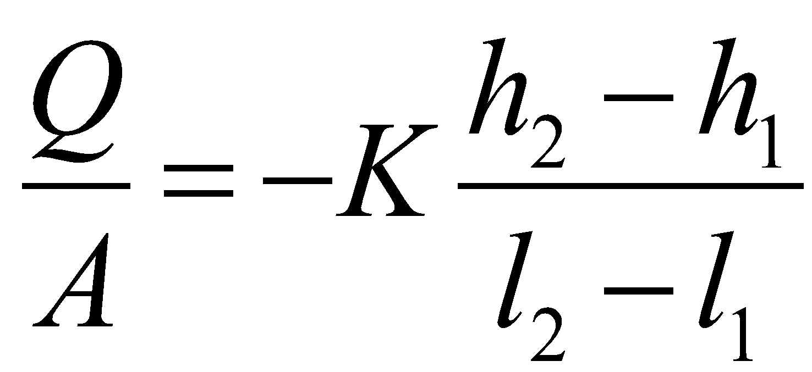
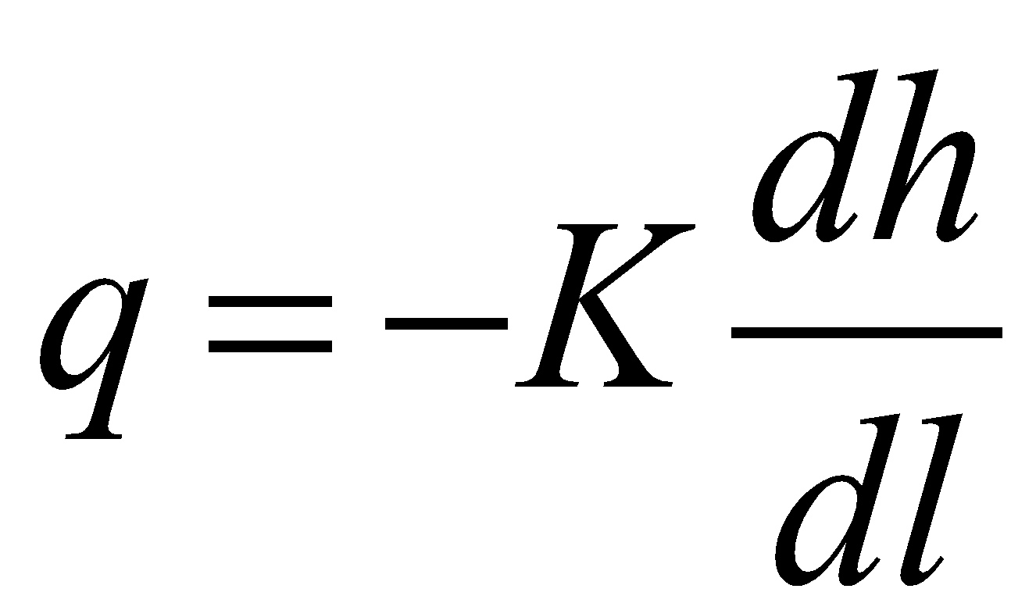
Groundwater Fluid Dynamics:
Darcy’s Experiments….
Total discharge
Rearrange…
Specific discharge
Notes:
Hydraulic conductivity K is a constant of proportionality explaining the relationship between hydraulic gradient and discahrge
dh/dl is the hydraulic gradient. The negative sign indicates that positive specific discharge (indicating direction of flow) corresponds with a negative hydraulic gradient.

Slide 23
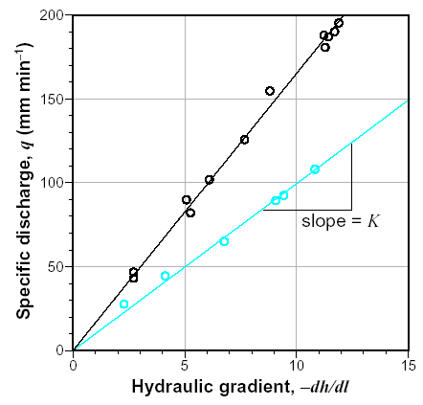
Groundwater Fluid Dynamics: hydraulic conductivity….
A
Specific discharge
BLACK High K sand
B
Which of these relationships is the higher K material, and which is the lower K material?
BLUE Low K sand
A is the high K material
B is the low K material
Notes:
A is high K sand
B is low K sand

Slide 24
Groundwater Fluid Dynamics: hydraulic conductivity….
K depends on the nature of both
the fluid and porous material
Grainsize
(analogous to D)
K
Fluid viscosity
K
Notes:
K depends on the nature of both the fluid and porous material

Slide 25
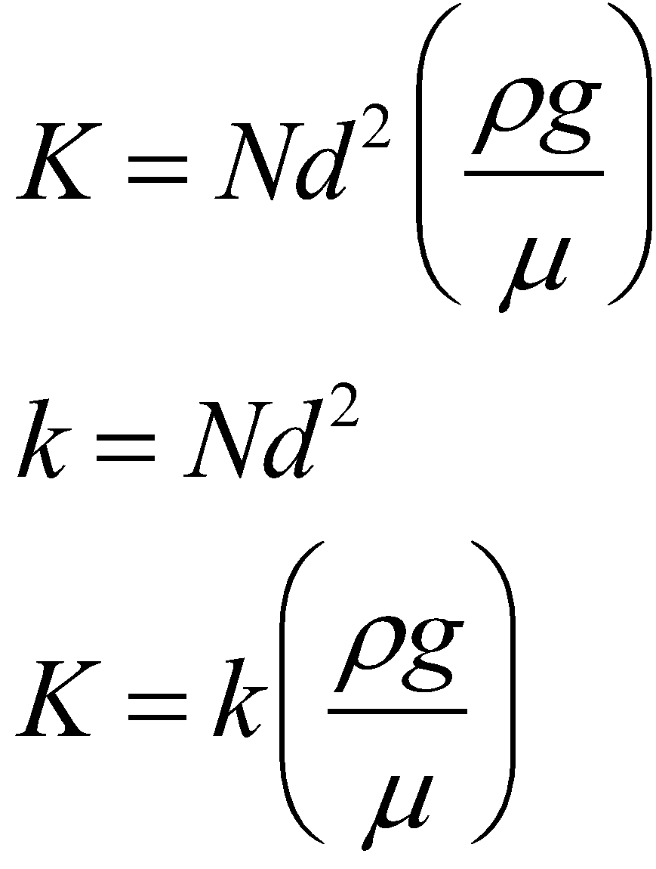
Groundwater Fluid Dynamics: hydraulic conductivity….
N = shape factor, d = mean grain diameter
k = intrinsic permeabiltiy
Is hydraulic conductivity temperature dependent?

Slide 26
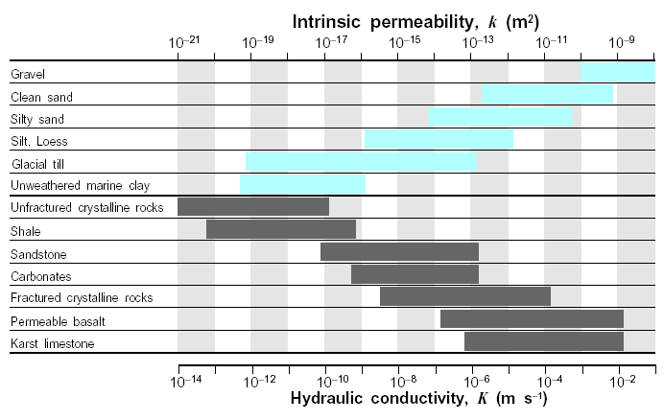
Groundwater Fluid Dynamics: hydraulic conductivity….

Slide 27
Groundwater Fluid Dynamics: average linear velocity….
- This (q) is NOT the linear velocity, despite the units [L/T]
- Recall we got this by dividing the total volumetric flow rate Q by the total column area A
Q
A
… but water only flows through a fraction of the total area A

Slide 28
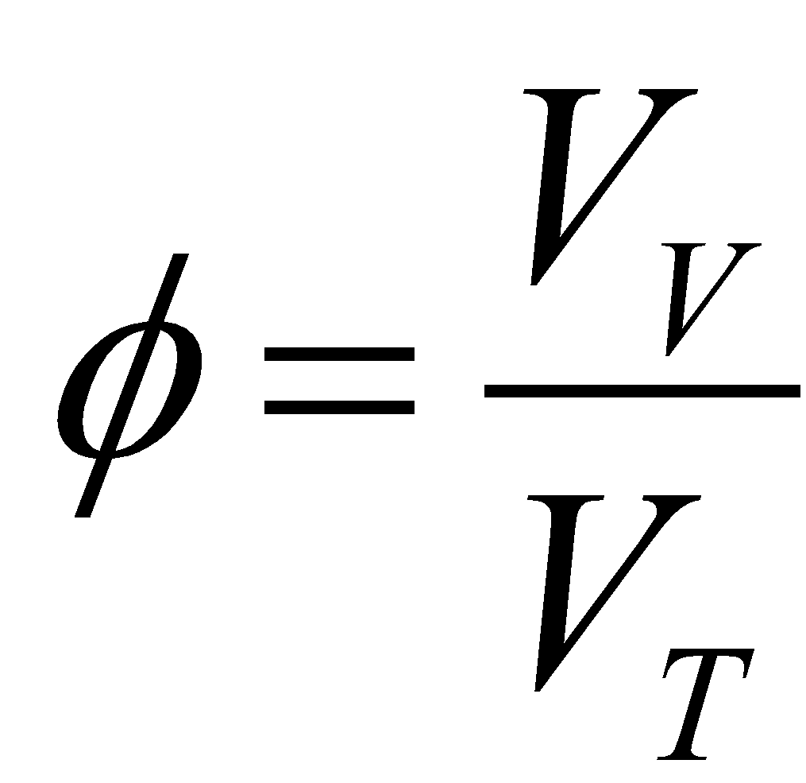
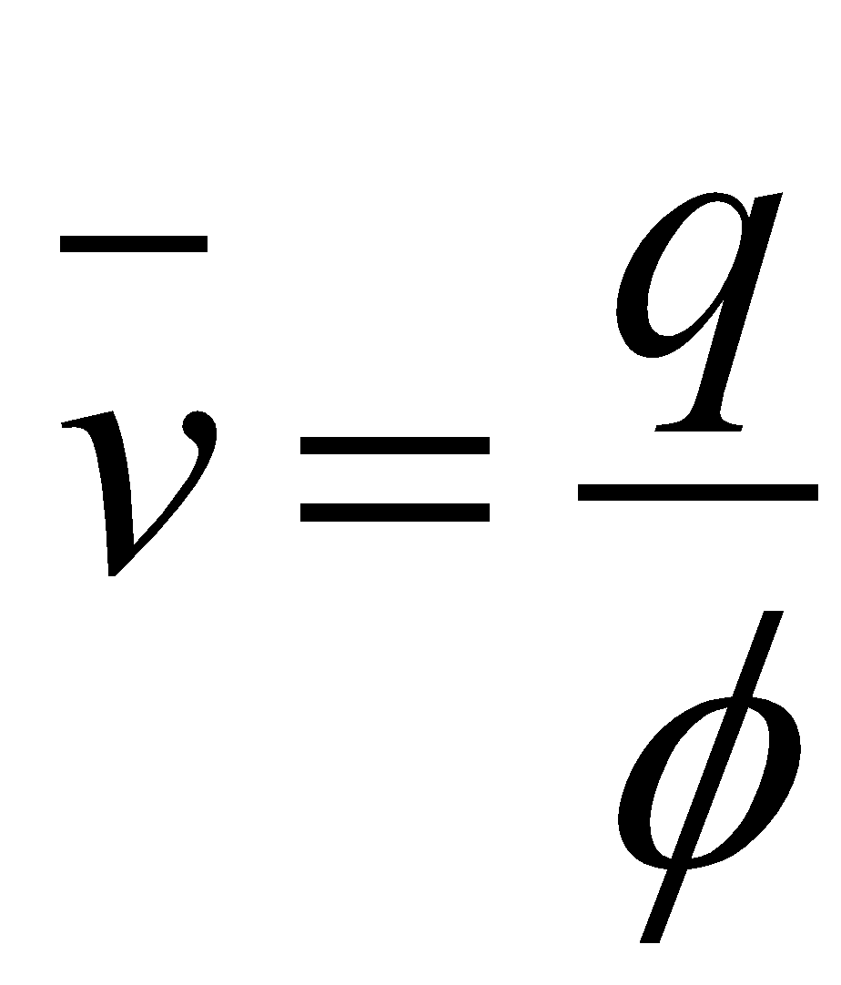
Groundwater Fluid Dynamics: average linear velocity….
A
Q
Recall, porosity is the fraction of fraction of a porous material which is void space
Average linear velocity is the specific discharge normalized by the porosity

Slide 29
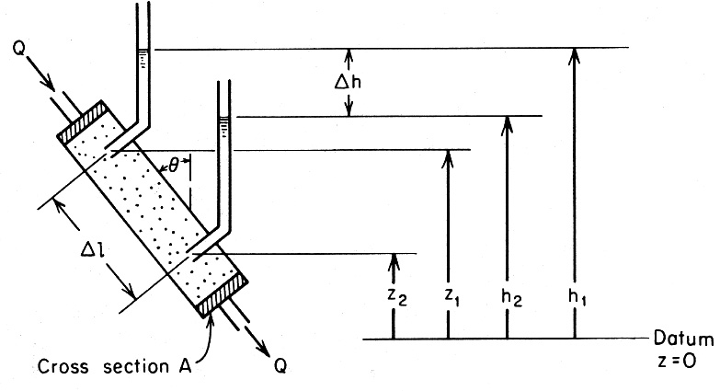
ψ₁
1
ψ₂
2
Experimental apparatus for the illustration of Darcy's equation. (From Freeze and Cherry)

Slide 30
Parallel conduit conceptual model for porous media flow.
v_{i}
A
A_{i}

Slide 31
Group learning challenge 1
Figure out how much the flow rate through a porous media will change for a 5 °C change in temperature.
Does flow rate increase or decrease as temperature increases

Slide 32
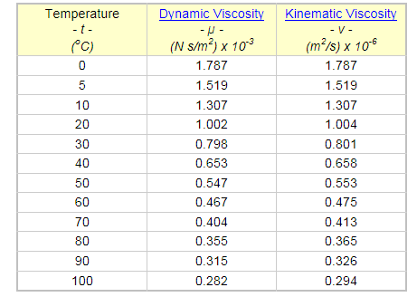
Water Viscosity at different temperatures
From http://www.engineeringtoolbox.com/water-dynamic-kinematic-viscosity-d_596.html

Slide 33
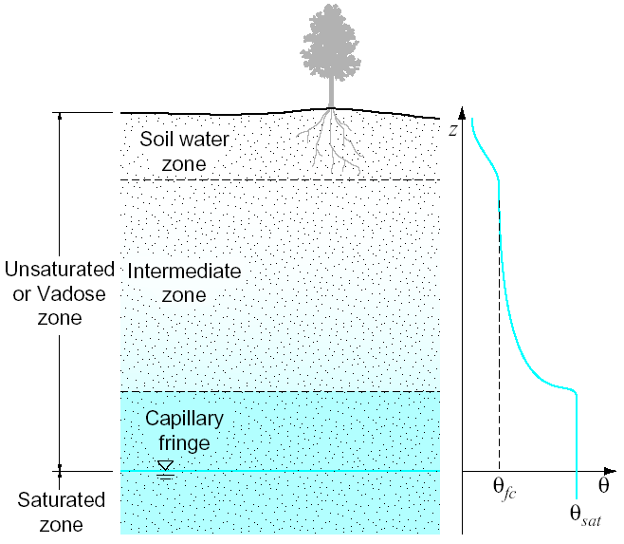
The Unsaturated Zone
Unsaturated Zone – the region between the soil surface and water table, where pores are partially filled with water and partially filled with air.
Water in the unsaturated zone is referred to as soil moisture
Understanding hydrologic fluxes in this zone requires resolving a three phase problem

Slide 34
The Unsaturated Zone
Soil water zone – zone directly below the soil surface where water may be discharged into the atmosphere by evaporation and transpiration.
Field capacity – the moisture condition prevailing when downward gravitational forces are in equilibrium with surface tension forces.

Slide 35
The Unsaturated Zone
Capillary fringe – zone where the pressure is less than atmospheric but soils are saturated, overlying the water table.
** water is being held against the force of gravity
Intermediate zone – simply the zone between the soil water zone and the capillary fringe. Because something gotta be there…

Slide 36
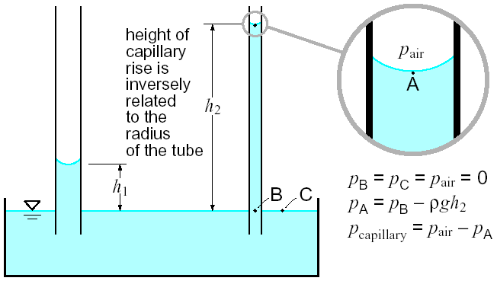
Forces in the unsaturated zone
Gage pressure = 0
Capillary forces – allow liquid to flow in narrow spaces (pores) without the assistance of, and in the opposite direction of gravity
Capillary pressure head – the negative (gage) pressure produced by capillary forces (when divided by ρg)

Slide 37
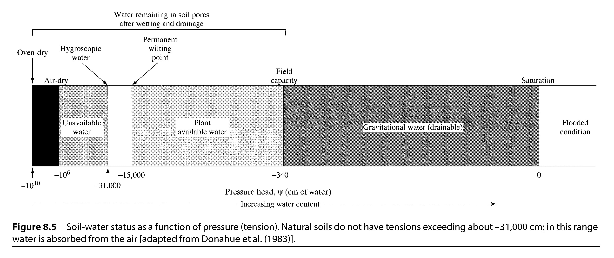
Soil-water status as a function of pressure (tension). Natural soils do not have tensions exceeding about -31000 cm; in this range water is absorbed from the air. [from Dingman, 1994]

Slide 38
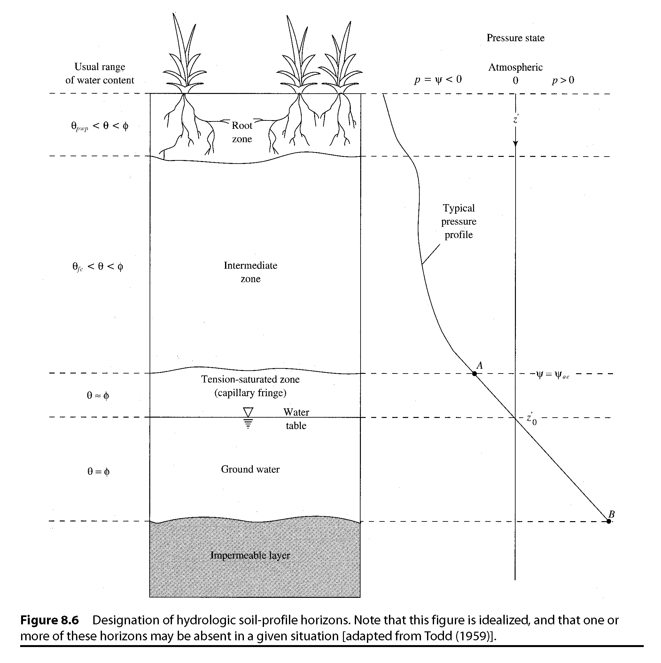
The Unsaturated Zone

Slide 39
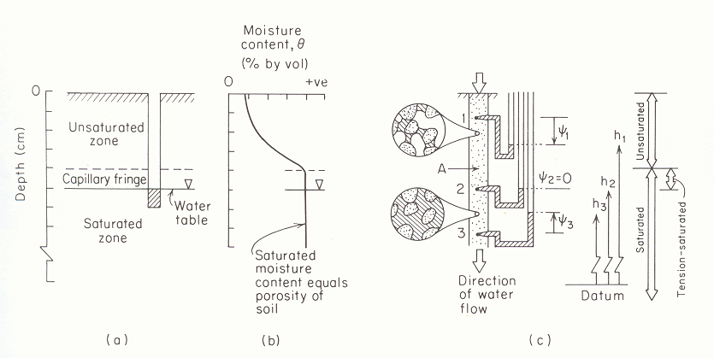
Negative Pressure Head. Suction vs Moisture content
(from Freeze and Cherry, 1979)

Slide 40
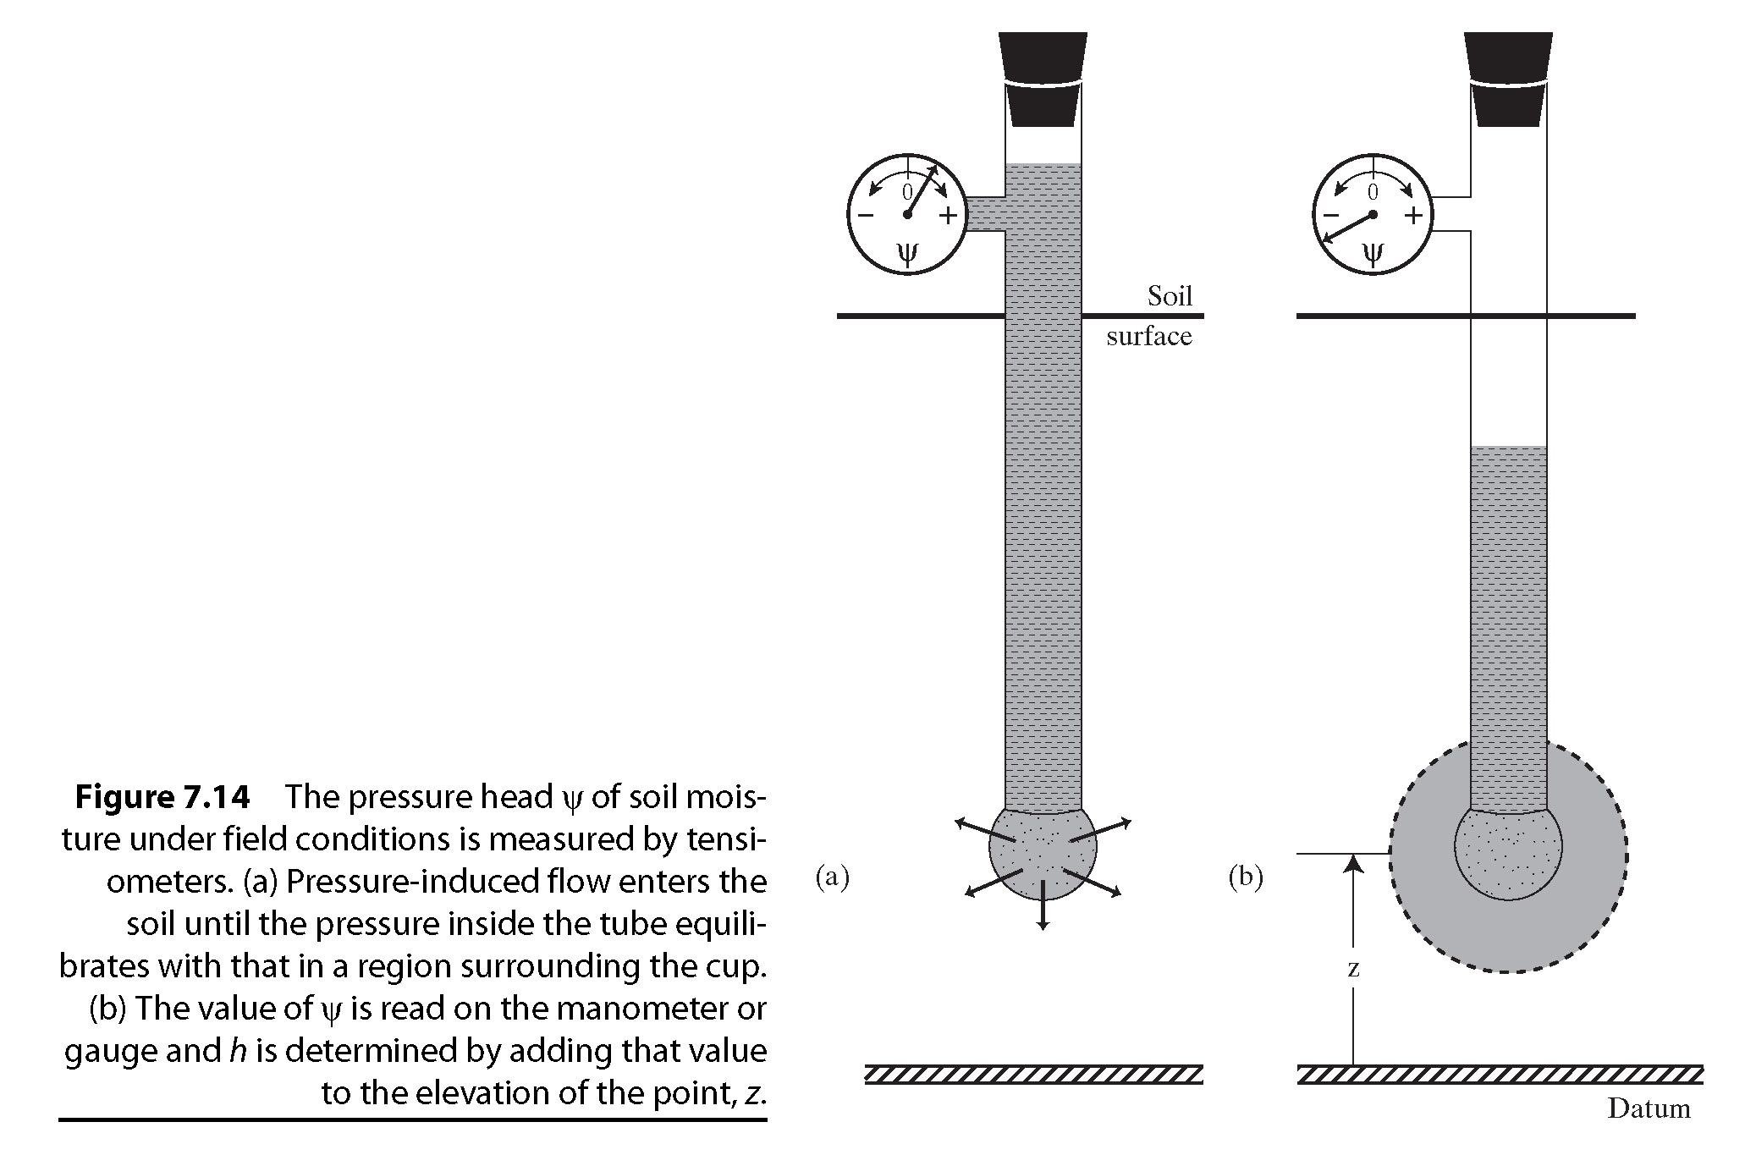
Pressure Head Measurement

Slide 41
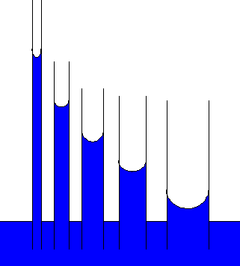
Suction head -|ψ|
Moisture Content θ
Illustration of capillary rise due to surface tension and relationship between pore size distribution and soil water retention curve.

Slide 42
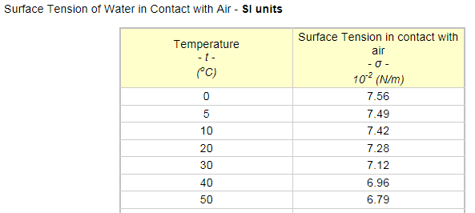
Surface Tension
From http://www.engineeringtoolbox.com/water-surface-tension-d_597.html

Slide 43

Forces in the unsaturated zone: negative gage pressure can “pull” water

Slide 44
Forces in the unsaturated zone: hydraulic head in the vadose zone
Hydraulic head in the vadose zone is the sum of negative capillary-pressure head, ψ, and the elevation head, z.
Capillary-pressure head is a function of the volumetric moisture content θ
The specific relationship between negative capillary-pressure head (suction) and the volumetric moisture content is known as the soil’s moisture characteristic (curve)

Slide 45
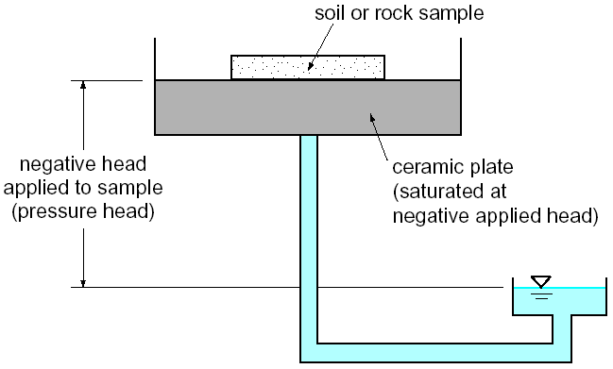
The moisture characteristic ψ=f(θ): measuring the negative head of a soil
A pressure plate measures the negative pressure head of a soil at a given moisture content

Slide 46
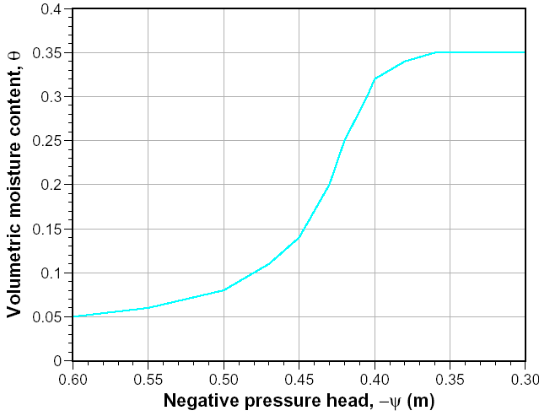
The moisture characteristic ψ=f(θ): the moisture characteristic curve
saturation
Exceed critical suction and rapidly drain pore spaces

Slide 47
Unsat’d hydraulic cond. K = f(θ) conductivity is a function of θ
Hydraulic conductivity decreases rapidly as the porous media becomes unsaturated.
  As suction is applied to soil, large pore spaces become filled with air first.
  Flow is restricted to larger pore spaces
  Recall..

Slide 48
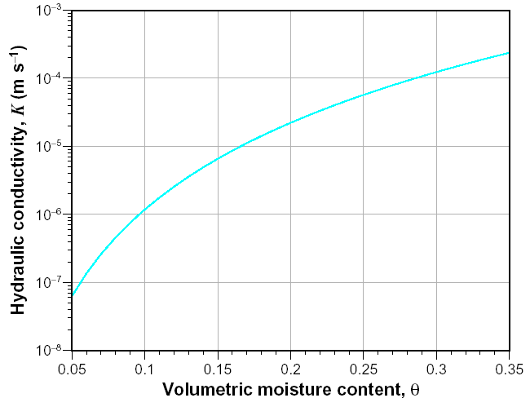
Unsat’d hydraulic cond. K = f(θ) conductivity is a function of θ
K varies by orders of magnitude as volumetric moisture content decreases from saturation

Slide 49
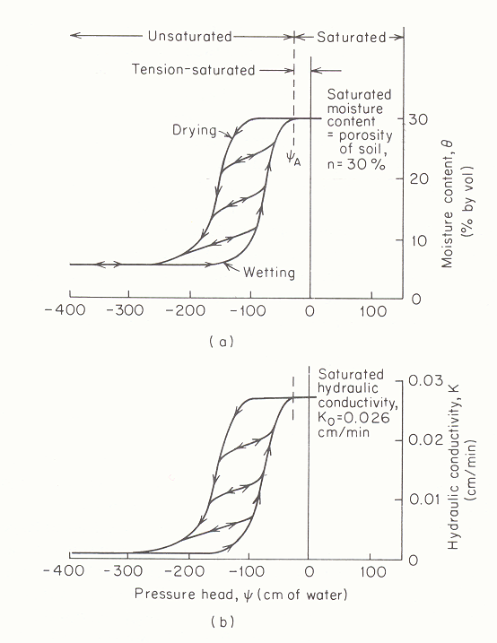
Residual moisture content θ_{r} =5%
Characteristic curve relating moisture content to pressure head (from Freeze and Cherry, 1979).

Slide 50
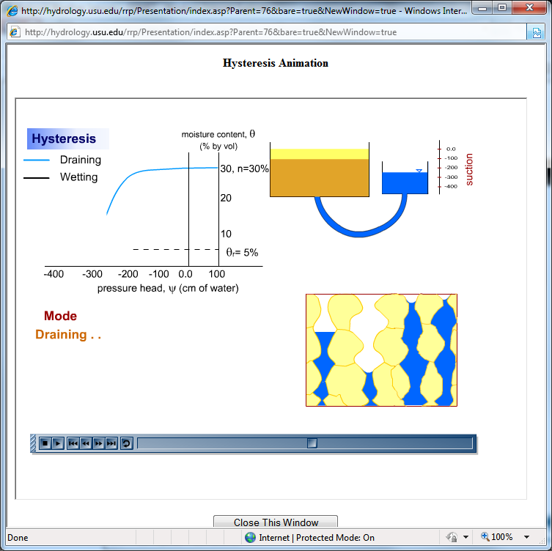
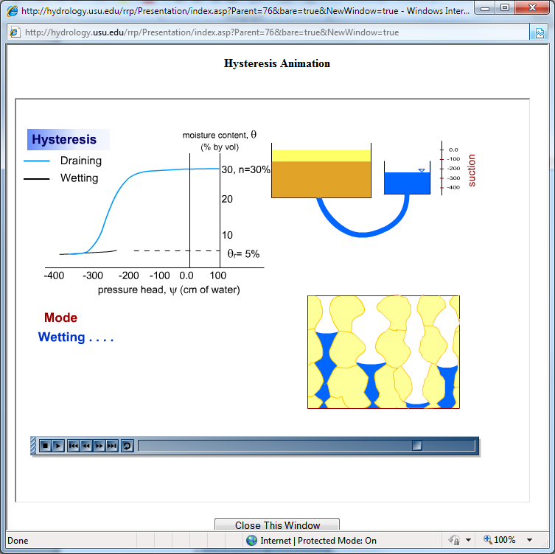
Basis for Hysteresis
See http://hydrology.usu.edu/rrp/ hysteresis animation

Slide 51
Characteristic curve relating Hydraulic Conductivity to pressure head (from Freeze and Cherry, 1979).

Slide 52
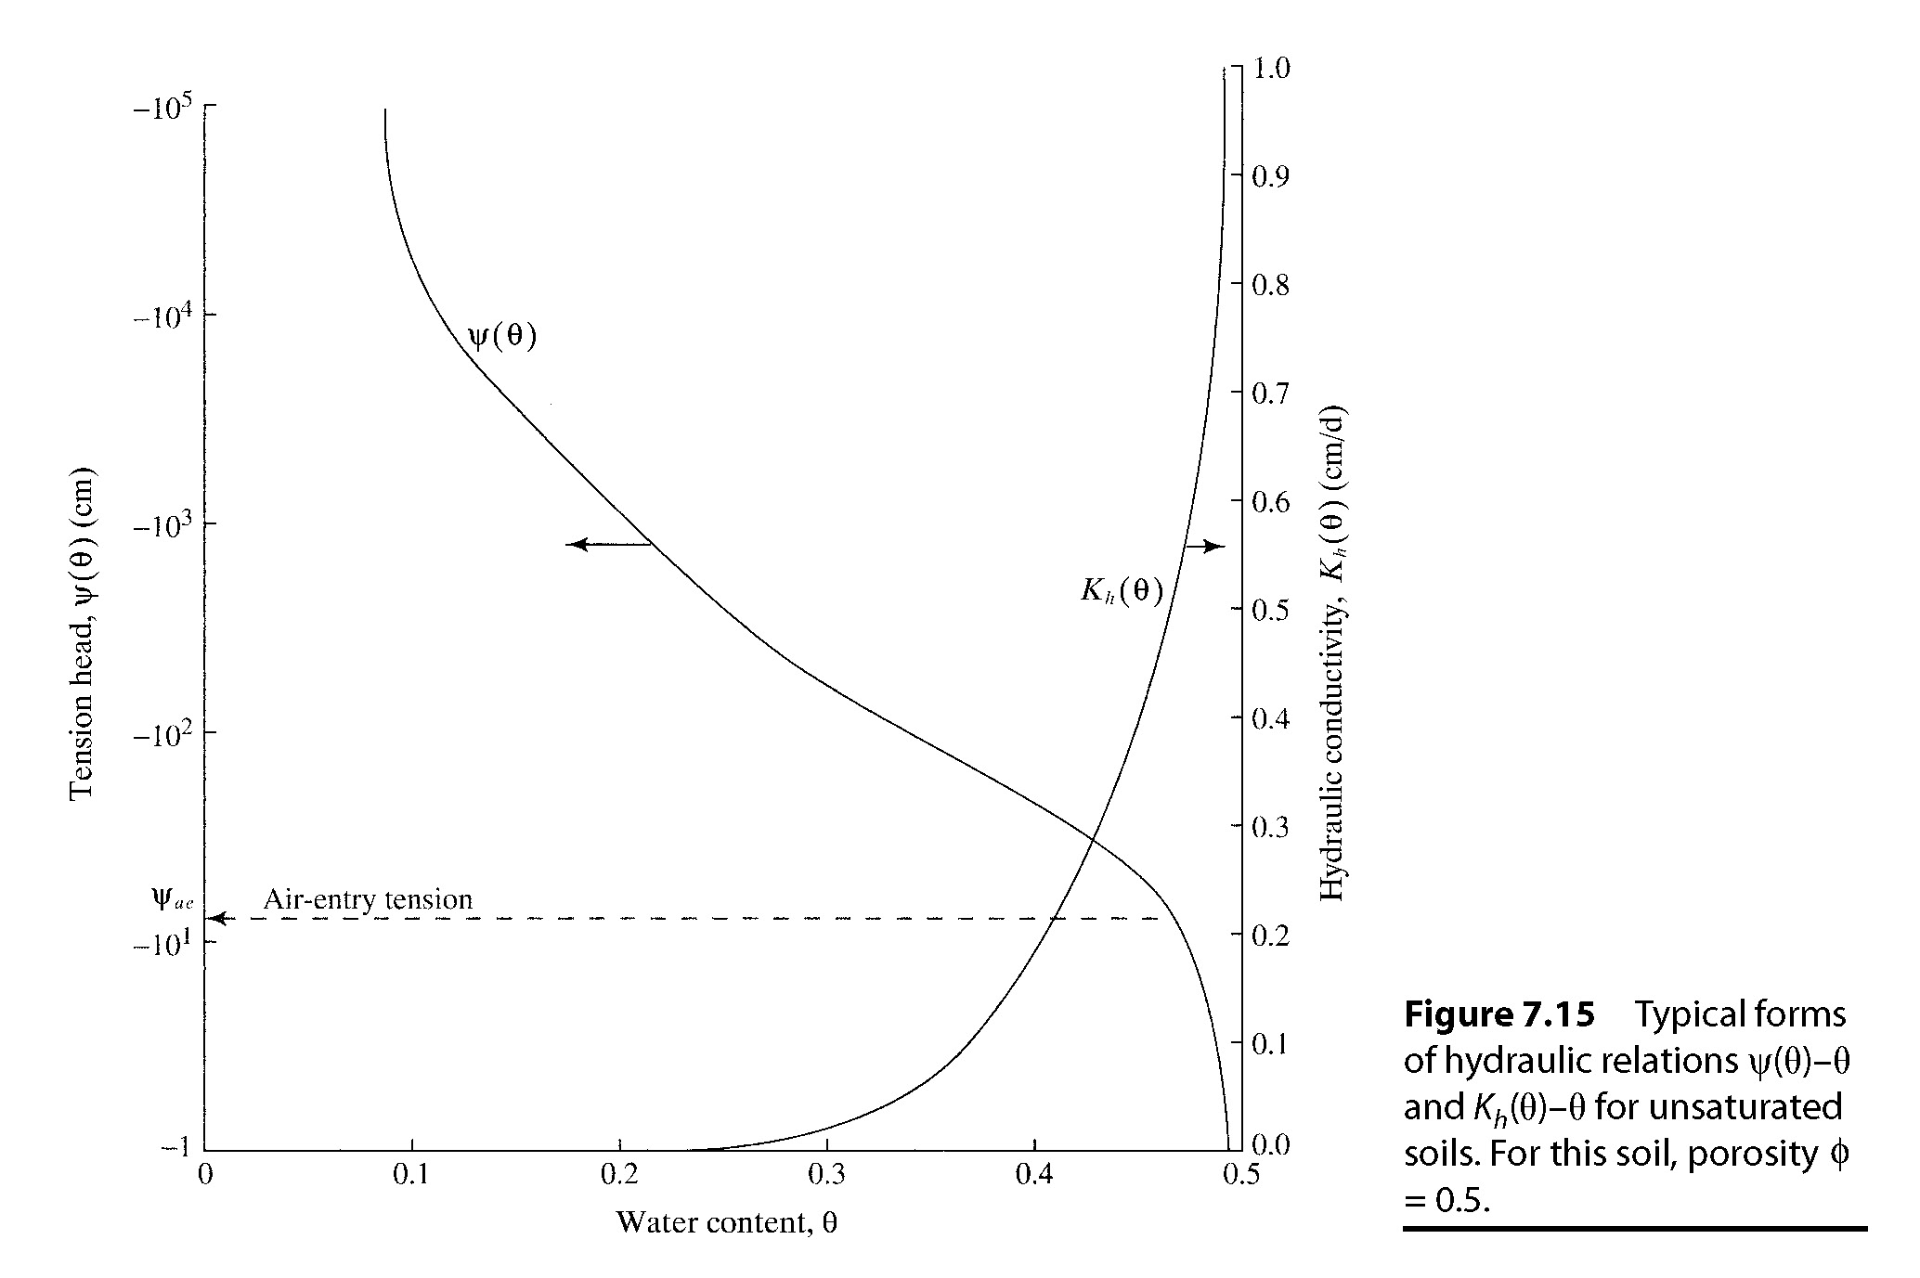
Variation of soil suction head, |ψ|, and hydraulic conductivity, K, with moisture content. (from Dingman, Chap 7)

Slide 53
Equations to representing soil water characteristic functions
Brooks and Corey (1966)
Clapp and Hornberger (1978)
van Genuchten (1980)

Slide 54
Clapp and Hornberger (1978) parameters for Soil Moisture Characteristic functions based on analysis of 1845 soils. Values in parentheses are standard deviations.
Also see Rosetta model (Update to URL in Module)
http://ars.usda.gov/Services/docs.htm?docid=8953

Slide 55
Soil suction head, |ψ|, for different soil textures using the Clapp and Hornberger (1978) parameterization.

Slide 56
Hydraulic conductivity K(θ) for different soil textures using the Clapp and Hornberger (1978) parameterization.

Slide 57
Residual moisture content θ_{r} =5%
Characteristic curve relating moisture content to pressure head (from Freeze and Cherry, 1979).

Slide 58
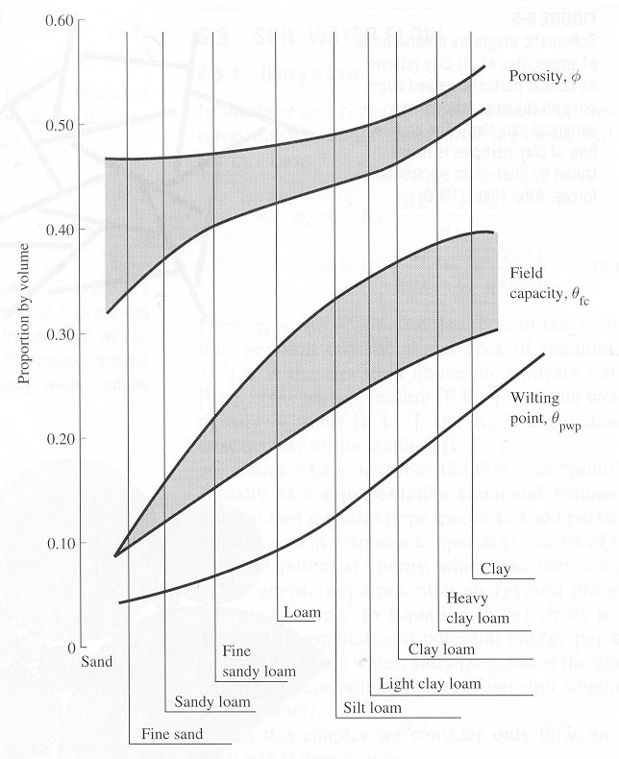
Ranges of porosities, field capacities, and permanent wilting points for soils of various textures. (from Dunne and Leopold, 1978)

Slide 59
Unsat’d Darcy’s Law: steady flow example
Ground surface
Determine the steady state vertical moisture flux between A and B….
A
θ=0.15
θ=0.25
B
3.5m
3m
Water table

Slide 60
Unsat’d Darcy’s Law: steady flow example
Ground surface
Determine the steady state vertical moisture flux between A and B….
A
θ=0.15
θ=0.25
B
3.5m
3m
Ψ(θ=0.25) = -0.42m
Water table
Ψ(θ=0.15) = -0.45m

Slide 61
Unsat’d Darcy’s Law: steady flow example
Ground surface
Determine the steady state vertical moisture flux between A and B….
A
θ=0.15
θ=0.25
B
A
3.5m
B
K(θ=0.25)
3m
K(θ=0.15)
Water table
K(θ_{av})

Slide 62
Unsat’d Darcy’s Law: steady flow example
Ground surface
Determine the steady state vertical moisture flux between A and B….
A
θ=0.15
θ=0.25
B
3.5m
3m
Water table
q_{z} = 1.88 x 10⁻⁵ m/s from A to B

Slide 63
Equilibrium moisture profiles
Let’s determine what the equilibrium soil moisture profile looks like in a homogeneous material above the water table, within the intermediate zone.
Note: assuming zero vertical flux conditions

Slide 64
Equilibrium moisture profiles: how does ψ vary with z?
Assuming K > 0, we can divide through and re-arrange
If there is no flux, and K >0, then the hydraulic gradient must be zero. Under these conditions the capillary-pressure head balances the elevation head throughout the moisture profile

Slide 65
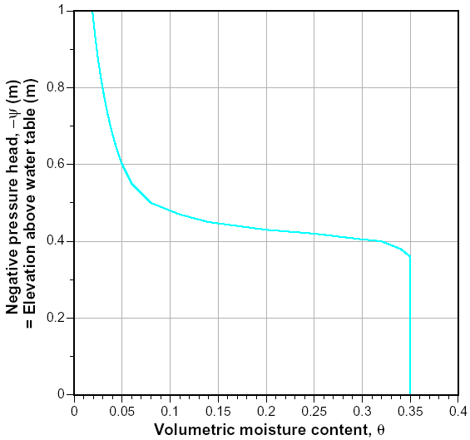
Equilibrium moisture profiles: leveraging the moisture characteristic
Recall VWC is function of ψ…

Slide 66
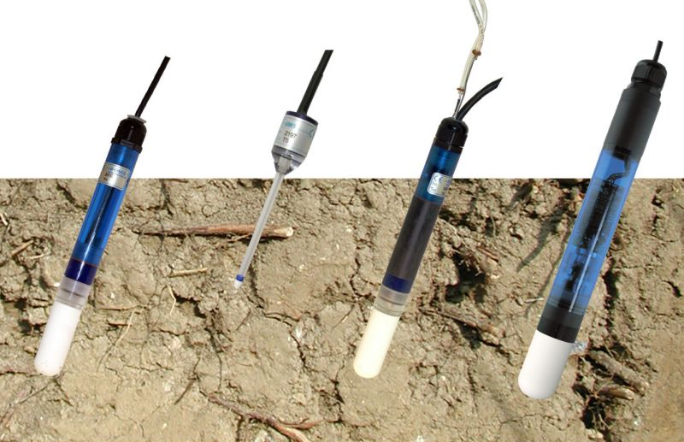
Capillary-head profiles indicate flow: measuring capillary-head
Recall the key to knowing answering this question was knowing the capillary-pressure head values at two (or more) locations. We need this to establish the magnitude and direction of the gradient
Tensiometer is an instrument used to measure the capillary-pressure head at a point (more or less).

Slide 67
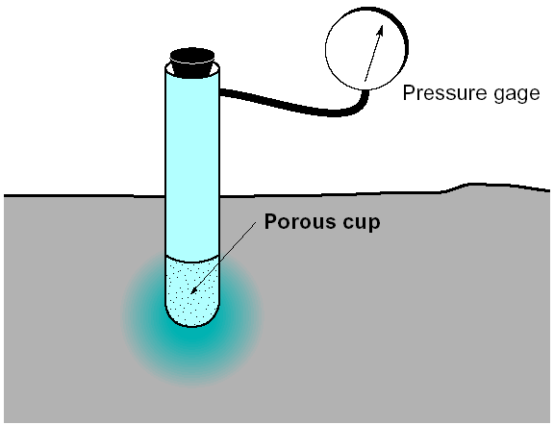
Capillary-head profiles indicate flow: measuring capillary-head
Water is moved from a tube into the surrounding soil through a porous cup. Changes in the amount of water in the tube, correspond to a change in internal pressure equal to the suction force being applied by the surrounding soil.
The pressure gage measures the capillary-pressure head relative to zero, (zero being atmospheric pressure)

Slide 68
Capillary-head profiles indicate flow: measuring capillary-head @ 2 locs
Ground surface
z_{A}
z_{B}
Water table

Slide 69
Capillary-head profiles indicate flow: measuring capillary-head @ 1 loc
Ground surface
If we measure capillary-pressure head at a single location, can we infer flow directions and magnitudes?
z_{A}
Water table

Slide 70
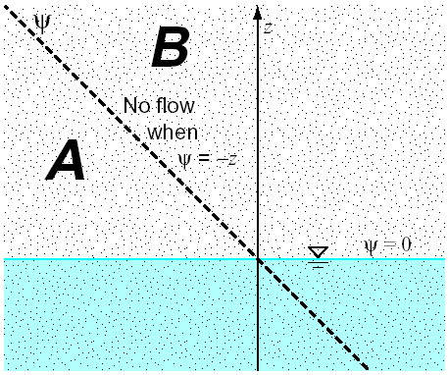
Capillary-head profiles indicate flow: measuring capillary-head @ 1 loc
Recall that under no-flow conditions the capillary-pressure head was perfectly balanced by the elevation head. No gradient – no flux
Region A – capillary-pressure head is more negative than the elevation head is positive. Pressure > gravity, so flow is upwards
Region B – capillary-pressure head is less negative than the elevation head is positive. Pressure < gravity, so flow is downwards

Slide 71
Problem 17 example

Slide 72
Group learning challenge 1
Figure out how much the flow rate through a porous media will change for a 5 °C change in temperature.
Does flow rate increase or decrease as temperature increases

