Slide 1

Applied Statistics and Probability for Engineers
Sixth Edition
Douglas C. Montgomery George C. Runger
Chapter 2
Probability

Slide 2
2
Probability
CHAPTER OUTLINE
2-1 Sample Spaces and Events
2-1.1 Random Experiments
2-1.2 Sample Spaces
2-1.3 Events
2-1.4 Counting Techniques
2-2 Interpretations and Axioms
of Probability
2-3 Addition Rules
2-4 Conditional Probability
2-5 Multiplication and Total
Probability Rules
2-6 Independence
2-7 Bayes’ Theorem
2-8 Random Variables

Slide 3
Learning Objectives for Chapter 2
After careful study of this chapter, you should be able to do the following:
Understand and describe sample spaces and events
Interpret probabilities and calculate probabilities of events
Use permutations and combinations to count outcomes
Calculate the probabilities of joint events
Interpret and calculate conditional probabilities
Determine independence and use independence to calculate probabilities
Understand Bayes’ theorem and when to use it
Understand random variables

Slide 4
Random Experiment
An experiment is a procedure that is
  carried out under controlled conditions, and
  executed to discover an unknown result.
An experiment that results in different outcomes even when repeated in the same manner every time is a random experiment.

Slide 5
Sample Spaces
The set of all possible outcomes of a random experiment is called the sample space, S.
S is discrete if it consists of a finite or countable infinite set of outcomes.
S is continuous if it contains an interval of real numbers.

Slide 6
Example 2-1: Defining Sample Spaces
Randomly select a camera and record the recycle time of a flash. S = R⁺ = {x | x > 0}, the positive real numbers.
Suppose it is known that all recycle times are between 1.5 and 5 seconds. Then
S = {x | 1.5 < x < 5} is continuous.
It is known that the recycle time has only three values(low, medium or high). Then S = {low, medium, high} is discrete.
Does the camera conform to minimum recycle time specifications?
S = {yes, no} is discrete.

Slide 7
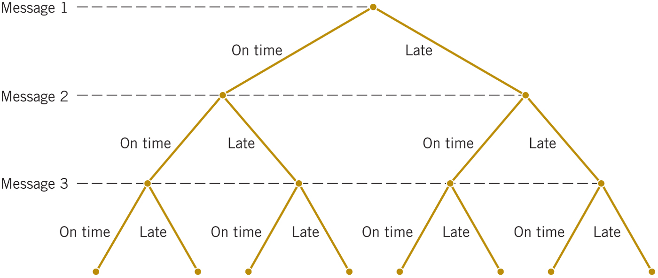
Sample Space Defined By A Tree Diagram
Example 2-2: Messages are classified as on-time(o) or late(l). Classify the next 3 messages.
S = {ooo, ool, olo, oll, loo, lol, llo, lll}

Slide 8
Events are Sets of Outcomes
An event (E) is a subset of the sample space of a random experiment.
Event combinations
  The Union of two events consists of all outcomes that are contained in one event or the other, denoted as E₁  E₂.
  The Intersection of two events consists of all outcomes that are contained in one event and the other, denoted as E₁  E₂.
  The Complement of an event is the set of outcomes in the sample space that are not contained in the event, denoted as E′.

Slide 9
Example 2-3 Discrete Events
Suppose that the recycle times of two cameras are recorded. Consider only whether or not the cameras conform to the manufacturing specifications. We abbreviate yes and no as y and n. The sample space is S = {yy, yn, ny, nn}.
  Suppose, E₁ denotes an event that at least one camera conforms to specifications, then E₁ = {yy, yn, ny}
  Suppose, E₂ denotes an event that no camera conforms to specifications, then E₂ = {nn}
  Suppose, E₃ denotes an event that at least one camera does not conform.
  then E₃ = {yn, ny, nn},
  Then E₁  E₃ = S
  Then E₁  E₃ = {yn, ny}
  Then E₁′ = {nn}

Slide 10
Example 2-4 Continuous Events
Measurements of the thickness of a part are modeled with the sample space: S = R⁺.
  Let E₁ = {x | 10 ≤ x < 12},
  Let E₂ = {x | 11 < x < 15}
  Then E₁  E₂ = {x | 10 ≤ x < 15}
  Then E₁  E₂ = {x | 11 < x < 12}
  Then E₁′ = {x | 0 < x < 10 or x ≥ 12}
  Then E₁′  E₂ = {x | 12 ≤ x < 15}

Slide 11
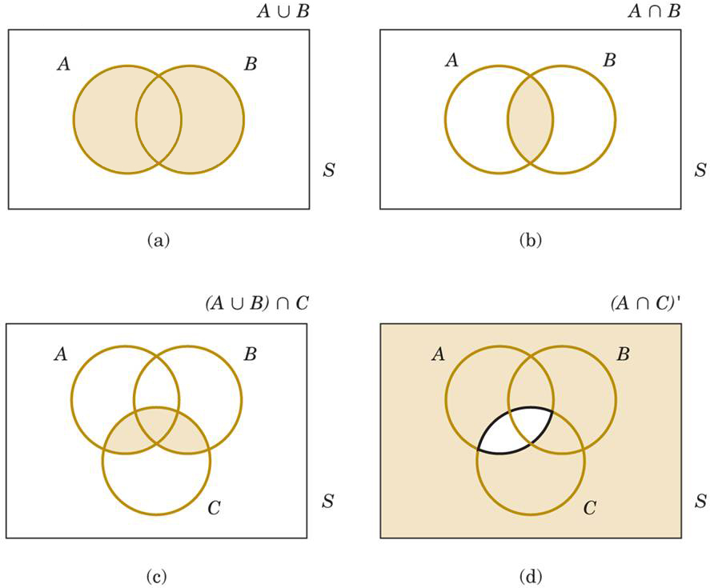
Venn Diagrams
Events A & B contain their respective outcomes. The shaded regions indicate the event relation of each diagram.

Slide 12
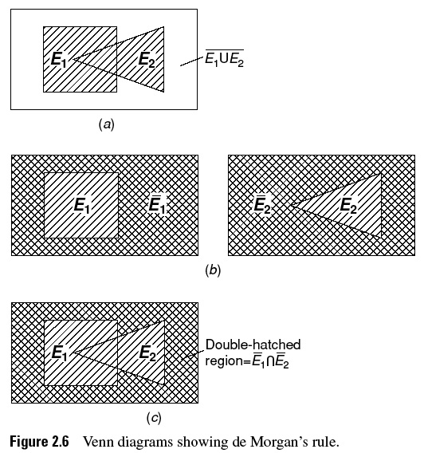
02_06
02_06
Notes:
02_06.jpg

Slide 13
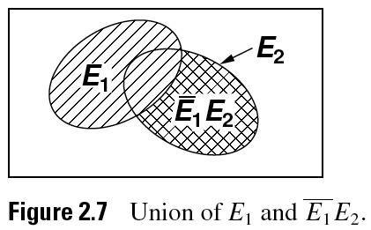
02_07
02_07
Notes:
02_07.jpg

Slide 14
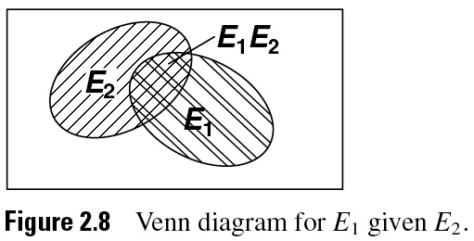
02_08
02_08
Notes:
02_08.jpg

Slide 15
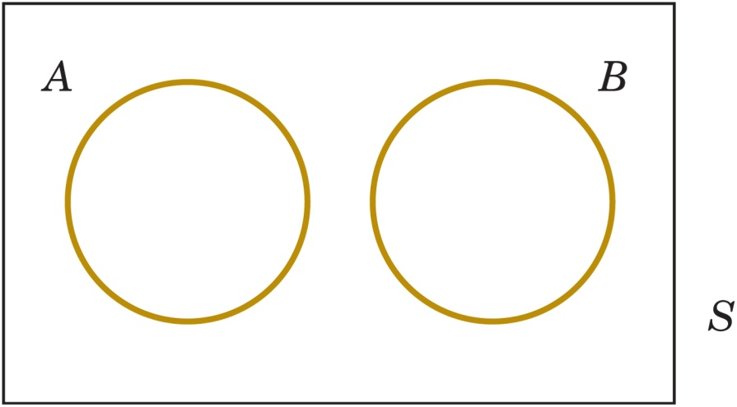
Mutually Exclusive Events
Events A and B are mutually exclusive because they share no common outcomes.
The occurrence of one event precludes the occurrence of the other.
Symbolically, A  B = Ø

Slide 16
Mutually Exclusive Events - Laws
Commutative law (event order is unimportant):
  A  B = B  A and A  B = B  A
Distributive law (like in algebra):
  (A  B)  C = (A  C)  (B  C)
  (A  B)  C = (A  C)  (B  C)
Associative law (like in algebra):
  (A  B)  C = A  (B  C)
  (A  B)  C = A  (B  C)

Slide 17
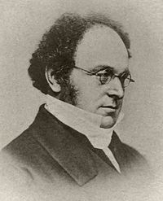
Mutually Exclusive Events - Laws
DeMorgan’s law:
  (A  B)′ = A′  B′ The complement of the union is the intersection of the complements.
  (A  B)′ = A′  B′ The complement of the intersection is the union of the complements.
Complement law:
(A′)′ = A.
  The rules can be expressed in English as:
  the negation of a disjunction is the conjunction of the negations; and
  the negation of a conjunction is the disjunction of the negations;
Search A: NOT (cars OR trucks)
Search B: (NOT cars) AND (NOT trucks)

Slide 18
Probability
Probability is the likelihood or chance that a particular outcome or event from a random experiment will occur.
In this chapter, we consider only discrete (finite or countably infinite) sample spaces.
Probability is a number in the [0,1] interval.
A probability of:
  1 means certainty
  0 means impossibility

Slide 19
Types of Probability
Subjective probability is a “degree of belief.”
  Example: “There is a 50% chance that I’ll
  study tonight.”
Relative frequency probability is based on how often an event occurs over a very large sample space.
Example:

Slide 20
Probability Based on Equally-Likely Outcomes
Whenever a sample space consists of N possible outcomes that are equally likely, the probability of each outcome is 1/N.
Example: In a batch of 100 diodes, 1 is laser diode. A diode is randomly selected from the batch. Random means each diode has an equal chance of being selected. The probability of choosing the laser diode is 1/100 or 0.01, because each outcome in the sample space is equally likely.

Slide 21
Probability of an Event
For a discrete sample space, the probability of an event E, denoted by P(E), equals the sum of the probabilities of the outcomes in E.
The discrete sample space may be:
  A finite set of outcomes
  A countably infinite set of outcomes.

Slide 22
Example 2-9: Probabilities of Events
A random experiment has a sample space {a,b,c,d}. These outcomes are not equally-likely; their probabilities are: 0.1, 0.3, 0.5, 0.1.
Let Event A = {a,b}, B = {b,c,d}, and C = {d}
  P(A) = 0.1 + 0.3 = 0.4
  P(B) = 0.3 + 0.5 + 0.1 = 0.9
  P(C) = 0.1
  P(A′ ) = 0.6 and P(B′ ) = 0.1 and P(C′ ) = 0.9
  Since event AB = {b}, then P(AB) = 0.3
  Since event AB = {a,b,c,d}, then P(AB) = 1.0
  Since event AC = {null}, then P(AC ) = 0

Slide 23
Axioms of Probability
Probability is a number that is assigned to each member of a collection of events from a random experiment that satisfies the following properties:
If S is the sample space and E is any event in the random experiment,
  P(S) = 1
  0 ≤ P(E) ≤ 1
  For any two events E₁ and E₂ with E₁E₂ = Ø,
  P(E₁E₂) = P(E₁) + P(E₂)
The axioms imply that:
  P(Ø) =0 and P(E′ ) = 1 – P(E)
  If E₁ is contained in E₂, then P(E₁) ≤ P(E₂).

Slide 24
Addition Rules
Joint events are generated by applying basic set operations to individual events, specifically:
  Unions of events, A  B
  Intersections of events, A  B
  Complements of events, A′
Probabilities of joint events can often be determined from the probabilities of the individual events that comprise them.

Slide 25
Example 2-10: Semiconductor Wafers
A wafer is randomly selected from a batch that is classified by contamination and location.
  Let H be the event of high concentrations of contaminants. Then P(H) = 358/940.
  Let C be the event of the wafer being located at the center of a sputtering tool. Then P(C) = 626/940.
  P(HC) = 112/940
  P(HC) = P(H) + P(C) − P(HC)
  = (358 + 626 − 112)/940
  This is the addition rule.

Slide 26
Probability of a Union
For any two events A and B, the probability of union is given by:
If events A and B are mutually exclusive, then

Slide 27
Addition Rule: 3 or More Events
Note the alternating signs.

Slide 28
Counting Techniques
There are three special rules, or counting techniques, used to determine the number of outcomes in events.
They are :
    Multiplication rule
    Permutation rule
    Combination rule
Each has its special purpose that must be applied properly – the right tool for the right job.

Slide 29
Counting – Multiplication Rule
Multiplication rule:
  Let an operation consist of k steps and there are
    n₁ ways of completing step 1,
    n₂ ways of completing step 2, … and
    n_{k} ways of completing step k.
  Then, the total number of ways to perform k steps is:
    n₁ · n₂ · … · n_{k}

Slide 30
Example 2-5 - Web Site Design
In the design for a website, we can choose to use among:
  4 colors,
  3 fonts, and
  3 positions for an image.
How many designs are possible?
Answer via the multiplication rule: 4 · 3 · 3 = 36

Slide 31
Counting – Permutation Rule
A permutation is a unique sequence of distinct items.
If S = {a, b, c}, then there are 6 permutations
  Namely: abc, acb, bac, bca, cab, cba (order matters)
Number of permutations for a set of n items is n!
n! = n·(n-1)·(n-2)·…·2·1
7! = 7·6·5·4·3·2·1 = 5,040 = FACT(7) in Excel
By definition: 0! = 1

Slide 32
Counting–Subset Permutations and an example
For a sequence of r items from a set of n items:
Example 2-6: Printed Circuit Board
A printed circuit board has eight different locations in which a component can be placed. If four different components are to be placed on the board, how many designs are possible?
Answer: Order is important, so use the permutation formula with n = 8, r = 4.

Slide 33
Counting - Similar Item Permutations
Used for counting the sequences when some items are identical.
The number of permutations of:
  n = n₁ + n₂ + … + n_{r} items of which
  n_{1,} n_{2, ….,} n_{r} are identical.
is calculated as:

Slide 34
Example 2-7: Hospital Schedule
In a hospital, a operating room needs to schedule three knee surgeries and two hip surgeries in a day. The knee surgery is denoted as k and the hip as h.
  How many sequences are there?
  Since there are 2 identical hip surgeries and 3 identical knee surgeries, then
  What is the set of sequences?
  {kkkhh, kkhkh, kkhhk, khkkh, khkhk, khhkk, hkkkh, hkkhk, hkhkk, hhkkk}

Slide 35
Counting – Combination Rule
A combination is a selection of r items from a set of n where order does not matter.
If S = {a, b, c}, n =3, then
  If r = 3, there is 1 combination, namely: abc
  If r = 2, there are 3 combinations, namely ab, ac, and bc
# of permutations ≥ # of combinations
Since order does not matter with combinations, we are dividing the # of permutations by r!, where r! is the # of arrangements of r elements.

Slide 36
Example 2-8: Sampling w/o Replacement-1
A bin of 50 parts contains 3 defectives and 47 non-defective parts. A sample of 6 parts is selected from the 50 without replacement. How many samples of size 6 contain 2 defective parts?
First, how many ways are there for selecting 2 parts from the 3 defective parts?
In Excel:

Slide 37
Example 2-8: Sampling w/o Replacement-2
Now, how many ways are there for selecting 4 parts from the 47 non-defective parts?
In Excel:

Slide 38
Example 2-8: Sampling w/o Replacement-3
Now, how many ways are there to obtain:
  2 from 3 defectives, and
  4 from 47 non-defectives?
  In Excel:

Slide 39
Conditional Probability
P(B | A) is the probability of event B occurring, given that event A has already occurred.
A communications channel has an error rate of 1 per 1000 bits transmitted. Errors are rare, but do tend to occur in bursts. If a bit is in error, the probability that the next bit is also in error is greater than 1/1000.

Slide 40
Conditional Probability Rule
The conditional probability of an event B given an event A, denoted as P(B | A), is:
P(B | A) = P(AB) / P(A) for P(A) > 0.
From a relative frequency perspective of n equally likely outcomes:
  P(A) = (number of outcomes in A) / n
  P(AB) = (number of outcomes in AB) / n
  P(B | A) = number of outcomes in AB / number of outcomes in A

Slide 41
Example 2-11
There are 4 probabilities conditioned on flaws in the below table.

Slide 42
Random Samples
Random means each item is equally likely to be chosen. If more than one item is sampled, random means that every sampling outcome is equally likely.
  2 items are taken from S = {a,b,c} without replacement.
  Ordered sample space: S = {ab,ac,bc,ba,ca,cb}
  Unordered sample space: S = {ab,ac,bc}

Slide 43
Example 2-12 : Sampling Without Enumeration
A batch of 50 parts contains 10 made by Tool 1 and 40 made by Tool 2. If 2 parts are selected randomly*,
a) What is the probability that the 2nd part came from Tool 2, given
that the 1st part came from Tool 1?
  P(E₁)= P(1st part came from Tool 1) = 10/50
  P(E₂ | E₁) = P(2nd part came from Tool 2 given that 1st part came from Tool 1)
  = 40/49
b) What is the probability that the 1st part came from Tool 1 and the
2nd part came from Tool 2?
  P(E₁∩E₂) = P(1st part came from Tool 1 and 2nd part came from Tool 2)
  = (10/50)∙(40/49) = 8/49
*Selected randomly implies that at each step of the sample, the items remain in the batch are equally likely to be selected.

Slide 44
Multiplication Rule
The conditional probability can be rewritten to generalize a multiplication rule.
P(AB) = P(B|A)·P(A) = P(A|B)·P(B)
The last expression is obtained by exchanging the roles of A and B.

Slide 45
Example 2-13: Machining Stages
The probability that a part made in the 1st stage of a machining operation meets specifications is 0.90. The probability that it meets specifications in the 2nd stage, given that met specifications in the first stage is 0.95.
What is the probability that both stages meet specifications?
Let A and B denote the events that the part has met1st and 2nd stage specifications, respectively.
P(AB) = P(B | A)·P(A) = 0.95·0.90 = 0.855

Slide 46
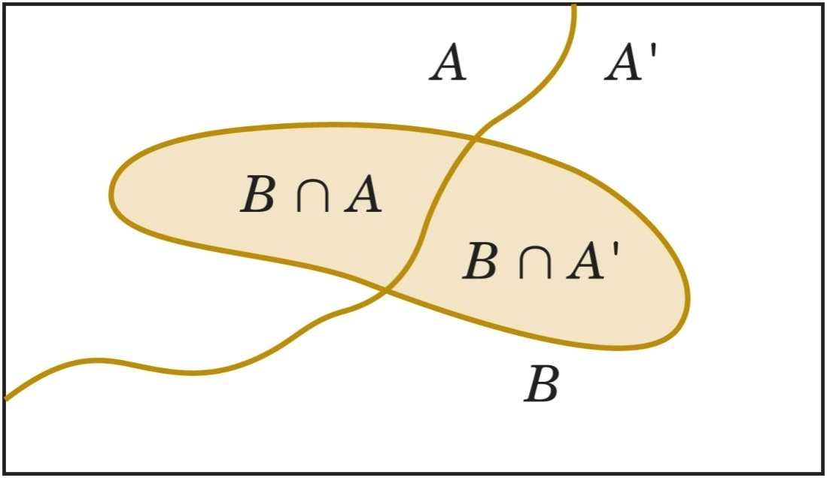

Two Mutually Exclusive Subsets
A and A′ are mutually
exclusive.
AB and A′ B are
mutually exclusive
B = (AB)  (A′ B)
Total Probability Rule
For any two events A and B

Slide 47
Example 2-14: Semiconductor Contamination
Information about product failure based on chip manufacturing process contamination is given below. Find the probability of failure.
  Let F denote the event that the product fails.
  Let H denote the event that the chip is exposed to high contamination during manufacture. Then
    P(F | H) = 0.100 and P(H) = 0.2, so P(F  H) = 0.02
    P(F | H′ ) = 0.005 and P(H′ ) = 0.8, so P(F  H′ ) = 0.004
    P(F) = P(F  H) + P(F  H′ ) (Using Total Probability rule)
  = 0.020 + 0.004 = 0.024

Slide 48
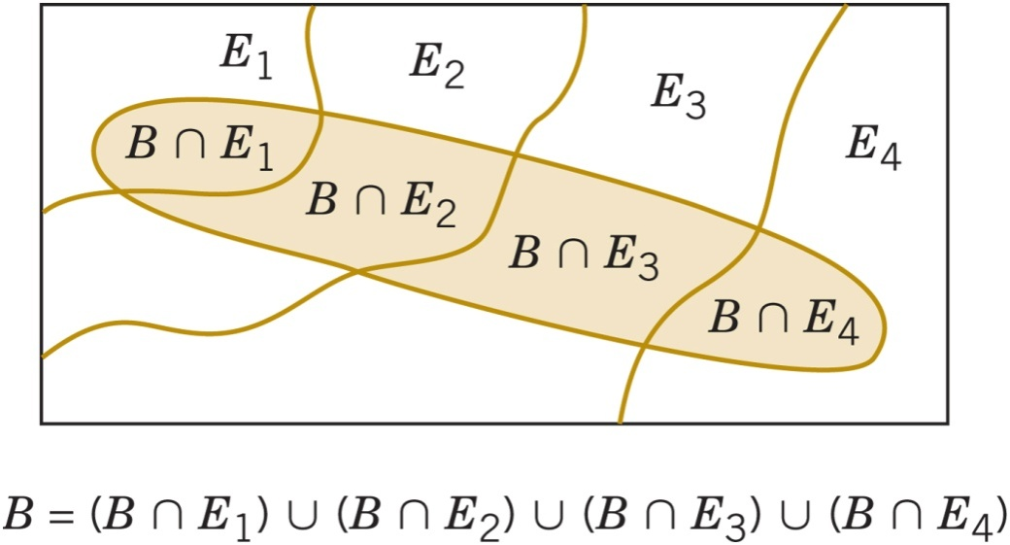
Total Probability Rule (Multiple Events)
A collection of sets E₁, E₂, … E_{k} such that
E₁ E₂ ……  E_{k} = S is said to be exhaustive.
Assume E₁, E₂, … E_{k} are k mutually exclusive and exhaustive. Then

Slide 49
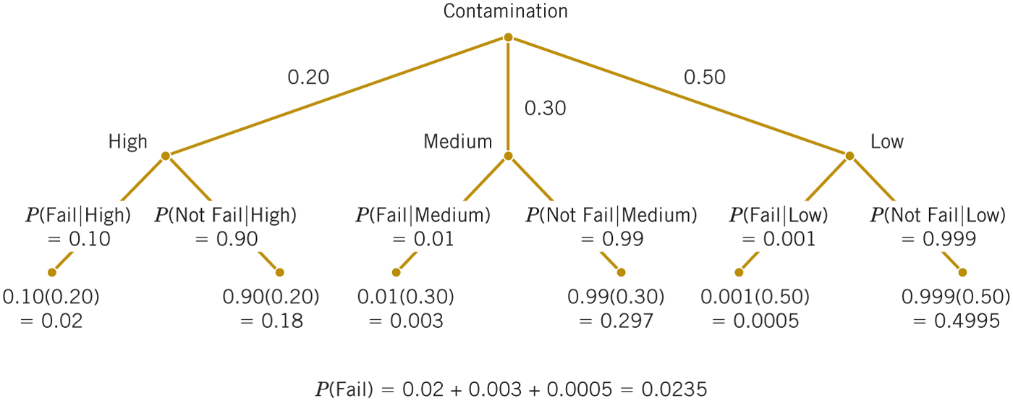
Example 2-15: Semiconductor Failures-1
Continuing the discussion of contamination during chip manufacture, find the probability of failure.

Slide 50
Example 2-15: Semiconductor Failures-2
Let F denote the event that a chip fails
Let H denote the event that a chip is exposed to high levels of contamination
Let M denote the event that a chip is exposed to medium levels of contamination
Let L denote the event that a chip is exposed to low levels of contamination.
Using Total Probability Rule,
P(F) = P(F | H)P(H) + P(F | M)P(M) + P(F | L)P(L)
= (0.1)(0.2) + (0.01)(0.3) + (0.001)(0.5)
= 0.0235

Slide 51
Event Independence
Two events are independent if any one of the following equivalent statements is true:
  P(A | B) = P(A)
  P(B | A) = P(B)
  P(AB) = P(A)·P(B)
This means that occurrence of one event has no impact on the probability of occurrence of the other event.

Slide 52
Example 2-16: Flaws and Functions
Table 1 provides an example of 400 parts classified by surface flaws and as (functionally) defective. Suppose that the situation is different and follows Table 2. Let F denote the event that the part has surface flaws. Let D denote the event that the part is defective.
The data shows whether the events are independent.

Slide 53
Independence with Multiple Events
The events E₁, E₂, … , E_{k} are independent if and only if, for any subset of these events:
P(E_{i1}E_{i2}  … , E_{ik}) = P(E_{i1})·P(E_{i2})·…·P(E_{ik})

Slide 54
Example 2-17: Semiconductor Wafers
Assume the probability that a wafer contains a large particle of contamination is 0.01 and that the wafers are independent; that is, the probability that a wafer contains a large particle does not depend on the characteristics of any of the other wafers. If 15 wafers are analyzed, what is the probability that no large particles are found?
Solution:
Let E_{i} denote the event that the i^{th} wafer contains no large particles,
i = 1, 2, …,15.
Then , P(E_{i}) = 0.99.
The required probability is P(E₁E₂ … E₁₅).
From the assumption of independence,
P(E₁E₂ … E₁₅) = P(E₁)·P(E₂)·…·P(E₁₅)
= (0.99)¹⁵
= 0.86.

Slide 55

Bayes’ Theorem
Thomas Bayes (1702-1761) was an English mathematician and Presbyterian minister.
His idea was that we observe conditional probabilities through prior information.
Bayes’ theorem states that,

Slide 56
Example 2-18
The conditional probability that a high level of contamination was present
when a failure occurred is to be determined. The information from
Example 2-14 is summarized here.
Solution:
Let F denote the event that the product fails, and let H denote the event
that the chip is exposed to high levels of contamination. The requested
probability is P(F).

Slide 57
Bayes Theorem with Total Probability
If E₁, E₂, … E_{k} are k mutually exclusive and
exhaustive events and B is any event,
where P(B) > 0
Note : Numerator expression is always one of
the terms in the sum of the denominator.

Slide 58
Example 2-19: Bayesian Network
A printer manufacturer obtained the following three types of printer failure probabilities. Hardware P(H) = 0.3, software P(S) = 0.6, and other P(O) = 0.1. Also, P(F | H) = 0.9, P(F | S) = 0.2, and P(F | O) = 0.5.
If a failure occurs, determine if it’s most likely due to hardware, software, or other.
Note that the conditionals given failure add to 1. Because P(O | F) is largest, the most likely cause of the problem is in the other category.

Slide 59
Random Variable and its Notation
A variable that associates a number with the outcome of a random experiment is called a random variable.
A random variable is a function that assigns a real number to each outcome in the sample space of a random experiment.
A random variable is denoted by an uppercase letter such as X. After the experiment is conducted, the measured value of the random variable is denoted by a lowercase letter such as
x = 70 milliamperes. X and x are shown in italics, e.g., P(X = x).

Slide 60
Discrete & Continuous Random Variables
A discrete random variable is a random variable with a finite or countably infinite range. Its values are obtained by counting.
A continuous random variable is a random variable with an interval (either finite or infinite) of real numbers for its range. Its values are obtained by measuring.

Slide 61
Examples of Discrete & Continuous Random Variables
Discrete random variables:
  Number of scratches on a surface.
  Proportion of defective parts among 100 tested.
  Number of transmitted bits received in error.
  Number of common stock shares traded per day.
Continuous random variables:
  Electrical current and voltage.
  Physical measurements, e.g., length, weight, time, temperature, pressure.

Slide 62
Important Terms & Concepts of Chapter 2
Addition rule
Axioms of probability
Bayes’ theorem
Combination
Conditional probability
Equally likely outcomes
Event
Independence
Multiplication rule
Mutually exclusive events
Outcome
Permutation
Probability
Random experiment
Random variable
  Discrete
  Continuous
Sample space
  Discrete
  Continuous
Total probability rule
Tree diagram
Venn diagram
With replacement
Without replacement

