Slide 1


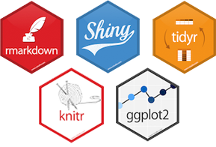
R Tutorial
CVEN 5454, Spring 2019
Contact: Sean Horvath
sean.horvath@colorado.edu

Slide 2
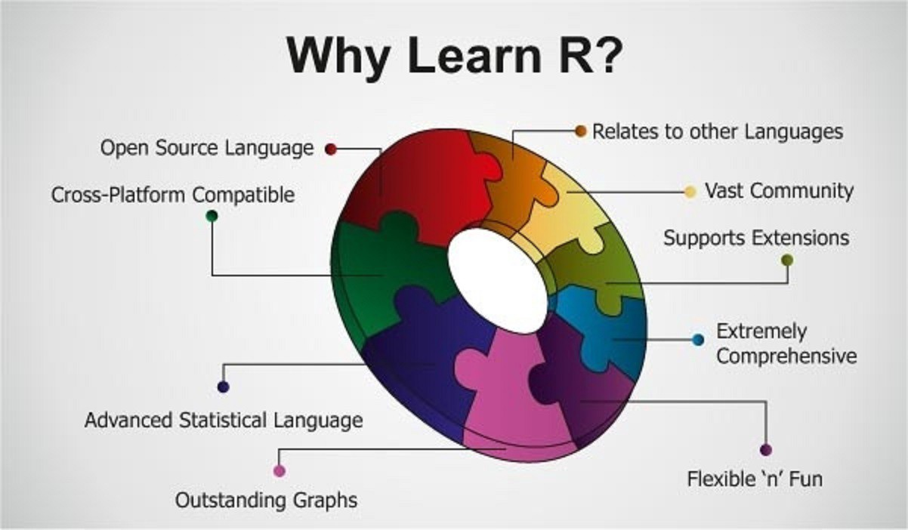

Slide 3

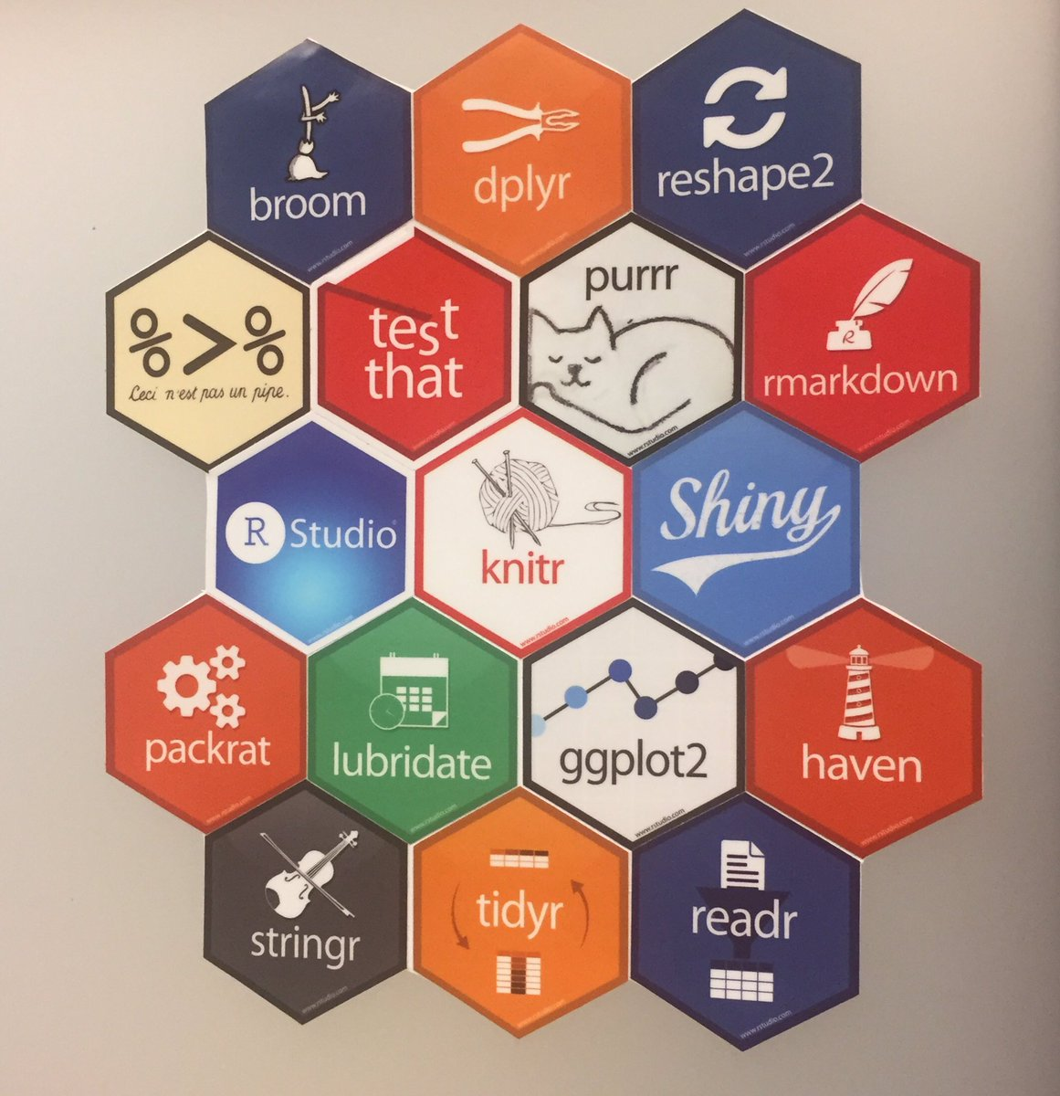
Objectives
Tidyverse
Data Types
Data Wrangling
Plotting
Base R
ggplot2
Rmarkdown
Purrr

Slide 4
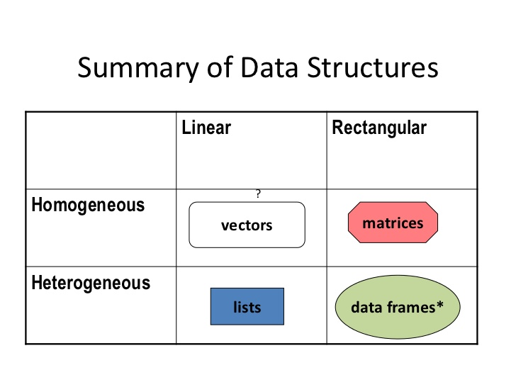
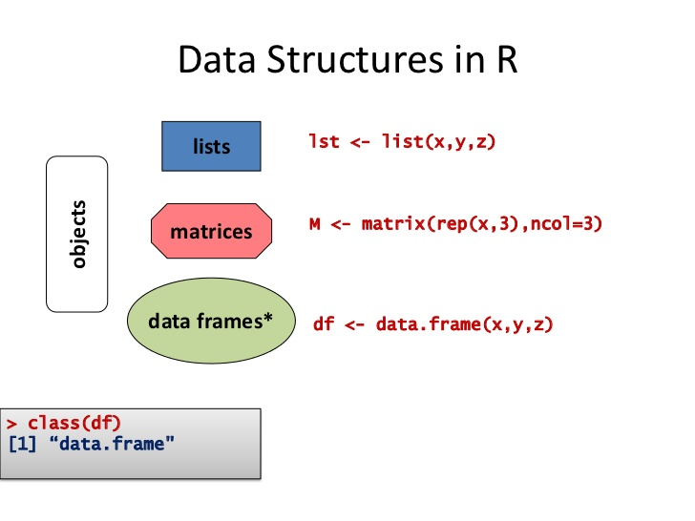

Slide 5
RMarkdown
First need to download LaTex, e.g. MikTex
Install packages “knitr” and “rmarkdown”
In RStudio:
File > New File > R Notebook

Slide 6
Useful Links:
Google!!!!
Stackoverflow.com
Online Book, R for Data Science - https://r4ds.had.co.nz/
Rmarkdown Book - https://bookdown.org/yihui/rmarkdown/
R cheatsheets - https://www.rstudio.com/resources/cheatsheets/

