Slide 1
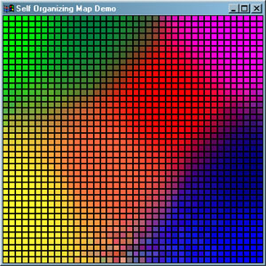
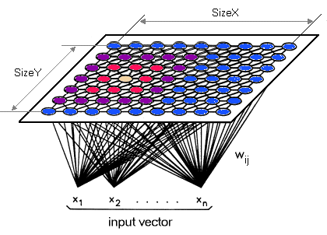
An Introduction to Self-Organizing Maps
November 5, 2020
Advanced Data Analysis Techniques
University of Colorado Boulder

Slide 2
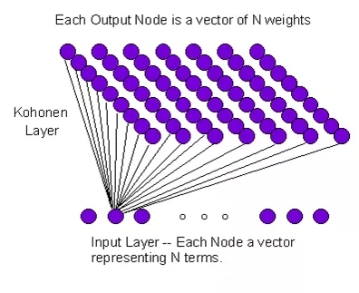
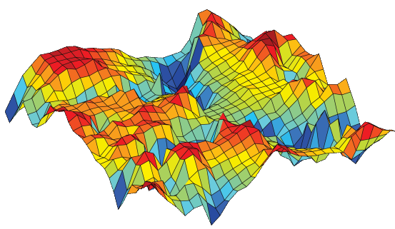
Self-Organizing Maps - Overview
Unsupervised Neural Network
Cluster High-Dimensional Data
Contains Input Layer, Weights, Kohonen Layer
Retains the Topology of the Input Data

Slide 3
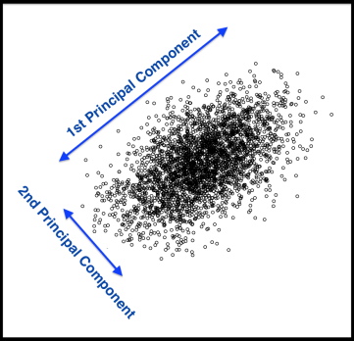

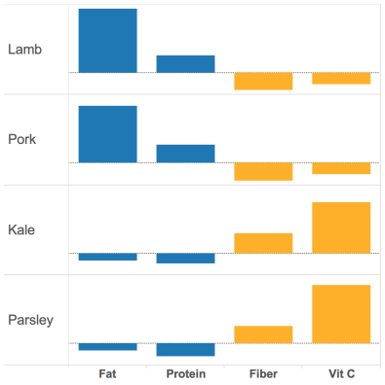
Other Clustering Methods
Principal Component Analysis
K Means

Slide 4

Self-Organizing Maps - Overview
Similarity between nodes
Nodes are organized in resulting map
Can capture nonlinear relationships
Nodes have physical meaning
Need to define grid size/type a priori
No method for determining best grid size
Can be computationally expensive

Slide 5
Define Terms
1
2
3
4
5
Node
1
Node 1
Node 2
Node 3
2
3
4
5
Node 25

Slide 6
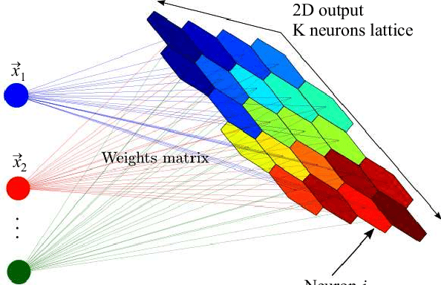
Define Terms
Node
Weight/Code Vector

Slide 7
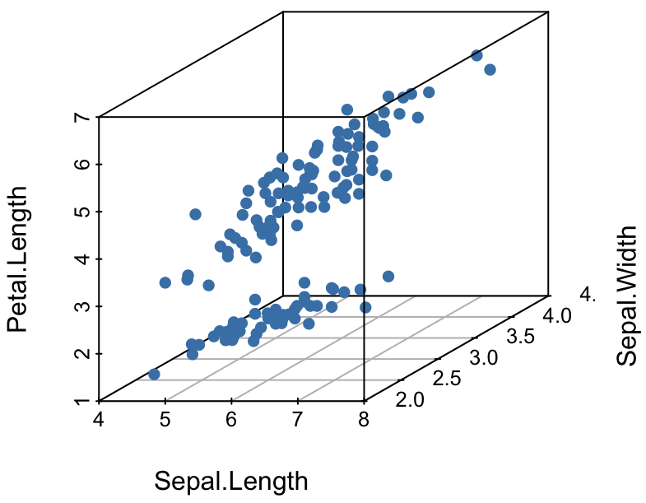
Define Terms
Node
Weight/Code Vector
x,y,z
Input Layer
x,y,z
x,y,z

Slide 8
Define Terms
Node
Weight/Code Vector
Input Layer
Kohonen Layer

Slide 9
Define Terms
Node
Weight/Code Vector
Input Layer
Kohonen Layer
Best Matching Unit, BMU

Slide 10
Define Terms
Node
Weight/Code Vector
Input Layer
Kohonen Layer
Best Matching Unit, BMU
Neighborhood/Radius

Slide 11
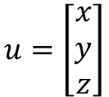
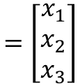
Input Layer
For a given observation, u, there are three variables:
Sepal.Length -> x
Sepal.Width -> y
Petal.Length -> z
$$u=\left[\begin{matrix}x \\ y \\ z\end{matrix}\right]$$
$$=\left[\begin{matrix}x_{1} \\ x_{2} \\ x_{3}\end{matrix}\right]$$

Slide 12
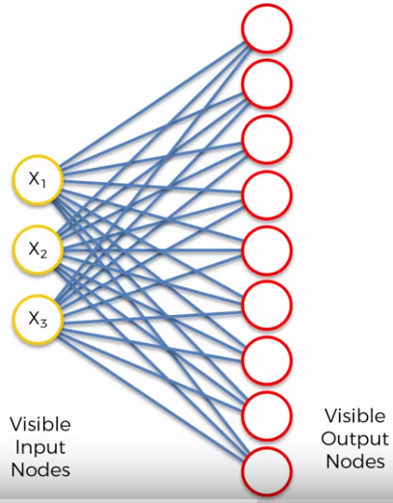
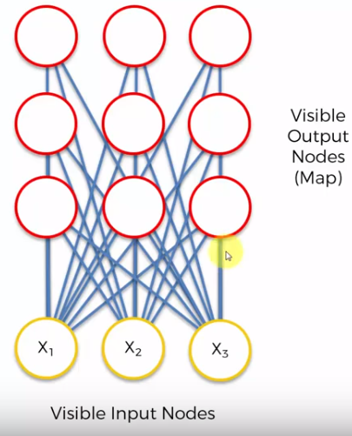
Learning Process

Slide 13
Learning Process
Step 1: Randomly position the grid’s nodes in the data space.

Slide 14
Learning Process
Step 2: Select one data point, either randomly or systematically cycling through the dataset in order
Data point u

Slide 15
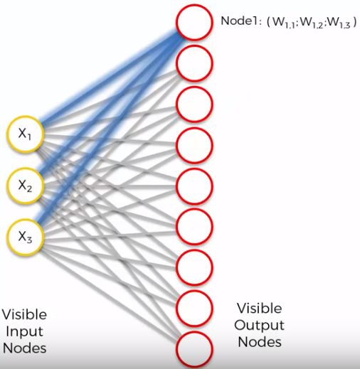
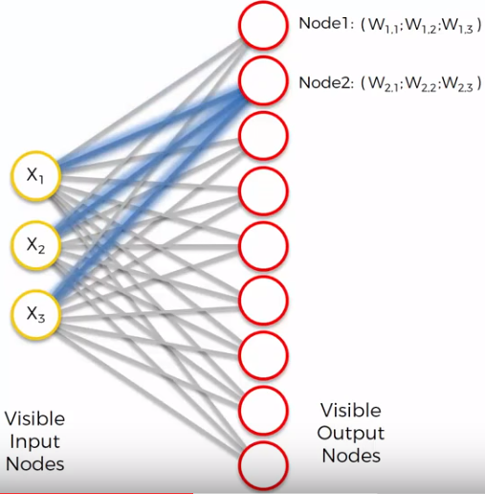
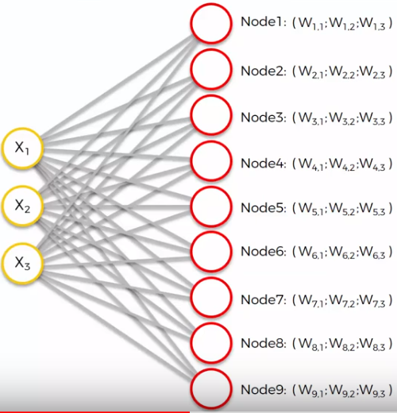
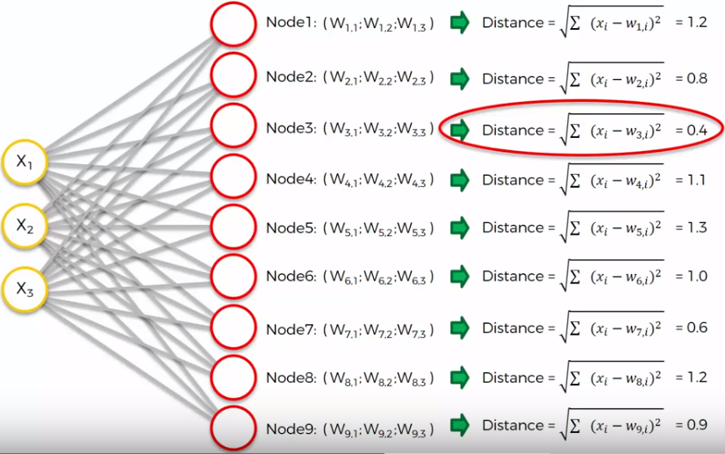
Learning Process
Step 3: Find the node that is closest to the chosen data point. This node is called the Best Matching Unit (BMU).

Slide 16
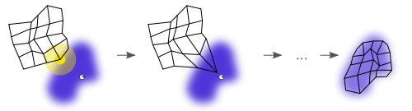
Learning Process
Step 4: Move the BMU closer to that data point. The distance moved by the BMU is determined by a learning rate, which decreases after each iteration.

Slide 17
Learning Process
Step 5: Move the BMU’s neighbors closer to that data point as well, with farther away neighbors moving less. Neighbors are identified using a radius around the BMU, and the value for this radius decreases after each iteration.

Slide 18

Learning Process
Step 6: Update the learning rate and BMU radius, before repeating Steps 1 to 4. Iterate these steps until positions of neurons have been stabilized.

Slide 19
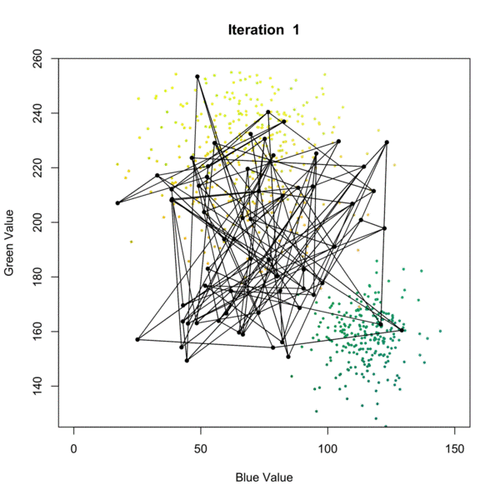
SOM Learning
Self-Organizing Map
Step 1: Randomly position the grid’s neurons in the data space.
Step 2: Select one data point, either randomly or systematically cycling through the dataset in order
Step 3: Find the neuron that is closest to the chosen data point. This neuron is called the Best Matching Unit (BMU).
Step 4: Move the BMU closer to that data point. The distance moved by the BMU is determined by a learning rate, which decreases after each iteration.
Step 5: Move the BMU’s neighbors closer to that data point as well, with farther away neighbors moving less. Neighbors are identified using a radius around the BMU, and the value for this radius decreases after each iteration.
Step 6: Update the learning rate and BMU radius, before repeating Steps 1 to 4. Iterate these steps until positions of neurons have been stabilized.

Slide 20
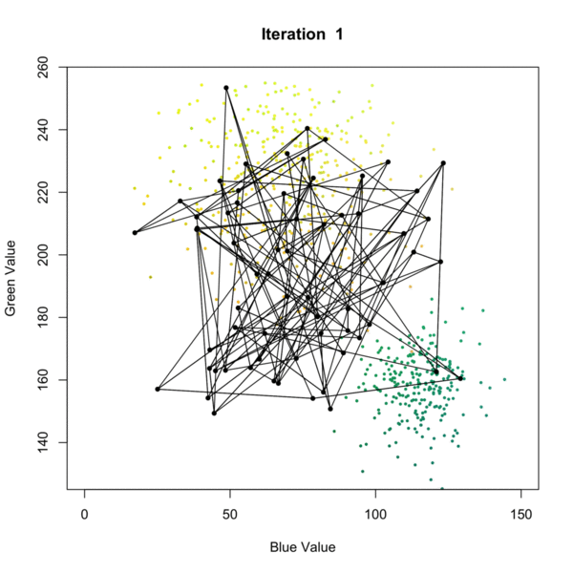
SOM Learning
Self-Organizing Map
Step 1: Randomly position the grid’s neurons in the data space.
Step 2: Select one data point, either randomly or systematically cycling through the dataset in order
Step 3: Find the neuron that is closest to the chosen data point. This neuron is called the Best Matching Unit (BMU).
Step 4: Move the BMU closer to that data point. The distance moved by the BMU is determined by a learning rate, which decreases after each iteration.
Step 5: Move the BMU’s neighbors closer to that data point as well, with farther away neighbors moving less. Neighbors are identified using a radius around the BMU, and the value for this radius decreases after each iteration.
Step 6: Update the learning rate and BMU radius, before repeating Steps 1 to 4. Iterate these steps until positions of neurons have been stabilized.

Slide 21
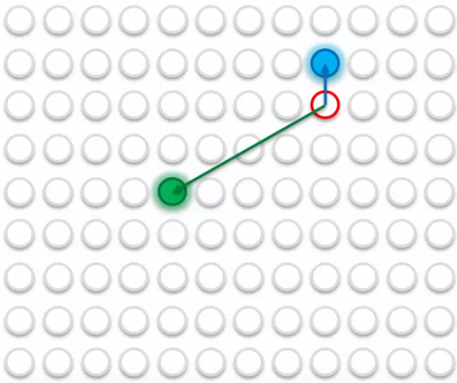
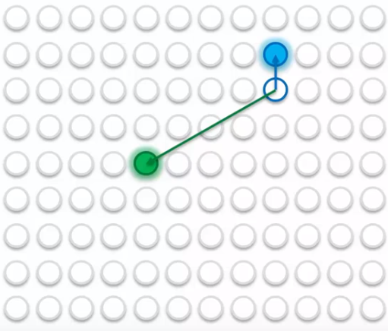
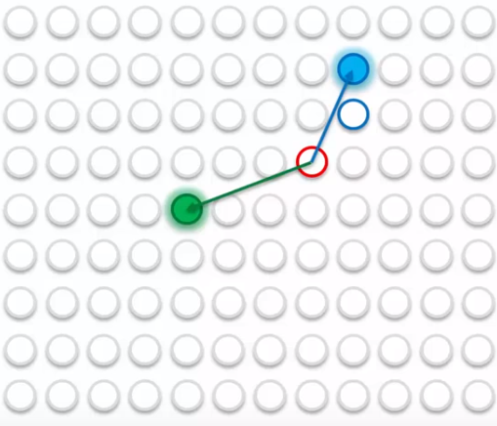
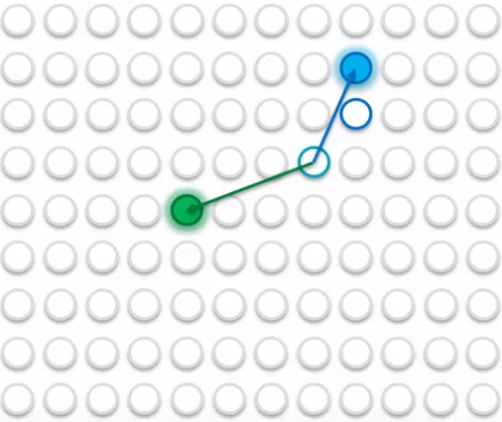
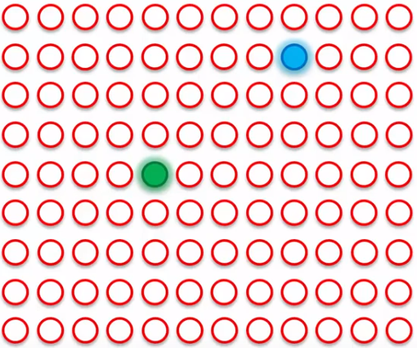
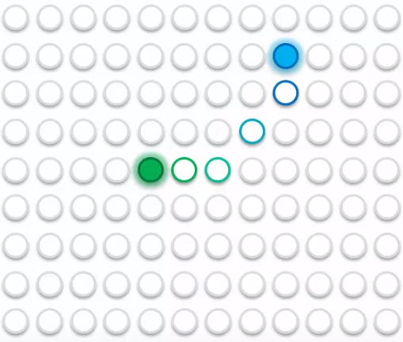
2D Map Perspective

Slide 22
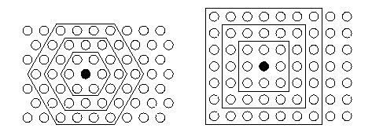
Grid Types
Toroidal Grid
Rectangular Grid

Slide 23
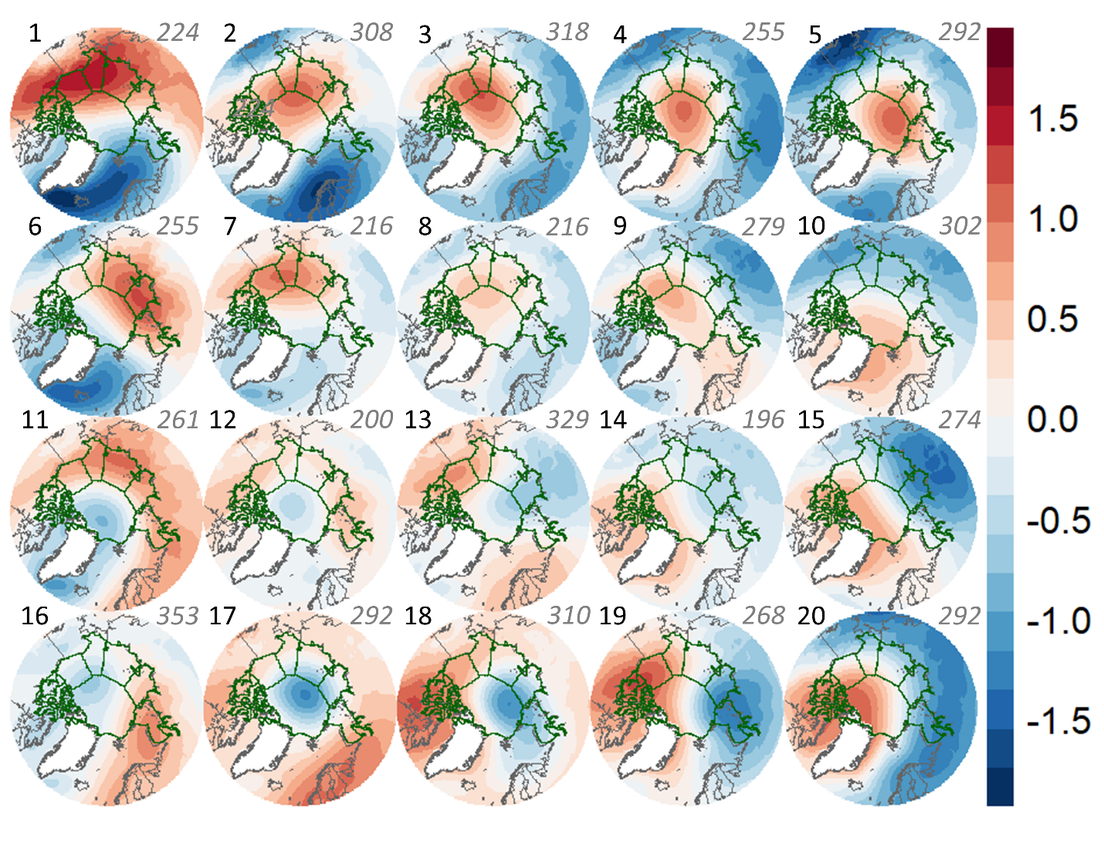
Result

Slide 24
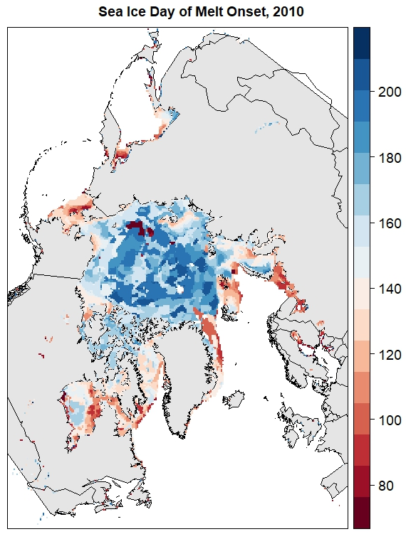
Melt Onset
Mortin et al., 2016

Slide 25
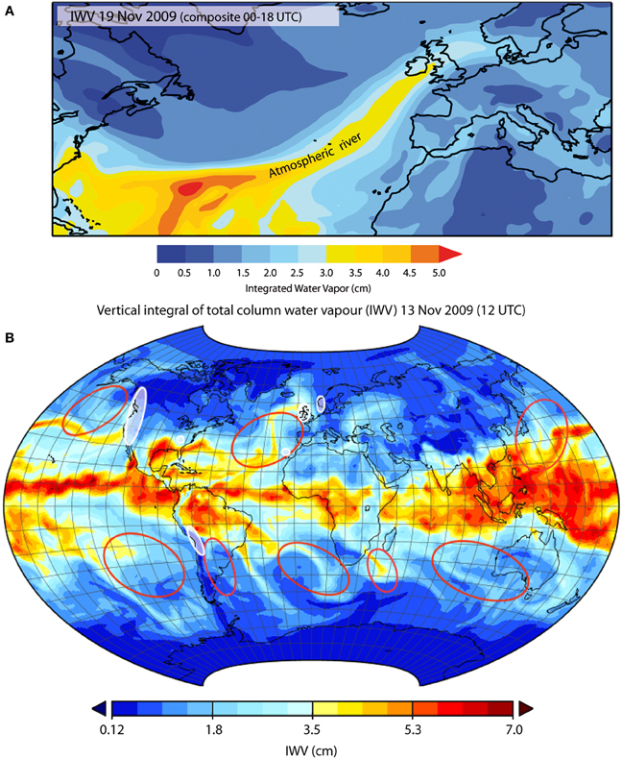
Atmospheric Rivers
https://www.frontiersin.org/articles/10.3389/feart.2014.00002/full

Slide 26
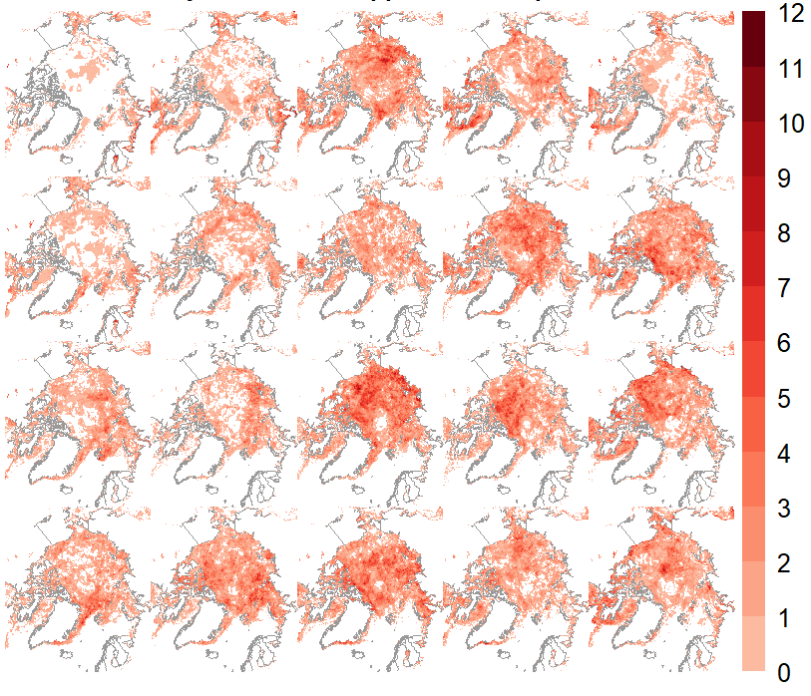
Results
High # of Melt Days
kPa
count

Slide 27
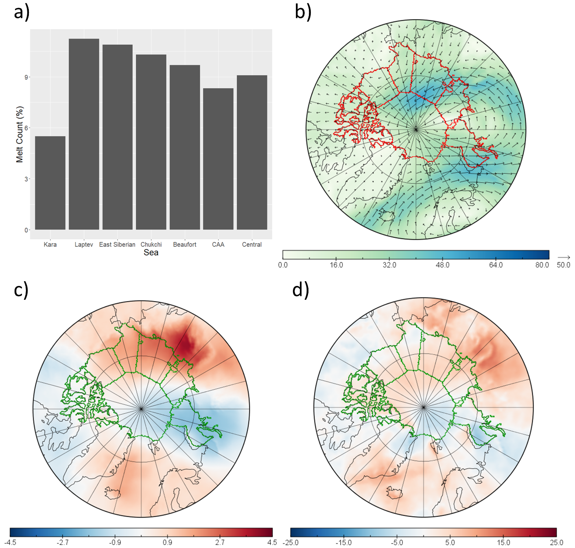
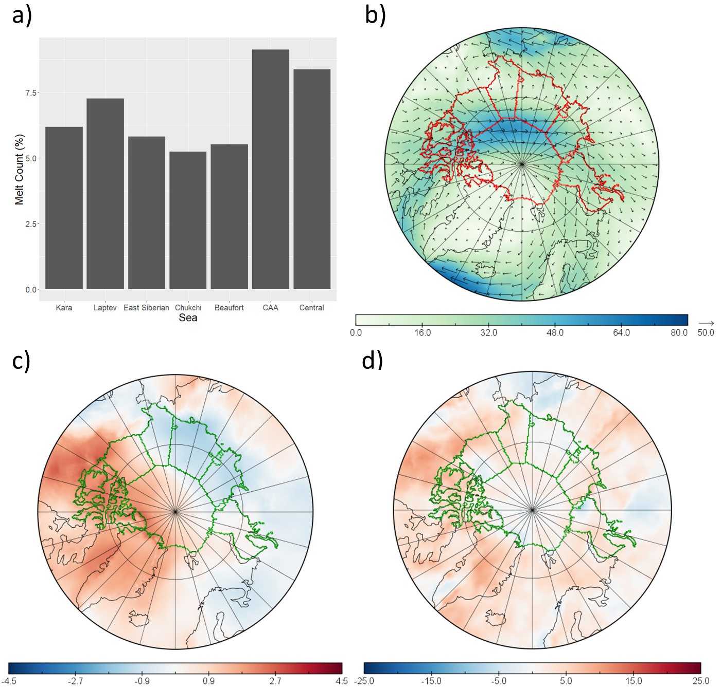
High Melt Nodes (examples)
Node 13
Node 10

Slide 28
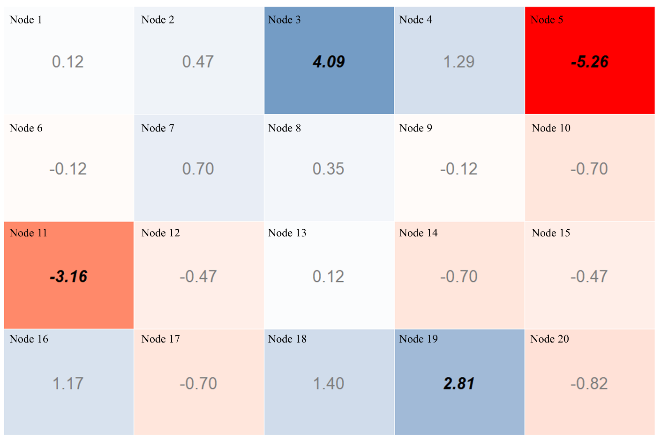
Frequency of Occurrence
Sea | 1st | 2nd | 3rd | 4th | Total
Kara | 8 (7) | 12 (4) | 11 (15) | 46 (64) | 77 (90)
Laptev | 16 (7) | 33 (17) | 13 (3) | 8 (17) | 70 (44)
East Siberian | 19 (11) | 14 (18) | 22 (21) | 25 (11) | 80 (61)
Chukchi | 16 (5) | 15 (4) | 33 (8) | 5 (12) | 69 (29)
Beaufort | 17 (3) | 11 (3) | 26 (16) | 14 (17) | 68 (39)
Central | 20 (17) | 25 (31) | 9 (33) | 15 (14) | 69 (95)
CAA | 16 (15) | 10 (7) | 10 (6) | 18 (8) | 54 (36)

Slide 29
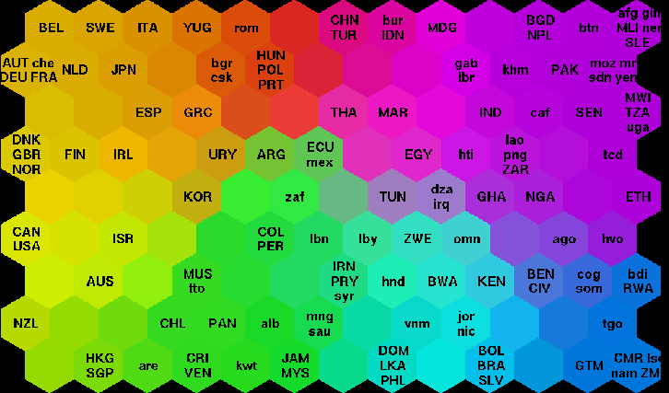
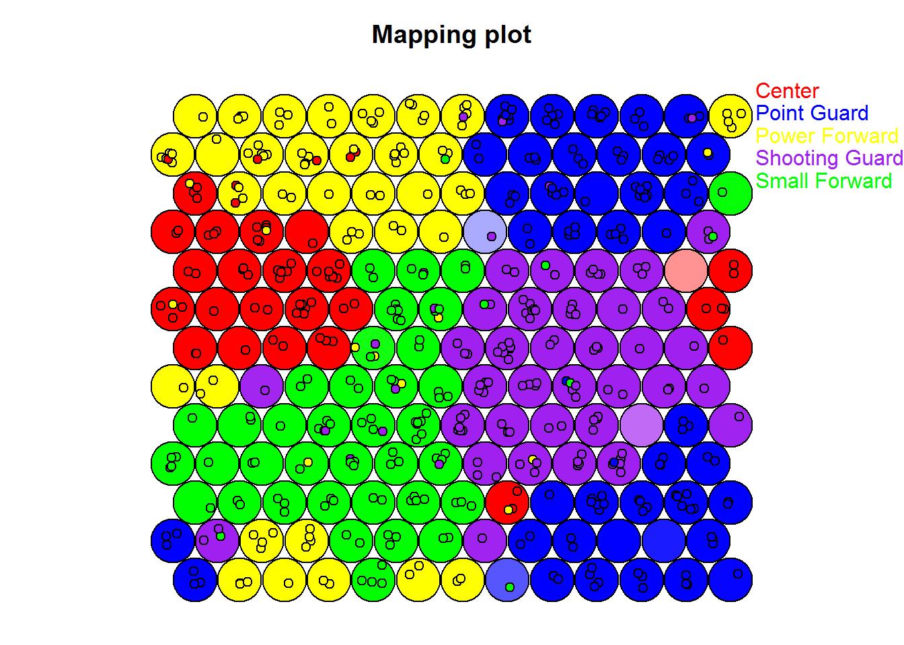
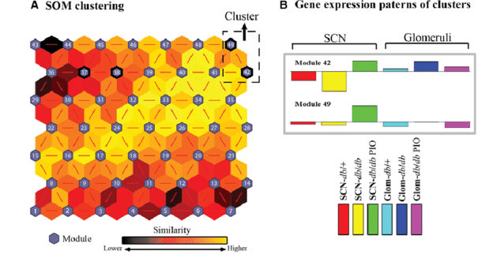
Thank you!
Questions?
Contact: Sean.Horvath@colorado.edu

Slide 30
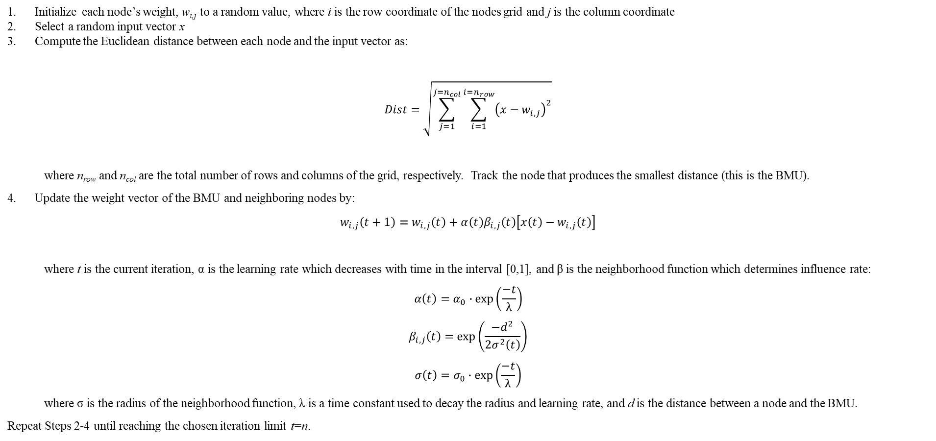
Extra
Initialize each node’s weight, w_{i,j} to a random value, where i is the row coordinate of the nodes grid and j is the column coordinate
Select a random input vector x
Compute the Euclidean distance between each node and the input vector as:
$$\begin{aligned}Dist=\sqrt{\sum_{j=1}^{j=n_{col}}{\sum_{i=1}^{i=n_{row}}{{\left(x−w_{i,j}\right)}^{2}}}}\#\end{aligned}$$
where n_{row} and n_{col} are the total number of rows and columns of the grid, respectively. Track the node that produces the smallest distance (this is the BMU).
Update the weight vector of the BMU and neighboring nodes by:
$$\begin{aligned}w_{i,j}\left(t+1\right)=w_{i,j}\left(t\right)+{α\left(t\right)β}_{i,j}\left(t\right)\left[x\left(t\right)−w_{i,j}\left(t\right)\right]\#\end{aligned}$$
where t is the current iteration, α is the learning rate which decreases with time in the interval [0,1], and β is the neighborhood function which determines influence rate:
$$\begin{aligned}α\left(t\right)=α_{0}∙\exp\left(\frac{−t}{λ}\right)\end{aligned}$$
$$\begin{aligned}β_{i,j}\left(t\right)=\exp\left(\frac{−d^{2}}{2σ^{2}\left(t\right)}\right)\end{aligned}$$
$$\begin{aligned}σ\left(t\right)=σ_{0}∙\exp\left(\frac{−t}{λ}\right)\#\end{aligned}$$
where σ is the radius of the neighborhood function, λ is a time constant used to decay the radius and learning rate, and d is the distance between a node and the BMU.
Repeat Steps 2-4 until reaching the chosen iteration limit t=n.

