Slide 1

Hampton Inn & Suites
Productivity Study

Slide 2
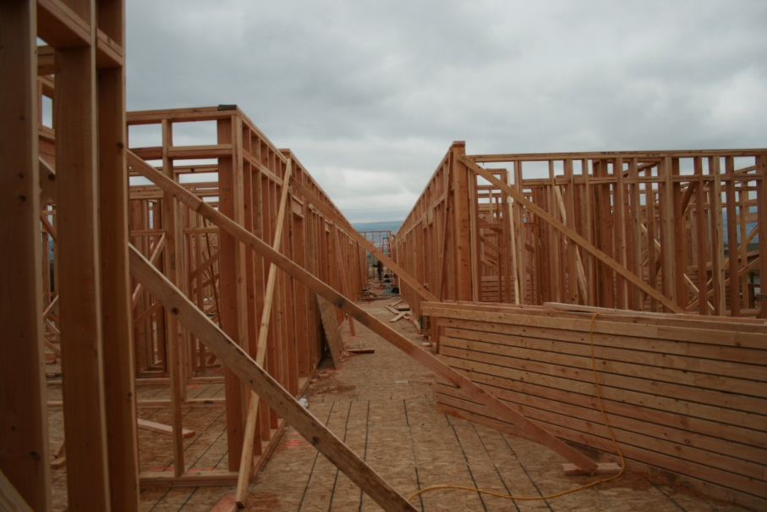
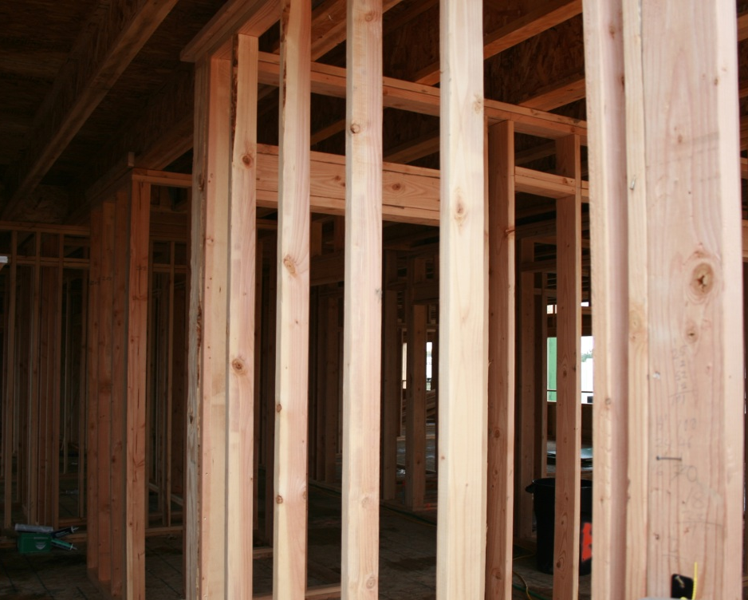
Agenda
Purpose & Process
Project Overview****
Work Sampling
Factors affecting Productivity*****
5 Min. Rating & Crew Balance Chart
Process Charts & Flow Diagrams
Discrete Model Simulations
Safety
Limitations
Conclusion

Slide 3
Purpose & Process
Reason for this study
  Analyze productivity
  Document processes
  Understand worker interaction
  Identify obstacles and barriers
  Provide recommendations
Process
  Study site as a whole
  Identify areas of possible improvement
  Analyze process in detail
  Model possible solutions
Work Sampling
5 min. Rating & Crew Balance Chart
Process Charts & Flow Diagrams
Discrete Model Simulation

Slide 4
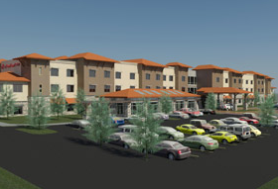
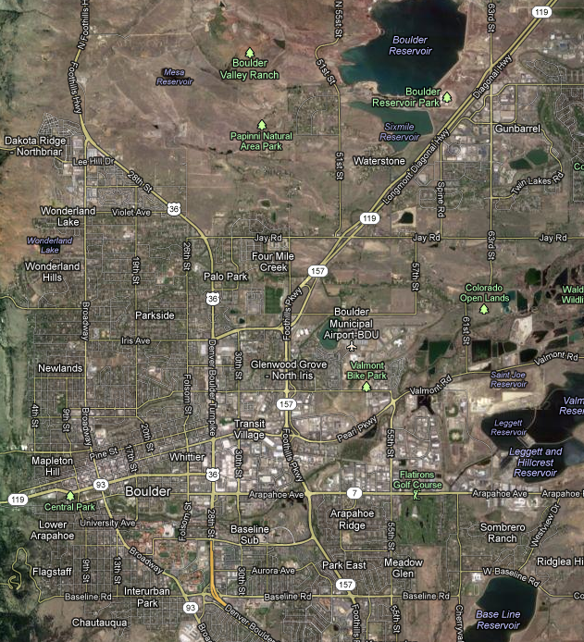
Project Overview
Construction Manager: Brinkman Partners
Client: Boulder Hospitality LLC
Design Team: Stephen Pahl Architecture
Construction Start: April 2012
Construction Finish: Summer 2013
Total Square Feet: 69,100
Location: Diagonal Highway & 63rd
Candidate for LEED Gold Certification
Amenities:
  100 rooms, Conference Room, Board Room, Pool, Hot tub, Workout Facility, and Breakfast Area

Slide 5
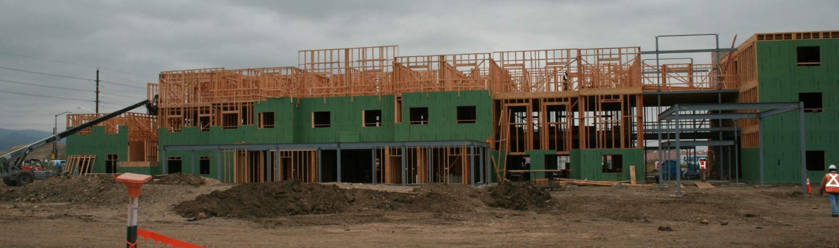
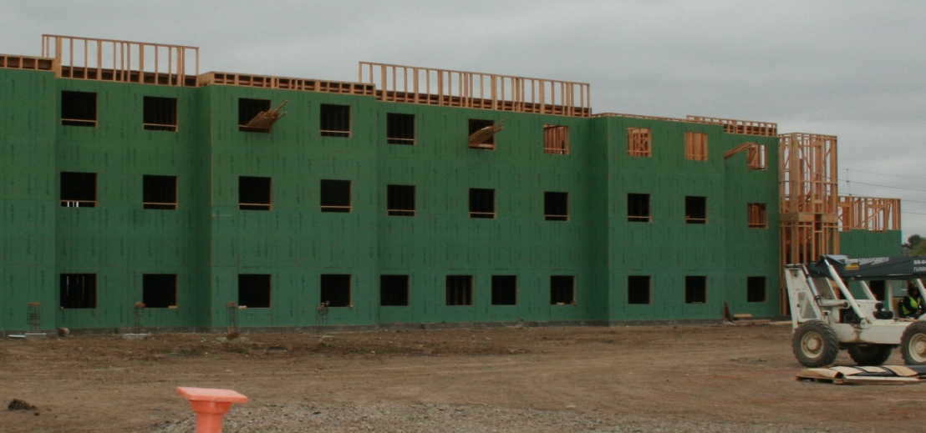
Project Overview
Trades on Site
  Framers ~25
  Plumbers ~15
  Electricians ~4
Progress to Date
  75% Frame
  30% Plumbing rough in
  15% Electrical rough
Factors Affecting Productivity
  Weather Conditions
  Contract Terms
  Change in Design Team
  Change in Supervision
  Change in Project Manager
  Incomplete Construction Details
  General lack of supervision
  Sub-Sub Contractors

Slide 6
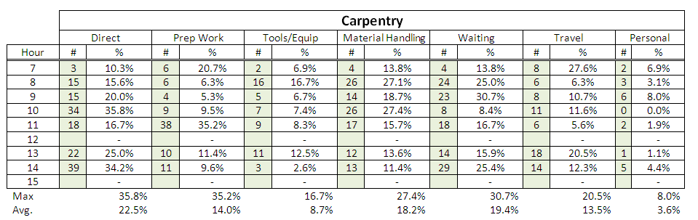
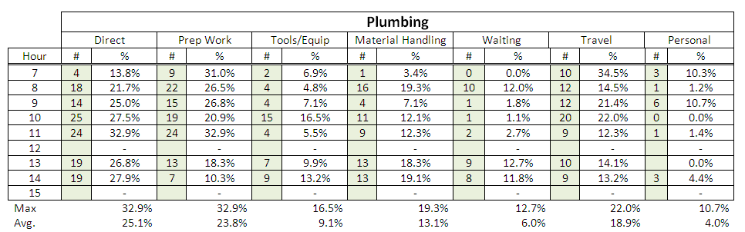
Work Sampling
Oct. 19: Cold and Dry
Oct. 26: Freezing & Snow
Observations
Carpentry: 605
Plumbing: 471
1076

Slide 7
Work Sampling

Slide 8
Work Sampling

Slide 9
Work Sampling

Slide 10
Work Sampling

Slide 11
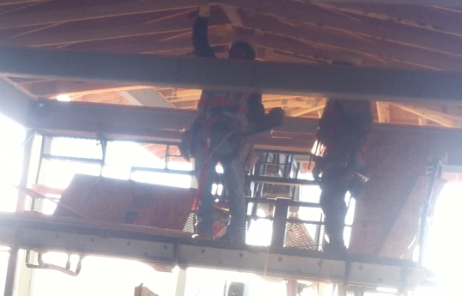
Activity Analysis
Trusses
Install worker
Focus on a crew of 2 framers
Only crew with a repetitive task
Highly confined space
Safety concern !!!
Scaffold basket
Prep worker

Slide 12
5 minutes rating - observed
Time | Framer 1 | Framer 2 | Observation
0 | I | II
00:30 | 1 | 0 | Framer 2 measuring
01:00 | 1 | 1
01:30 | 0 | 1 | Framer 1 waiting
02:00 | 1 | 1
02:30 | 0 | 1 | Framer 1 waiting
03:00 | 0 | 1 | Framer 1 waiting
03:30 | 0 | 1 | Framer 1 waiting
04:00 | 1 | 1
04:30 | 1 | 1
05:00 | 0 | 1 | Framer 1 waiting
Total | 5 | 9
A lot of waiting time
But a good effectiveness
One framer highly productive
The other one waiting

Slide 13
Crew Balance chart - observed
Confirms the waiting time
  Only one minute of active time for the prep worker
Almost 40sec to record measurements !
The two processes are not synced

Slide 14

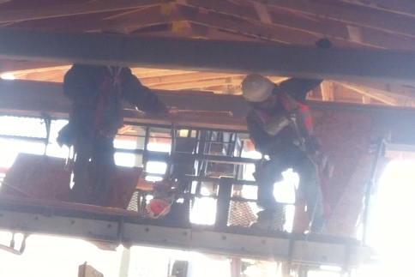
Analysis and recommendation
Only one worker really required !
But we can’t
  For safety reasons
We have to find a way to sync the workers
  Increase the prep worker productivity

Slide 15
5 minutes rating & crew balance chart – Possible improvements
Time | Framer 1 | Framer 2 | Observation
0 | I | II
00:30 | 0 | 0 | Framer 2 measuring
01:00 | 0 | 1
01:30 | 1 | 1 | Framer 1 waiting
02:00 | 1 | 1
02:30 | 1 | 1 | Framer 1 waiting
03:00 | 0 | 1 | Framer 1 waiting
03:30 | 1 | 1 | Framer 1 waiting
04:00 | 1 | 1
04:30 | 1 | 1
05:00 | 1 | 1 | Framer 1 waiting
Total | 7 | 9
Measure and record remaining braces

Slide 16
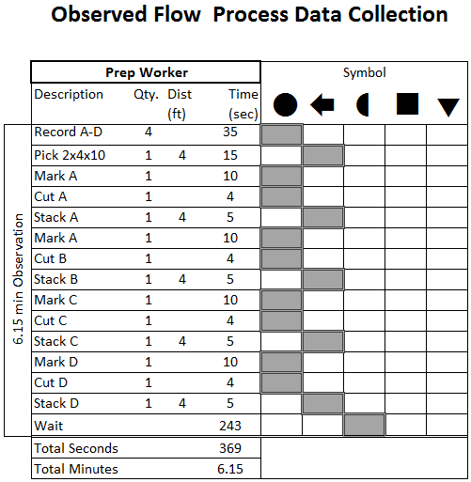
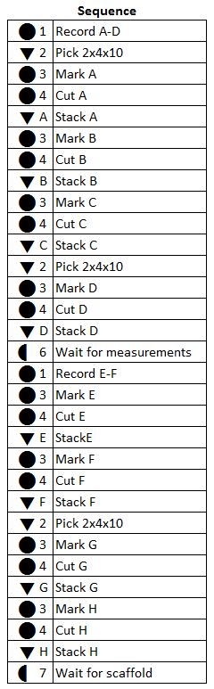
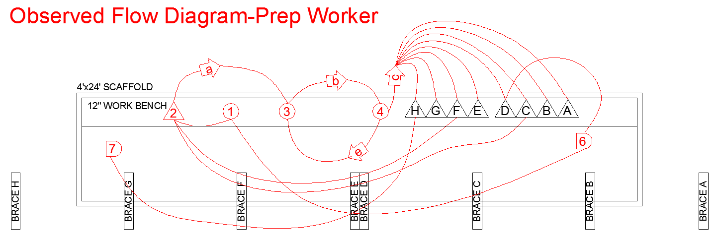
Process Chart & Flow Diagram of Prep Worker
Spatial Logistics
Labor
Tools
Materials

Slide 17
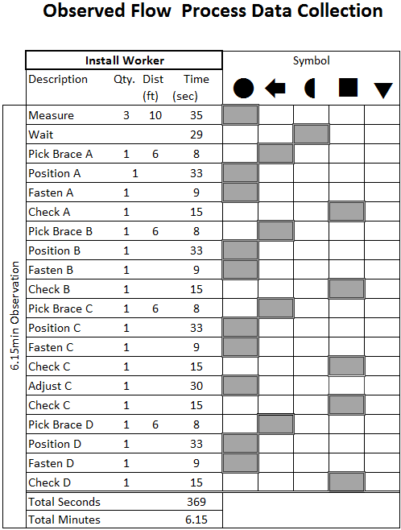
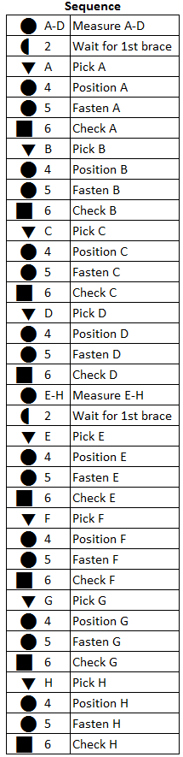
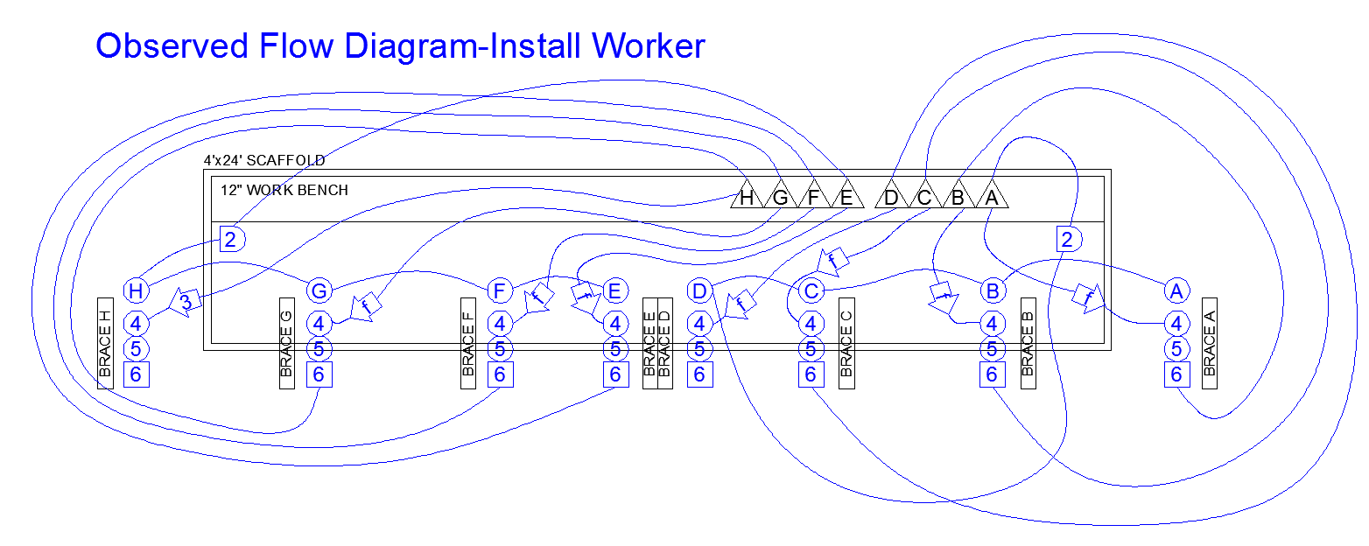
Process Chart & Flow Diagram of Install Worker

Slide 18
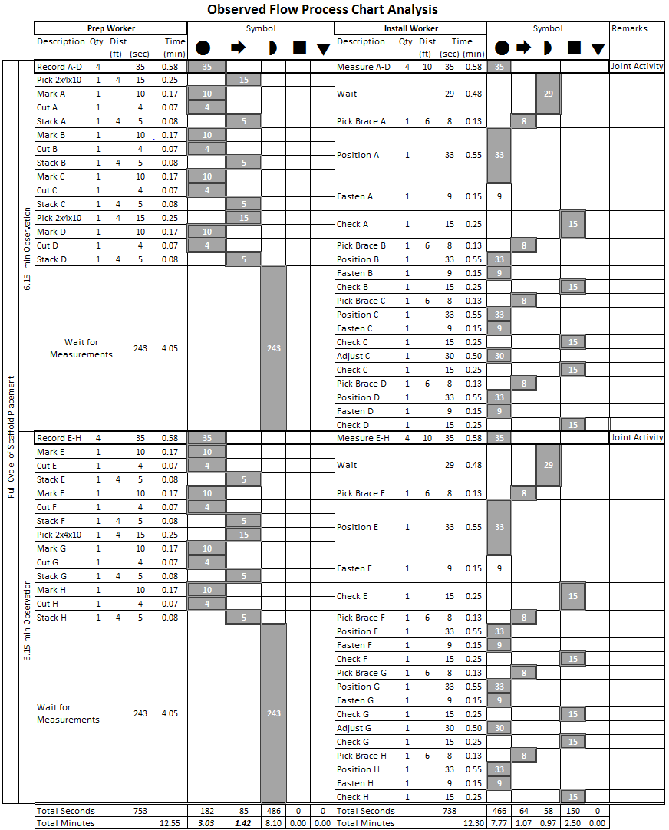
Combined Analysis
x2

Slide 19
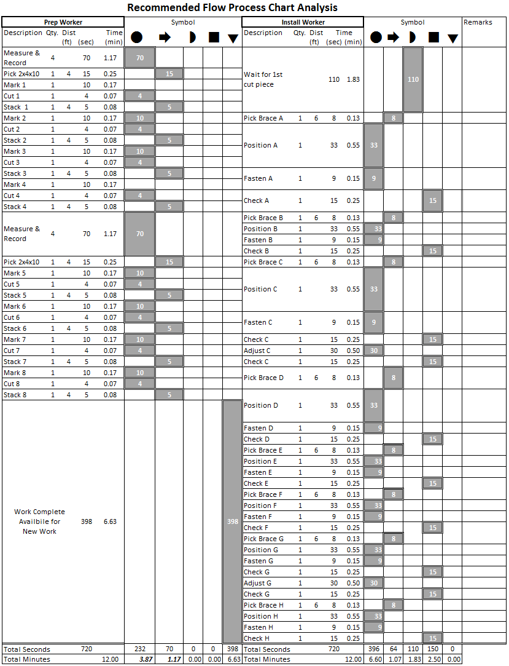
Process Optimization

Slide 20
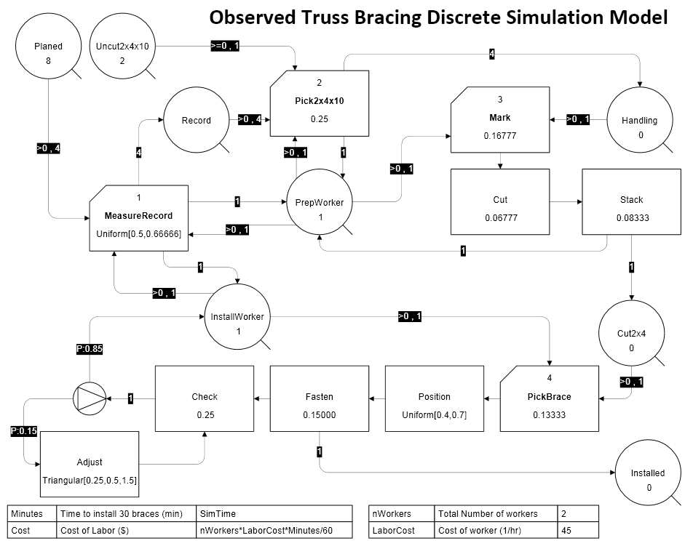
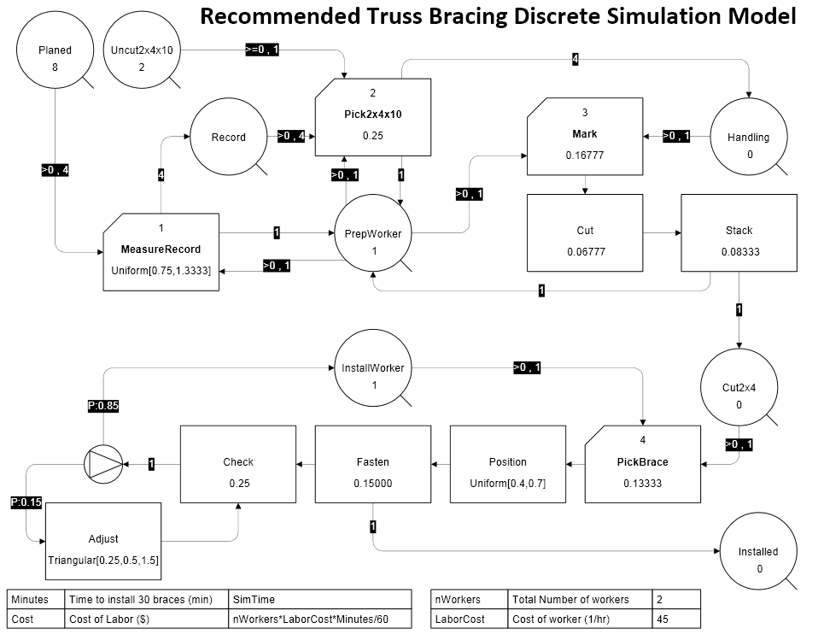
Discrete Model
 | Observed
 | Minutes
Avg. | 12.39
σ | 1.34
Min | 10.10
Max | 20.74
 | Recommended
 | Minutes
Avg. | 11.68
σ | 1.38
Min | 9.37
Max | 20.18
Savings
Cycle
0.71 min
Total
71 min
Cycle Required approx. 100 Times to complete the project

Slide 21
Projected Savings
The prep worker has 6.63 min of free time at the end of each cycle
Reassign to install 2-3 braces
Keep Clear of install worker by installing braces from H to G
Reduce Cycle time by an additional 2.16 min per cycle
 | No change | Prep measure | Prep install 2 braces | Savings
Total time (min) | 1239 | 1168 | 952 | 287 | 23%
$ | 1,858.50 | 1,752.00 | 1,428.00 | 430.00

Slide 22
Safety
Observations
Recommendations
Exposure
  Cold Climates
  Snow & Ice
  Wet Conditions
General Working Conditions
  Congestion (Layout)
  Schedule Compression
Direct Safety Violations
  Lack of Railing
  Toe Boards
  Spotting
Housekeeping
  General Housekeeping
Exposure
  Schedule - Coordinate with “Dry In”
  Proper Work Attire
General Working Conditions
  Design Considerations
  Schedule Revision
Direct Safety Violations
  On-Site Safety Manager
Housekeeping
  Labor Ready

Slide 23
Limitation of the study
Only Friday work observed
  (only one day, not the most productive of the week)
Indoor work over three floors
  Low visibility
Transition between trades
  End of framing
  Detail work and beginning of learning curve
Hawthorne effect
  We explained the purpose of the study
Interpretation of prep vs. direct
  between 3 observers
3 observation days: Changing crews, weather,..

Slide 24
Conclusion
Plumber & Framer direct work activity was LOW
Truss Bracing task could be reduced by 6-23%
Many inefficiencies throughout the jobsite
Onsite SUPERVISION would likely have the greatest effect on productivity

Slide 25
Questions?

Slide 26
Factors Affecting Productivity
  Weather Conditions
    Cold & Wet
  Outdated plans
    Revisions & Rework
  Contract changes
    Uncooperative Architecture Firm
    Mechanical Contracted Thru Architect
  Sub-Sub Contractor
    Framing Crew was Sub-Sub
  Changes in Supervision
    Turnover
  Changes Project Management
    New Project Manager
  Missed Scope
    Storefront
    HVAC Pads

